Slide 1
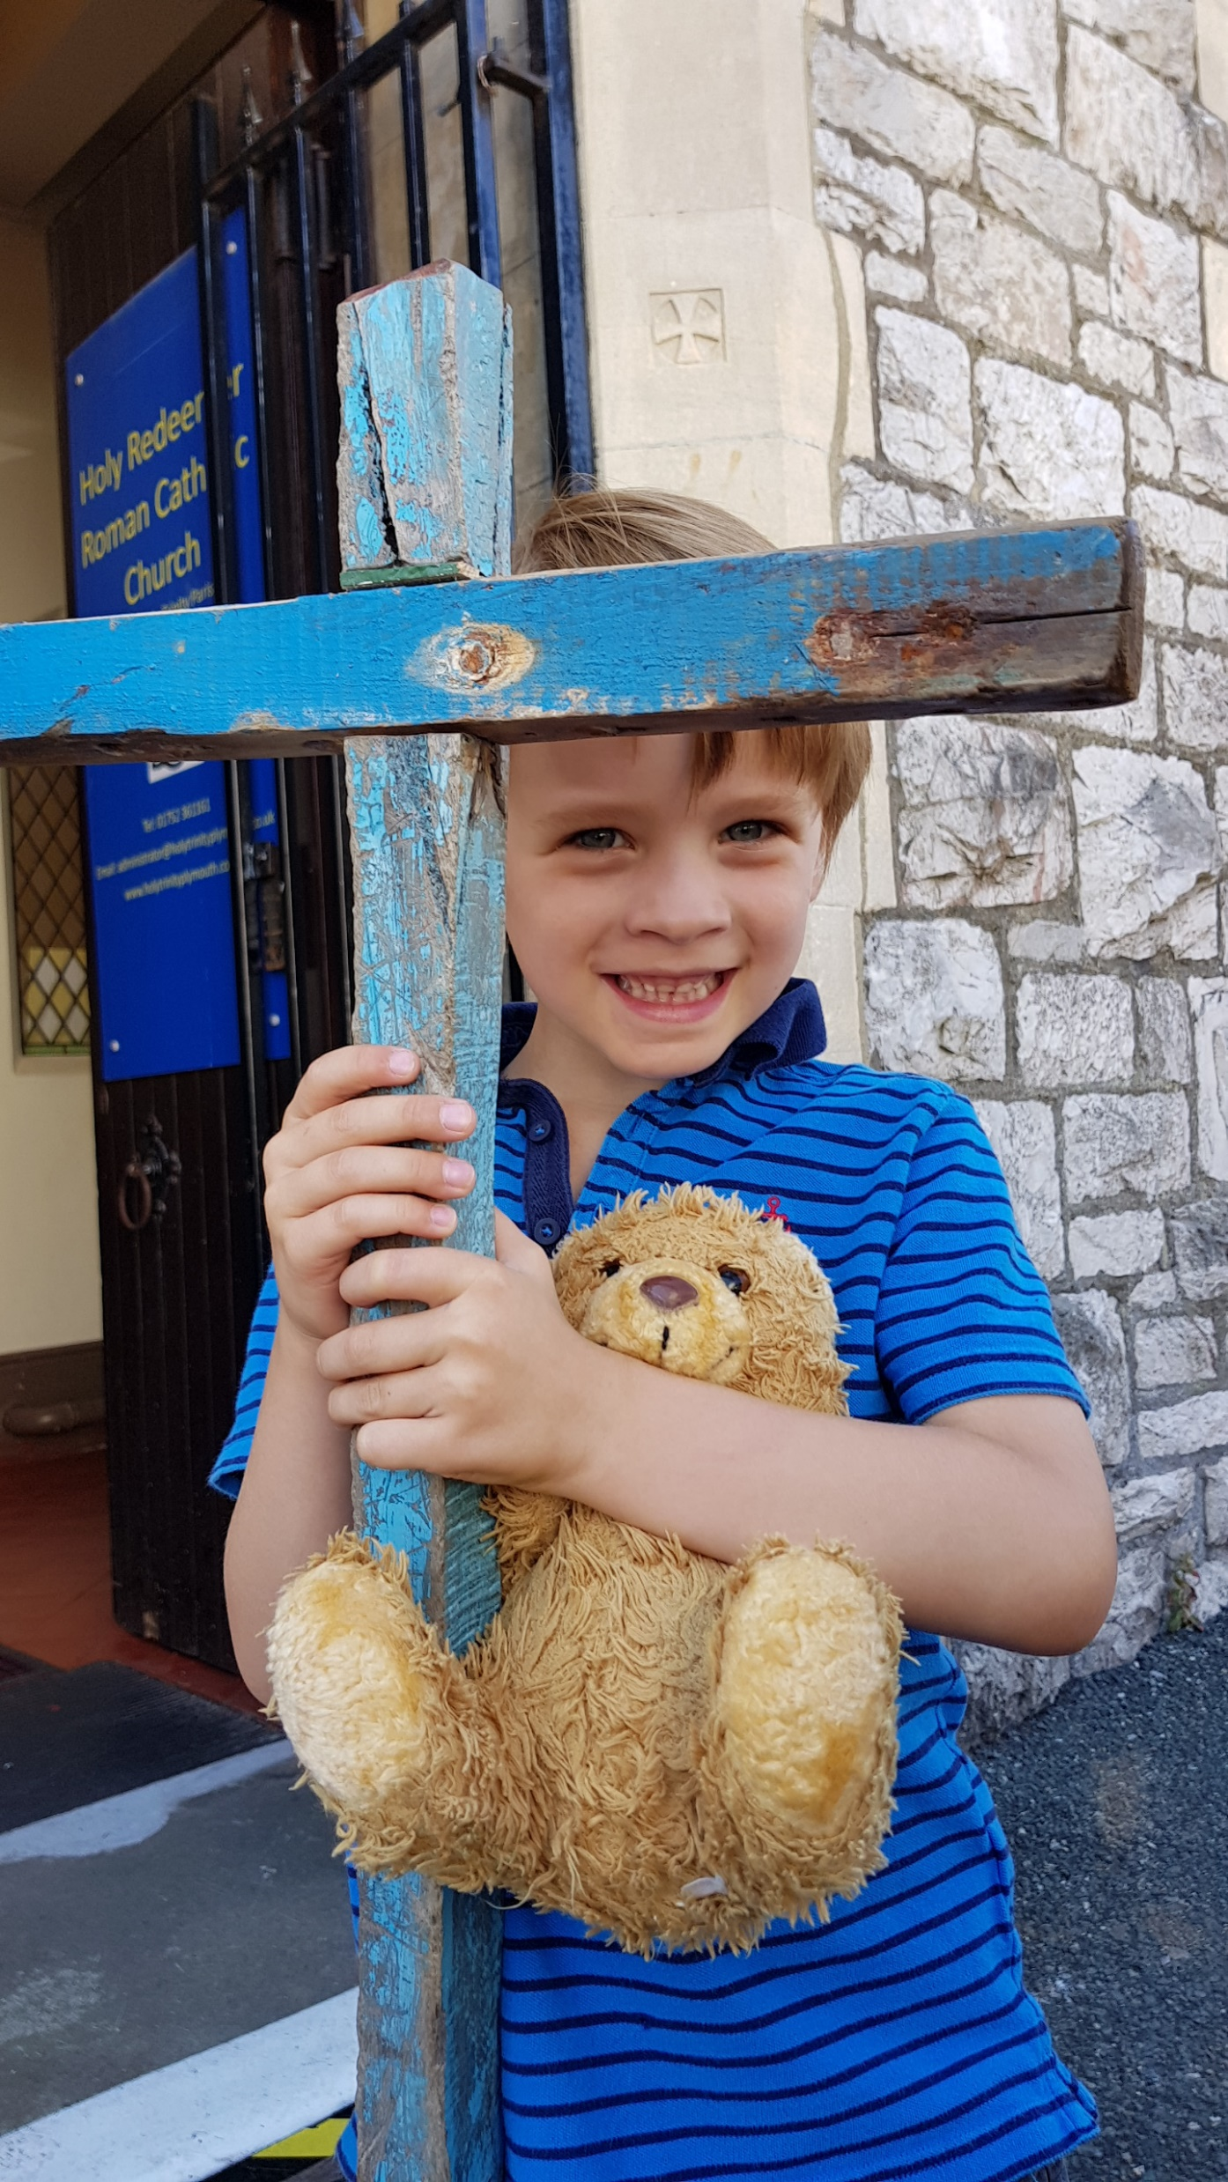
Holy week and Easter Celebration of the word
We gather…
Notes:
OPTIONAL- Appropriate music could be played quietly for a few minutes to help create a prayerful atmosphere for collective worship or while pupils enter if an assembly. You may wish to light a candle and have a Bible displayed. The liturgical colour for today is white.
Symbols for a prayer table could include an Easter garden, broken chains or a cross decorated with flowers or draped in a white cloth.
Reader: Welcome to our time of prayer.

Slide 2
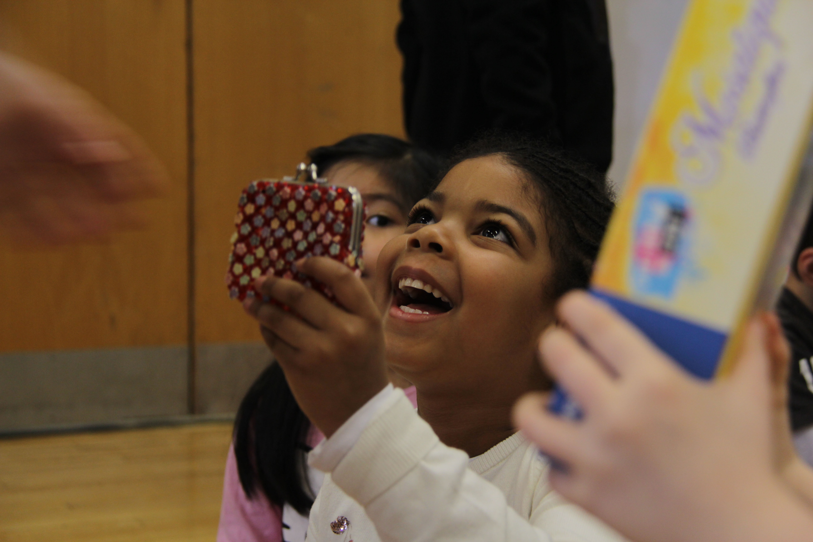
We gather…
Notes:
Reader: Have you ever had a wonderful surprise?
(Children could be asked to reflect quietly or you may choose to allow them to share answers in pairs or to the wider assembly. You may wish to share a story of a surprise you had)
Reader: Today we’re going to hear a story about some people who had an amazing surprise. We are going to think about what happens during Holy Week and what it means for us.

Slide 3
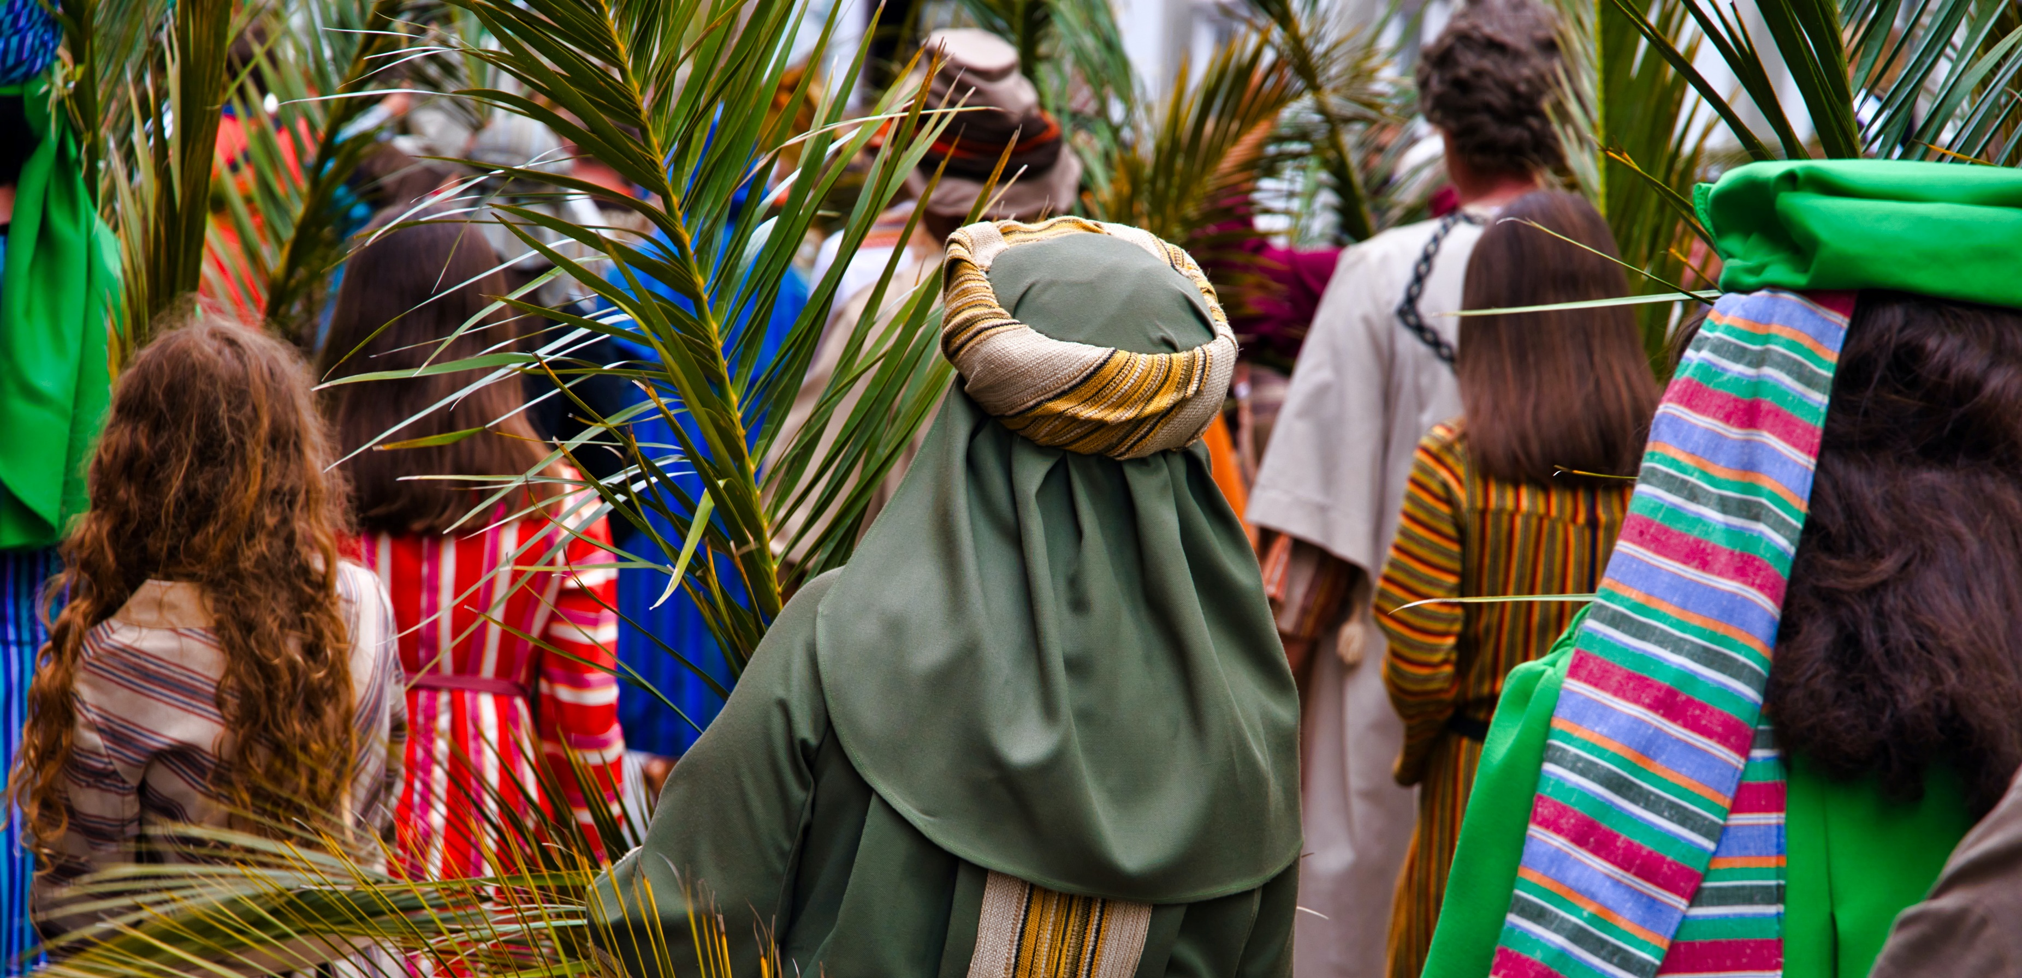
Palm Sunday
Notes:
Reader: Jesus rode on a donkey into Jerusalem on Palm Sunday. The people waved branches at him, shouting, “Hosanna”.
Photo by Brady Leavell on Unsplash

Slide 4
What would it be like to be in the crowd that welcomed Jesus to Jerusalem?
How can I welcome Jesus today?
Notes:
Reader: Let’s reflect quietly -
What would it be like to be in the crowd that welcomed Jesus to Jerusalem?
How can I welcome Jesus today? (pause)

Slide 5
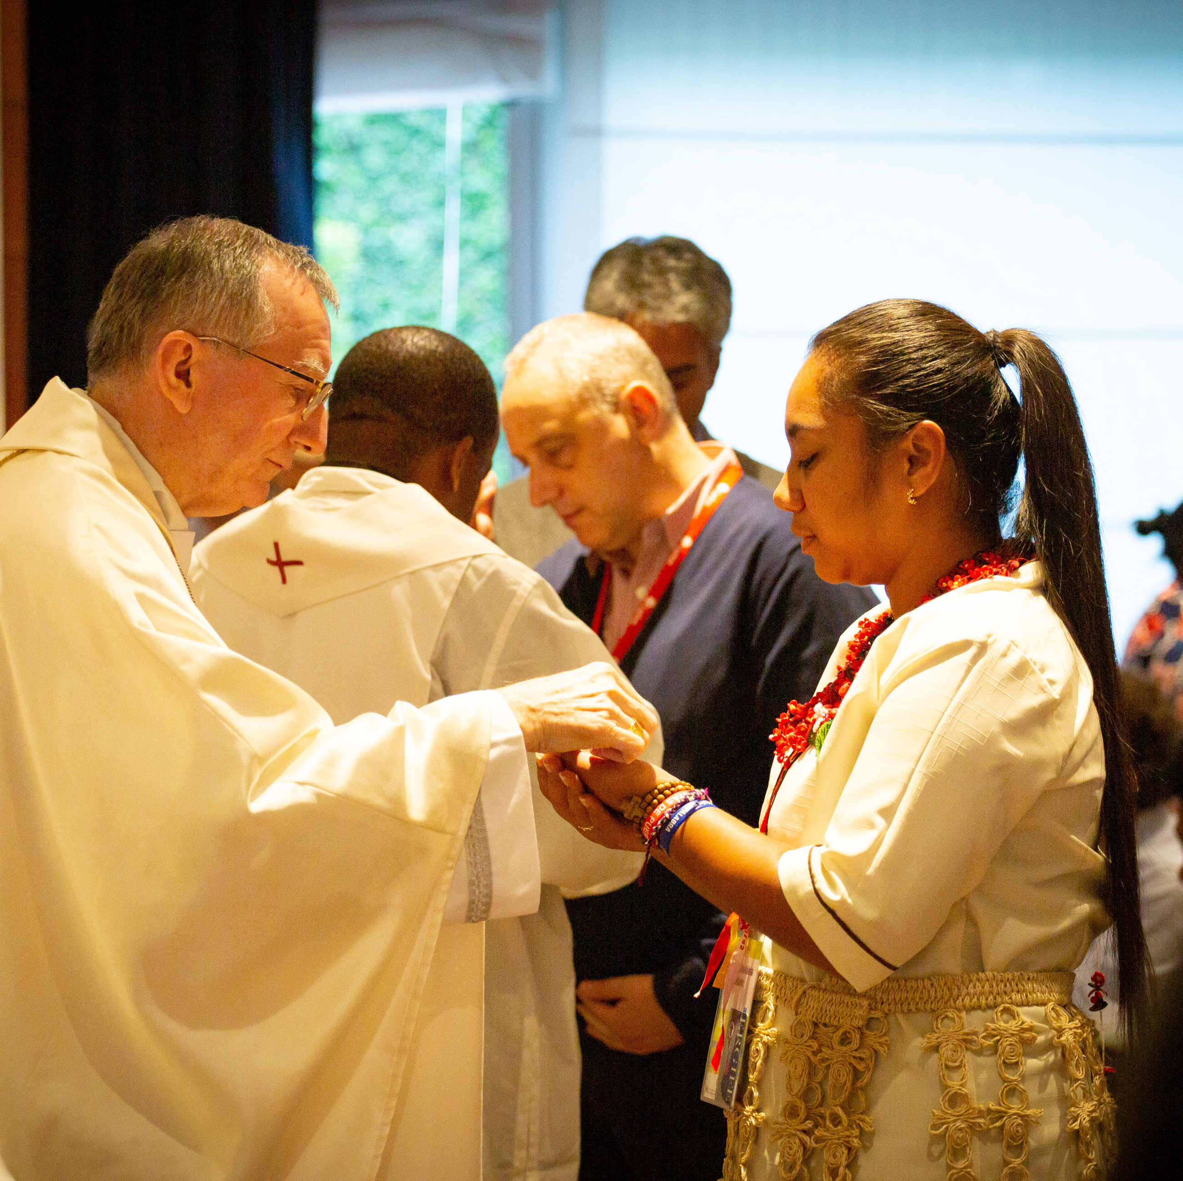
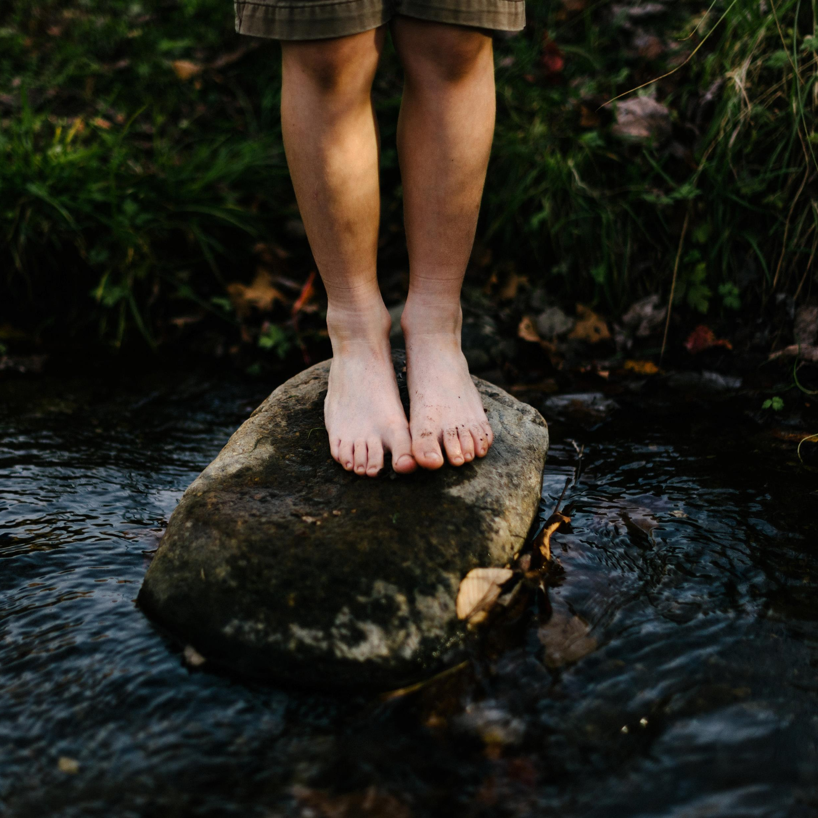
Maundy Thursday
Notes:
Reader: Jesus celebrated the Last Supper with his friends. He washed their feet which was usually the job of a servant. Then he broke bread saying ‘This is my body’ and shared wine saying ‘This is my blood.’ This was on Maundy Thursday.
Reader: Jesus told his followers to do this in remembrance of him and we continue to do so when we celebrate the Eucharist together.
Photo on left: Jordan Whitt on Unsplash
Photo on right: Louise Norton/Caritas Internationalis (2019)

Slide 6
How would it feel to have someone as important as Jesus washing my feet?
How can I serve people humbly like Jesus?
Notes:
Reader: Let’s reflect quietly -
How would it feel to have someone as important as Jesus washing my feet?
How can I serve people humbly like Jesus? (pause)

Slide 7
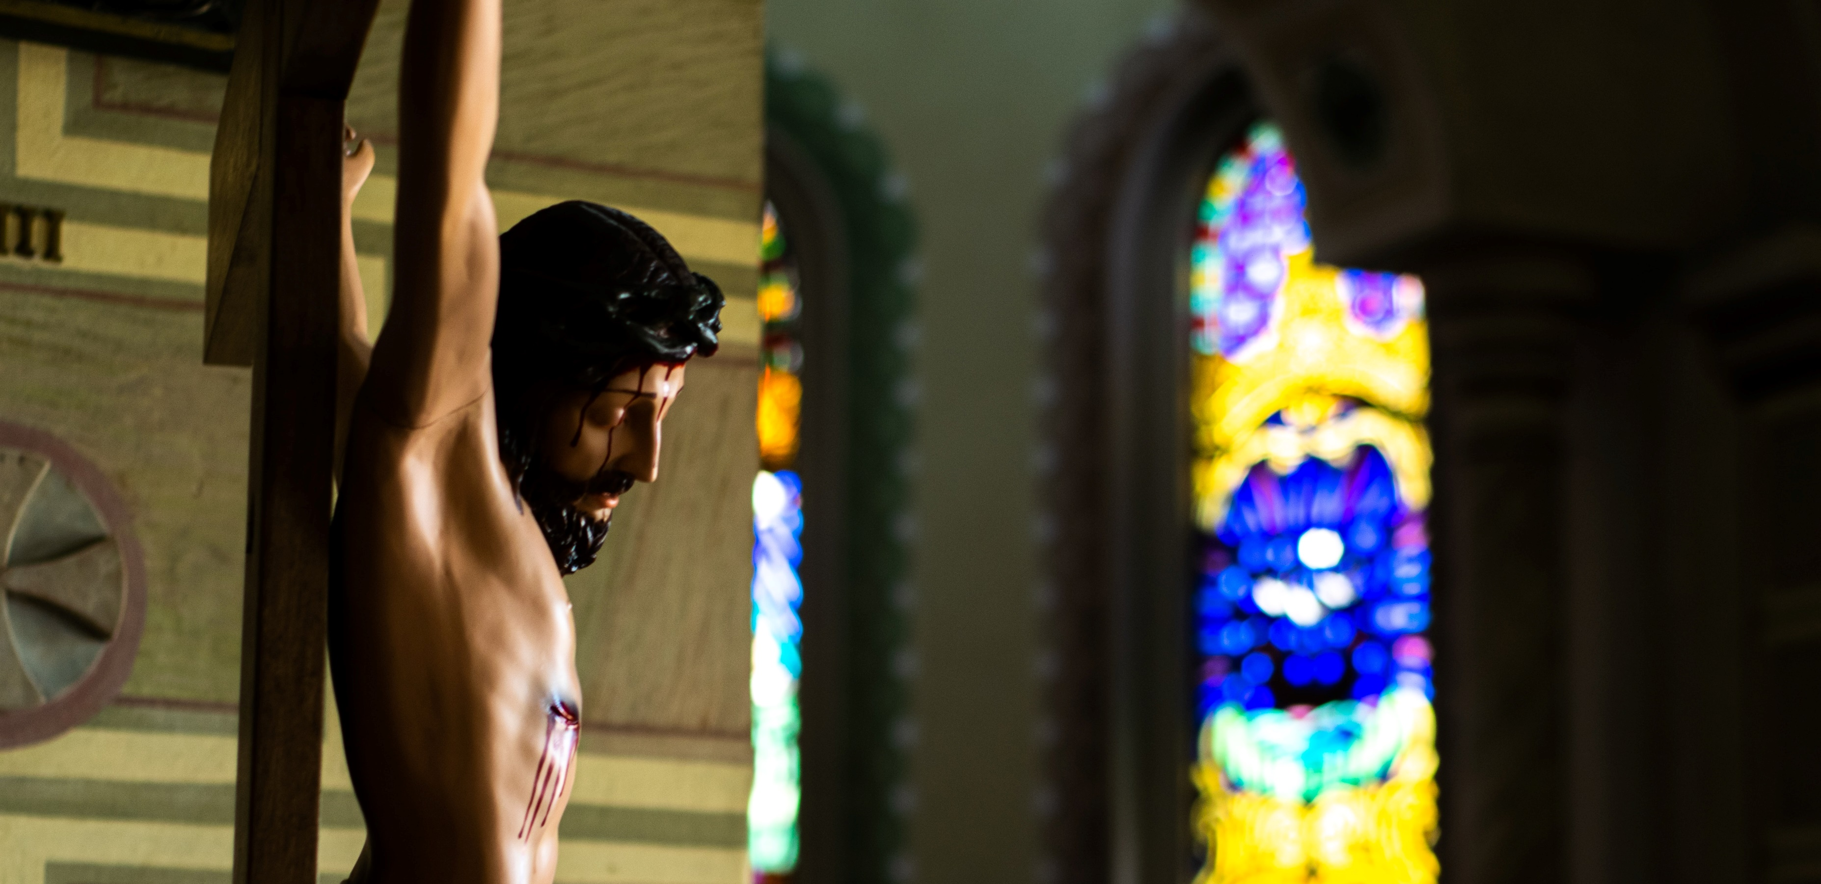
Good Friday
Notes:
Reader: Jesus was arrested and crucified on Good Friday.
Even on the Cross he forgave the people who were hurting him.
Photo by Mateus Campos Felipe on Unsplash

Slide 8
How does it feel to know that Jesus is always loving and forgiving?
How I can be forgiving?
Notes:
Reader: Let’s reflect quietly -
How does it feel to know Jesus always loving and forgiving?
How can I be forgiving? (pause)

Slide 9
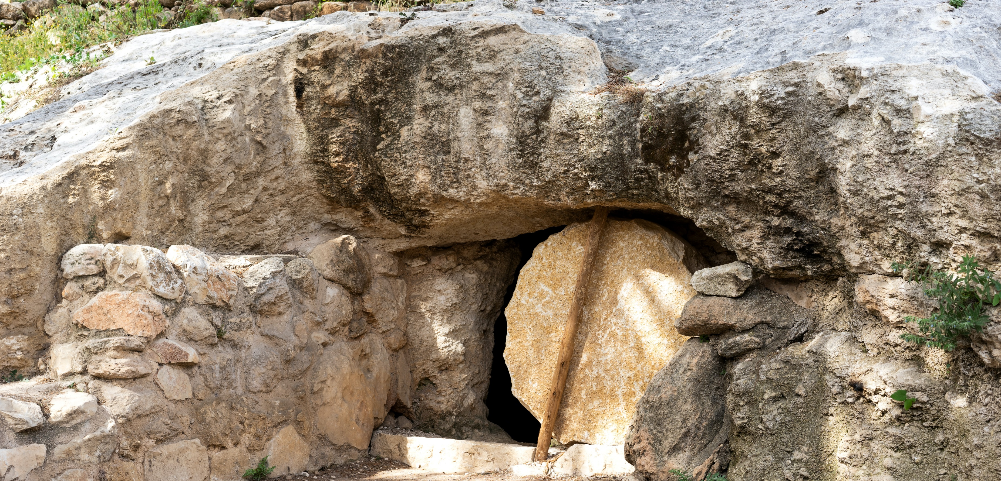
A reading from the Gospel of Mark
We listen…
Notes:
Reader: Let’s listen now to what happened next. What was the wonderful surprise?
Reader:
After the Sabbath was over, Mary Magdalene, Mary the mother of James, and Salome bought spices to go and anoint the body of Jesus.
Very early on Sunday morning, at sunrise, they went to the tomb. On the way they said to one another, “Who will roll away the stone for us from the entrance to the tomb?” (It was a very large stone.) Then they looked up and saw that the stone had already been rolled back. So they entered the tomb, where they saw a young man sitting at the right, wearing a white robe—and they were alarmed.
“Don't be alarmed,” he said. “I know you are looking for Jesus of Nazareth, who was crucified. He is not here—he has been raised! Look, here is the place where he was placed. Now go and give this message to his disciples, including Peter: ‘He is going to Galilee ahead of you; there you will see him, just as he told you.’”
Photo by Jeremy Mura on Unsplash

Slide 10
SACRED SILENCE…
Why do you think the three women went to Jesus tomb?
How does it make you feel to know Jesus is risen?
What difference does the resurrection make for Jesus’ followers?
Notes:
Optional slide- Following the reading of the Word, you may wish to provide a moment for ‘Sacred Silence’ with questions for children to ponder.
Why do you think the three women went to Jesus tomb?
How does it make you feel to know Jesus is risen?
What difference does the resurrection make for Jesus’ followers?
Vector by Kelly Sikkema on Unsplash

Slide 11
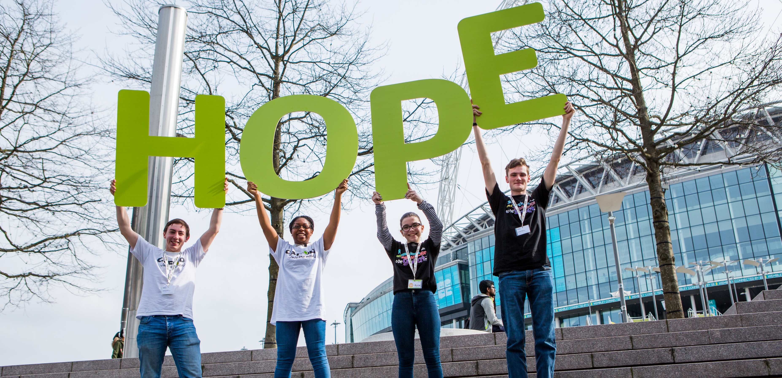
We respond…
Notes:
Reader: What a wonderful surprise for Jesus’ friends to find out he had risen from the dead.
Reader. His resurrection reminds us that even in the most difficult situations there is always hope.
Photo: Thom Flint/ CAFOD (2017)
Volunteers hold up CAFOD's HOPE sign on the steps outside Wembley Stadium during Flame 2017.

Slide 12
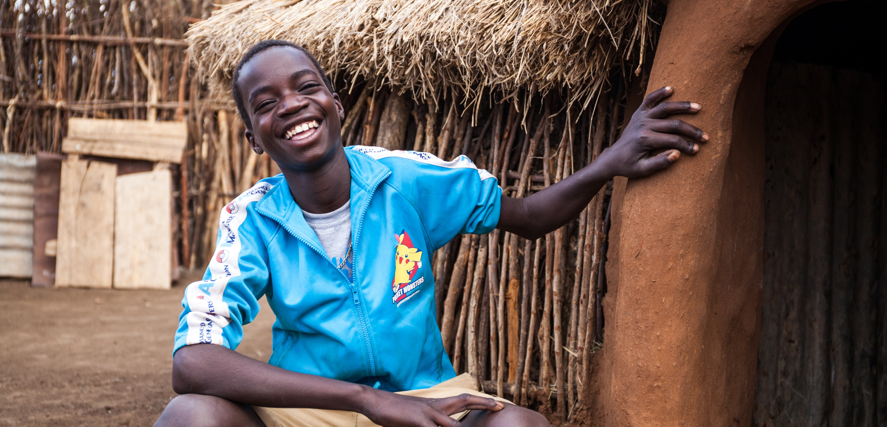
We respond…
Notes:
Reader: This love and hope has led Christians to reach out to their brothers and sisters throughout the world.
Reader: It continues to inspire the work of Christian charities, like CAFOD, who work with partners around the world to try to bring hope to people in very practical ways and campaign for a fairer world.
Photo: Thom Flint/CAFOD (2019)
Fabiano in Uganda who no longer has to make a long journey for water thanks to a solar pump.

Slide 13
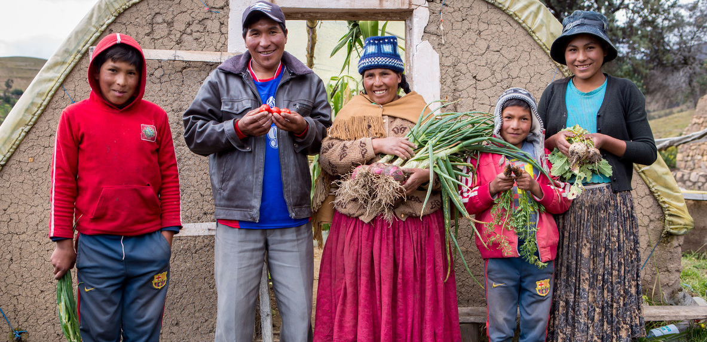
We respond…
Notes:
Reader: Nicanora and her family have a new hope.
Their home in rural Bolivia has seen increasingly extreme weather as a result of the climate crisis, making it almost impossible to grow fruit and vegetables.
Reader: Thankfully, with the support of CAFOD, Nicanora and her family have built a greenhouse. So far, they have been grown lettuce, celery, maize, spinach, peppers and tomatoes.
Reader: The whole family is getting involved. The children love to plant seeds and watch them grow. Nicanora told us: “Their hands are good for growing. They have green fingers!”
Reader: Let’s pray that we will be people who share Easter joy and hope with others.
Photo: Louise Norton/ CAFOD (2018)
Nicanora and her family in Bolivia

Slide 14
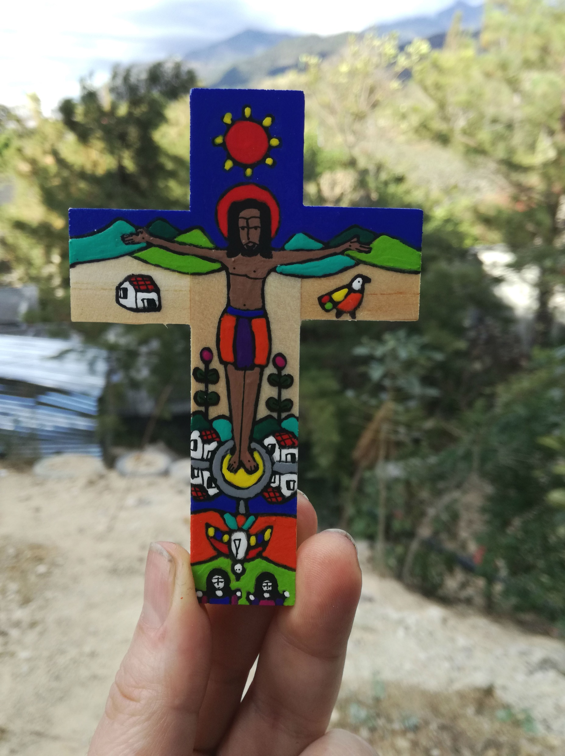
We respond…
Response: May we follow his example of love and service.
Notes:
All children are invited to join in with the response on the slide.
Reader: We remember Jesus riding into Jerusalem on a humble donkey
May we follow his example of love and service.
Reader: We reflect on Jesus washing his disciple’s feet
May we follow his example of love and service.
Reader: We think of Jesus on the cross, forgiving others
May we follow his example of love and service.
Reader: We rejoice in Jesus risen from the dead
May we follow his example of love and service.
Photo credits:
Left: Brady Leavell on Unsplash
Top: Jordan Whitt on Unsplash
Bottom: Mateus Campos Felipe on Unsplash
Right:Kelly Sikkema on Unsplash

Slide 15
Risen Christ,
We give thanks for the new life you have given us.
Show us how to be loving and forgiving,
To live in hope and make a change,
So that all people may live in peace,
free from poverty.
Amen.

Slide 16
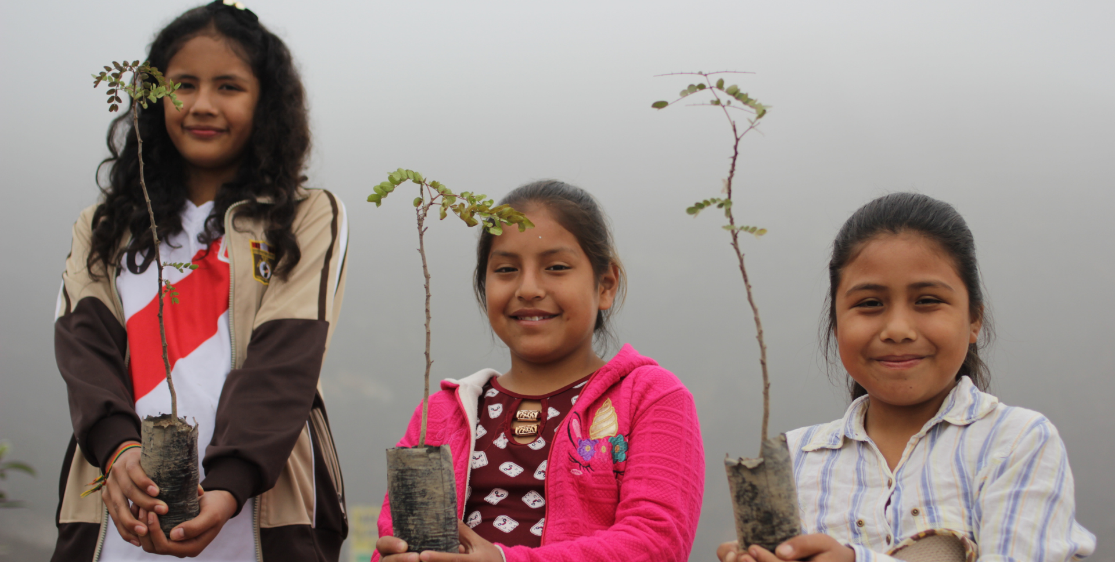
Going forth…
Notes:
Optional Slide - children could be asked to reflect quietly or you may choose to allow them to share answers in pairs or to the wider assembly
Reader: How can each of us spread the hope that Easter brings?
Photo credit: Gemma Salter/CAFOD (2018)
Children caring for the environment in Peru.

