Slide 1
Who created Advent calendars?
When was the first Advent calendar made?
What is the average price people will spend on an Advent calendar?

Slide 2
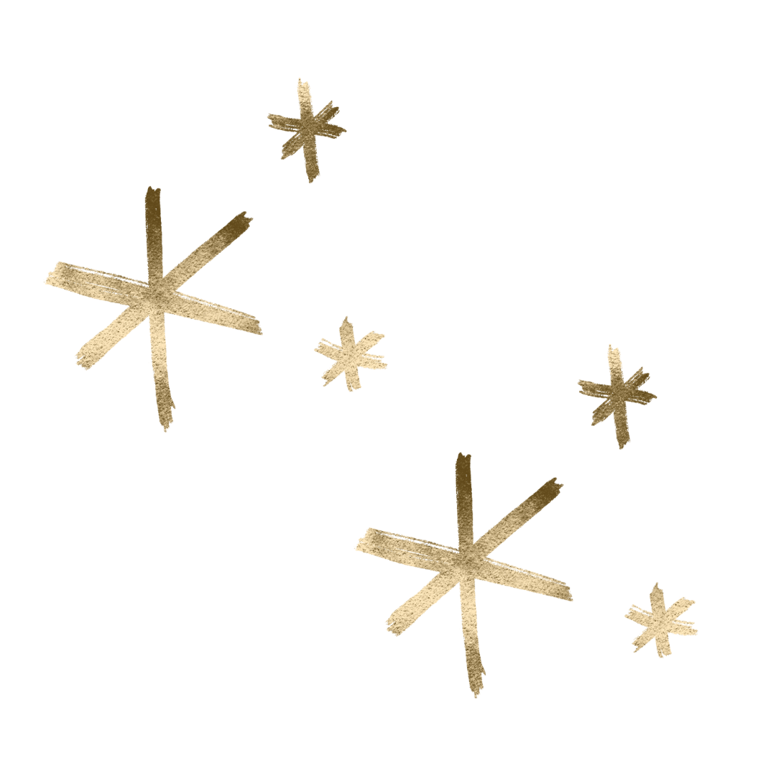
Advent Assembly 2024

Slide 3
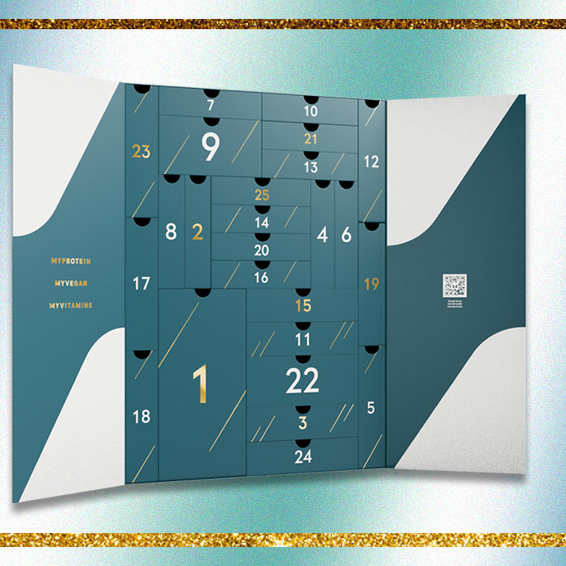
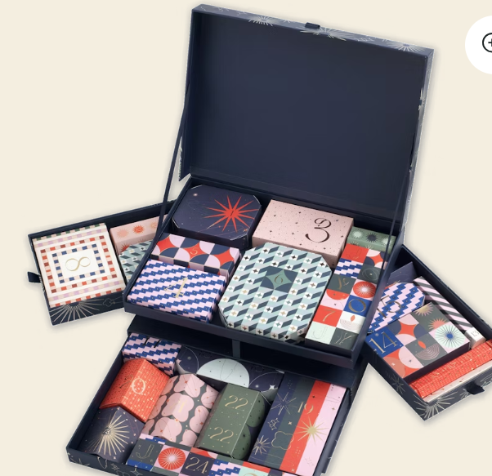
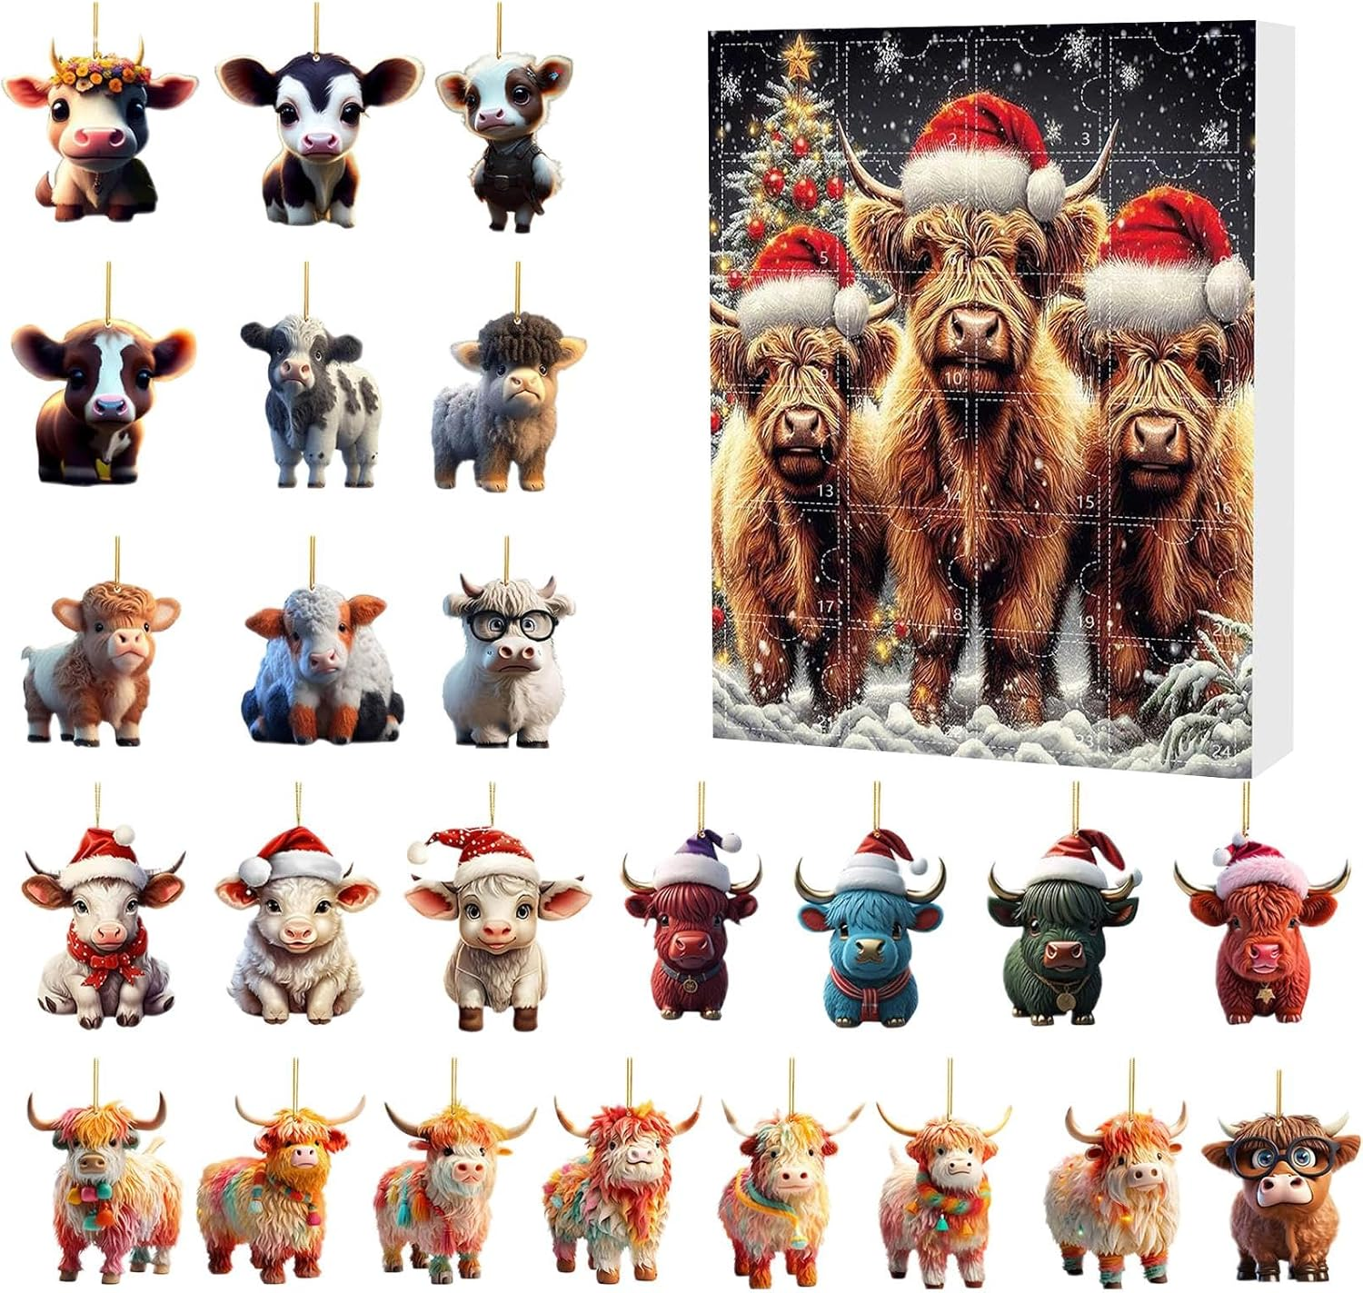
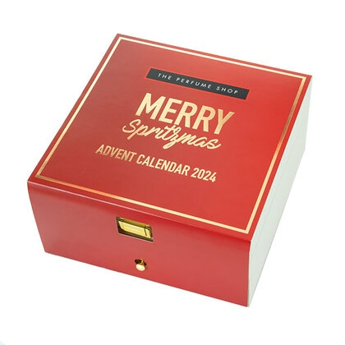
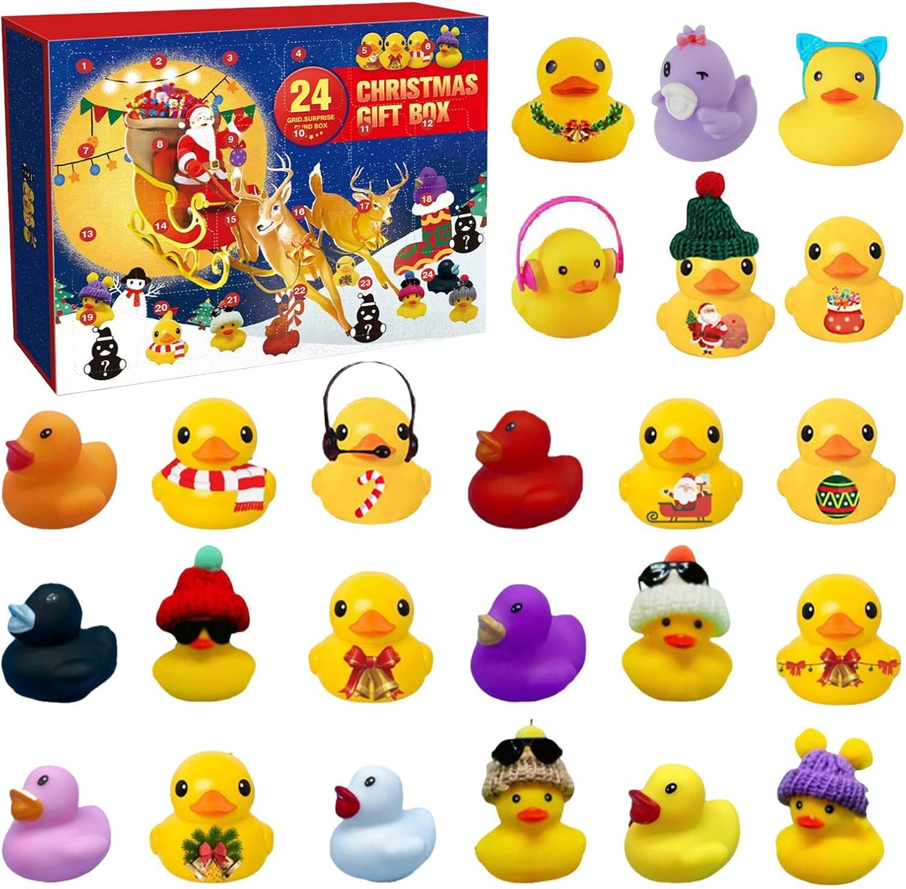
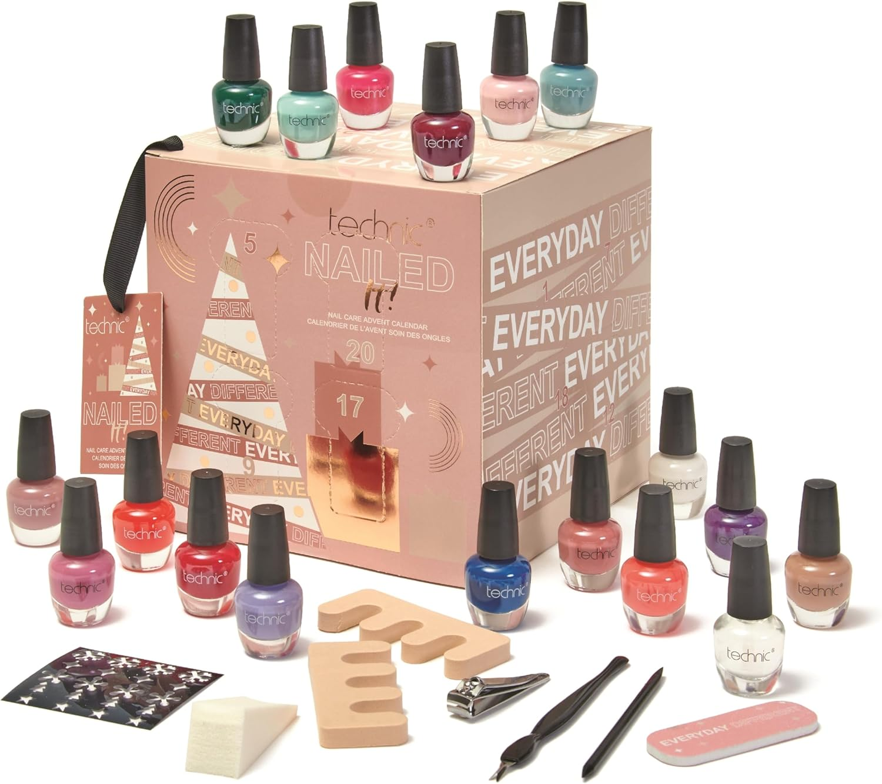
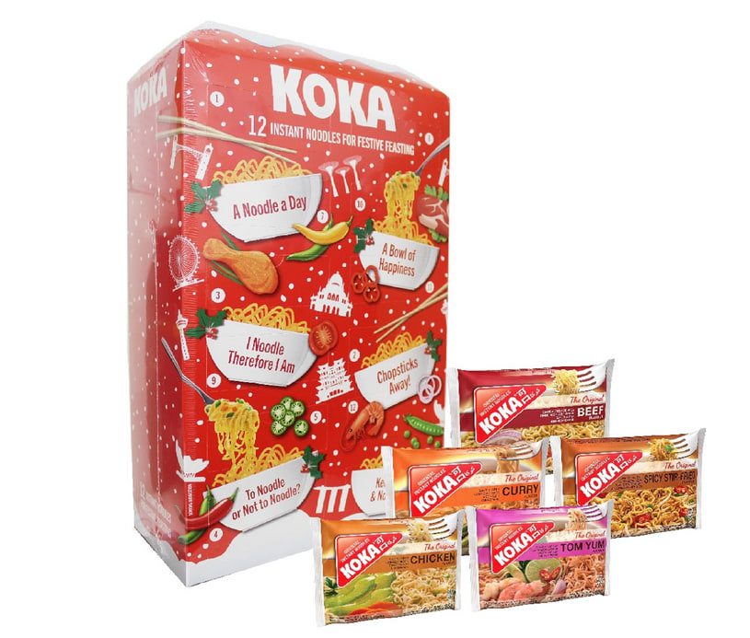
There are so many different types of Advent calendars now!
Protein bars
Stationery
Perfume
Highland cow Christmas ornaments
Rubber ducks
Nail varnish
Instant noodles

Slide 4
Advent calendars were first used by Germans and were used as part of Christian devotionals.
Cadbury’s made their first chocolate Advent Calendar in 1971.
51% of UK parents or guardians buy an Advent calendar for someone else…
48% of UK adults will spend £5 or less on an Advent calendar

Slide 5
Well… in the CAFOD Secondary Advent calendar we’ve been opening up the stories that are behind every World Gift.
Daniel, Dodo, Maria and Steve, Raissa, Bernadette, Yuliia, Sally, Agnjetschka and Anna and Orest all have been involved with projects that are supported through World Gifts.

Slide 6
Advent is about waiting expectantly. It’s meant to be a period where we slow down and wait expectantly for Jesus’ return.
We don’t much like waiting in the modern world but by taking time we start to see the whole world in a new way, and we can know our friends and family in a much deeper way.

Slide 7
We see…
The determination of Daniel in the DRC
woodworking project
The resilience of Agnjetschka in Poland in running soup kitchens
The gratitude of Dodo in the DRC in the sewing project
The commitment of Sally in Lebanon in peacebuilding projects
The wisdom of Yuliia in Ukraine in speaking about peace

Slide 8
And we experience…
the joy of working together
the depths of peace
the faithfulness of friends
the kindness of others
the hope of of a better world
the justice in equality

Slide 9
And we reflect on Jesus…
the Good Shepherd
Emmanuel
the King of kings
the Prince of Peace
the Wonderful Counsellor
and Light of the World

Slide 10
This is Yuliia. She lives in Ukraine. Yuliia wants to be a baker when she’s older and enjoys making pastries with her Mum and Grandmother.
Yuliia was evacuated two years ago with her family along a Red Cross route. The family left their beloved home and made a traumatic journey to where they live today in a village in another part of the country. “My dream,” she says, “is to have peace over our heads.”
What can Yuliia teach us?
Yuliia in Ukraine. You can support children around the world through our Therapy through play World Gift.

Slide 11
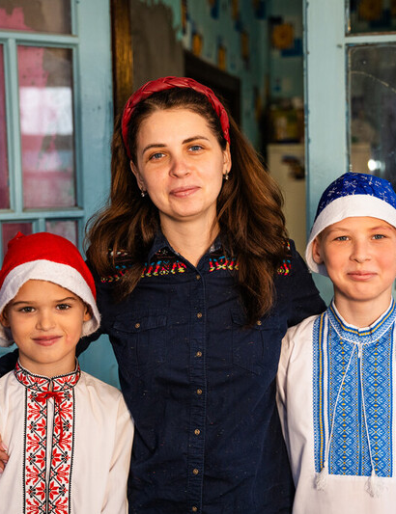
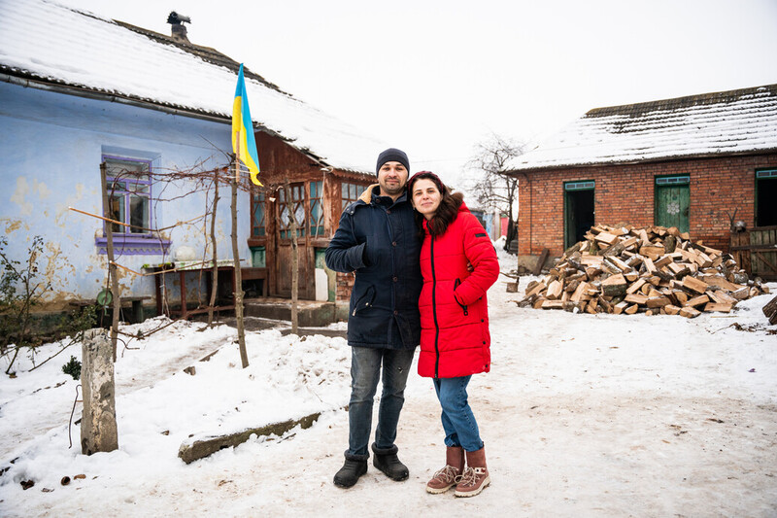
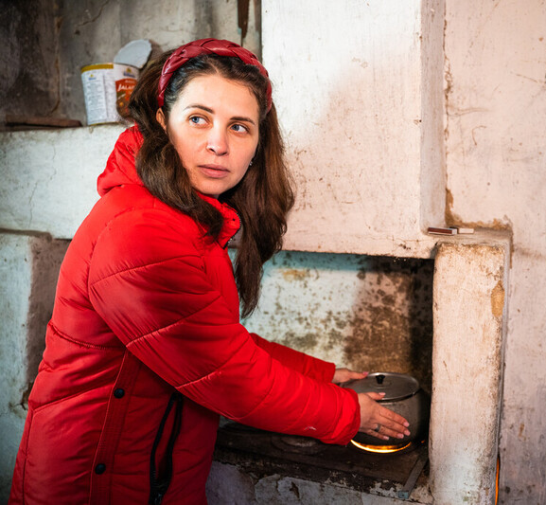
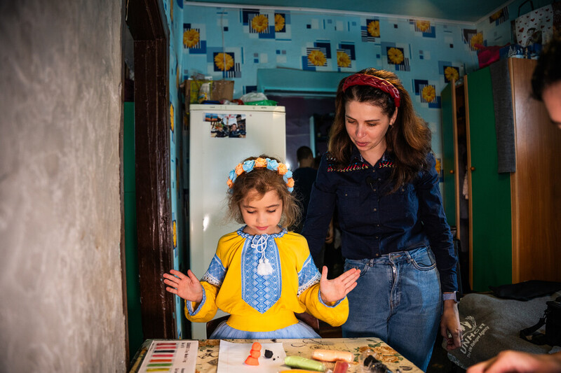
Ukraine can get really cold in the depths of winter so her family were very grateful for the Firewood for winter World Gift.
Here are photos of the firewood arriving,
some of Yuliia’s family members; her Mum and Dad and brothers. And in the bottom left we can see her Mum, Maria, is now able to heat the fire to cook dinner on their stove.

Slide 12
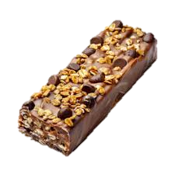
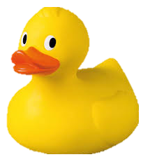
Advent was never about protein bars and rubber ducks!
It was about a new vision of a better tomorrow.
That’s what we’re all about at CAFOD!

Slide 13
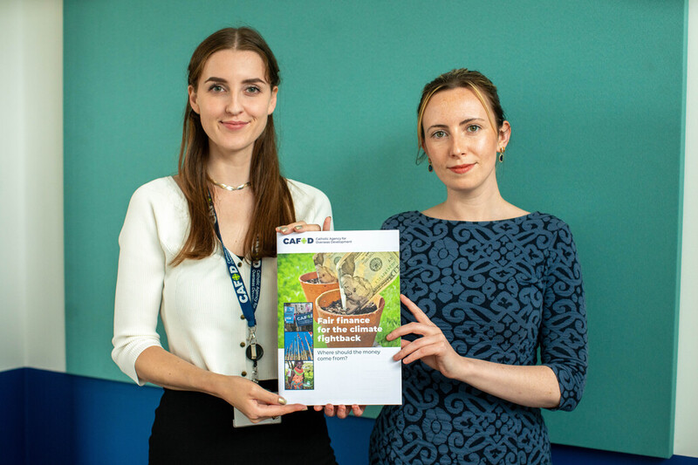
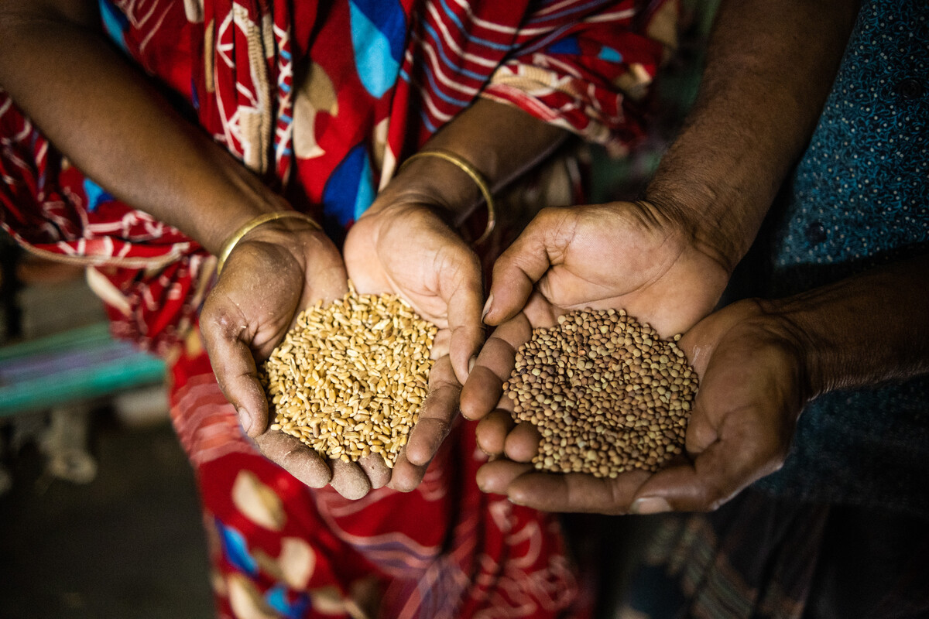
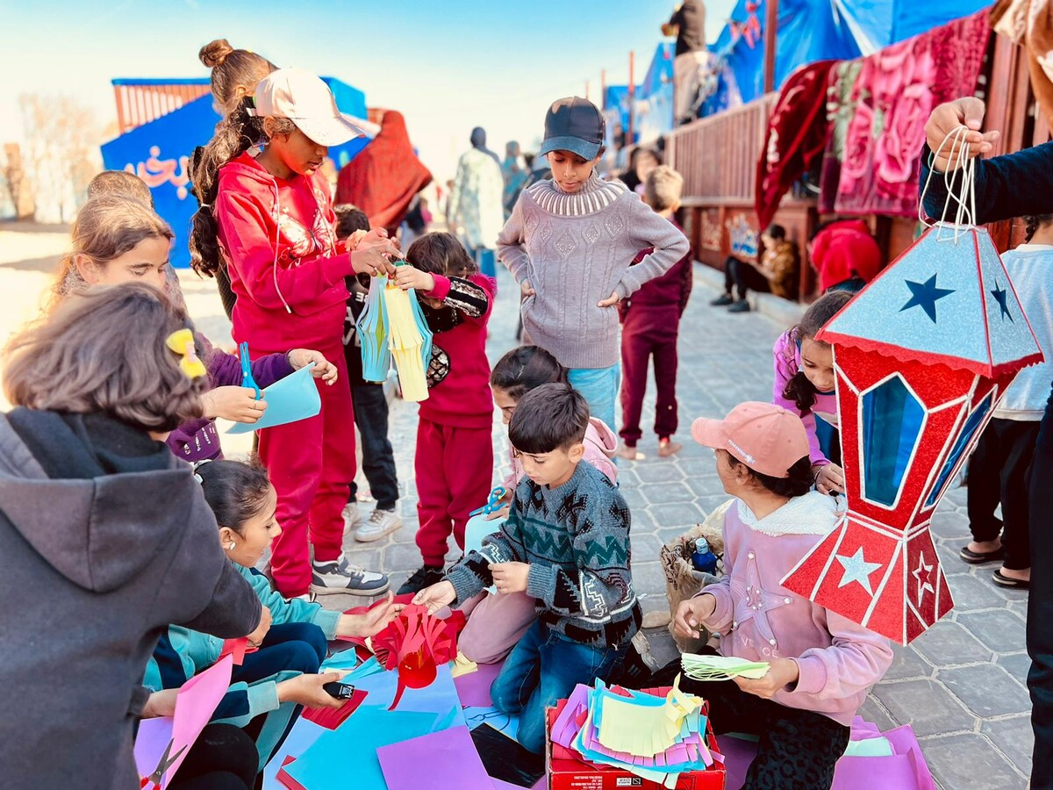
We advocate for
We campaign for….
We support projects
fair finance
seed sovereignty
Liz and Maria, CAFOD policy experts
Selina in Bangladesh
…and so much more…!
that promote peace
Children’s groups in Gaza

Slide 14
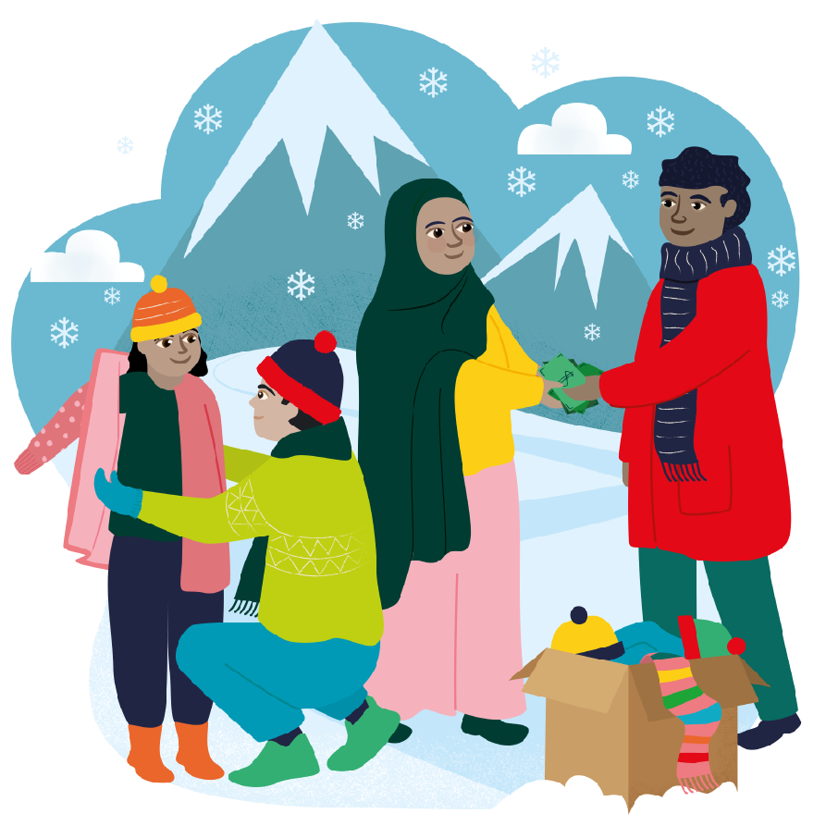
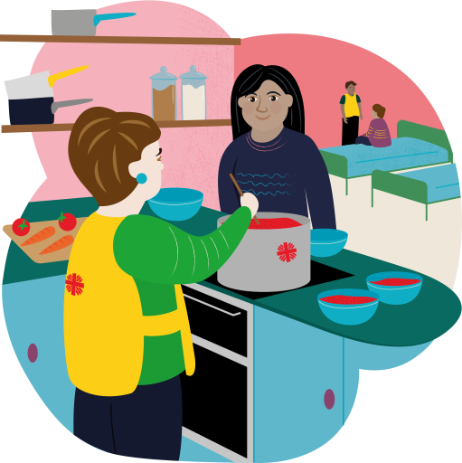
That’s why we have World Gifts! Your school can celebrate Christmas together and help transform the lives of families and communities living in poverty.
This year we have a special school stocking….!
It includes 5 World Gifts Promoting peace
Super Soup Kitchen
Winter Survival kit
Therapy through play
Firewood for winter
£100 Stocking

Slide 15
Prayer
Maranatha! Open our eyes to the dignity of all people And our ears to the cries of the earth. Maranatha! Let us walk in solidarity with the poor And cleanse our world from oppression. Maranatha! Let us shout out for justice for all And renew our hope for change. Maranatha! The Lord is coming Let us share the Good News! Amen.
Notes:
Prayer credit: Sue Cooper, CAFOD

Slide 16
Thank you from everyone at CAFOD!
Thank you for supporting World Gifts this Christmas time. Happy Christmas (when it comes!)

