Slide 1
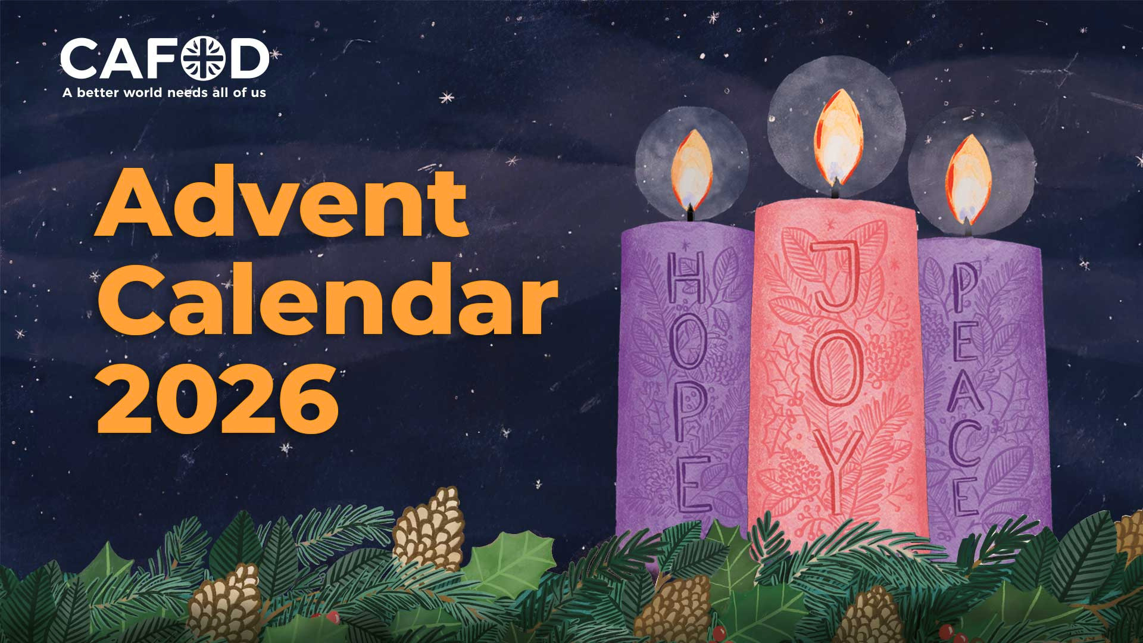
Notes:
Advent Wreath Illustration: Emma Hartley Walton, CAFOD.

Slide 2
Celebrating the season of Advent
Welcome to CAFOD's primary school’s Advent calendar 2026!
The word Advent means "coming" or "arrival".
Advent is a special time of preparation, when we get ready to celebrate the birth of Jesus at Christmas and look forward in hope to His coming again.
As a new liturgical year begins, Advent gives us a chance to start afresh, grow closer to God and prepare our hearts for Jesus.
Throughout Advent, we are invited to spend time with God in prayer, listen carefully to His word and put our faith into action.
How will you prepare your heart for Jesus this Advent?
Notes:
Advent Wreath Illustration: Emma Hartley Walton, CAFOD.
Star graphic: WC Studio from WC Studio, via Canva.

Slide 3
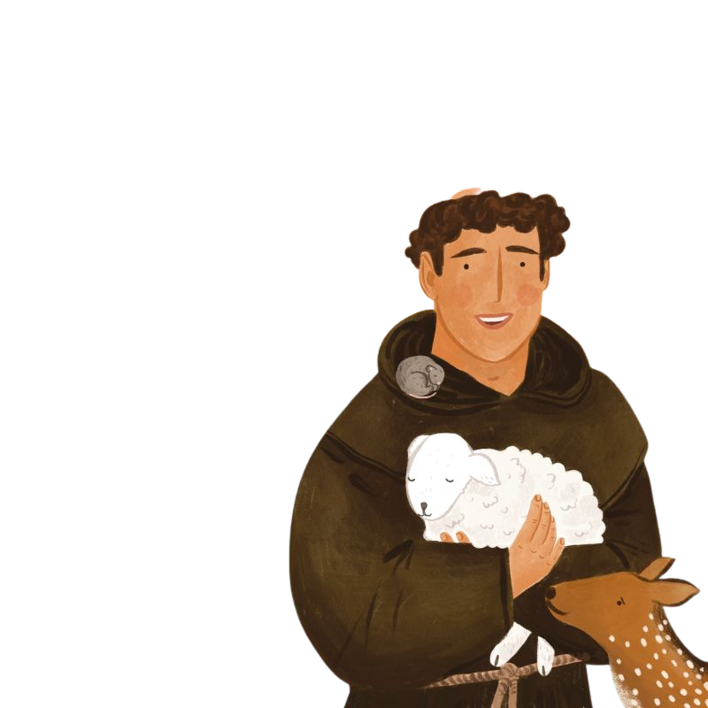
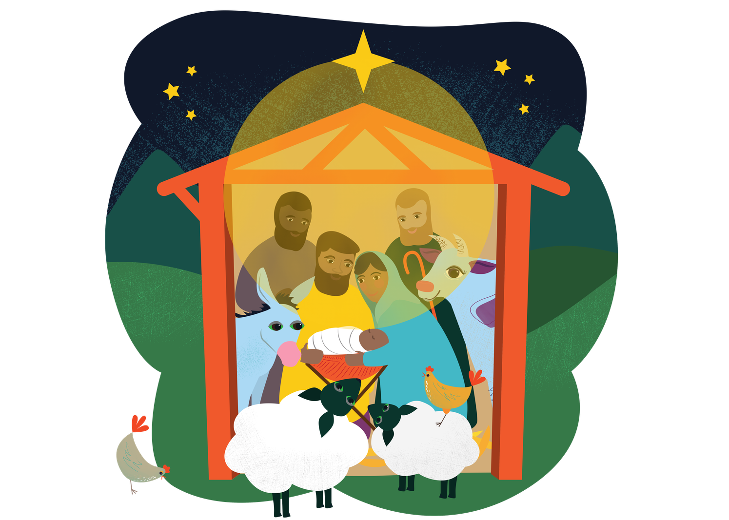
The Jubilee Year of Saint Francis of Assisi
Throughout 2026, we have been celebrating the Jubilee Year of Saint Francis of Assisi, 800 years after his death.
Francis loved God and saw His goodness in all people and in creation. He cared deeply for those who were poor, sick or in need, and he encouraged others to do the same.
Francis also loved Christmas. Over 800 years ago,
he created the first Nativity scene to help people imagine what it was like when Jesus was born in Bethlehem and how Jesus came from humble beginnings.
This Advent, Saint Francis can inspire us to notice God's love all around us: in prayer, in creation and in people near and far.
Who might you learn from, help or pray for this Advent?
Notes:
Nativity Illustration: Sam Obsorne, CAFOD.
Saint Francis of Assisi Illustration: Emma Hartley Walton, CAFOD.
Star graphic: WC Studio from WC Studio, via Canva.

Slide 4
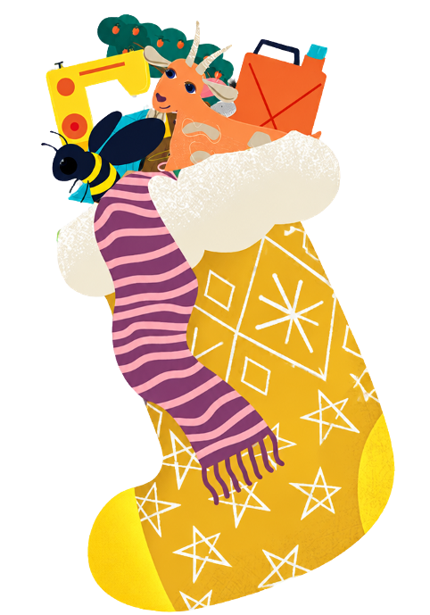
CAFOD’S World Gifts
Each day, CAFOD's Primary Advent Calendar invites you to:
Listen to scripture from the readings of the day.
Respond to what you have heard with an activity.
Pray together.
Encounter people from our global family.
Act through a simple Advent mission.
Along the way, you will also discover some of CAFOD's wonderful World Gifts for Schools!
These virtual charity gifts help support communities around the world.
Could your class, school or family choose one or more to fundraise for this Advent to help our global brothers and sisters?
Let's begin our Advent journey together!
Notes:
World Gift Illustration: Sam Obsorne, CAFOD.
Star graphic: WC Studio from WC Studio, via Canva.

Slide 5
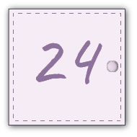


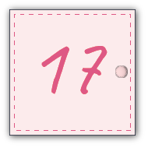


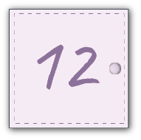
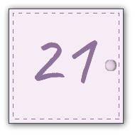

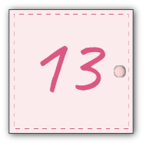







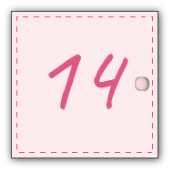



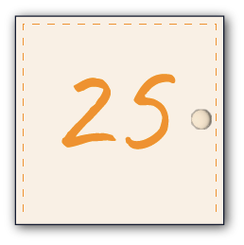





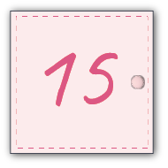
CAFOD’s Primary Advent Calendar
Start here...
Notes:
Star graphic: WC Studio from WC Studio, via Canva.

Slide 6

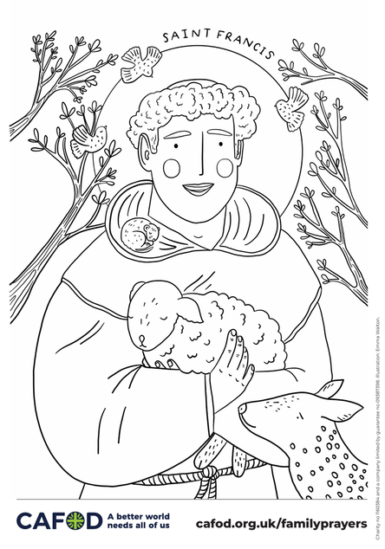
Sunday 29 November - First Sunday of Advent
Sunday’s Gospel
“Be on watch, be alert, for you do not know when the time will come.”
Mark 13:33
Advent is a special season of waiting and preparation.
When we are excited about something, it can be easy to get distracted by all the planning and celebrations. In today's Scripture, Jesus tells us to “be on watch, be alert.” He wants us to pay attention to God and to the people around us.
Today’s Activity
Saint Francis of Assisi tried to follow Jesus by paying close attention to God, to people who were being overlooked and to the wonders of creation.
As we celebrate the end of his Jubilee Year,
why not explore CAFOD's Saint Francis of Assisi family prayer ideas here and discover how we can follow his example today.
Notes:
Advent Candles and Saint Francis of Assisi Illustrations: Emma Hartley Walton, CAFOD.

Slide 7
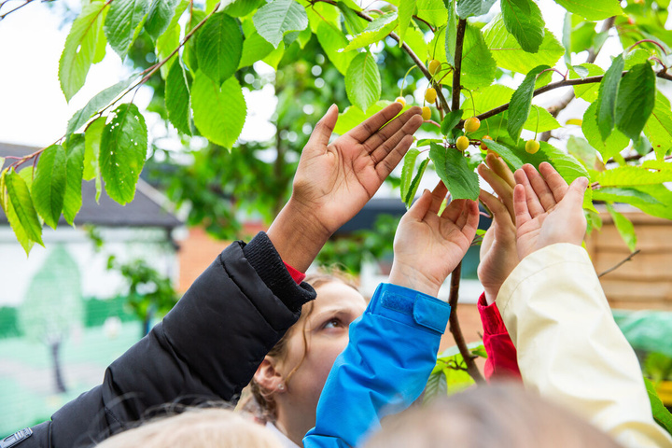
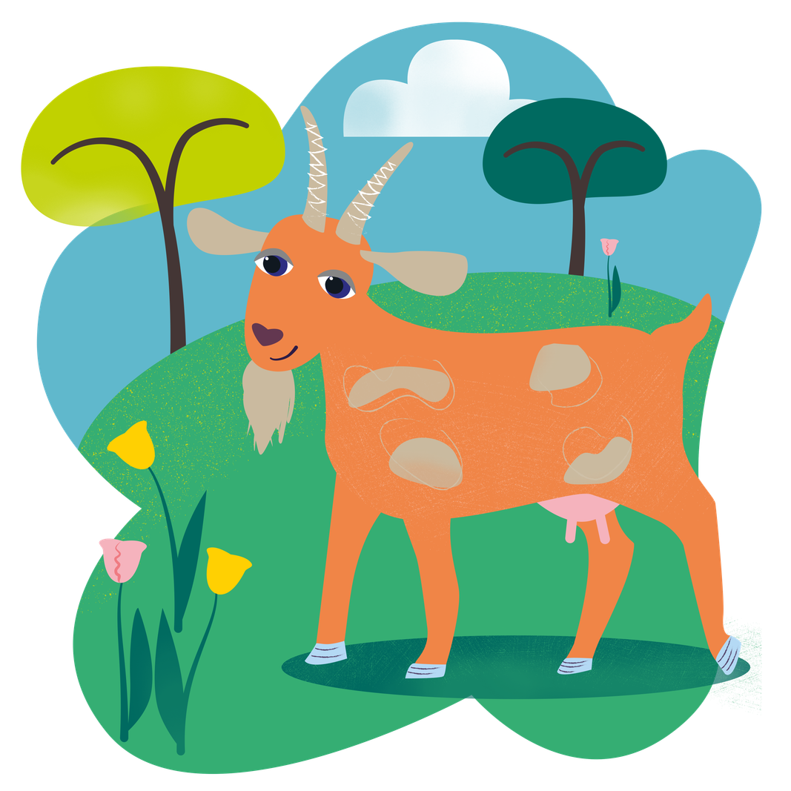
Sunday 29 November - First Sunday of Advent
Let us pray
God of hope,
as we begin our Advent journey,
help us to be alert to your presence.
Open our eyes to the people who need our love and care,
and draw us closer to Jesus each day.
Amen.
Today’s Mission
Saint Francis is the patron saint of the environment and animals. He loved God’s creation and all of God's creatures. Join us in praying a prayer inspired by Saint Francis' Canticle of the Sun.
World Gift: Could your class help support a family
by choosing The goat that gives (£30) gift this Advent? A goat can provide milk and help families earn an income.
Notes:
Photo: Thom Flint, CAFOD. St Gregory’s Primary School, Chorley, demonstrating LiveSimply
World Gift Illustration: Sam Obsorne, CAFOD.
Advent Wreath Illustrations: Emma Hartley Walton, CAFOD.

Slide 8
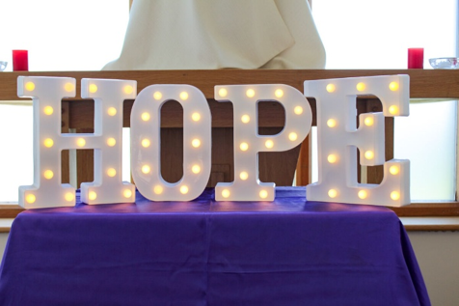
Monday 30 November - First week of Advent
Today’s Scripture
“Oh no, sir,” answered the officer. “I do not deserve to have you come into my house. Just give the order, and my servant will get well." Matthew 8:8
The officer was a Roman soldier. The Romans had taken over the area where Jesus lived by force and so the Jewish people and the Romans did not get along. This soldier, however, believed that Jesus could heal his servant.
Jesus was impressed with the soldier's faith, saying that God's kingdom is open to anyone who believes, no matter who they are.
As we start our Advent journey, how do we show God that we truly have faith in him?
Today’s Activity
Let us share our faith together: join with hundreds of children across England and Wales to take part in CAFOD’s National Advent Assembly!
Notes:
Photo: Vicky Ahmed, CAFOD.
Advent Wreath Illustrations: Emma Hartley Walton, CAFOD.

Slide 9
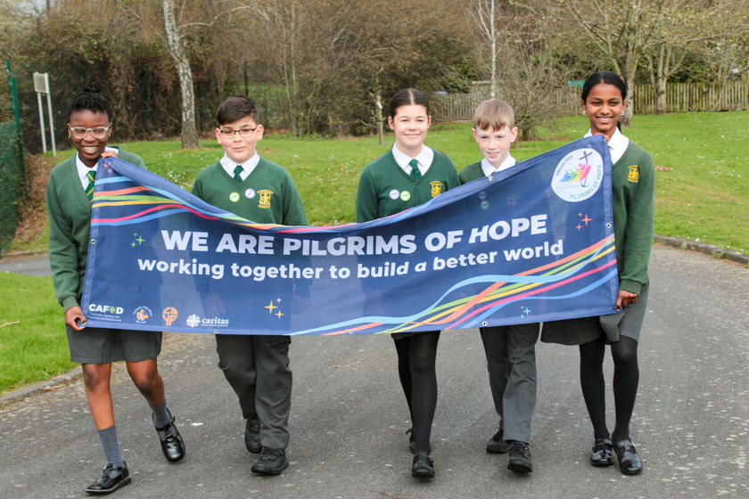

Monday 30 November - First week of Advent
Let us pray
God of hope,
as we wait in hope for Jesus this Advent,
help us to trust in your love and care.
Teach us to think of others
and bring their needs to you in prayer.
Amen.
Today’s Mission
The 2025 Jubilee called us to be Pilgrims of Hope, working for a better world where everyone and creation can flourish.
Keep that hope alive by revisiting your school's Jubilee Pledge. Explore CAFOD’s Ways to live out your Jubilee Pledge.
Print or display CAFOD’s Jubilee Pledge labels and share your school’s achievements!
Notes:
Photo: Vicky Ahmed, CAFOD. Jubilee Pilgrims of Hope - St Francis Xavier's RC Primary School, Herefordshire
Advent Wreath Illustrations: Emma Hartley Walton, CAFOD.

Slide 10
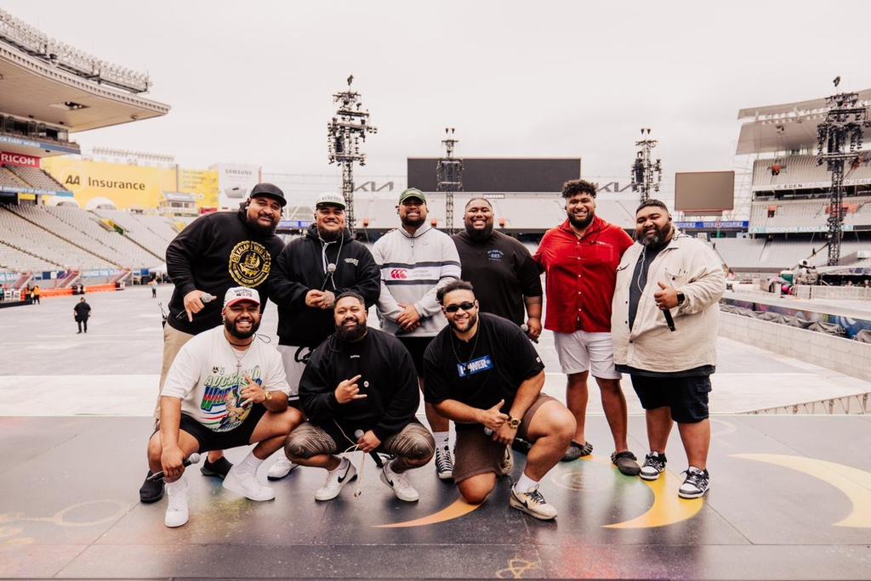
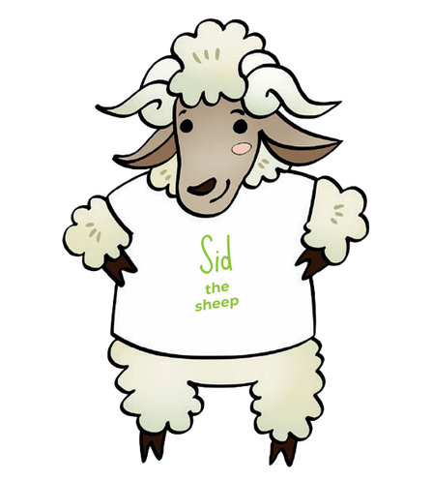
Tuesday 1 December - First week of Advent
Today’s Scripture
“In his days, justice shall flourish and peace till the moon fails.” Psalm 71:7
If we live as Jesus teaches us, peace and justice will flourish. But we know many of our brothers and sisters around the world live with no justice and no peace; some with not enough food or clean water, some affected by conflict. Yet today’s Psalm gives us hope.
How can we be signs of hope in our world this Advent?
Today’s Activity
Last month, on World Youth Sunday, we met the Pacific Artists for Climate Justice. They come from The Pacific Islands, where communities are already seeing the effects of climate change, including rising sea levels and more extreme weather.
The Pacific Artists for Climate Justice use their musical gifts to share stories of hope and raise awareness of the challenges facing their communities.
Let’s listen to their song This Is Our Home!
Notes:
Photo: Pacific Artists for Climate Justice
Advent Wreath Illustrations: Emma Hartley Walton, CAFOD.

Slide 11
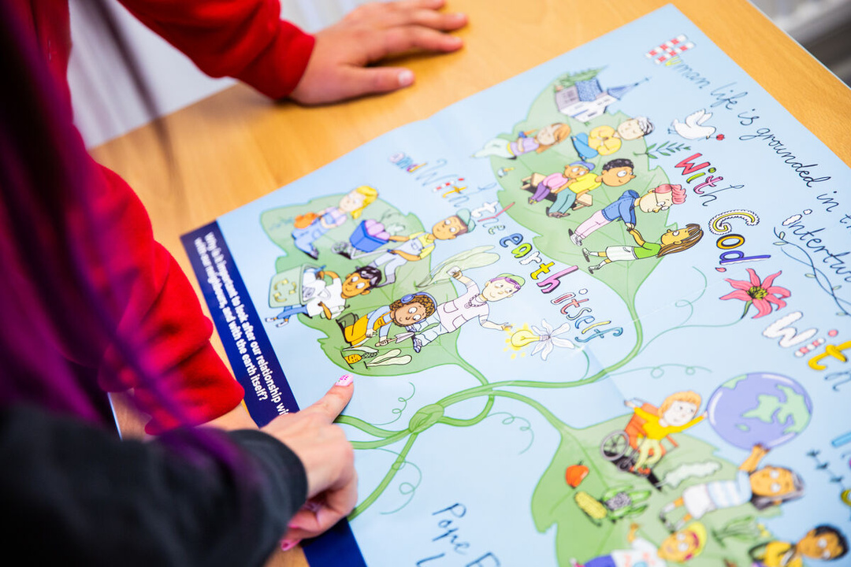
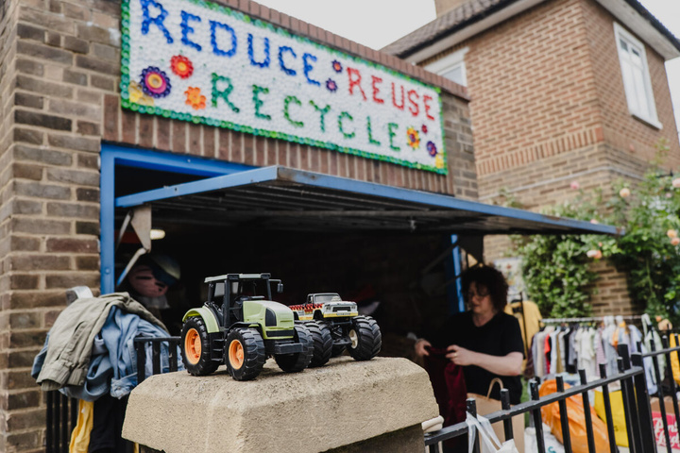
Tuesday 1 December - First week of Advent
Let us pray
God of hope,
help justice and peace to flourish.
Inspire us to use our gifts and talents to do your work,
care for creation and build a better future for all.
Amen.
Today’s Mission
Use your gifts for our common home!
Listen to This Is Our Home and sing along with the lyrics. Could your school record yourselves singing the song and share the video with CAFOD as part of our collection of voices?
Notes:
Photo: Thom Flint, CAFOD.
St Gregory’s Primary School, Chorley, demonstrating LiveSimply
Advent Wreath Illustrations: Emma Hartley Walton, CAFOD.

Slide 12
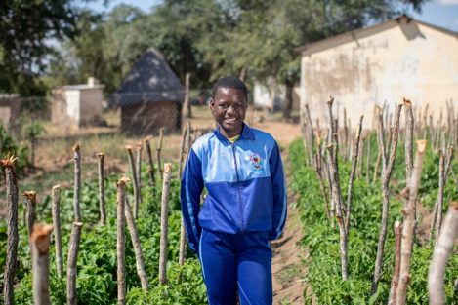
Wednesday 2 December - First week of Advent
Today’s Scripture
“The disciples asked him, “Where will we find enough food in this desert to feed this crowd?”” Matthew 15:33
Jesus worries that those who have come to hear him are hungry, but the disciples are overwhelmed thinking of finding food for 5,000 people. That's a big crowd! The disciples weren't prepared for so many people but with Jesus' help they feed everyone with five loaves and two fishes from a little boy.
Advent is a time for preparation. How can we prepare in the right way for Jesus' coming?
Tayla, Zimbabwe.
Today’s Activity
Food and water are gifts from God that help us live, learn and grow. But sadly not everyone has enough of these gifts to flourish.
Tayla lives in Zimbabwe. She loves maths and dreams of becoming a doctor. Sometimes Tayla arrived at school tired because she had to walk a long way to collect water.
CAFOD's local partners helped build a new water system in her community. Now Tayla's school has safe water and can grow vegetables too.
Think about the food in your lunchbox or on your plate today. Who helped it get there? Give thanks for them today.
Notes:
Photo: Cynthia Matonhodze, CAFOD.
Zimbabwe 2025 - Solar-powered water and community gardens
Advent Wreath Illustrations: Emma Hartley Walton, CAFOD.

Slide 13
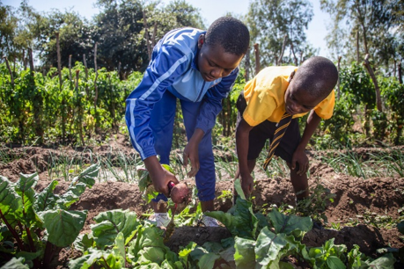
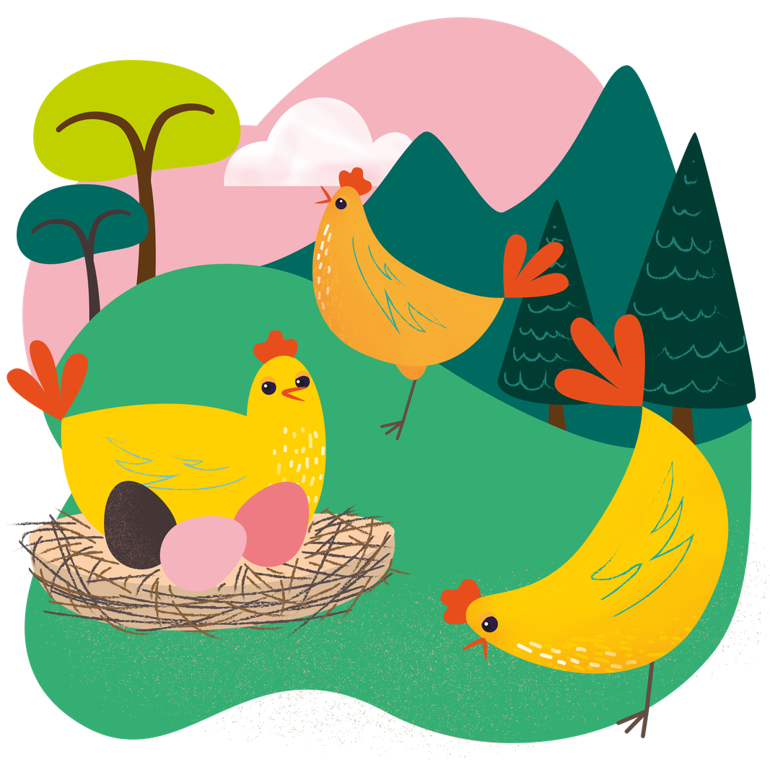
Wednesday 2 December - First week of Advent
Let us pray
God of hope,
thank you for the gifts of food and water.
May we be generous and share what we have with others.
Amen.
Today’s Mission
Create an Advent grace for your class to pray before meals during Advent.
Could your class help families produce eggs to eat or sell with the Chirpy chickens (£20) World Gift?
Learn more about this gift here!
Notes:
Photo: Cynthia Matonhodze, CAFOD.
Zimbabwe 2025 - Solar-powered water and community gardens
World Gift Illustration: Sam Obsorne, CAFOD.
Advent Wreath Illustrations: Emma Hartley Walton, CAFOD.

Slide 14
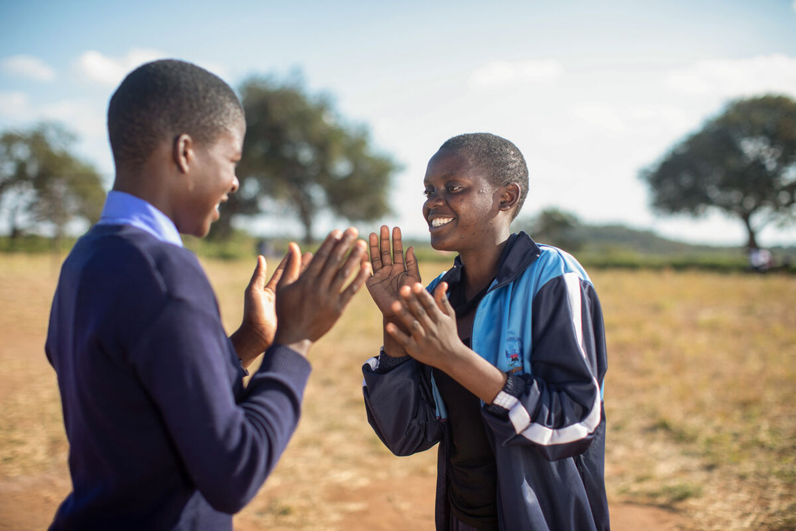

Thursday 3 December - First week of Advent
Today’s Scripture
“The rain poured down, the rivers flooded over, the wind blew hard against that house, and it fell. And what a terrible fall that was!” Matthew 7:27
In today’s Gospel, when there is a flood, a man's house falls down because he had built it on sand, which isn't a good idea, is it? The man who built his house on rock was more prepared. His house survived the storm.
Advent calls us to prepare our hearts for Jesus in the right way. How would God like us to be prepared and ready for the coming of Jesus at Christmas?
Today’s Activity
Today is the International Day of Persons with Disabilities. God made each of us unique and special. Every person deserves to feel welcomed, included and able to take part.
Catholic Social Teaching teaches us about Participation. This means that everyone has a part to play and should have the opportunity to take part fully in society.
Think about your school.
What helps everyone feel welcome in your classroom or school? Why is it important that everyone should be able to take part?
Spend some time sharing your ideas together.
Notes:
Photo: Cynthia Matonhodze, CAFOD.
Zimbabwe 2025 - Solar-powered water and community gardens.
Advent Wreath Illustrations: Emma Hartley Walton, CAFOD.

Slide 15
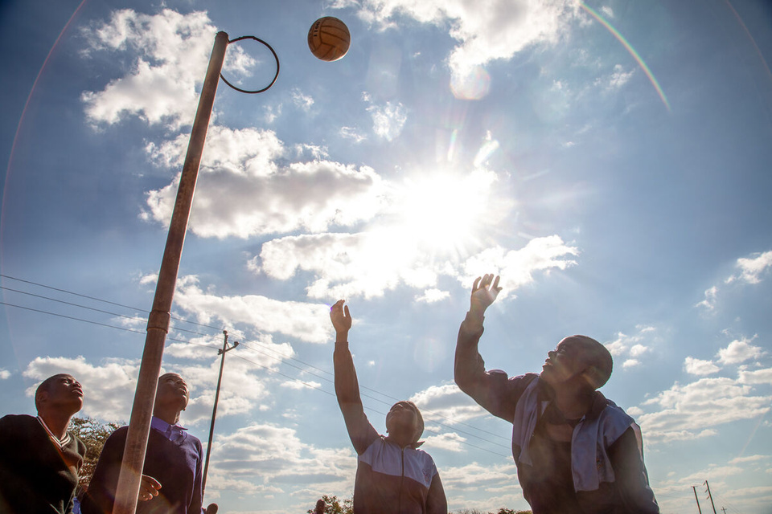

Thursday 3 December - First week of Advent
Let us pray
God of hope,
thank you for making each of us unique and special.
Help us to welcome everyone, include everyone
and make sure nobody is left out.
Amen.
Today’s Mission
Make sure no one is left out. Invite someone new to play or learn with you today to share hope!
World Gift: Help bring children together through a Fabulous football World Gift (£15)!
Notes:
Photo: Cynthia Matonhodze, CAFOD.
Advent Wreath Illustrations: Emma Hartley Walton, CAFOD.
World Gift Illustration: Sam Obsorne, CAFOD.

Slide 16
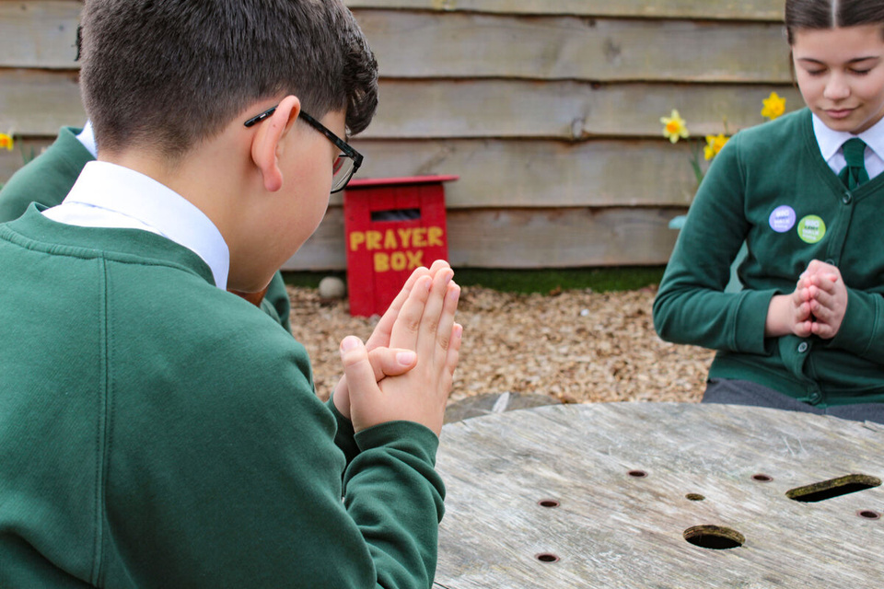
Friday 4 December - First week of Advent
Today’s Scripture
“Hope in him, hold firm and take heart.
Hope in the Lord!” Psalm 26:14
Advent is a season of hope. And hope helps us to be brave and to face any difficulties we might have.
It helps us to be there for one another and to walk alongside our global family experiencing poverty and injustice, to work together to build a better world.
As we prepare this Advent for the birth of Jesus, how can we continue to be signs of hope in the world?
Today’s Activity
Light is a symbol of hope. As we light the candles on the Advent wreath, we remember that Christmas is getting closer!
We invite you to pass an electric candle around the classroom. When the candle comes to you, if you would like to, you could share a prayer intention out loud. You might pray for someone in your family,
a friend, your school, our world, or a place that needs hope and peace at this time.
Notes:
Photo: Vicky Ahmed, CAFOD. Jubilee Pilgrims of Hope - St Francis Xavier's RC Primary School, Herefordshire.
Advent Wreath Illustrations: Emma Hartley Walton, CAFOD.

Slide 17
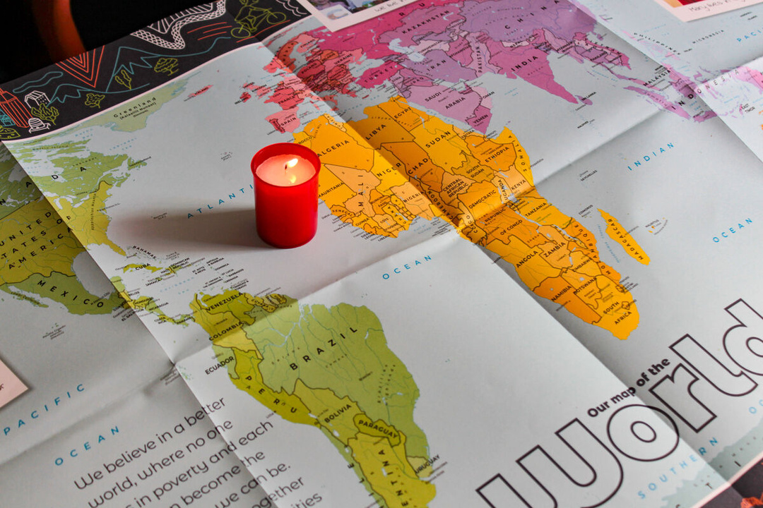
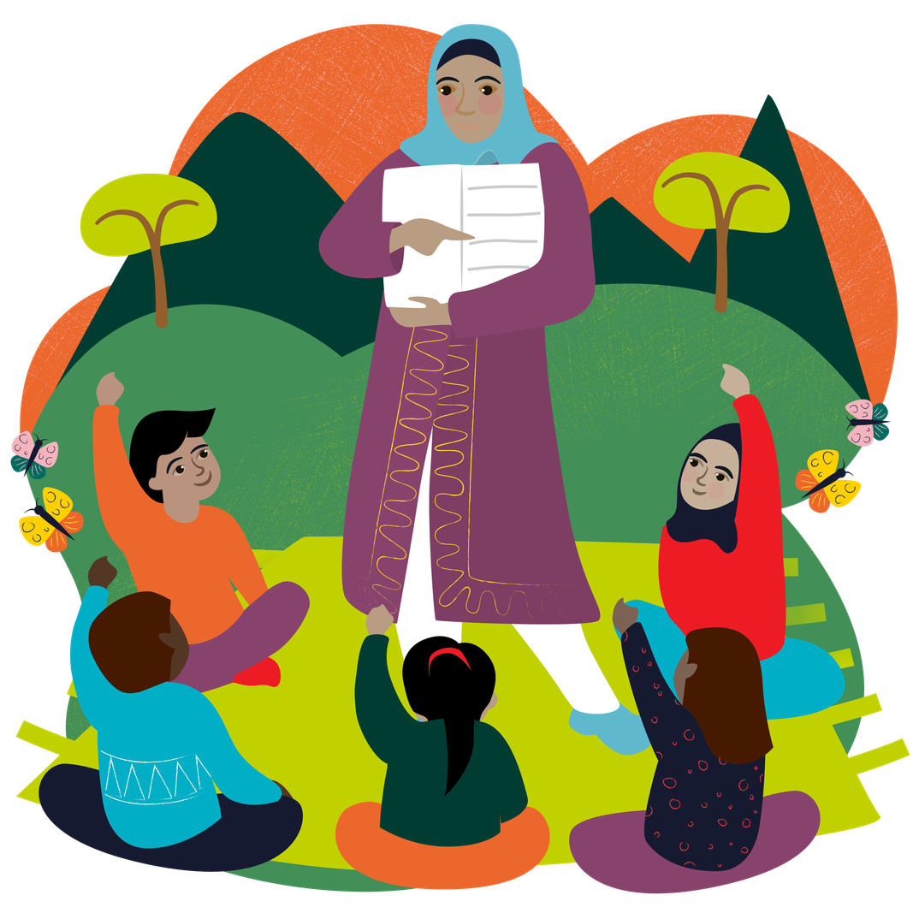
Friday 4 December - First week of Advent
Let us pray
God of hope,
thank you for being our light.
Help us to shine your light
through our words and actions this Advent.
Amen.
Today’s Mission
Be a light for someone today.
Smile, help, encourage or include someone who needs a little extra kindness.
Watch CAFOD’s Hope reflection for children for inspiration!
World Gift: Share hope for a brighter future with a Teach someone to read World Gift (£12)!
Notes:
Photo: Vicky Ahmed, CAFOD.
Advent Wreath Illustrations: Emma Hartley Walton, CAFOD.
World Gift Illustration: Sam Obsorne, CAFOD.

Slide 18

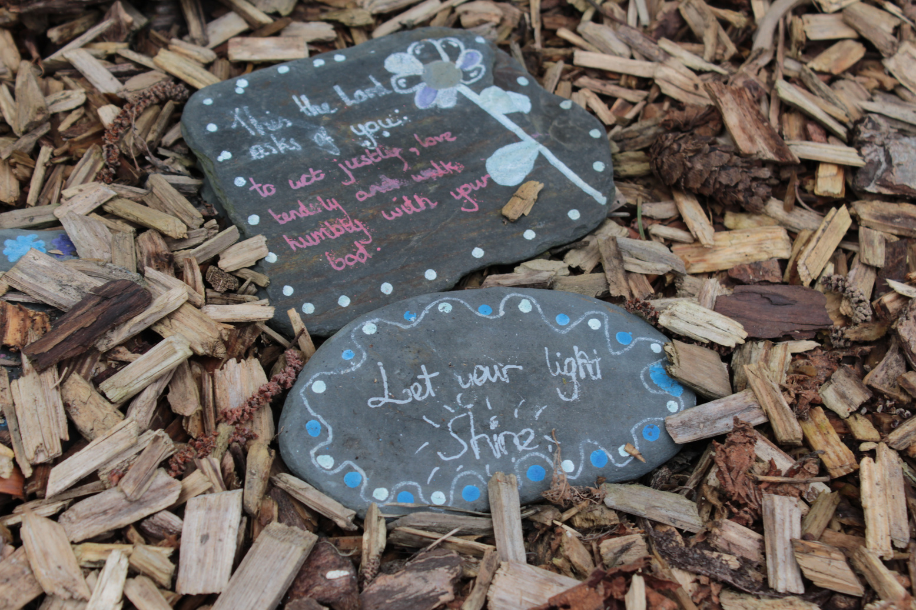
Sunday 6 December - Second Sunday of Advent
Sunday’s Gospel
“Someone is shouting in the desert,
“Get the road ready for the Lord;
make a straight path for him to travel!””
Mark 1:3
In Sunday’s Gospel, John the Baptist tells people to “get the road ready for the Lord!”. He asks them to think about the things in their lives that might be getting in the way of God so that they can prepare their hearts for God.
Sometimes unkindness, arguments, selfishness or not listening to others can make it harder for peace to grow.
How can you get ready for the Lord and welcome peace into your life?
Today’s Activity
Advent is a time to “make a straight path” for Jesus in our hearts and in our world.
Hold a small stone in your hand.
Think quietly about any worries, distractions or things you are sorry for. Imagine placing them into the stone and handing them over to God.
If you can, place all the stones together to make a straight path and remember John the Baptist's message from the Gospel.
Notes:
Photo: Vicky Ahmed, CAFOD
Advent Wreath Illustrations: Emma Hartley Walton, CAFOD.

Slide 19
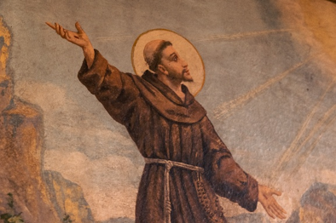
Sunday 6 December - Second Sunday of Advent
Let us pray
Saint Francis of Assisi’s Peace Prayer
Lord, make me an instrument of your peace.
Where there is hatred, let me sow love;
where there is doubt, faith;
where there is despair, hope;
where there is darkness, light;
and where there is sadness, joy.
Amen.
Saint Francis of Assisi, pray for us.
Today’s Mission
Choose one small action today to help you prepare the way for peace: say sorry, forgive, listen carefully, include someone, or care for creation.
Notes:
Photo: BlueIncDrone, Light Stock.
Advent Wreath Illustrations: Emma Hartley Walton, CAFOD.
Saint Francis of Assisi Illustration: Emma Hartley Walton, CAFOD.

Slide 20
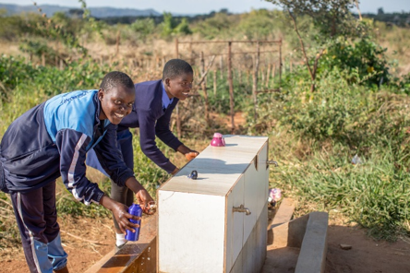
Monday 7 December - Second week of Advent
Today’s Scripture
“The lame will leap and dance,
and those who cannot speak will shout for joy.
Streams of water will flow through the desert;
the burning sand will become a lake,
and dry land will be filled with springs.”
Isaiah 35:6-7
In Isaiah’s joyful vision, people who cannot walk will dance, those who cannot speak will shout for joy.
Water will spring in the desert. New life will bloom.
At Advent, we look forward joyfully to new life with Jesus' birth.
How can we bring joy to others around us this Advent?
Maggie,
Zimbabwe.
Today’s Activity
Maggie is sixteen and lives in Zimbabwe with her family. She loves school and playing netball, but lack of rain has brought drought to her area and meant that she had to walk long distances to collect safe water.
Watch CAFOD's film about how water projects are helping communities in Zimbabwe.
Then explore the Zimbabwe photopack and discuss the pictures together.
How are water and clean facilities helping children stay healthy and learn?
Notes:
Photo: Cynthia Matonhodze, CAFOD.
Zimbabwe 2025 - Solar-powered water and community gardens
Advent Wreath Illustrations: Emma Hartley Walton, CAFOD.

Slide 21
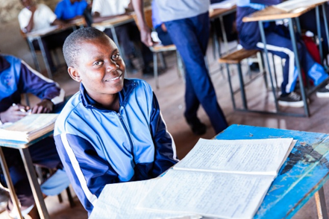
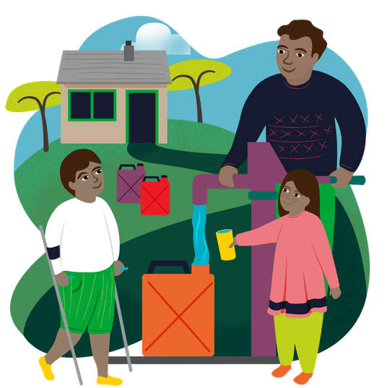
Monday 7 December - Second week of Advent
Let us pray
God of life,
thank you for the gift of water.
Help us to use it wisely and not waste it.
We pray for people who do not have safe water to drink.
Amen.
Today’s Mission
Value every drop. Think about how you use water today and try not to waste it.
World Gift: Learn about how you can help families access safe water with CAFOD’s Water for a Family World Gift (£35).
Notes:
Advent Wreath Illustrations: Emma Hartley Walton, CAFOD.
World Gift Illustration: Sam Obsorne, CAFOD.
Advent Wreath Illustrations: Emma Hartley Walton, CAFOD.

Slide 22
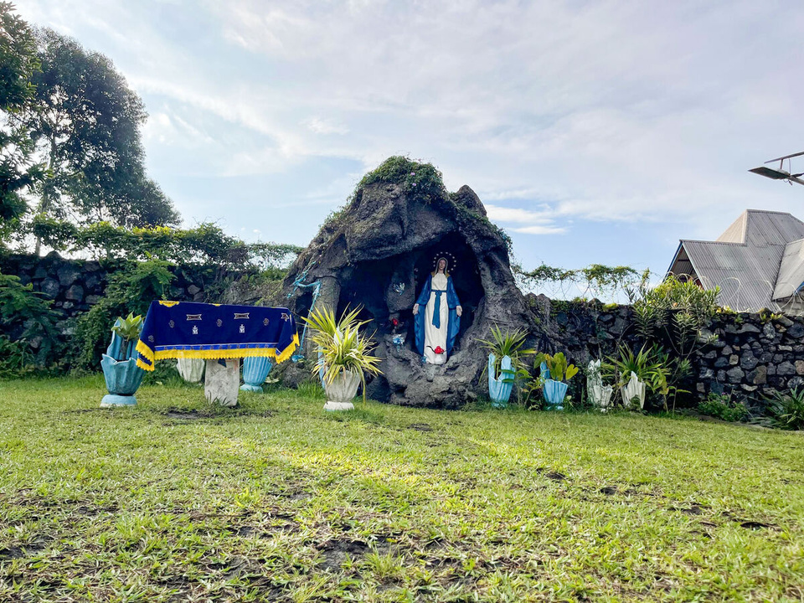
Tuesday 8 December - Second week of Advent
Today’s Scripture
“The angel came to her and said, “Peace be with you!
The Lord is with you and has greatly blessed you!””
Luke 1:28
Today we celebrate the Immaculate Conception of the Blessed Virgin Mary.
From the very beginning of her life, Mary was chosen to serve God.
Let's take a moment to imagine what it must have been like for Mary when the angel asked her to be the mother of Jesus – perhaps frightening, confusing, overwhelming?
She knew it would be difficult, yet Mary said 'yes' because she trusted God.
Today’s Activity
Sometimes God asks us to say yes too.
We might be asked to be kind, forgive someone, care for creation, share with others or be a better listener.
Every time we say yes to doing something good, we help show God's love to others.
Sing the Hail Mary song and join in with the signing too. As you sing, think about how you can say yes to God this Advent.
Notes:
Advent Wreath Illustrations: Emma Hartley Walton, CAFOD.

Slide 23
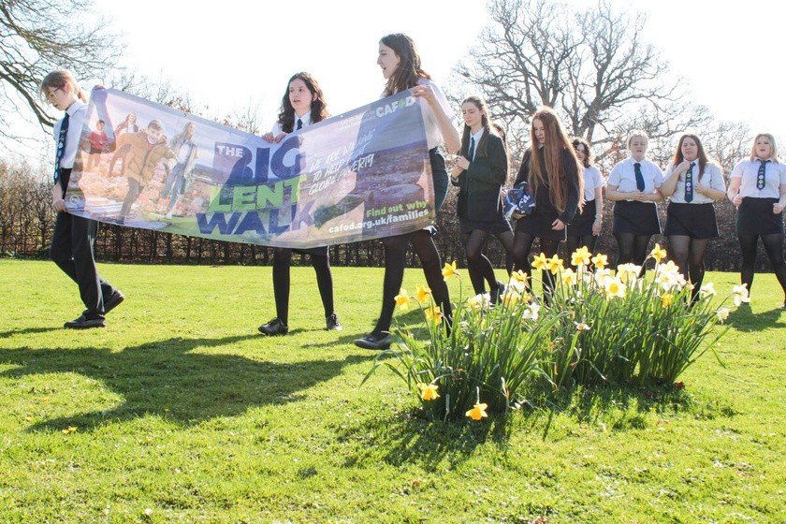
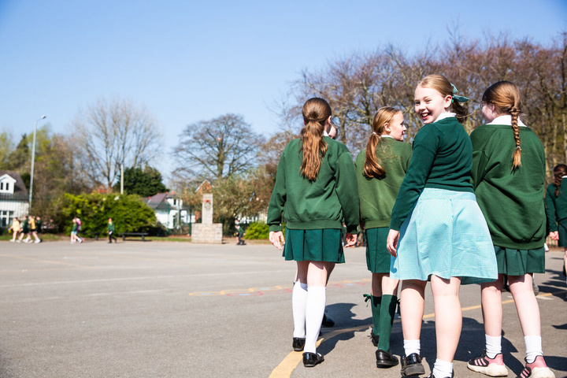
Tuesday 8 December - Second week of Advent
Let us pray
God of peace,
give us courage to say “yes” to you like Mary did
and to help build your Kingdom of love and peace on earth.
Amen.
Today’s Mission
Say “yes” to CAFOD's Big Lent Walk 2027!
Start thinking about how your class could take part during Lent: walk, run, skip or even dribble a football while raising money to help our global family. Sign up here!
Notes:
Photo: Vicky Ahmed, CAFOD.
Jubilee Pilgrims of Hope - St Mary's RC High School, Herefordshire
Photo: Thom Flint, CAFOD. Big Lent Walk at St Bartholomew's, Rainhill
Advent Wreath Illustrations: Emma Hartley Walton, CAFOD.

Slide 24


Wednesday 9 December - Second week of Advent
Today’s Scripture
"Come to me, all of you who are tired from carrying heavy loads, and I will give you rest." Matthew 11:28
We can be tired for many reasons: a busy day at school, an energetic game of sport or maybe we have stayed up late. Sometimes though, we may feel tired because we are worried about something or we feel afraid.
Let's remember that God is always there for us to share our troubles with.
How can we help others who are feeling worried
about something?
Today’s Activity
In Pope Leo XIV's document, “Dilexi Te”, he teaches us that God has a special love for people who are poor, vulnerable or struggling. We are called to show that same love to others.
Watch CAFOD’s Dilexi te animation for children.
As you watch, think about a Bible story where Jesus cared for people who are poor or vulnerable.
Notes:
Dilexi Te Illustration: V Srodi/M Nino/Ministory, CAFOD.
Advent Wreath Illustrations: Emma Hartley Walton, CAFOD.

Slide 25
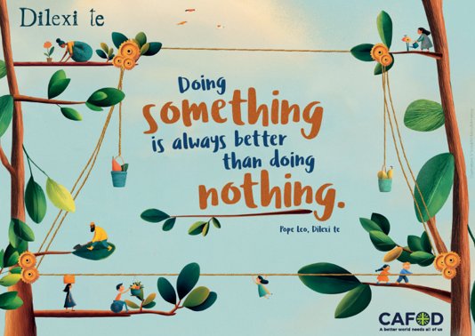
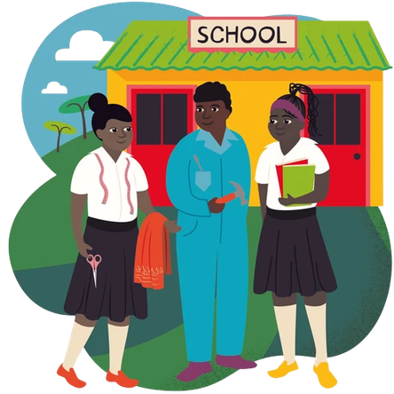
Tuesday 8 December - Second week of Advent
Wednesday 9 December - Second week of Advent
Let us pray
Lord Jesus,
you showed us that God’s love is for everyone.
Help us to notice people who need kindness,
and show your love through our words and actions.
Amen.
Today’s Mission
Look at CAFOD's Dilexi te Activity Pack.
Which Pope Leo quote is most important to you
and why?
Put love into action today. World Gift: Help a child fulfil their potential with the amazing
Back to school gift (£63)!
Notes:
Dilexi Te Illustration: V Srodi/M Nino/Ministory, CAFOD.
Advent Wreath Illustrations: Emma Hartley Walton, CAFOD.
World Gift Illustration: Sam Obsorne, CAFOD.

Slide 26
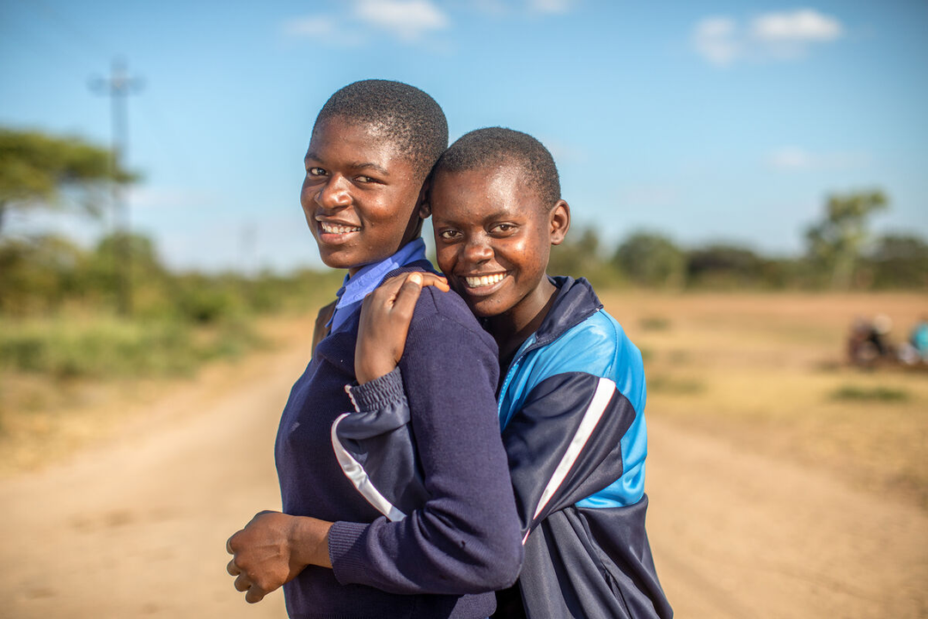
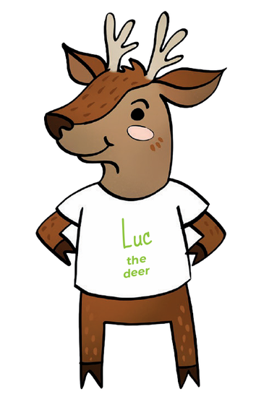
Thursday 10 December - Second week of Advent
Today’s Scripture
“The Lord is kind and full of compassion, slow to anger, abounding in love.” Psalm 144:8
None of us is perfect. We all make mistakes. But as we hear in today’s psalm, the Lord is kind and full of compassion. God is slow to anger, full of love for all of us.
Today is Human Rights Day. One of the principles of Catholic Social Teaching is Human Dignity. This reminds us that every person is special and made in God's image.
We are therefore called to treat everyone with kindness, respect and care.
Today’s Activity
How can we show our family, friends and our global brothers and sisters that they are important?
KS1: Draw a picture of yourself and decorate it with all the things that make you special.
KS2: Complete CAFOD's Human Dignity activity sheet.
Talk about the gifts and qualities that make each person unique.
Notes:
Photo: Cynthia Matonhodze, Zimbabwe 2025 - Solar-powered water and community gardens.
Advent Wreath Illustrations: Emma Hartley Walton, CAFOD.

Slide 27
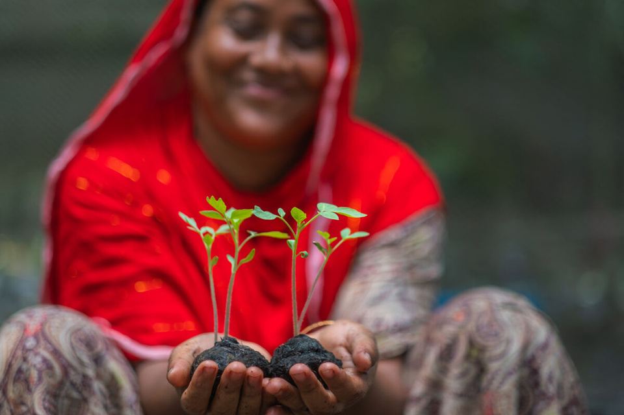
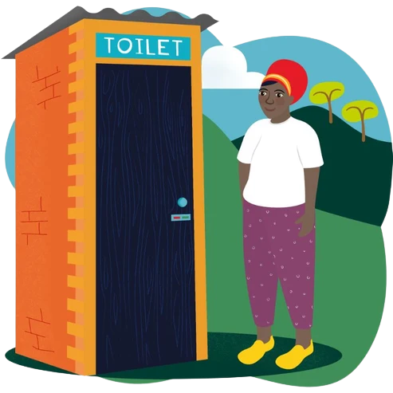
Thursday 10 December - Second week of Advent
Let us pray
God of compassion,
thank you for making each of us unique.
Help us to treat others with dignity and respect,
and remember that everyone is precious to you.
Amen.
Today’s Mission
Every person is made in God's image. Do something for someone that helps them feel valued, included and cared for.
World Gift: Promote human dignity and help communities stay healthy and safe with CAFOD’s Terrific Toilet gift (£89)!
Notes:
Photo: Amit Rudro, CAFOD. Floating gardens in Bangladesh.
Advent Wreath Illustrations: Emma Hartley Walton, CAFOD.
World Gift Illustration: Sam Obsorne, CAFOD.

Slide 28
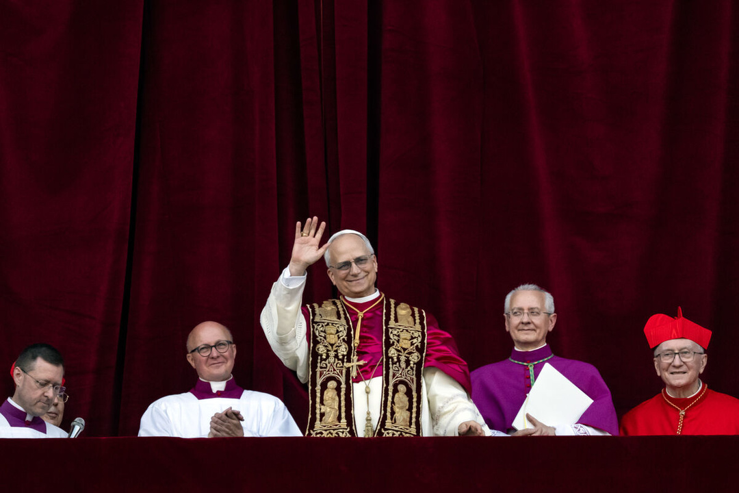
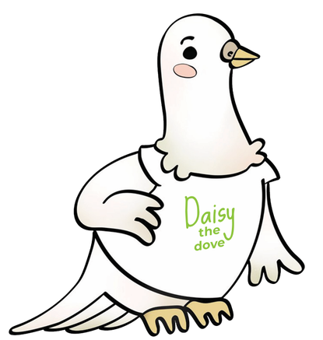
Friday 11 December - Second week of Advent
Today’s Scripture
“When the Son of Man came, he ate and drank, and everyone said, ‘Look at this man! He is a glutton and wine drinker, a friend of tax collectors and other outcasts!’ God's wisdom, however, is shown to be true by its results.” Matthew 11:19
Jesus wonders why people are struggling to believe his message of hope because he ate, drank and spent time not with the powerful, but with ordinary people and those whom others overlooked.
Jesus was a peacemaker. He was welcoming and saw the value and dignity of every person.
What would the world think if Jesus came back to walk this earth today and befriended the homeless and refugees, rather than prime ministers and presidents?
Today’s Activity
Pope Leo XIV's first words as Pope were “Peace be with you.”
Peace grows when we welcome others, listen carefully and make sure everyone feels included.
Jesus reminds us that being a peacemaker starts with the way we treat people each day.
Today, we invite you to share the sign of peace! Learn how to sign “peace be with you” in sign language, or place your hands together and gently bow to the people around you as you say: “Peace be with you.”
Notes:
Photo: Must credit: © Mazur/cbcew.org.uk
Habemus Papam - Pope Leo XIV
Advent Wreath Illustrations: Emma Hartley Walton, CAFOD.
World Gift Illustration: Sam Obsorne, CAFOD.

Slide 29
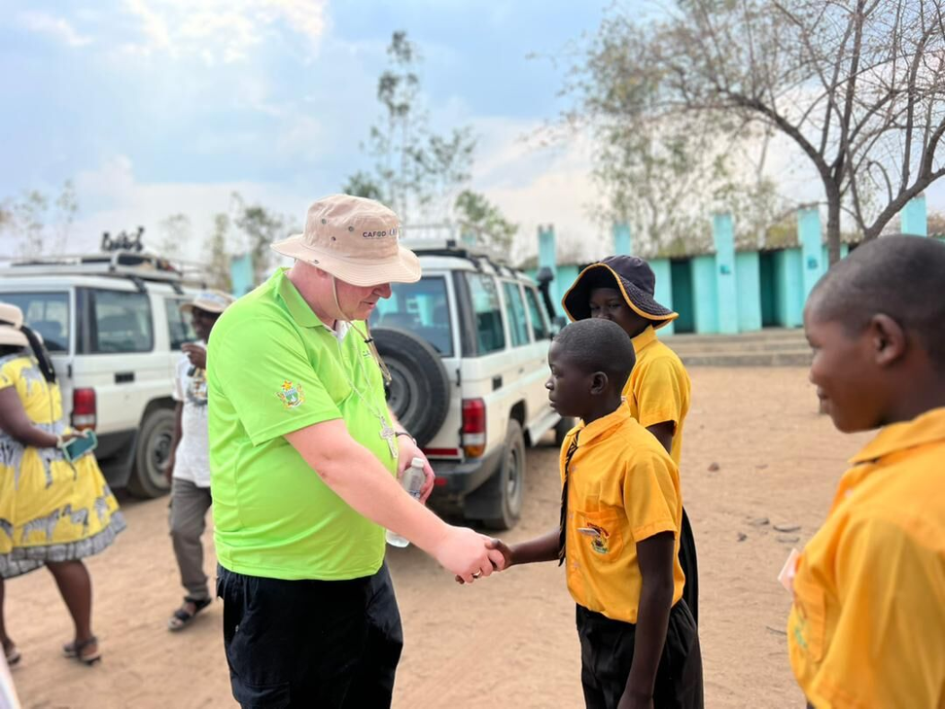
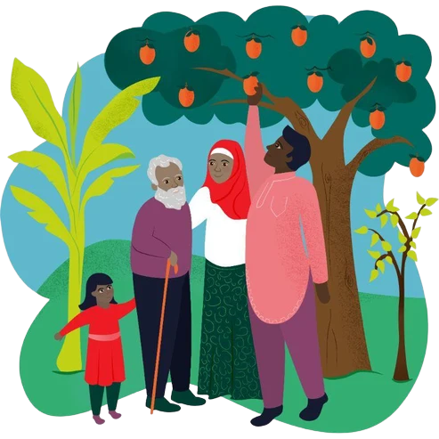
Friday 11 December - Second week of Advent
Let us pray
Prince of peace,
open our hearts to be kind and welcoming to everyone we meet.
Help us to be peacemakers in our words and actions.
Amen.
Today’s Mission
Be a peacemaker today.
Make an extra effort to be gentle, listen carefully and treat others with respect.
World Gift: Trees for life (£8) is a gift that keeps on giving! Help families bear fruit each year.
Notes:
Photo: Credit
CAFOD Zimbabwe.
Bishop Stephen Wright visits Zimbabwe
Advent Wreath Illustrations: Emma Hartley Walton, CAFOD.
World Gift Illustration: Sam Obsorne, CAFOD.

Slide 30

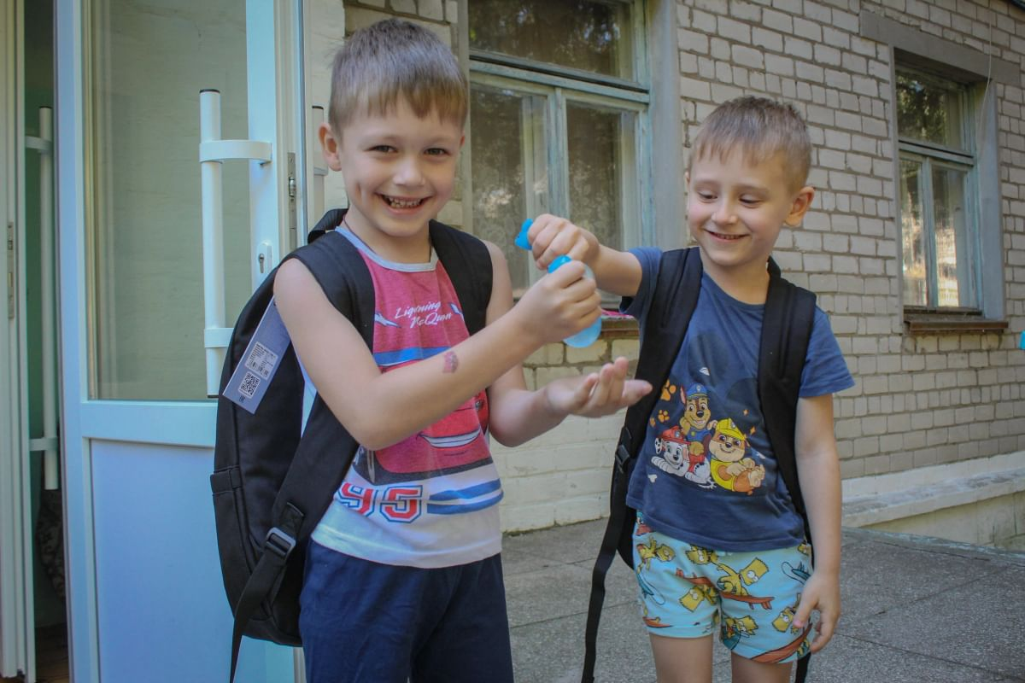
Sunday 13 December - Third Sunday of Advent
Sunday’s Gospel
“God sent his messenger, a man named John, who came to tell people about the light, so that all should hear the message and believe.”
John 1:6-7
Today we celebrate Gaudete Sunday!
Gaudete means “rejoice.”
On this third Sunday of Advent, we light the rose candle and rejoice because Christmas is drawing closer!
John the Baptist came to point people towards Jesus, the Light of the World. We can do that too by sharing joy, kindness and hope with others.
Today’s Activity
Start a gratitude journal.
Write or draw three things you are thankful for today.
If you are with others, take part in a gratitude circle and share your blessings with one another.
Notes:
Photo Credit:
Caritas Ukraine, CAFOD.
The School Backpack campaign - Ukraine, summer 2025
Advent Wreath Illustrations: Emma Hartley Walton, CAFOD.

Slide 31
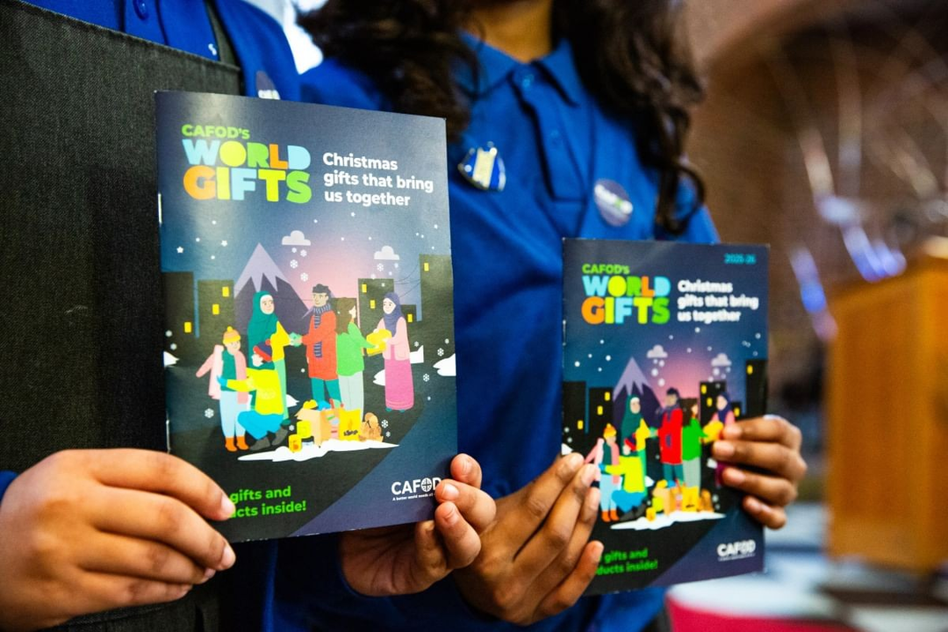

Sunday 13 December - Third Sunday of Advent
Let us pray
God of all joy,
thank you for all the blessings in our lives.
We give thanks for everything that makes us smile and helps us feel safe.
Help us to share your joy with others
as we prepare for Christmas.
Amen.
Today’s Mission
Say thank you to someone who has helped you or shown you kindness recently.
World gift: share more joy and help communities have honey to eat and sell with the gift of
Happy queen bees (£5)!
Notes:
Photo: Thom Flint, CAFOD. CAFOD Lent Family Fast Day Mass at Immaculate Conception, Rotherham
Advent Wreath Illustrations: Emma Hartley Walton, CAFOD.
World Gift Illustration: Sam Obsorne, CAFOD.

Slide 32
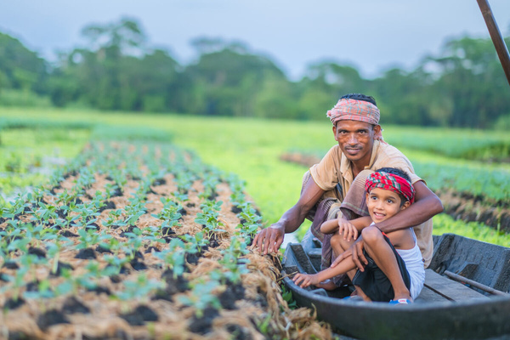


Monday 14 December - Third week of Advent
Today’s Scripture
"Jesus came back to the Temple; and as he taught, the chief priests and the elders came to him and asked, 'What right do you have to do these things? Who gave you such right?'” Matthew 21:23
The chief priests often tried to catch Jesus out to show off their power and authority.
In some countries, those in power do not treat their people fairly. Some families have lost their farms because their land has been taken away, which means they can't make their living growing crops, making it difficult to put food on the table.
How can we speak out for our brothers and sisters around the world who are not treated fairly?
Today’s Activity
Zunayed is six years old and lives in Bangladesh.
His father learned how to build floating gardens so that families could continue growing food when floods covered the land.
Zunayed enjoys visiting the floating gardens with his father and helping to check how the plants are growing.
Their story reminds us that people can find creative ways to care for creation and help their communities flourish.
Think about your school.
What are you already doing to care for creation?
What could you do even better?
Celebrate your achievements of stewardship with CAFOD’s Jubilee Pledge labels!
Notes:
Photo: Amit Rudro, CAFOD.
Floating gardens in Bangladesh
Advent Wreath Illustrations: Emma Hartley Walton, CAFOD.

Slide 33


Monday 14 December - Third week of Advent
Let us pray
God of creation,
help us to listen and learn from others.
We thank you for the work of CAFOD, which supports and empowers local partners to share their gifts and skills with their community.
Amen.
Today’s Mission
Think creatively for creation.
Choose one new thing your class or school could do to care for our common home.
World Gift: Help communities in Bangladesh build Floating gardens to grow food and earn a living!
Notes:
Photo: Thom Flint, CAFOD. St Gregory’s Primary School, Chorley, demonstrating LiveSimply.
Advent Wreath Illustrations: Emma Hartley Walton, CAFOD.
World Gift Illustration: Sam Obsorne, CAFOD.

Slide 34

Tuesday 15 December - Third week of Advent
Today’s Scripture
“The Lord is close to the broken-hearted.” Psalm 33:18
Today's Psalm reminds us that God is always close to us, especially when life is difficult.
Everyone has times when they feel worried, sad or lonely. Perhaps someone is unkind to us at school,
a much-loved relative has died, or we feel overwhelmed by things.
What brings comfort is knowing that God is very near to us, and we can ask him for help.
How might we help others who are sad?
Today’s Activity
Create a Kindness Chain.
Write one kind thing you could do for somebody else on a strip of paper. Join all the strips together and create a chain for your classroom.
We are stronger together - “a better world needs all of us!”
Notes:
Photo: Cynthia Matonhodze, CAFOD.
Zimbabwe 2025 - Solar-powered water and community gardens
Advent Wreath Illustrations: Emma Hartley Walton, CAFOD.

Slide 35

Tuesday 15 December - Third week of Advent
Let us pray
God of joy,
thank you for staying close to us,
especially when we feel sad, lonely or worried.
Help us notice people who need kindness,
and help us to bring them comfort and friendship.
Amen.
Today’s Mission
Do a kind deed to help someone smile.
World Gift: Share some festive cheer! Could your school fundraise for CAFOD’s special Christmas stocking this Advent (£100)?
Check out the amazing five gifts included in this year’s school’s stocking.
Notes:
Photo: Thom Flint, CAFOD.
St Joseph's school, Dudley, take part in Lent 2026 activity
Advent Wreath Illustrations: Emma Hartley Walton, CAFOD.
World Gift Illustration: Sam Obsorne, CAFOD.

Slide 36

Wednesday 16 December - Third week of Advent
Today’s Scripture
“Jesus answered John's messengers, “Go back and tell John what you have seen and heard: the blind can see, the lame can walk, those who suffer from dreaded skin diseases are made clean, the deaf can hear, the dead are raised to life, and the Good News is preached to the poor.”” Luke 7:22
In today's Gospel, Jesus tells people to look at what is happening around them. Lives are changing, people are being helped and the poor are hearing Good News.
In Dilexi Te, Pope Leo XIV reminds us that God has a special love for people who are poor, vulnerable or overlooked.
Today’s Activity
Catholic Social Teaching calls us to put the needs of the vulnerable first, this is called the Preferential Option for
the Poor.
KS1 - draw a picture of all the things that help people live a happy and healthy life and say a prayer for the people who do not have what they need to flourish.
KS2 - Complete CAFOD's Preferential Option for the Poor activity.
How can we help people who need extra support?
Notes:
Dilexi Te Illustration: V Srodi/M Nino/Ministory, CAFOD.
Advent Wreath Illustrations: Emma Hartley Walton, CAFOD.

Slide 37


Wednesday 16 December - Third week of Advent
Let us pray
Loving God,
help us to put the needs of the vulnerable first,
to recognise the dignity of every person,
and be a voice of hope for the voiceless.
Amen.
Today’s Mission
Like we hear Jesus do in the scripture, share some Good News today!
Encourage someone, be positive, help a friend or do something kind for somebody who needs it.
World Gift: Could your school give some good news by fundraising for an udderly wonderful Marvellous moo cow gift (£155)?
Notes:
Photo: Cynthia Matonhodze
Zimbabwe 2025 - Solar-powered water and community gardens.
Advent Wreath Illustrations: Emma Hartley Walton, CAFOD.
World Gift Illustration: Sam Obsorne, CAFOD.

Slide 38

Thursday 17 December - Third week of Advent
Today’s Scripture
“And Jacob was the father of Joseph, who married Mary, the mother of Jesus, who was called the Messiah."
Matthew 1:16
In today’s Gospel, we hear all about Jesus' ancestors.
Jesus' ancestors were members of His family who lived before Him. Our families can be made up of mums, dads, sisters, brothers, grandparents, aunties, uncles, cousins and our friends. But there is also our global family.
Who do you think our global family is? And how can we treat them 'like family' when they may be far away?
Today’s Activity
When Jesus taught us the Our Father, He used words like "our," "we" and "us." These are words that remind us we belong together and that we pray not just for ourselves, but for everyone in God's family.
Pray the Our Father Prayer together.
As you pray, listen carefully for the words "our," "we" and "us." Count how many times you hear them. Why do you think Jesus taught us to pray in this way?
Notes:
Photo: Vicky Ahmed, CAFOD.
Advent Wreath Illustrations: Emma Hartley Walton, CAFOD.

Slide 39

Thursday 17 December - Third week of Advent
Let us pray
God our Father,
thank you for the gift of our families and our global family.
Help us to remember that every person is your child,
loved by you.
May we care for others with kindness, respect and compassion.
Amen.
Today’s Mission
Find a globe or world map. Close your eyes and gently place your finger on a country.
Say a prayer for the people who live there and ask God to bless them with peace, hope and joy.
Remember, they are part of our global family too.
Notes:
Photo: Vicky Ahmed, CAFOD. Jubilee Pilgrims of Hope - St Francis Xavier's RC Primary School, Herefordshire.
Advent Wreath Illustrations: Emma Hartley Walton, CAFOD.

Slide 40

Friday 18 December - Third week of Advent
Today’s Scripture
“A virgin will become pregnant and have a son,
and he will be called Immanuel”
(which means, “God is with us”).”
Matthew 1:23
When Mary was pregnant with Jesus, she and Joseph travelled a long way to Bethlehem.
Today, people journey across the world for many reasons, including work, holidays and visiting family.
But some are forced to travel because of poverty or war. Migrants do not always receive a warm welcome.
Too often they are sent on their way.
Today’s Activity
On International Migrants Day, think about how we can show compassion for others and welcome them into our communities.
Create a classroom welcome poster for your door or prayer focus this Advent.
Notes:
Painterly illustration of Mary and Joseph traveling to Bethlehem on their journey: Prixel Creative, Lightstock.
Advent Wreath Illustrations: Emma Hartley Walton, CAFOD.

Slide 41


Friday 18 December - Third week of Advent
Let us pray
Loving God,
you are with us wherever we go.
Be close to people who are far from home
and help them find welcome and peace.
Amen.
Today’s Mission
Help somebody feel welcome today.
Look out for someone who may feel left out and help them feel included.
Notes:
Photo: George Wambugu, CAFOD. Sudan crisis: refugee camp - March 2025
Photo: Thom Flint, CAFOD. Hunger, nutrition and livelihoods in Sierra Leone.
Advent Wreath Illustrations: Emma Hartley Walton, CAFOD.

Slide 42


Sunday 20 December - Fourth Sunday of Advent
Sunday’s Gospel
“Remember your relative Elizabeth. It is said that she cannot have children, but she herself is now six months pregnant, even though she is very old. For there is nothing that God cannot do.”
Luke 1:37
In today’s Gospel, we hear lots of good news: Elizabeth is expecting a baby in her old age, and Mary has been chosen to be the mother of Jesus. Nothing is impossible for God!
Today, the Church asks us to pray for expectant mothers and babies around the world. Every child deserves to be welcomed with love and given the chance to flourish.
Today’s Activity
Today we invite you to pray a decade of the Rosary for expectant mothers and babies. Pray one Our Father, Ten Hail Marys and the Glory Be prayer.
You can use rosary beads, a piece of string and tie your own prayer knots with the string, or simply use your fingers to help you keep count.
Notes:
Photo: Thom Flint, CAFOD.
Stills taken from a Hail Mary film shoot in Goma, DRC, featuring Desanges from CAFOD partner CAJED.
Advent Wreath Illustration: Emma Hartley Walton, CAFOD.

Slide 43


Sunday 20 December - Fourth Sunday of Advent
Let us pray
God of love,
we pray for expectant mothers
and families around the world.
Give them hope, strength and courage,
and surround them with your love and care.
Amen.
Yasmine, mother in Gaza
Today’s Mission
Continue to pray for expectant mothers and babies around the world.
Could your school or family of schools work together to fundraise for a Health Clinic World Gift (£4000)?
This gift can make an enormous difference to communities with important medicines,
medical equipment, and helps keep the clinic ambulance running.
Notes:
Photo: Trocaire | Raw Media, CAFOD.
Displaced families in Gaza - Yasmine.
World Gift Illustration: Sam Obsorne, CAFOD.
Advent Wreath Illustration: Emma Hartley Walton, CAFOD.

Slide 44

Monday 21 December - Fourth week of Advent
Today’s Scripture
“You are the most blessed of all women and blessed is the child you will bear!" Luke 1:42
In today's Gospel, Mary visits her cousin Elizabeth.
Their encounter is full of welcome, joy and love.
When we spend time with other people, we learn from them and can help one another to grow.
Together, we can make a difference.
Like Mary and Elizabeth, we are called to encourage one another and help build a better world together.
Today’s Activity
Can you think of a time when you visited someone, or when someone visited you, and it made you feel happy, loved or welcomed?
Share your story with a partner or in a group.
Notes:
Photo: Thom Flint, CAFOD. Hunger, nutrition and livelihoods in Sierra Leone.
Advent Wreath Illustration: Emma Hartley Walton, CAFOD.

Slide 45

Monday 21 December - Fourth week of Advent
Let us pray
God of love,
thank you for the people we meet and the friendships we share.
Give us welcoming hearts,
help us to listen with kindness
and see your presence in everyone we meet.
Amen.
Today’s Mission
Follow Mary's example and make time for someone today. Listen carefully, show interest in their story and help them feel welcomed, valued and loved.
Notes:
Photo: Thom Flint
St Gregory’s Primary School, Chorley, demonstrating LiveSimply
Advent Wreath Illustration: Emma Hartley Walton, CAFOD.

Slide 46

Tuesday 22 December - Fourth week of Advent
Today’s Scripture
"He has stretched out his mighty arm and scattered the proud with all their plans." Luke 1:51
Mary reminds us that God has done wonderful things. God chose a humble young woman to be the mother of Jesus, trusting her with an important part in His plan for the world. Sometimes it can be difficult to know how we can make a difference. Mary shows us that when we trust God and respond generously to His call, even small actions can have a big impact.
What can we do to help make a difference to our global family living in poverty?
Today’s Activity
When Mary visited Elizabeth, she prayed a beautiful song called the Magnificat. In her song, Mary thanks God for all the good things He has done. She praises God for caring for people who are hungry, poor or overlooked.
Listen to the Magnificat together and sing along if you know the words!
Which words help you think about God's love and care
for others?
Notes:
Magnificat Illustration: Emma Hartley Walton, CAFOD.
Advent Wreath Illustration: Emma Hartley Walton, CAFOD.

Slide 47


Tuesday 22 December - Fourth week of Advent
Let us pray
God of love,
thank you for the example of Mary, Jesus' greatest disciple. Give us courage to say yes to you and follow in your footsteps.
Amen.
Today’s Mission
Mary's Magnificat reminds us that everyone is important to God. Listen to the Magnificat again - which principles of Catholic Social Teaching can you find throughout her song?
Explore CAFOD's Catholic Social Teaching resources for children here.
Notes:
Photo: Thom Flint, CAFOD. Hail Mary Shoot in Goma, DRC.
Advent Wreath Illustration: Emma Hartley Walton, CAFOD.

Slide 48

Wednesday 23 December - Fourth week of Advent
Today’s Scripture
"The time came for Elizabeth to have her baby, and she gave birth to a son. Her neighbours and relatives heard how wonderfully good the Lord had been to her,
and they all rejoiced with her." Luke 1:57-58
Elizabeth's baby became John the Baptist, who prepared the way for the Lord. In today’s Gospel, Elizabeth's family and friends hear her good news and celebrate with her.
Christmas is nearly here and there is so much to celebrate and be thankful for!
Today’s Activity
Write an acrostic poem using the word:
A D V E N T
or
C H R I S T M A S
Fill it with words that remind you of the Good News of Jesus and all the things you are thankful for this Advent.
Notes:
Photo: Pearl, Lightstock.
Advent Wreath Illustration: Emma Hartley Walton, CAFOD.

Slide 49

Wednesday 23 December - Fourth week of Advent
Let us pray
God of love,
thank you for all we have to celebrate.
As we prepare to welcome Jesus,
help us to rejoice with others
and share your hope and joy.
Amen.
Today’s Mission
Celebrate and say thank you.
Thank someone who has helped your class, school or community make a difference this year.
Notes:
Photo: Thom Flint, CAFOD.
CAJED livelihoods projects, Goma, DRC
Advent Wreath Illustration: Emma Hartley Walton, CAFOD.

Slide 50

Thursday 24 December - Christmas Eve
Today’s Scripture
“I will sing forever of your love, O Lord.”
Psalm 88:2
It’s Christmas Eve! We are filled with excitement as we look forward to the birth of Jesus. There may be decorations, special food and presents, but it is our Lord’s 'love' in this psalm that we are really celebrating.
A love for all of us, no matter who we are or where we come from.
How can we share this love with one another, so that all of God’s children throughout the world may live in harmony and peace?
Today’s Activity
Listen to or sing a favourite Christmas hymn or carol and reflect on the true meaning of Christmas.
Notes:
Photo: Svitlana Dmytrenko, CAFOD. Ukraine winterisation support.
Anna and Orest playing with a sand timer preparing for Christmas in Ukraine.
Caritas Khmelnytskyi – the organisation CAFOD works with in Ukraine – helped the family with fuel so that they would have heat during the worst months.
Advent Wreath Illustration: Emma Hartley Walton, CAFOD.

Slide 51


Thursday 24 December - Christmas Eve
Let us pray
God of love,
as we prepare to celebrate the birth of Jesus,
help us remember the true meaning of Christmas.
Bless our families and our global family,
and help us share your love with others.
Amen.
Today’s Mission
Still looking for a Christmas gift?
Choose a CAFOD World Gift and share the joy of Christmas with our global family.
Try CAFOD's World Gifts word search and discover some of the gifts that help families around the world.
Notes:
Advent Wreath Illustrations: Emma Hartley Walton, CAFOD.
World Gift Illustration: Sam Obsorne, CAFOD.

Slide 52

Friday 25 December - Christmas Day
Today’s Scripture
“She gave birth to her first son, wrapped him in cloths and laid him in a manger-there was no room
for them to stay in the inn.”
Luke 2:7
Happy Christmas!
Today we celebrate the birth of Jesus.
God chose to come into the world as a small and humble baby.
Jesus reminds us that every person is precious to God and that we are all part of one global family.
Today’s Activity
Saint Francis of Assisi loved Christmas. He created the first Nativity scene to help people think about the birth of Jesus and remember what Christmas is really about.
Spend a few quiet moments looking at a crib or Nativity scene today and give thanks for the gift of the Holy Family - Mary, Joseph and Jesus.
Notes:
Photo: Blue Wave Creative, Lightstock.
Advent Wreath Illustrations: Emma Hartley Walton, CAFOD.

Slide 53


Friday 25 December - Christmas Day
Let us pray
God of love,
thank you for the gift of the Holy Family.
Fill us with hope, peace, joy and love this festive season.
Help us to share your light with our neighbours and our global family.
Amen.
Today’s Mission
Now the season of Christmastide begins!
Keep celebrating the joy of Christmas with
CAFOD's Christmas family prayer ideas, with
short prayers and activities from Christmas Day through to Epiphany.
Notes:
Photo: Kara Gebhardt, Lightstock.
Advent Wreath Illustrations: Emma Hartley Walton, CAFOD.

