Slide 1
Choose a photo to use in your liturgical prayer
We gather
We respond
We go forth

Slide 2
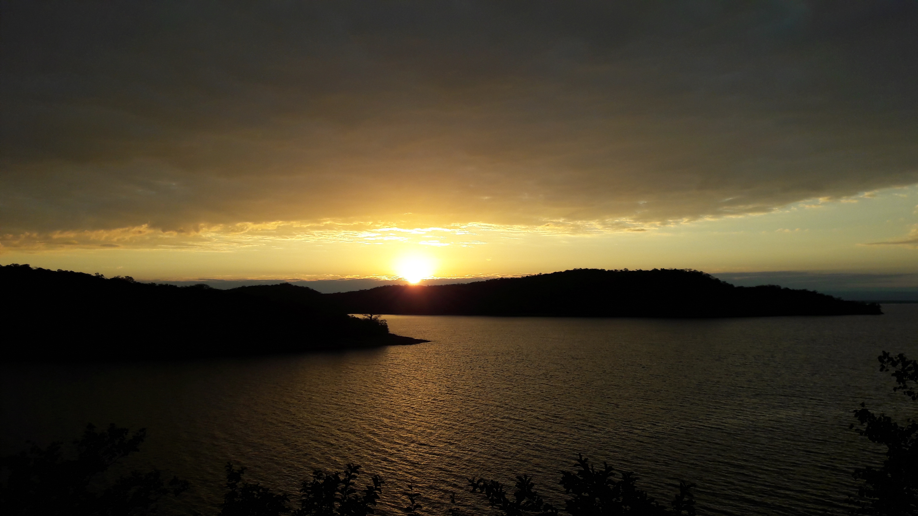
Notes:
Caption: Sunset over Lake Kariba, Zimbabwe.
Photo credit: Sally Kitchener | CAFOD (2017)

Slide 3
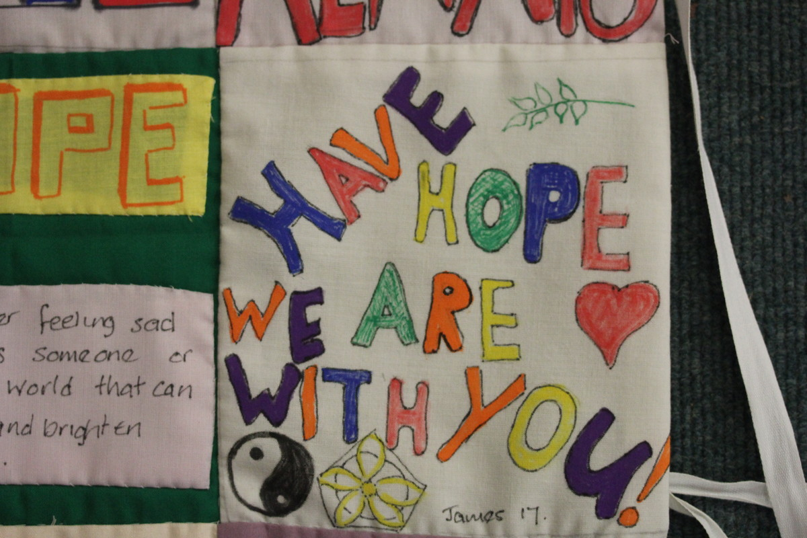
Notes:
The CAFOD group at St George’s parish, Norwich created this wall hanging to express their solidarity with communities in Magdalena Medio, Colombia who participated in a peacebuilding project. Students from Notre Dame High School in Norwich and the Explorer Scouts designed the squares and the CAFOD group sewed them together.
The women's group in Colombia had also created a quilt to raise awareness of the important role played by rural women in all areas: social, cultural and family. It highlighted the contribution to development and peace made by women in different contexts. The Norwich quilters asked CAFOD to present their wall hanging to the women's group in Colombia.
Photo credit: Joe Savage (2021)

Slide 4
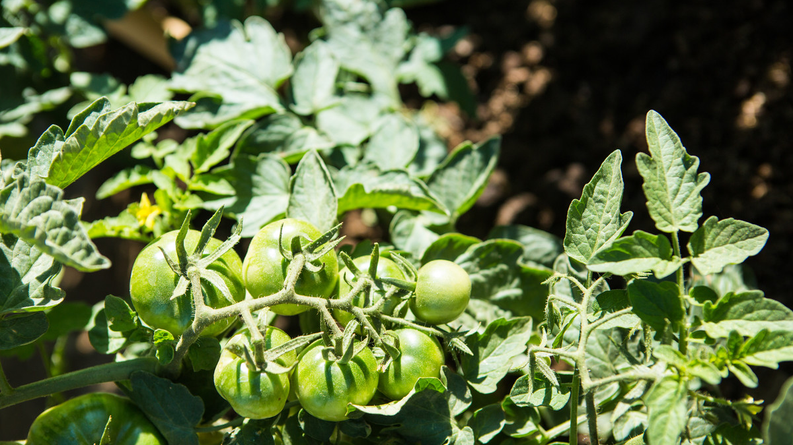
Notes:
Caption: Tomatoes growing at Chinyama community vegetable garden, Zimbabwe. Caritas Gokwe provided vegetable seeds, nutrition and farming training, and fenced off a community vegetable garden to keep it safe from livestock. 47 community members now grow a range of nutritious vegetables on their plots for their families to eat and to sell.
Photo credit: Thom Flint | CAFOD (2017)

Slide 5
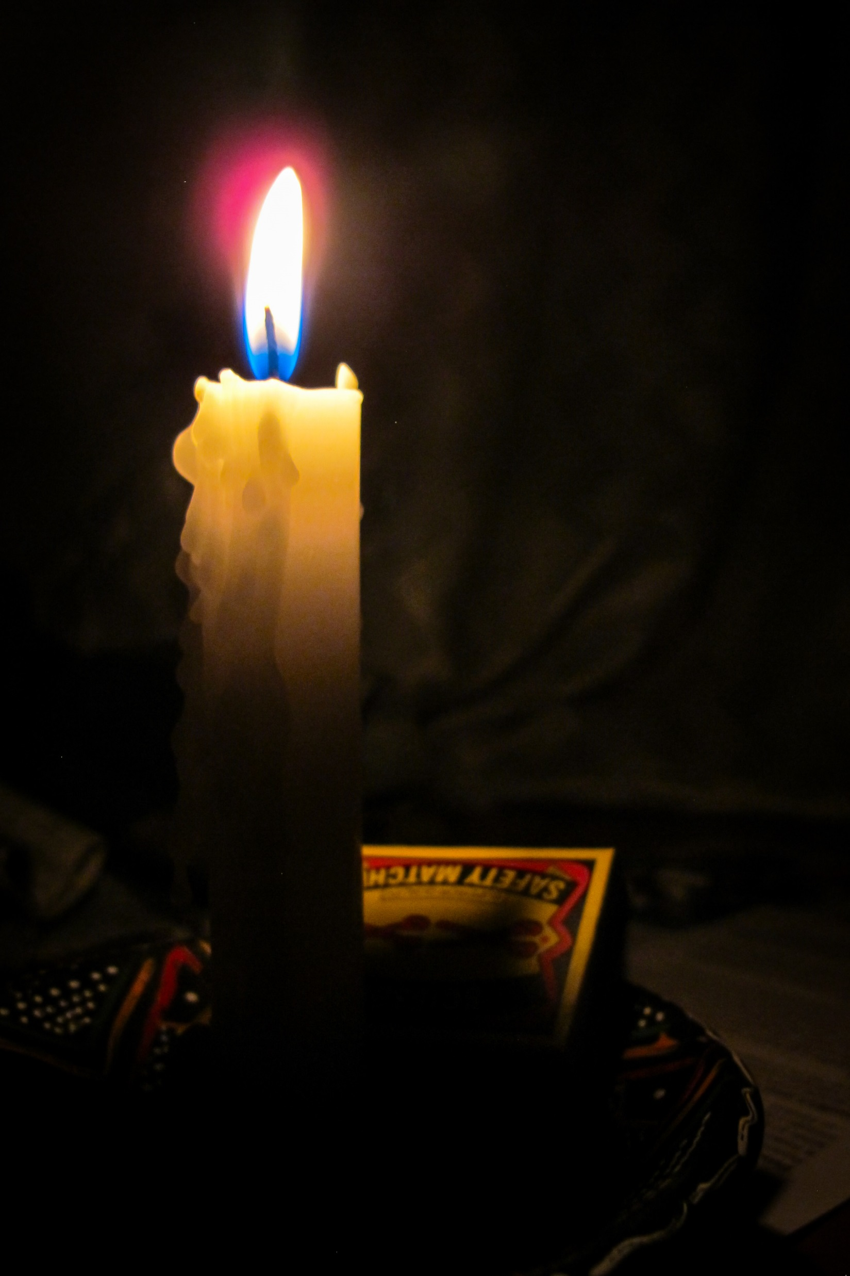
Notes:
Caption: Candle and a box of matches.
Photo credit: CAFOD (2017)

Slide 6
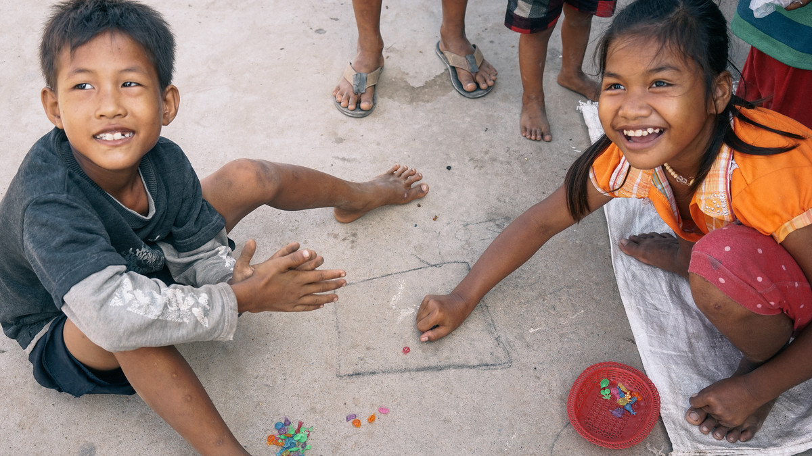
Notes:
Caption: Children playing a traditional game, Chker Choi Vong, in Cambodia
Photo credit: Greg Mo | CAFOD (2015)

Slide 7
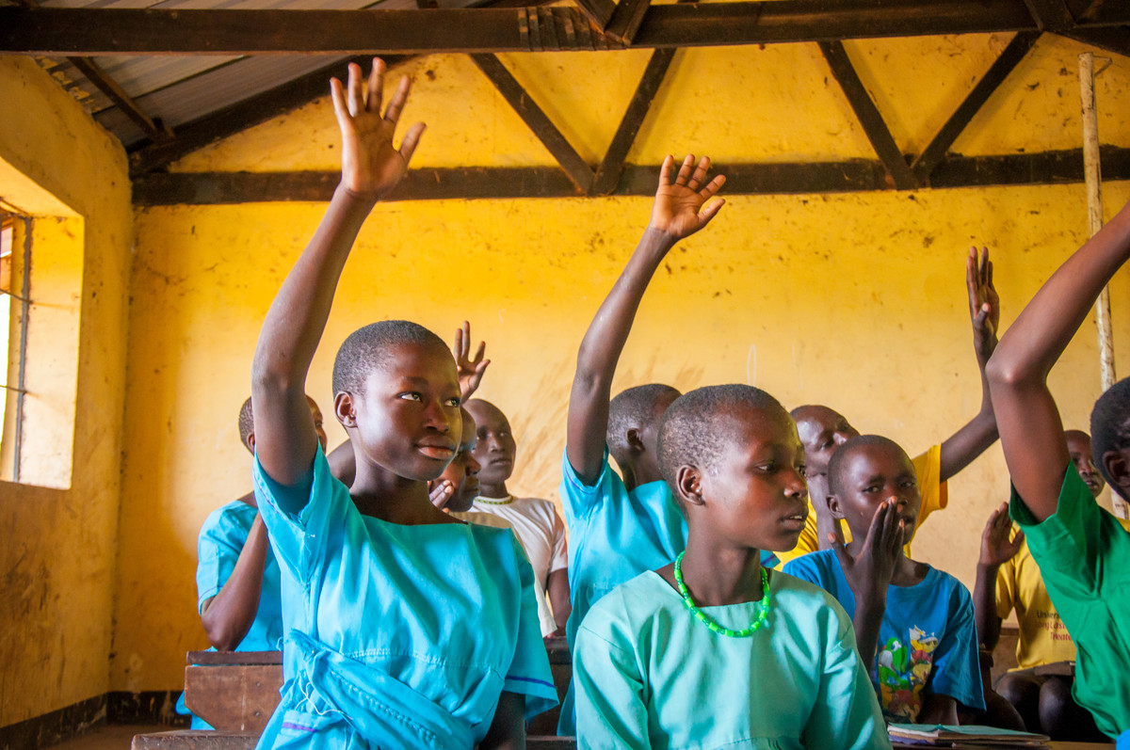
Notes:
Caption: Students in Uganda attend classes at a school supported by CAFOD’s local partner, Caritas Moroto. Caritas fixed the school borehole to provide clean water and gave training in how to build a bathing shelter. They also supplied soap. As a result, hygiene and illness are no longer a problem and girls who live far away can stay in the school dormitories because they are clean. The number of girls in the school has now increased.
Photo credit: David Mutua | CAFOD (2015)

Slide 8
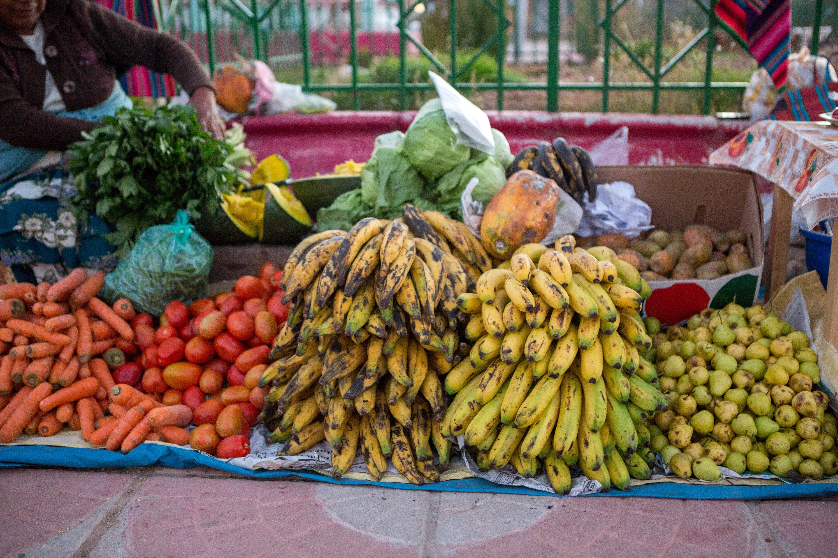
Notes:
Caption: Fruit and vegetables sold at market, Bolivia.
Photo credit: Ben White | CAFOD (2016)

Slide 9
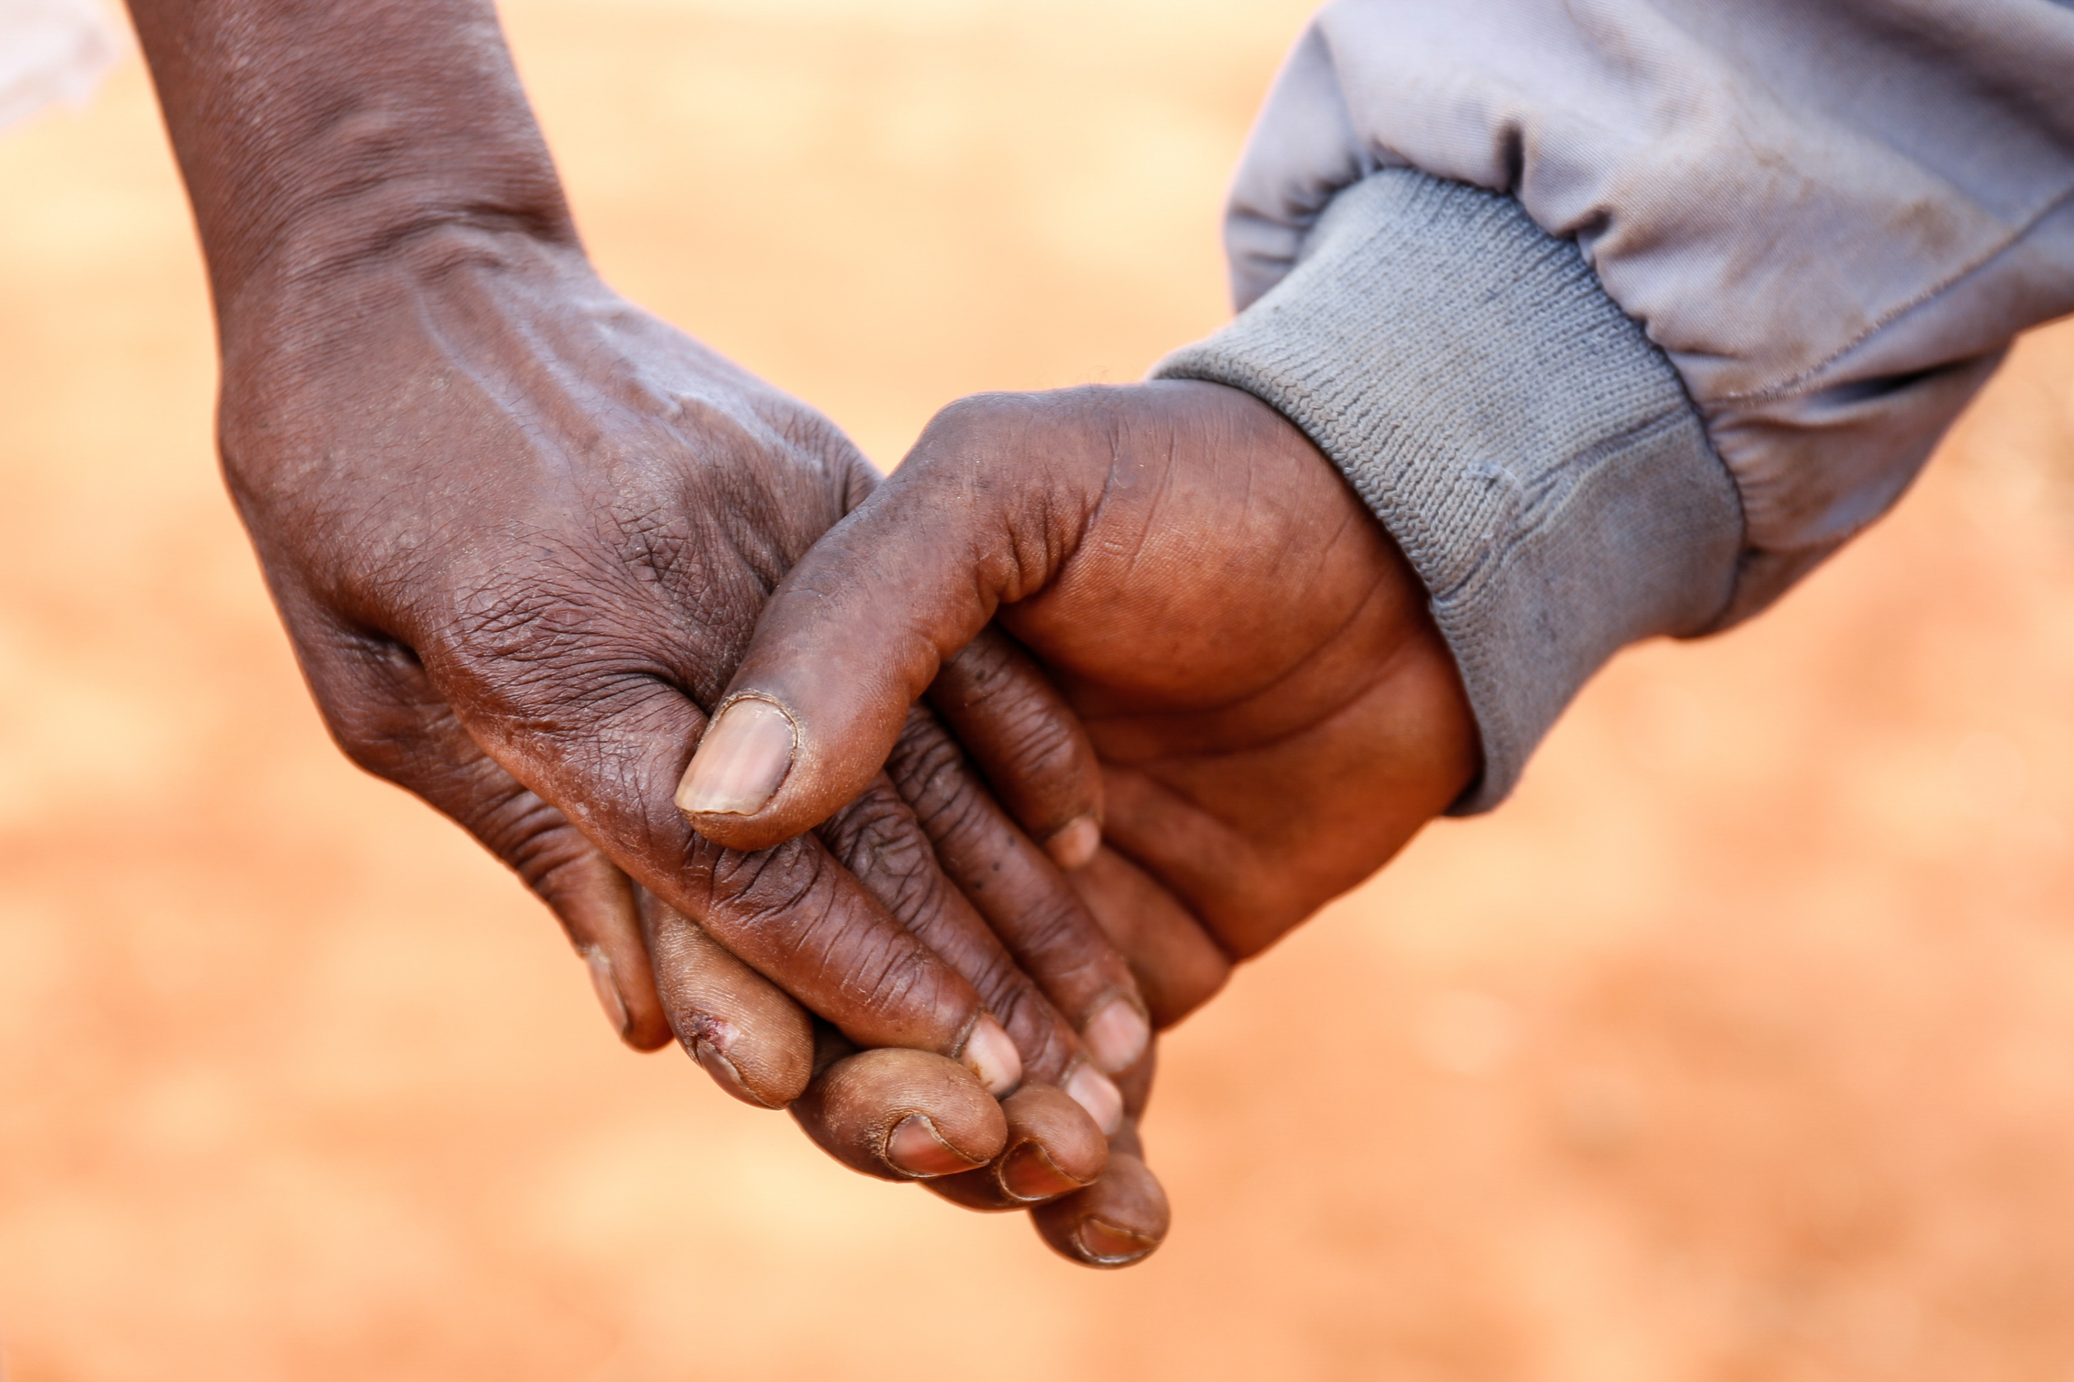
Notes:
Caption: Holding hands
Photo credit: David Mutua (2015)

Slide 10
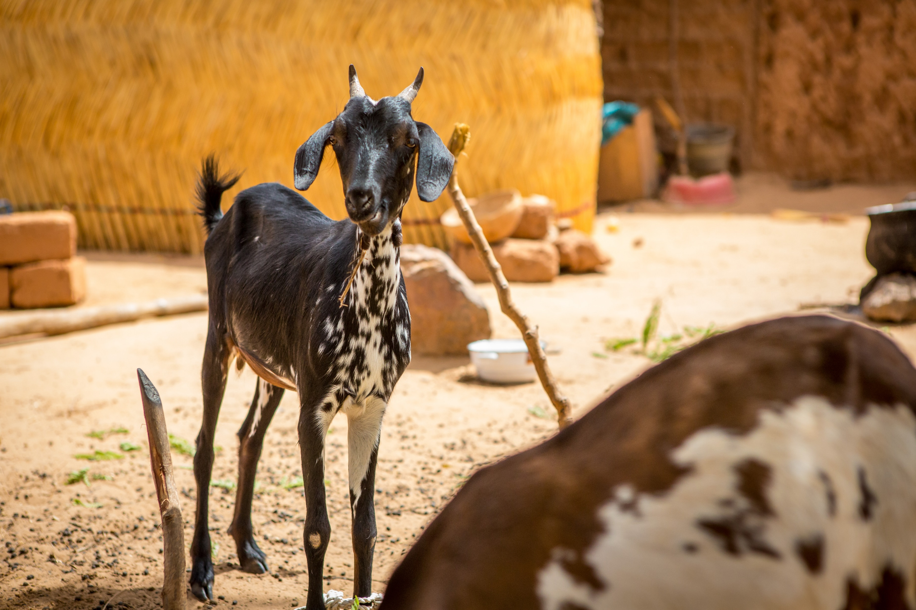
Notes:
Caption: Goats are given to families to give them a source of milk. This milk is very rich in nutrients, so is particularly good for growing children. The manure from the goats will also be great for the farmers, whose increased crop yields will in turn ensure that their goats will have plenty to eat.
Photo credit: Ben White | CAFOD (2014)

Slide 11
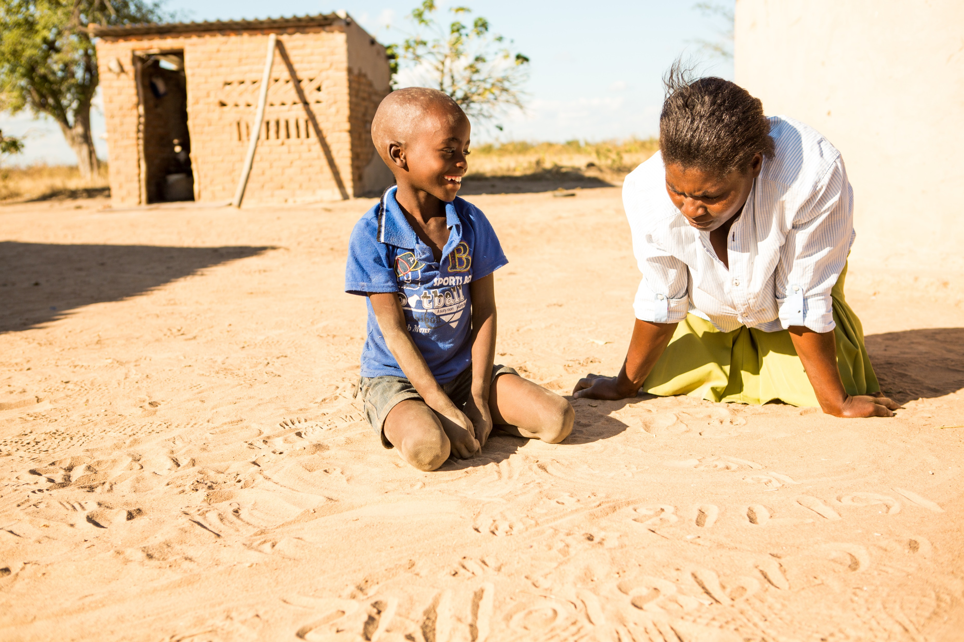
Notes:
Caption: Svondo and his mum, Marian in Zimbabwe.
A few years ago, Marian did not have enough to feed her family. Her older son, Tawanda, was malnourished. CAFOD partners supported Marian and her community with training on setting up and maintaining a vegetable garden. Now, she and her neighbours can feed their families and make an income. Her youngest son, Svondo, is growing up strong and healthy.
Photo credit: Thom Flint | CAFOD (2017)

Slide 12
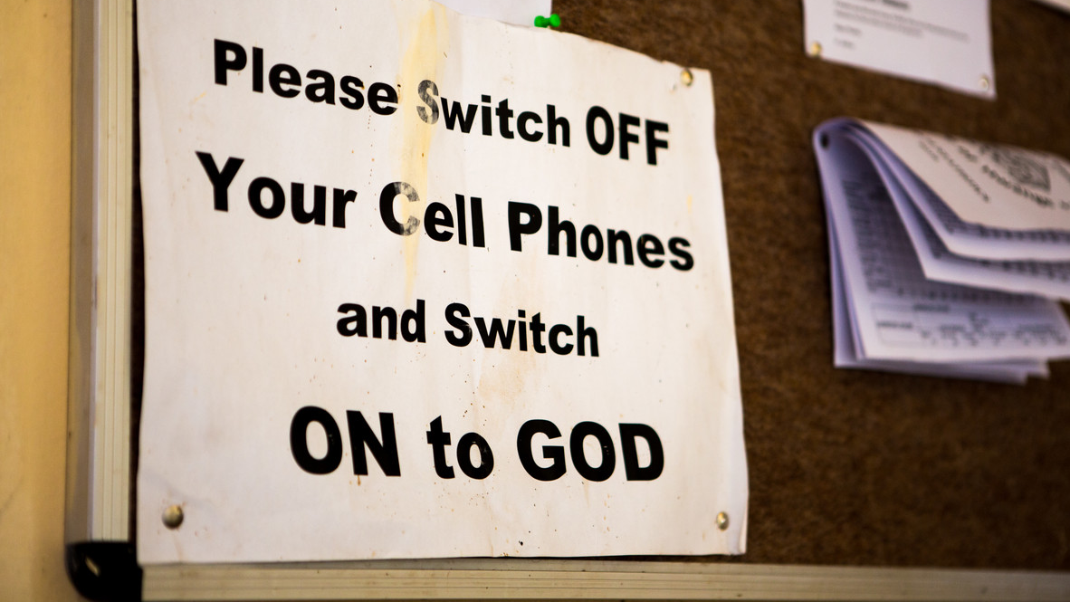
Notes:
A notice on a noticeboard inside All Souls Catholic Church in Binga, Zimbabwe.
Credit: Thom Flint | CAFOD (2017)

Slide 13
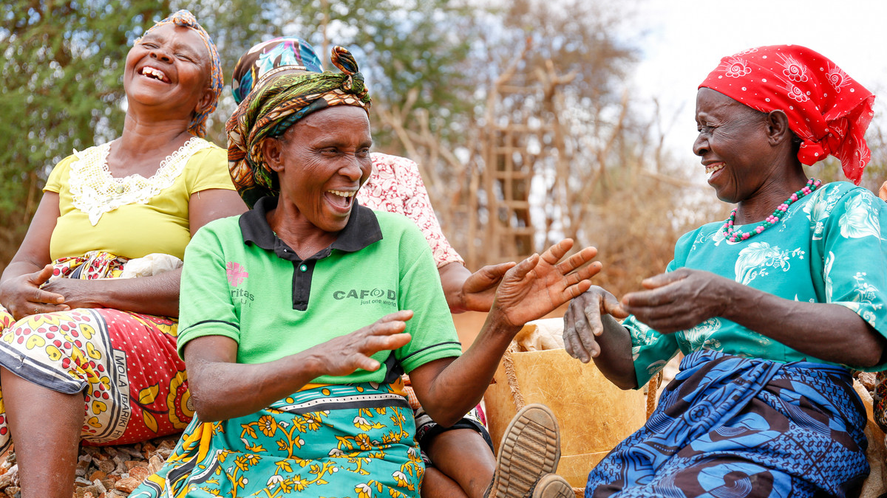
Notes:
Sabeth Kitonyo, 61, (in green) laughs with friends while taking a break from crushing rocks.
Sabeth took part in the ‘Hands On’ project, led by CAFOD partner, Caritas Kitui.
Funded by Hands On supporters, the community in Kitui, Kenya, rebuilt the great Musosya dam and reservoir, bringing water back to their community. Over two years, the community planted more than 10,000 trees, built 1,100 stone check dams, built four wells, learnt new farming techniques and planted a community farm, all of which contribute to the success of the main dam.
Credit: David Mutua | CAFOD (2015)

Slide 14
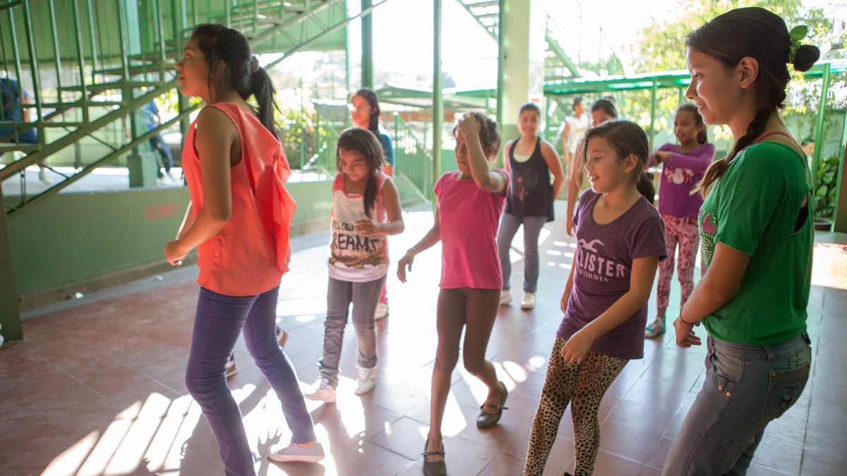
Notes:
Caption: Isabel (right) lives with her family on the outskirts of San Salvador, the capital of El Salvador.
She lives in a violent part of the city. There are lots of gangs in the area. CAFOD funds a peace-building project in the area to help people in the community to find more peaceful ways of living together. As part of the project, our partner, the Sisters of St Clare, runs a club with different sport, music and dance activities to help children and young people develop their talents. Isabel is one of the young leaders and teaches other young people to dance.
Photo credit: Ben White / CAFOD (2015)

