Slide 1
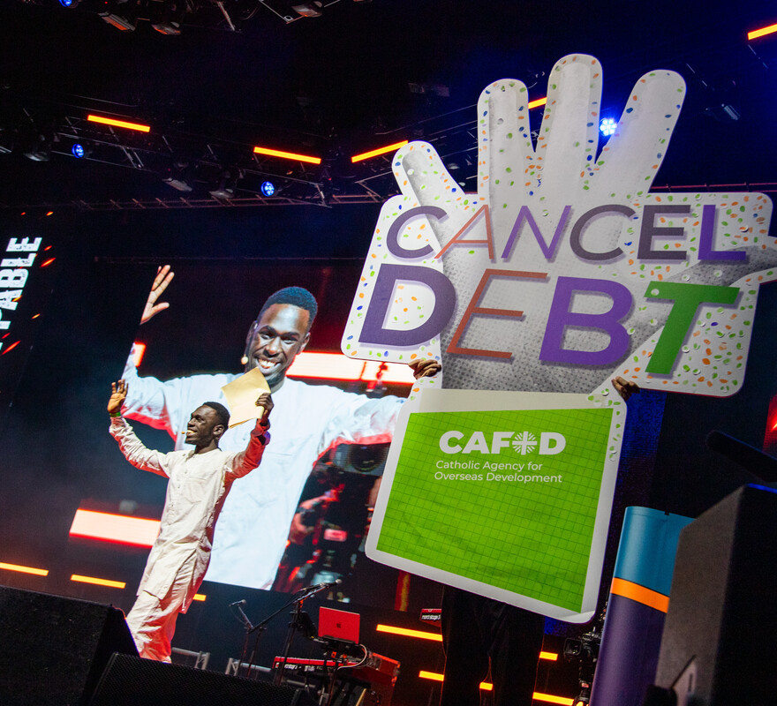
What can you do so other people will see the Holy Spirit working through you?
Gospel Celebration of the Word
Notes:
Children’s liturgy: Second Sunday in Ordinary Time (Year A)
Preparation of the worship space
Colour: green
Props: paper windmill, pictures showing the effects of the wind (e.g. tree bent over, sailing boat, wind turbine, flag flying)
Song suggestions
Spirit of the living God (306, Laudate)
Welcome
Today we hear about something special that happened to Jesus after his baptism. The Holy Spirit came down and rested on him. We are going to think about the Holy Spirit and how it can help us to do what is right.
Brian Maeba at Flame
Photo credit: Mazur/catholicnews.org.uk

Slide 2
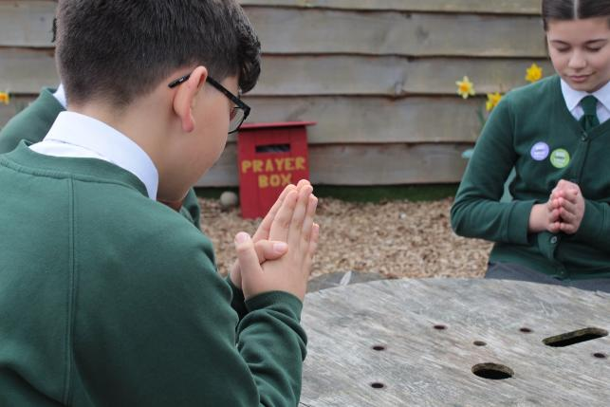

God of light, You sent the Spirit down upon your Son so others might know who he was. Send your Spirit upon us, so we might spread your message of love and peace to others. Amen.
Gather
Notes:
St Francis Xavier's RC Primary School, Herefordshire
Photo credit: Vicky Ahmed

Slide 3

Gospel: John 1: 29-34
The next day John saw Jesus coming to him, and said, “There is the Lamb of God, who takes away the sin of the world! This is the one I was talking about when I said, ‘A man is coming after me, but he is greater than I am, because he existed before I was born.’ I did not know who he would be, but I came baptising with water in order to make him known to the people of Israel.”
And John gave his testimony: “I saw the Spirit come down like a dove from heaven and stay on him. I still did not know that he was the one, but God, who sent me to baptise with water, had said to me, ‘You will see the Spirit come down and stay on a man; he is the one who baptises with the Holy Spirit.’ I have seen it,” said John, “and I tell you that he is the Son of God.”
Word

Slide 4
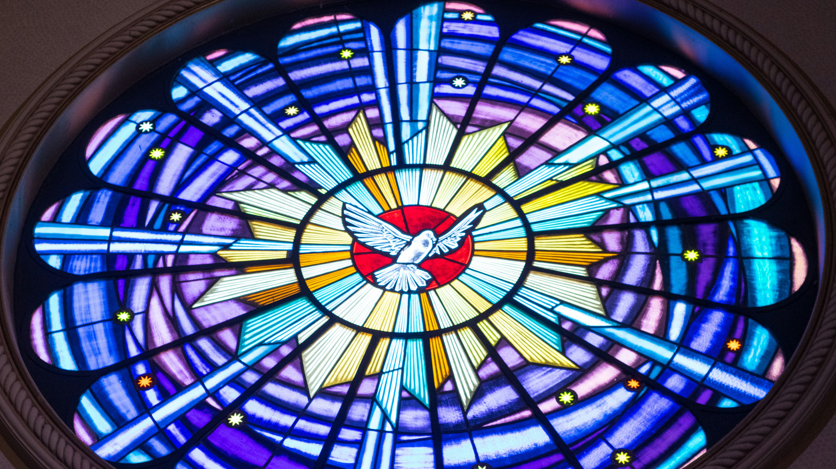

What do you remember from the Gospel reading?
John tells us that he saw the Holy Spirit come down like a dove to rest on Jesus. Because of this, John believed that Jesus was the Son of God.
A dove is one way that the Holy Spirit shows itself, but most of the time the Spirit is invisible. We cannot see it.
Respond
Notes:
Stained glass window
Photo credit: Mateus Campos Felipe on Unsplash

Slide 5
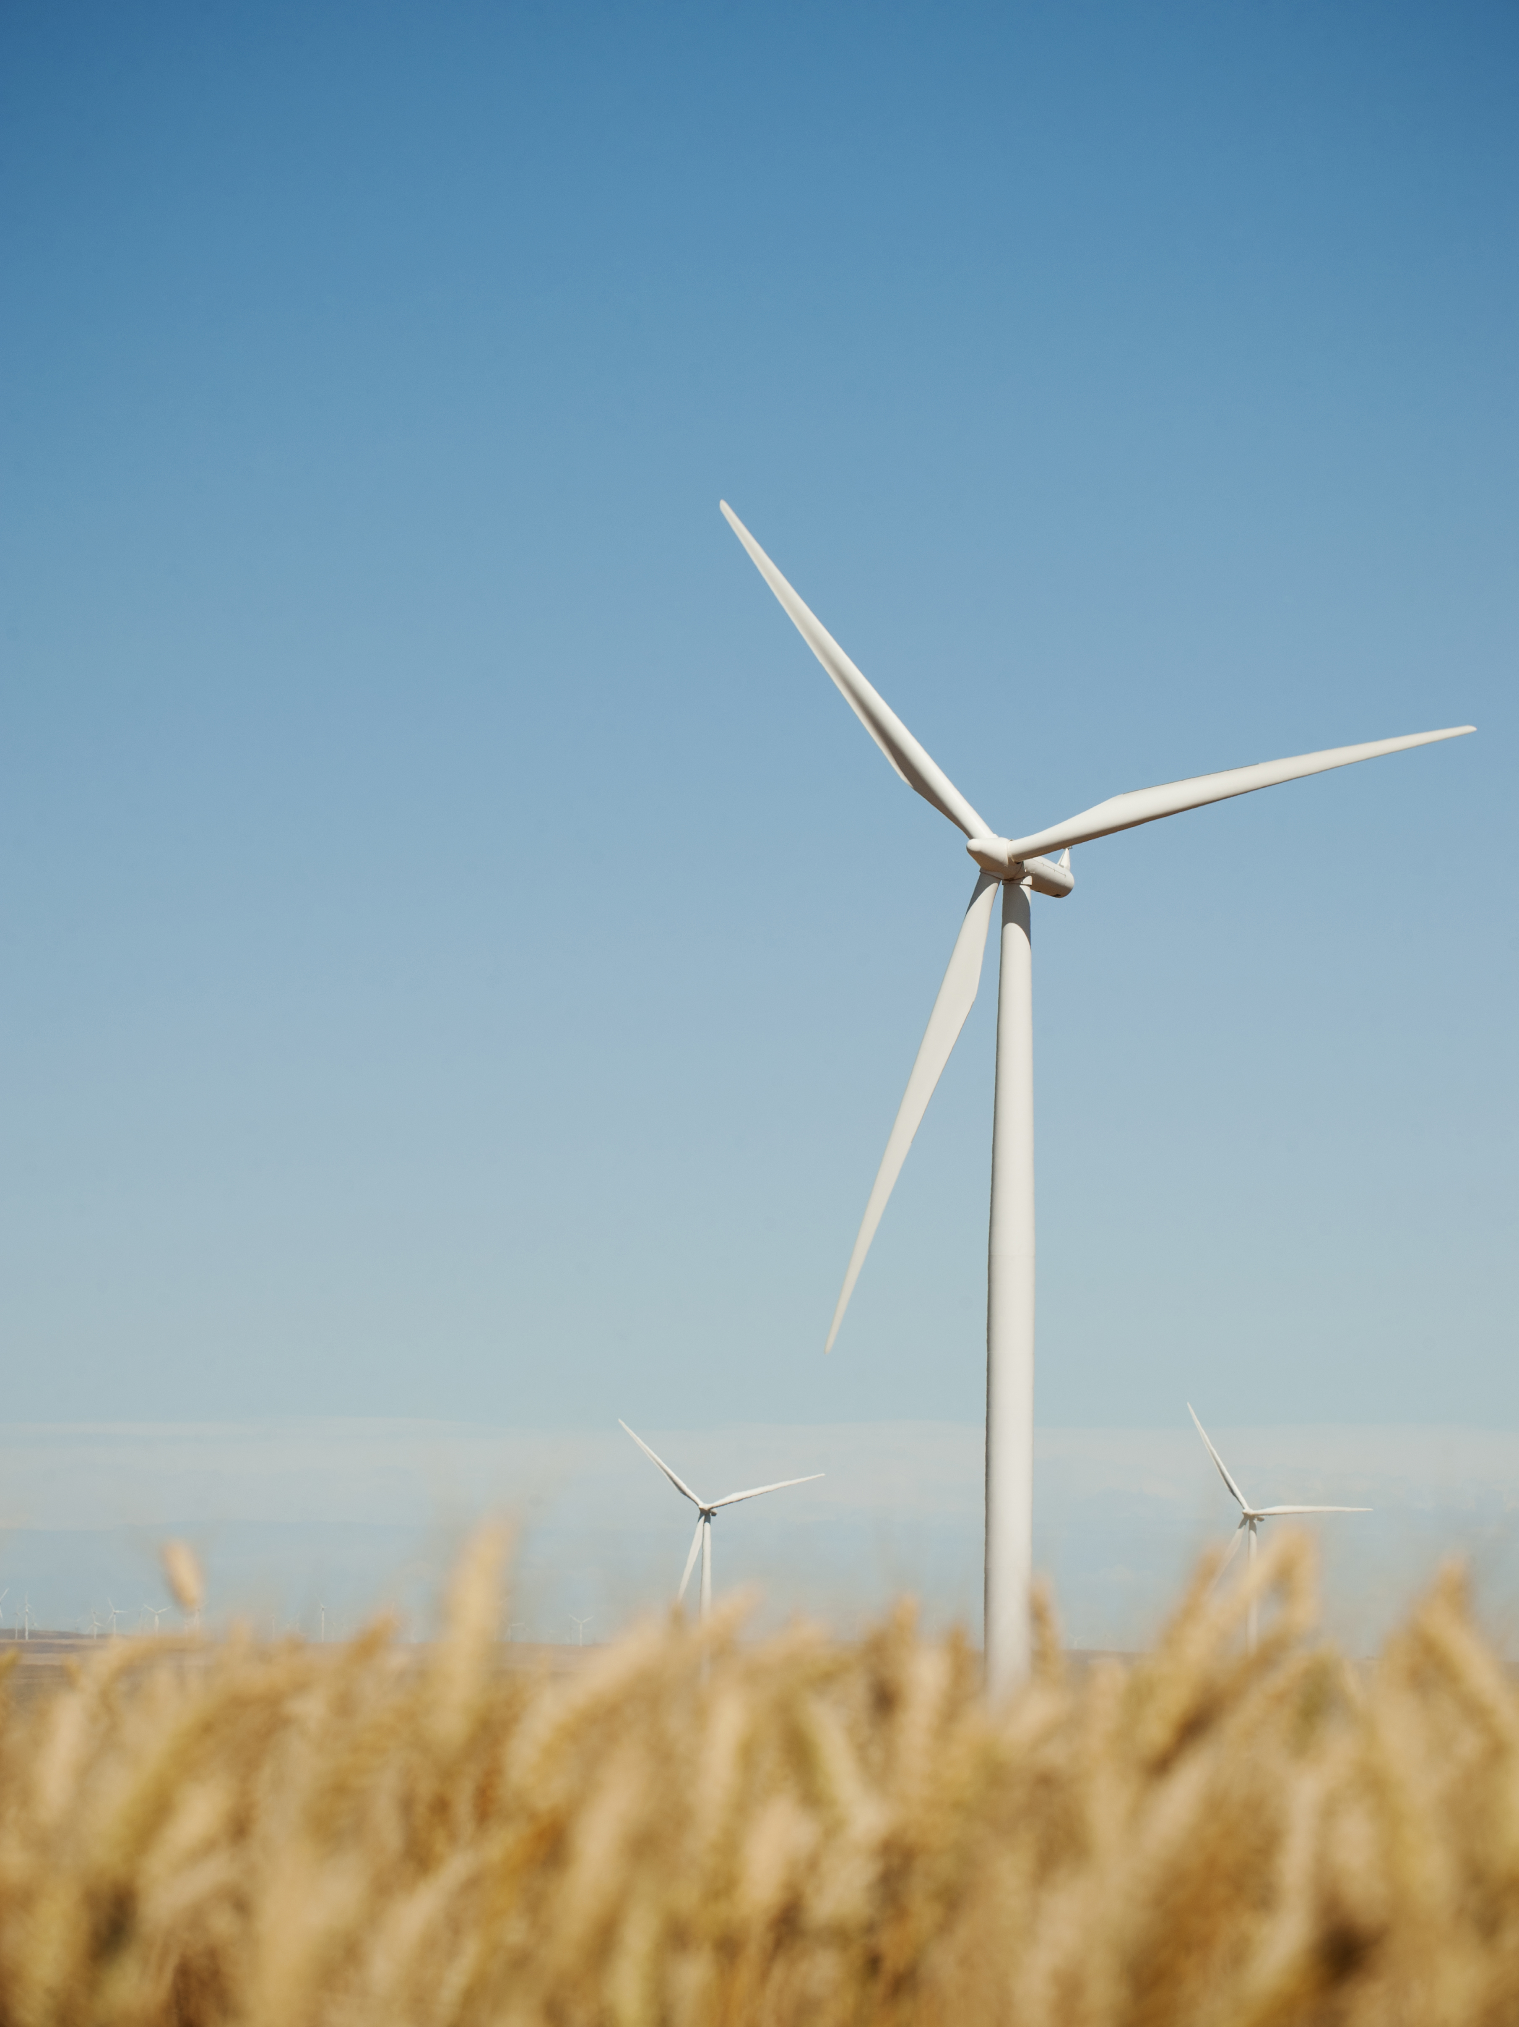
One way to think about the Holy Spirit is like the wind. You cannot see the wind, but you can see the branches of a tree moving when the wind blows. Or you can see a windmill spinning round.
Can you think of any other examples of when you can see the wind?
The wind can be very strong. The wind can be very helpful. How does it help to make things work in these photos?
Notes:
"Or you can see a windmill spinning round." (You could demonstrate this if you have a paper windmill).
Wind turbine
Photo credit: Stock image

Slide 6
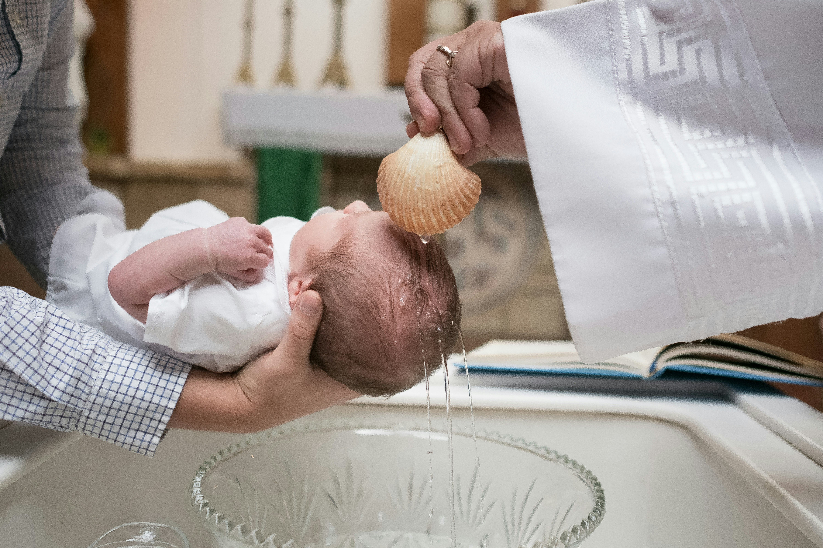
Like the wind, the Holy Spirit helps us.
We receive the Holy Spirit when we are baptised.
This same Spirit stays with us all through our lives, helping us to do the things that we find difficult.
Notes:
Baptism
Photo credit: Josh Applegate on Unsplash

Slide 7
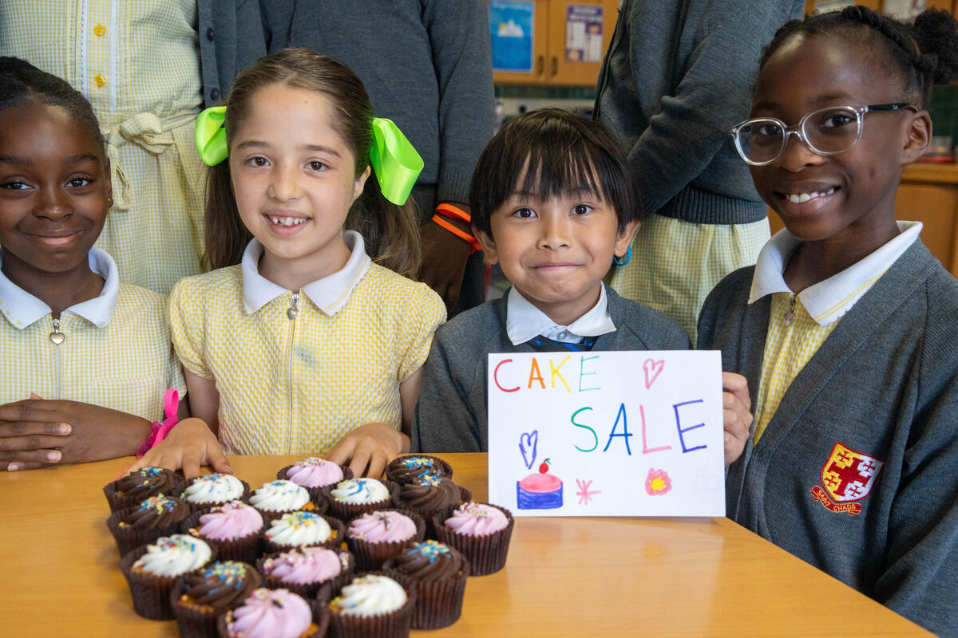
Jesus asks us to love other people, to care for people who are sick and to be signs of hope in our world, especially to people who are poor.
This is not always easy, especially when people are in many different countries to us.
But when we do these things, other people can see the Holy Spirit working through us, just as we can see the wind in the trees.
Raising money for CAFOD to help our global family in need
Notes:
A cake sale at St Chad's primary school
Photo credit: Joe Newman

Slide 8
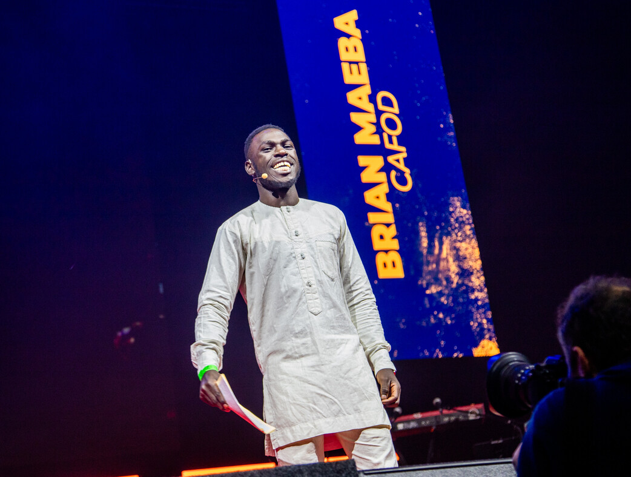
Brian lives and works in Kenya, training young people in farming so that they can earn a living and look after the environment.
He says: “God has not given us a spirit of fear, but of power and love. With God’s strength and guidance, you can achieve great things, beyond your wildest dreams.”
Notes:
Brian Maeba speaking at Flame 2025, Wembley
Photo credit: Mazur/catholicnews.org.uk

Slide 9
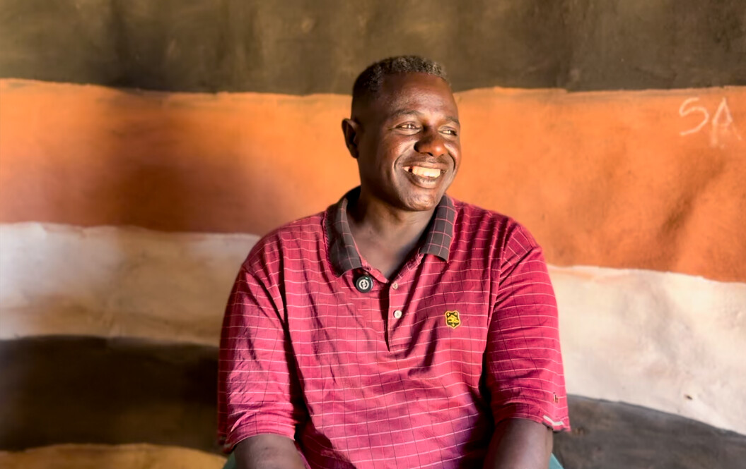
Abbiott works as a climate change officer in the Borana community in Ethiopia where he was born.
He saw how drought had affected his people and wanted to make a difference.
Abbiott went to university to study climate change so that he could help his community, build a better world and share God's love.
"Working together is good," says Abbiott.
Notes:
Abbiott, Southern Ethiopia
Photo credit: Louise Norton

Slide 10
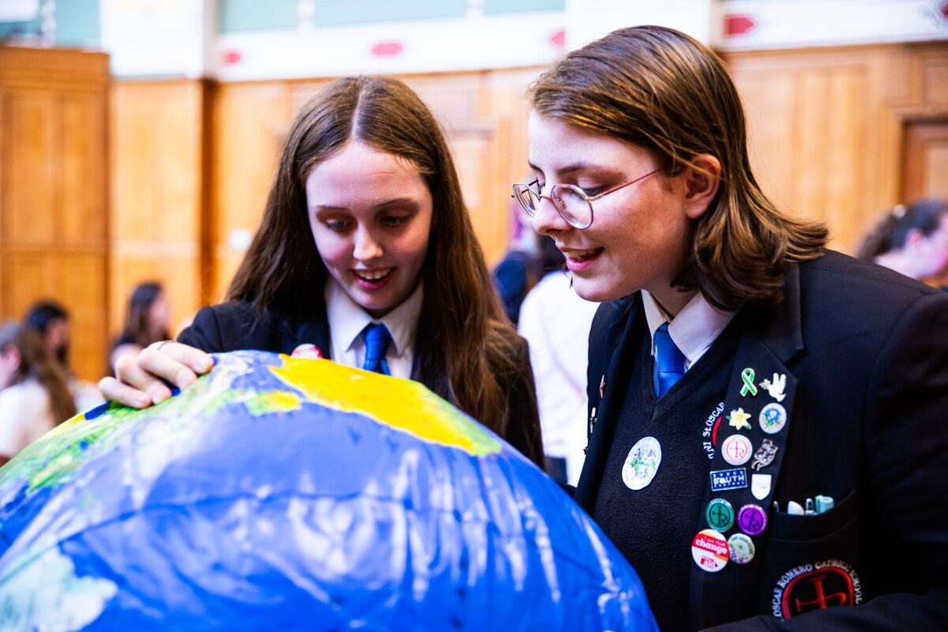
The Holy Spirit can help us to take care of the world that God has given us. Can you think of ways we can do that?
The Holy Spirit can help us to be kind, generous, brave, and to work together with others to make the world a better place for everyone. Can you think of ways that we can do this?
Oscar Romero pupils with CAFOD at the UK Parliament
Notes:
Pupils from Oscar Romero School take part in CAFOD activities at the 2025 mass lobby of the UK Parliament
Photo credit: Thom Flint

Slide 11
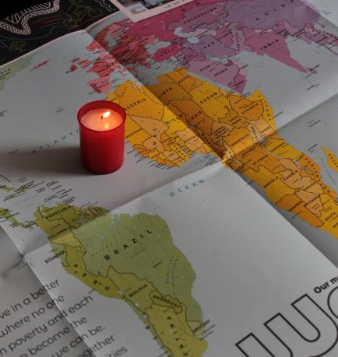
Let us pray
We pray for all people who are poor:
that they may see the signs of the Holy Spirit working around them, as we come together with them to build a better world.
Lord in your mercy…
We pray for our parish, families and friends:
that with the help of the Holy Spirit, we may work together to look after our world and make it a fairer place for everyone to live in.
Lord in your mercy…

Slide 12
Let us pray
We pray for world leaders:
that the Holy Spirit may guide them when they make important decisions, so that they make life better for all their people.
Lord in your mercy…
God of power, fill us with your spirit:
inspire us to make changes to our lives, so that we can support one another to build a better world. Amen.

Slide 13
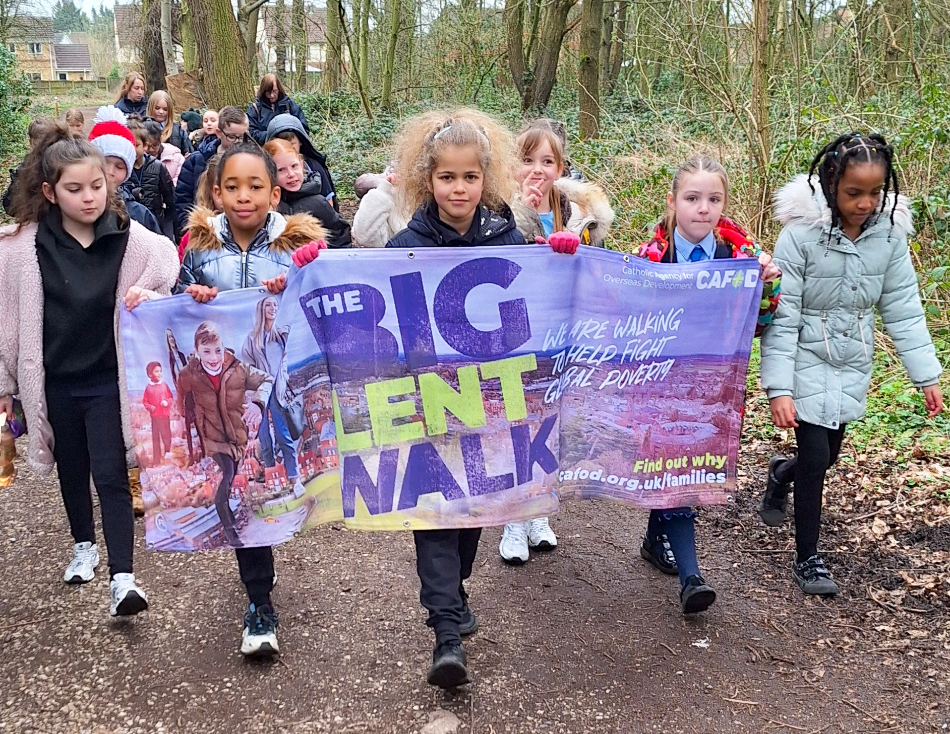

What can you do this week so other people will see the Holy Spirit working through you?
Send
Children on a Big Lent Walk in Liverpool
Notes:
Community Big Lent Walk, Reading
Photo credit: Amit Rudro

Slide 14
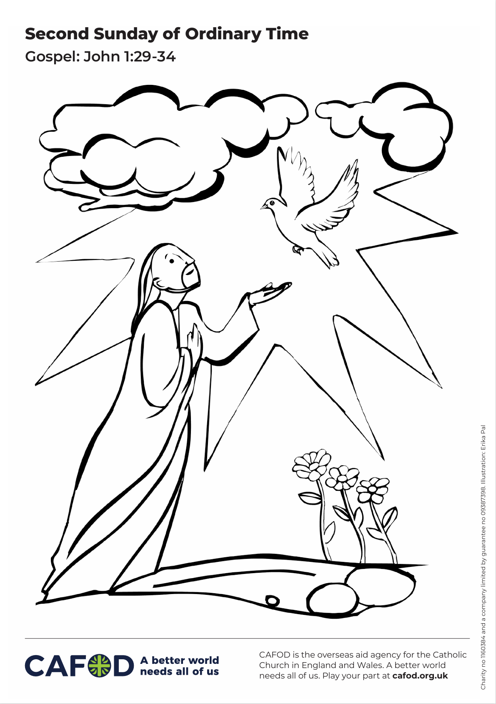
Activity suggestions
Download the illustration
Invite the children to colour in the accompanying picture. On the back they could draw or write one thing that they will do in the coming week, so that other people can see the Spirit working through them.
Make doves with the children to remind them of how the Holy Spirit appeared in the reading:
Draw the body of a dove on white card for children to cut around
Draw the eyes onto the dove.
Encourage the children to fold an A4 piece of paper to make a fan. (Fold on the long side)
Cut a slit in the body of the dove and pass the fan through to create wings. You can also cut another slit in the tail for a second fan if you wish.
Notes:
Illustration: Erika Pal

Slide 15
5. Encourage the children to write or draw on the dove what they will do in the coming week so that people can see the Holy Spirit working through them.
Remind the children to share all that they have heard and thought about today with the people at home.
Encourage them to do one thing during the week that helps to look after the world that God has given us, or which helps other people, so that others can see the Holy Spirit through them.
See dove template on next page.

Slide 16
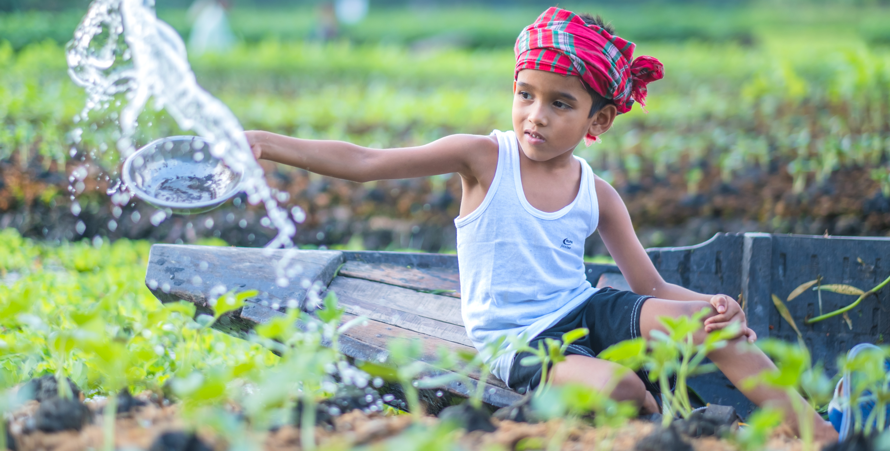
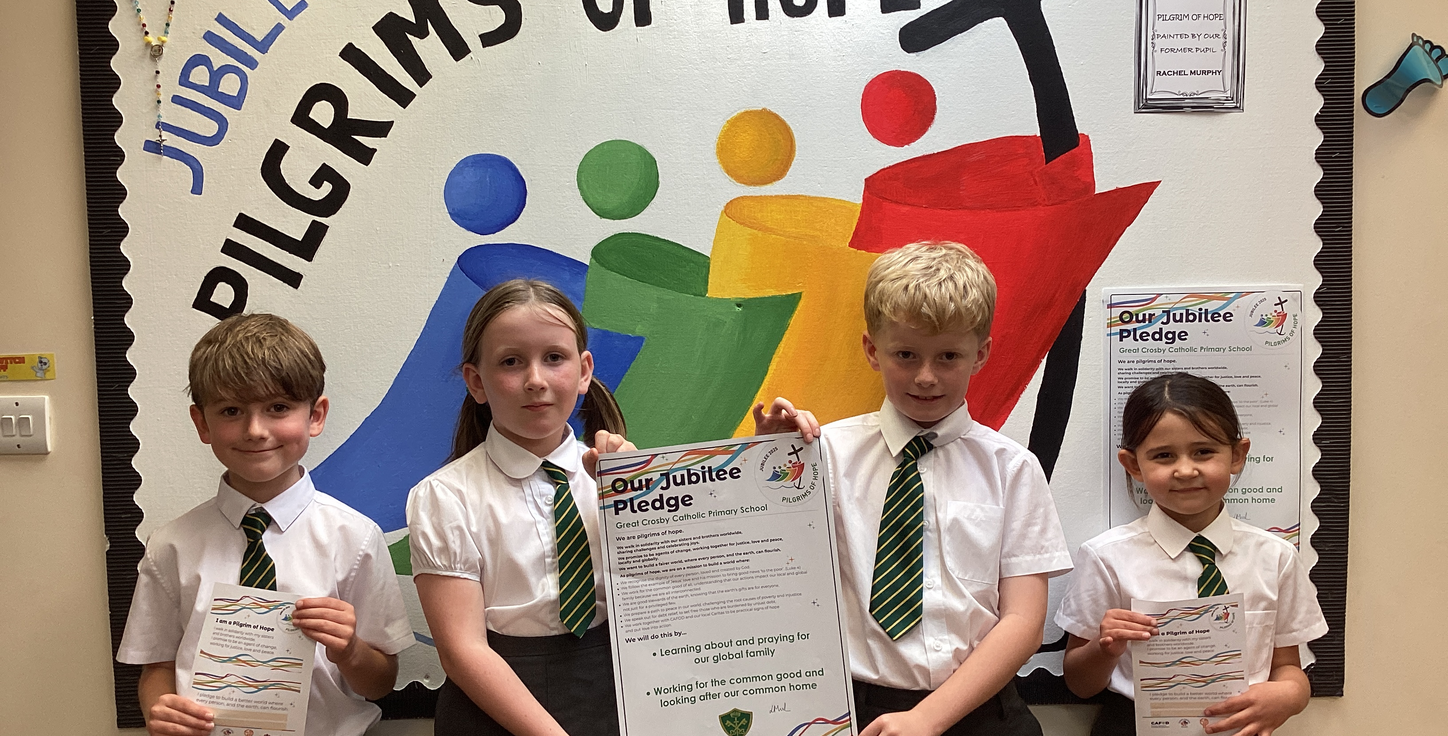
Get involved with CAFOD this term
Big Lent Walk resources
Save the date!
Jubilee Pledge resources
Join us on the Big Lent Walk!
Join our national assembly
It's not too late to make a Jubilee Pledge!

Slide 17
