Slide 1
Promoting peace
Exploring CST principles in CAFOD’s work
Notes:
Photo credit: Jessica Michelmore

Slide 2
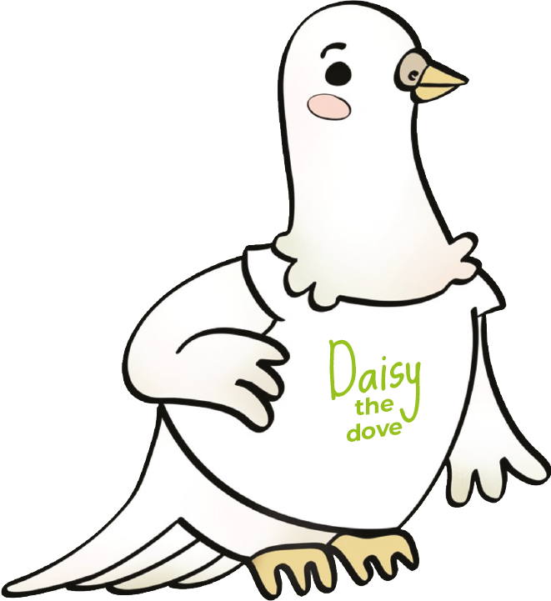
Promoting peace means we believe in
being
Peacemakers.

Slide 3
“Those who promote peace have joy."
Proverbs 12:20

Slide 4
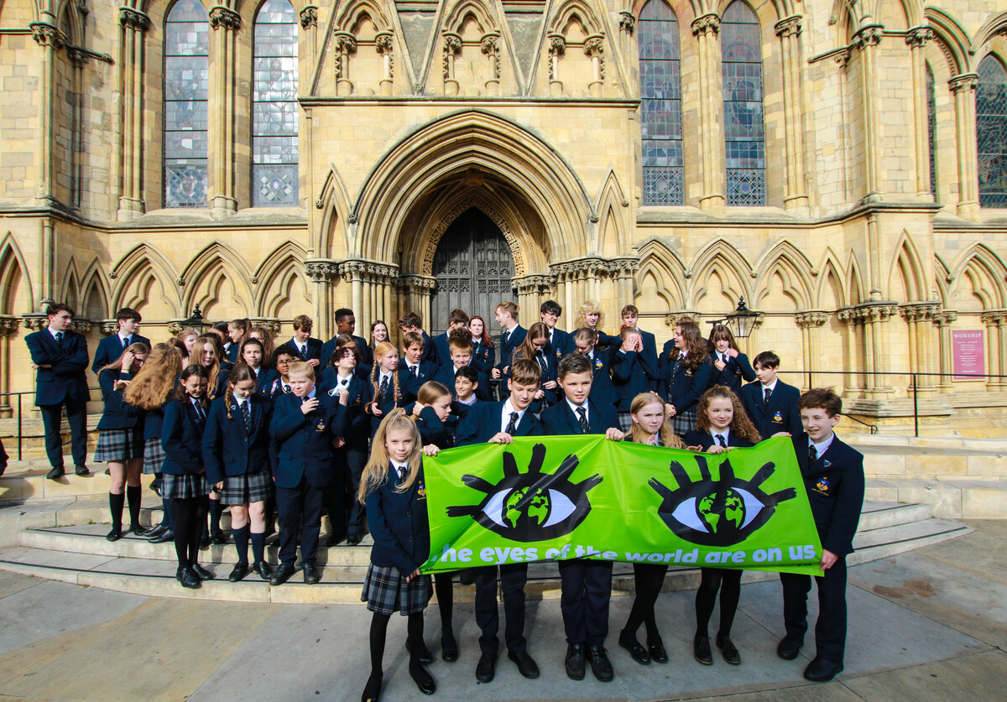
Promoting peace
We can be God’s peacemakers by speaking up for our brothers and sisters in need around the world.
Notes:
Photo credit: Thom Flint

Slide 5
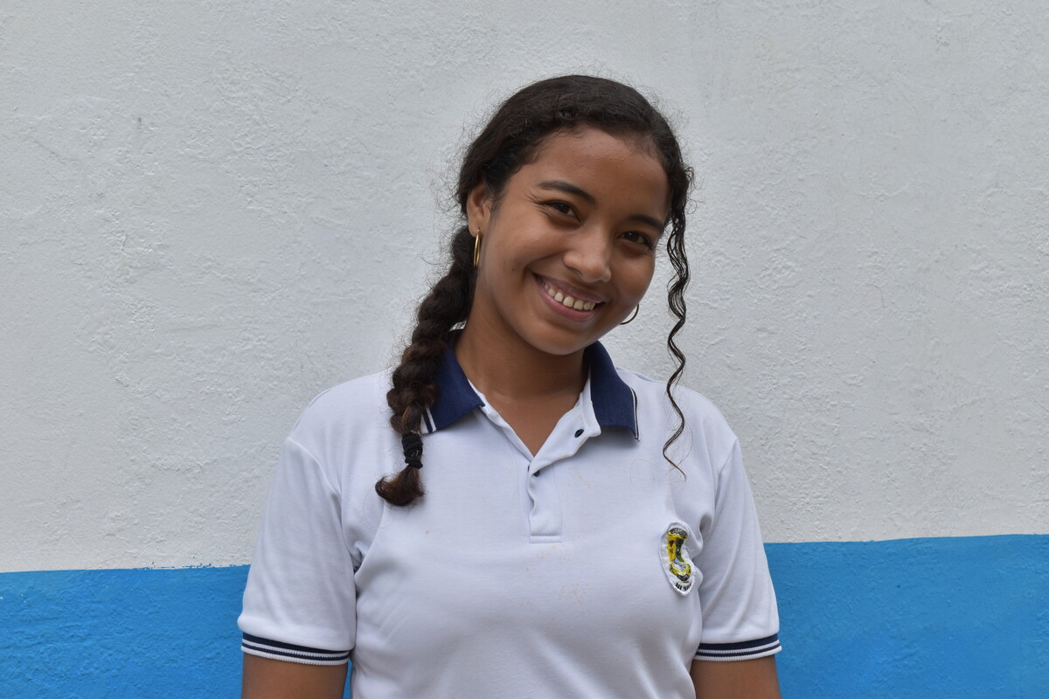
This is Rosana.
She lives in Colombia where there has been fighting for more than 50 years.
Notes:
Photo credit: Jessica Michelmore

Slide 6
Rosana and her school friends are part of a peace-building project.
"My classmates and I had to share our dreams, aims and goals," says Rosana.
"We are not interested in continuing with war, we have much greater aspirations,” she says.
Notes:
Photo credit: Jessica Michelmore

Slide 7
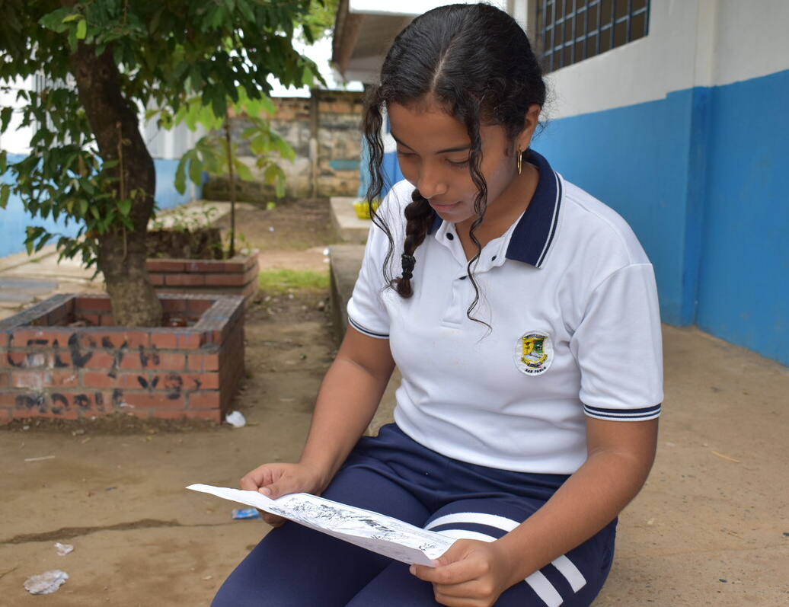
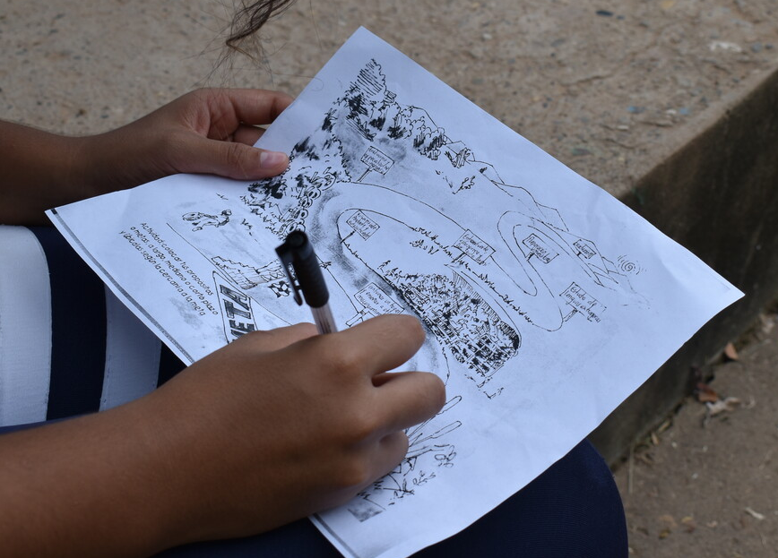
With CAFOD's help, peace-building workshops teach young people how to avoid a life of violence.
They are taught to share what they have learnt with their families and neighbours so everyone can try to live peaceful lives.
“Now is the moment for the country to leave violence behind us," says Rosana.
Notes:
Photo credit: Jessica Michelmore

Slide 8
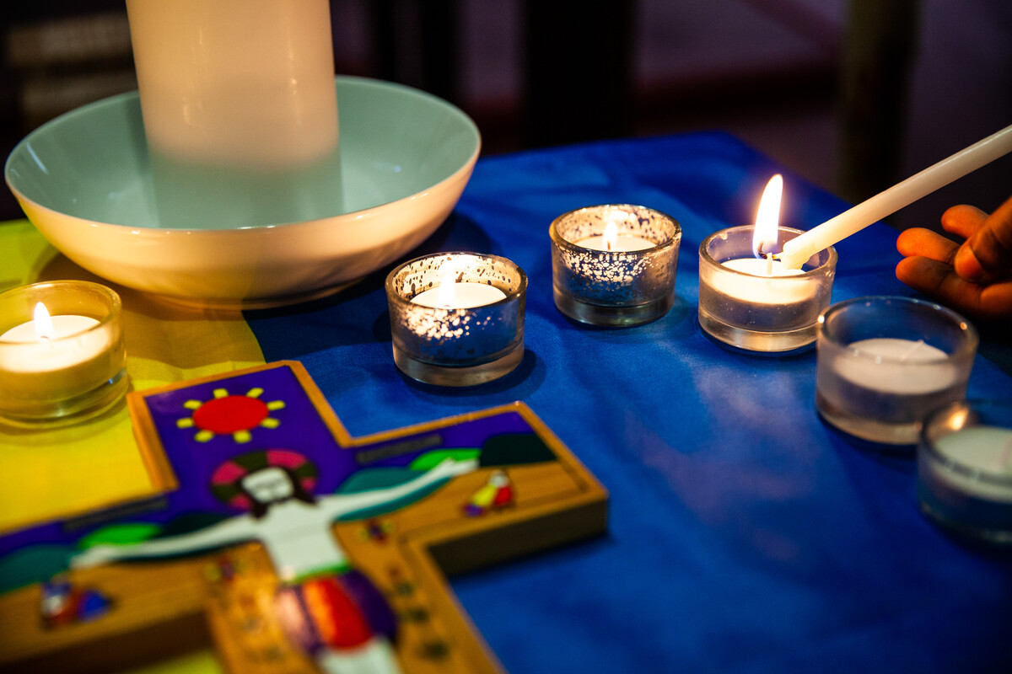
"Today the world has a profound thirst for peace.
In many countries, people are suffering due to wars which are always the cause of suffering and poverty.”
Pope Francis,
20 September 2016
Notes:
Photo credit: Thom Flint

Slide 9
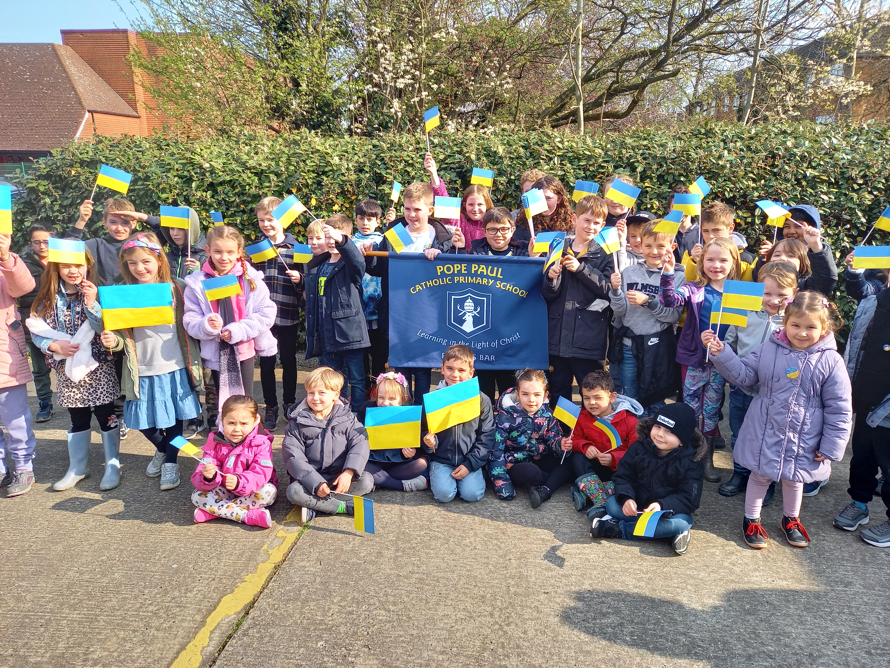
Being peacemakers
Understanding, respecting and loving one another helps us all live in peace.
The children and community of Pope Paul Catholic Primary School promoted peace by walking for the people of war-torn Ukraine.
Sarah, a pupil, said: "Our walk was to play our part in building a better world – and we raised £1,200 for CAFOD's Ukraine appeal."
Notes:
Photo credit: Pope Paul Catholic primary school

Slide 10
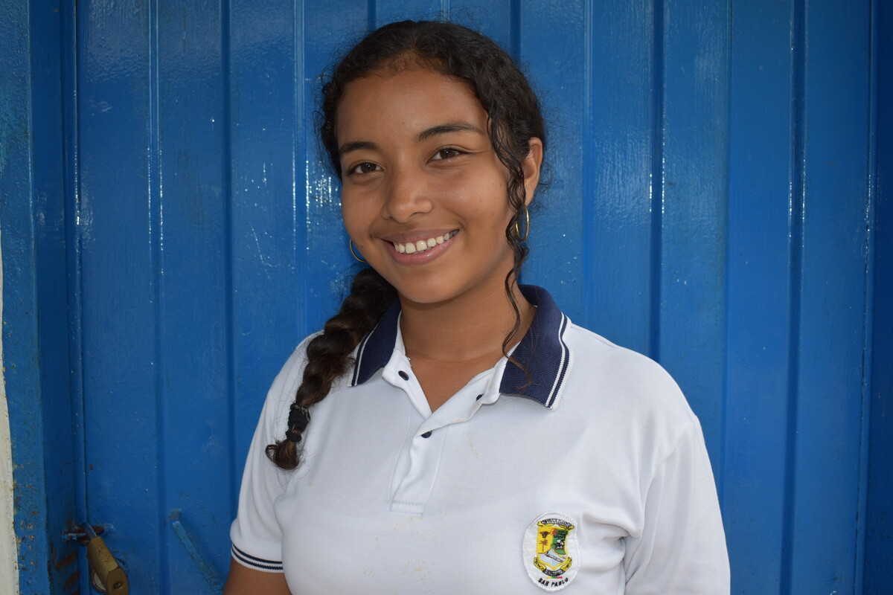
Let us pray
Loving God,
We believe you want to bring your peace to our homes, our communities and our world.
Help us to be peacemakers, listening to and loving each other.
Lord in your mercy
Hear our prayer
Being a peacemaker
Promoting peace
Notes:
Photo credit: Jessica Michelmore

Slide 11
Being peacemakers
Daisy the Dove reminds us that being a peacemaker, just like Rosana, helps to promote peace.
How can we be peacemakers?

