Slide 1
Notes:
Pope Francis inspired a generation of children and young people throughout England and Wales to live wisely, think deeply and love generously.

Slide 4
‘‘Live wisely, think deeply and love generously.’’

Slide 6
‘‘Young people demand change!’’
Notes:
Pope Francis said, ‘Young people demand change’. He believed that children and young people could build a better world.

Slide 11
‘‘If we are to build a better world, we cannot build this dream alone, we need to dream together.’’
Notes:
He said ‘If we are to build a better world, we cannot build this dream alone, we need to dream together.’

Slide 13
Children’s groups in Gaza

Slide 14
Daniel and his family, DRC

Slide 15
Caritas Ukraine volunteers

Slide 16
Khera, Marsabit in Kenya
Chicken project

Slide 17
‘‘Hear the cry of the earth and cry of the poor.’’
Notes:
He asked us to hear the cry of the earth and the cry of the poor. He said ‘climate change affects us all, but it is the poorest communities who suffer the most.’

Slide 19
Seed sovereignty
Selina in Bangladesh

Slide 20
Sea safety project
James in New Kru, Liberia

Slide 21
Notes:
He asked us to welcome refugees and migrants.

Slide 26
Notes:
He asked us to work for peace and stand for justice.

Slide 27
Woodworking project
Daniel and friends, DRC

Slide 28
Firewood project
Maria and her family, Ukraine

Slide 29
‘‘We are a single family living in a common home.’’
Notes:
We were affirmed by this call and it inspired us to take action for our global family. We remember his words, ‘We are a single family living in a common home.’

Slide 32
Notes:
Pope Francis’s words have influenced children and young people in every Catholic school in England and Wales.

Slide 34
Notes:
In this Jubilee Year, we answer his call to be signs of hope, standing in solidarity with people experiencing poverty and taking action to build a better world.

Slide 36
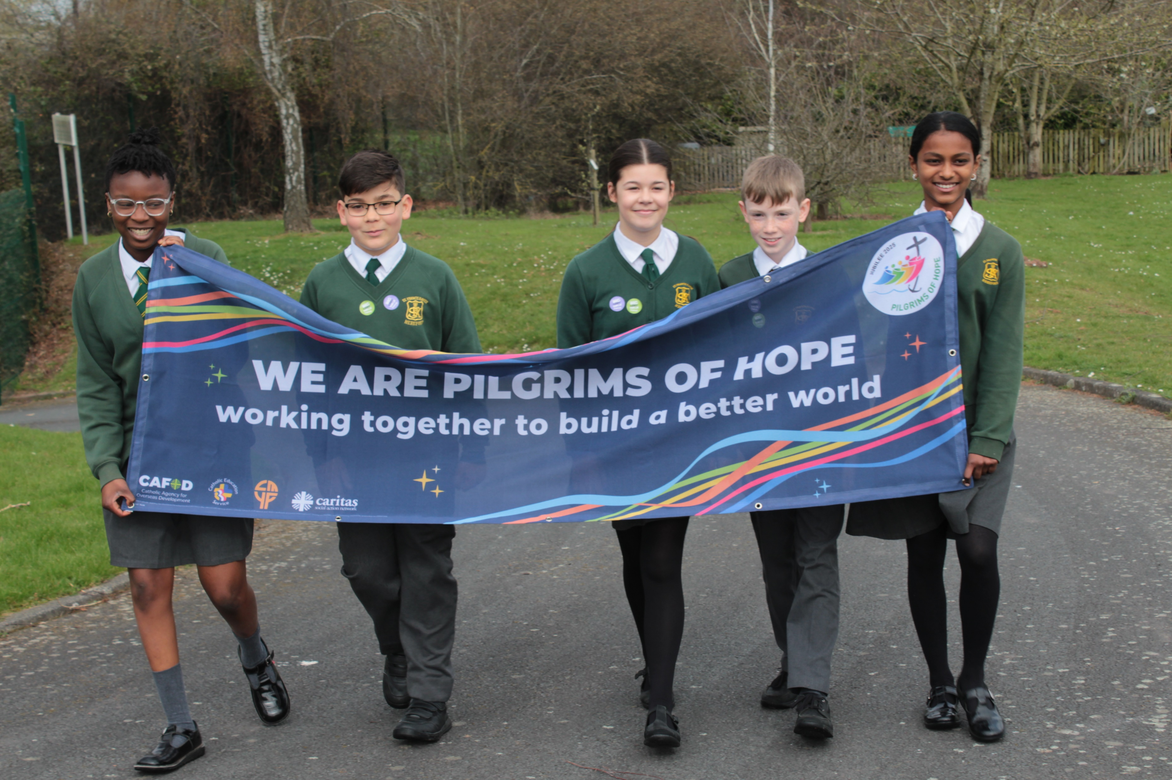

Slide 38
Notes:
Thank you Pope Francis. We are now your pilgrims of hope.

