Slide 1
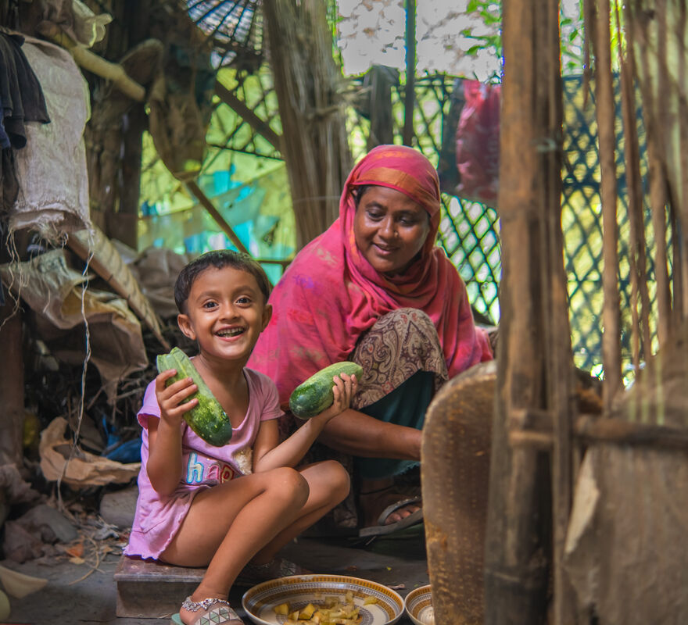
What will you do to show that you care for others?
Gospel Celebration of the Word
Notes:
Children’s liturgy: Third Sunday of Lent (Year A)
Preparation of the worship space
Colour: purple
Song suggestions:
O Lord all the world belongs to you (847, Laudate)
Welcome
Today we hear Jesus talking to a Samaritan woman at a well. This story reminds us that God loves all people no matter where they are from. God asks us to be like Jesus and to respect and care for all people no matter who they are.
Muslima in the kitchen with her grandmother, Bangladesh
Photo credit: Amit Rudro

Slide 2
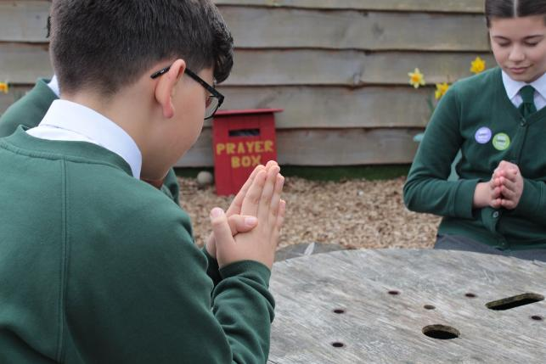

God of peace, You care for all people in our world. Move us to do the same and to work together to build a better world. Amen.
Gather
Notes:
St Francis Xavier's RC Primary School, Herefordshire
Photo credit: Vicky Ahmed

Slide 3

Gospel: John 4: 5-42 or John 4: 5-15, 19-26, 39-42
In Samaria, he came to a town named Sychar, which was not far from the field that Jacob had given to his son Joseph. Jacob’s well was there, and Jesus, tired out by the journey, sat down by the well. It was about noon.
A Samaritan woman came to draw some water, and Jesus said to her, “Give me a drink of water.” (His disciples had gone into town to buy food.)
The woman answered, “You are a Jew, and I am a Samaritan – so how can you ask me for a drink?” (Jews will not use the same cups and bowls that Samaritans use.)
Jesus answered, “If only you knew what God gives and who it is that is asking you for a drink, you would ask him, and he would give you life-giving water.”
Word

Slide 4
“Sir,” the woman said, “you haven’t got a bucket, and the well is deep. Where would you get that life-giving water? It was our ancestor Jacob who gave us this well; he and his sons and his flocks all drank from it. You don’t claim to be greater than Jacob, do you?”
Jesus answered, “All those who drink this water will be thirsty again, but whoever drinks the water that I will give him will never be thirsty again. The water that I will give him will become in him a spring which will provide him with life-giving water and give him eternal life.”
The woman said, “Sir, give me that water! Then I will never be thirsty again, nor will I have to come here to draw water.”

Slide 5
“I see you are a prophet, sir,” the woman said. “My Samaritan ancestors worshipped God on this mountain, but you Jews say that Jerusalem is the place where we should worship God.”
Jesus said to her, “Believe me, woman, the time will come when people will not worship the Father either on this mountain or in Jerusalem. You Samaritans do not really know whom you worship; but we Jews know whom we worship, because it is from the Jews that salvation comes.
"But the time is coming and is already here, when by the power of God’s Spirit people will worship the Father as he really is, offering him the true worship that he wants. God is Spirit, and only by the power of his Spirit can people worship him as he really is.”

Slide 6
The woman said to him, “I know that the Messiah will come, and when he comes, he will tell us everything.”
Jesus answered, “I am he, I who am talking with you.”
Many of the Samaritans in that town believed in Jesus because the woman had said, “He told me everything I have ever done.” So when the Samaritans came to him, they begged him to stay with them, and Jesus stayed there two days.
Many more believed because of his message, and they said to the woman, “We believe now, not because of what you said, but because we ourselves have heard him, and we know that he really is the Saviour of the world.”

Slide 7
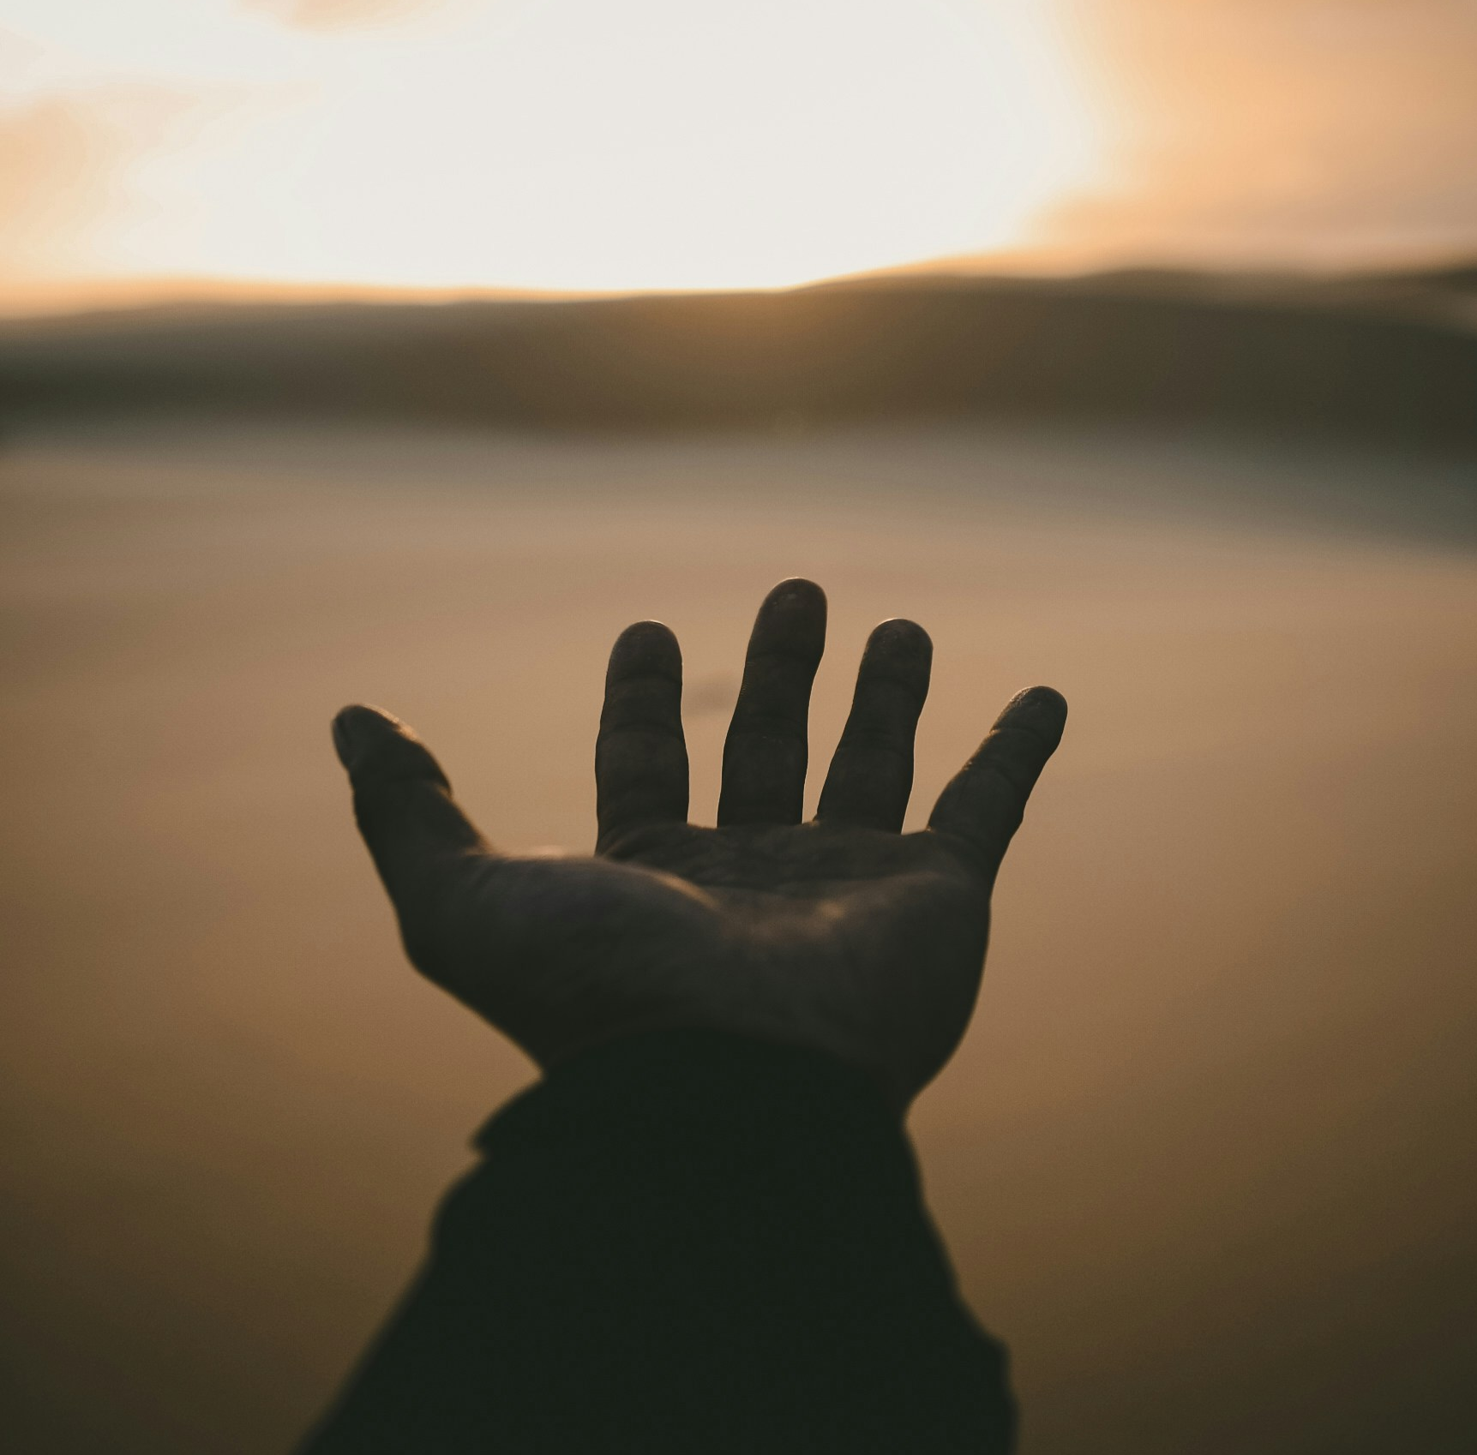

What do you remember from the Gospel reading?
Jesus is thirsty and so he asks a Samaritan woman for a drink from the well.
The woman is surprised because normally Jews and Samaritans did not get along. It was also unusual at the time for a man to talk to a woman he didn’t know.
But even though it is unusual, Jesus talks to the woman anyway. Why do you think he does this?
Respond
Notes:
Outstretched hand
Photo credit: Billy Pasco on Unsplash
Anuarite Kahindo sharing milk with her children, DRC
Photo credit: Arlette Bashizi

Slide 8
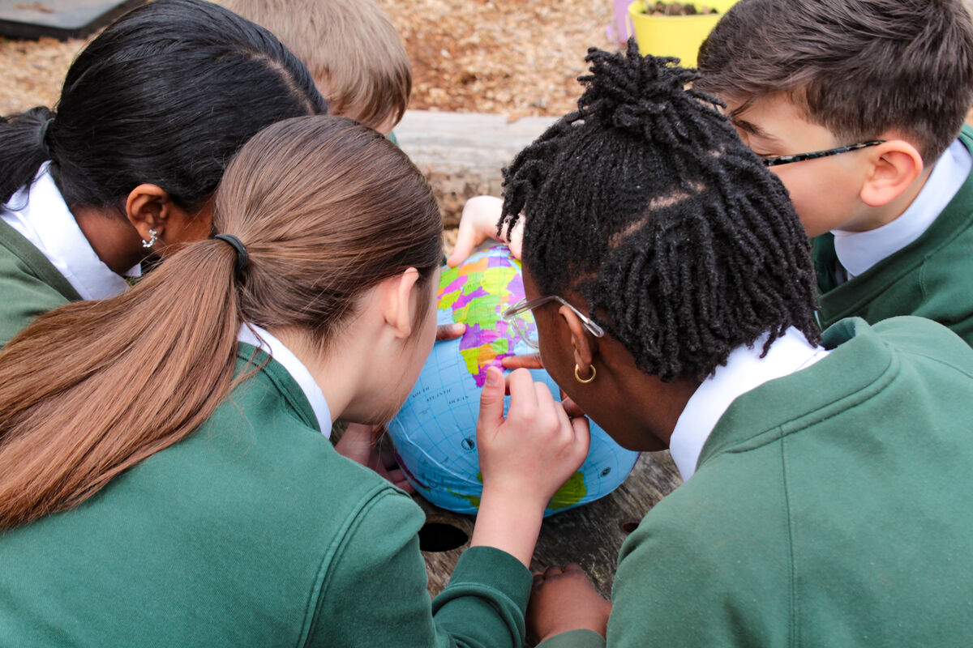
Jesus is showing us that God loves everyone; no matter who they are, where they come from or the colour of their skin – man or woman, boy or girl, rich or poor.
Even though we are all different, we still need the same things to live our lives.
Can you think what those things might be?
Notes:
St Francis Xavier's RC Primary School, Herefordshire
Photo credit: Vicky Ahmed

Slide 9
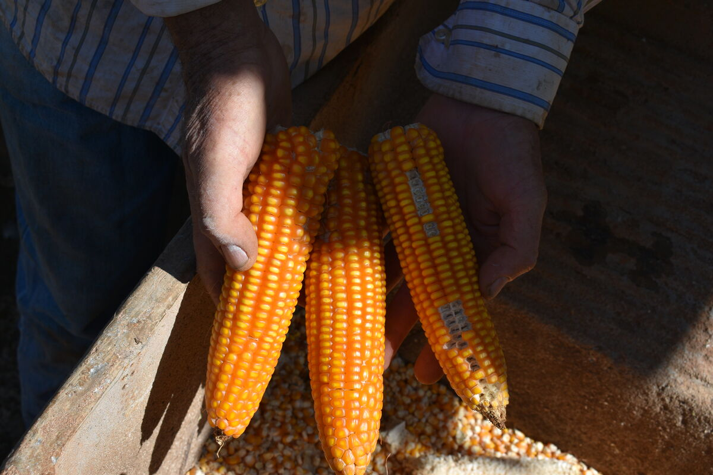
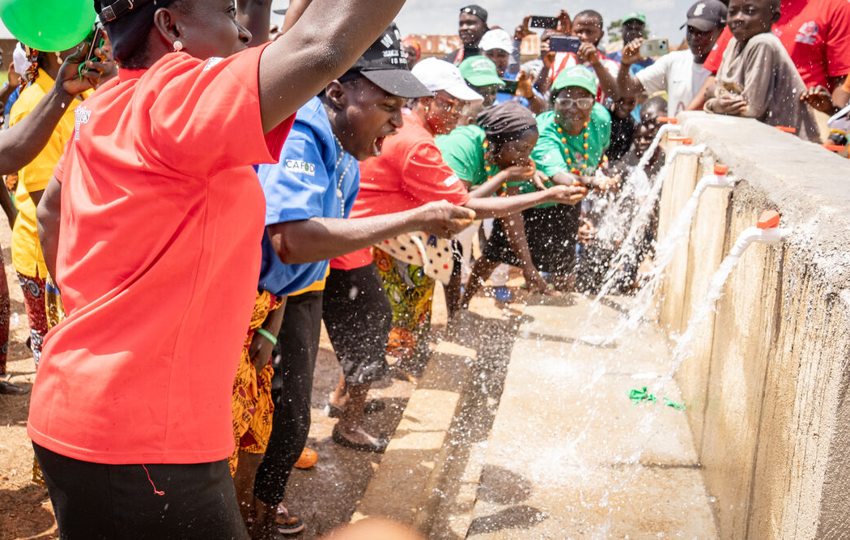
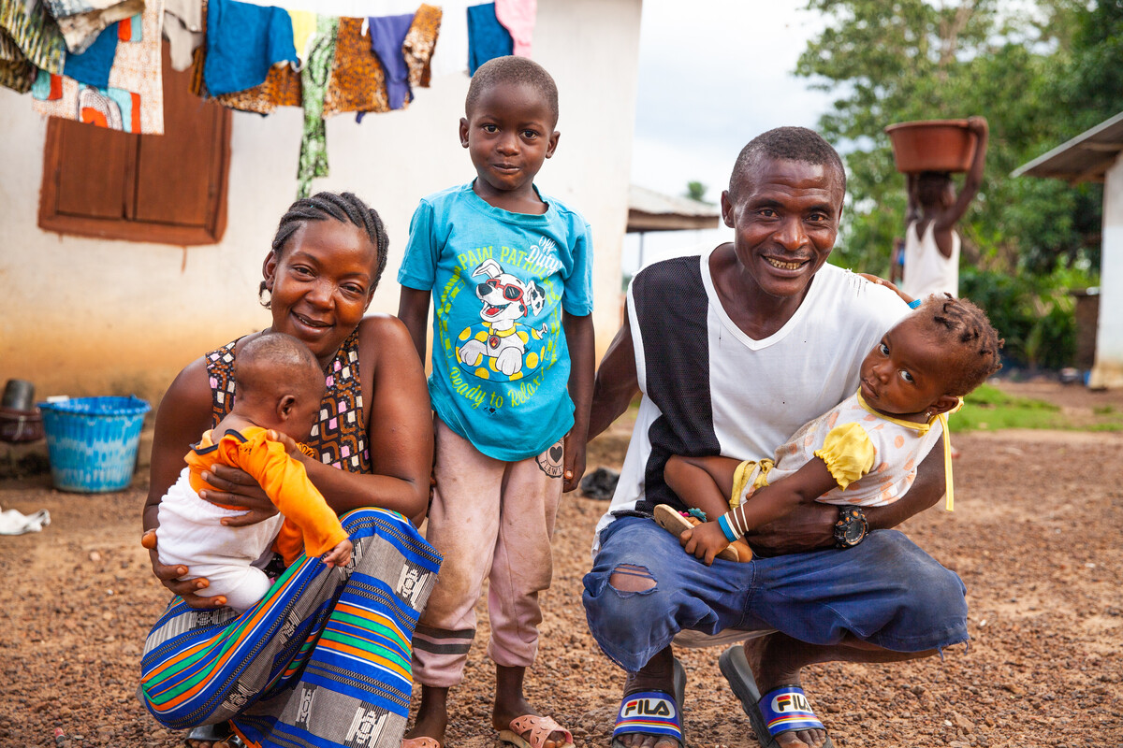
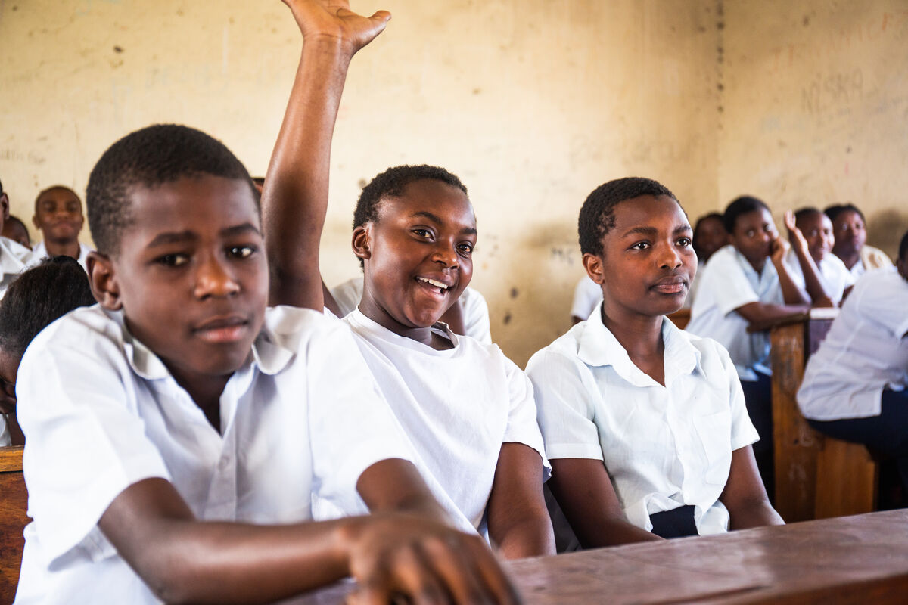
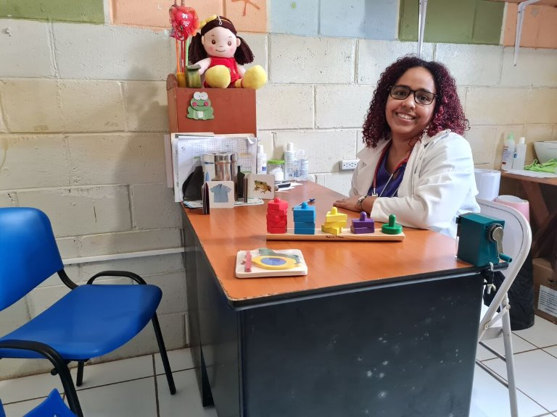
Just like Jesus in the story, we all need water to drink. We need food to eat. A safe place to live, somewhere to learn and someone to look after us when we are sick.
Jesus shows the woman that he is Christ, the Son of God, by knowing all about her life even though he has never met her before.
How do you think this makes the woman feel?
Clockwise: Farming corn in Brazil; a new borehole in Nigeria; Sagesse and friends in DRC; Dr Monica in El Salvador; Jenneh and her family in Sierra Leone
Notes:
Farming in rural São Paulo, Brazil
Photo credit: Kezia Lavan
Commissioning ceremony of the new solar-powered borehole, Nigeria
Photo credit: Kasim Jibril and Jonathan Gonyok
Jenneh and her family, Sierra Leone
Photo credit: Thom Flint
Sagesse at school in Goma, DRC
Photo credit: Thom Flint
Monica, Clínica Ana Manganaro, El Salvador
Photo credit: Clínica Ana Manganaro

Slide 10
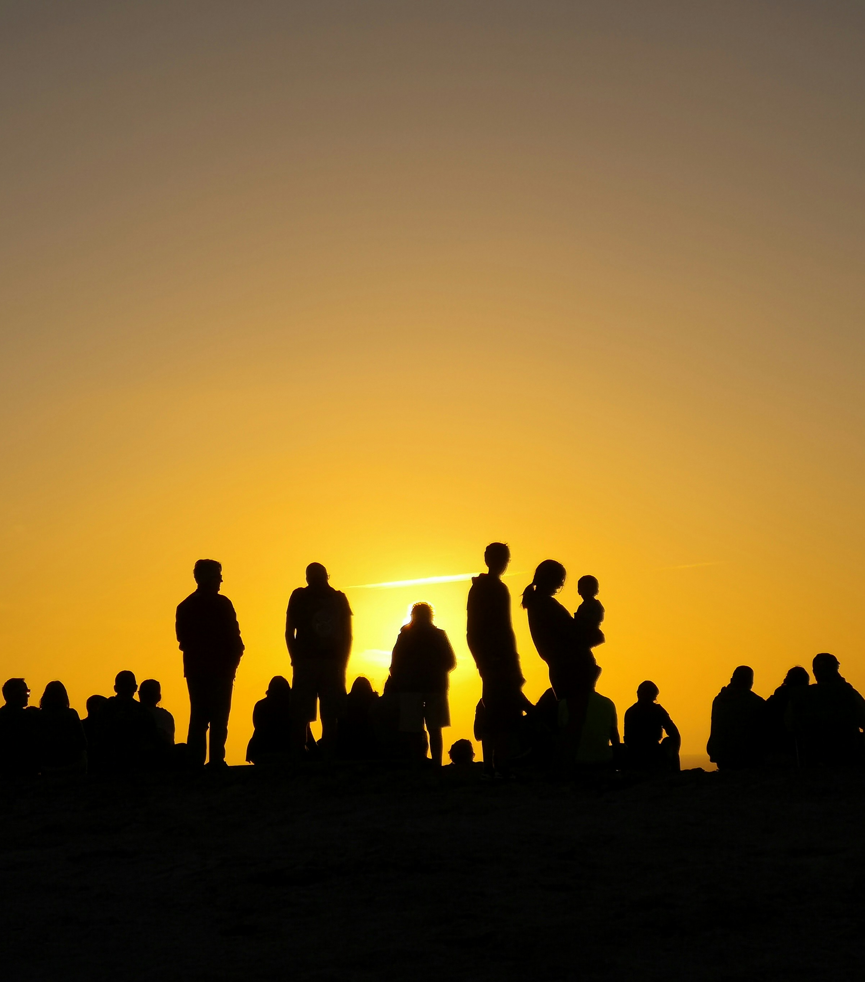
God also knows everything there is to know about us. And God loves us. How does this make you feel?
Sometimes people forget that God loves us all and that we are all part of one global family.
They only see the differences between themselves and another group of people. This can lead to many problems.
Notes:
People
Photo credit: Fernando Marques on Unsplash

Slide 11
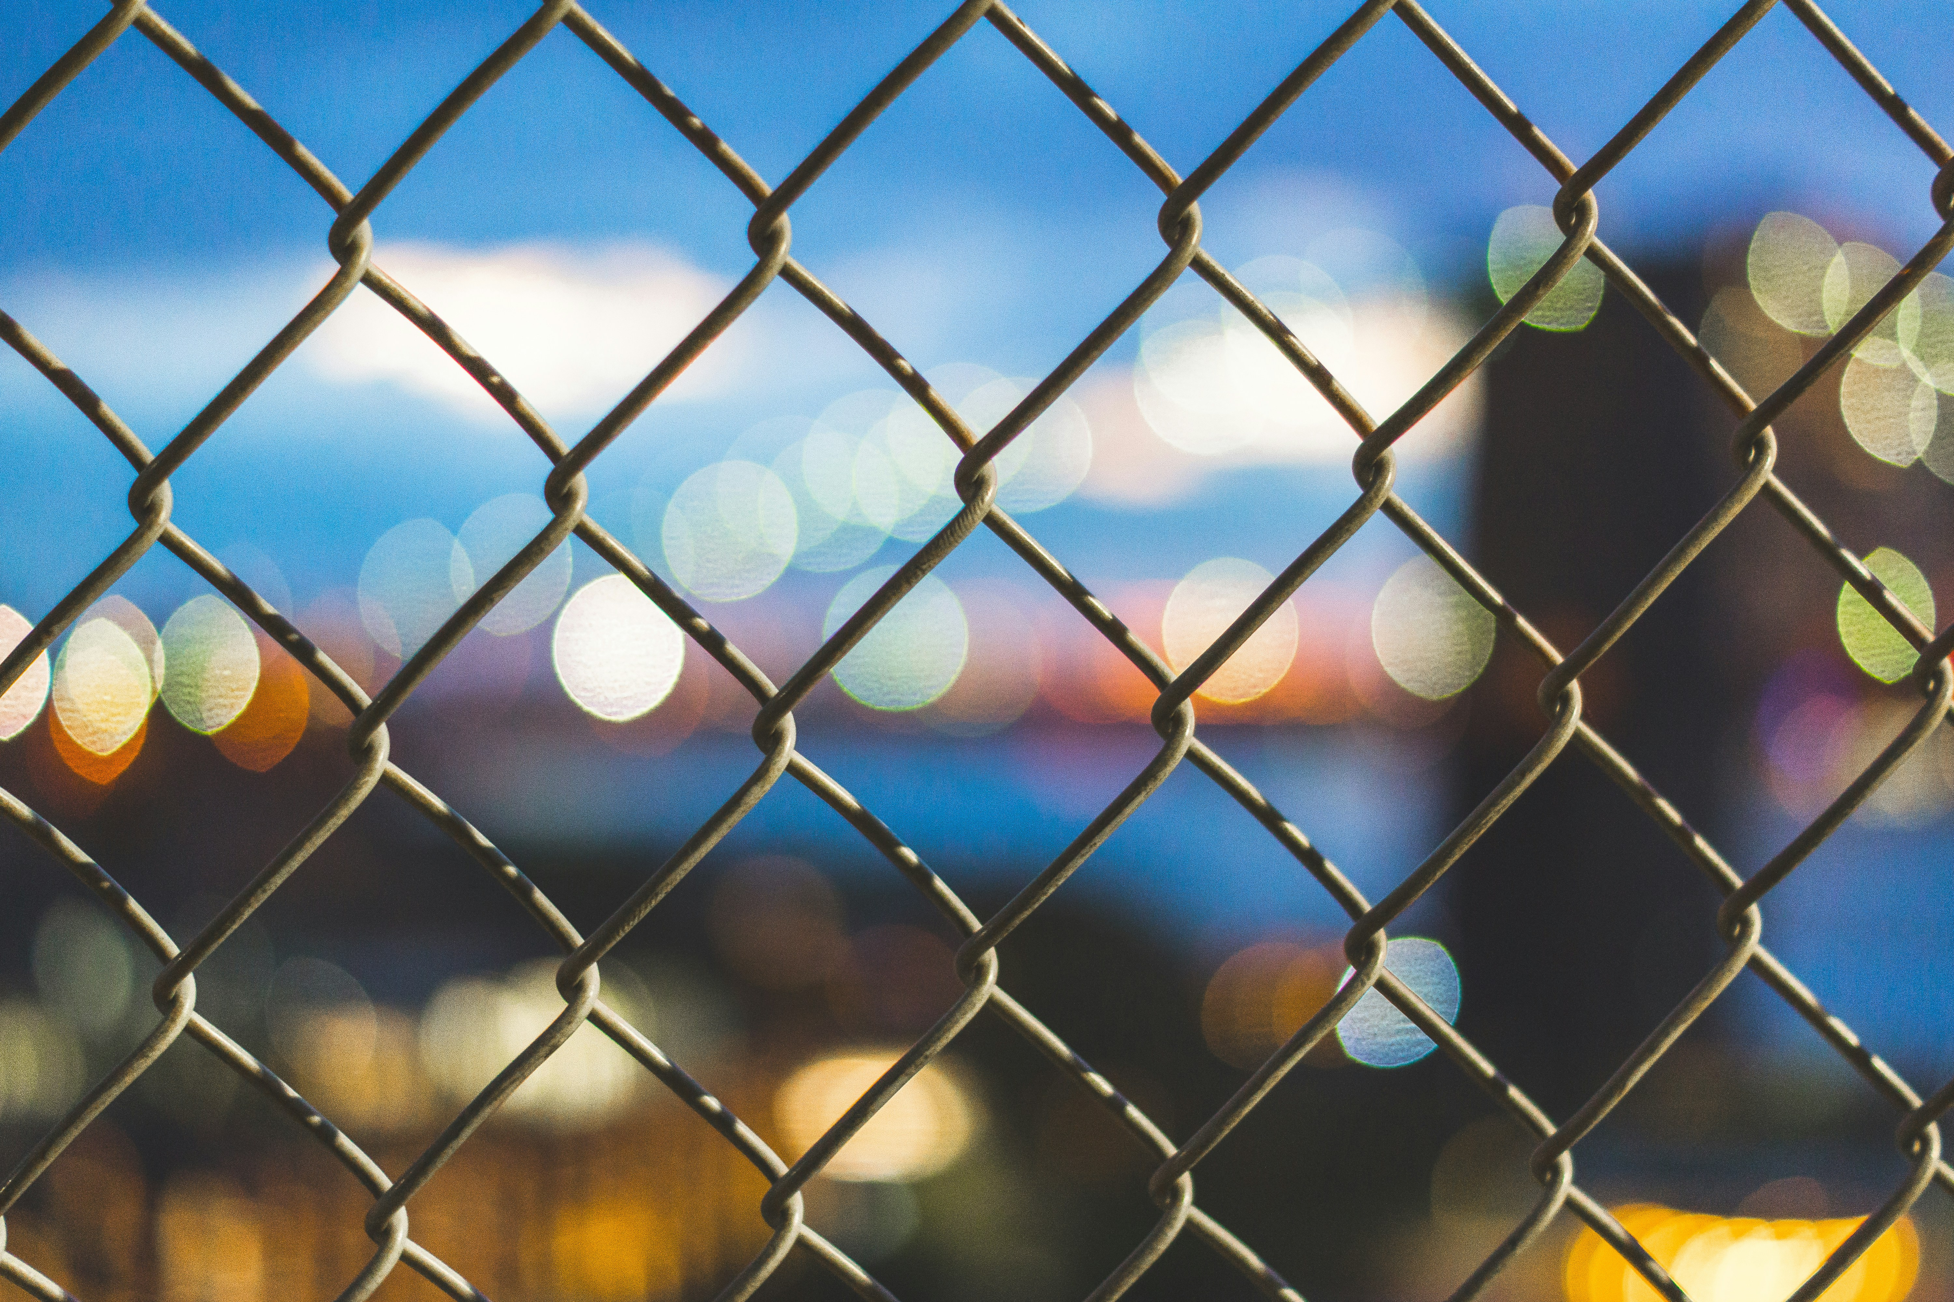
What problems might we have when we only look at what’s different between ourselves and someone else?
It can lead to people being afraid, or not very nice to each other. This can also mean that there are arguments and fighting.
Do you think this is how God wants us to treat each other?
What do you think God wants us to do?
Notes:
Wire
Photo credit: Martin Olsen on Unsplash

Slide 12
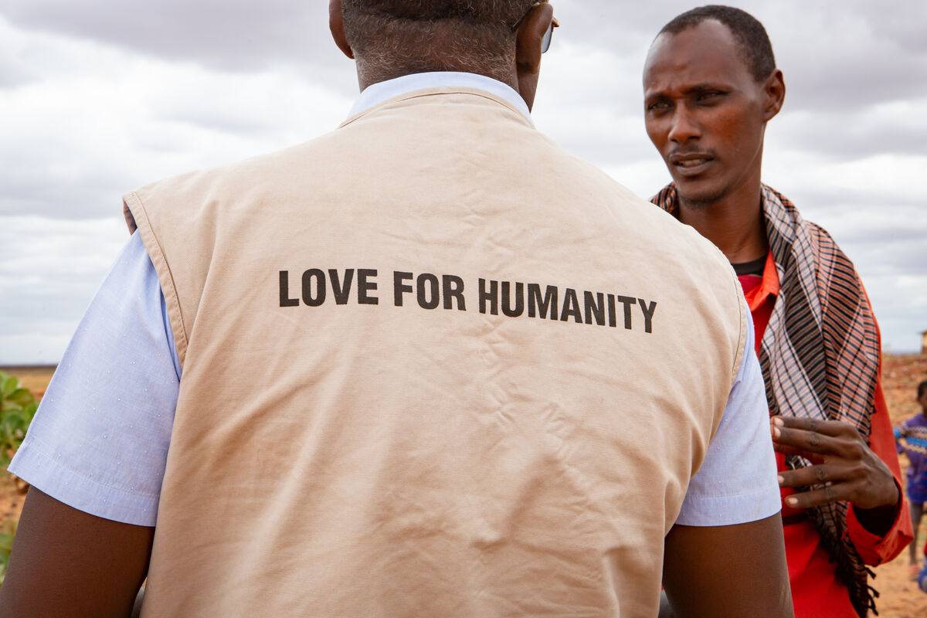
God calls us to love and care for all people no matter who they are, because we are all part of one global family.
We are called to help each other when things are difficult and to work together to make the world a better place for everyone to live in.
Caritas helping the community in northern Kenya
Notes:
Obayedul around the floating gardens, Bangladesh
Photo credit: Amit Rudro

Slide 13
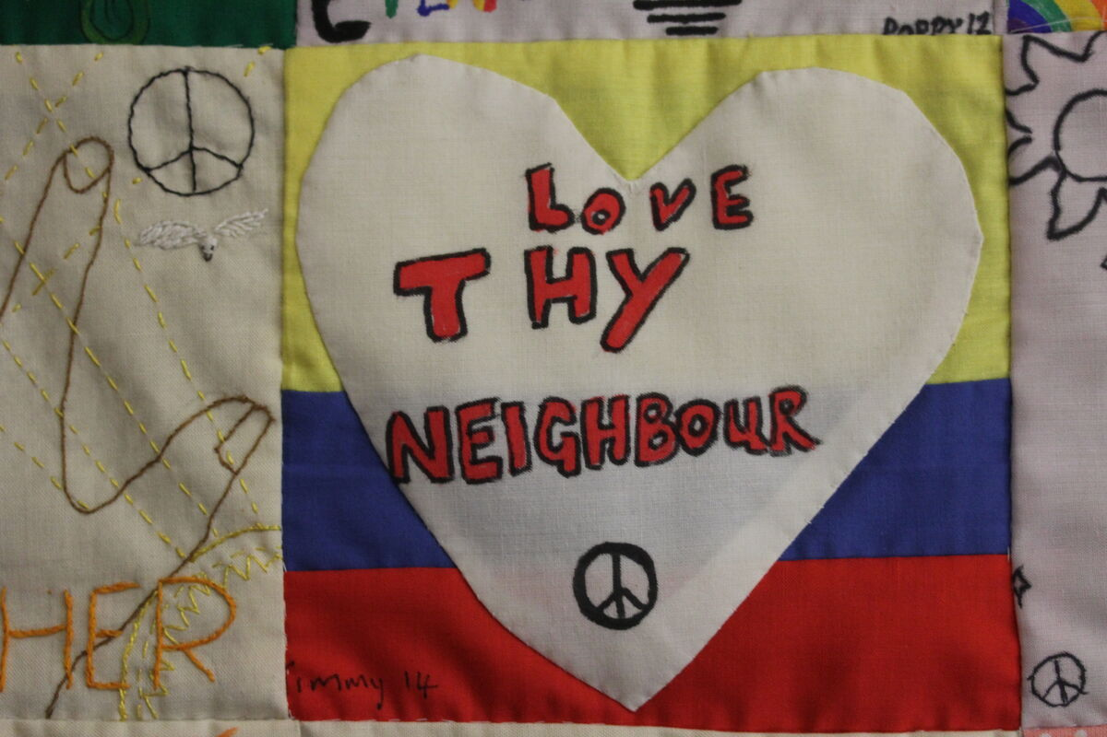
So this week let’s do what we can to help other people.
Let’s treat those who are different from us with kindness and respect.
Let’s share with others and try to live in peace.
Notes:
Hands On Magdalena Medio Norwich wall hanging, UK
Photo credit: Joe Savage

Slide 14
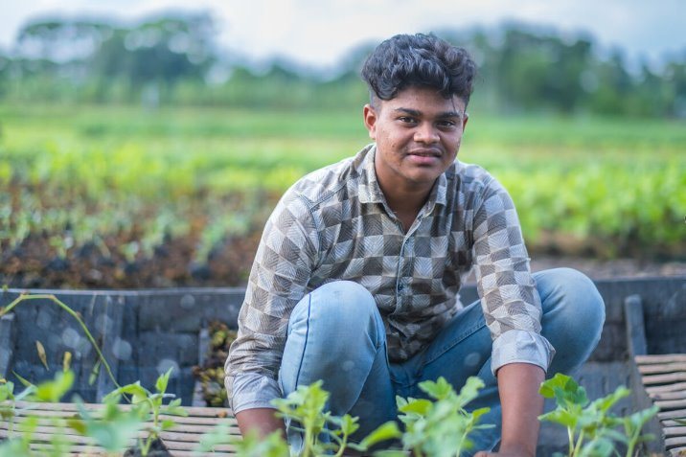
We can help our global brothers and sisters this Lent – people like Bayezid.
Sixteen-year-old Bayezid lives in a village called Choto Bashail in Bangladesh.
Bayezid has always helped his family grow vegetables on a floating garden plot.
But in recent years, growing crops has become very tough. Climate change has increased rainfall and too much rain can damage plants.
Notes:
Bayezid, Bangladesh
Photo credit: Amit Rudro

Slide 15
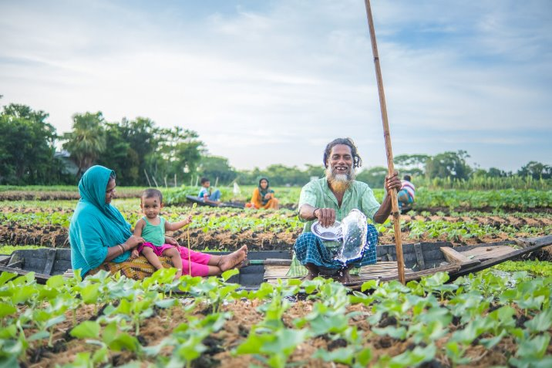
With CAFOD’s help, local experts work with families to build more floating gardens.
Because they are buoyant, the gardens rise with growing water levels, they are not flooded and the crops stay safe. It is a method that has been around for centuries.
Families are able to eat what they grow and sell what is leftover to buy other things they need.
Notes:
Salam Molla and his family at work
Photo credit: Amit Rudro

Slide 16

During Lent, we can pray for those living in poverty, asking God to be with them as they work hard to put food on the table for their families.
We can also do the Big Lent Walk to walk in solidarity with our brothers and sisters in need and get sponsored.
With the money you raise, CAFOD's local experts can help our global family to help themselves.
Notes:
Local market, Marsabit, northern Kenya
Photo credit: Louise Norton

Slide 17
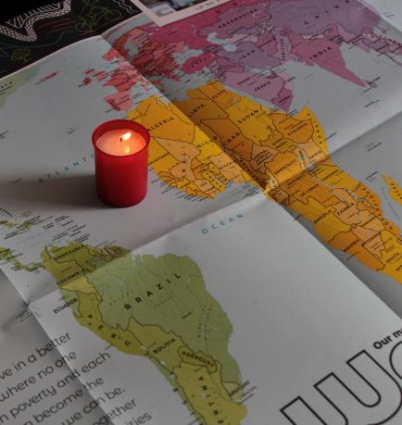
Let us pray
We pray for people who are treated badly because they are different:
that they may find comfort in God's love for all people.
Lord in your mercy…
We pray for our parish, families and friends:
that knowing we are all children of God, we may respect and care for all people around the world and encourage others to do the same.
Lord in your mercy...

Slide 18
Let us pray
We pray for the church around the world:
that she may follow Jesus' example and be welcoming to all, especially to those who are poor.
Lord in your mercy…
Caring God: fill our hearts with love for all your people. Move us to treat all people with kindness and respect and to work to make the world a better place for all of us to live in. Amen.

Slide 19
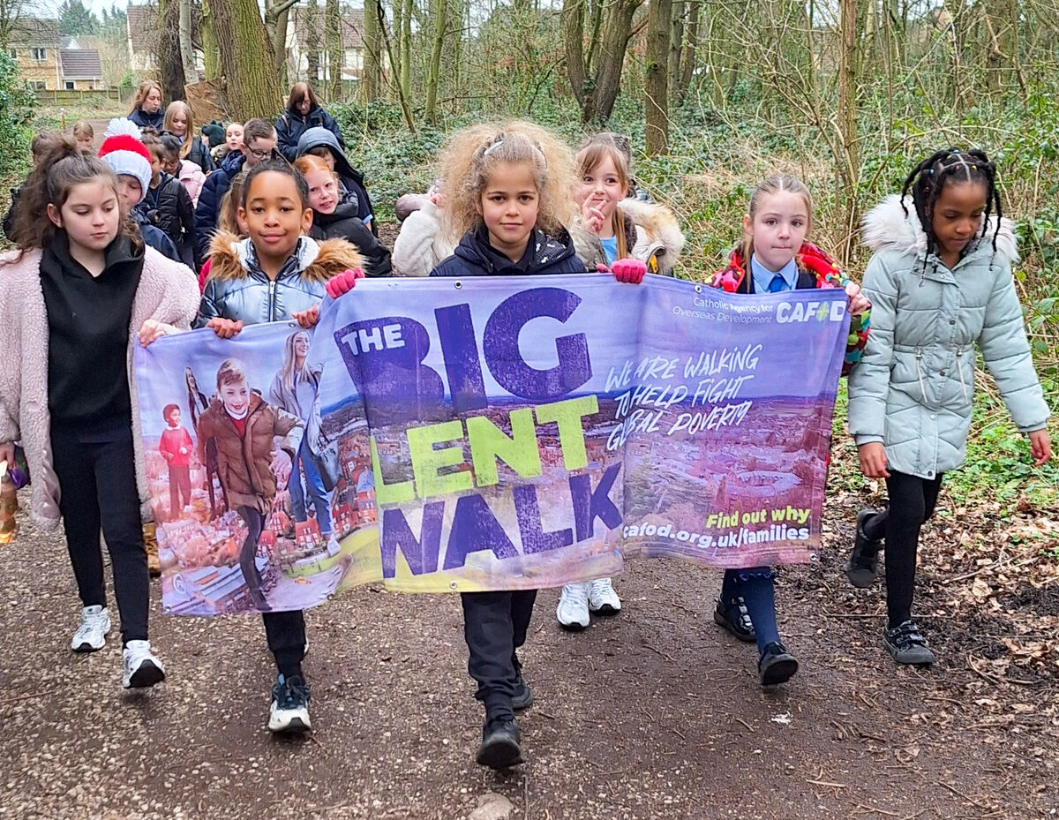

What will you do this week to show that you care for others?
Send
Notes:
Liverpool school children taking part in the Big Lent Walk
Photo credit: CAFOD Liverpool

Slide 20
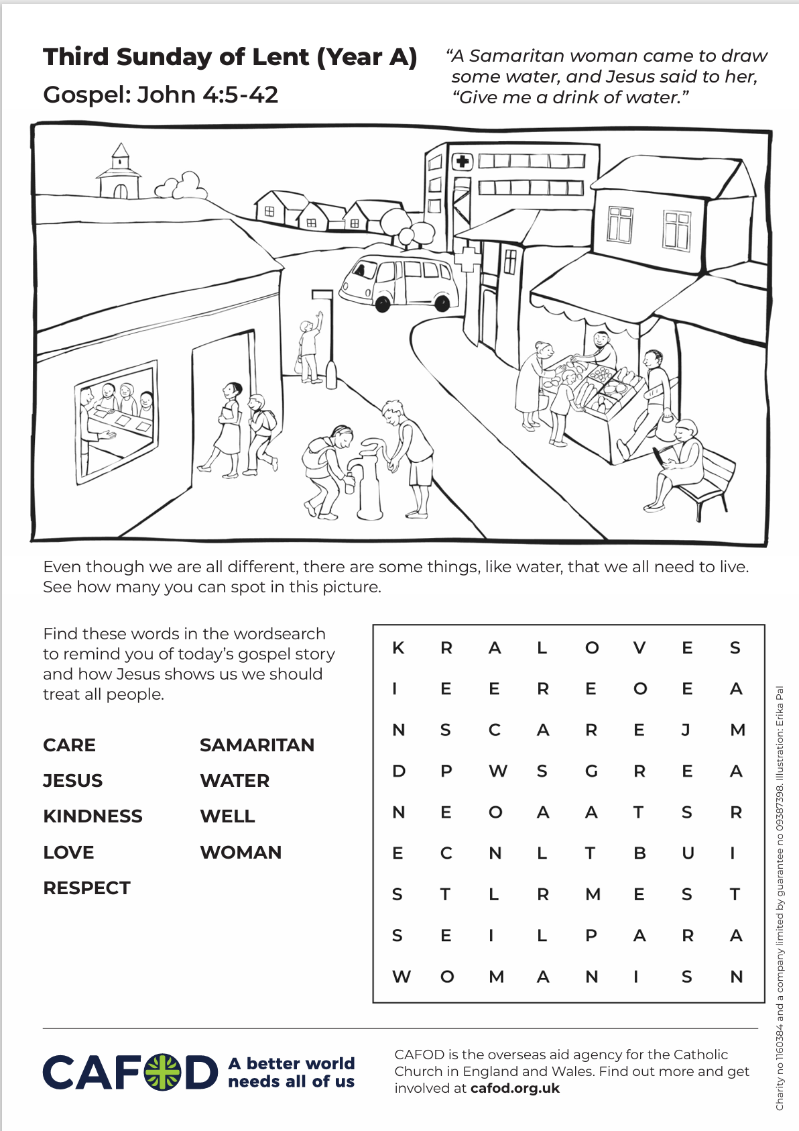
Activity suggestions
Download the illustration
Share the accompanying activity sheet with the children and encourage them to complete it, either in the liturgy or at home. Invite them to colour in the illustration and to see if they can spot in it all the things that we all need to live, no matter where we are in the world.
One thing that makes us different from others and which can lead to us not understanding them is the language that we speak. Check with the children if any of them speak another language at home. Invite them to share how to say hello in that language and get all the children to repeat it.
Why not share the examples on the following slide?
The Big Lent Walk 2026
Notes:
Illustration: Erika Pal

Slide 21
Kiswahili: Jambo (jam-boh)
Spanish: Hola (oh-lah)
French: Bonjour (bon-zhoor)
Mandarin: Ni hao (nee-haow)
Japanese: Konichiwa (kon-nee-chee-wah)
Hindi: Namaste (Nah-may-stay)
Arabic: Salaam a’alaykum (sal-ahm al-ay-kum)
Encourage the children to draw a picture of themselves in the middle of a piece of paper and to write five things about themselves. E.g. My name is…. I am …. years old. My eyes are … (colour). My hair is …. (colour). I like ….
Encourage the children to share what they have written so that they can see how different yet how similar they all are. Remind them that the differences between us are a good thing. How boring it would be if we were all the same!

Slide 22
Remind the children to share all that they have heard and thought about today with the people at home. Invite them to think about how they treat other people this week and to remember that God wants us to care for everyone, even if they are different. Remind them to do at least one thing this week to show how they care for others.
See Lent 2026 resources for primary schools for more child-friendly fundraising and other activities this Lent.
Notes:
Illustration: Erika Pal

Slide 23

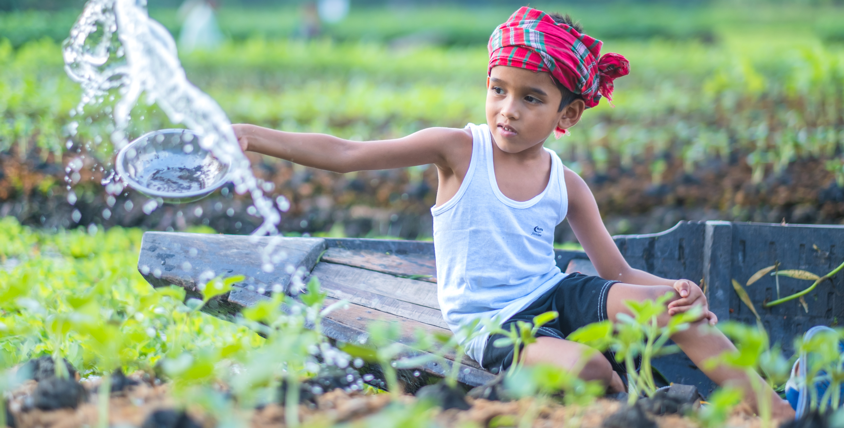
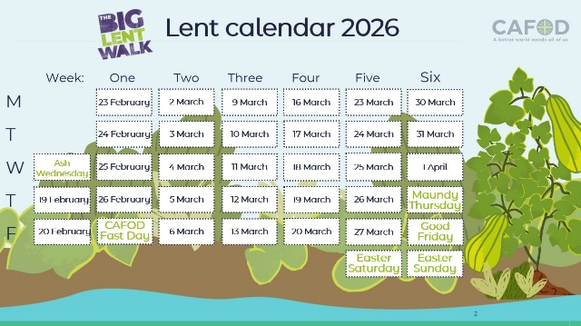
Get involved with CAFOD this term
Big Lent Walk resources
Lent national assembly
Lent resources
Join us on the Big Lent Walk!
Join our national assembly
Explore our Lent 2026 resources

Slide 24
