Slide 1
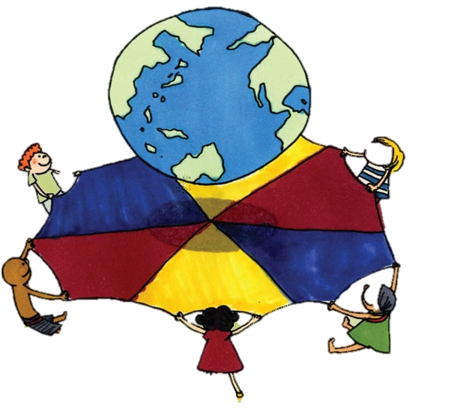
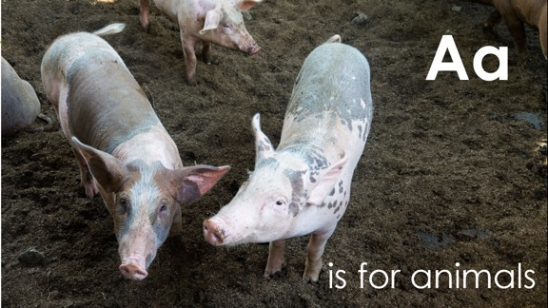
Global A-Z picture pack
26 alphabet slides with activities to support
global learning in EYFS and KS1
Notes:
Note:
You can use the contents page on the next slide to go to whichever letter you’d like.
The home button will return you to this A-Z menu.
The hand action button will display the activity for each letter.

Slide 3
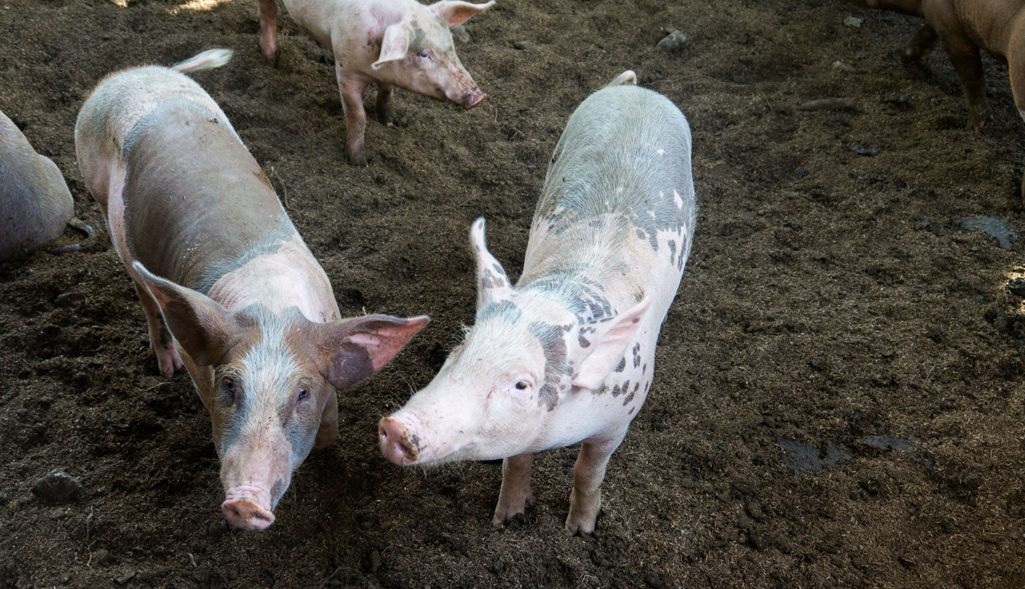
Aa
is for animals
Notes:
Photo credit: Hannah Caldwell I CAFOD (2018)
Pigs at the Babatngon Agro Forestry project in the Philippines supported by Caritas Palo.

Slide 4
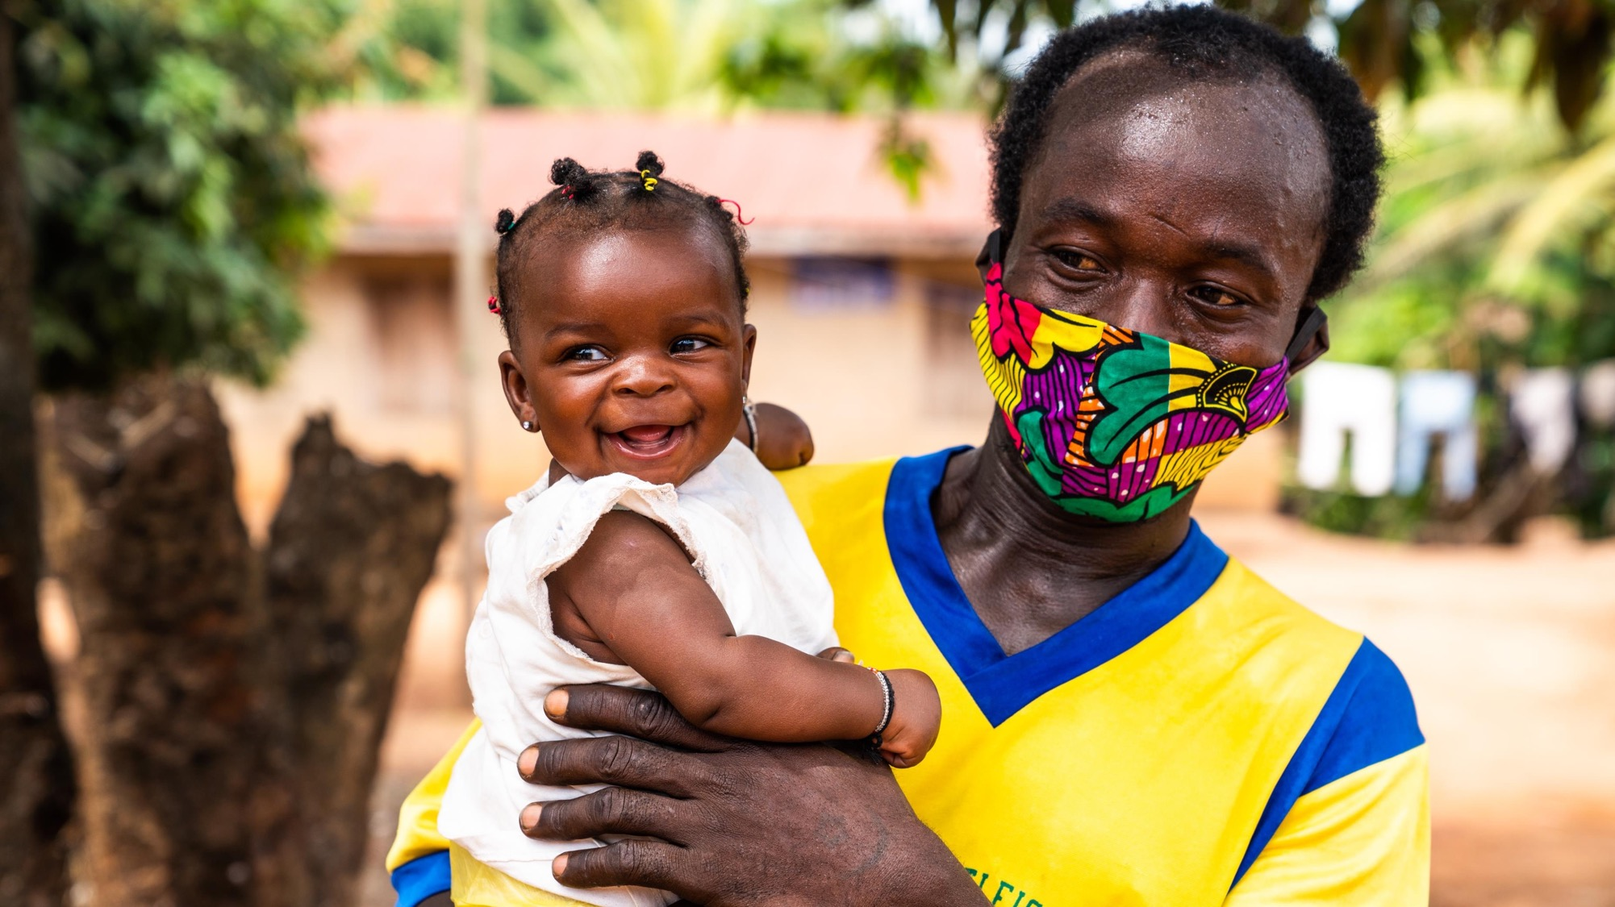
Bb
is for
baby
Notes:
Photo credit: Michael Duff (2021)
James, a farmer in Sierra Leone, with his baby.

Slide 5
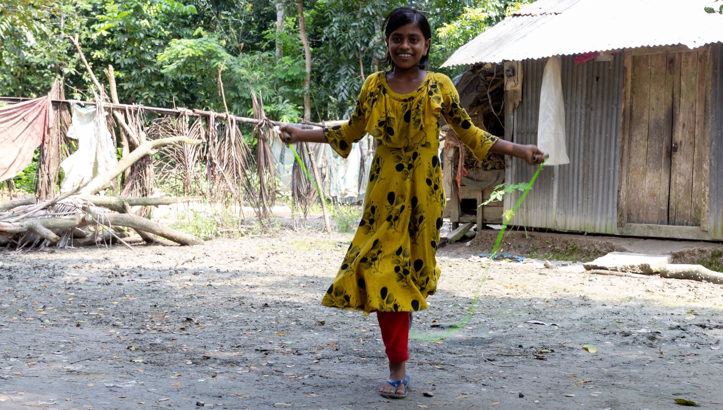
Cc
is for clothes
Notes:
Photo credit: Nazmul Shanji (2021) Maria (13 years old) lives in Bangladesh

Slide 6
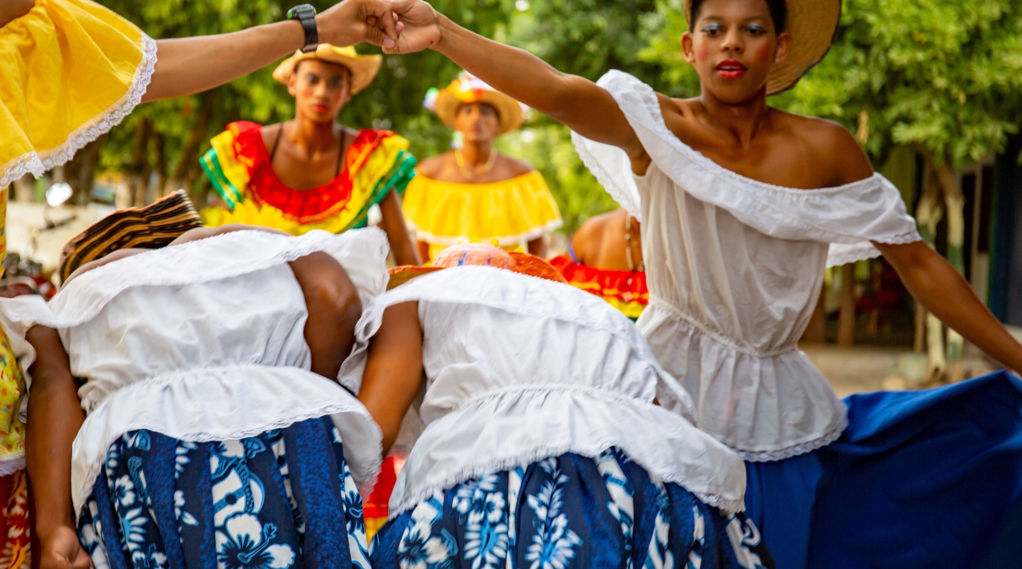
Dd
is for
dancing
Notes:
Photo credit: Louise Norton (2019) A traditional dance in Arenal, Colombia.

Slide 7
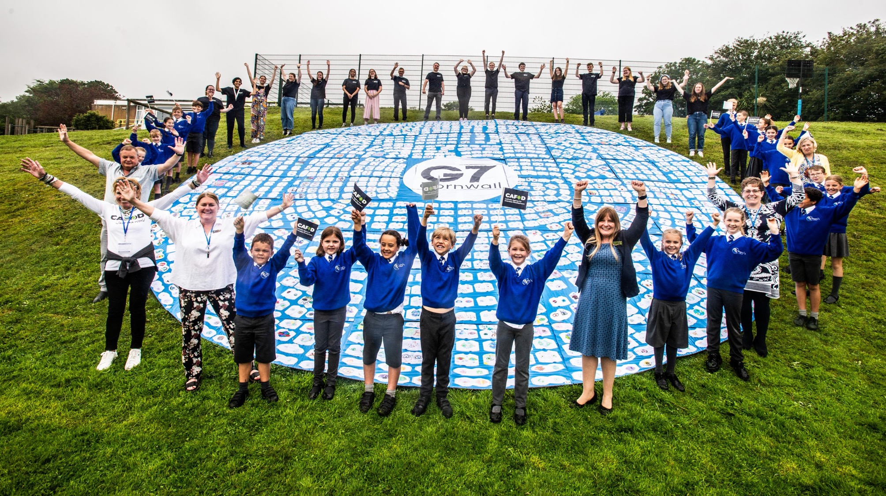
Ee
is for everyone
Notes:
Photo credit: Annie Bungeroth (2021)
School children in Falmouth, UK, with their eyes of the world art installation.

Slide 8
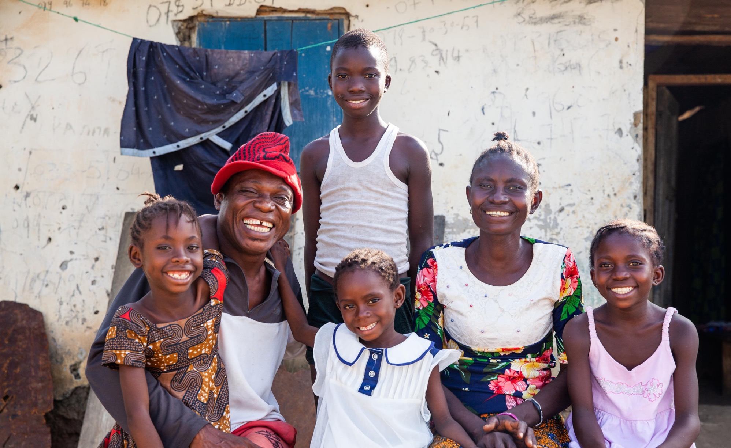
Ff
is for family
Notes:
Photo credit: Thom Flint (2021)
Ishmael and Lucia with their family in Sierra Leone.

Slide 9
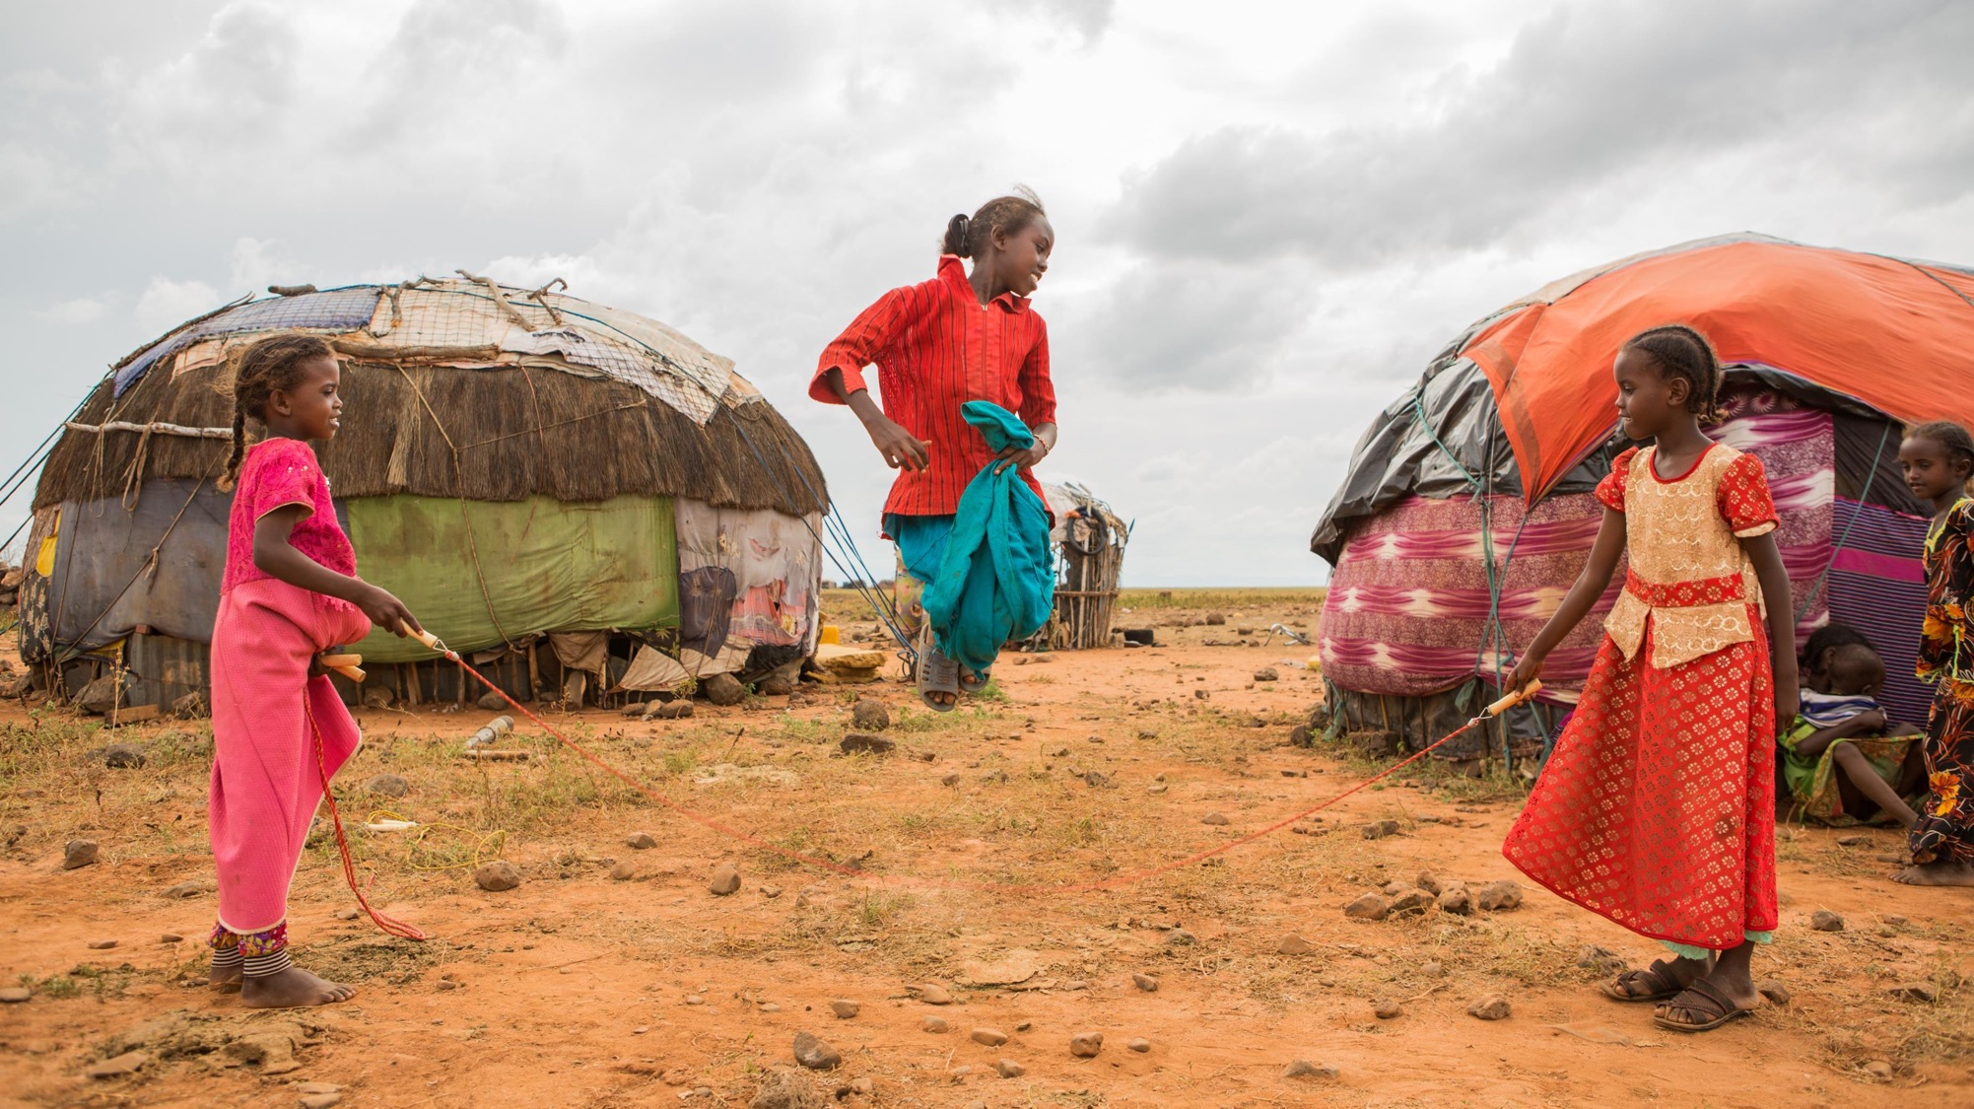
Gg
is for games
Notes:
Photo credit: Thom Flint (2018) Children skipping in Bubisa, Kenya

Slide 10
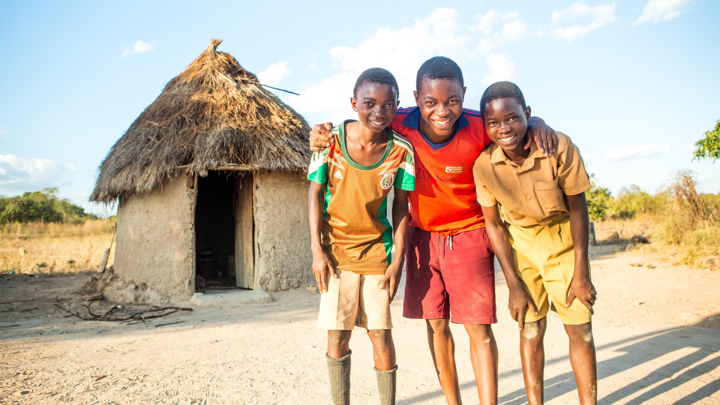
Hh
is for homes
Notes:
Photo credit: Thom Flint (2017)
Tinotenda with his twin brothers, Edward and Emmanuel, outside their home in Zimbabwe

Slide 11
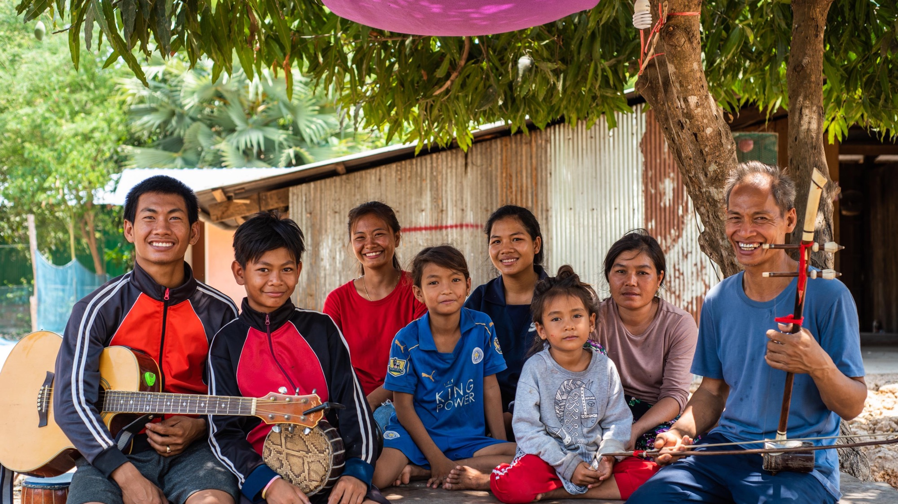
Ii
is for instruments
Notes:
Photo credit: Tom Chheat / KBO
Teachers and students in Cambodia.

Slide 12
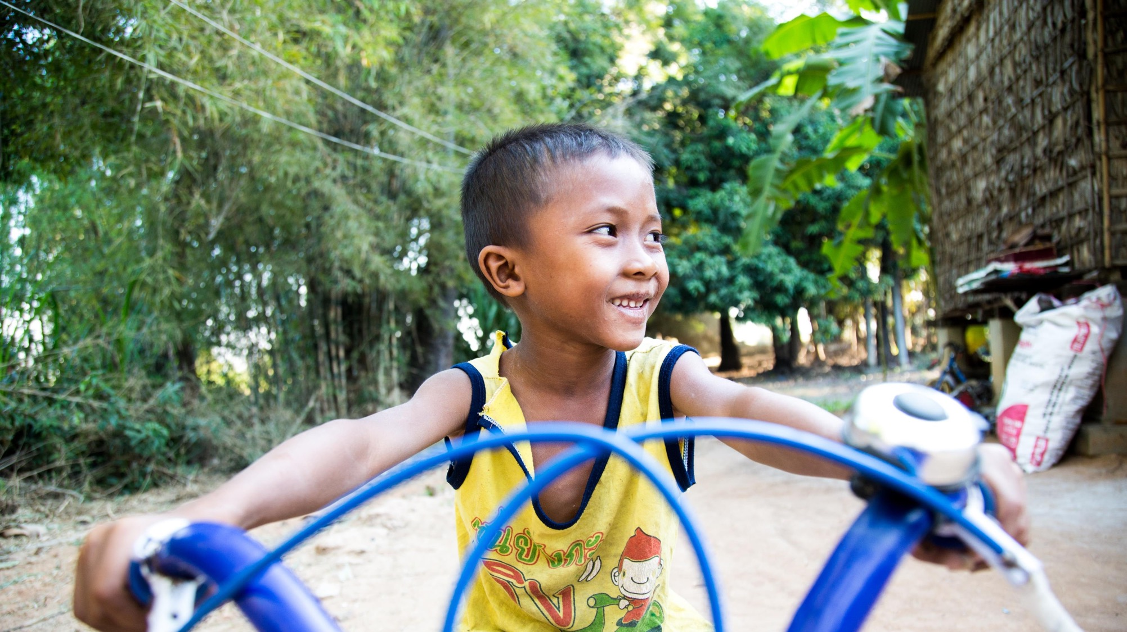
Jj
is for journey
Notes:
Photo credit: Chin Panhavion (2017)
8 year old Bun Li riding his bike outside his family’s home in Cambodia

Slide 13
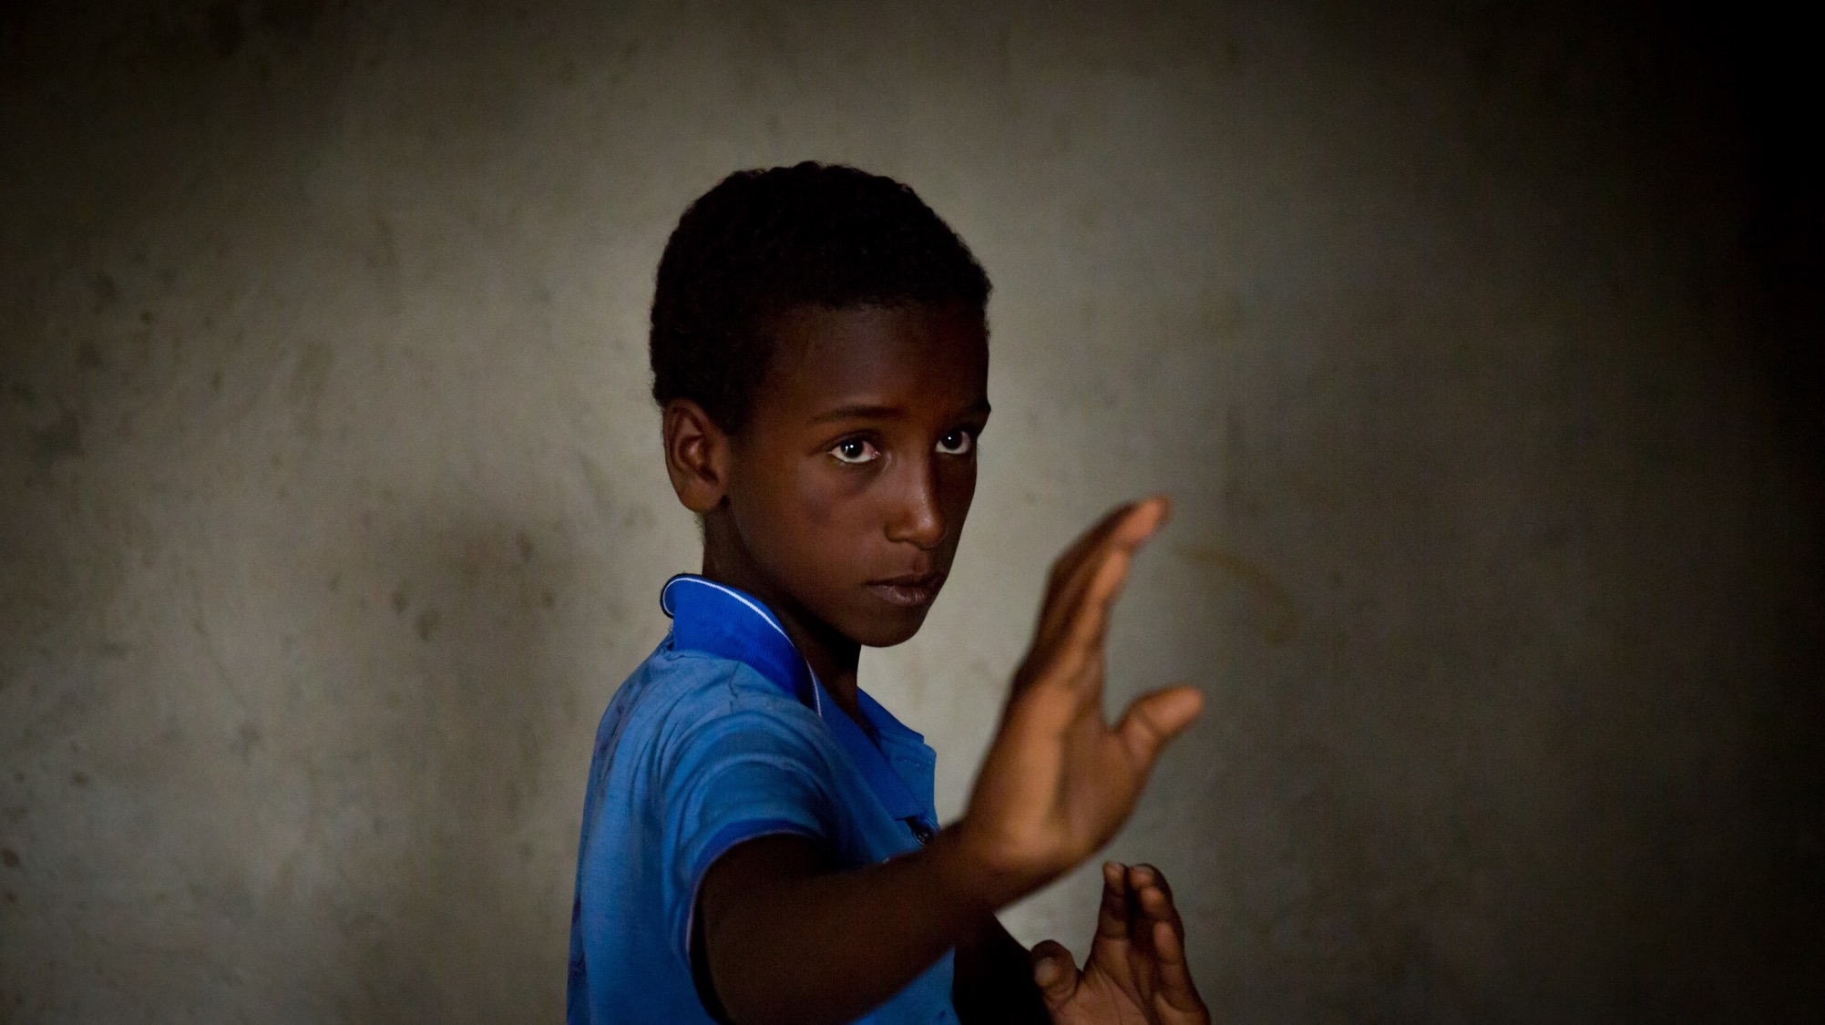
Kk
is for karate
Notes:
Photo credit: Louise Norton (2019)
Mohammed, age 11, from Ethiopia, loves doing karate.

Slide 14
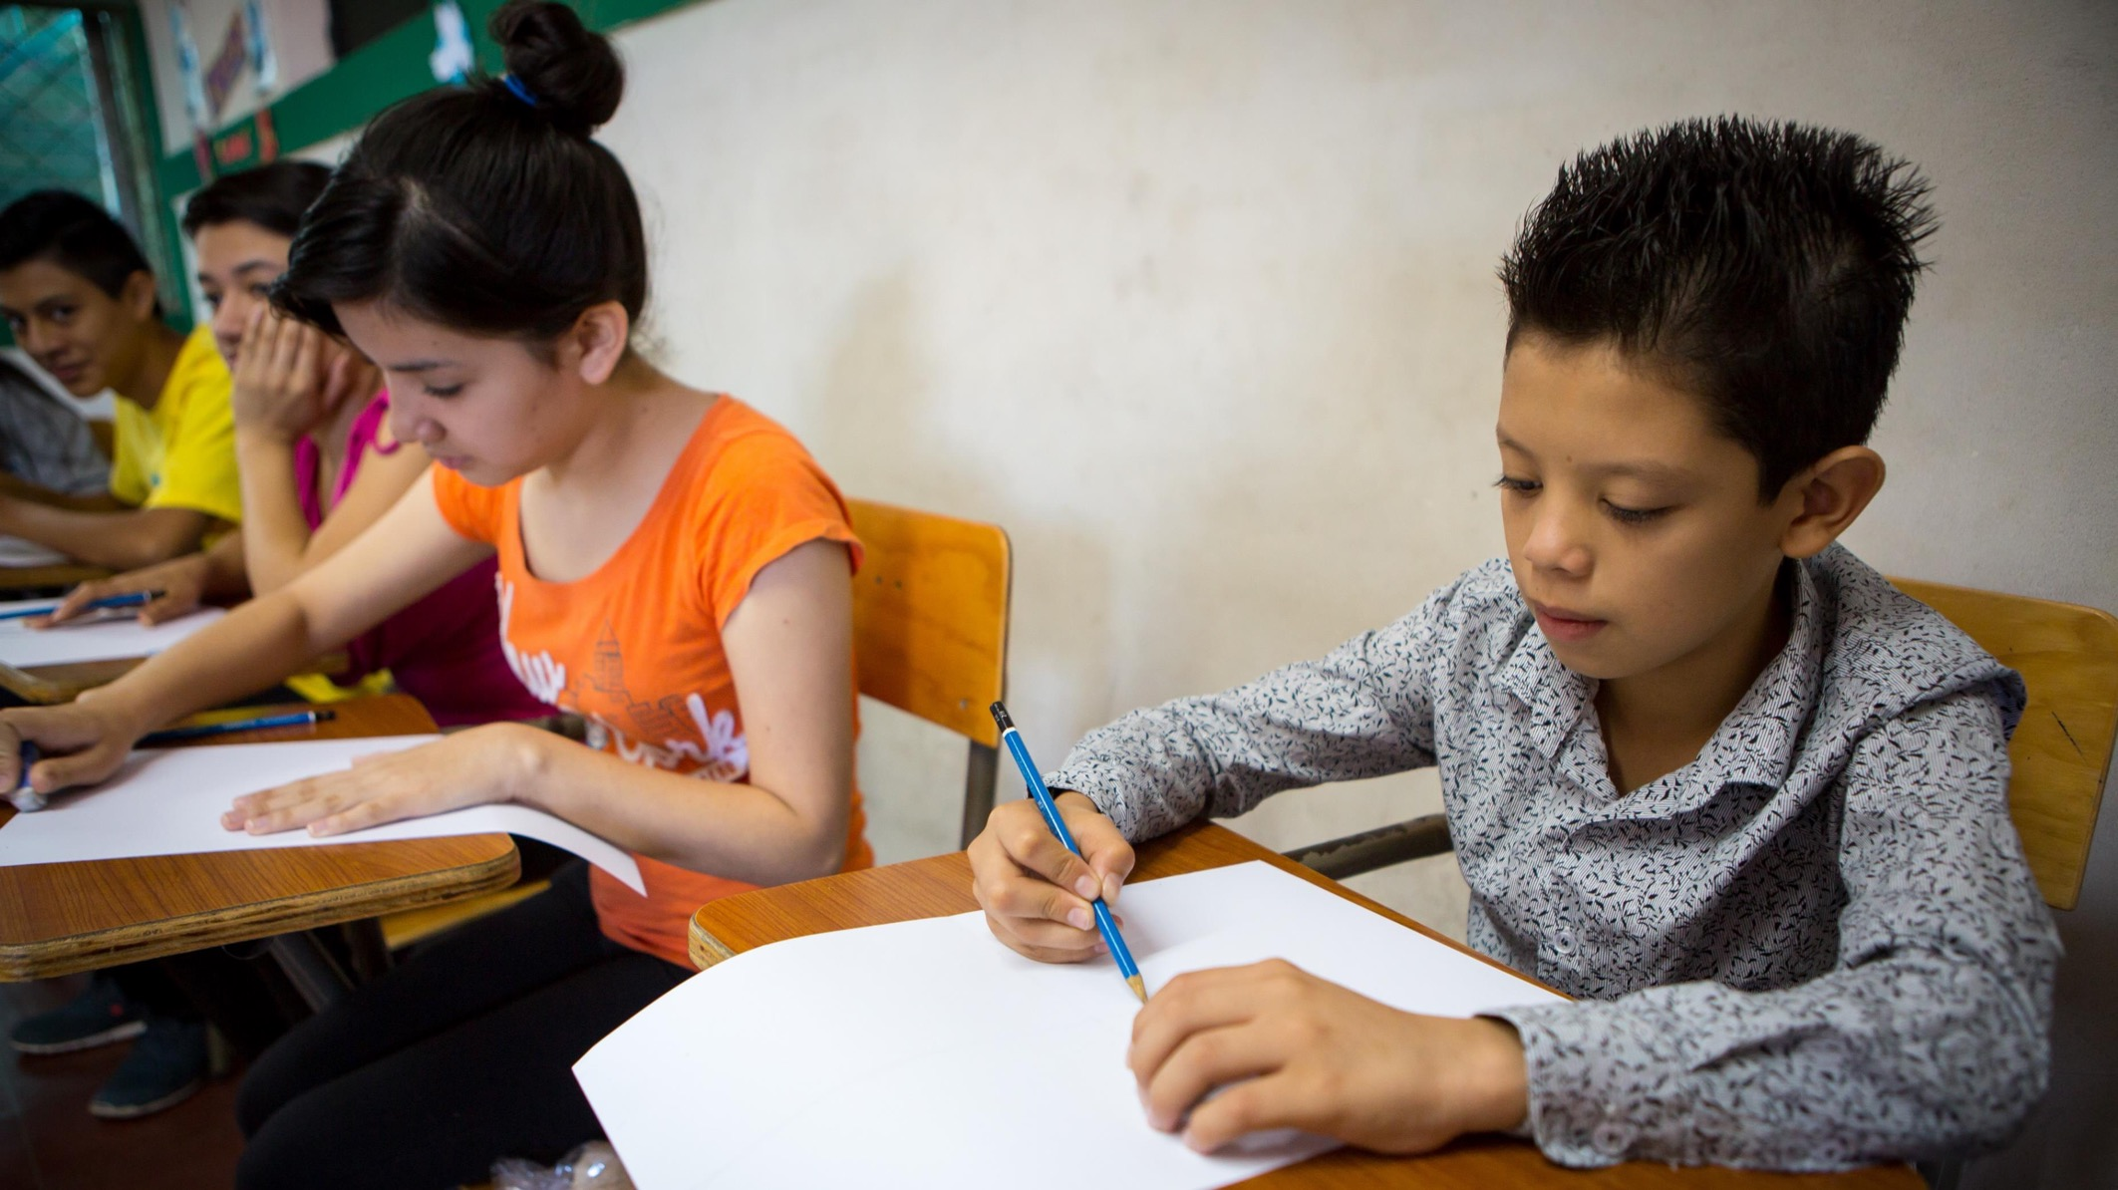
Ll
is for learning
Notes:
Photo credit: Louise Norton (2017)
Children in class in El Salvador.

Slide 15
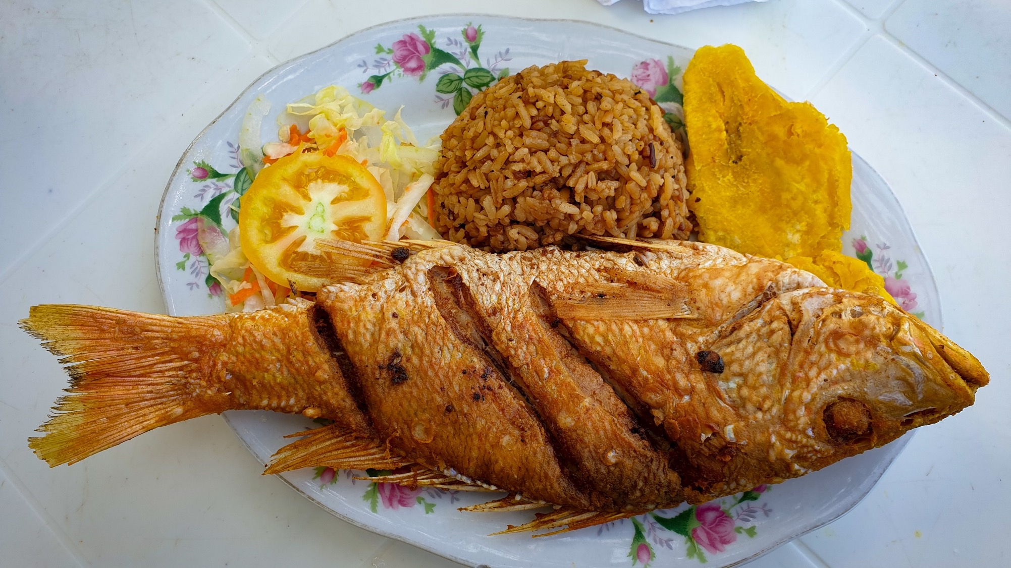
Mm
is for meals
Notes:
Photo credit: Sally Kitchener (2019)
Traditional Colombian coastal meal of fish, coconut rice and patacón.

Slide 16
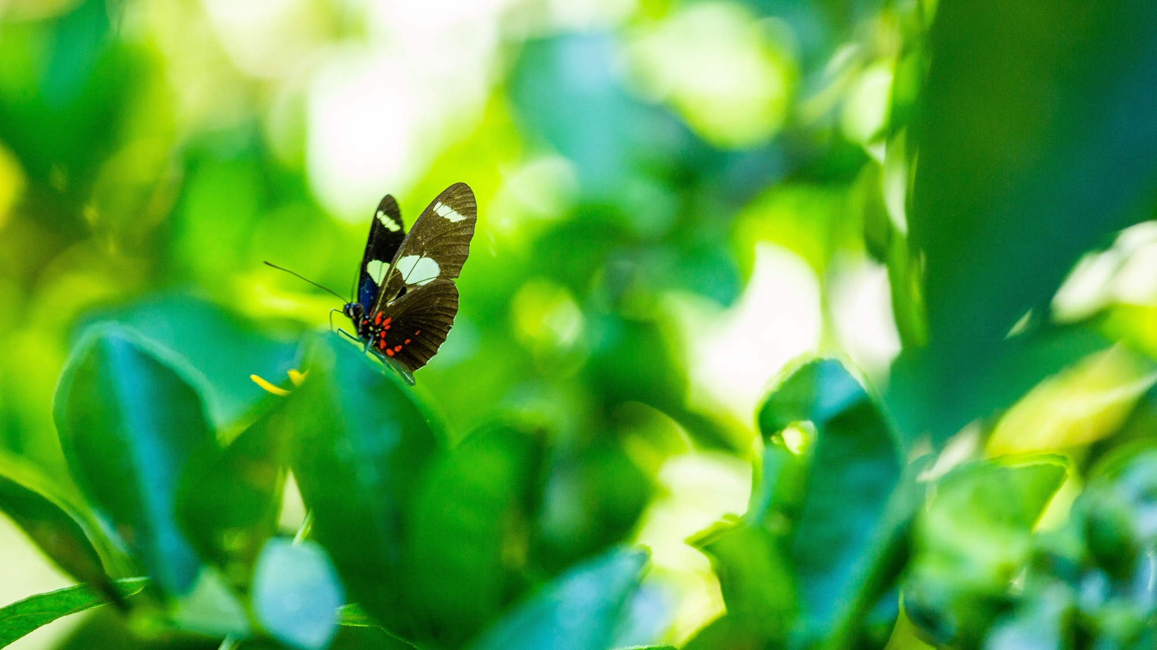
Nn
is for nature
Notes:
Photo credit: Thom Flint (2020)
A butterfly in Brazil

Slide 17
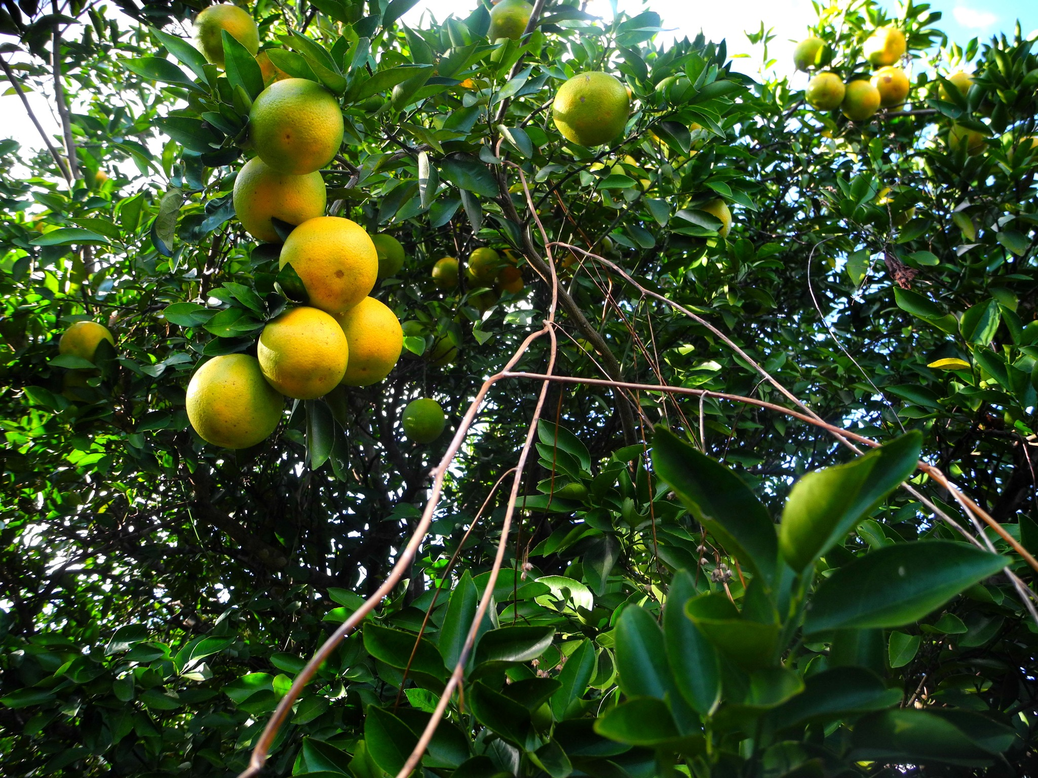
Oo
is for
orange
Notes:
Photo credit: Tania Dalton (2018)
Oranges growing in El Salvador.

Slide 18
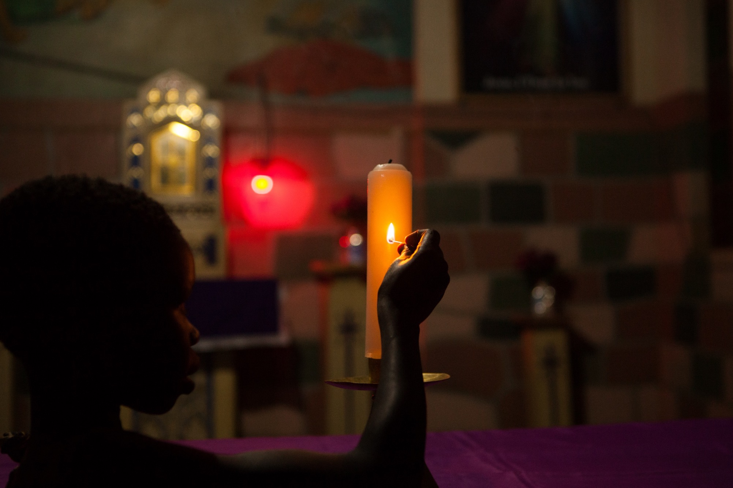
Pp
is for prayer
Notes:
Photo credit: Thom Flint (2019)
A girl lights a candle in Uganda.

Slide 19
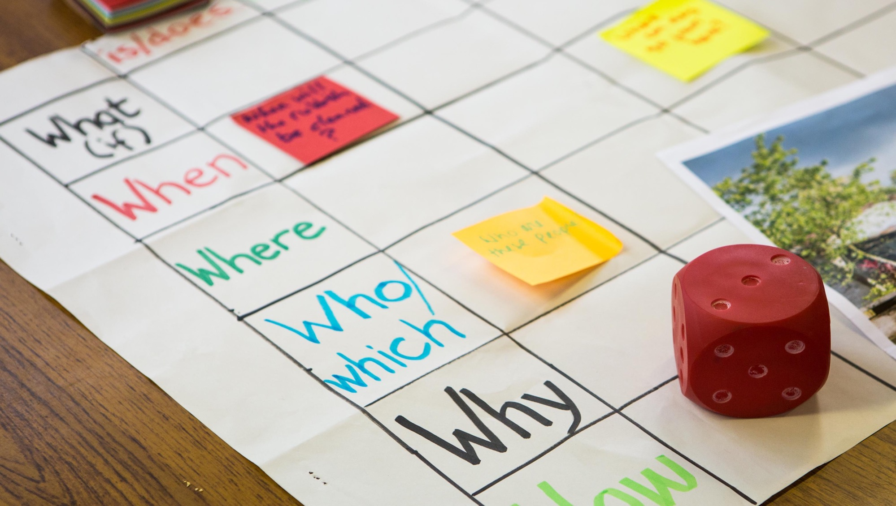
Qq
is for
questions
Notes:
Photo credit: Thom Flint (2019)
CAFOD CPD for teachers

Slide 20
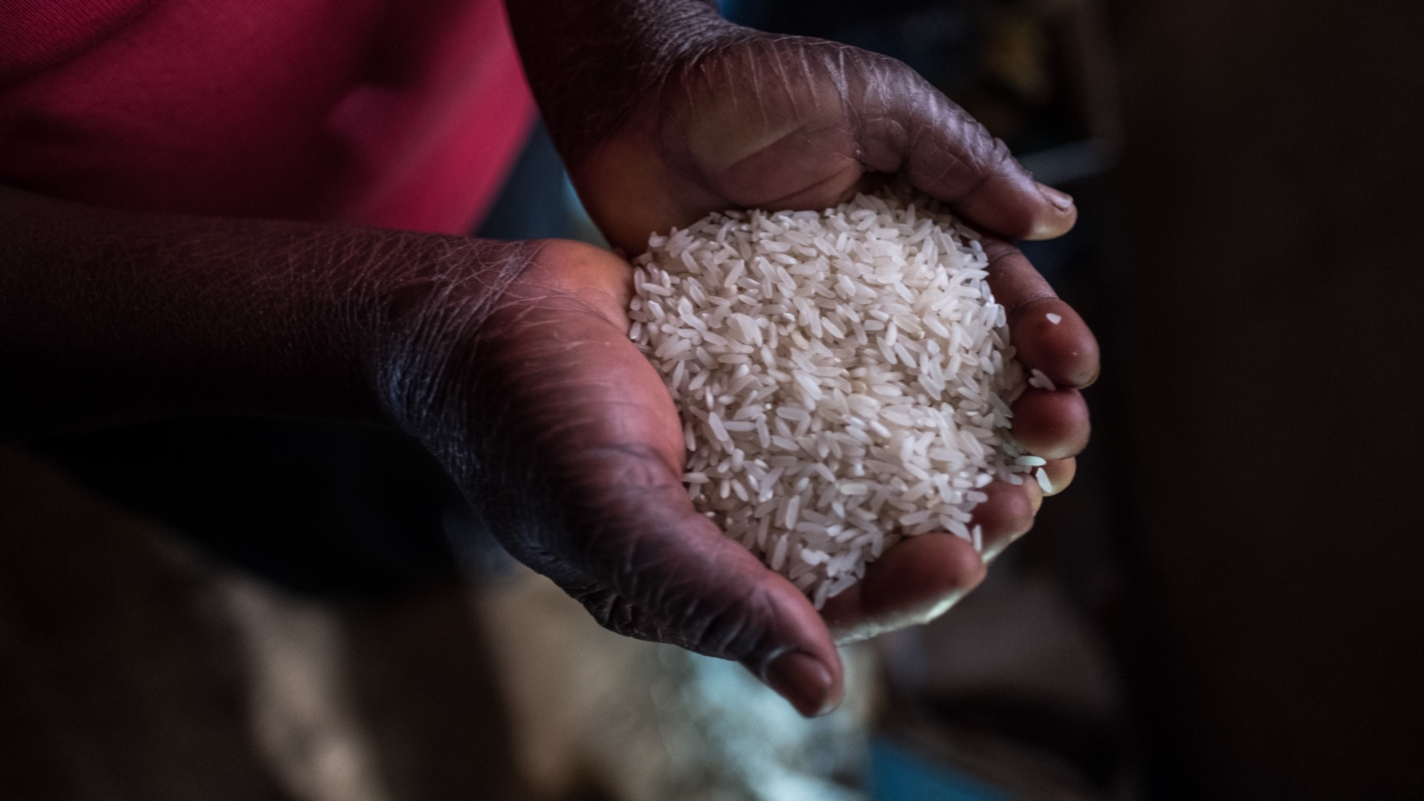
Rr
is for rice
Notes:
Photo credit: Tommy Trenchard/ Caritas Internationalis (2019)
Democratic Republic of the Congo (DRC)

Slide 21
Ss
is for sun
Notes:
Photo credit: Louise Norton (2019)
Sunrise in Ethiopia

Slide 22
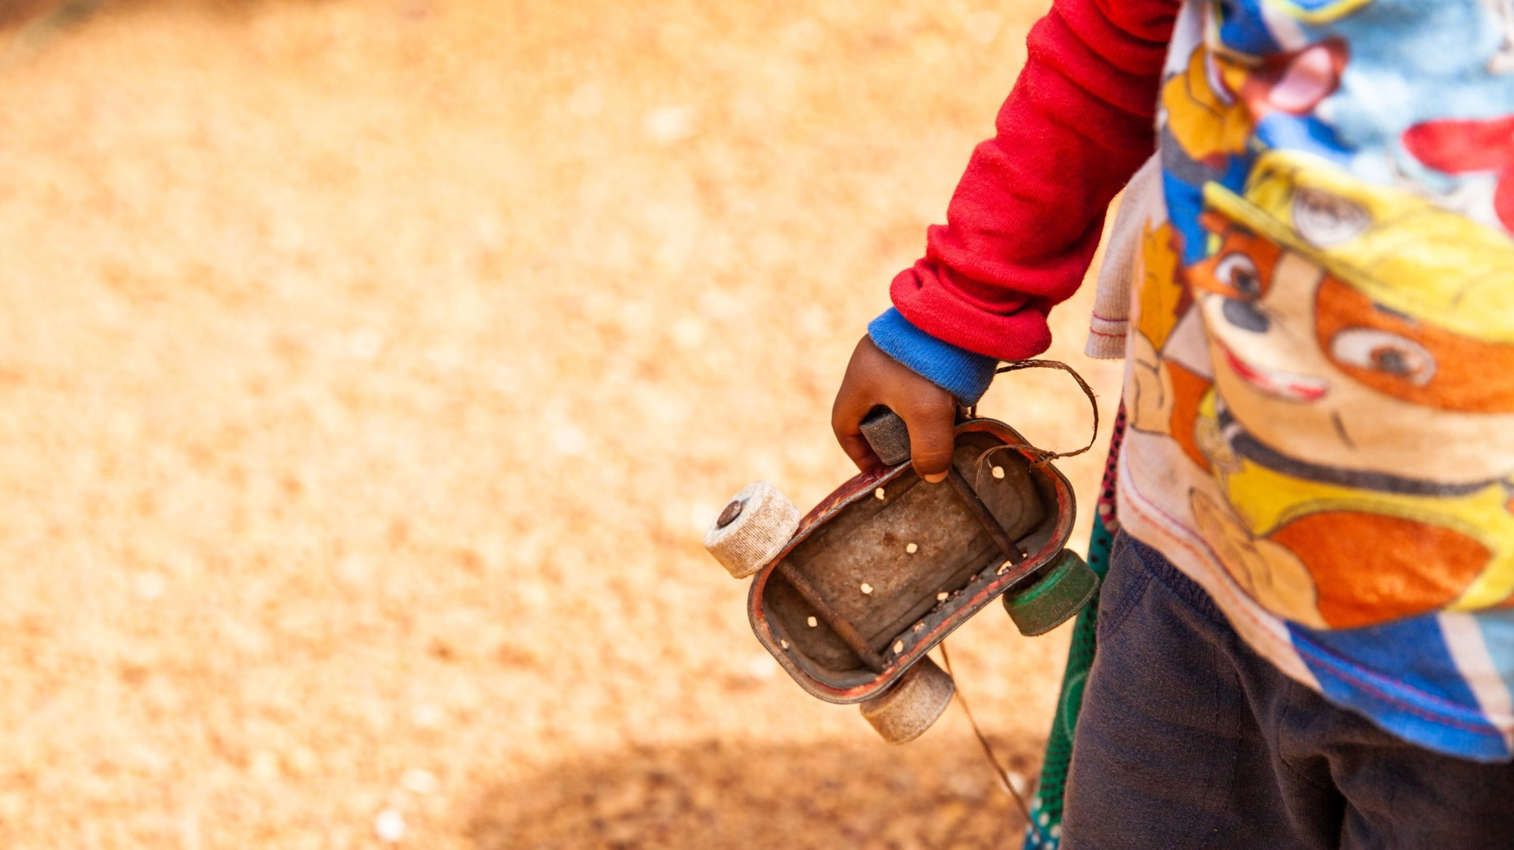
Tt
is for toys
Notes:
Photo credit: Thom Flint (2021)
3 year old Usman is holding a homemade toy car made from a used sardine can, in Sierra Leone

Slide 23
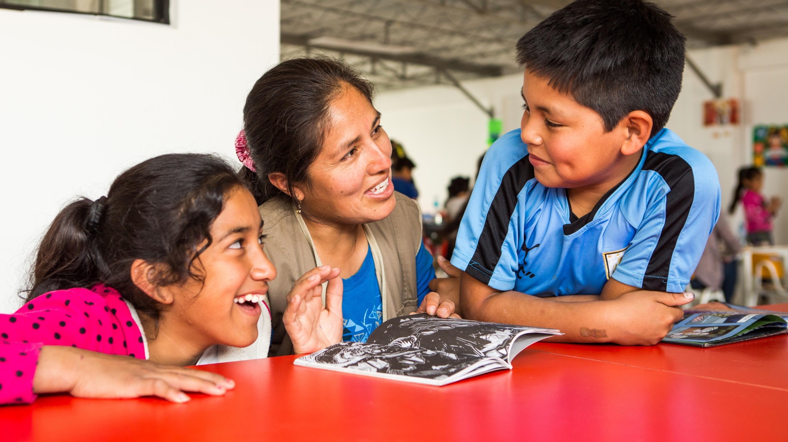
Uu
is for understanding
Notes:
Photo credit: Thom Flint (2017) Luz with Jean-Pierre and Esmerelda at the reading club in Peru.

Slide 24
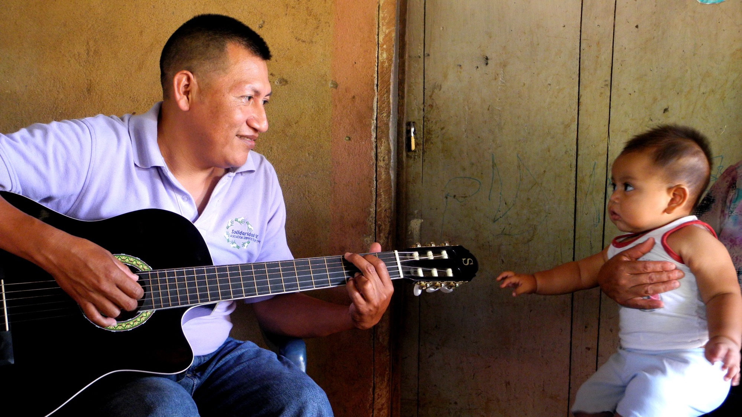
Vv
is for visitors
Notes:
Photo credit: Tania Dalton (2018)
Carlos, a local expert working for CAFOD partner Solidarity CVX in El Salvador, plays guitar whilst Julia’s baby looks on fascinated.

Slide 25
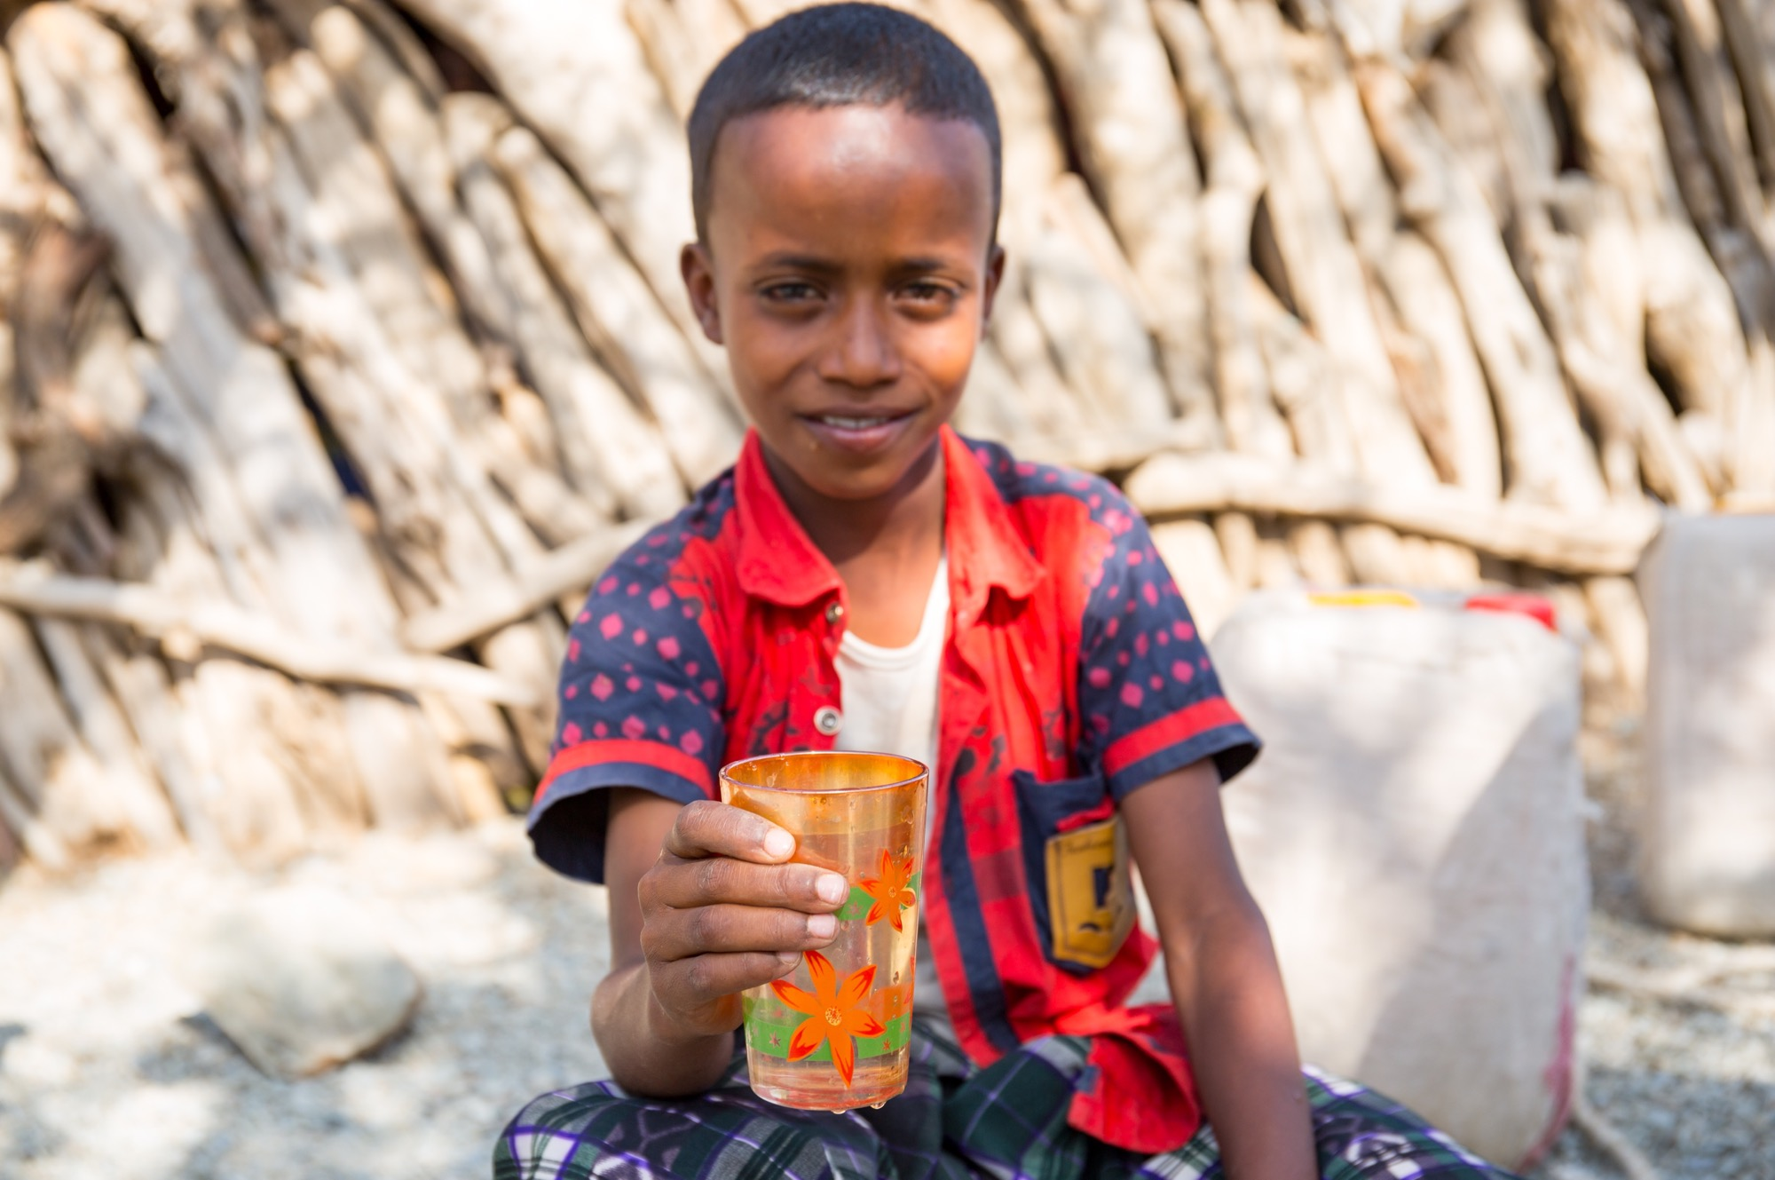
Ww
is for water
Notes:
Photo credit: Louise Norton (2019)
Abdul holding a glass of water in Ethiopia

Slide 26
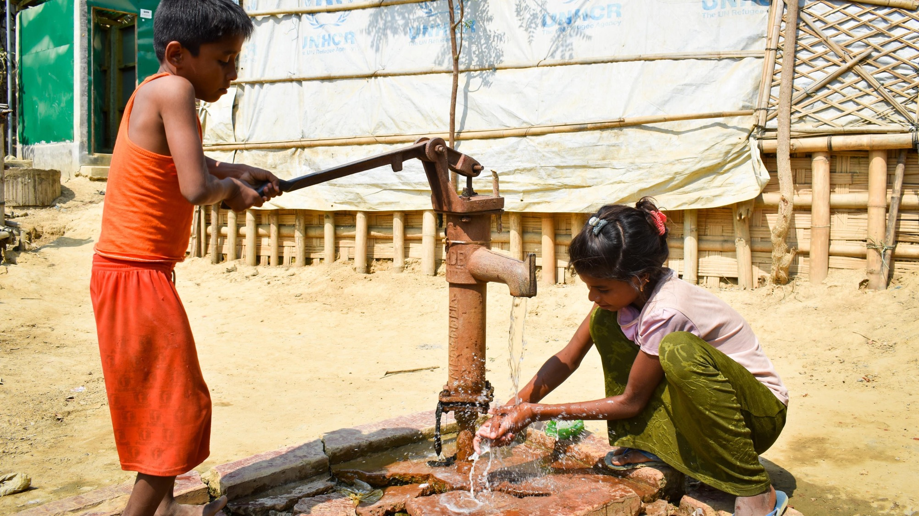
Xx
is for eXample
Notes:
Credit: Inmanuel Chayan Biswas/ Caritas Bangladesh
Children at a water pump in Bangladesh

Slide 27
Yy
is for you

Slide 28
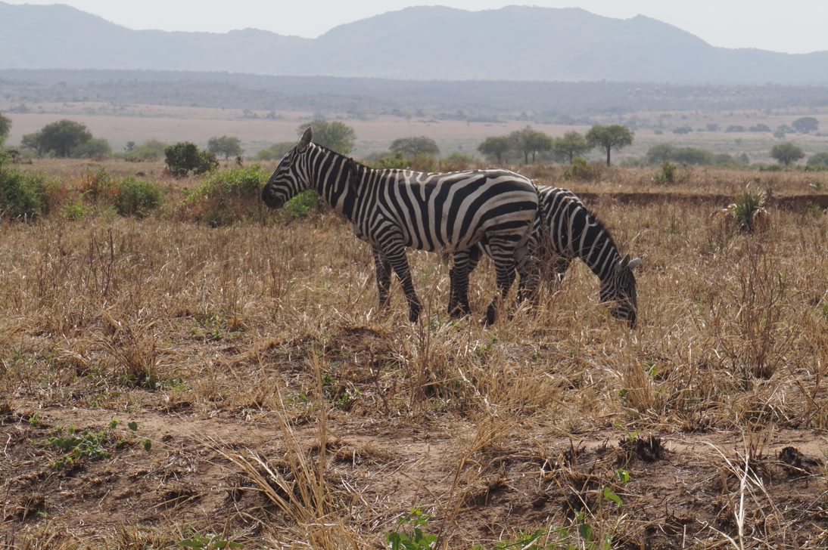
Zz
is for zebra
Notes:
Photo credit: Bethany Friery (2018)
Zebras in Karenga National Park, Karamoja, Uganda.

