Slide 1
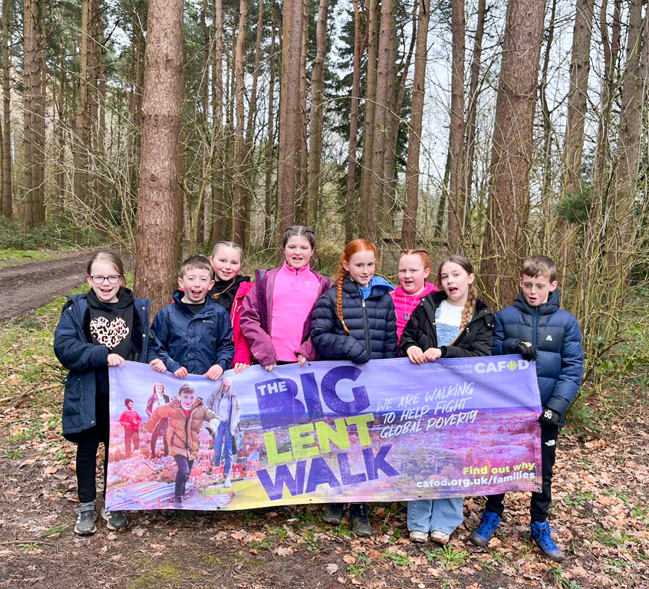
How will you make sure your love shines for others?
Gospel Celebration of the Word
Notes:
Children’s liturgy: Second Sunday of Lent (Year A)
Preparation of the worship space
Colour: purple
Song suggestions
Share the Light, Bernadette Farrell
Welcome
Today we hear about something very special that happened to Jesus while he was on a mountain with three of his friends. His appearance changed as his face and clothes shone like the sun. This also changed the lives of his friends as they realised that Jesus was the Son of God. We can make changes to how we live our lives to play our part in making the world a better place for everyone. Let’s think about how today.
The sun
Photo credit: Stock image

Slide 2
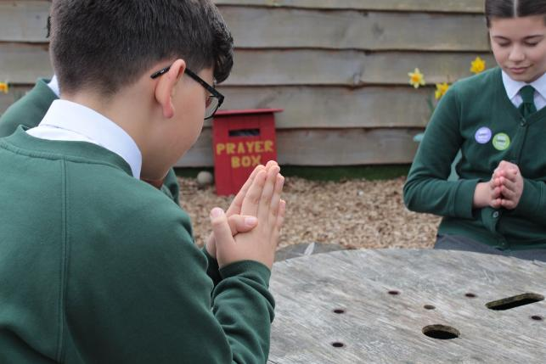

God of light and power, You sent your Son Jesus to show us how to live our lives. Help us to recognise him in all people we meet and to take action to change the world for the better. Amen.
  Gather
Notes:
St Francis Xavier's RC Primary School, Herefordshire
Photo credit: Vicky Ahmed

Slide 3

Gospel: Matthew 17 1-9
Six days later Jesus took with him Peter and the brothers James and John and led them up a high mountain where they were alone. As they looked on, a change came over Jesus: his face was shining like the sun, and his clothes were dazzling white.
Then the three disciples saw Moses and Elijah talking with Jesus. So Peter spoke up and said to Jesus, “Lord, how good it is that we are here! If you wish, I will make three tents here, one for you, one for Moses, and one for Elijah.”
While he was talking, a shining cloud came over them, and a voice from the cloud said, “This is my own dear Son, with whom I am pleased – listen to him!”
Word

Slide 4
When the disciples heard the voice, they were so terrified that they threw themselves face downwards on the ground. Jesus came to them and touched them. “Get up,” he said. “Don’t be afraid!” So they looked up and saw no one there but Jesus.
As they came down the mountain, Jesus ordered them, “Don’t tell anyone about this vision you have seen until the Son of Man has been raised from death.”

Slide 5


What do you remember from the Gospel reading?
Jesus goes to the top of a mountain with Peter, James and John. When he gets there his appearance changes – his face and clothes shine with light.
How do you think the disciples feel when they see this?
A voice then comes from a cloud, saying: “This is my Son, the Beloved. Listen to him.”
Respond
Notes:
Clouds
Photo credit: Stock image
Shaking hands
Photo credit: Marlis Trio Akbar on Unsplash
Anuarite Kahindo sharing milk with her children, DRC
Photo credit: Arlette Bashizi

Slide 6
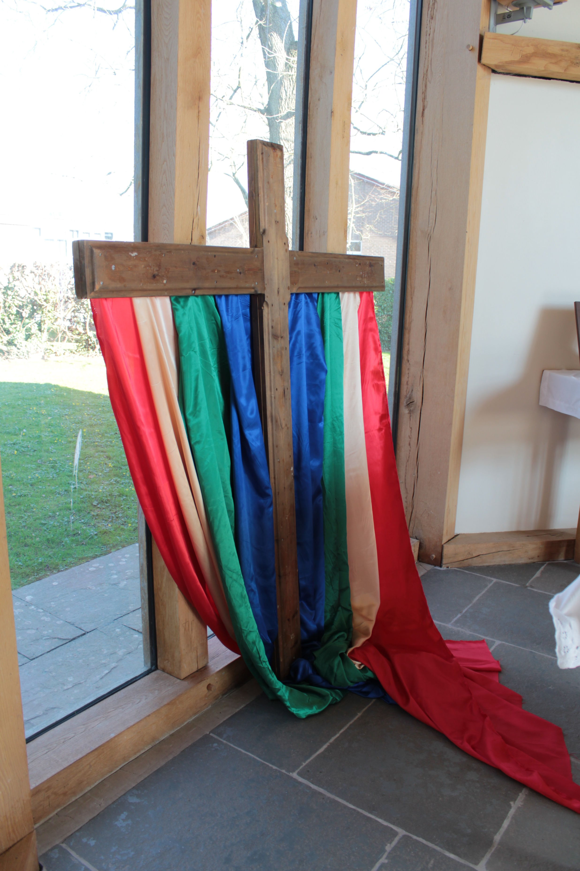
Whose voice do you think this is?
How do you think the disciples feel when they hear God’s voice?
The disciples are very afraid, but Jesus tells them not to be. Then everything looks normal again.
How do you think we can listen to God?
Do we need to climb a mountain?
Notes:
St Mary’s High School, Herefordshire
Photo credit: Vicky Ahmed

Slide 7
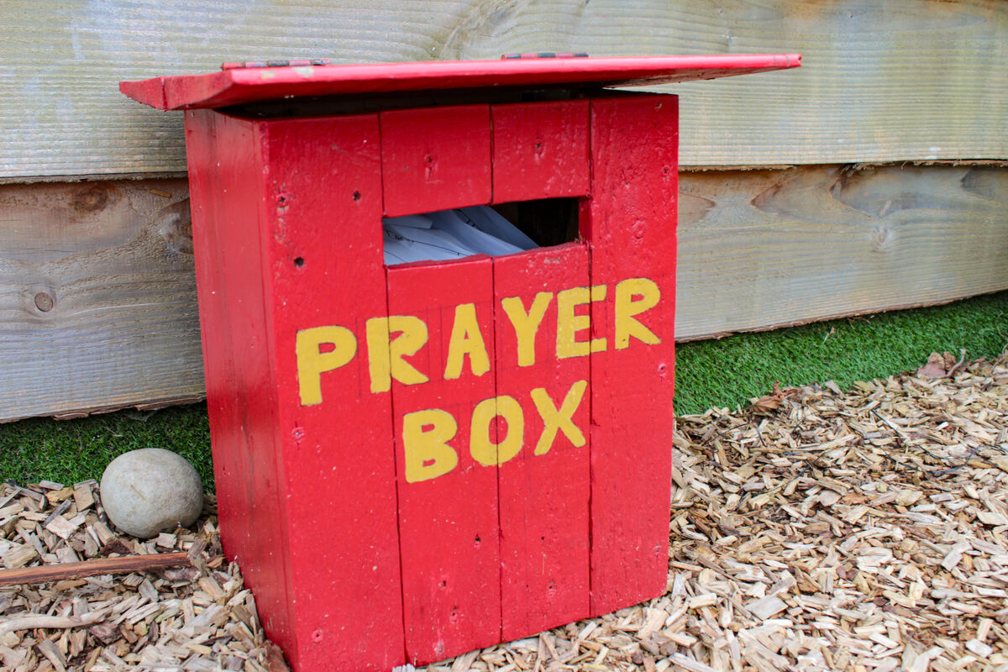
We can hear God’s voice when we stop and pray; when we make time for God in our lives. And when we make the right choices in how we treat others.
The disciples’ lives are changed by what happened on the mountain.
They now know just how special Jesus is – that he is God’s Son. They have seen his face shine like the sun and they have heard God speak to them.
Notes:
St Francis Xavier's RC Primary School, Herefordshire
Photo credit: Vicky Ahmed

Slide 8
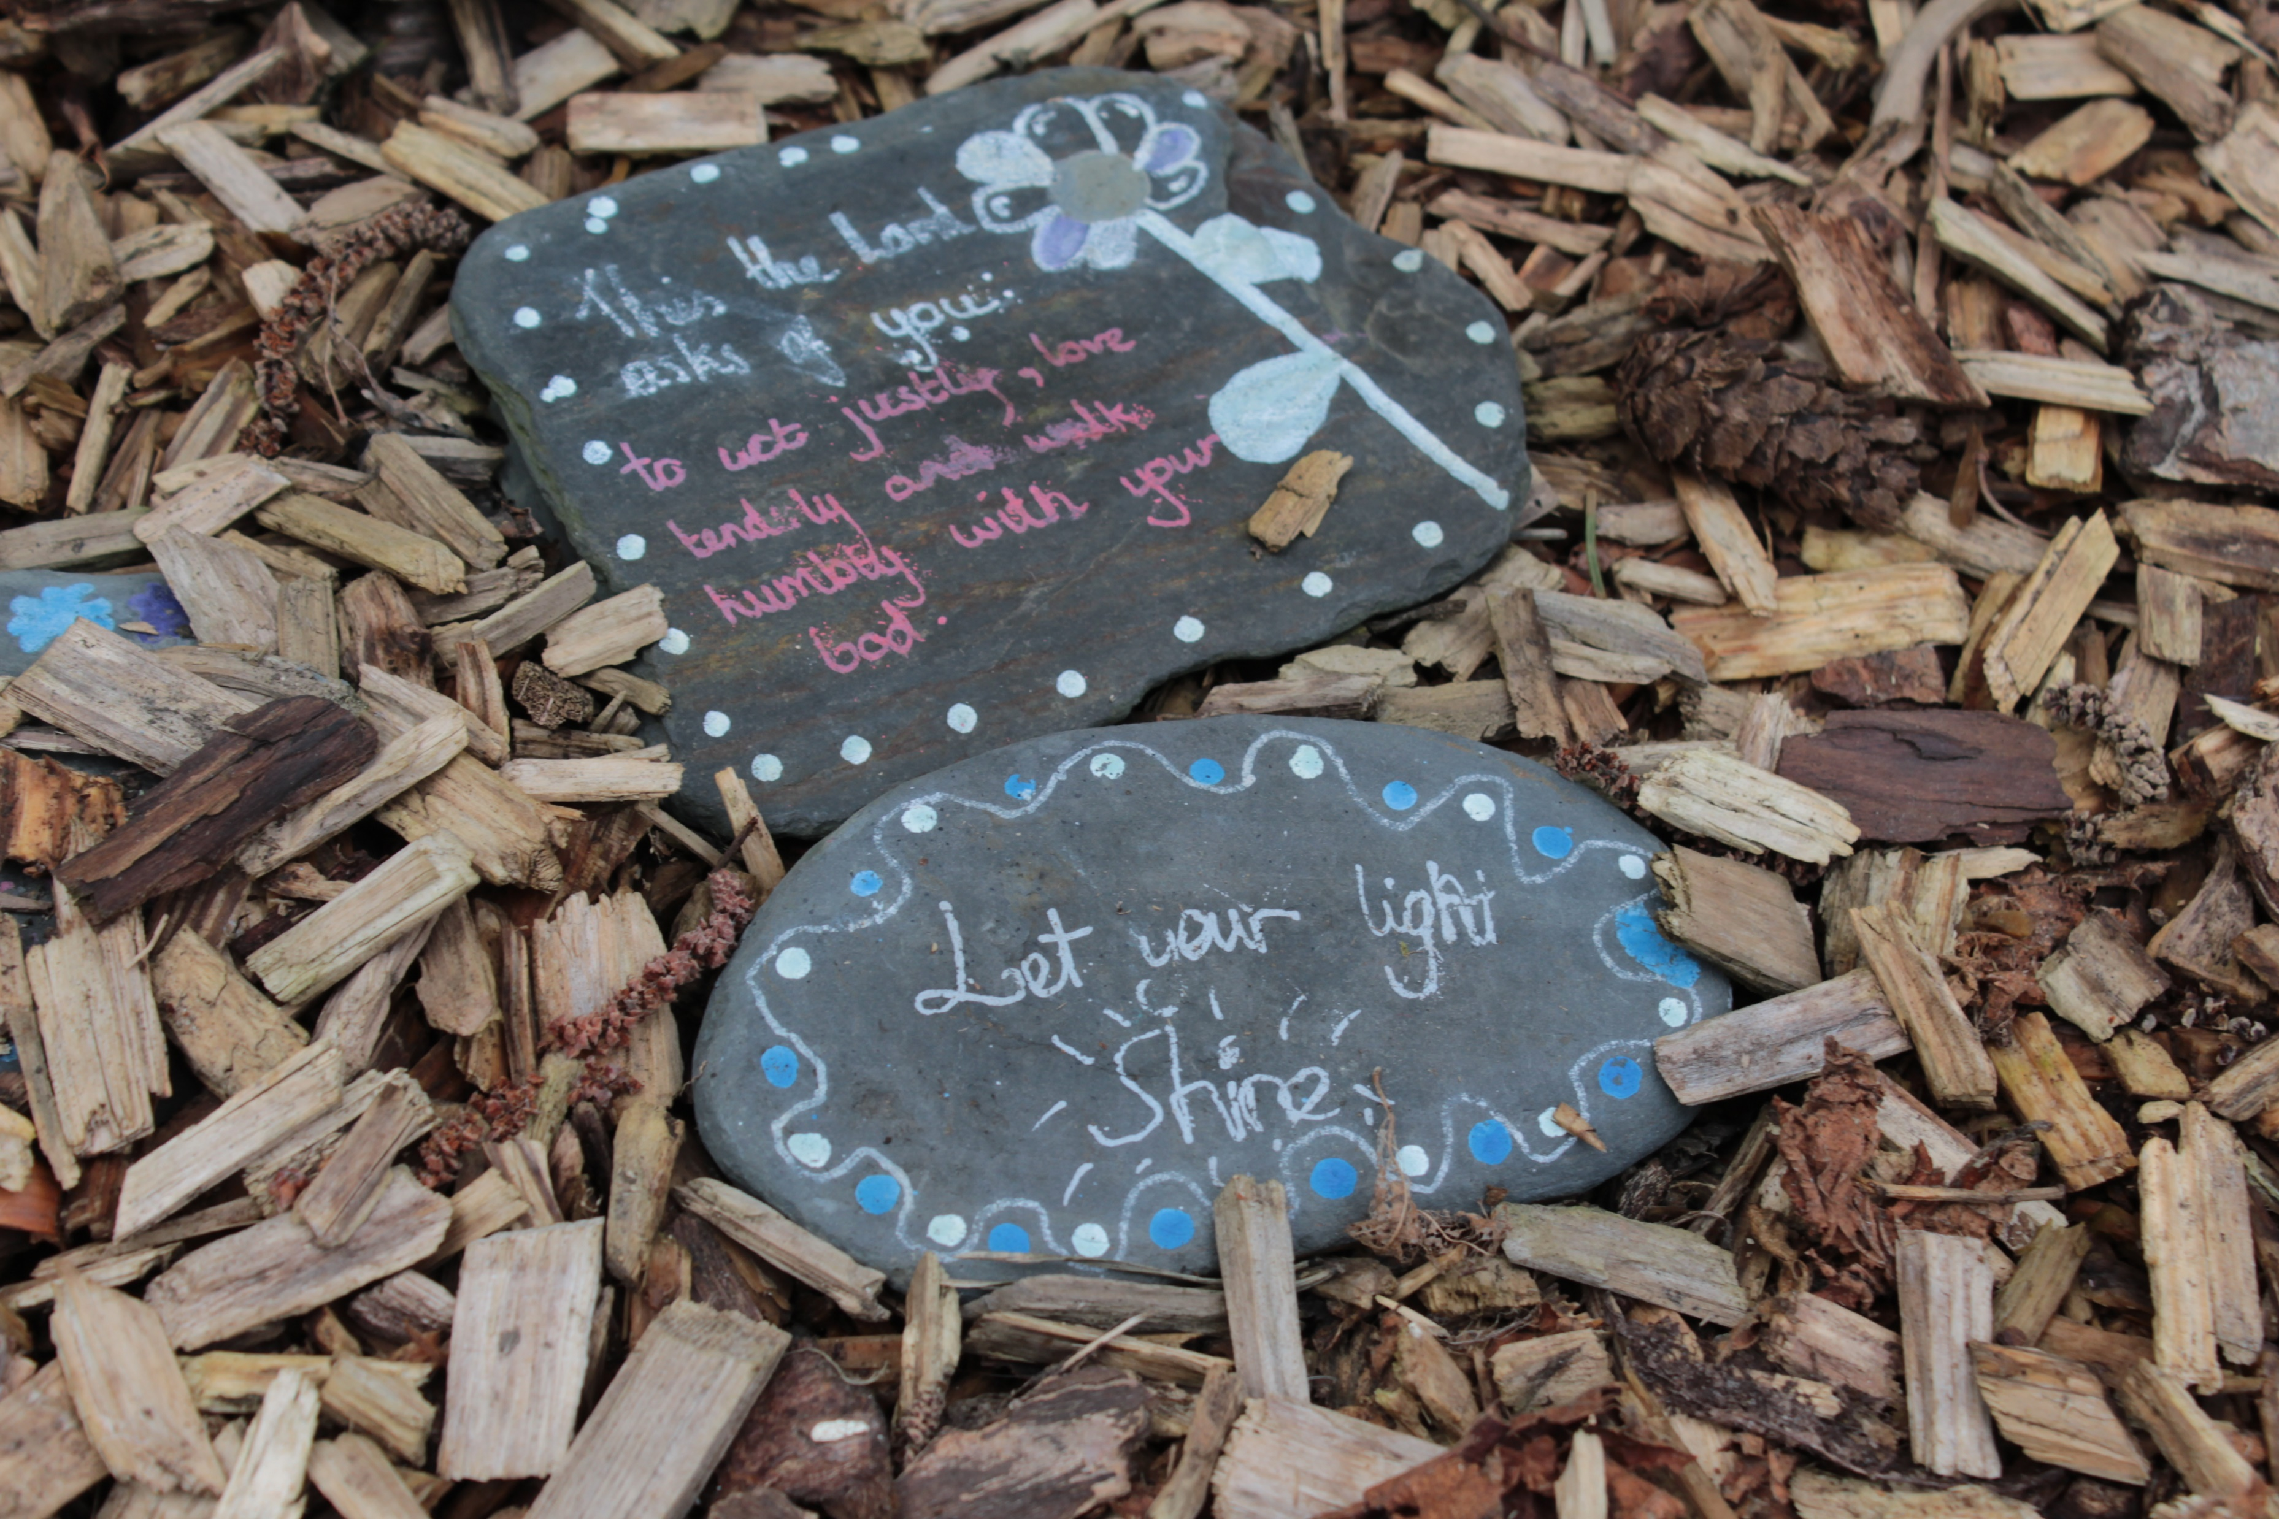
Our lives are changed by Jesus too.
Jesus lives in all of us. He asks us to always try to do what is right, to stand up for what we believe in and to help other people. Jesus calls us to show God’s love to others.
Our love for one another can also shine out like the sun as we treat all people as we ourselves would want to be treated.
Notes:
St Francis Xavier's RC Primary School, Herefordshire
Photo credit: Vicky Ahmed

Slide 9
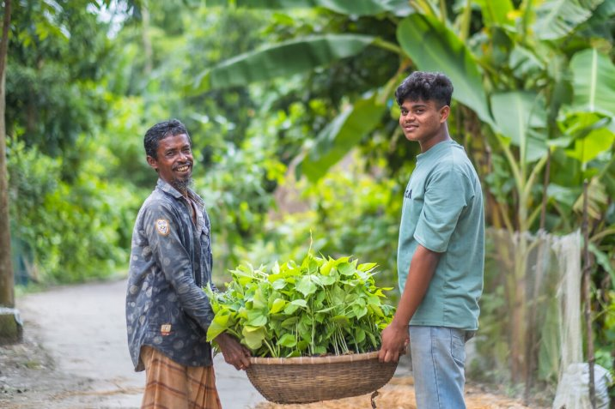
People all around the world are different but they were all made by God. Every person is unique and special.
CAFOD supports people who are
poor around the world as they work
to change their lives for the better.
It helps people like Obayedul in Bangladesh. That's him in the picture with his son, Bayezid.
Notes:
Obayedul and his son, Bayezid, Bangladesh
Photo credit: Amit Rudro

Slide 10
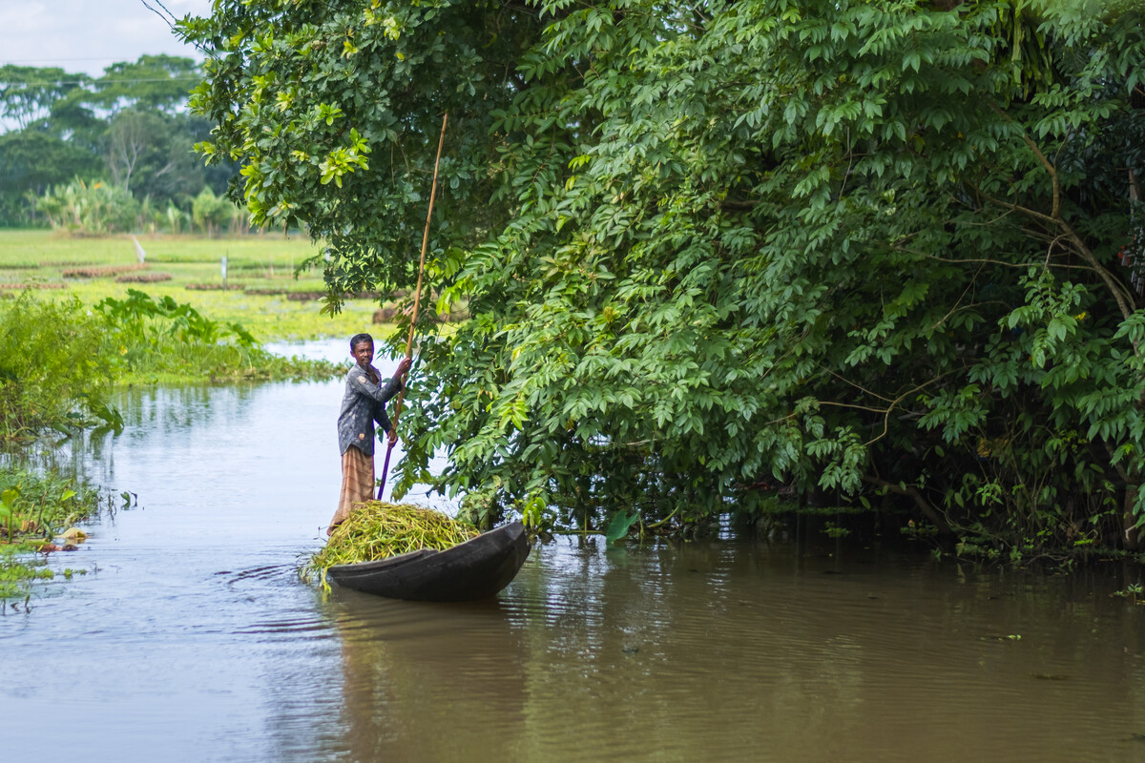
Obayedul had training and learned how to create a floating garden. This means he can grow crops even when too much rain leads to flooding.
Obayedul has also shared the new skills he has learnt with other people in his village, to help the whole community.
Notes:
Obayedul around the floating gardens, Bangladesh
Photo credit: Amit Rudro

Slide 11
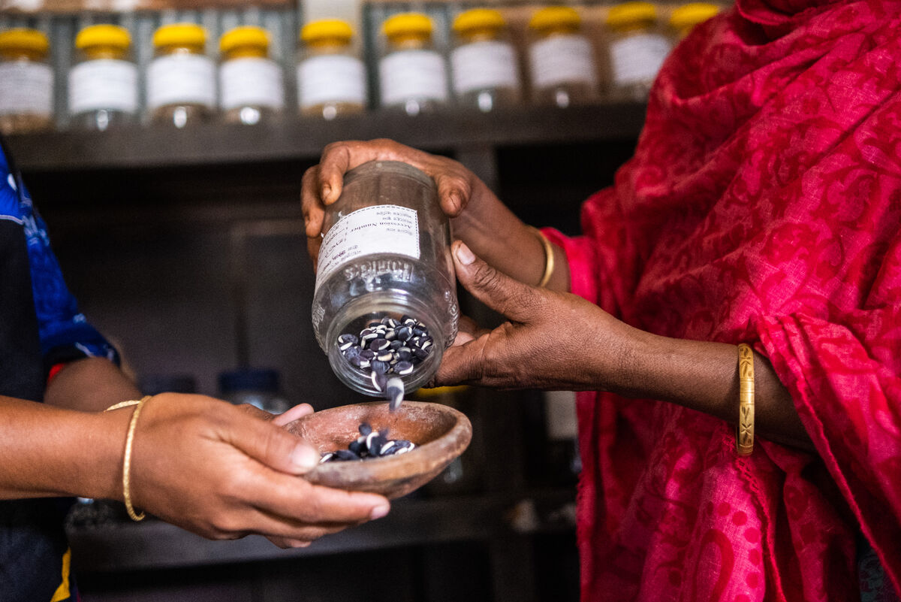
Lent is a time when we pray, do kind things for other people, give up things and give to others, as we prepare to celebrate the great feast of Easter.
When we fundraise for others, or give up fast food, snacks or some other treat, we stand in solidarity with people who are living in poverty.
Notes:
Receiving seeds, Bangladesh
Photo credit: Amit Rudro

Slide 12
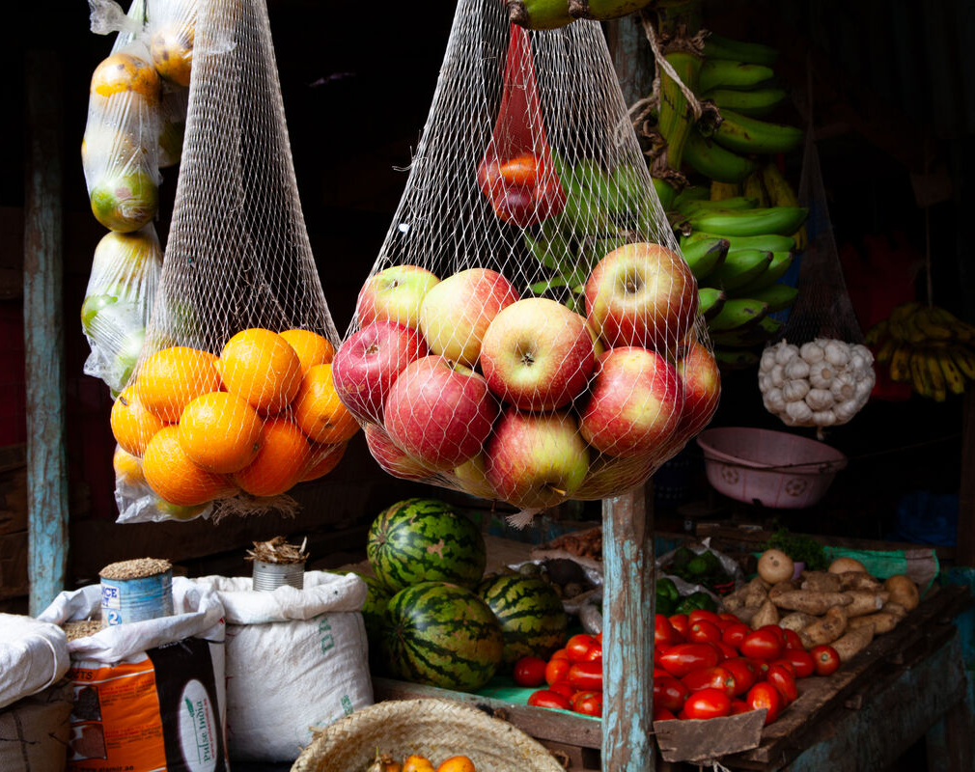
On Lent Family Fast Day, we show love to our brothers and sisters by eating simply and giving thoughtfully -
so another family has enough food to eat and clean water to drink.
What other things can you do this Lent to listen to God and to play your part in building a better world?
Notes:
Local market, Marsabit, northern Kenya
Photo credit: Louise Norton

Slide 13
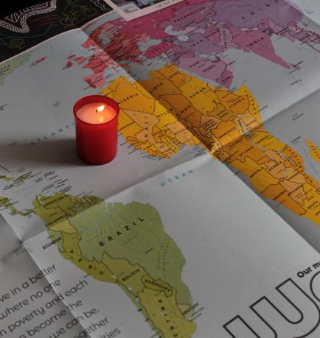
Let us pray
We pray for all world leaders:
that they may be inspired by Jesus' example and lead their people with fairness and compassion.
Lord in your mercy…
We pray for our parish, families and friends:
that we may see Jesus in all people that we meet and let our love shine out in all that we do.
Lord in your mercy...

Slide 14
Let us pray
We pray for our brothers and sisters around the world:
that they may feel supported by us as they work to build a hopeful future.
Lord in your mercy…
God of love: help us to share the light of your love with one another and to play our part in building a better world. Amen.

Slide 15
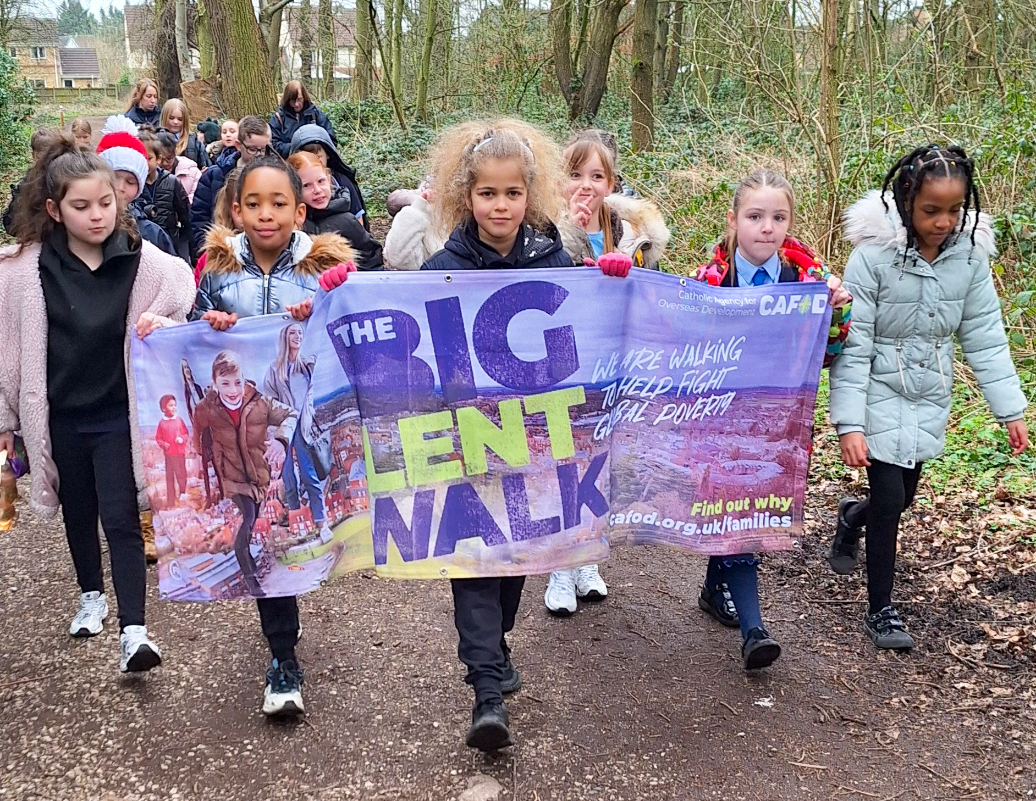

How will you make sure your love for other people shines out like the sun this week?
Send
Notes:
Community Big Lent Walk, Reading
Photo credit: Amit Rudro

Slide 16
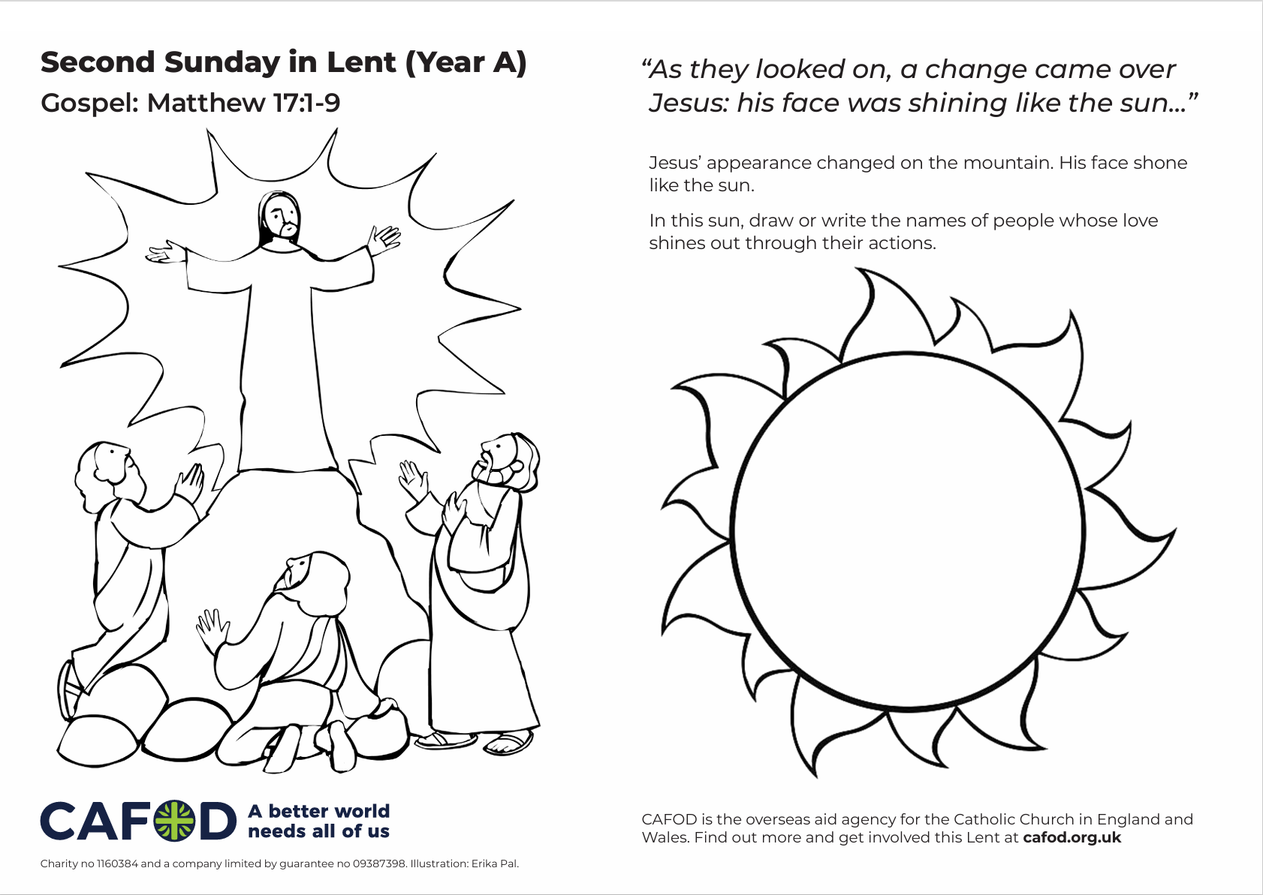

Activity suggestions
Download the illustration
Share the accompanying activity sheet with the children and encourage them to complete it, either in the liturgy or at home. Remind the children that Jesus’ face shone like the sun. Encourage them to colour the illustration and to draw or write in the sun the names of people whose love shines out in their lives. On the back, invite the children to write or draw what they will do this Lent to help their love for other people shine out.
Encourage the children to join CAFOD’s Big Lent Walk and help raise money to support communities around the world who are living in poverty. Find out more at
The Big Lent Walk 2026
Notes:
Illustration: Erika Pal

Slide 17
Activity suggestions
Remind the children to share all that they have heard and thought about today with the people at home. Encourage them to do one thing during the week to help their love for others shine like the sun.
See Lent 2026 resources for primary schools for more child-friendly fundraising and other activities this Lent.
Notes:
Illustration: Erika Pal

Slide 18
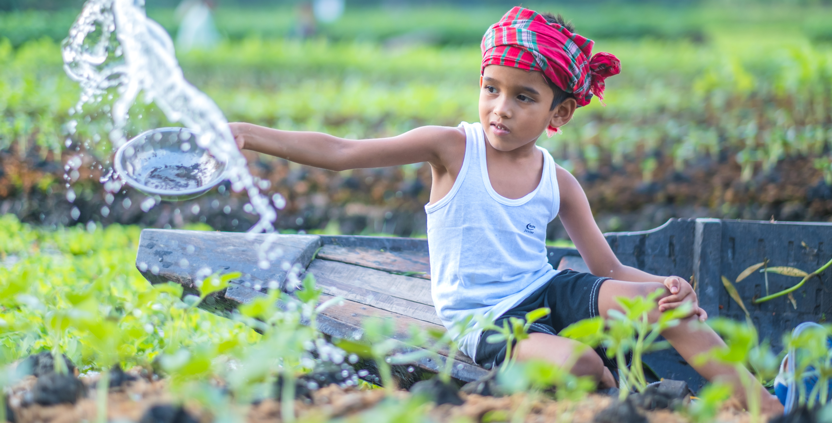
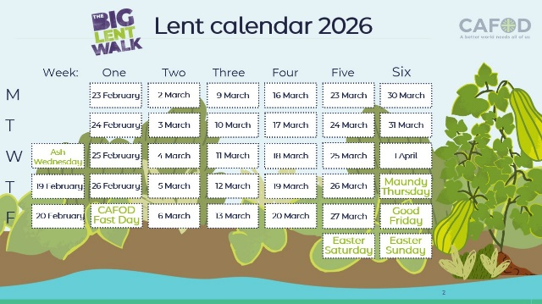
Get involved with CAFOD this term
Big Lent Walk resources
Lent national assembly
Lent resources
Join us on the Big Lent Walk!
Join our national assembly
Explore our Lent 2026 resources

Slide 19


