Slide 1
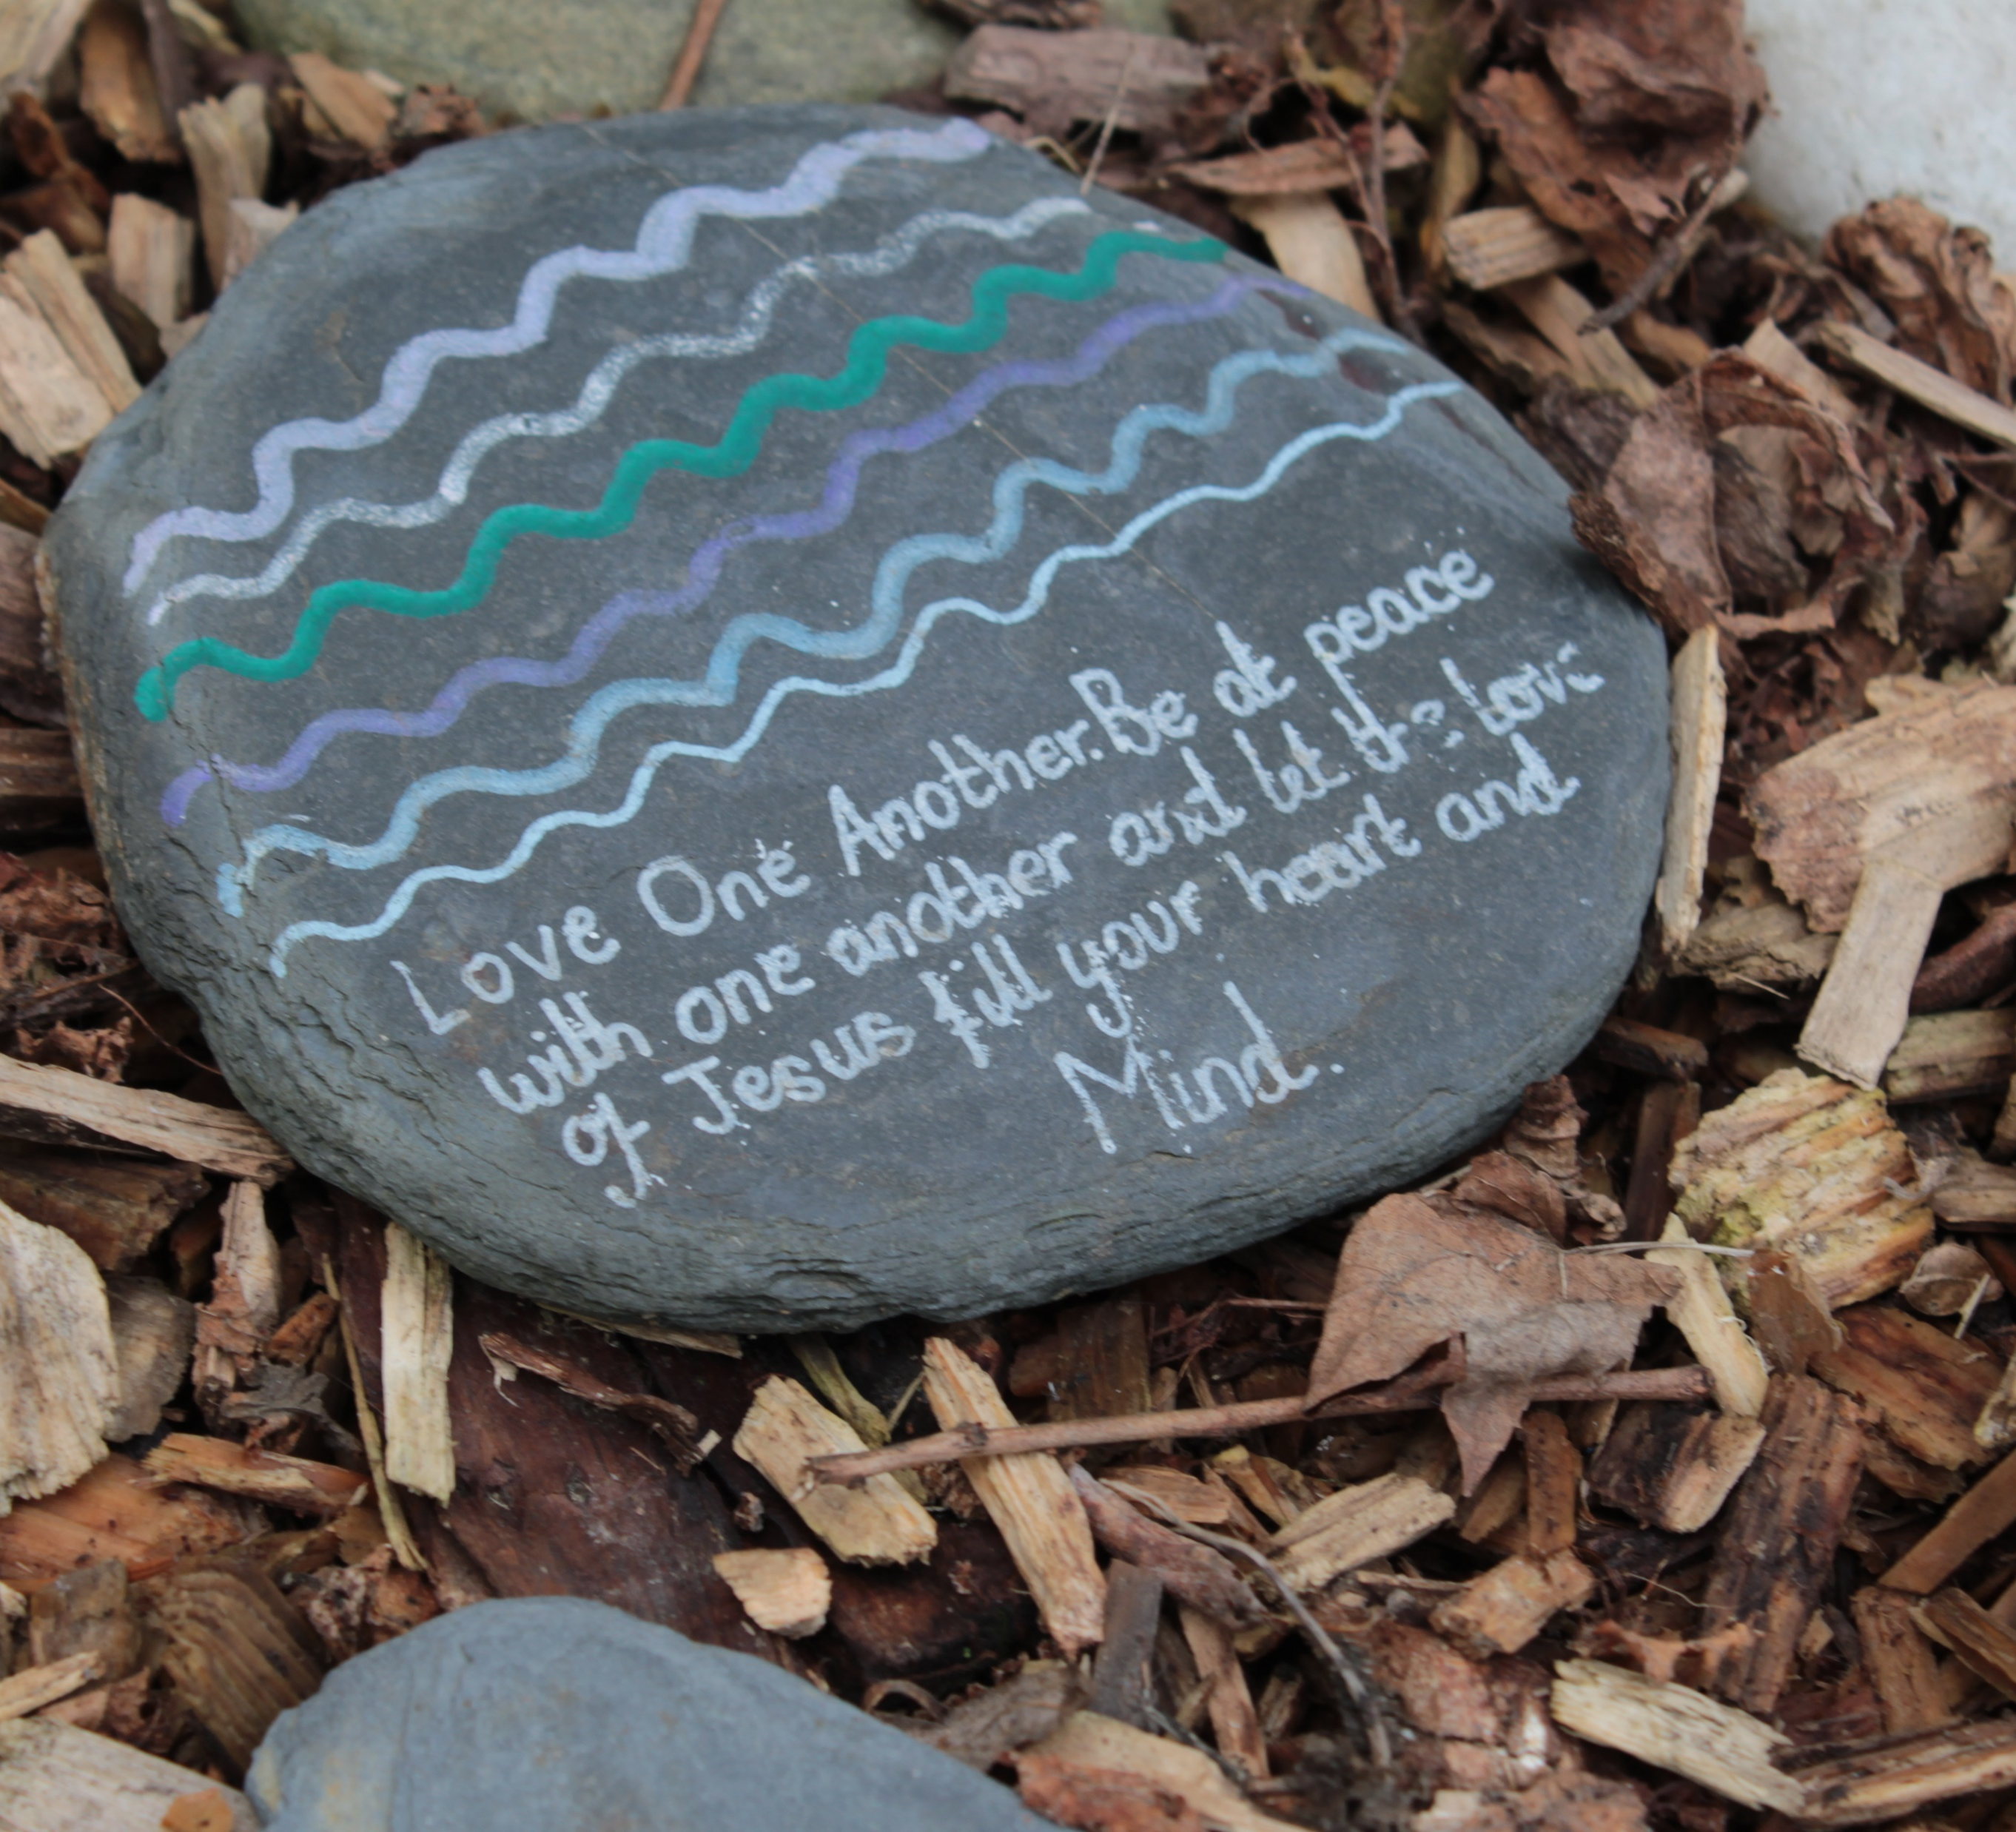
How will you try to make peace with others?
Gospel Celebration of the Word
Notes:
Children’s liturgy: Sixth Sunday in Ordinary Time (Year A)
Preparation of the worship space
Colour: green
Song suggestions
Make me a channel of your peace (898, Laudate) Peace is flowing like a river (902, Laudate)
Welcome
We are all God’s children and we are all part of one big global family. Today we hear about how we must not argue with our brothers and sisters and how, if we do, we need to make peace with them. Let’s think about making peace with all our brothers and sisters around the world.
Peace pebble
Photo credit: Victoria Ahmed

Slide 2
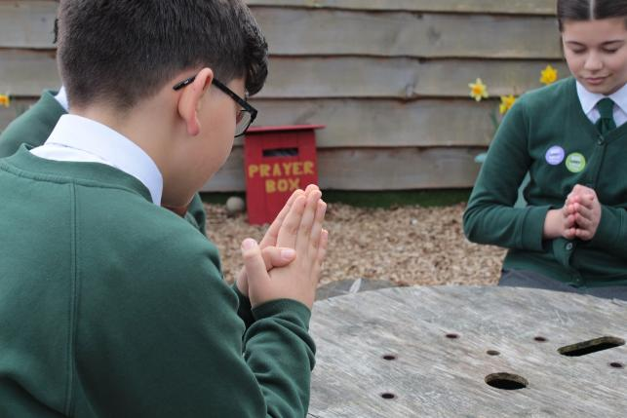

Loving God, When we do wrong and hurt others, help us to be brave and say sorry. Help us all to live in peace together. Amen.
Gather
Notes:
St Francis Xavier's RC Primary School, Herefordshire
Photo credit: Vicky Ahmed

Slide 3

Gospel: Matthew 5:17-37 or Matthew 5: 20-24, 27-28, 33-34a, 37
“I tell you, then, that you will be able to enter the Kingdom of heaven only if you are more faithful than the teachers of the Law and the Pharisees in doing what God requires.
“You have heard that people were told in the past, ‘Do not commit murder; anyone who does will be brought to trial.’ But now I tell you: whoever is angry with his brother will be brought to trial, whoever calls his brother ‘You good-for-nothing!’ will be brought before the Council, and whoever calls his brother a worthless fool will be in danger of going to the fire of hell.
"So, if you are about to offer your gift to God at the altar and there you remember that your brother has something against you, leave your gift there in front of the altar, go at once and make peace with your brother, and then come back to offer your gift to God.
Word
Notes:
This is the shortened version of the reading.

Slide 4
“You have heard that it was said, ‘Do not commit adultery.’ But now I tell you: anyone who looks at a woman and wants to possess her is guilty of committing adultery with her in his heart.
“You have also heard that people were told in the past, ‘Do not break your promise, but do what you have vowed to the Lord to do.’ But now I tell you: do not use any vow when you make a promise. Do not swear by heaven, for it is God’s throne.
“Just say ‘Yes’ or ‘No’ – anything else you say comes from the Evil One.”

Slide 5


What do you remember from the Gospel reading?
Jesus tells us that we must try hard not to get angry with our sisters and brothers or call them names.
If we do argue with them, we must try to make it up with them and become friends again as soon as possible.
Respond
Notes:
Shaking hands
Photo credit: Marlis Trio Akbar on Unsplash
Anuarite Kahindo sharing milk with her children, DRC
Photo credit: Arlette Bashizi

Slide 6
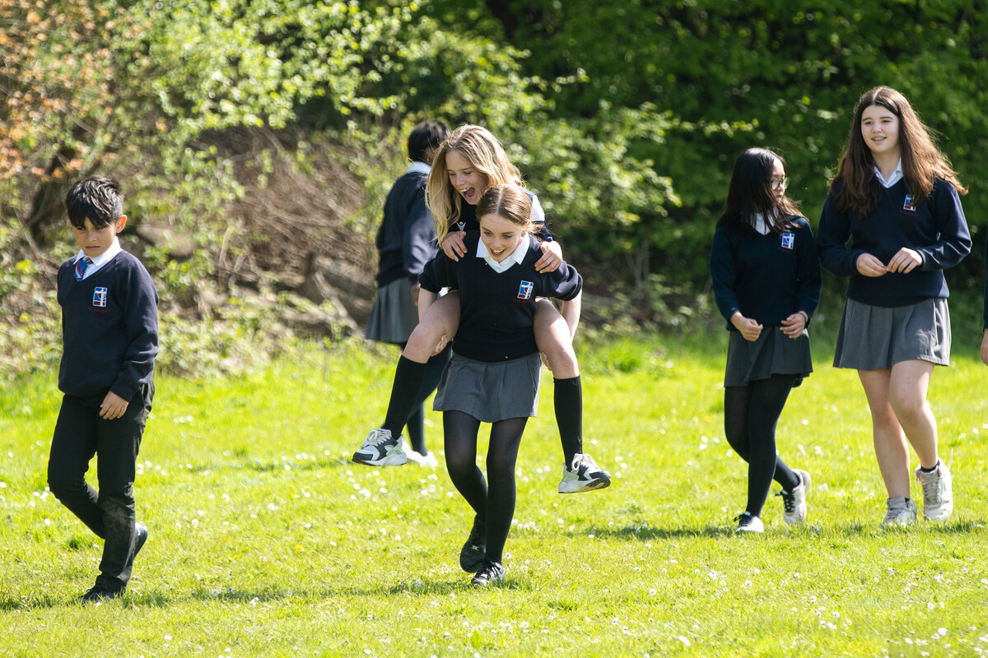
Have you ever argued with someone?
How did it make you feel to argue with them?
How did you make up with them?
Was it easy or difficult?
How did you feel once you were friends again?
Notes:
Friends at St Gregory's Catholic School
Photo credit: Joe Newman

Slide 7
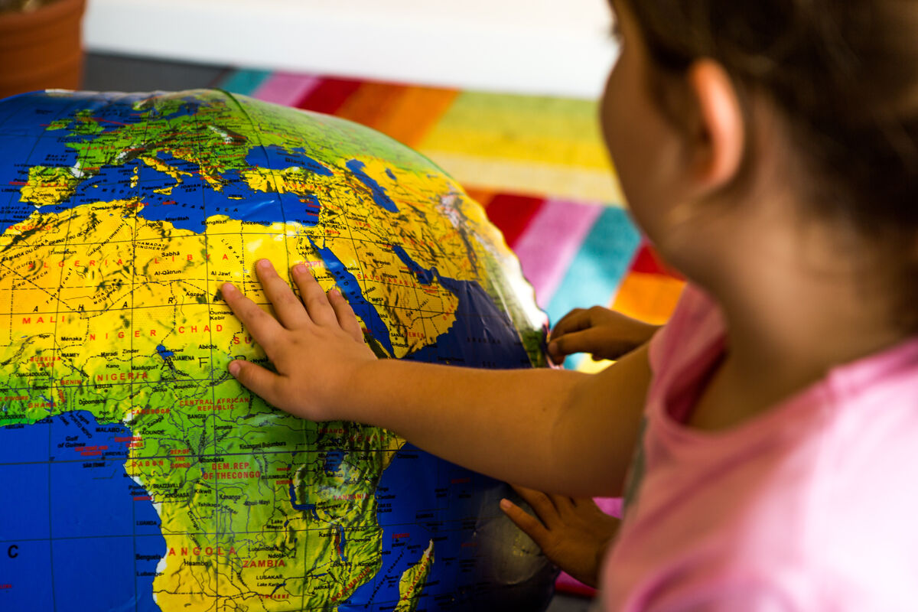
We believe that we are all part of God’s family.
This is one big global family that includes all people, wherever they are in the world.
We believe that all people are our sisters and brothers and God asks us to try to treat them as we want to be treated.
Notes:
Exploring the globe
Photo credit: CAFOD

Slide 8
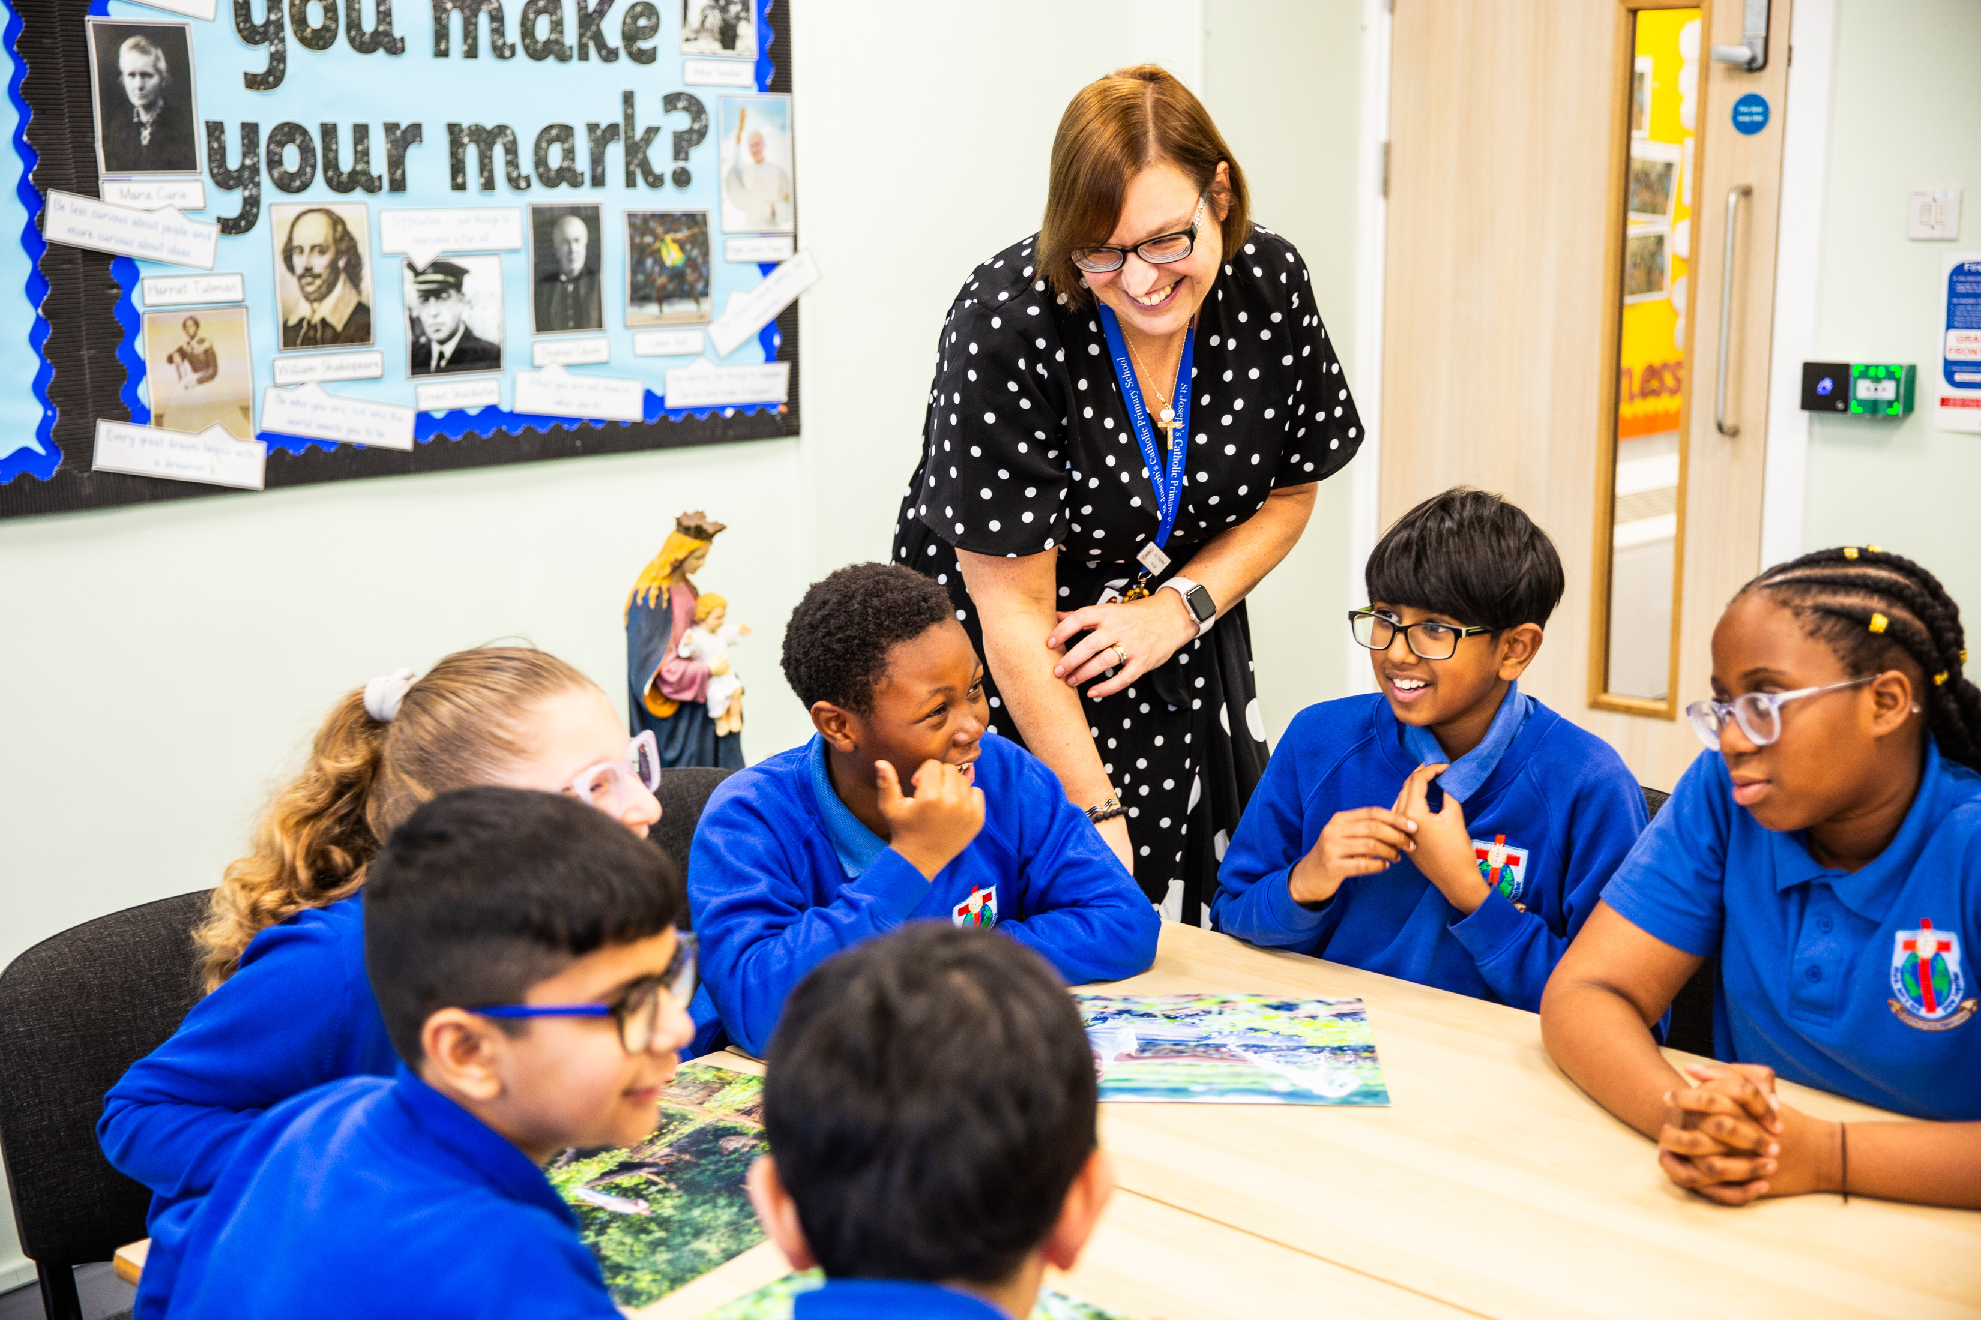
In our global family we are all different.
Look at the person sitting next to you.
How are they different from you?
How are they the same?
Sometimes people spend too much time thinking about the differences between us, rather than seeing that we are all part of the same global family. This can lead to arguments and problems.
Notes:
St Joseph’s Catholic Primary Schol
Photo credit: Amit Rudro

Slide 9
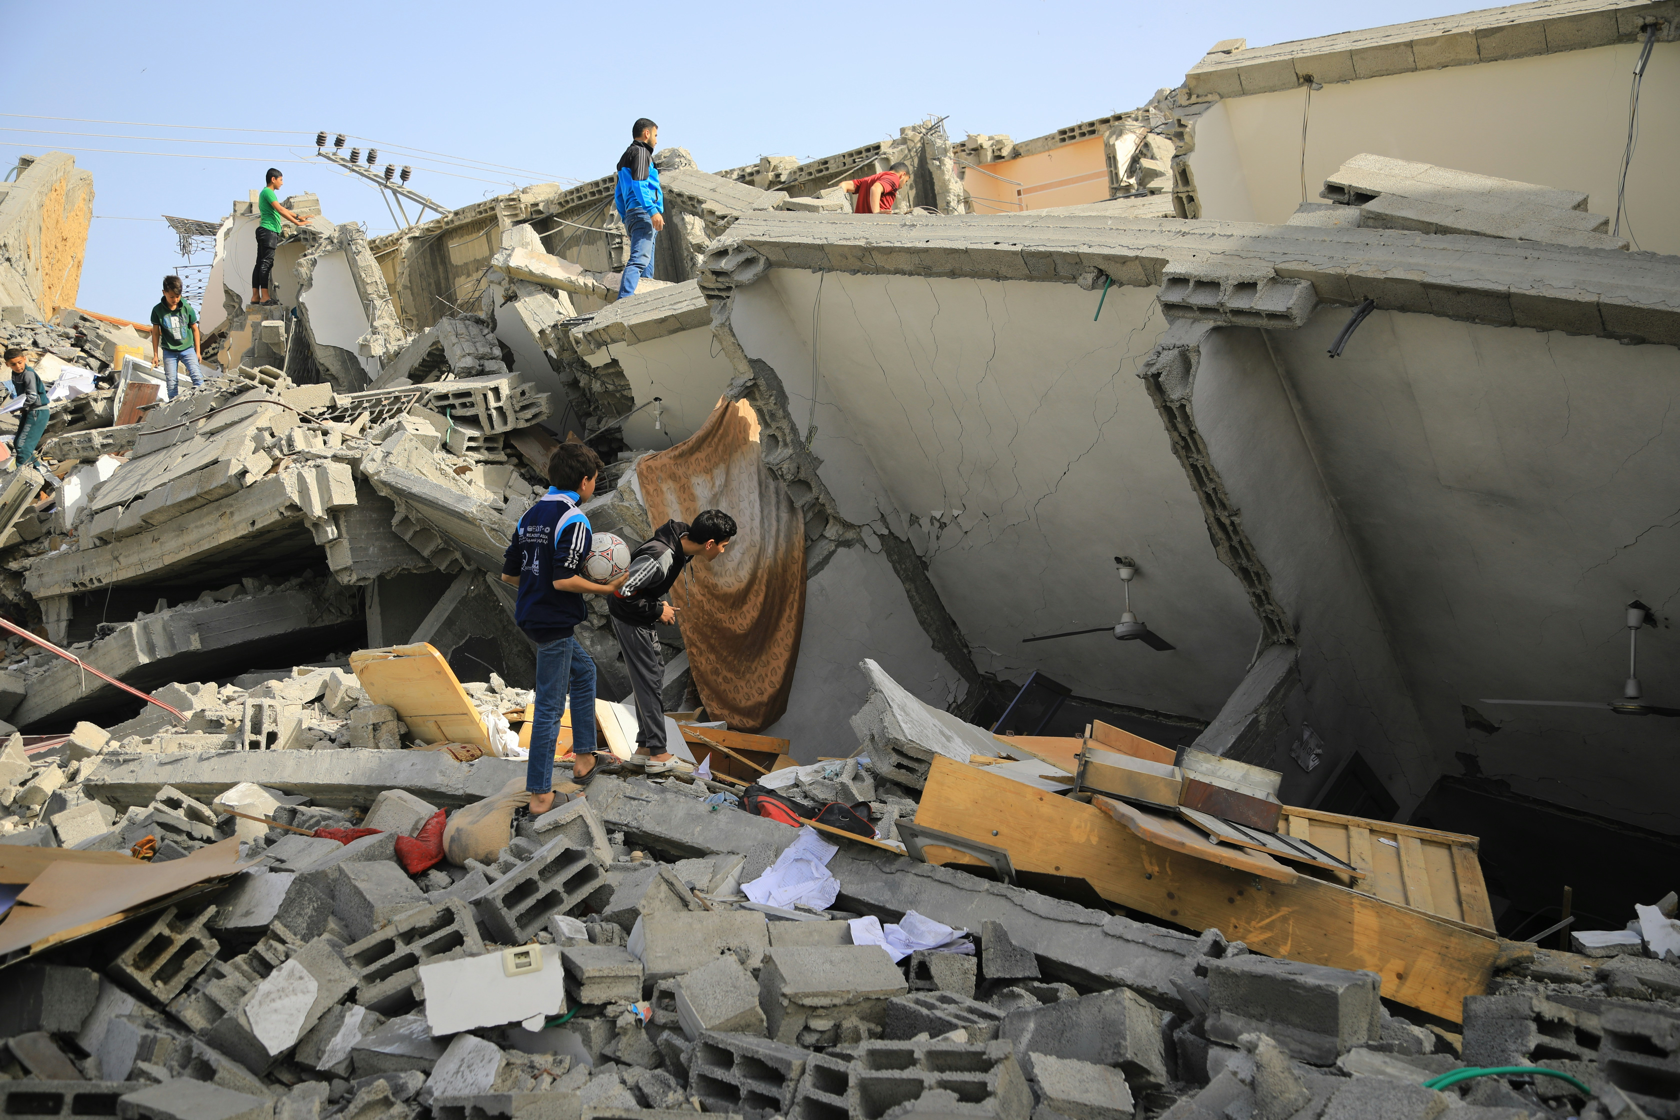
In some cases, it can lead to war or fighting between countries which means that people get hurt and have to leave their homes.
How do you think it would feel to live somewhere where there was a war?
Do you know anyone who has had to leave their home and move to a different place that was safer?
Notes:
Destroyed building
Photo credit: Mohammed al Bardawil

Slide 10
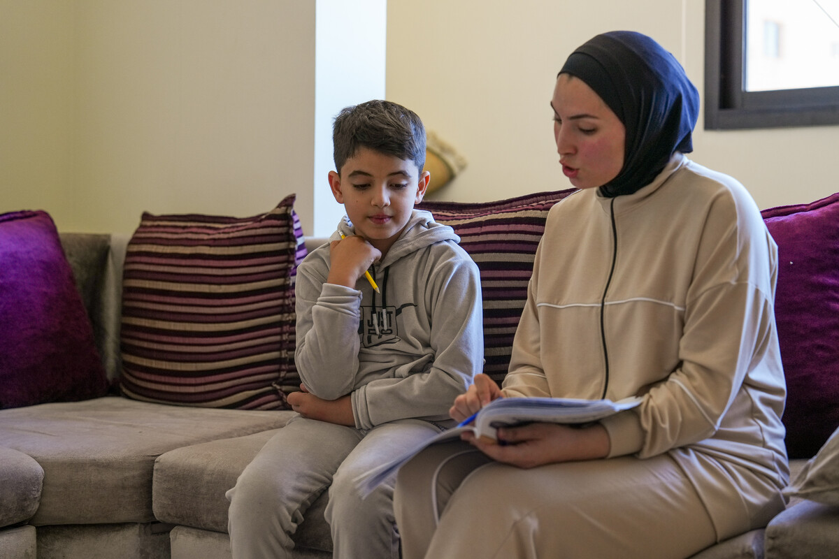
Many children flee war – like eight-year-old Zein. He escaped from southern Lebanon to a refugee camp.
With CAFOD's help, his family receive food and bedding. "But what I want most is to go home," says Zein.
Jinane, his sister, says: “There are no schools here, so I'm teaching
my brother, but he no longer likes studying saying he doesn't feel comfortable because of the war."
Notes:
Zein with his sister, Jinane, Southern Lebanon
Photo credit: Elisa Oddone/Arete/DEC

Slide 11
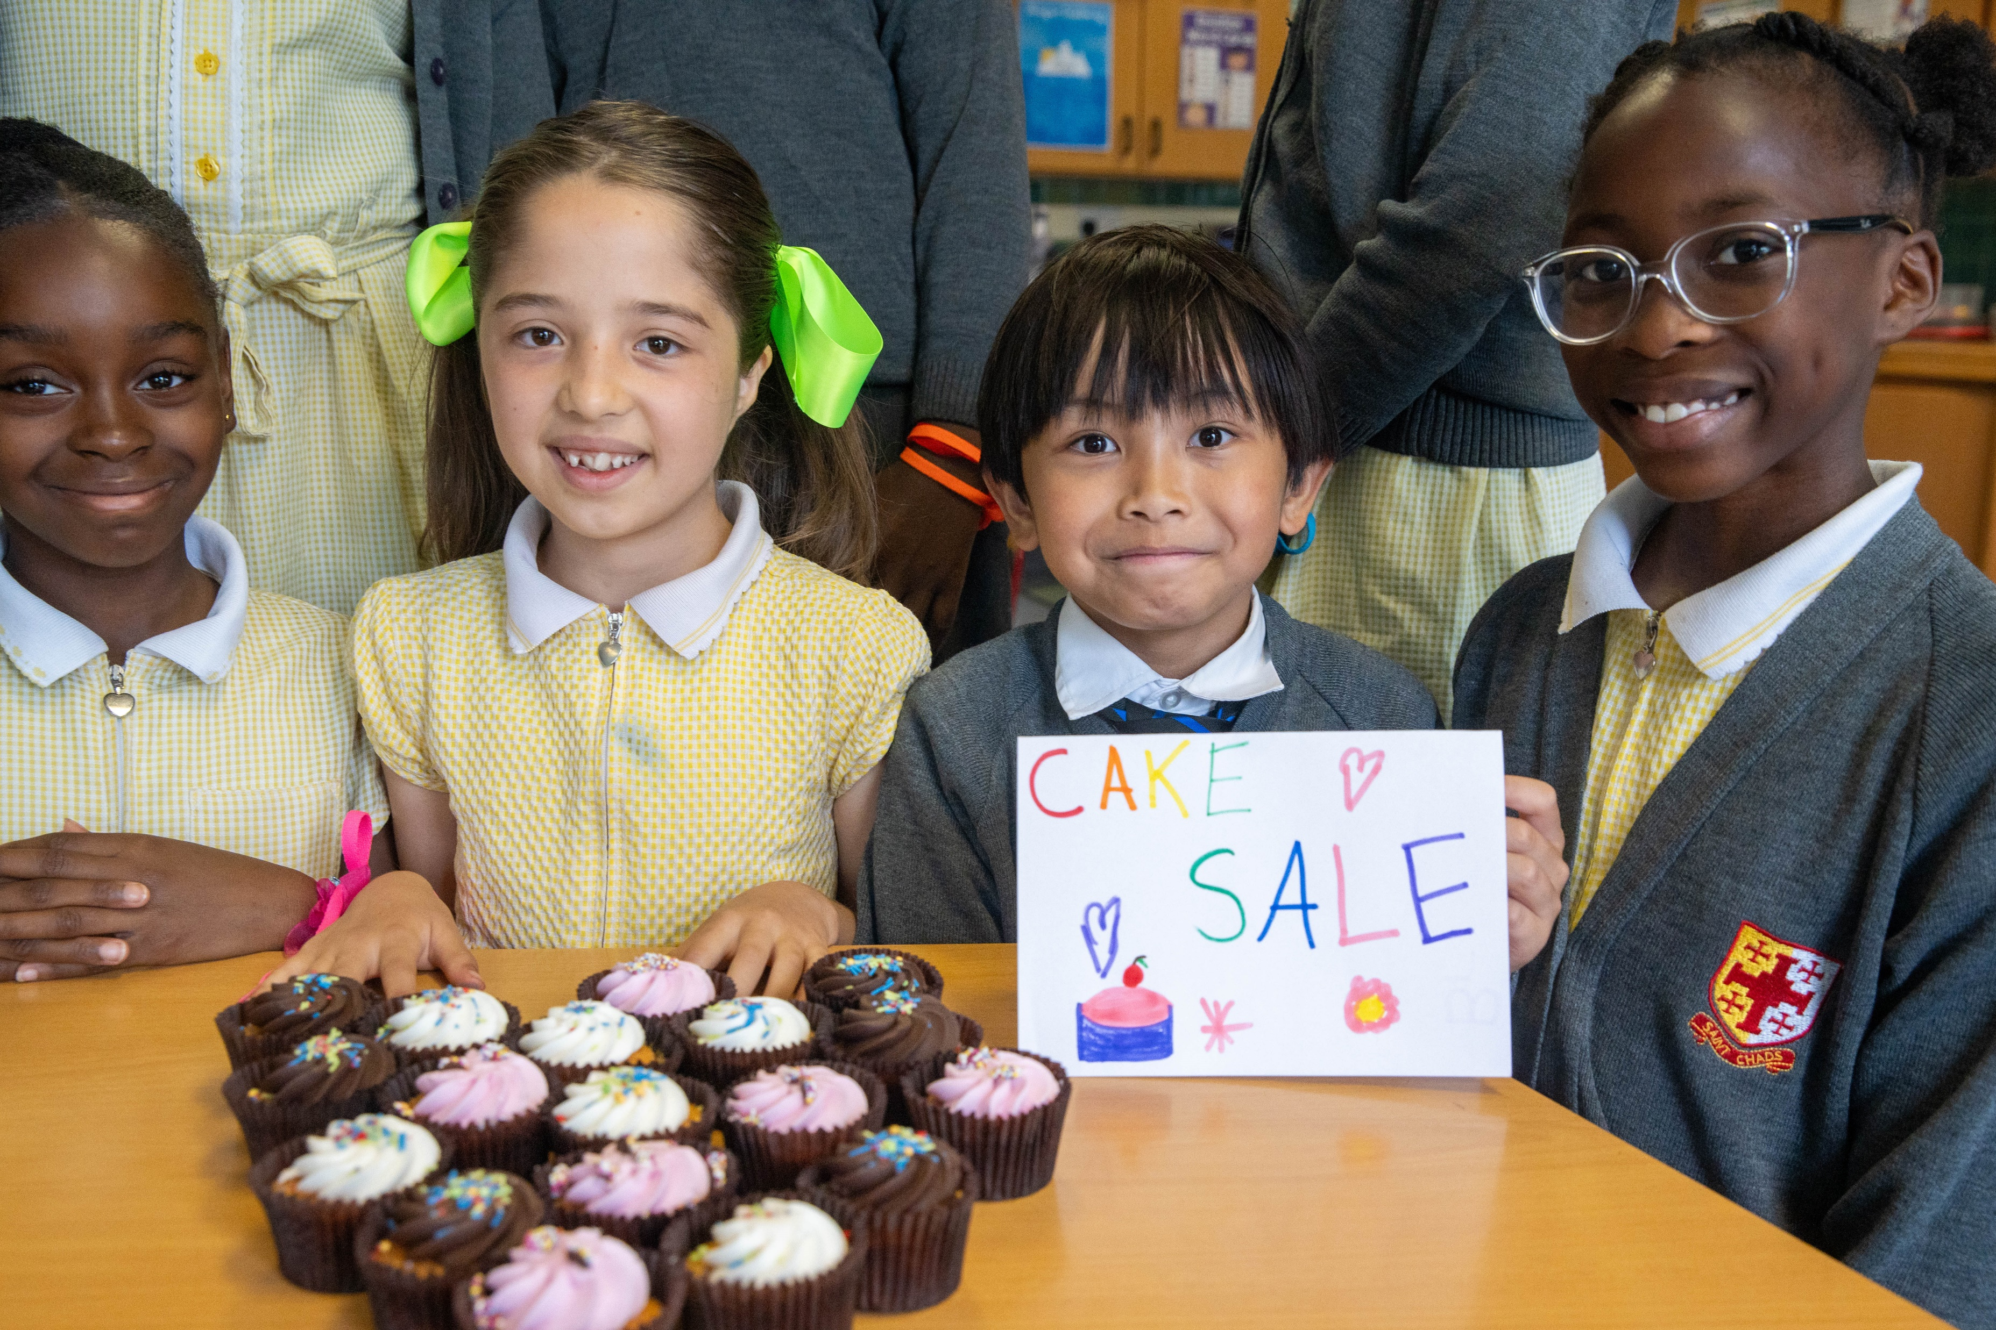
We are all different, but we all
have our own special gifts.
What is your special gift?
Are you good at sharing?
Are you good at making friends?
Are you a brilliant singer, dancer, builder, baker, scientist?
Notes:
St Chad’s Catholic Primary School

Slide 12
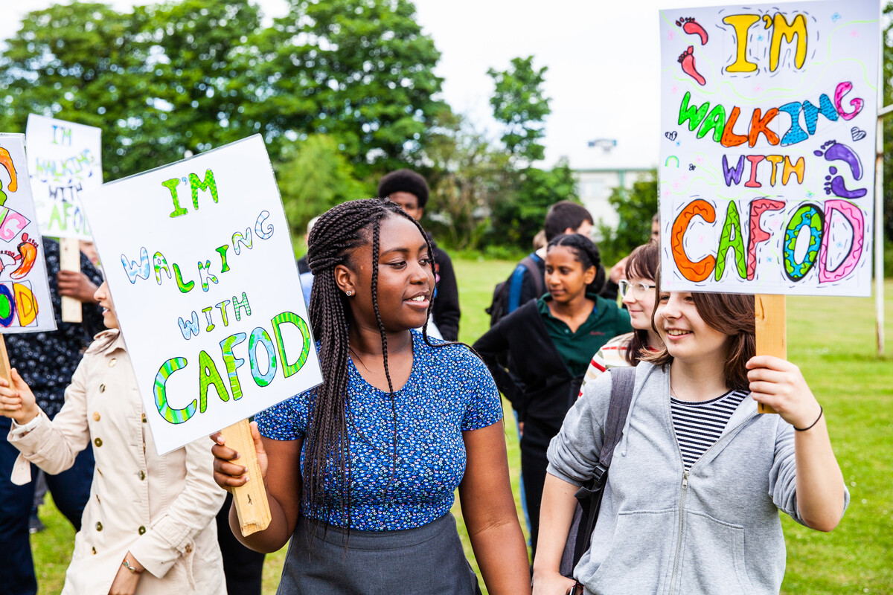
We can use our special gifts to work together to make the world a fairer and better place for everyone rather than fighting with people who are different.
This week, can you try not to argue with others or be hurtful towards anyone?
Notes:
All Saints school, Sheffield
Photo credit: Thom Flint

Slide 13
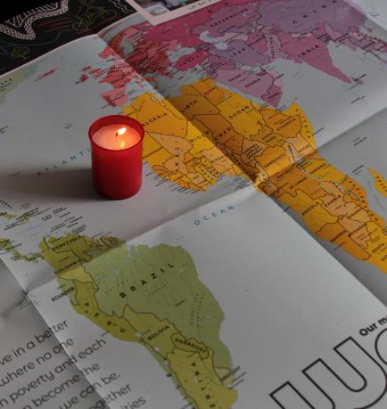
Let us pray
We pray for all world leaders:
that they may seek peace and end war, so that all people may live in peace and safety.
Lord in your mercy…
We pray for our parish, families and friends:
that we may say sorry to people we upset, accept those who are different and work together for peace and fairness throughout the world.
Lord in your mercy...

Slide 14
Let us pray
We pray for our brothers and sisters throughout the world:
that they may use their gifts to make a fairer world and change their lives for the better.
Lord in your mercy…
God of mercy and peace: forgive us when we get angry with others and help us to make peace with them, so that we can all work together to make a better world. Amen.

Slide 15
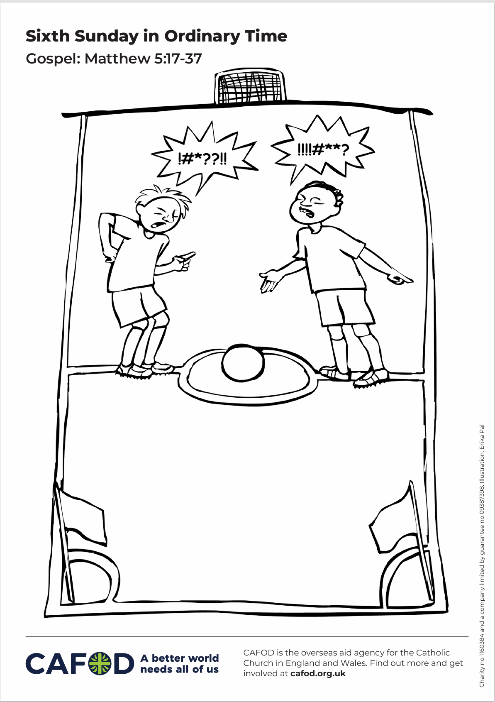

How will you try to make peace with others this week?
Send

Slide 16
Activity suggestions
Download the illustration
Invite the children to look at the accompanying illustration of an argument. Can they draw underneath what they think should happen next?
Remind the children to share all that they have heard and thought about today with the people at home.
Encourage them to go through the week trying not to argue or upset other people just because they are different. Remind them to try to make peace with others where they can.
Notes:
Illustration: Erika Pal

Slide 17
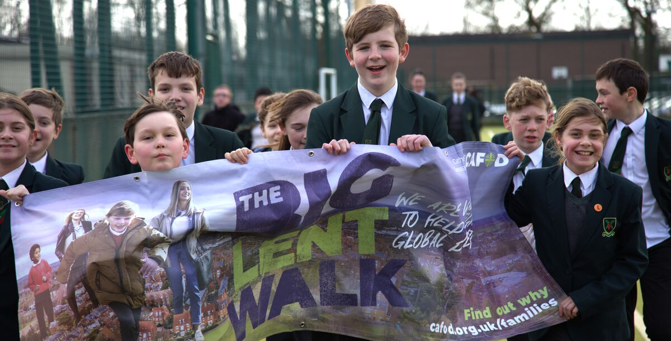
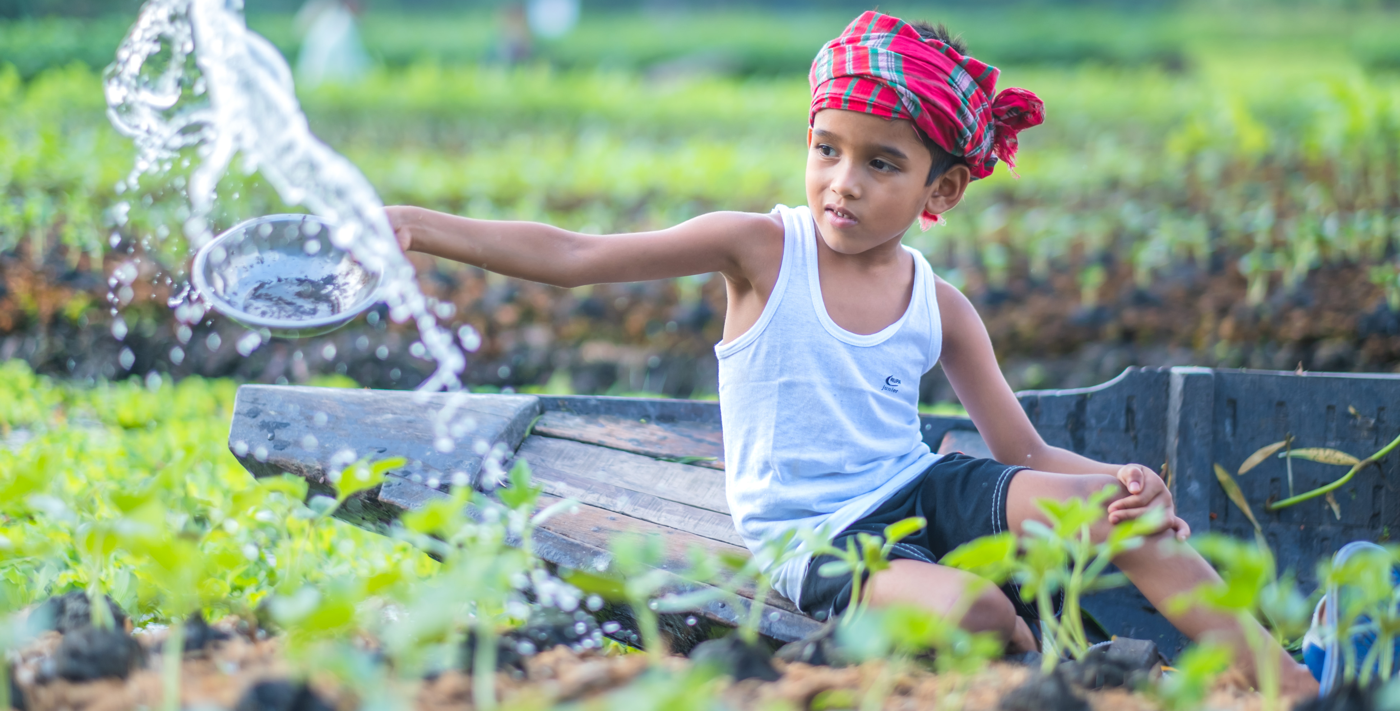
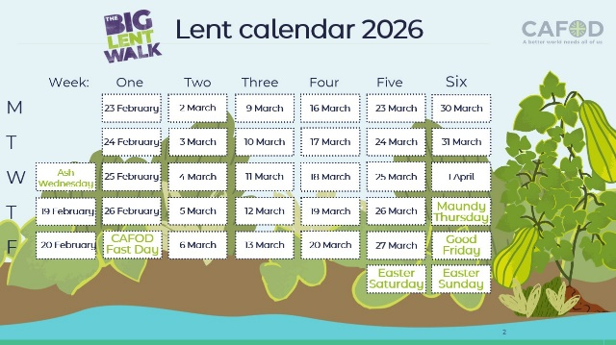
Get involved with CAFOD this term
Big Lent Walk resources
Save the date!
Lent resources
Join us on the Big Lent Walk!
Join our national assembly
Explore our Lent 2026 resources

Slide 18
