Slide 1
Notes:
Length 1 minute 30 seconds

Slide 2
A blessing
from Samburu, Kenya
Notes:
Blessing taken from: An African Prayer Book by Desmond Tutu, p.128. Doubleday, 1995.
PowerPoint created by Molly, CAFOD volunteer, summer 2016. CAFOD youth team.
Music: Ice Age 2, Neil Williams / Miles Bould / Sarah Ozelle / Rupert Pfaff from audionetwork.com

Slide 3
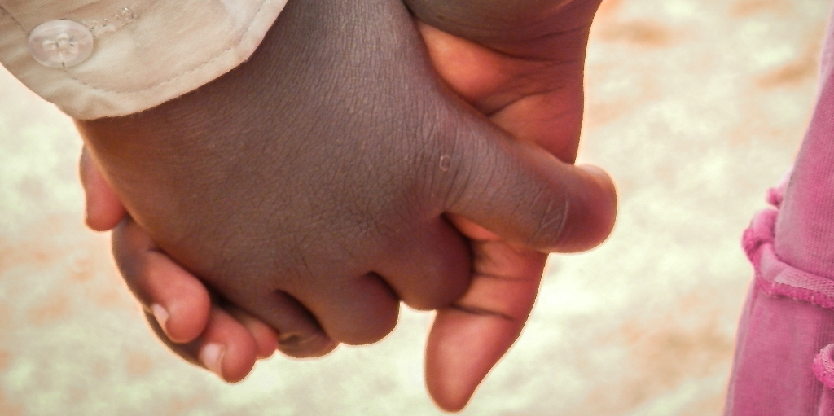
May God raise you up above everything.
Notes:
CREDIT LINE: Jane Andanje/CAFOD
COUNTRY: South Sudan
LOCATION: Gumbo, Juba
CAPTION: holding hands

Slide 4
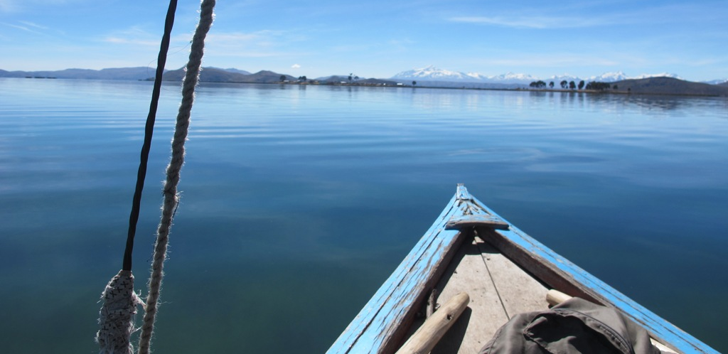
Spread out like lake water.
Notes:
CREDIT LINE: Maria Marshall/CAFOD
COUNTRY: Bolivia
LOCATION: Altiplano
CAPTION: Prow of boat on lake

Slide 5
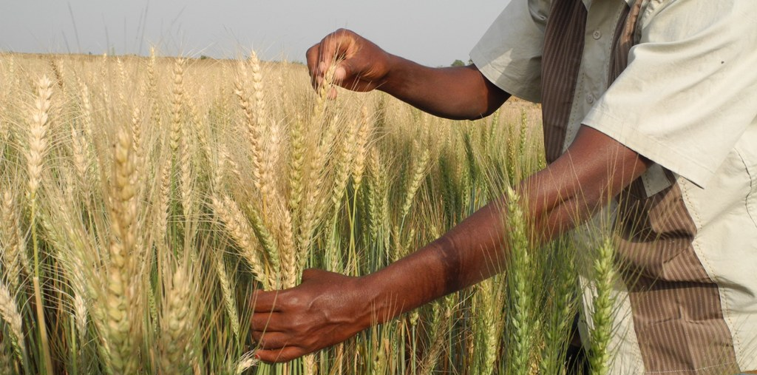
Be abundance that never ends,
Notes:
CREDIT LINE: Paula Nyunt/CAFOD
COUNTRY: Bangladesh
LOCATION: Rajshahi District
CAPTION: A drought-resilient crop of wheat.

Slide 6
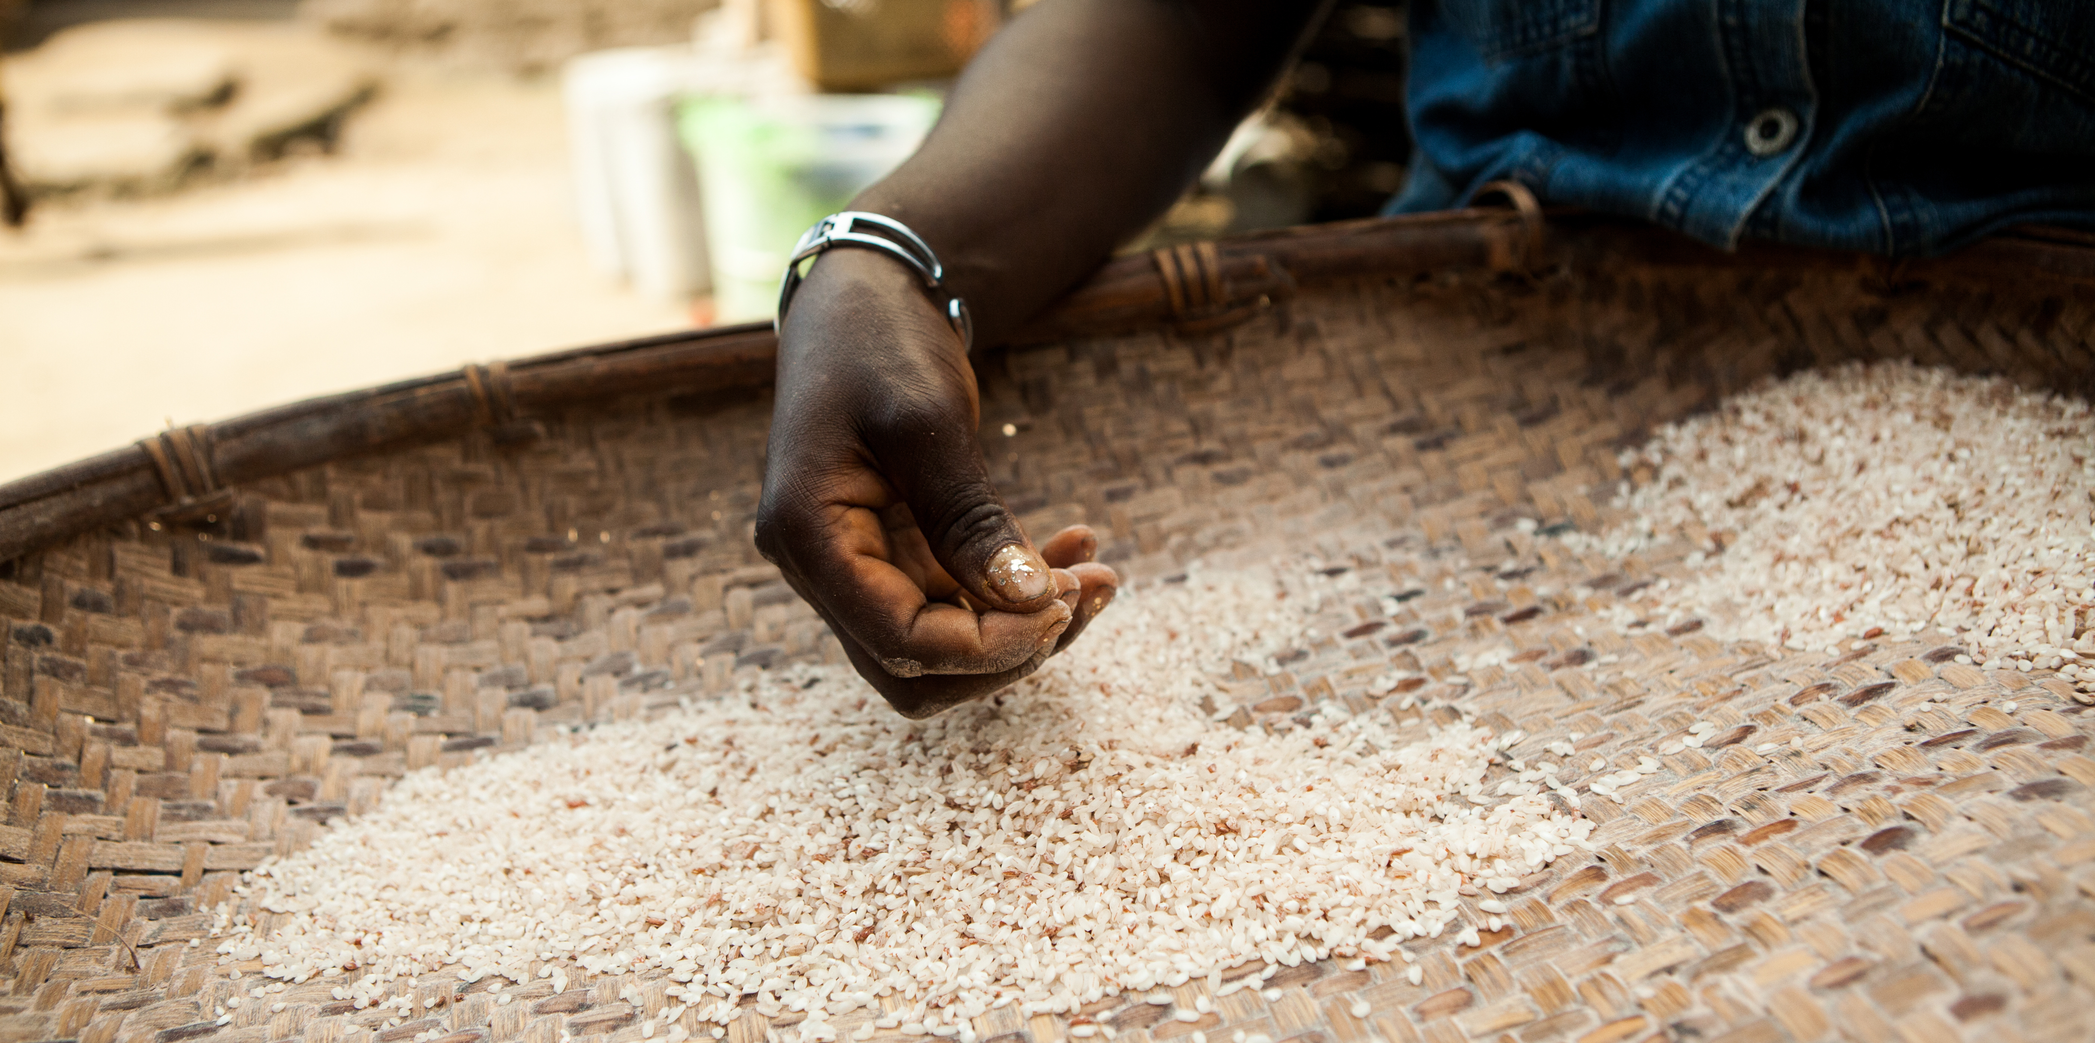
that never changes.
Notes:
CREDIT LINE: Simon Rawles/CAFOD
COUNTRY: Sierra Leone
LOCATION: Kenema, Eastern Province
CAPTION: Husking or shucking rice grains.

Slide 7
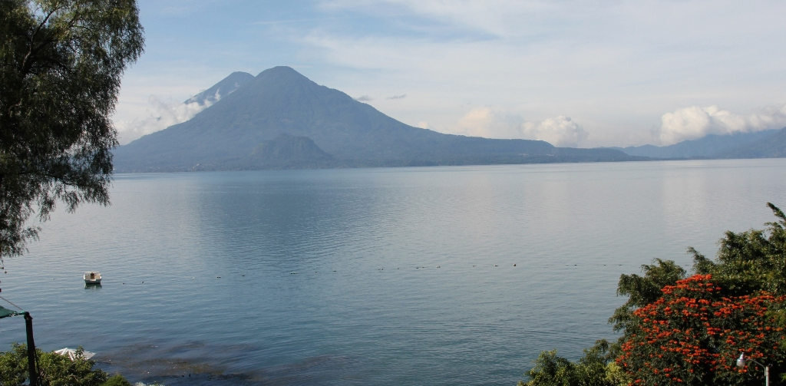
Be like a mountain.
Notes:
CREDIT LINE: Shea Bradley/CAFOD
COUNTRY: Guatemala
LOCATION: El Quiché department
CAPTION: landscape with lake and mountain

Slide 8
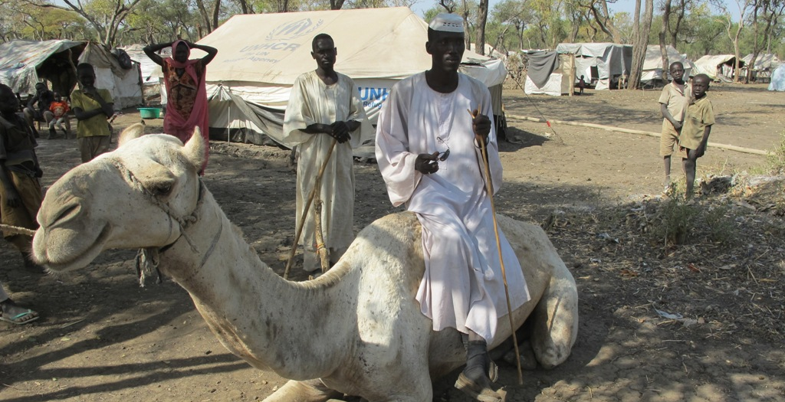
Be like a camel.
Notes:
CREDIT LINE: Nick Harrop/CAFOD
COUNTRY: Sudan
LOCATION: Maban County, South Sudan
CAPTION: Abdulgadar Abdallah, 33yrs, with his camel in Yusuf Batil refugee camp. All his other animals died on the journey here due to lack water and food.

Slide 9
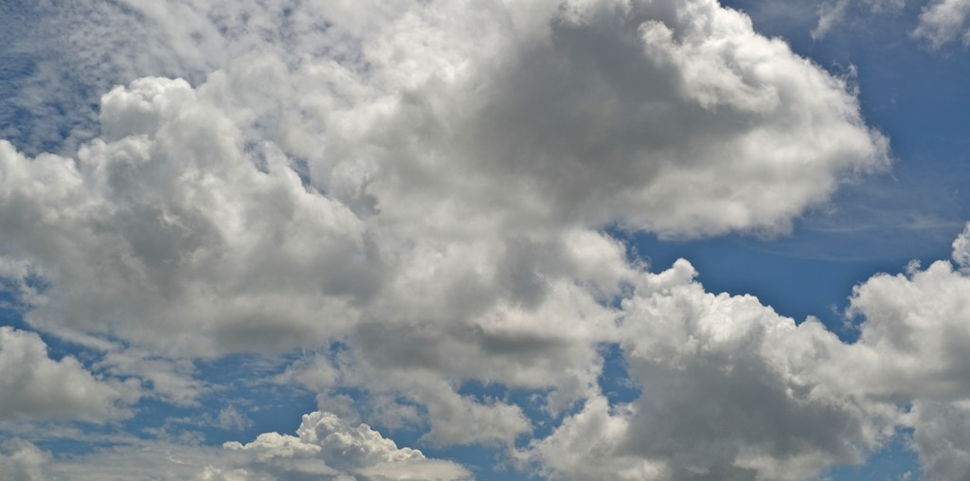
Be like a cloud…
Notes:
CREDIT LINE: Annie Bungeroth
COUNTRY: Kenya
LOCATION: Logorate
CAPTION: Sky with clouds

Slide 10
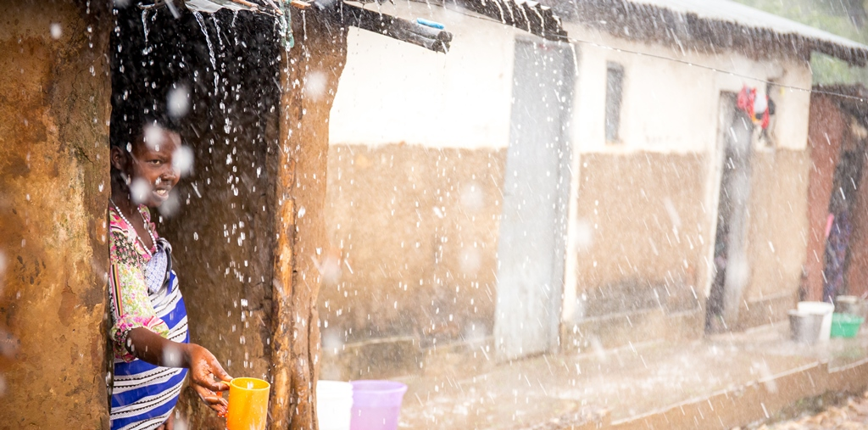
a cloud that brings rain always.
Notes:
CREDIT LINE: CAFOD/Ben White
COUNTRY: Uganda
LOCATION: Karamoja, northeast Uganda
CAPTION: Sheltering from rain

Slide 11
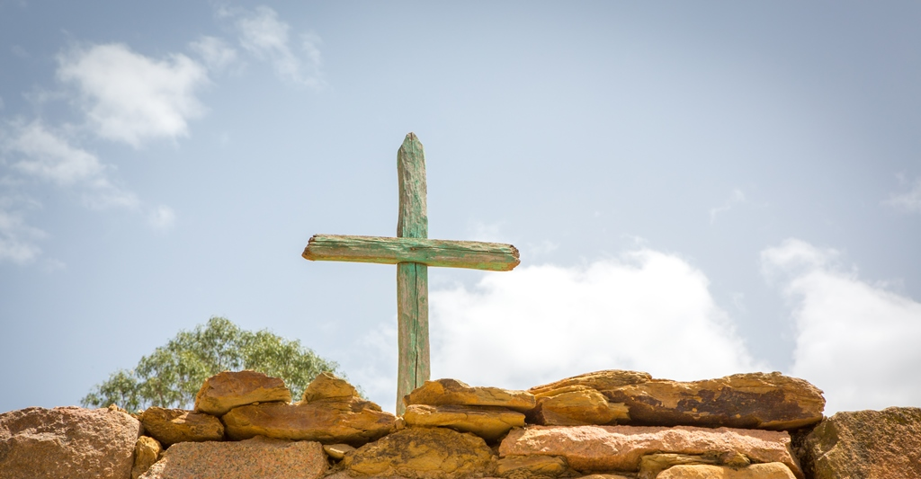
And God promised that it would be so.
Notes:
CREDIT LINE: Louise Norton/CAFOD
COUNTRY: Ethiopia
LOCATION: Adigrat, Tigray region
CAPTION: Cross on rooftop

Slide 12
