Slide 1
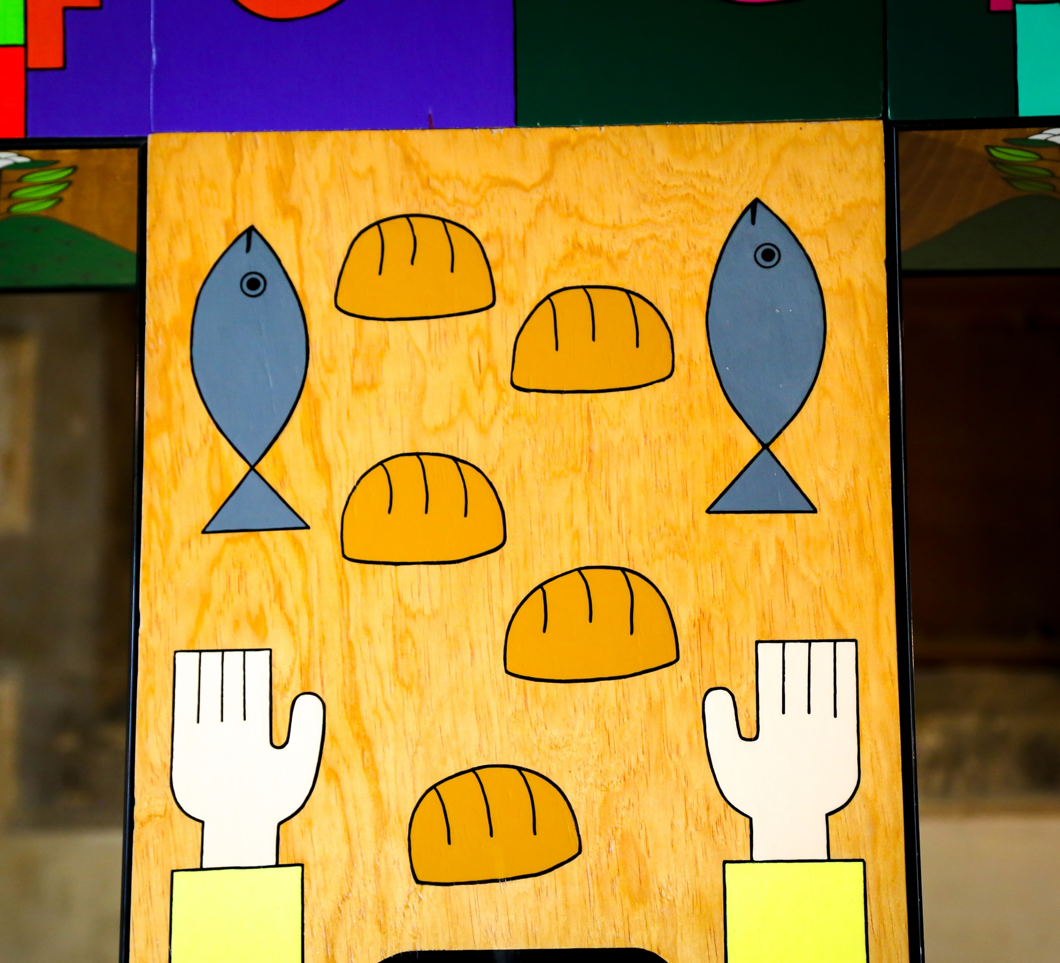
Corpus Christi
Celebration of the word
Gather
For Primary Schools
Notes:
Photo credit: St Oscar Romero memorial cross in Southwark cathedral. By Salvadoran artist Fernando Llort
Song suggestions
Eat this bread, drink this cup (633, Laudate)
Bread of life, hope of the world (78, Laudate)
Bread for the world, a world of hunger (625, Laudate)

Slide 2
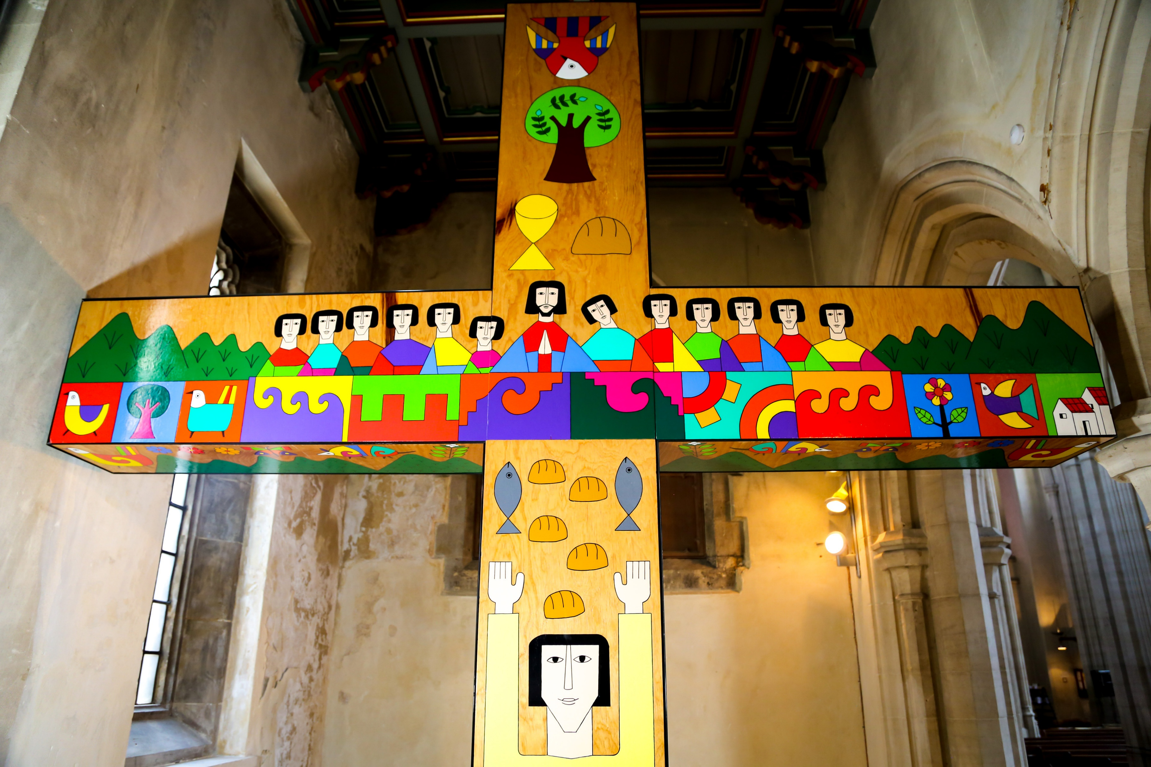
Welcome to our time of prayer.
Notes:
Photo credit: St Oscar Romero memorial cross in Southwark cathedral. By Salvadoran artist Fernando Llort
Reader: In the name of the +Father, and of the +Son, and of the +Holy Spirit Amen.
Today we celebrate the Feast of Corpus Christi. Just as one loaf of bread is made with many grains of wheat, so there are millions of people around the world, but we are all joined together as one family.
Reader: When we gather as a church or school community to receive the Body of Christ we show that we are united as the Body of Christ. When we share with our neighbour, we become sisters and brothers in Jesus, and bring his life and love into the world.

Slide 3
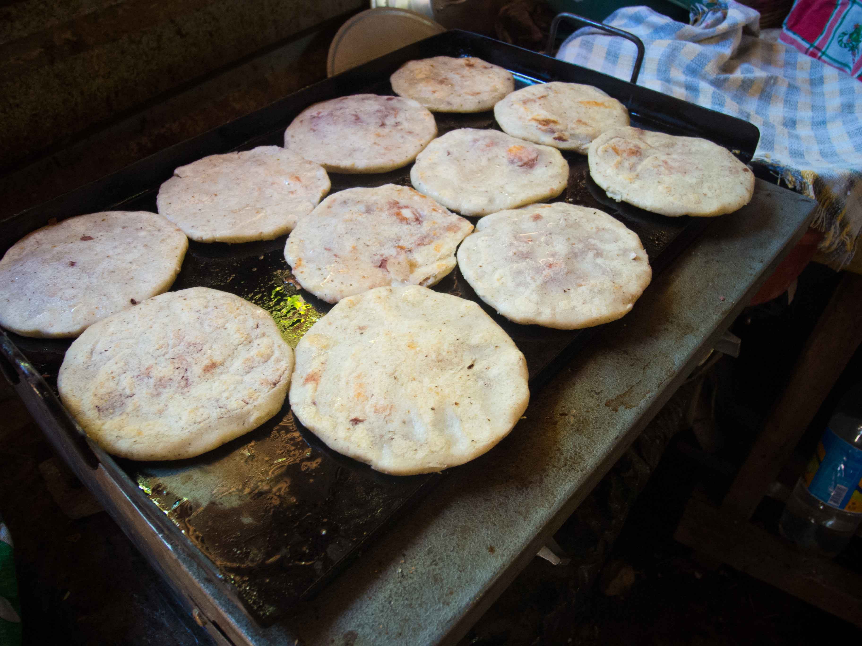
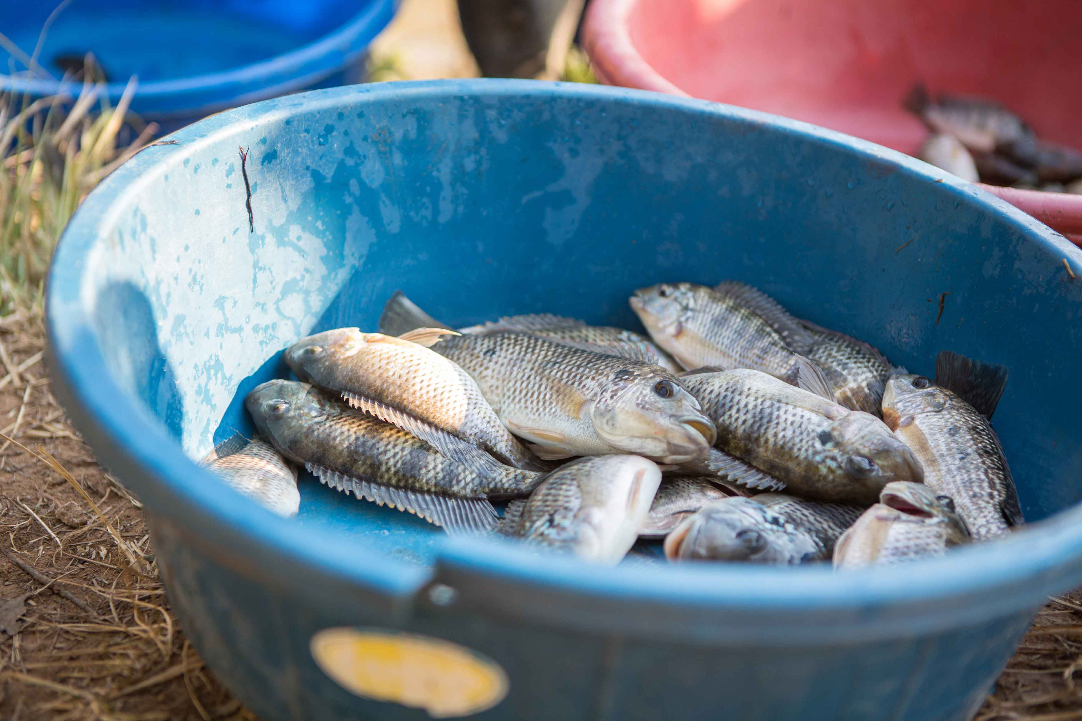
A reading from the
Gospel of Matthew
Word
Notes:
Photo credit: Fish farming in, Zambia and Pupusa bread in El Salvador.
Reader: A reading from the Gospel of Matthew
“As Jesus stepped ashore he saw a large crowd; and he took pity on them and healed their sick.
When evening came, the disciples went to him and said, 'This is a lonely place, so send the people away, and they can go to the villages to buy themselves some food.'
Jesus replied, 'There’s no need for them to go: give them something to eat.’
But they answered, 'All we have with us is five loaves and two fish.’
So Jesus said, 'Bring them here to me.’ He took the five loaves and the two fish, raised his eyes to heaven and said the blessing.
And breaking the loaves he handed them to his disciples, who gave them to the crowds.
They all ate as much as they wanted, and they collected the scraps left over, twelve baskets full.
The Gospel of the Lord
All: Praise to you Lord Jesus Christ. (Matthew 14: 14-21)

Slide 4

SACRED SILENCE…
What is God saying to us?
Jesus shared bread and showed his love for everyone.
He wants us to do the same.
How can we do this?

Slide 5
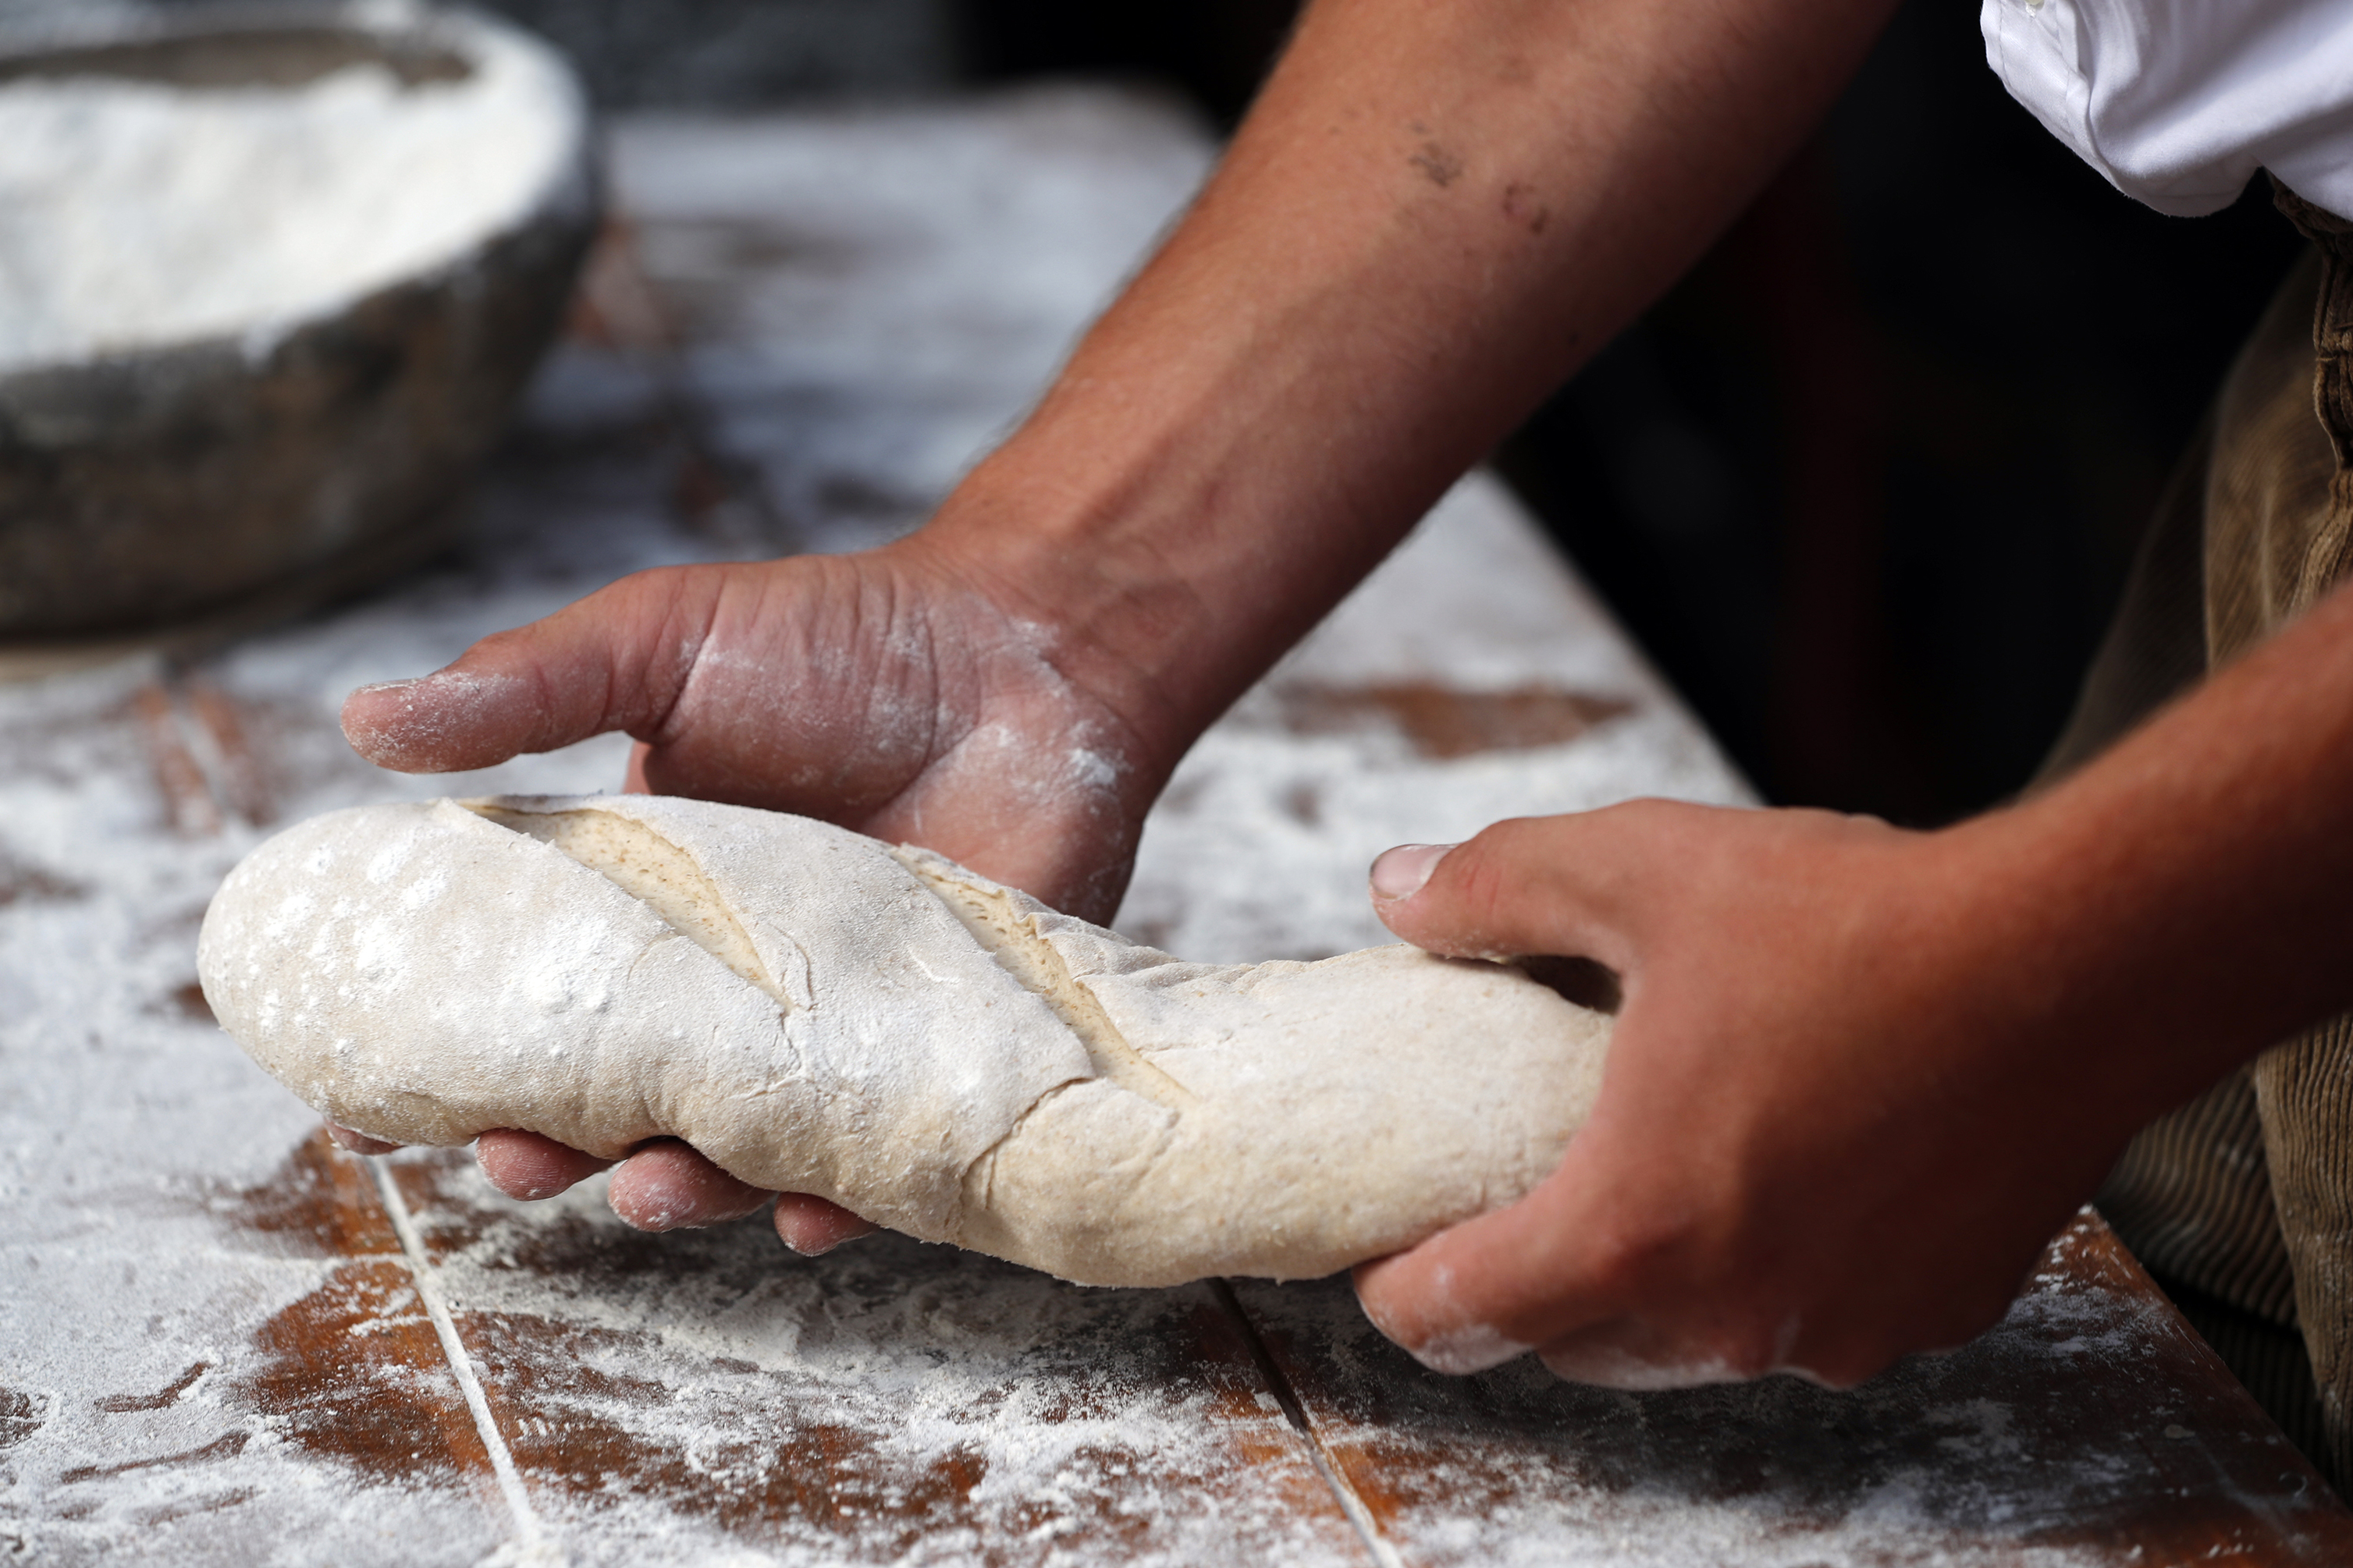
Respond
Notes:
Reader: Bread is a very important food. It is a basic food eaten by people all over the world. It is an 'everyday' food that all Jesus’ listeners would have recognised and understood.
When was the last time you had some bread?
How often do you eat bread? Every day, once a week or just on special occasions?
How many different types of bread can you name? (e.g.brown, white, baguette, pitta, naan, chapati, tortilla, injera, rolls etc.)

Slide 6
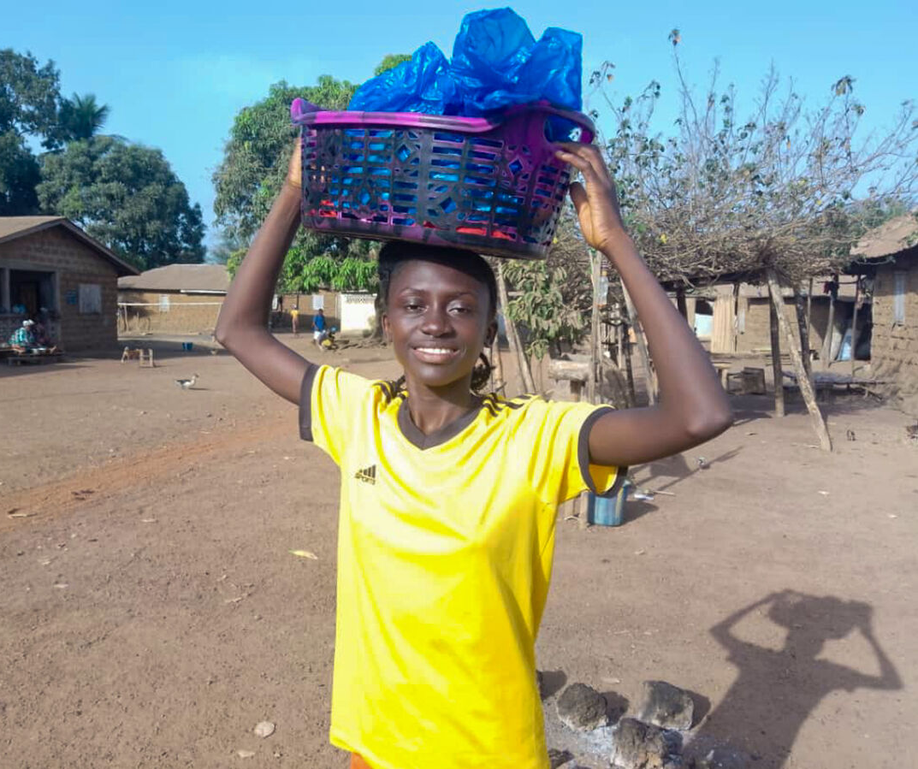
Yeabu in
Sierra Leone
Notes:
Photo credit: Yeabu, Sierra Leone
KADDRO
Reader: Yeabu is 16 years old. She lives in Sierra Leone and wants to become a nurse to help people in her community.
Yeabu lives with her grandmother who had a bakery business, but she became ill and had to stop baking.
In their village, there is a savings and loans group run by the local women. Yeabu had an idea and went to the group for a loan.

Slide 7
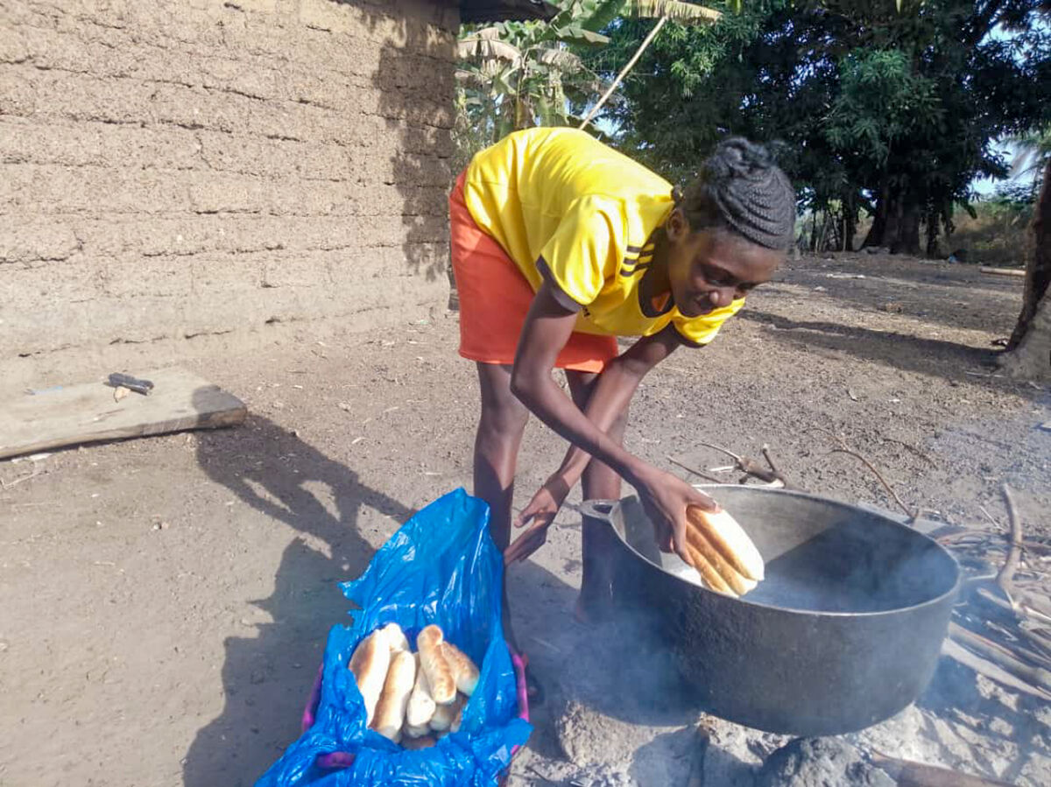
Notes:
Yeabu, Sierra Leone
Photo credit: KADDRO
Yeabu restarted her grandmother’s bread business and it's doing well.
She has paid back the loan and can also buy the things she needs:
“I bought a science book. My dream is to become a nurse but also to set up a bakery and name it after my grandmother. Re-starting the bakery makes her proud - I saw the smile on her face."

Slide 8
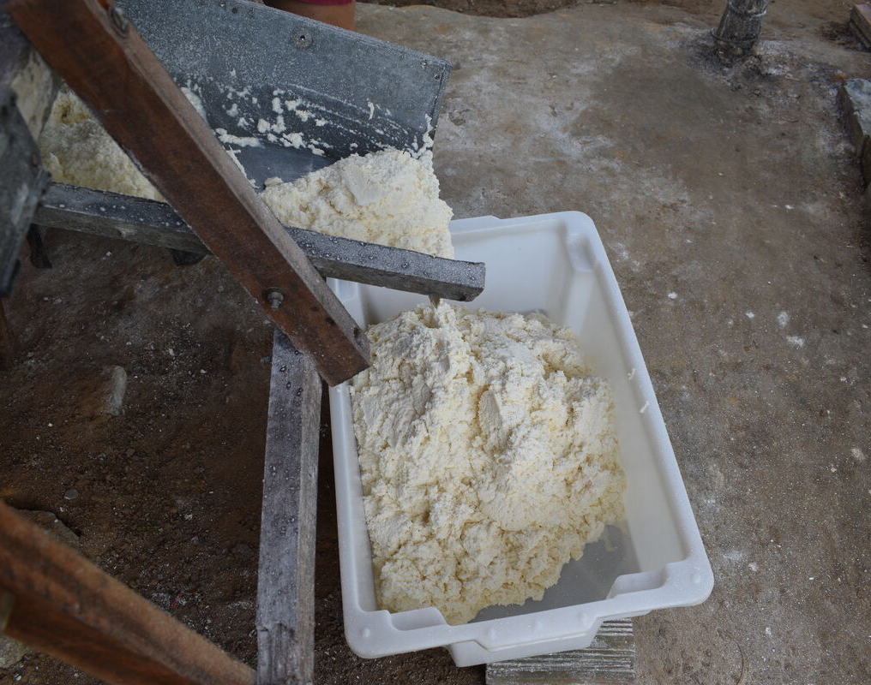
Notes:
Photo credit: Cassava flour, Brazil
Reader:
We pray for all people who make sure that we have bread to eat every day - the people who grow the ingredients, who make the flour.
We pray for Yeabu and for all people who make bread around the world; for all people who sell bread and for those who buy it for us to eat.
We pray especially for people who are struggling for enough food to eat at this time, in our own community and throughout the world.

Slide 9

Dear Jesus,
We thank you for all your gifts, especially for the gift of yourself in Communion.
Help us to share all our gifts with our sisters and brothers.
Thank you for all we have received.
Amen
Send

