Slide 1
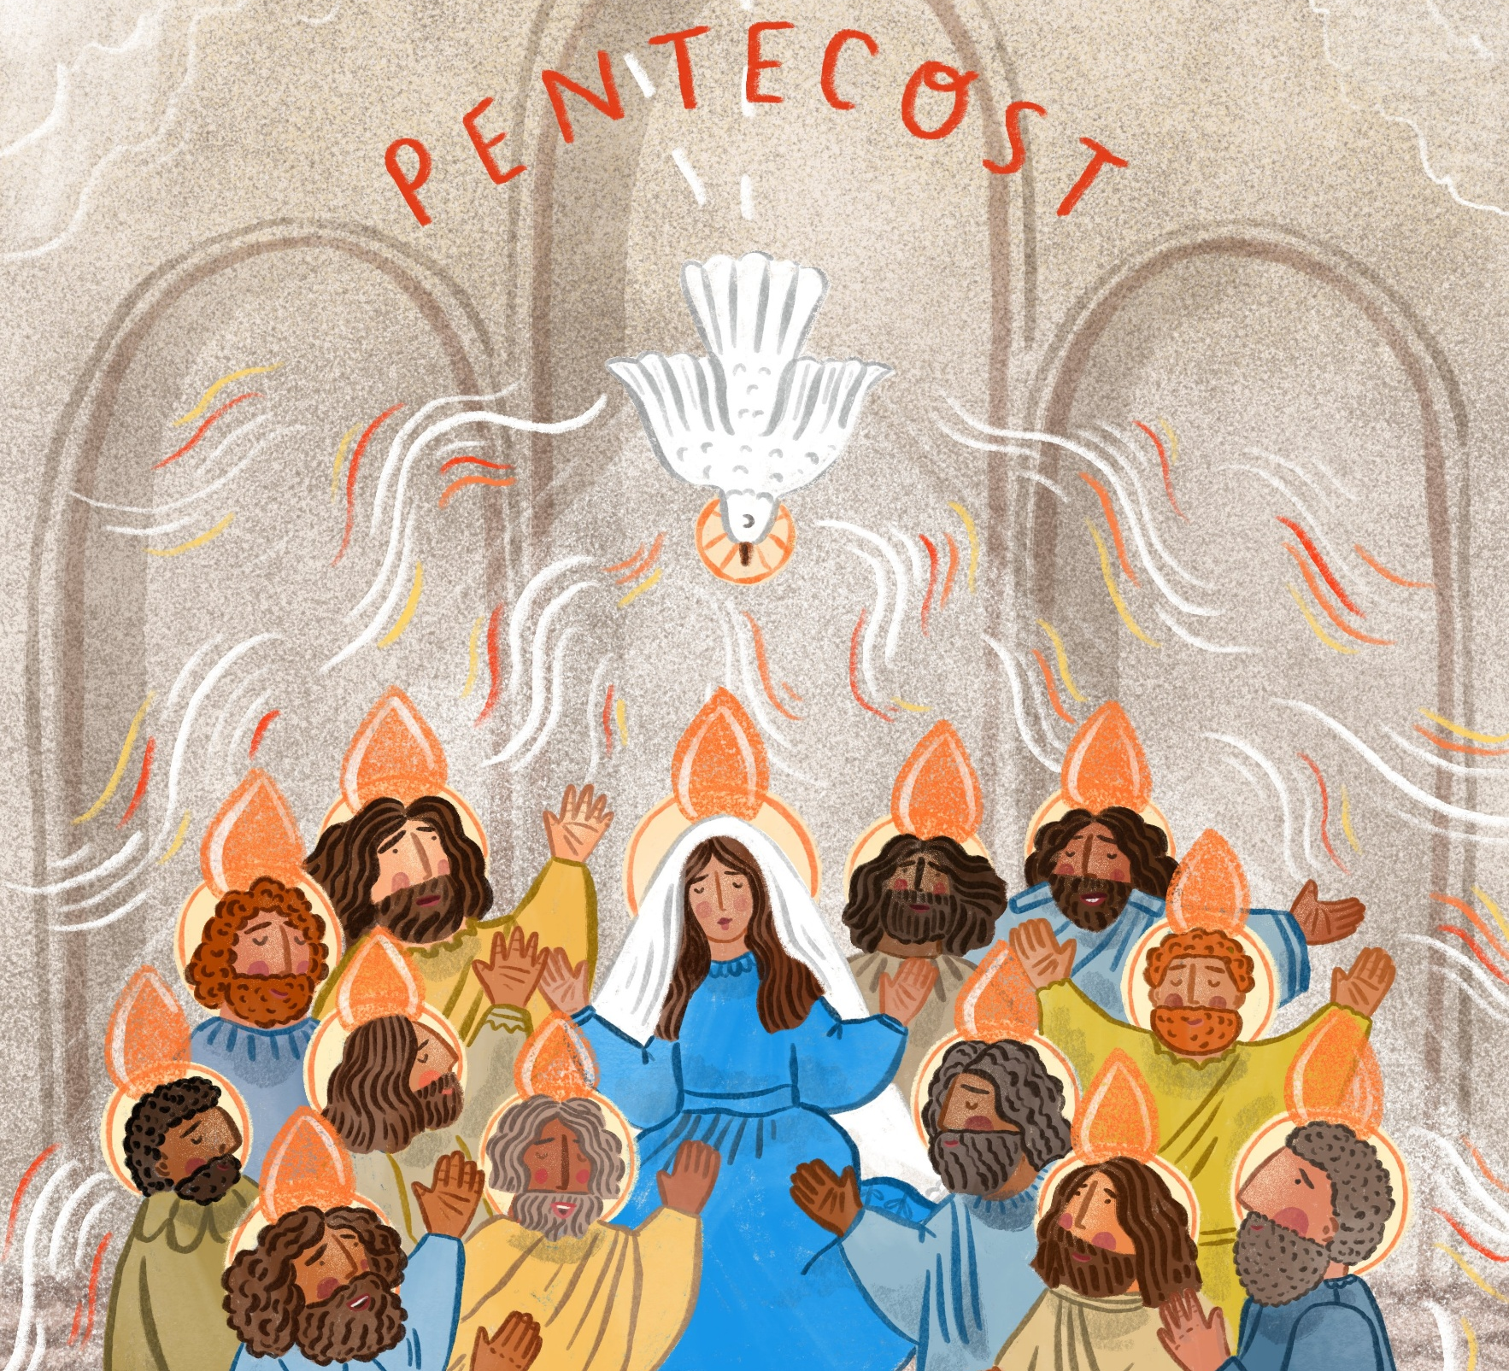
Pentecost
Celebration of the word
Gather
For Primary Schools
Notes:
Song suggestions
Shine Jesus shine (770, Laudate) Spirit of the Living God (306, Laudate)

Slide 2

Welcome to our time of prayer.
Notes:
Reader: Today we are celebrating the great feast of Pentecost, the coming of the Holy Spirit and the birthday of the Church.
And so, as God’s people, we gather in the name of the +Father, and of the +Son, and of the +Holy Spirit.

Slide 3
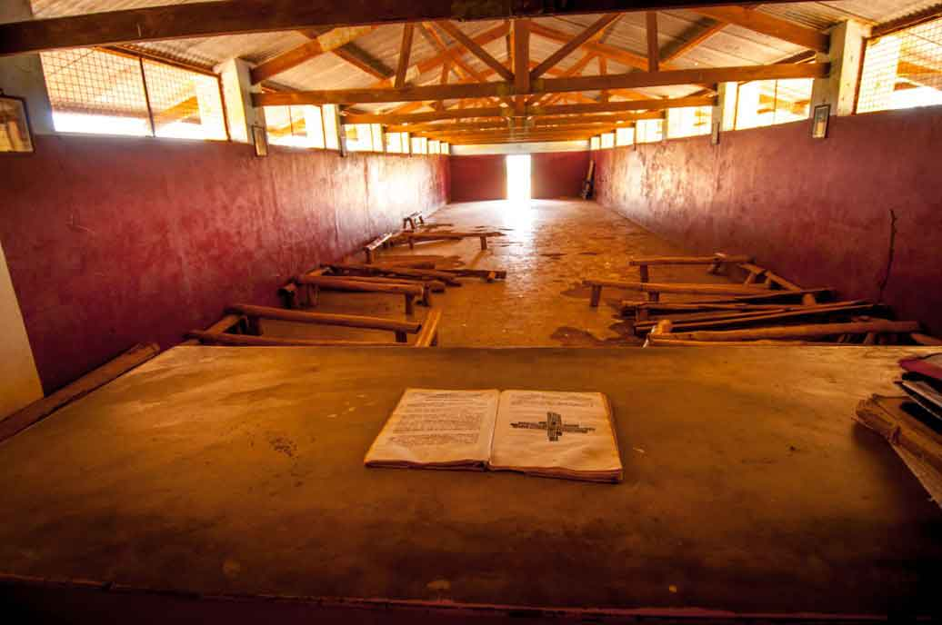
A reading from the
Acts of the Apostles
Word
Notes:
Photo credit: A Catholic chapel in Uganda
David Mutua
Reader: In the Acts of the Apostles, we hear about how the apostles were filled with the Holy Spirit.
Reader: A reading from the Acts of the Apostles: “When Pentecost day came round, the apostles and Mary met together to pray. Suddenly there came from heaven a sound like a violent wind which filled the entire house where they were sitting; there appeared to them tongues of fire, which separated and came to rest on the head of each of them. They were all filled with the Holy Spirit…”
The Word of the Lord
All: Thanks be to God
(Acts 2: 1-4)

Slide 4

SACRED SILENCE…
What is God saying to us?
Imagine you were sitting with Mary and the apostles.
How would you have felt being filled with the Holy Spirit?
Notes:
Optional slide- Following the reading of the Word, you may wish to provide a moment for ‘Sacred Silence’ with questions for children to ponder.
Reader: Just like the apostles and Mary and the early followers of Jesus, our school family gathers together today. We too want to be filled with the Holy Spirit.
Reader: Imagine you were sitting with Mary and the apostles. How would you have felt being filled with the Holy Spirit?
Let us have a moment of silence to think about God’s words.

Slide 5








Respond
Faithfulness
Notes:
Reader: But what does it mean to be filled with the Holy Spirit? How do we know when it happens? What difference does it make?
Reader: In one of his letters, St Paul, a famous teacher and follower of Jesus, tells us how to recognise the presence of the Holy Spirit in our lives and he calls these qualities ‘fruits’. Just as we can tell that a tree is good because it produces good fruit, in the same way, we can tell that we are allowing the Holy Spirit to work in us, by the way we behave towards other people.
Reader: From Paul’s letter to the Galatians. “The fruits of the Spirit are love, joy, peace, patience, kindness, generosity, faithfulness, gentleness and self control.”
Reader: When have you felt the Holy Spirit working through you? Can you remember times when you have experienced the following fruits in your life?
(Each of the next 9 slides has the name of one of the fruits of the Holy Spirit. Click through each slide slowly.)

Slide 6
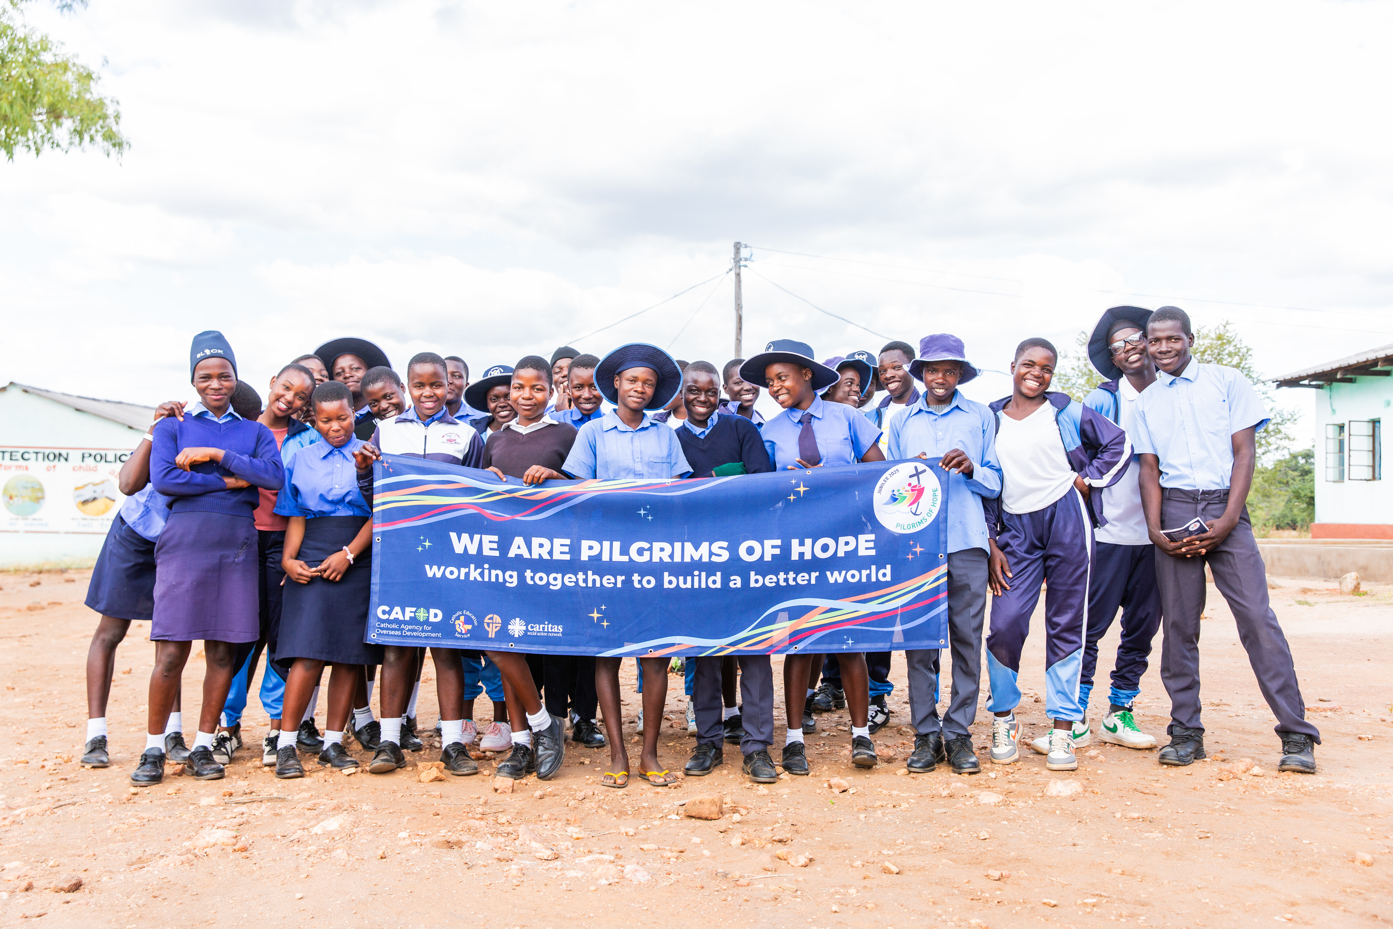
Notes:
Photo credit: Solar-powered water and community gardens in Zimbabwe
Thom Flint
The ‘Gender Clubs’ at Bungwe secondary school are a safe space for students to learn about their rights as children and express themselves freely.
They write poetry, sing and perform plays. It aims to build up their confidence.

Slide 7
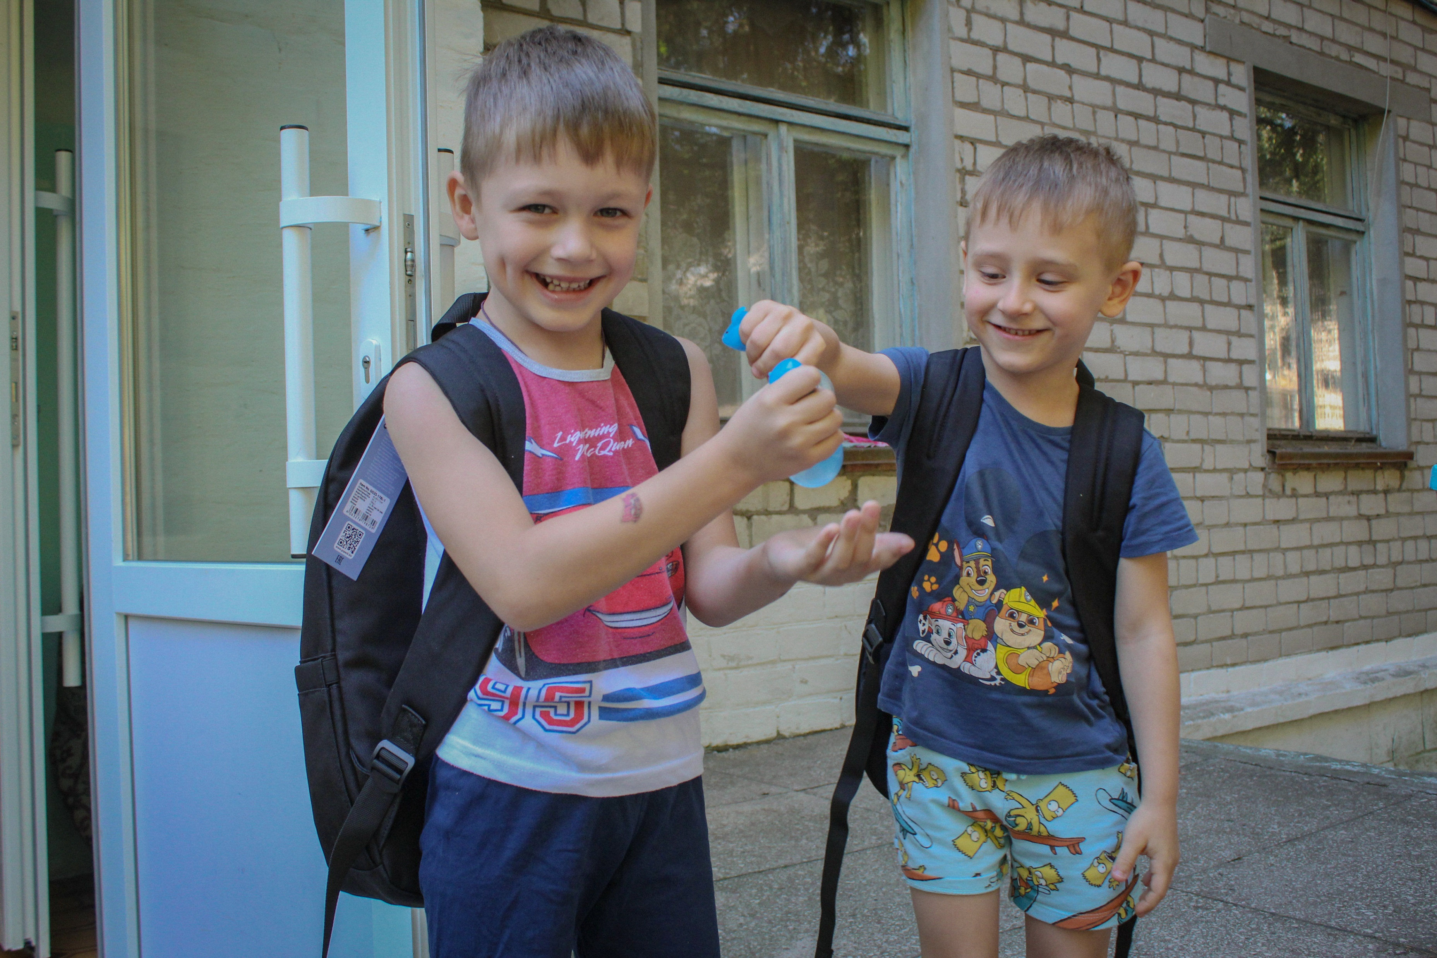
Notes:
Photo credit: Children in Ukraine
Ben White
The School Backpack campaign in Ukraine provides children with fully equipped school bags that bring stability, joy and comfort during the ongoing war.

Slide 8
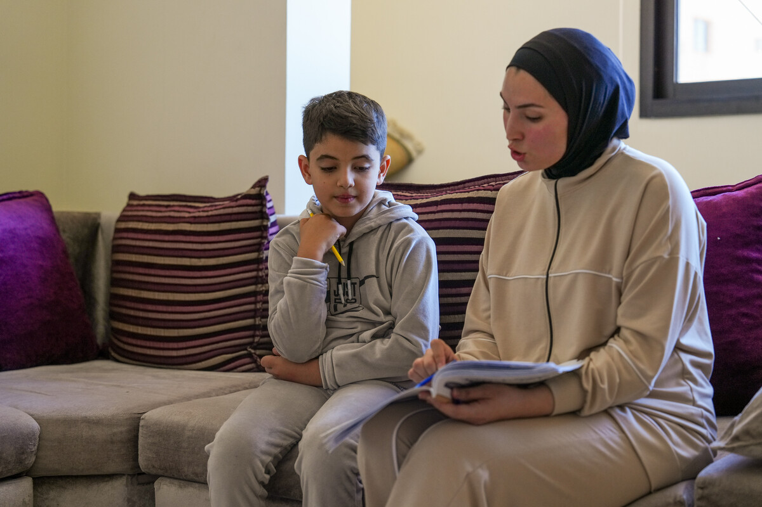
Notes:
Photo credit DEC
*CAFOD use psuedonyms for the security of our partners.
Zein* is 8 years old and had to leave his home in southern Lebanon because of the war. He is staying at a camp for displaced people in North Lebanon.

Slide 9
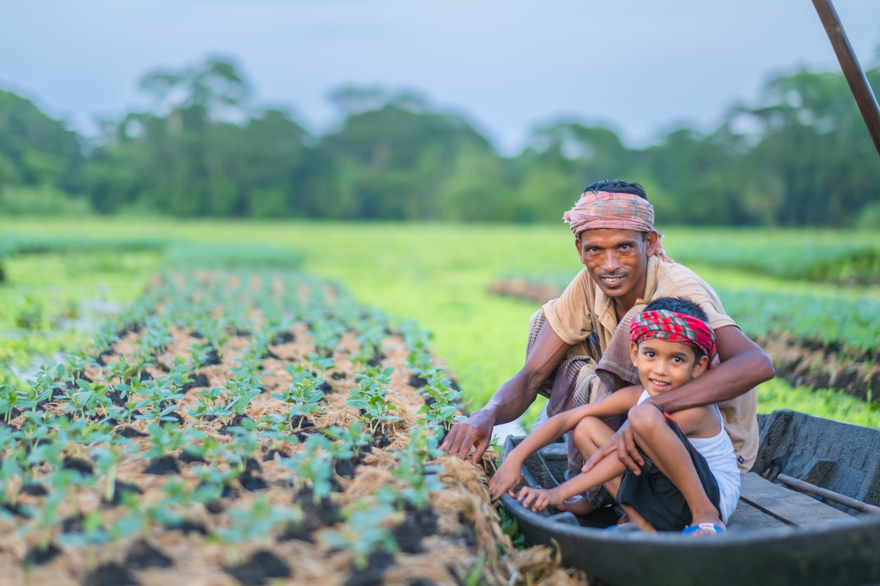
Notes:
Photo credit: A floating garden in Bangladesh
Amit Rudro
In some parts of the world, there is too little rain. In Bangladesh, there is too much. The result is the same – seeds don't grow, plants die, families go hungry. With CAFOD’s help, communities in Bangladesh are building floating gardens that are immune to floods, allowing them to grow enough food to eat and sell, helping them make a living.

Slide 10
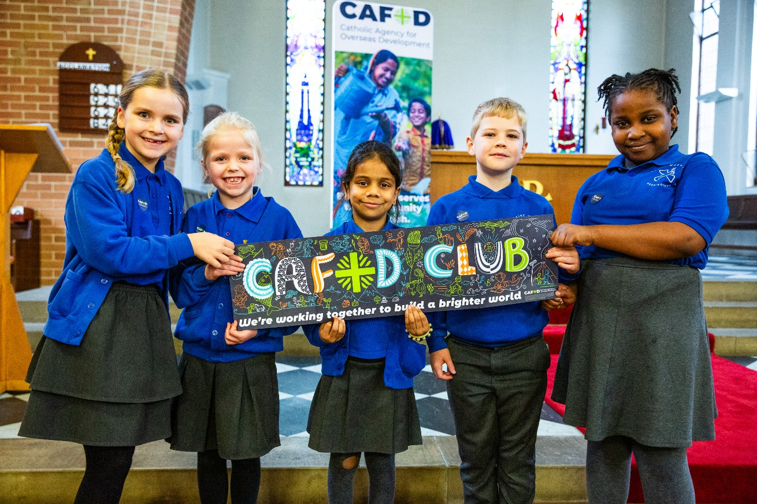
Notes:
Photo credit: Children in a CAFOD club
Thom Flint
Children all around England and Wales are setting up CAFOD clubs, working together to build a better world.

Slide 11
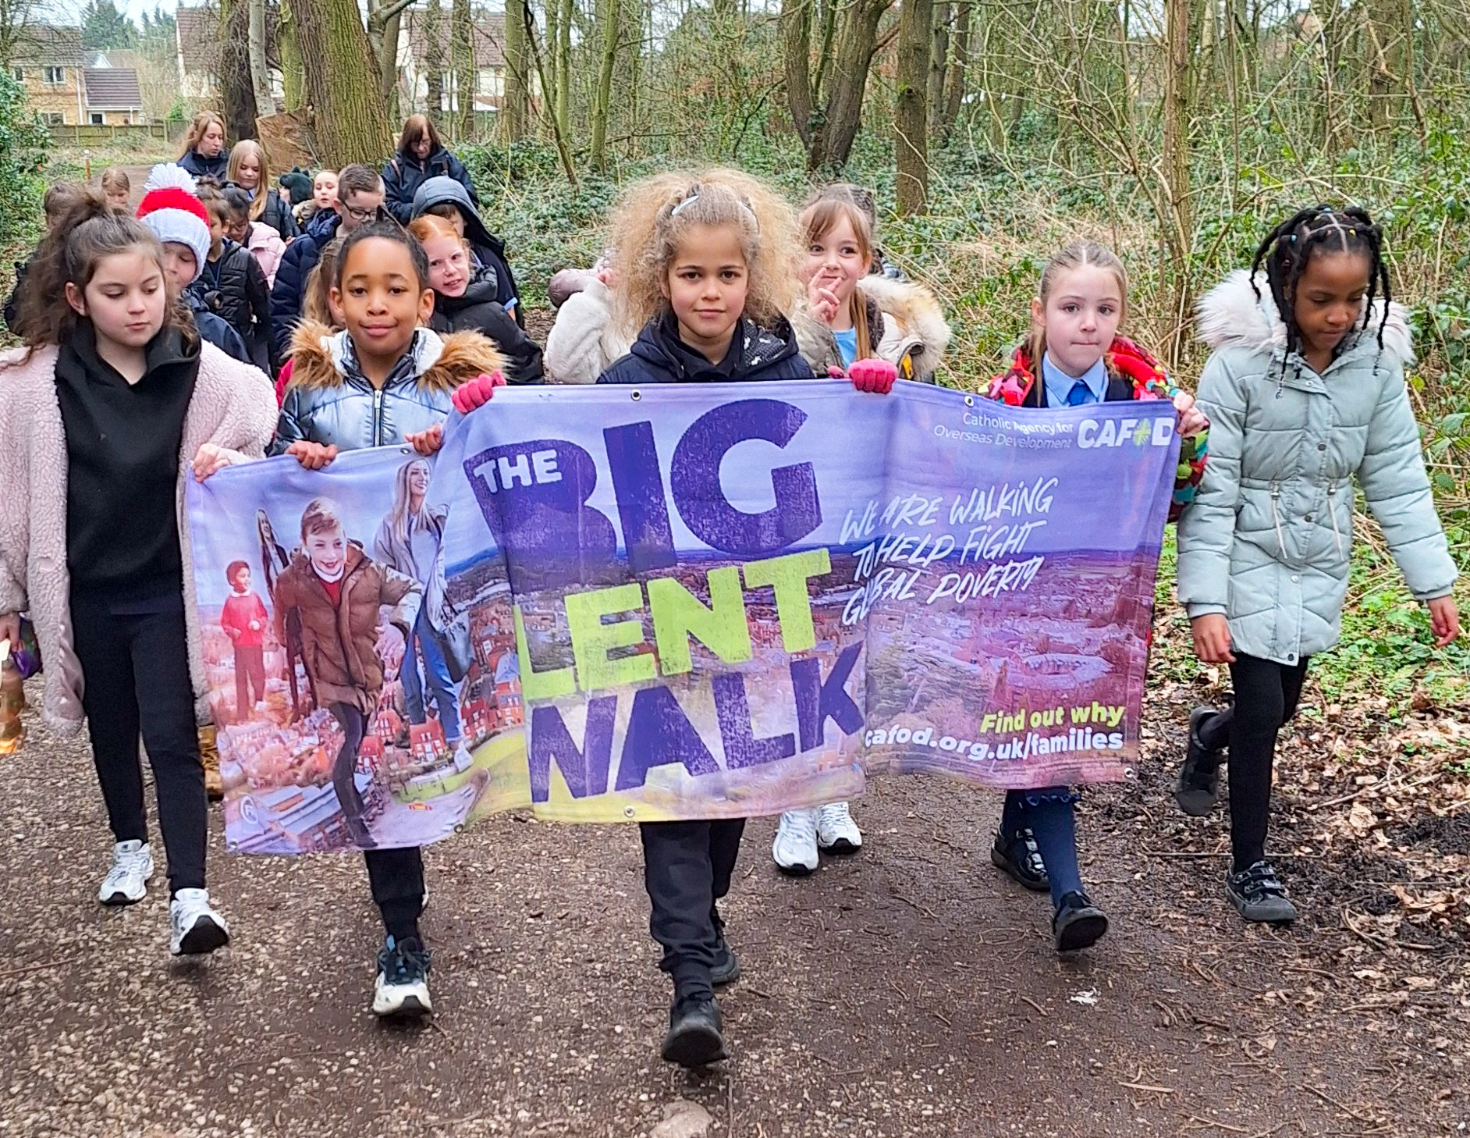
Notes:
Photo credit: Children on a Big Lent Walk
CAFOD
Every Lent, children raise money for communities around the world by walking and getting sponsored.

Slide 12
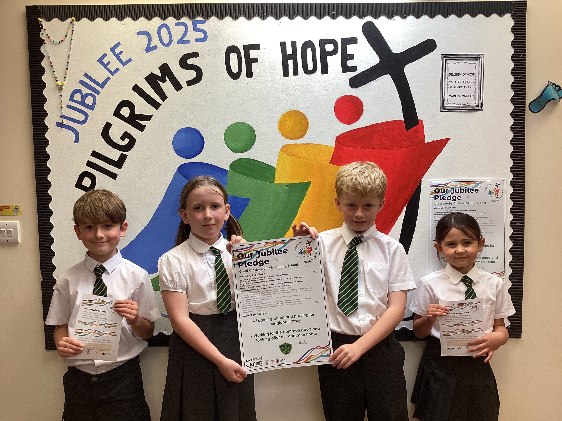
Faithfulness
Notes:
Background information: Children taking part in Stations of the Cross in El Salvador
Photo credit: Mark Chamberlain | CAFOD (2017)
. Pope Francis and Pope Leo asked us all to be living signs of hope in the Jubilee Year 2025, and schools across England and Wales made special Pledges where they committed to building a better world and putting Catholic Social Teaching into action.

Slide 13
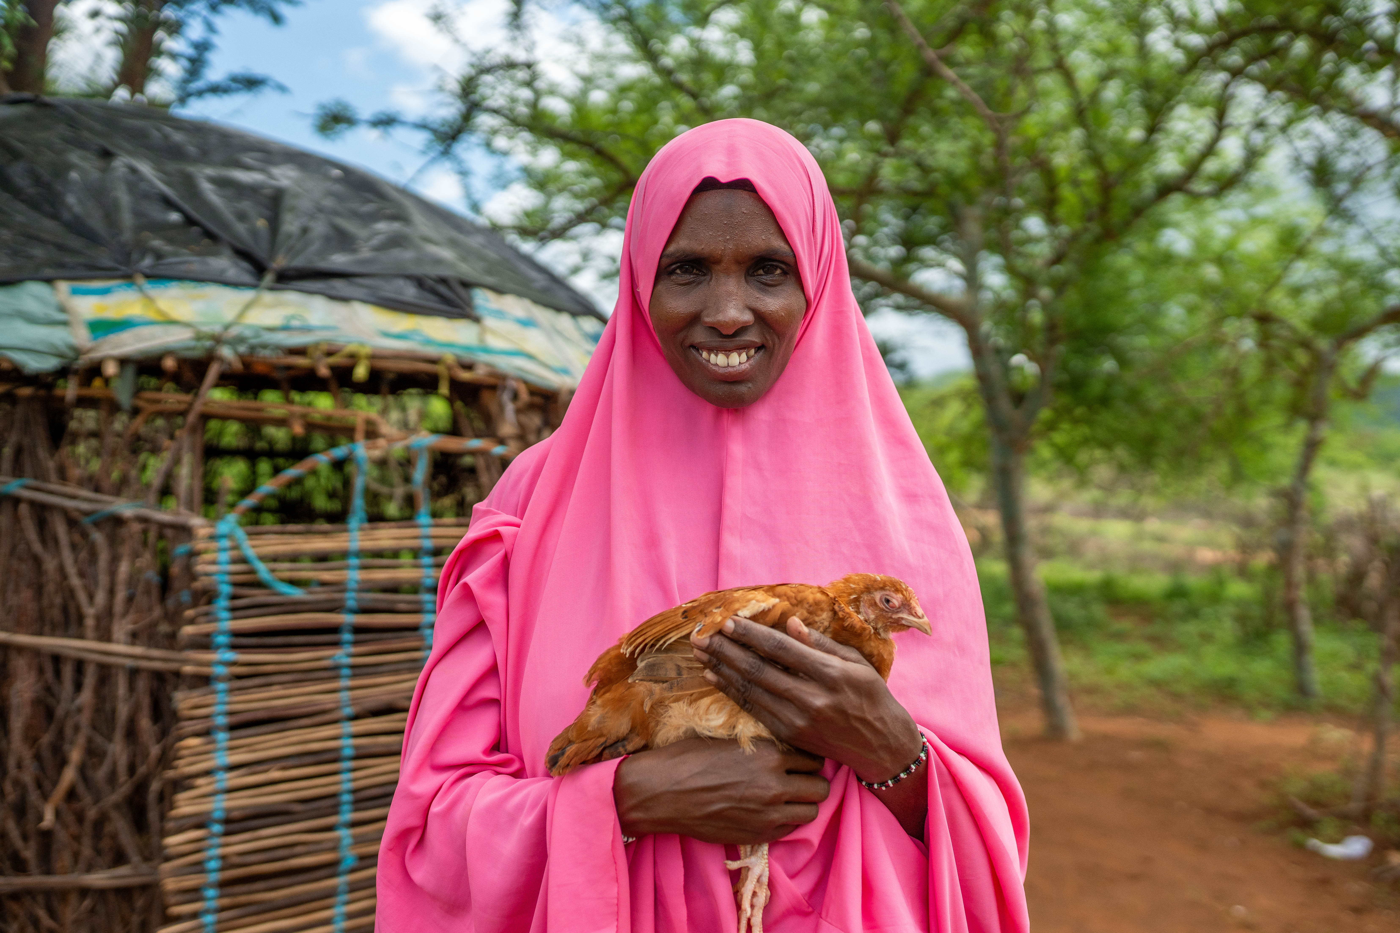
Notes:
Photo credit: Kerra in Kenya
Louise Norton
Kerra is part of a women’s group in Kenya. The women are raising and caring for chickens to make a living.

Slide 14
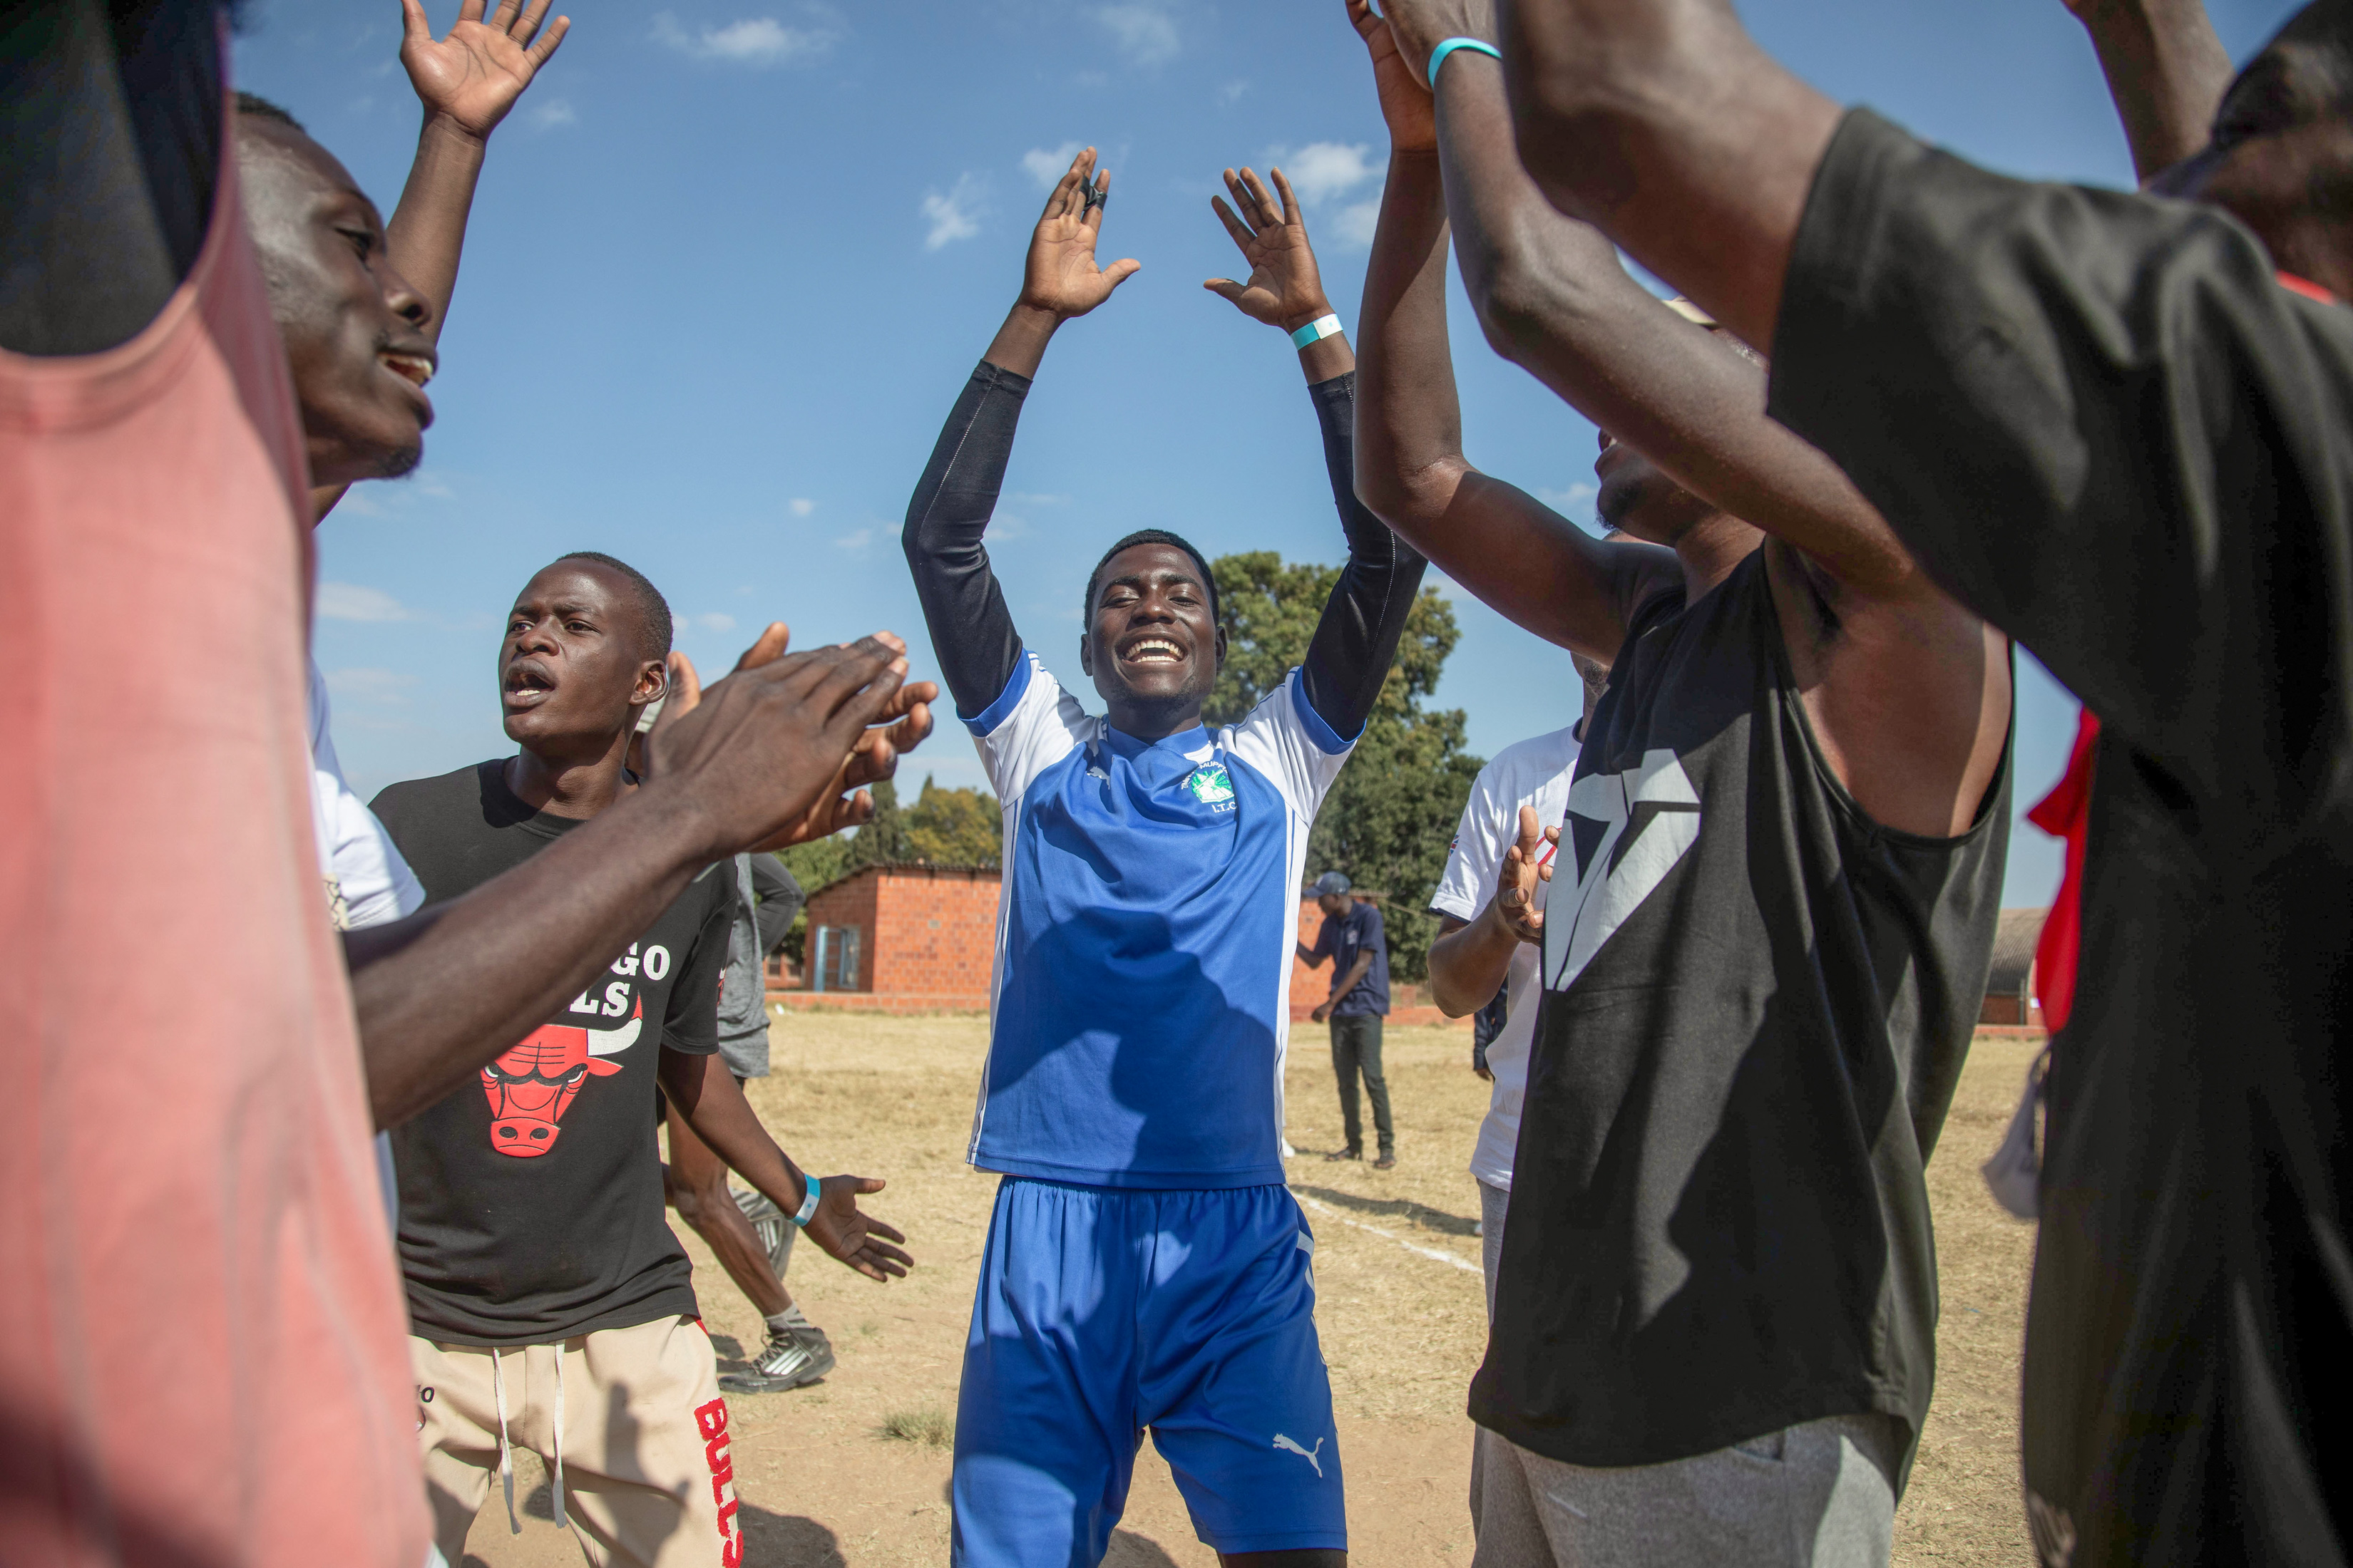
Notes:
Photo credit: A sports club in Zimbawe
Cynthia Matonhodze
Young people in Zimbabwe take part in sports activities with CAFOD partners, as a way to build community, peace, cooperation and hope.

Slide 15
Respond
Response: Come, Holy Spirit, help us to transform your world
Notes:
Reader: We recognise the presence of God in our hearts, in our families and in our school community. We ask the Holy Spirit to work through us, as we share our lives and give our support to our sisters and brothers throughout the world.
And so we pray…
- Spirit of life, you made the disciples talk in different languages, speak through us, and fill us with the language of your love.
(Response: Come, Holy Spirit, help us to transform your world)
- We pray that love may fill our hearts so that we are open to others (Response)
- We pray that all your children may experience joy in their lives (Response)
- We pray that wars may end, and peace comes to those who suffer (Response)
- We pray that we may avoid putting ourselves first, and instead focus on thinking about the needs of others (Response)

Slide 16
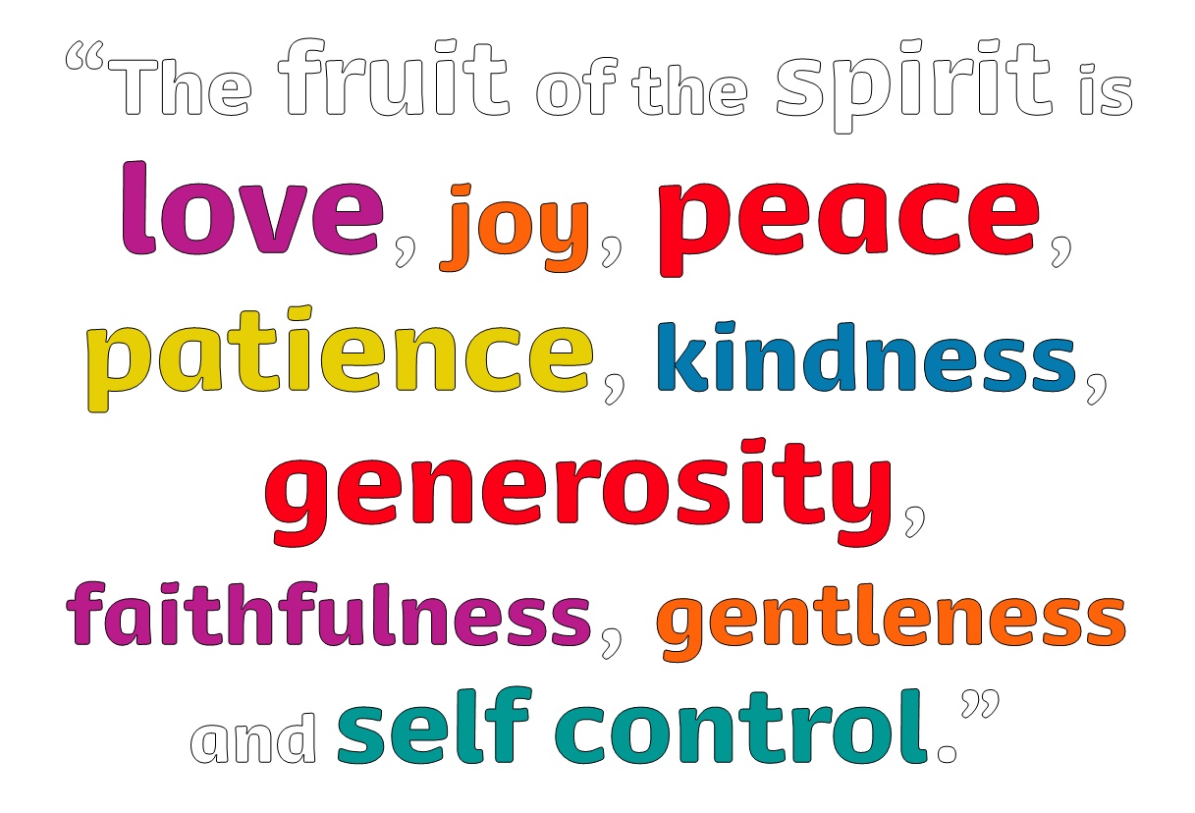

Send
Notes:
What can we all do to support to our sisters and brothers throughout the world?

