Slide 1
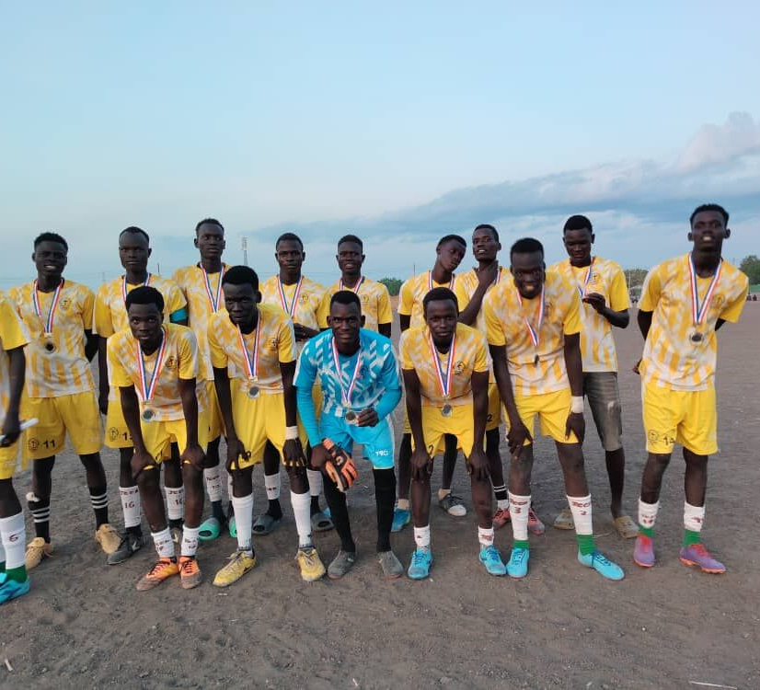
How can we do our best to treat people the way we would like to be treated and help others do the same?
Gospel Celebration of the Word
Notes:
Children’s liturgy: Twenty-fourth Sunday in Ordinary Time (Year A)
Preparation of the worship space
Colour: green
Song suggestions
Freely, freely (849, Laudate)
O Lord, all the world belongs to you (847, Laudate)
Welcome
Today Jesus talks about forgiveness – about how God is always ready to forgive us if we say sorry. And about how we should try to forgive others if they say sorry to us. Let’s think a bit more about this today...
Building peace through sport, South Sudan
Photo credit: Caritas Diocese of Malakal

Slide 2
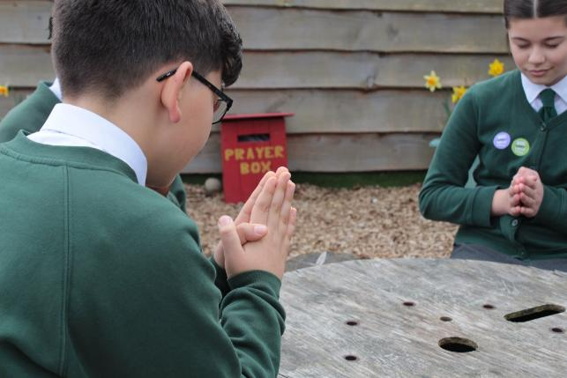
Merciful God,
We are truly sorry for the things that we have done wrong. Forgive us and help us to try to forgive others as your son Jesus teaches us. Amen.
  Gather
Notes:
St Francis Xavier's RC Primary School, Herefordshire
Photo credit: Vicky Ahmed

Slide 3
Gospel: Matthew 18:21-35
Then Peter came to Jesus and asked, “Lord, if my brother keeps on sinning against me, how many times do I have to forgive him? Seven times?”
“No, not seven times,” answered Jesus, “but seventy times seven, because the Kingdom of heaven is like this.
"Once there was a king who decided to check on his servants' accounts. He had just begun to do so when one of them was brought in who owed him millions of pounds. The servant did not have enough to pay his debt, so the king ordered him to be sold as a slave, with his wife and his children and all that he had, in order to pay the debt.
"The servant fell on his knees before the king. ‘Be patient with me' he begged 'and I will pay you everything!’ The king felt sorry for him, so he forgave him the debt and let him go.
Word

Slide 4
Gospel: Matthew 18:15-20
“Then the man went out and met one of his fellow servants who owed him a few pounds. He grabbed him and started choking him. ‘Pay back what you owe me!’ he said. His fellow-servant fell down and begged him, ‘Be patient with me, and I will pay you back!’ But he refused; instead, he had him thrown into jail until he should pay the debt.
When the other servants saw what had happened, they were very upset and went to the king and told him everything. So he called the servant in.
‘You worthless slave!’ he said. ‘I forgave you the whole amount you owed me, just because you asked me to. You should have had mercy on your fellow-servant, just as I had mercy on you.’ The king was very angry, and he sent the servant to jail to be punished until he should pay back the whole amount.”
And Jesus concluded, “That is how my Father in heaven will treat every one of you unless you forgive your brother from your heart.”
Word

Slide 5

What do you remember from the Gospel reading?
Peter asks Jesus how many times he should forgive someone. What does Jesus answer?
Jesus says Peter should forgive someone not just seven times, but seventy times seven. That’s 490 times! That’s a lot!
Do you think Jesus wants us to count how many times we forgive someone? What happens if we forgive them more than 490 times?
Respond
Notes:
Numbers
Photo credit: Stock image

Slide 6
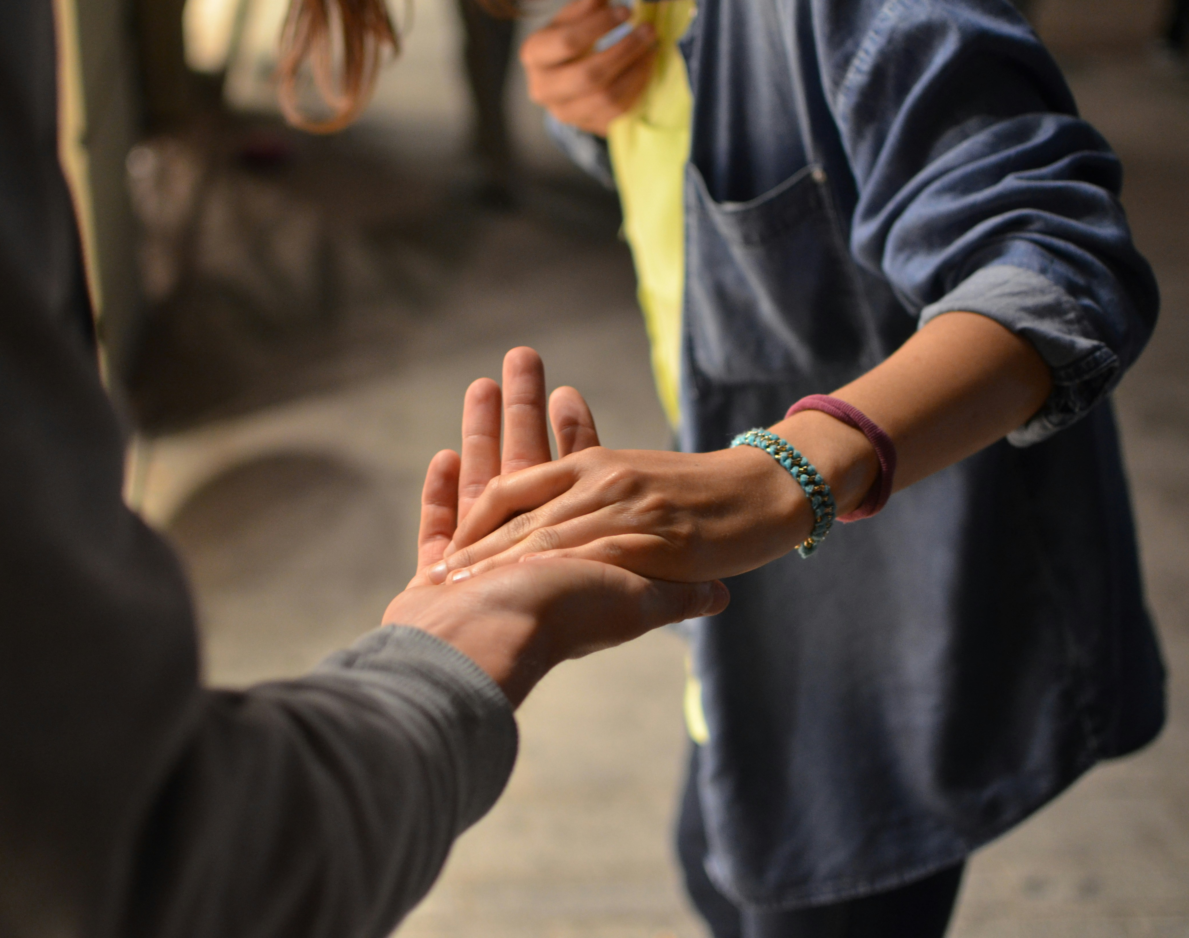
Jesus chose seventy times seven because it’s a really big number – he is saying to Peter that there should be no end to our forgiveness, just like there is no end to God’s forgiveness.
If someone is truly sorry and tries to change then we should try to forgive them.
Jesus tells Peter a story to show what he means. Can you remember what happens in the story?
Notes:
Hands
Photo credit: Remi Walle on Unsplash

Slide 7
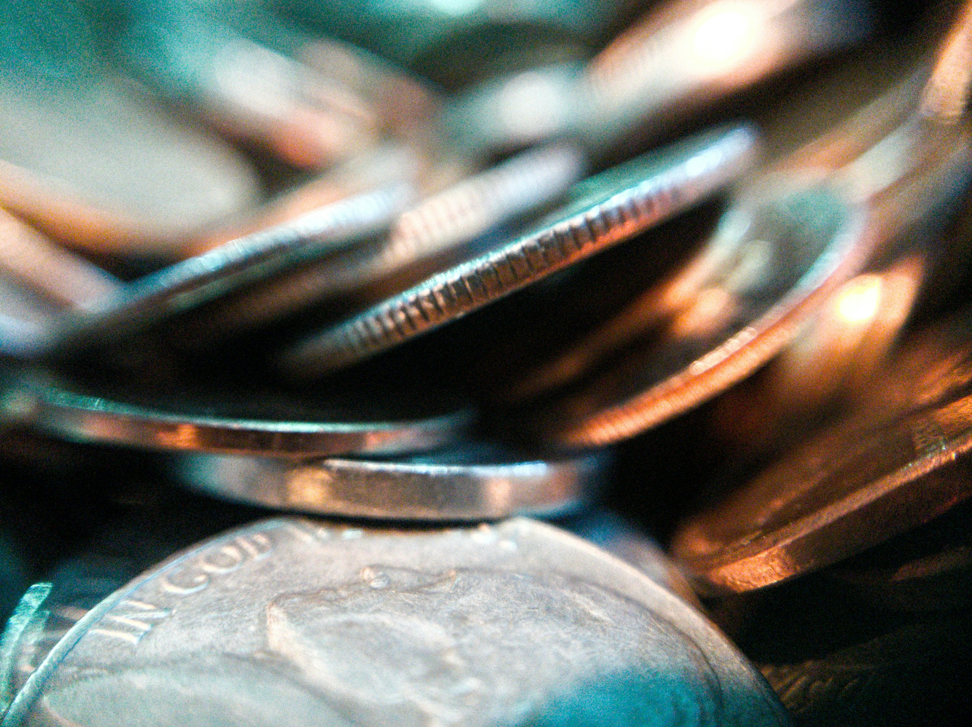
A servant owes the king lots of money and cannot pay it back. So the king decides to punish him.
But the servant asks the king to be patient and he will pay back all the money he owes. What does the king say?
The king agrees to be patient. How do you think the servant felt when he heard this?
Notes:
Money
Photo credit: Joshua Hohne on Unspash

Slide 8

But when the servant meets someone else who owes him money, what does he do?
Even though the second servant says he will pay, he is shown no mercy. The first servant has him thrown into prison.
What does the king say when he hears about this? The king is very cross and punishes the first servant. He wanted the servant to act with mercy, just as the king had done for him.
Notes:
Prison bars
Photo credit: T on Unsplash

Slide 9

Who do you think the king in this story is meant to be? And who is the first servant?
The king is God – who is always ready to be patient, merciful and forgiving with us if we ask, and if we try to change our ways.
The servant is like us – we sometimes find it hard to change our ways, to stop doing what we know is wrong.
Notes:
Reaching out
Photo credit: Marc-Olivier Jodoin on Unsplash

Slide 10
Can you think of a time when you have been forgiven? How did you feel?
Can you think of a time when someone has said sorry and said that they would not do it again, and you found it hard to forgive?
Why was it hard? How did you feel?
Notes:
Thoughtful
Photo credit: Janko Ferlic on Unsplash

Slide 11
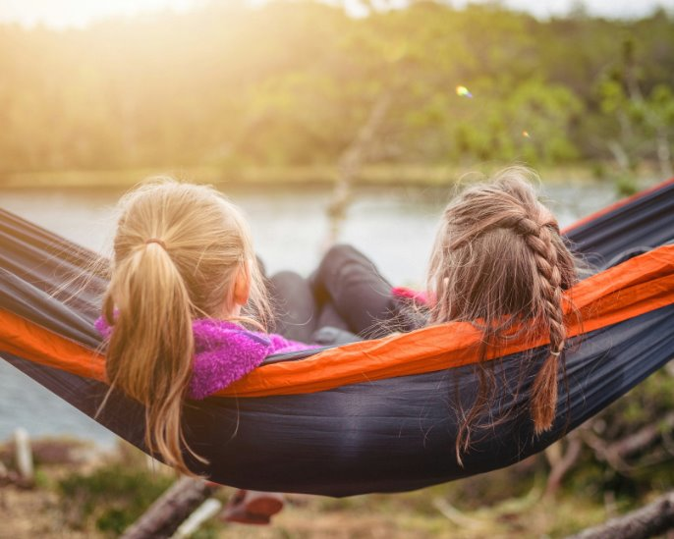
Can you think of a time when someone has said sorry and tried to change and you did forgive them? How did you feel then?
How can we help other people to see that what they are doing is wrong and that they need to make a change?
Notes:
Together
Photo credit: Janko Ferlic on Unsplash

Slide 12
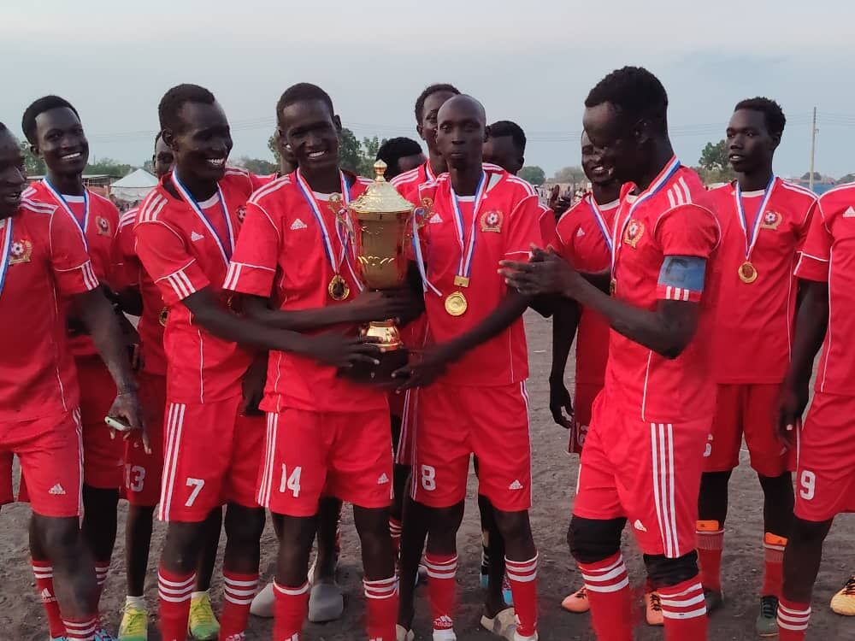
More sport! You may remember hearing the story of Vimbai who works to build peace in Zimbabwe by organising sports tournaments.
In South Sudan, CAFOD helps young people come together for football matches and running competitions. These friendly sports events help people to focus on what they have in common, rather than their differences.
Notes:
Building peace through sport, South Sudan
Photo credit: Caritas Diocese of Malakal

Slide 13
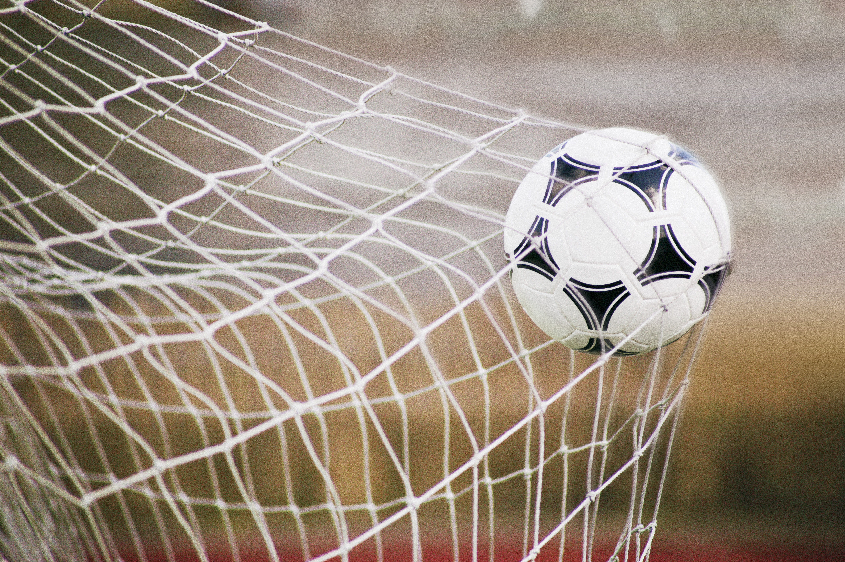
Being in a team helps people create relationships which means they can understand each other better and trust one another. You have to trust someone if you are going to pass them the ball in front of the net or the goal so they can score and help your team win!
Making these relationships helps people to forgive others and make changes in communities that are often divided.
Notes:
Goal!
Photo credit: Stock image

Slide 14
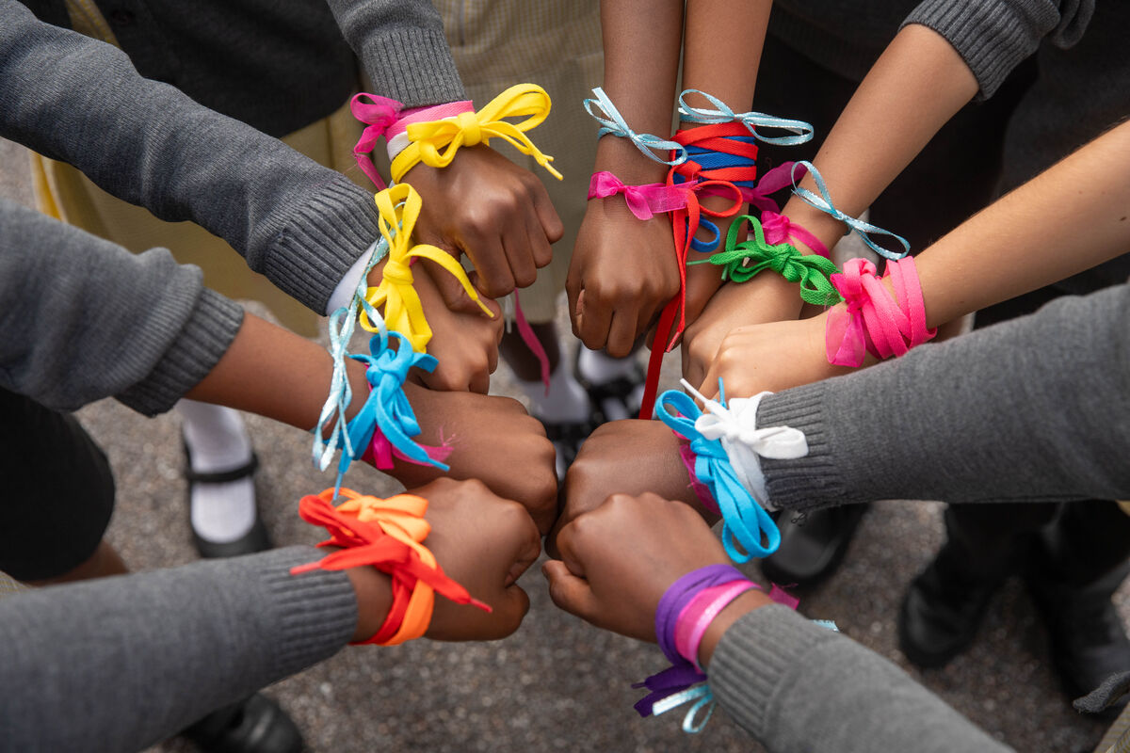
Let’s try our best to make a change in the way we treat other people, to say sorry when we have done something wrong, and to forgive and help others make a change in the way they behave.
Notes:
St Chad's primary school, London
Photo credit: Joe Newman

Slide 15
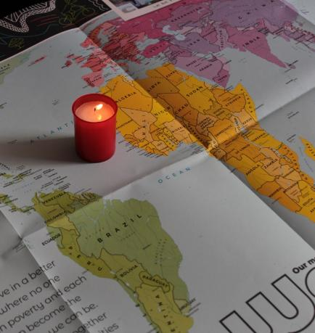
Let us pray
We pray for the church throughout the world: that it may be a living example of God's love and forgiveness for all.
Lord in your mercy…
We pray for our parish, families and friends:
that God may give us courage to say sorry when we have done something wrong and inspire us to try and be better.
Lord in your mercy...

Slide 16
Let us pray
We pray for our brothers and sisters around the world:
that we may share God's mercy, help others to treat people as we would wish to be treated and build a better world where all flourish.
Lord in your mercy…
God of love: help us to share your forgiveness with others. Guide us to do what is right and to make this world a fairer place for all who live in it. Amen.

Slide 17
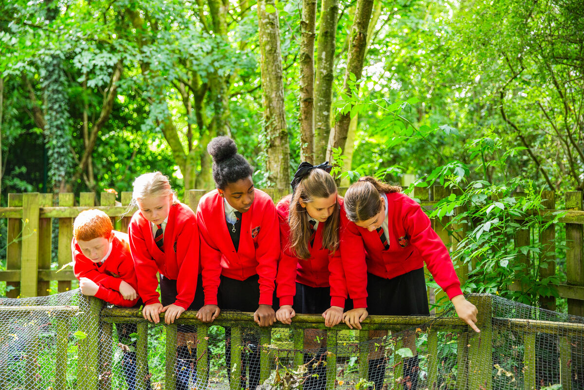
How can we do our best this week to treat people the way we would like to be treated and help others do the same?
Send
Notes:
St Gregory’s Primary School, Chorley
Photo credit: Thom Flint

Slide 18
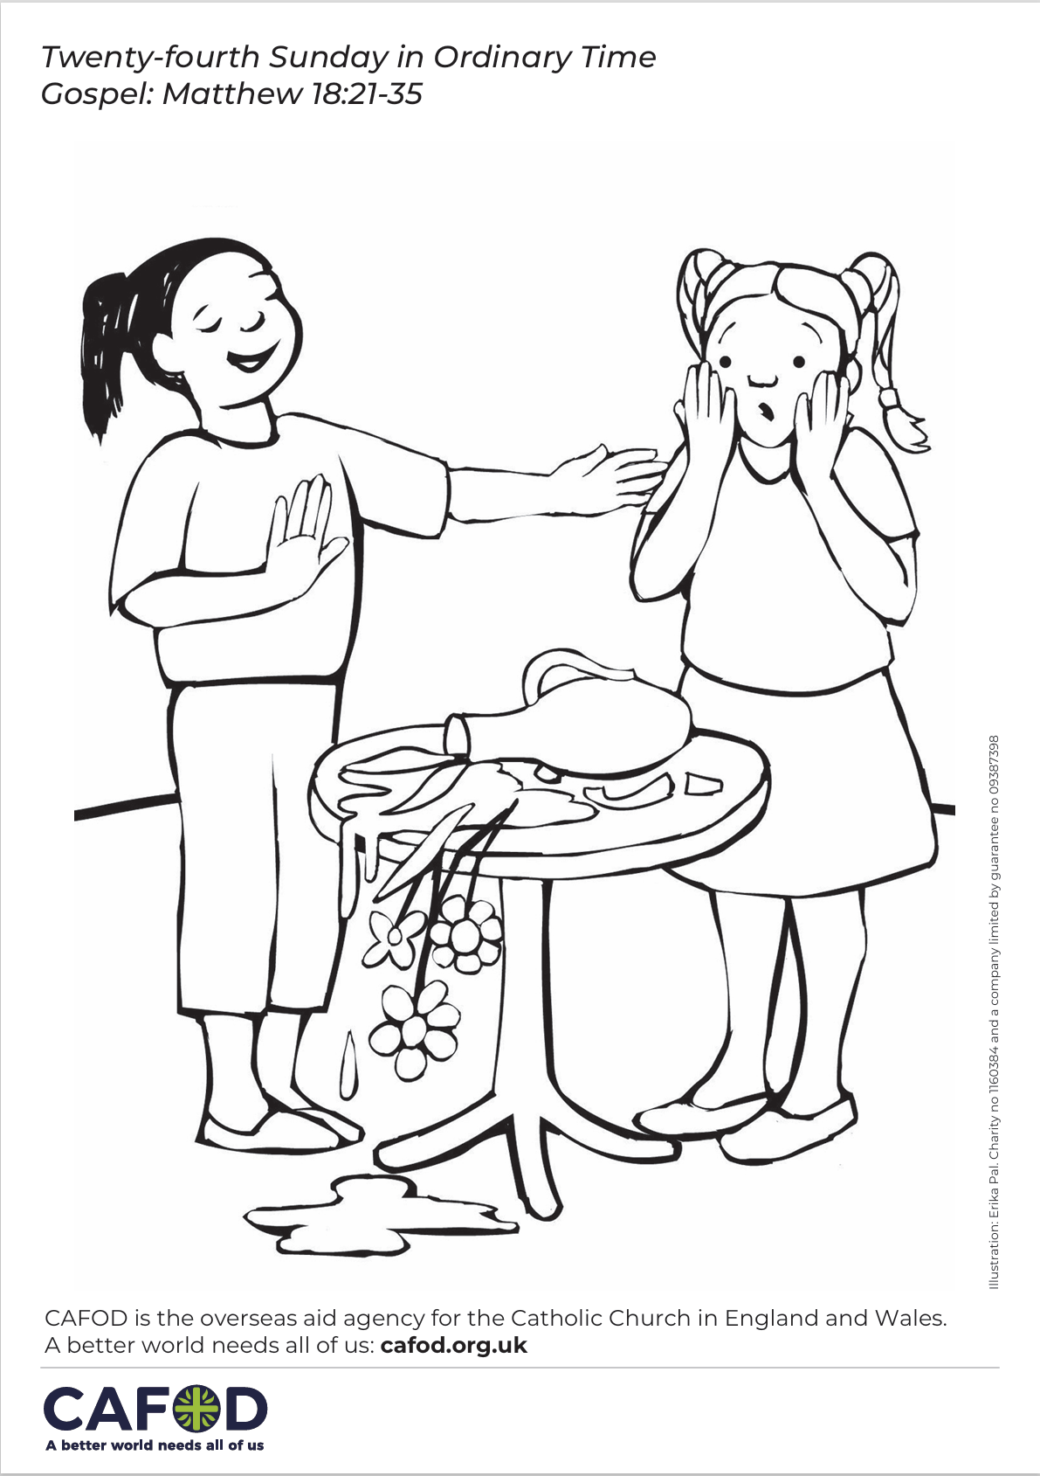
Activity suggestions
Download the illustration
Invite the children to colour in the accompanying illustration where someone has done something wrong and to write or draw on the back what they will do the next time someone asks them for forgiveness.
Encourage the children to think about something that they have done wrong. How can they make a change so that in the future they can try to be better? Encourage them to say sorry to God quietly in their hearts and to say sorry to the other person out loud in the coming week.
Invite the children to discuss all that they have heard and thought about today with their grown ups at home. Encourage the children to look out for things that they know are wrong in the coming week. Can they find a way to change the situation, so that the world is better for everyone?
See Family prayer ideas for more child-friendly activities.
Notes:
Illustration: Erika Pal

Slide 19
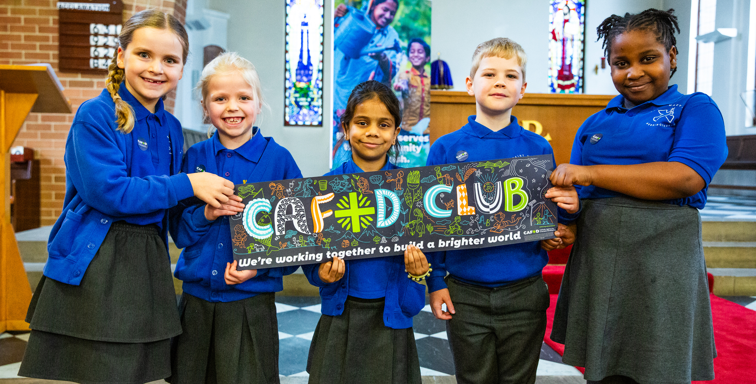
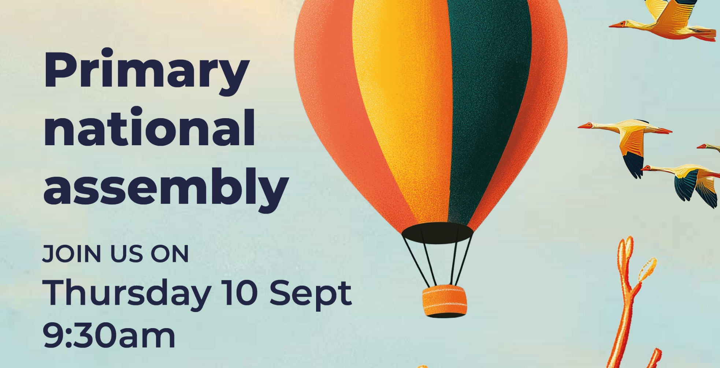
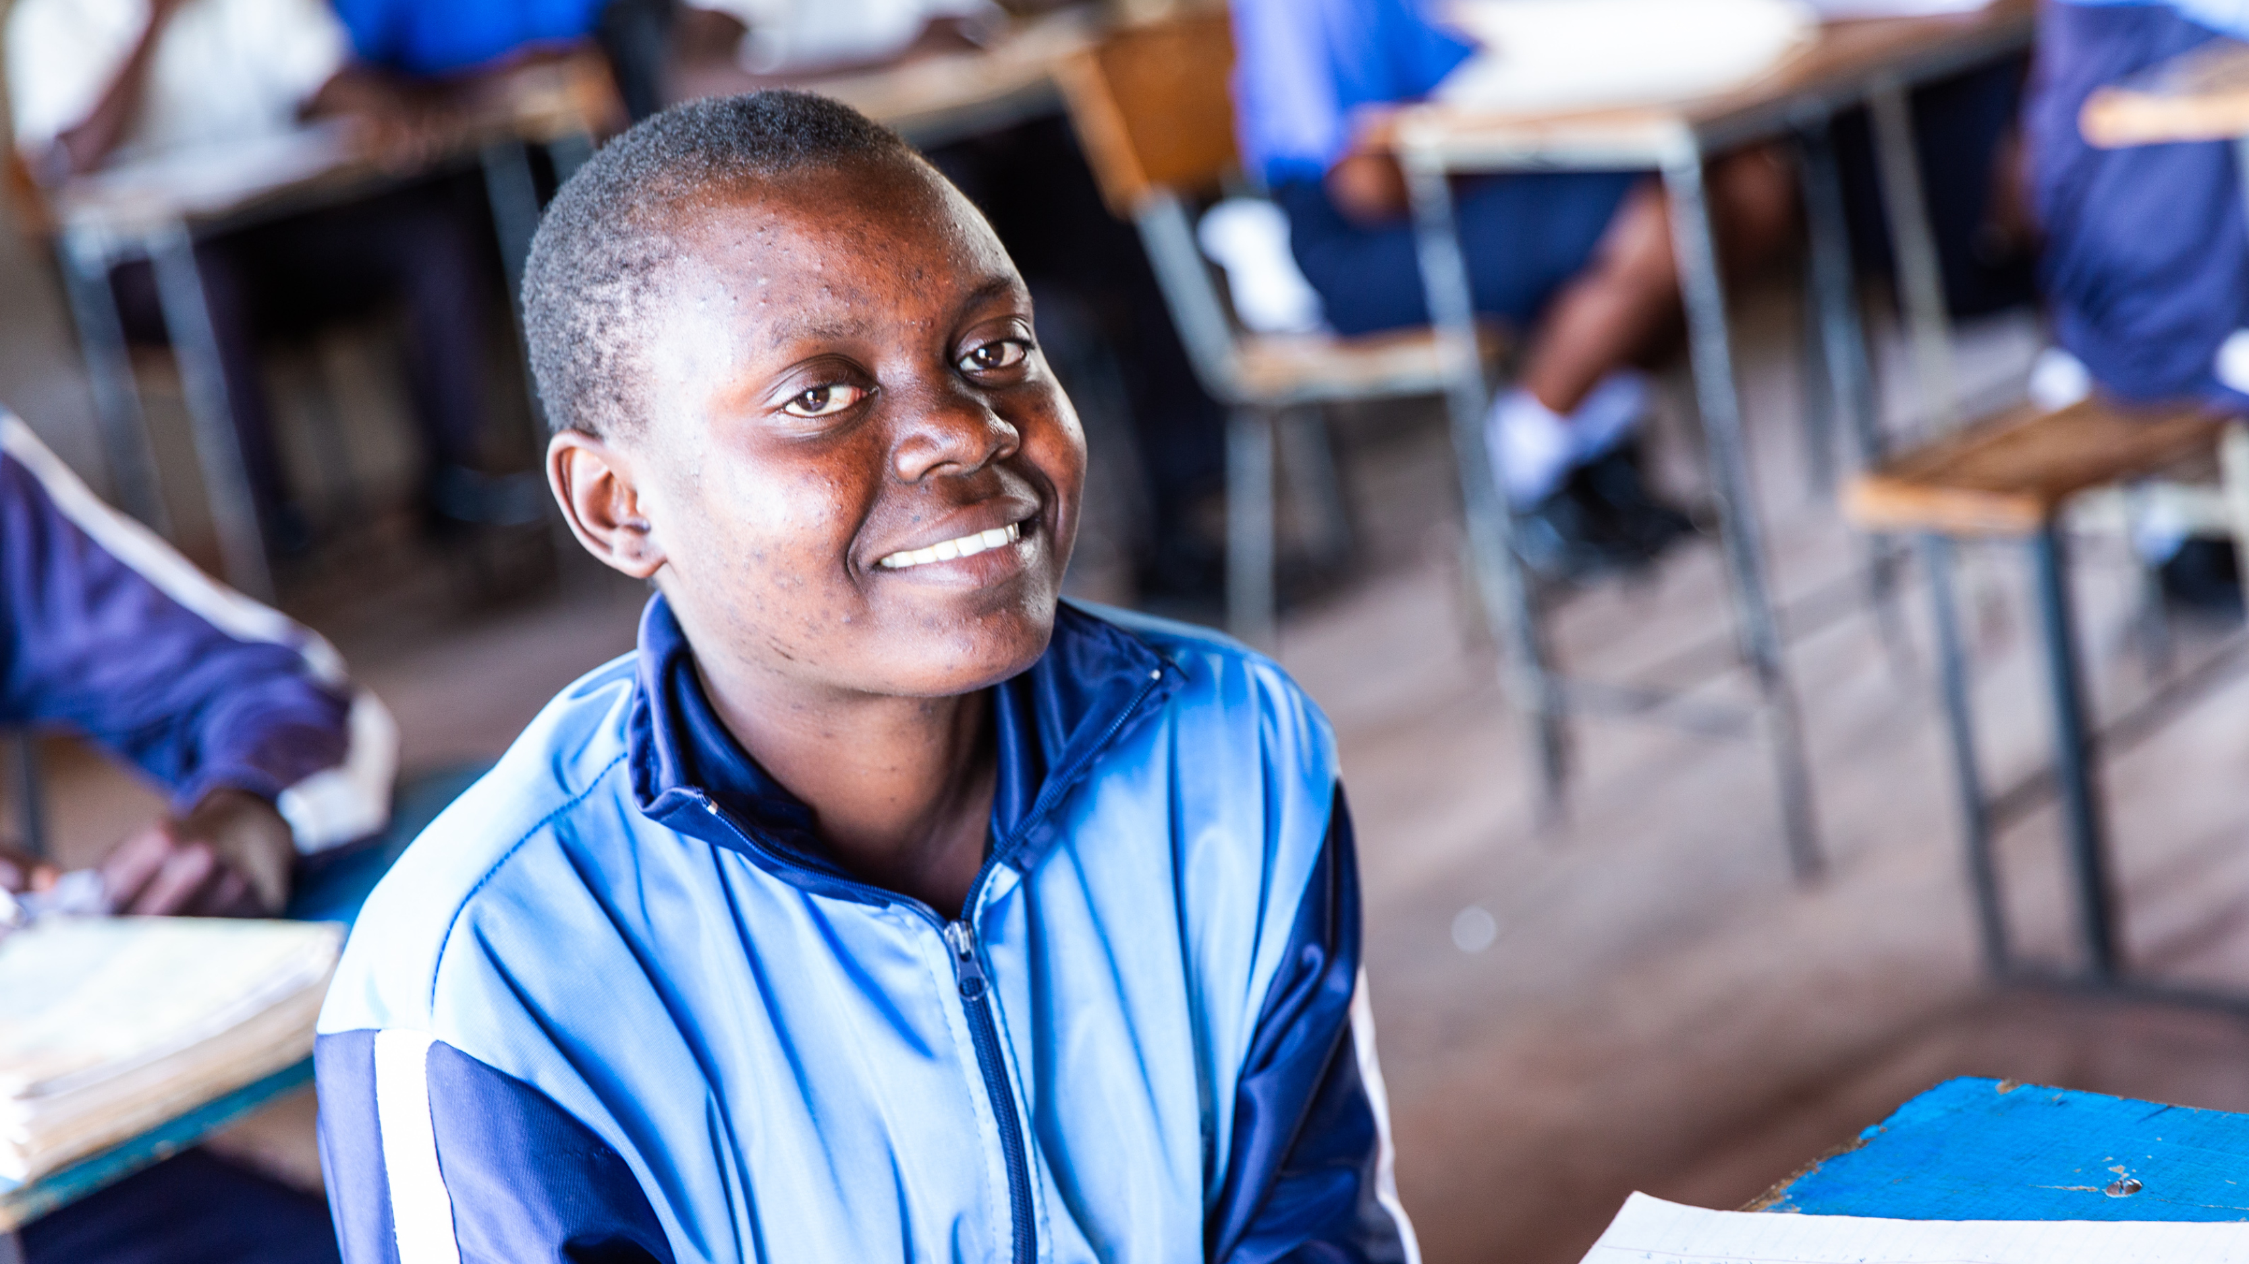
Get involved with CAFOD this term
Explore our resources for the new school term
Join our national assembly
Autumn fundraising resources

Slide 20
