Slide 1
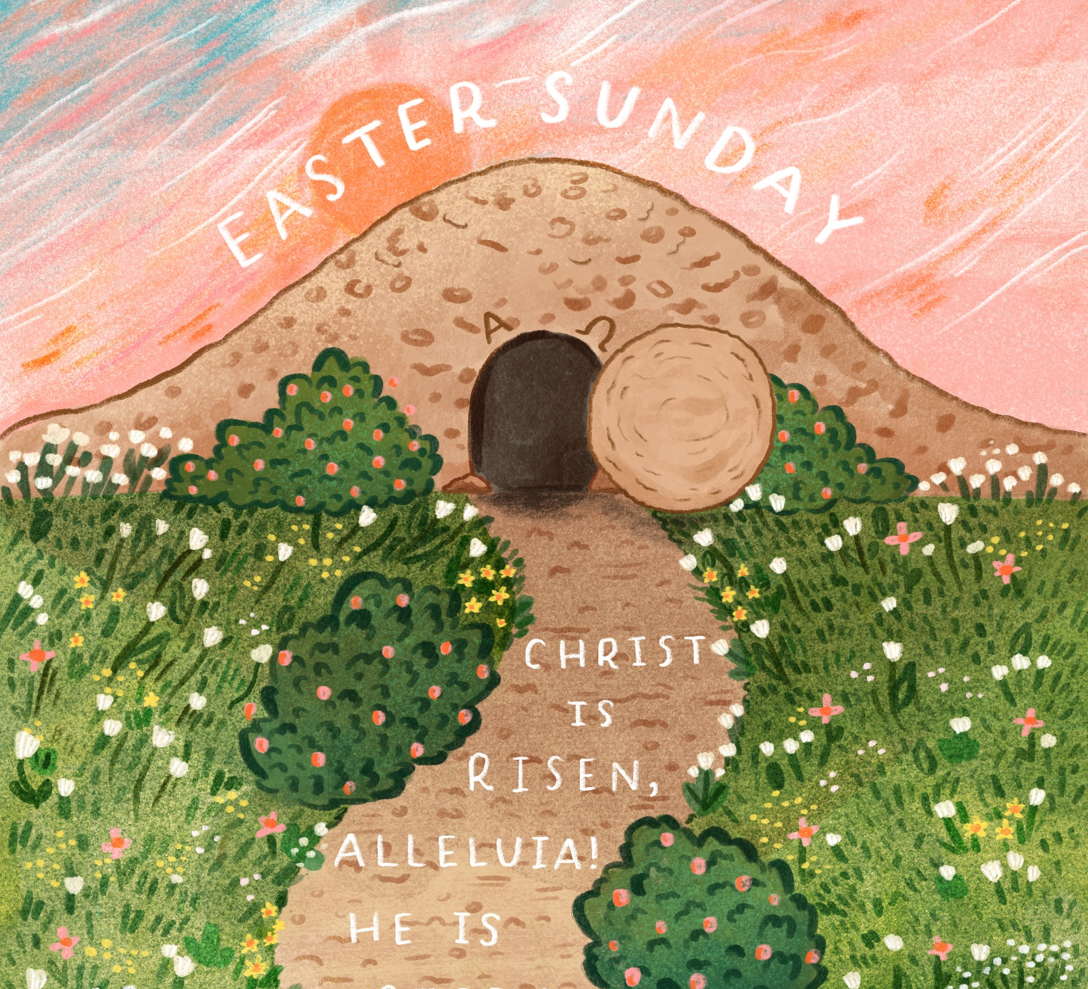

Holy Week and Easter Celebration of the word
We gather…
For Primary Schools

Slide 2
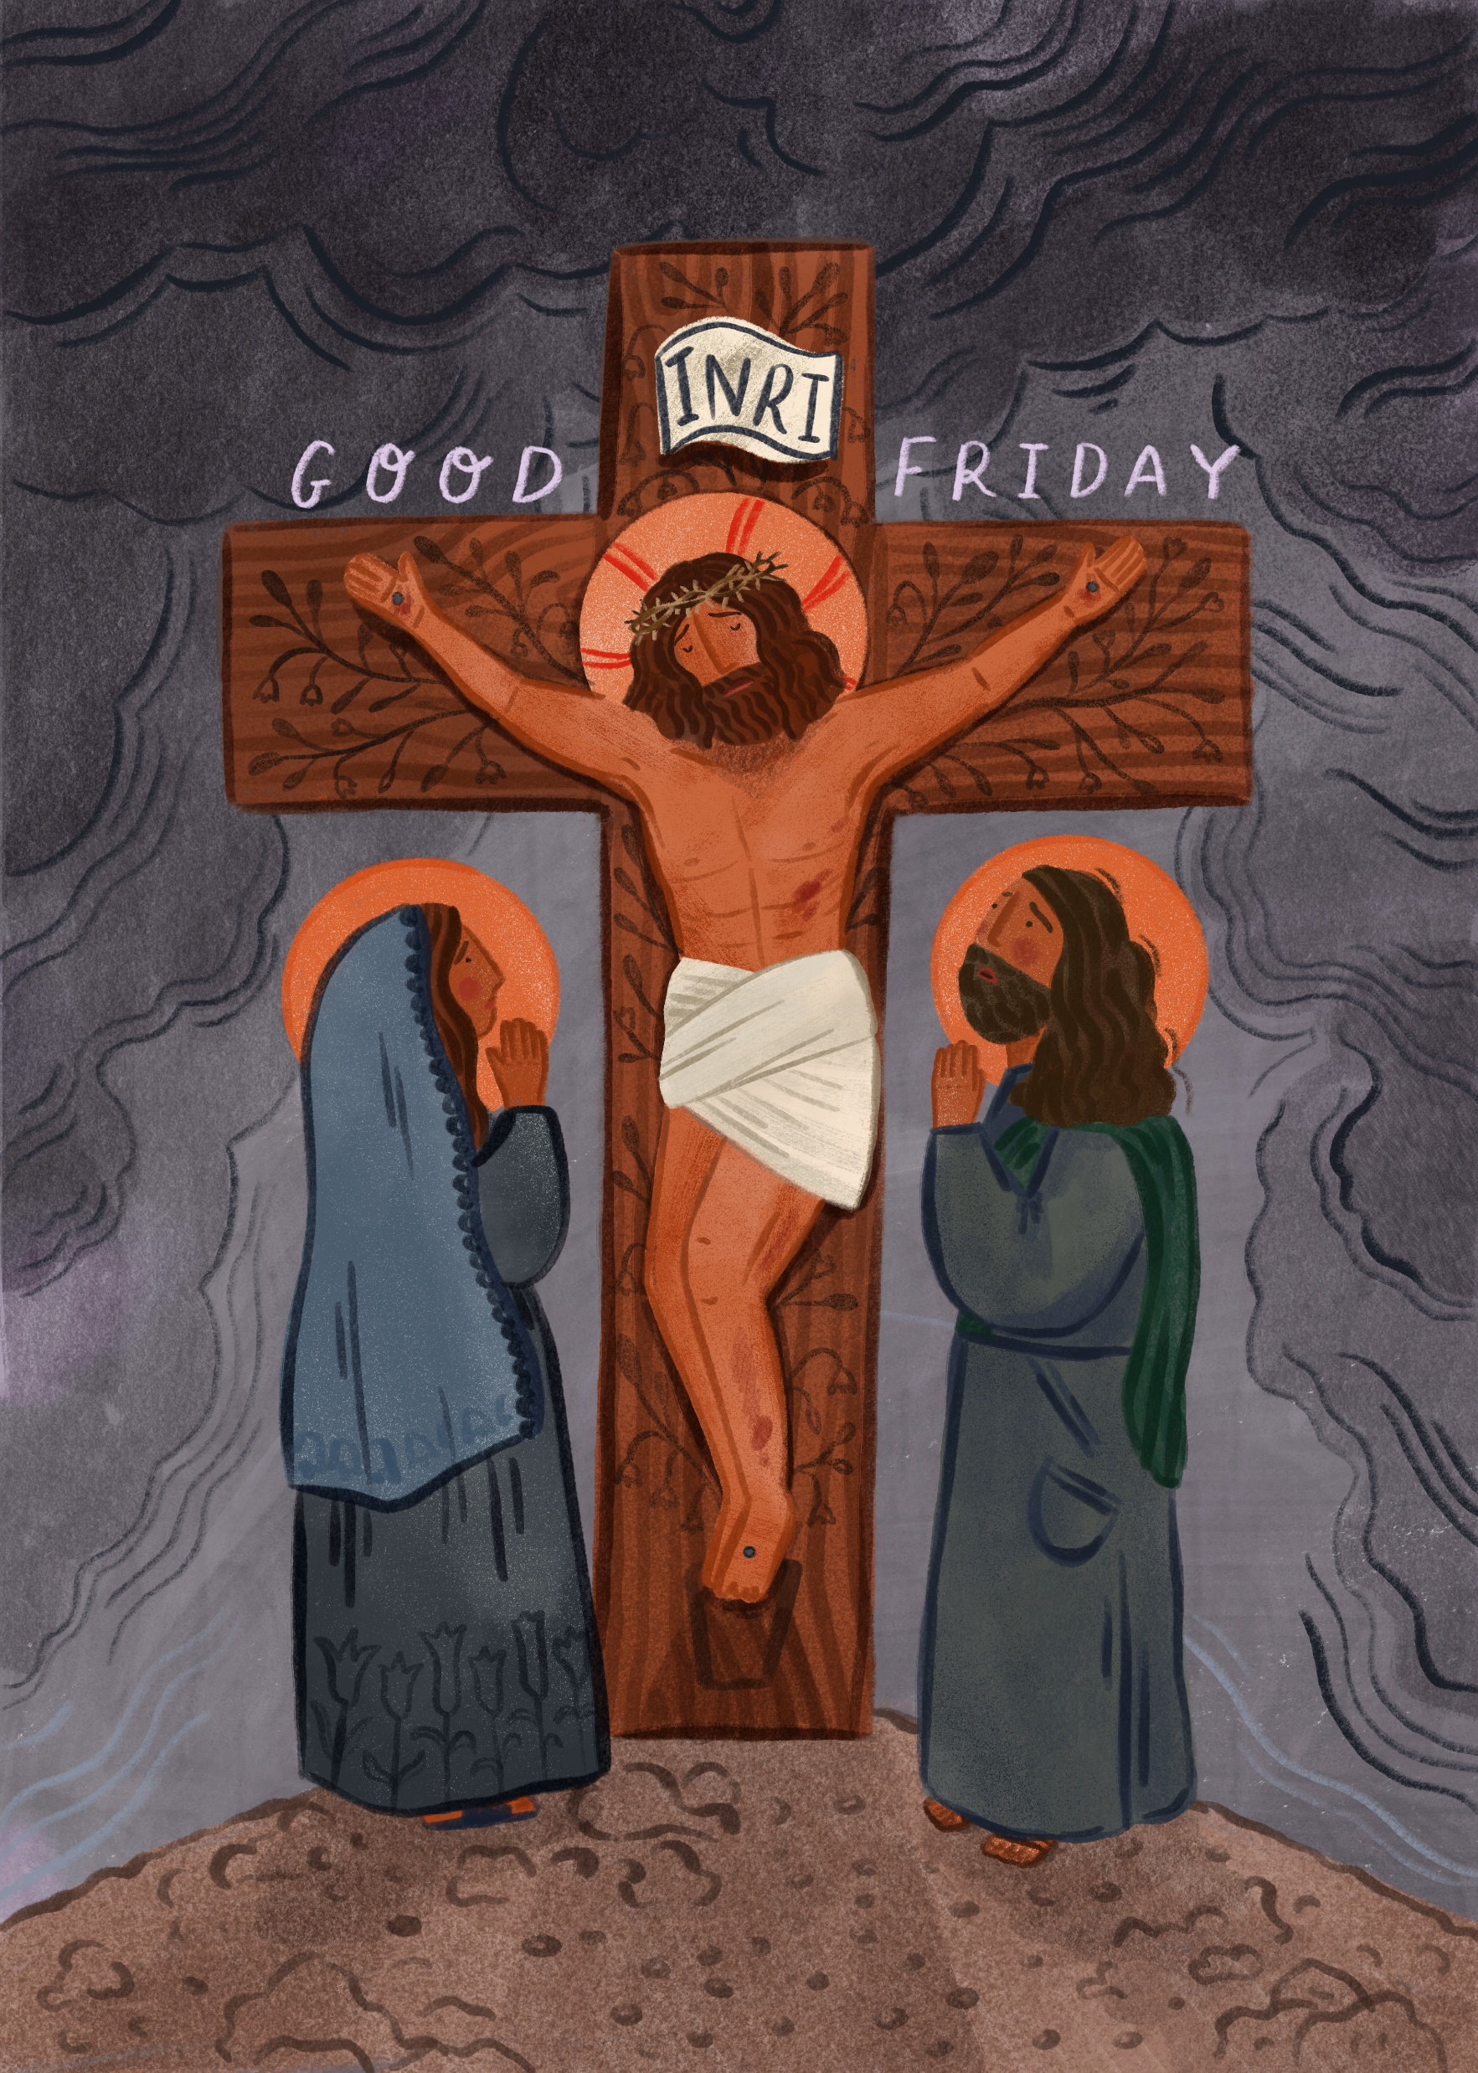
Welcome to our time of prayer.
We gather
Notes:
Photo credit; The Romero Cross, made in El Salvador
OPTIONAL- Appropriate music could be played quietly for a few minutes to help create a prayerful atmosphere for collective worship or while pupils enter if an assembly. You may wish to light a candle and have a Bible displayed. The liturgical colour for today is white.
Symbols for a prayer table could include an Easter garden, broken chains or a cross decorated with flowers or draped in a white cloth.
Reader: Welcome to our time of prayer.

Slide 3
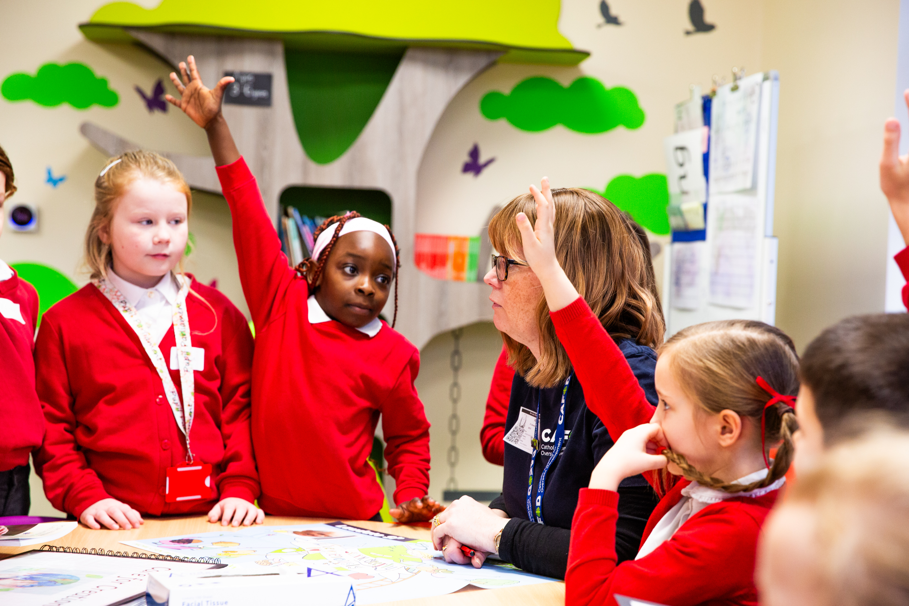
Have you ever had a wonderful surprise?
Notes:
Photo credit: Children in Doncaster
Thom Flint
Reader: Have you ever had a wonderful surprise?
(Children could be asked to reflect quietly or you may choose to allow them to share answers in pairs or to the wider assembly. You may wish to share a story of a surprise you had)
Reader: Today we’re going to hear a story about some people who had an amazing surprise. We are going to think about what happens during Holy Week and what they mean for us.

Slide 4
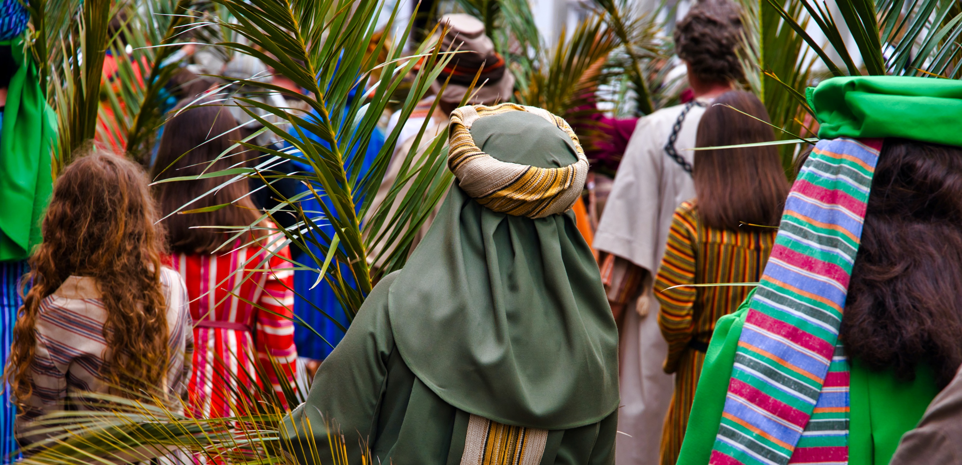
Notes:
Photo credit: Brady Leavell
Unsplash
Reader: Jesus rode on a donkey into Jerusalem on Palm Sunday. The people waved branches at him, shouting, “Hosanna”.

Slide 5

What would it be like to be in the crowd that welcomed Jesus to Jerusalem?
How can I welcome Jesus today?
Notes:
Reader: Let’s reflect quietly -
What would it be like to be in the crowd that welcomed Jesus to Jerusalem?
How can I welcome Jesus today? (pause)

Slide 6
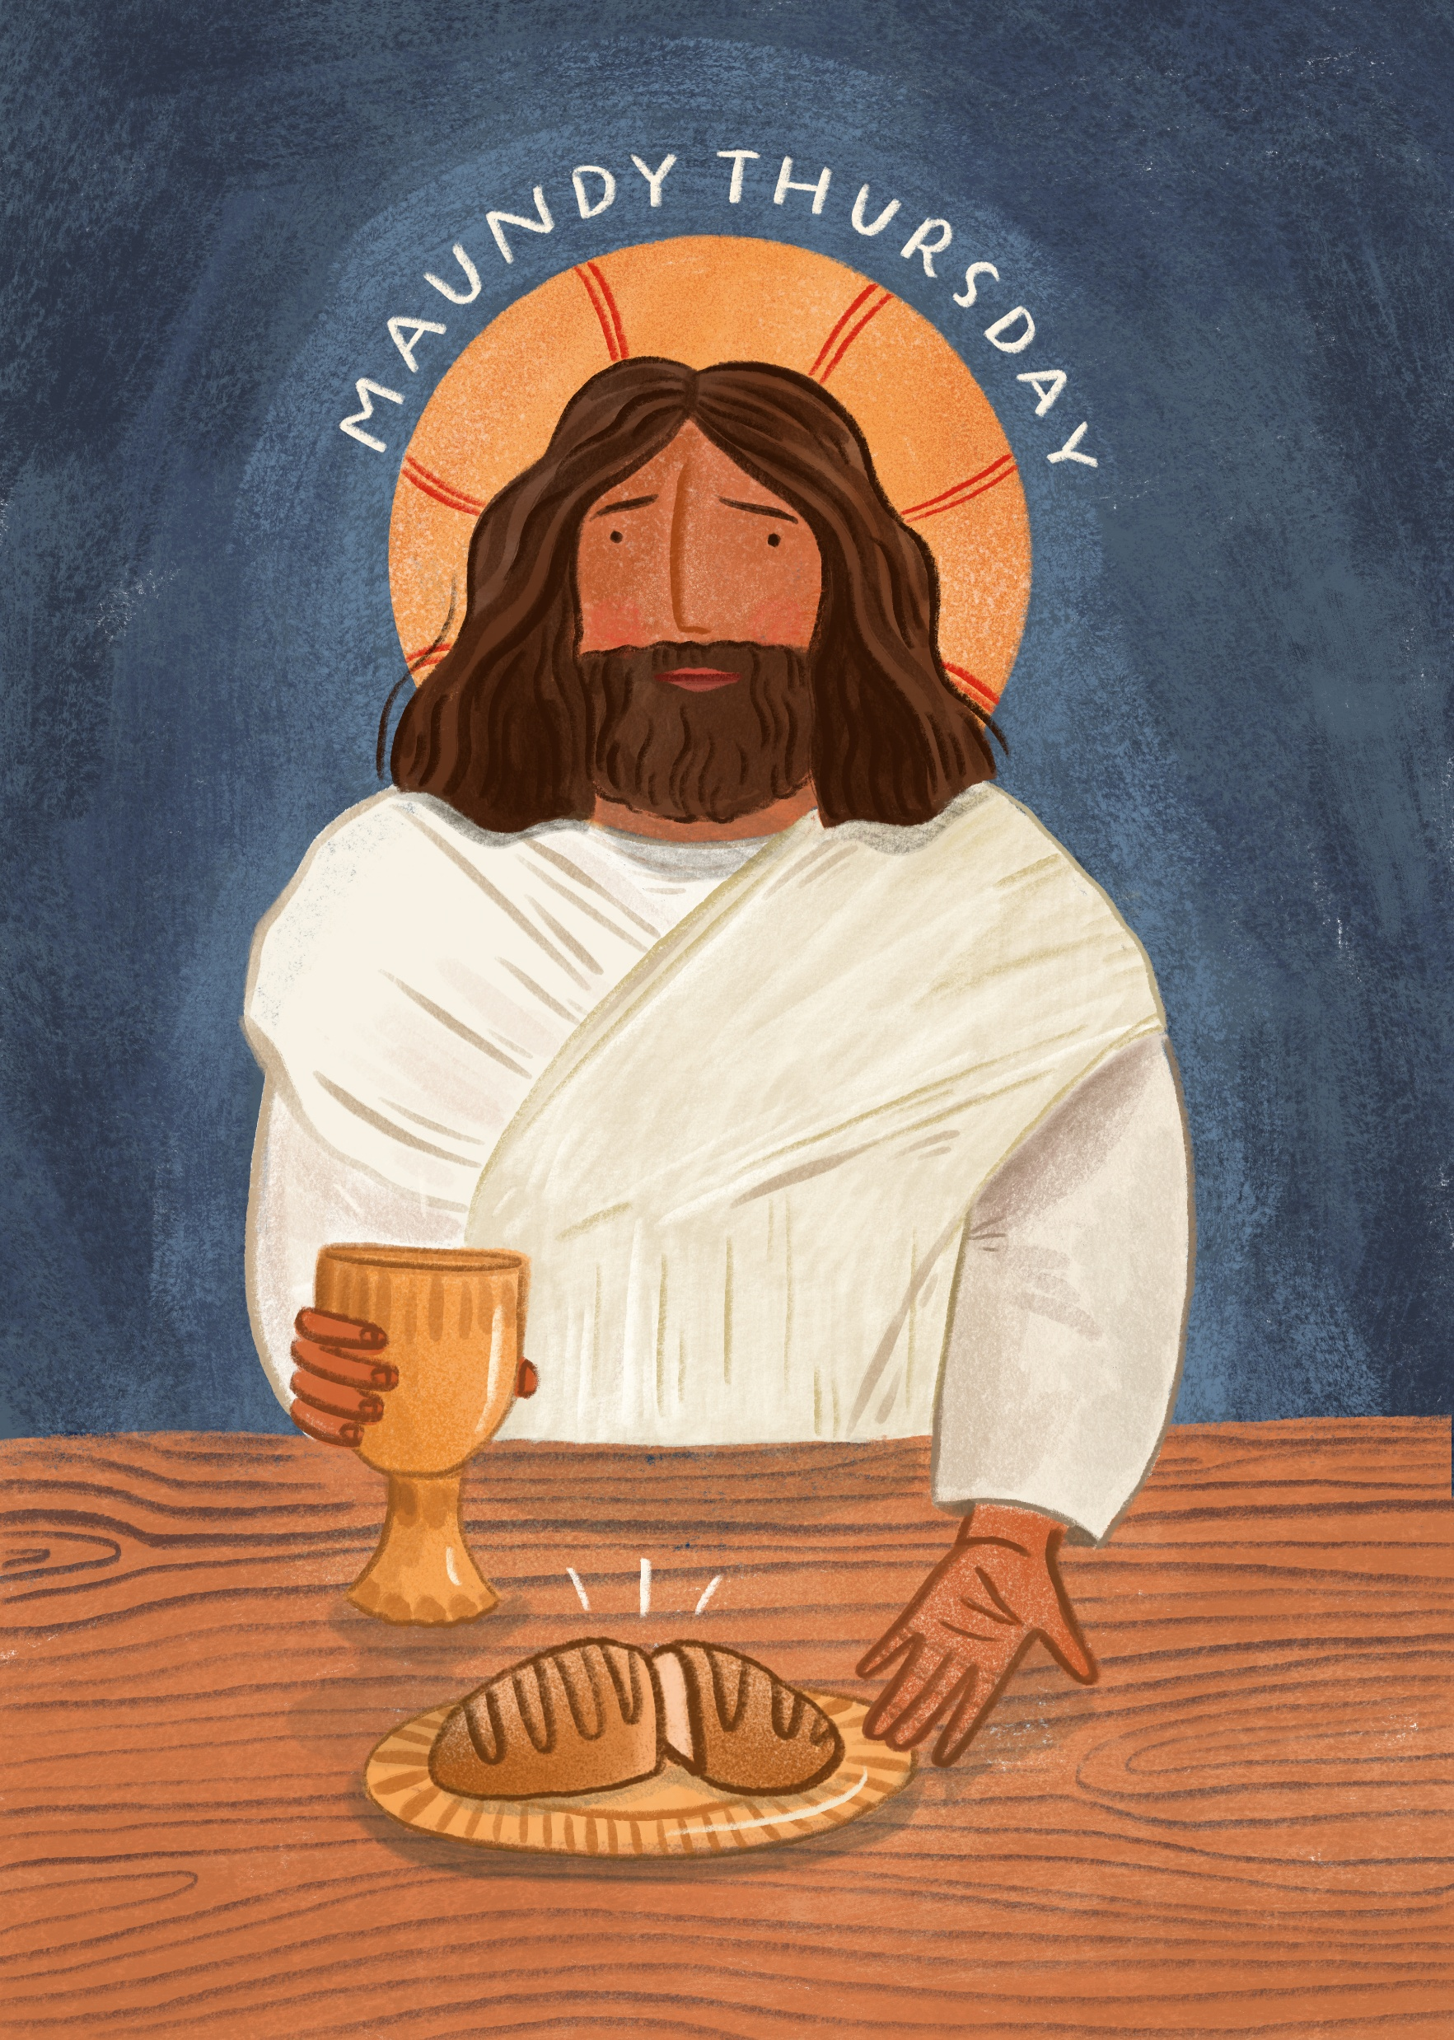
Notes:
Reader: Jesus celebrated the Last Supper with his friends. He washed their feet which was usually the job of a servant. Then he broke bread saying ‘This is my body’ and shared wine saying ‘This is my blood.’ This was on Maundy Thursday.
Reader: Jesus told his followers to do this in remembrance of him and we continue to do so when we celebrate the Eucharist together.

Slide 7
How would it feel to have someone as important as Jesus washing my feet?
How can I serve people humbly like Jesus?
Notes:
Reader: Let’s reflect quietly -
How would it feel to have someone as important as Jesus washing my feet?
How can I serve people humbly like Jesus? (pause)

Slide 8
Notes:
Reader: Jesus was arrested and crucified on Good Friday.
Even on the Cross he forgave the people who were hurting him.

Slide 9
How does it feel to know that Jesus is always loving and forgiving?
How I can be forgiving?
Notes:
Reader: Let’s reflect quietly -
How does it feel to know Jesus always wants to forgive me when we I something wrong?
How can I be forgiving when people hurt me? (pause)

Slide 10


A reading from the Gospel of Mark
We listen…
Notes:
Reader: Let’s listen now to what happened next. What was the wonderful surprise?
Reader:
After the Sabbath was over, Mary Magdalene, Mary the mother of James, and Salome bought spices to go and anoint the body of Jesus.
Very early on Sunday morning, at sunrise, they went to the tomb. On the way they said to one another, “Who will roll away the stone for us from the entrance to the tomb?” (It was a very large stone.) Then they looked up and saw that the stone had already been rolled back. So they entered the tomb, where they saw a young man sitting at the right, wearing a white robe—and they were alarmed.
“Don't be alarmed,” he said. “I know you are looking for Jesus of Nazareth, who was crucified. He is not here—he has been raised! Look, here is the place where he was placed. Now go and give this message to his disciples, including Peter: ‘He is going to Galilee ahead of you; there you will see him, just as he told you.’”

Slide 11
SACRED SILENCE…
Why do you think the three women went to Jesus’ tomb?
How does it make you feel to know Jesus is risen?
What difference does the resurrection make for Jesus’ followers?
Notes:
Optional slide- Following the reading of the Word, you may wish to provide a moment for ‘Sacred Silence’ with questions for children to ponder.
Why do you think the three women went to Jesus tomb?
How does it make you feel to know Jesus is risen?
What difference does the resurrection make for Jesus’ followers?

Slide 12
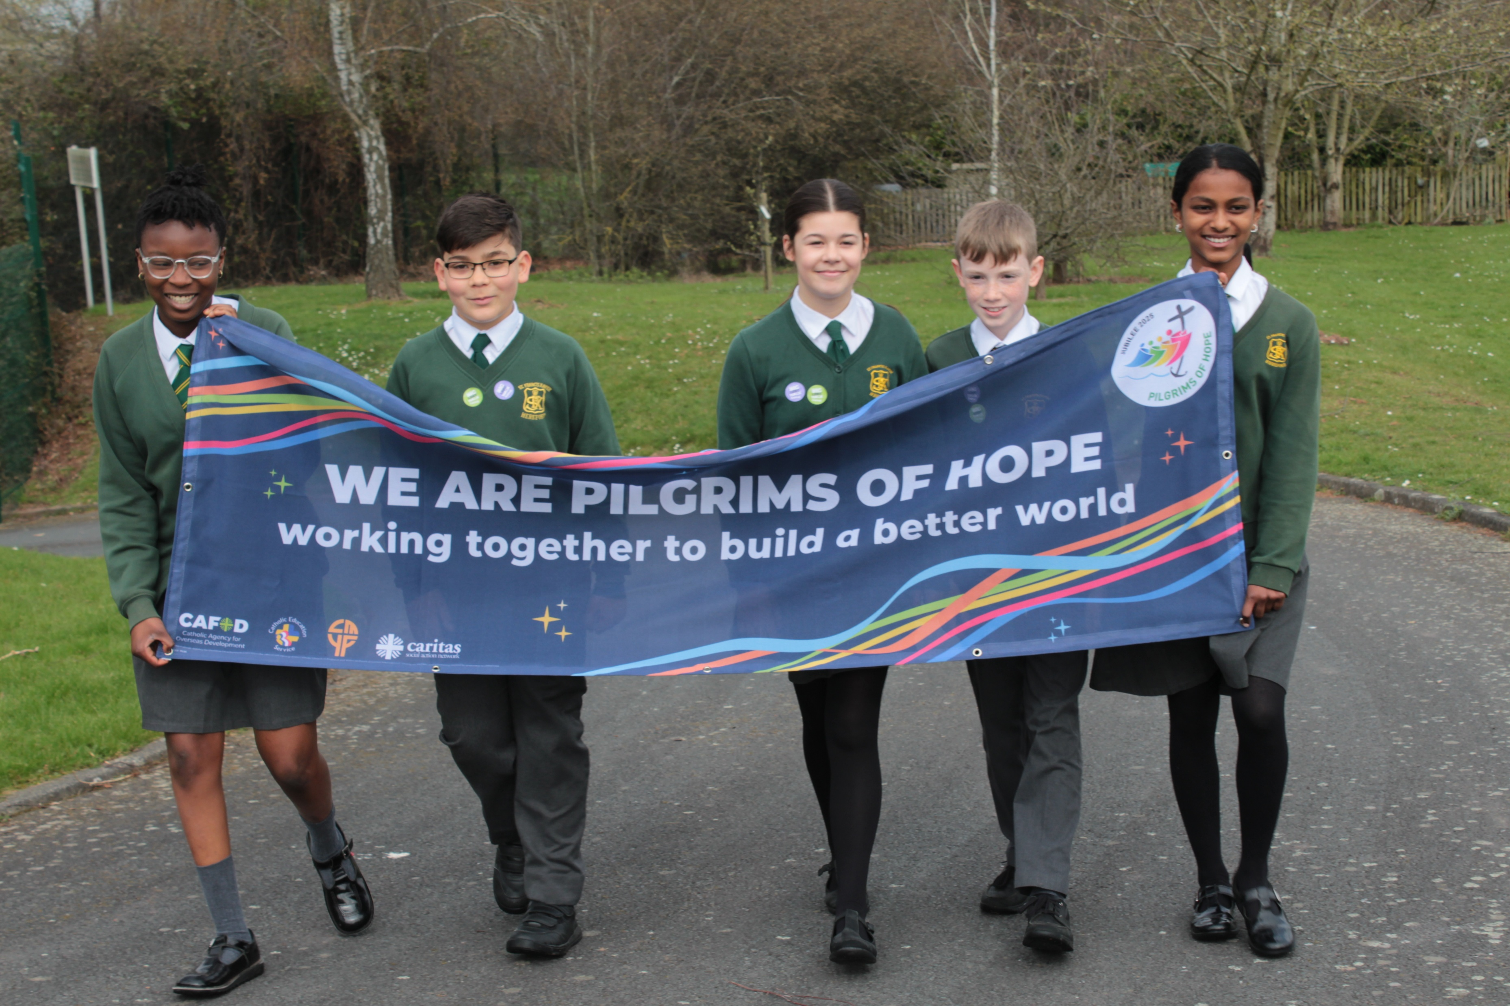
Notes:
Photo credit: Children in Herefordshire
Victoria Ahmed
Reader: What a wonderful surprise for Jesus’ friends to find out he had risen from the dead.
Reader. His resurrection reminds us that even in the most difficult situations there is always hope.

Slide 13
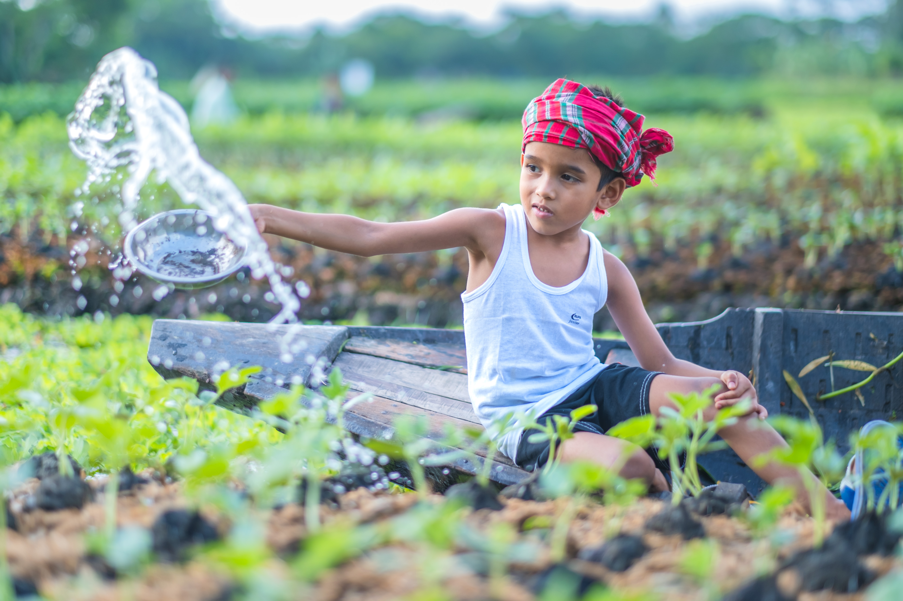

We respond…
Notes:
Photo Credit: Zunayed in Bangladesh on a floating garden
Amit Rudro
Reader: This love and hope has led Christians to reach out to their brothers and sisters throughout the world.
Reader: It continues to inspire the work of Christian charities, like CAFOD, who work with partners around the world to try to share hope to people in very practical ways and campaign for a fairer world.
In some parts of the world, there is too little rain. In Bangladesh, there is too much. The result is the same – seeds don't grow, plants die, families go hungry.

Slide 14
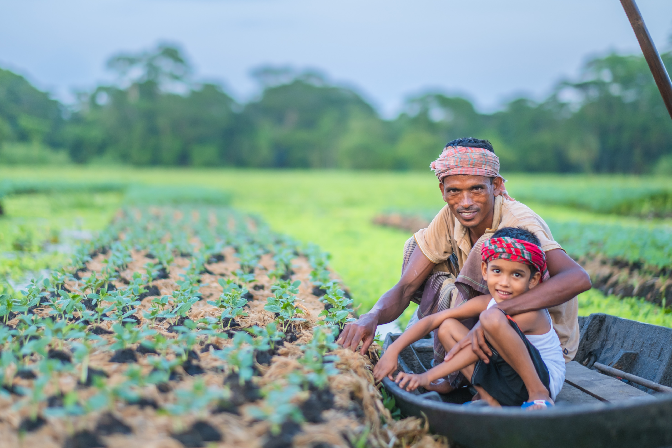
Notes:
Photo Credit: Zunayed and his father in Bangladesh on a floating garden
Amit Rudro
Reader: But Zunayed and his family have a new hope.
With CAFOD’s help, communities in Bangladesh are building floating gardens that are immune to floods, allowing them to grow enough food to eat and sell, helping them make a living.
A better world needs all of us.
Reader: Let’s pray that we will all build a better world and share hope together.

Slide 15
We respond…
Response: May we follow his example of love and service.
Notes:
All children are invited to join in with the response on the slide.
Reader: We remember Jesus riding into Jerusalem on a humble donkey
May we follow his example of love and service.
Reader: We reflect on Jesus washing his disciple’s feet
May we follow his example of love and service.
Reader: We think of Jesus on the cross, forgiving others
May we follow his example of love and service.
Reader: We rejoice in Jesus risen from the dead
May we follow his example of love and service.

Slide 16
Risen Christ,
We give thanks for the new life you have given us.
Show us how to be loving and forgiving,
To live in hope and make a change,
So that all people may live in peace,
free from poverty.
Amen.

Slide 17
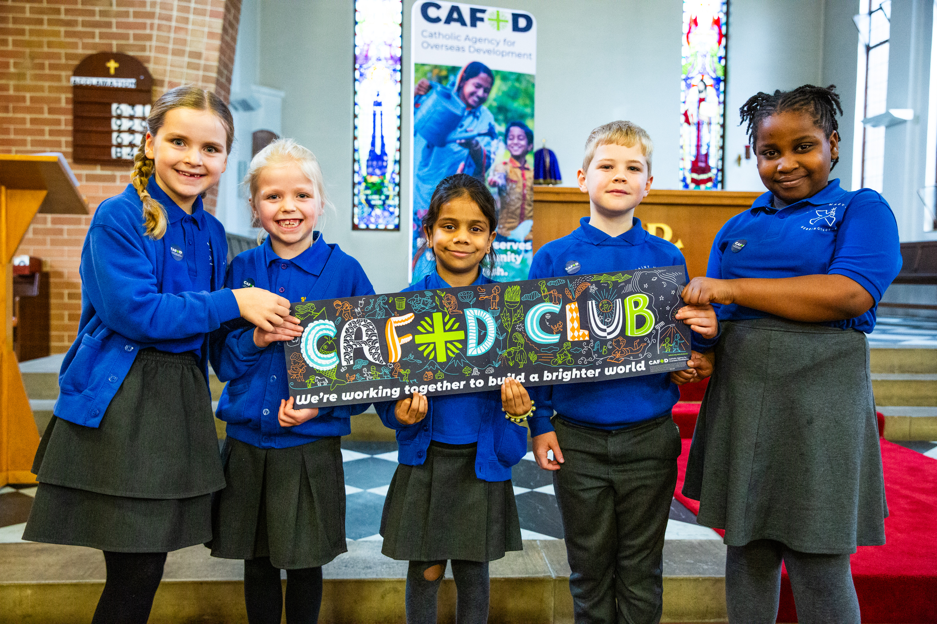

Going forth…
Notes:
Photo credit: Children in Rotherham
Thom Flint
Optional Slide - children could be asked to reflect quietly or you may choose to allow them to share answers in pairs or to the wider assembly
Reader: How can each of us spread the hope that Easter brings?

