Slide 1
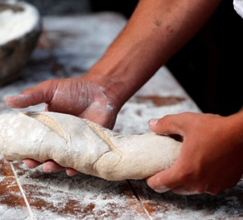
Corpus Christi
Gospel Celebration of the Word
Notes:
Children’s liturgy: The Most Holy Body and Blood of Christ (Year A)
Preparation of the worship space
Colour: white
Props: Different types of bread from around the world for the children to try or pictures of different types of bread for the children to look at, a world map.
Song suggestions
Eat this bread, drink this cup (633, Laudate)
Bread of life, hope of the world (78, Laudate)
Bread for the world, a world of hunger (625, Laudate)
Welcome
Today Jesus tells us that anyone who eats the bread that he offers will live forever. How amazing! But how can this be? Let’s think about this and the importance of bread around the world today.
Yeabu, Sierra Leone
Photo credit: KADDRO

Slide 2
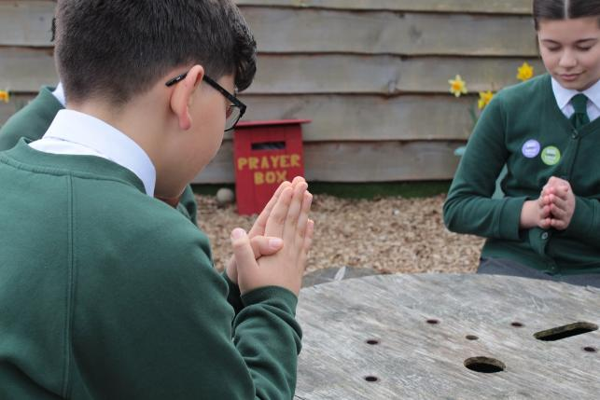
Christ Jesus,
Bread of Life, feed us with your love and wisdom and move us to help one another, so that all people may have enough to eat. Amen.
  Gather
Notes:
St Francis Xavier's RC Primary School, Herefordshire
Photo credit: Vicky Ahmed

Slide 3
Gospel: John 6: 51-58
Jesus said, “I am the living bread that came down from heaven. If anyone eats this bread, he will live for ever. The bread that I will give him is my flesh, which I give so that the world may live.”
This started an angry argument among them. “How can this man give us flesh to eat?” they asked.
Jesus said to them, “I am telling you the truth: if you do not eat the flesh of the Son of Man and drink his blood, you will not have life in yourselves. Those who eat my flesh and drink my blood have eternal life, and I will raise them to life on the last day.
Word

Slide 4
Gospel: John 6: 51-58
"For my flesh is the real food; my blood is the real drink. Those who eat my flesh and drink my blood live in me, and I live in them. The living Father sent me, and because of him I live also.
"In the same way, whoever eats me will live because of me. This, then, is the bread that came down from heaven; it is not like the bread that your ancestors ate. They later died, but those who eat this bread will live forever."
Word

Slide 5
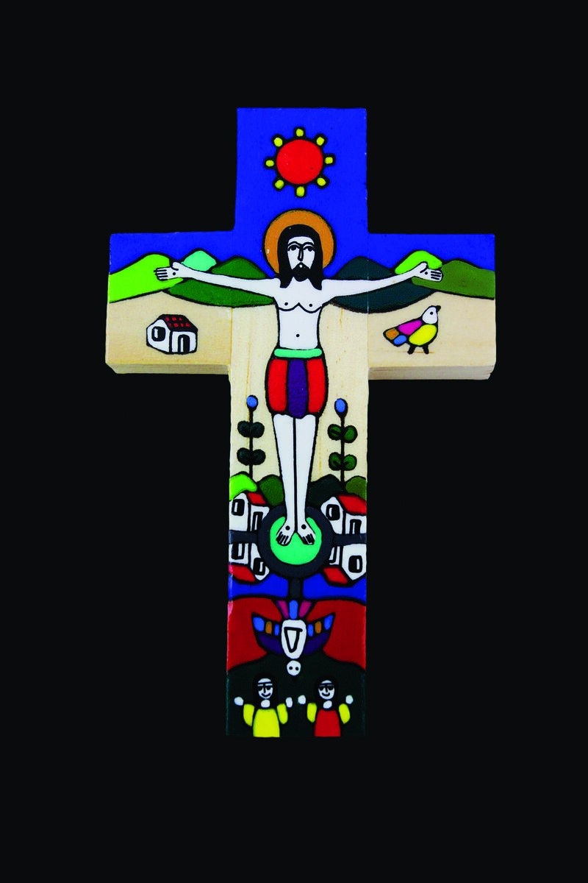
What do you remember from the Gospel reading?
Today Jesus tells us that he is the living bread which has come down from heaven. Anyone who eats this bread will live forever.
He goes on to say that the bread he gives is his flesh, and that whoever eats his flesh and drinks his blood lives in him and he lives in them.
What do you think this means? We can’t eat Jesus can we?!
Respond
Notes:
Romero cross
Photo credit: CAFOD

Slide 6
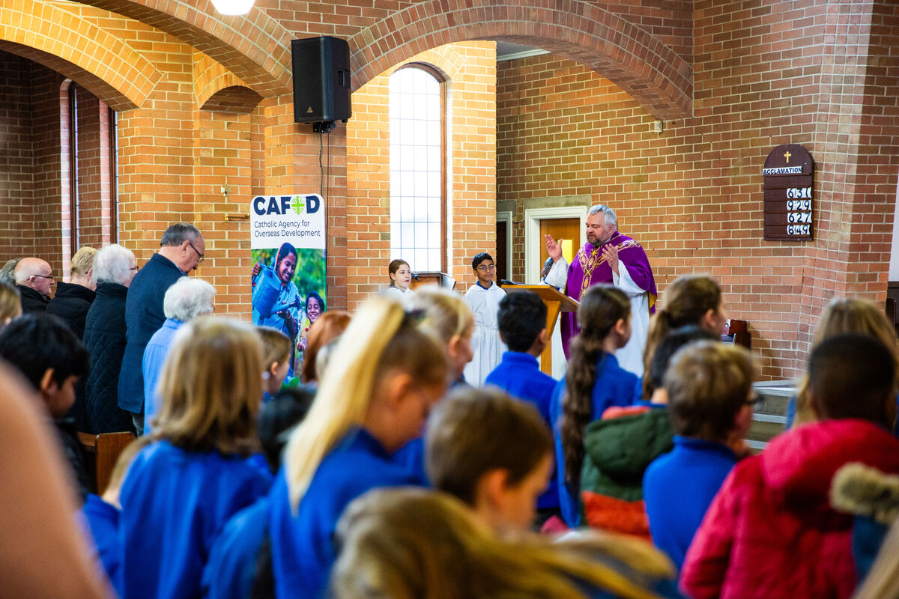
Every time we come to Mass, the bread and wine are changed into the body and blood of Jesus.
And we come to share in it, even if we only have a blessing, welcoming Jesus into our lives.
Why do you think Jesus chose to talk about bread?
Notes:
With older children who have made or are preparing for their First Holy Communion, you could talk more about the significance of the Eucharist at this point. For younger ones, we have chosen to focus more on the importance of bread around the world.
Children from St Mary's school at Immaculate Conception Church, Rotherham
Photo credit: Thom Flint

Slide 7

Bread is a very important food.
It is a basic food eaten by people all over the world. It is an 'everyday' food that all Jesus’ listeners would have recognised and understood.
When was the last time you had some bread?
How often do you eat bread? Every day, once a week or just on special occasions?
Notes:
Bread
Photo credit: Stock images

Slide 8
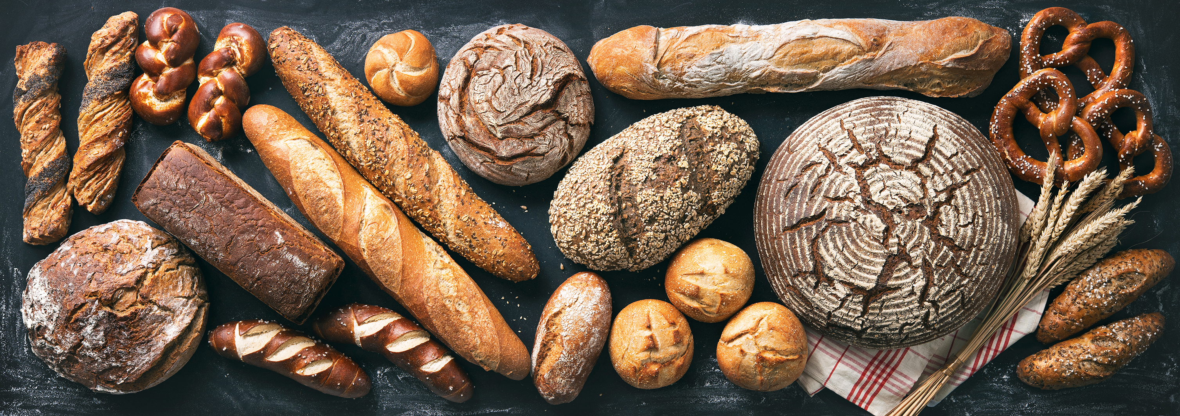
How many different types of bread can you name? How many different types of bread have you tried?
Bread is very important in the lives of many people around the world today. In fact, it can be life-changing.
Notes:
How many different types of bread can you name? (e.g.brown, white, baguette, pitta, naan, chapati, tortilla, injera, rolls etc.)
Bread shop
Photo credit: Stock images

Slide 9
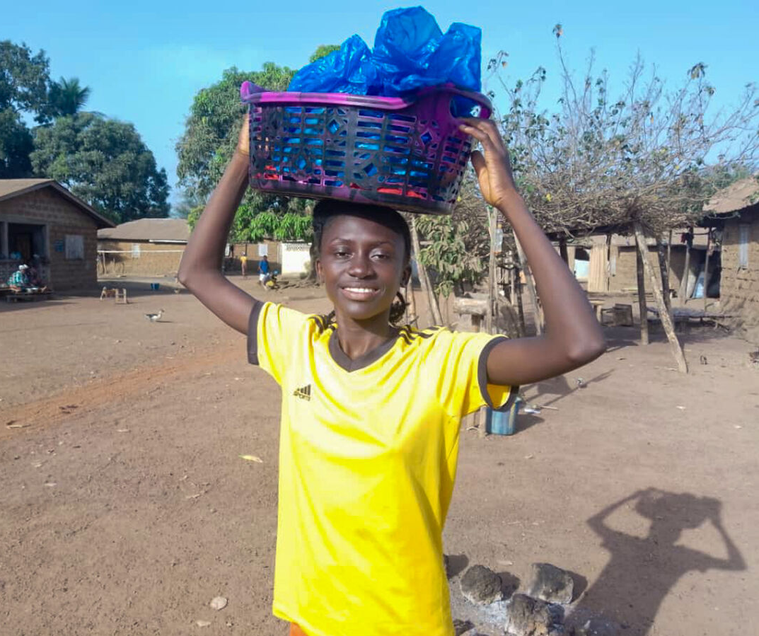
Yeabu is 16 years old. She lives in Sierra Leone and wants to become a nurse to help people in her community.
Yeabu lives with her grandmother who had a bakery business, but she became ill and had to stop baking.
In their village, there is a savings and loans group run by the local women. Yeabu had an idea and went to the group for a loan.
Notes:
Yeabu, Sierra Leone
Photo credit: KADDRO

Slide 10
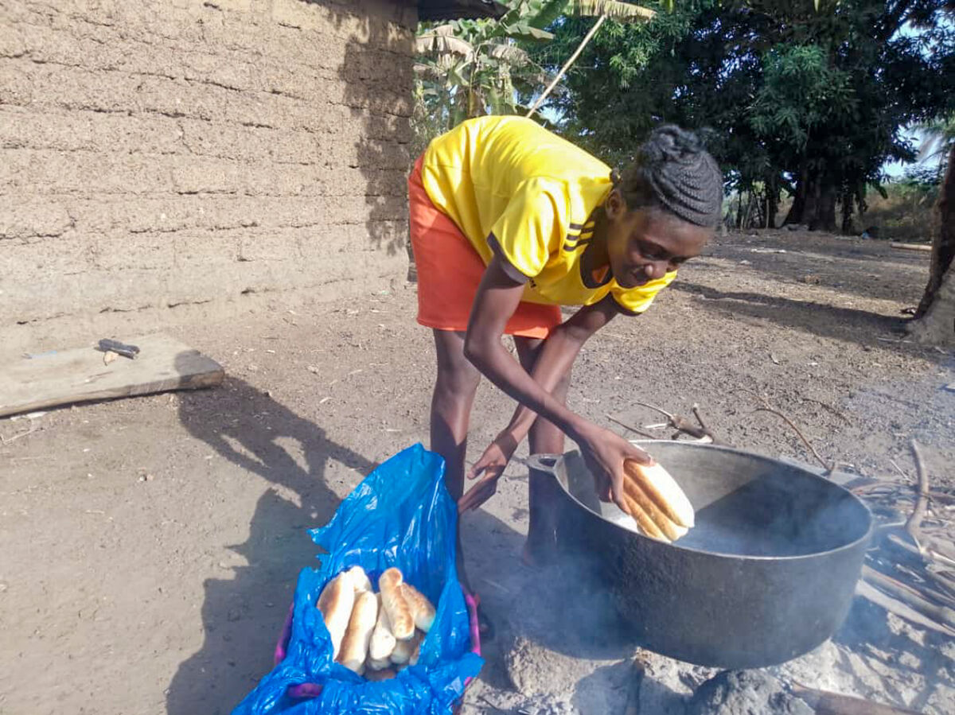
Yeabu restarted her grandmother’s bread business and it's doing well.
She has paid back the loan and can also buy the things she needs:
“Last week I bought a science book. My dream is to become a nurse but also to set up a bakery and name it after my grandmother. Re-starting the bakery makes her proud - I saw the smile on her face."
Notes:
Yeabu, Sierra Leone
Photo credit: KADDRO

Slide 11
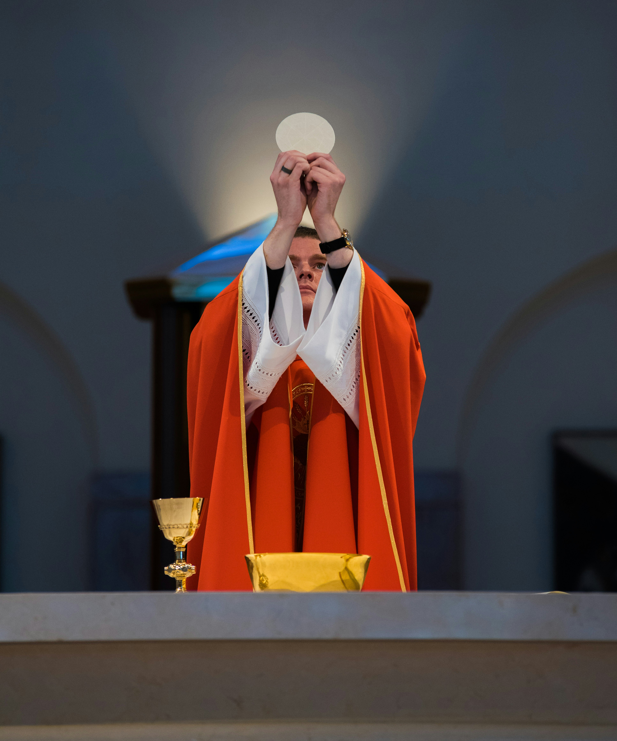
Let's think now how very special the bread at Mass is, because it becomes Jesus’ body.
We look forward to taking part in this special meal with the whole parish community, through a special blessing, or, if we have made our First Holy Communion, by receiving the Body of Christ.
Notes:
A priest and the Host
Photo credit: Josh Applegate on Unsplash

Slide 12
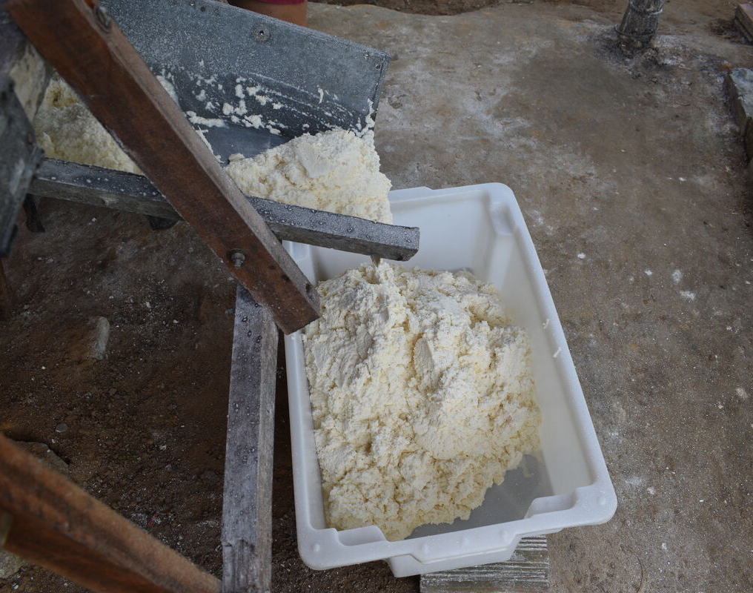
We pray for all people who make sure that we have bread to eat every day - the people who grow the ingredients, who make the flour.
We pray for Yeabu and for all people who make bread around the world; for all people who sell bread and for those who buy it for us to eat.
Notes:
Cassava flour, Brazil
Photo credit: Kezia Lavan

Slide 13
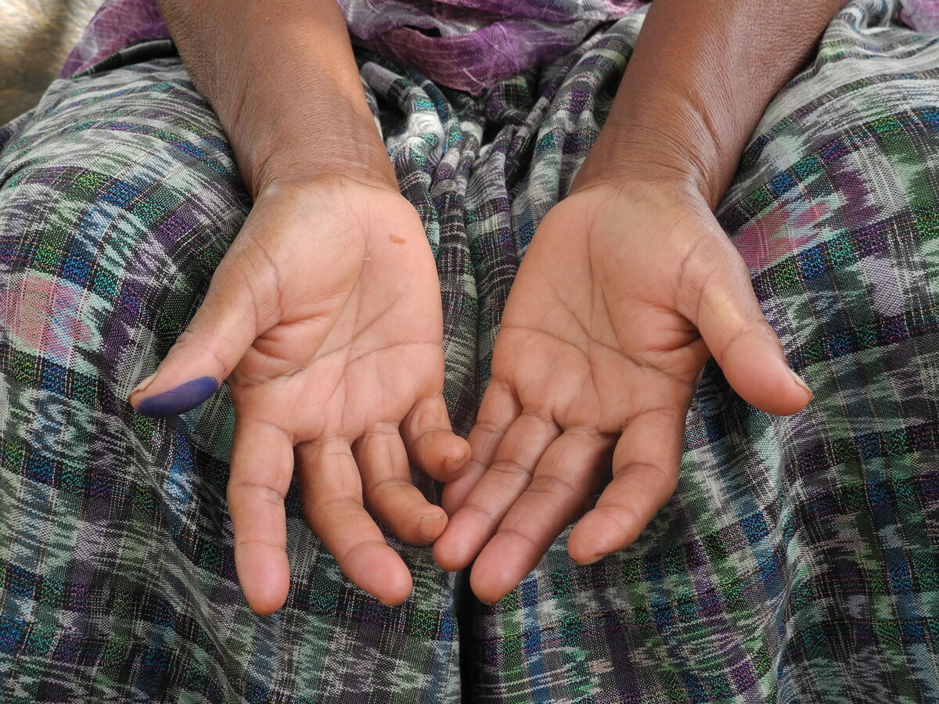
We pray especially for people who are struggling for enough food to eat at this time, in our own community and throughout the world.
What can we do to support them during this coming week?
Notes:
Lucia, Guatemala
Photo credit: Montserrat Fernandez

Slide 14
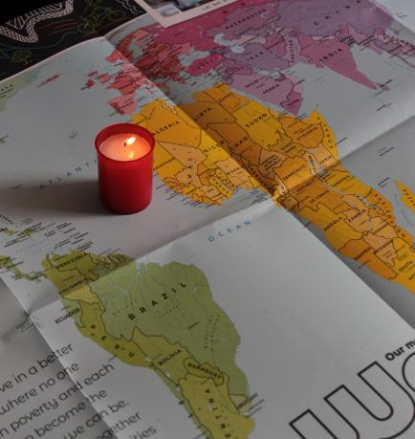
Let us pray
We pray for all people in our world, especially those who struggle to find enough food to eat:
that they may have their fair share of the good things that God has given for everyone.
Lord in your mercy…
We pray for our parish, families and friends:
that we may be inspired to work together with others so that all people have enough to eat.
Lord in your mercy...

Slide 15
Let us pray
We pray for the Church throughout the world:
that nourished by the Body of Christ, we may be strengthened to live our lives as God calls us to do.
Lord in your mercy…
Lord, Giver of Life: we thank you for the gifts you have given us. Watch over all your people and work through us so that all your children around the world may have enough to eat.
Amen.

Slide 16
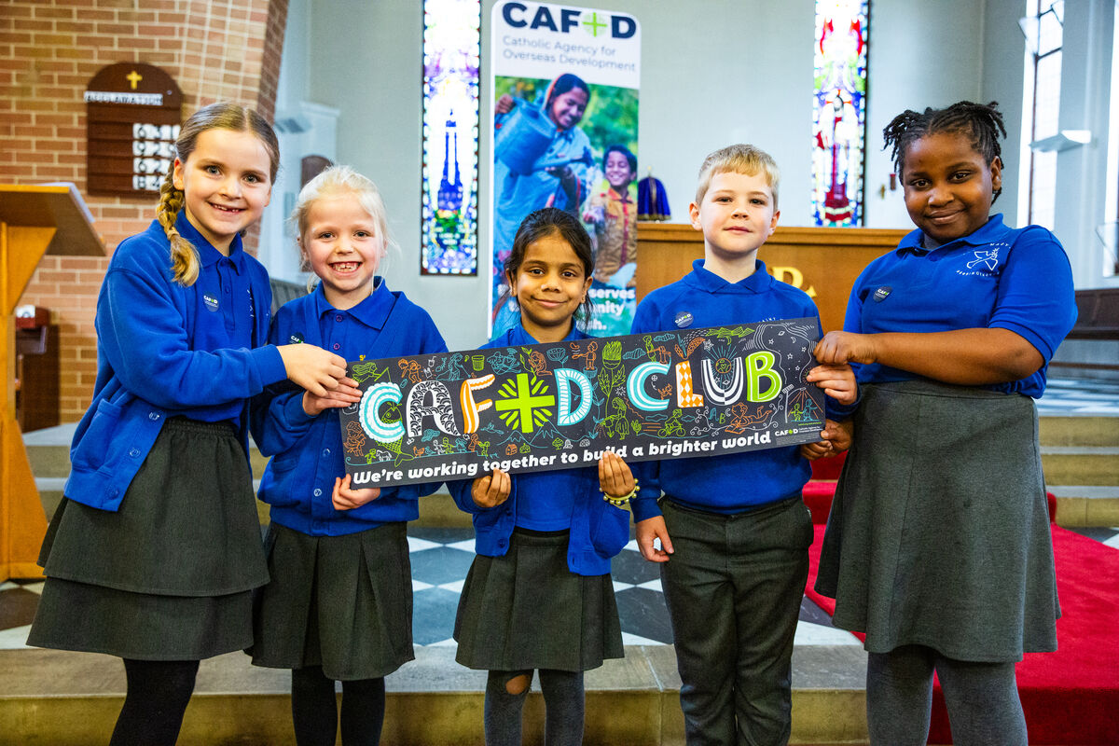
What will you do this week to help those who do not have enough bread to eat?
Send
Notes:
Children from St Mary's school at Immaculate Conception Church, Rotherham
Photo credit: Thom Flint

Slide 17
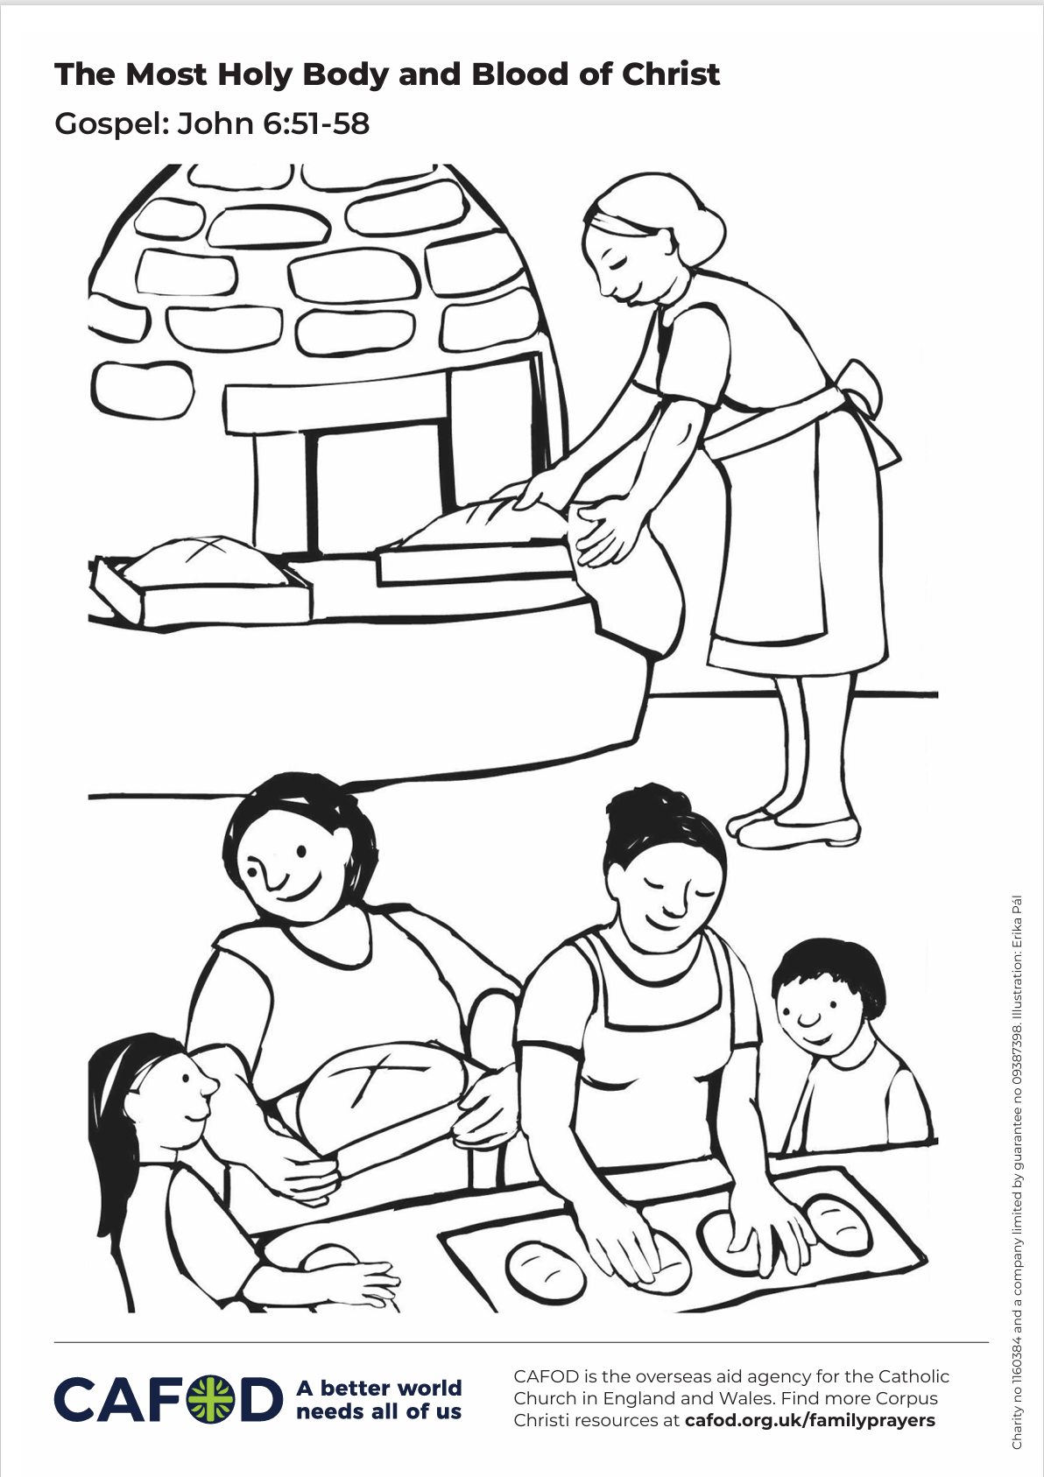
Activity suggestions
Download the illustration
Invite the children to colour in the accompanying illustration of a bakery in El Salvador and on the back to write or draw what they will do to help make sure that all people around the world have enough food to eat.
Get different types of bread from around the world to show the children and let them feel and taste them. (Do bear in mind any allergies) Or you could look at images of different types of bread if that is easier.
Encourage the children to name any of these different breads that they recognise. What are they like? Do they enjoy them? Explain to the children which country the breads originally come from and show them or challenge the older ones to find on a map where that country is.
Notes:
Illustration: Erika Pal

Slide 18
Activity suggestions
Talk about how even though all these breads are different, they are still bread. Much the same, all people are different but they are still people – special and loved by God.
Encourage the children to think about and pray for all people involved in making their bread, from those who grow the ingredients, to those who bake and sell the bread.
Remind the children to share all they have heard and thought about today with the people at home. Encourage them to remember Yeabu in Sierra Leone each time they eat bread in the week and to pray for all people around the world struggling to get enough to eat. Perhaps they could do one thing in the week to help those who are hungry in their local community or around the world.
For more CAFOD ideas and activities, please go to Primary teaching resources
Notes:
Illustration: Erika Pal

Slide 19

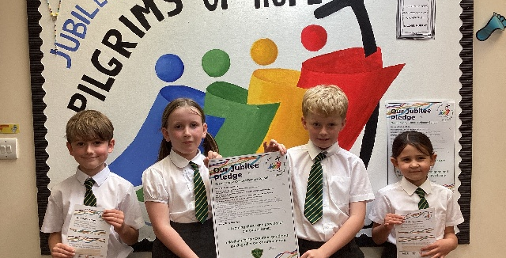

Get involved with CAFOD this term
Explore our summer term resources
Ways to mark your Pledge anniversary
Fundraise for a World Gift

Slide 20
