Slide 1
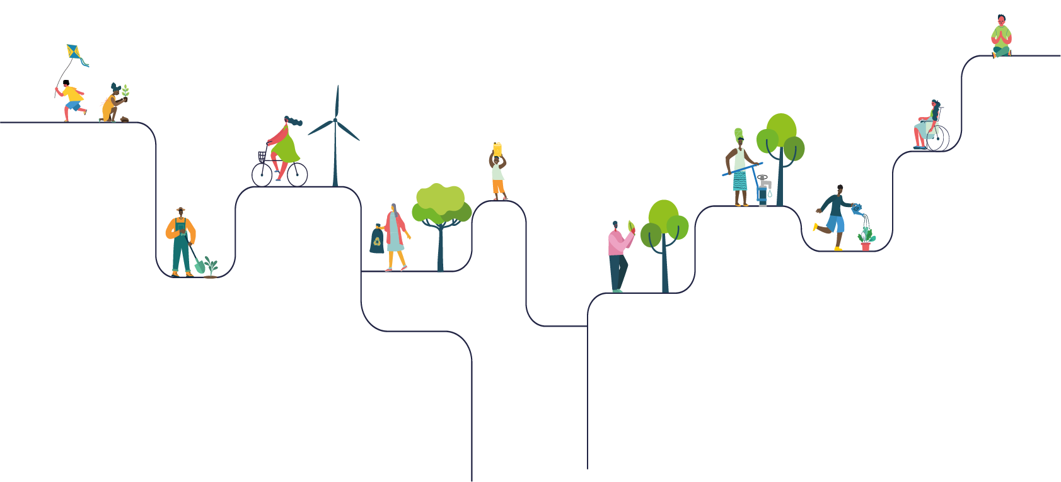
Award for Schools
Primary school assembly

Slide 2
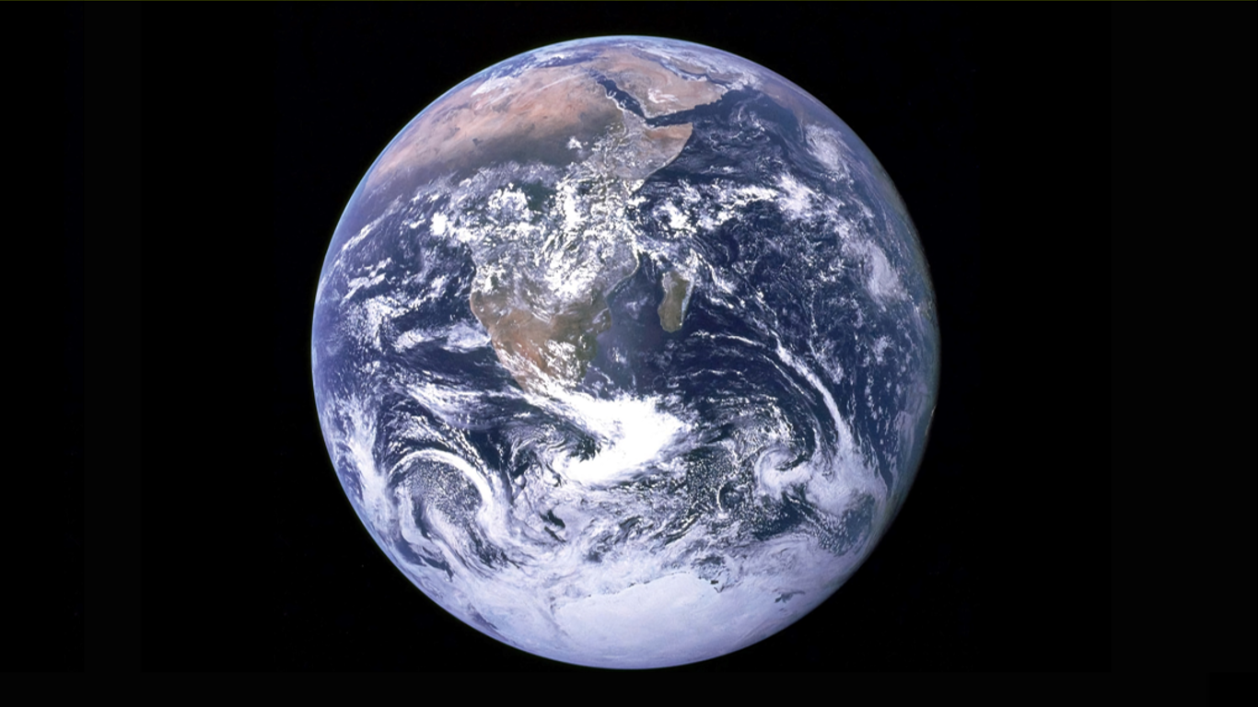
Notes:
Photo credit: NASA (Unsplash)

Slide 4
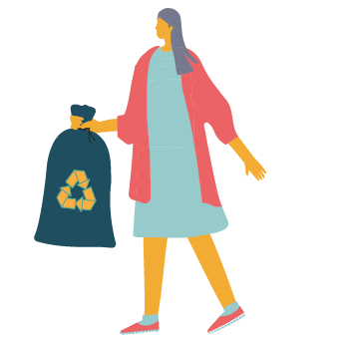
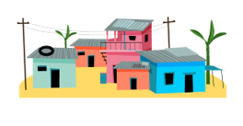
Live simply
Live sustainably
Live in solidarity

Slide 5
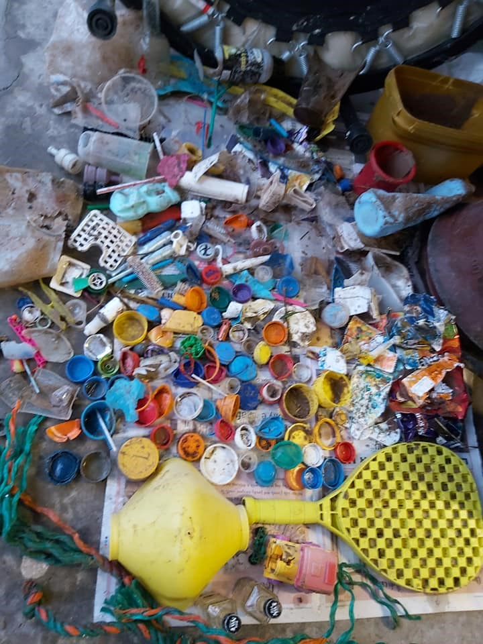
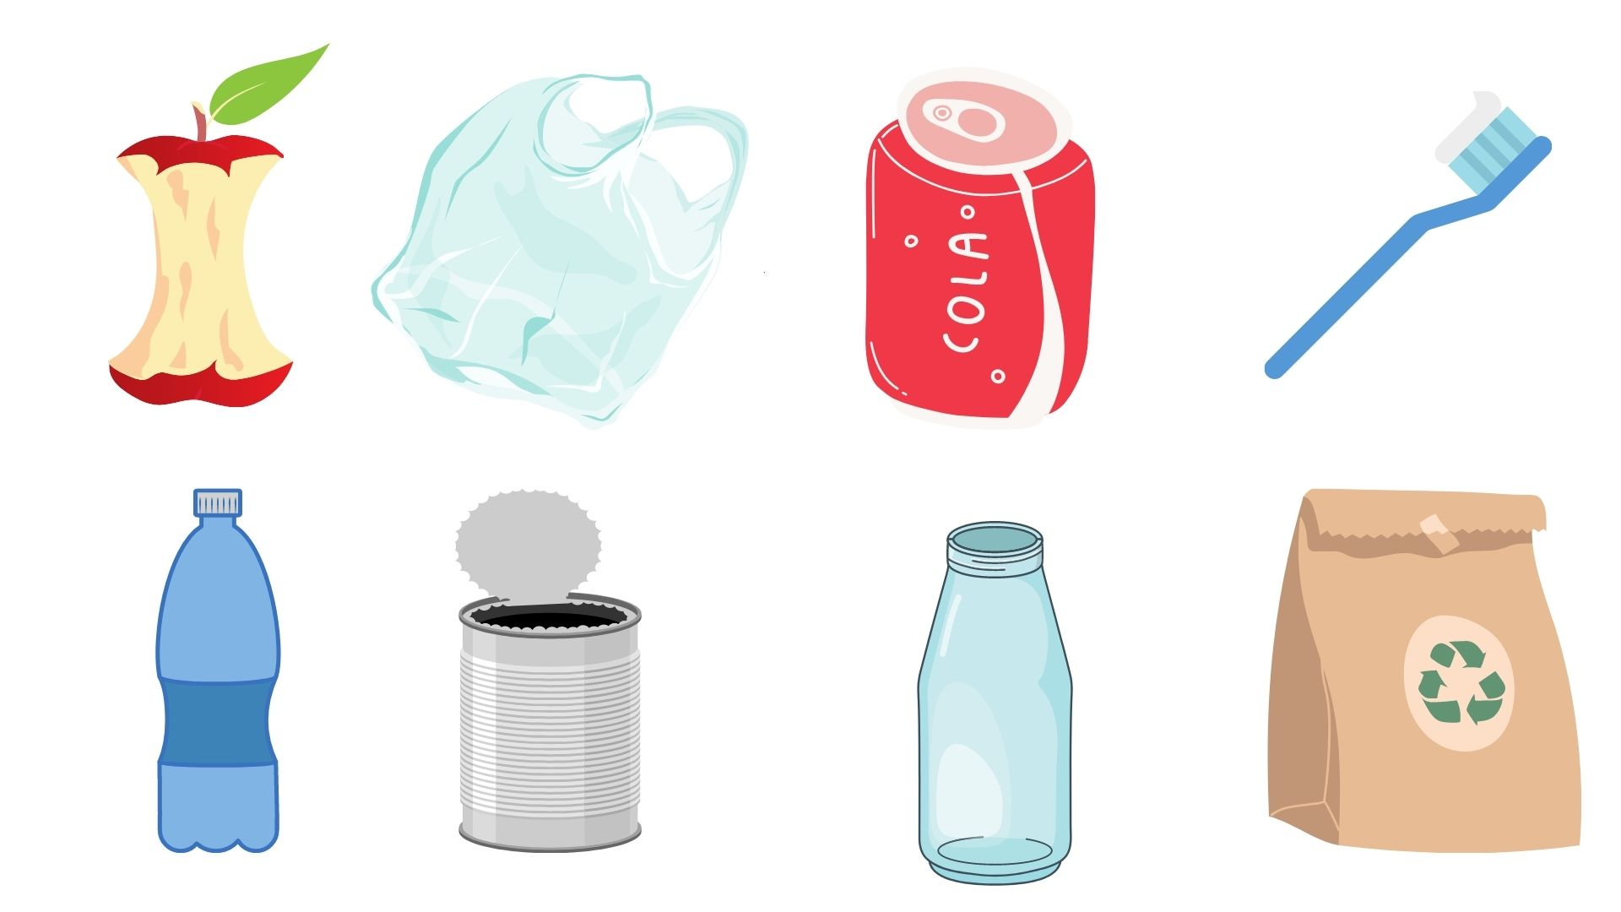
How long until it’s gone?

Slide 6
How long until it’s gone?
1 month
2 months
10-20 years
50 years
Apple core
2 months
Plastic bag
10-20 years
Aluminium can
200 years
Toothbrush
500 years
200 years
450 years
500 years
Unknown
Plastic bottle
450 years
Tin can
50 years
Glass bottle
Unknown
Paper bag
1 month
Notes:
Statistics source: National Oceanic and Atmospheric Administration, US.

Slide 8
What does it mean to live simply?

Slide 10
What does it mean to live sustainably?

Slide 11
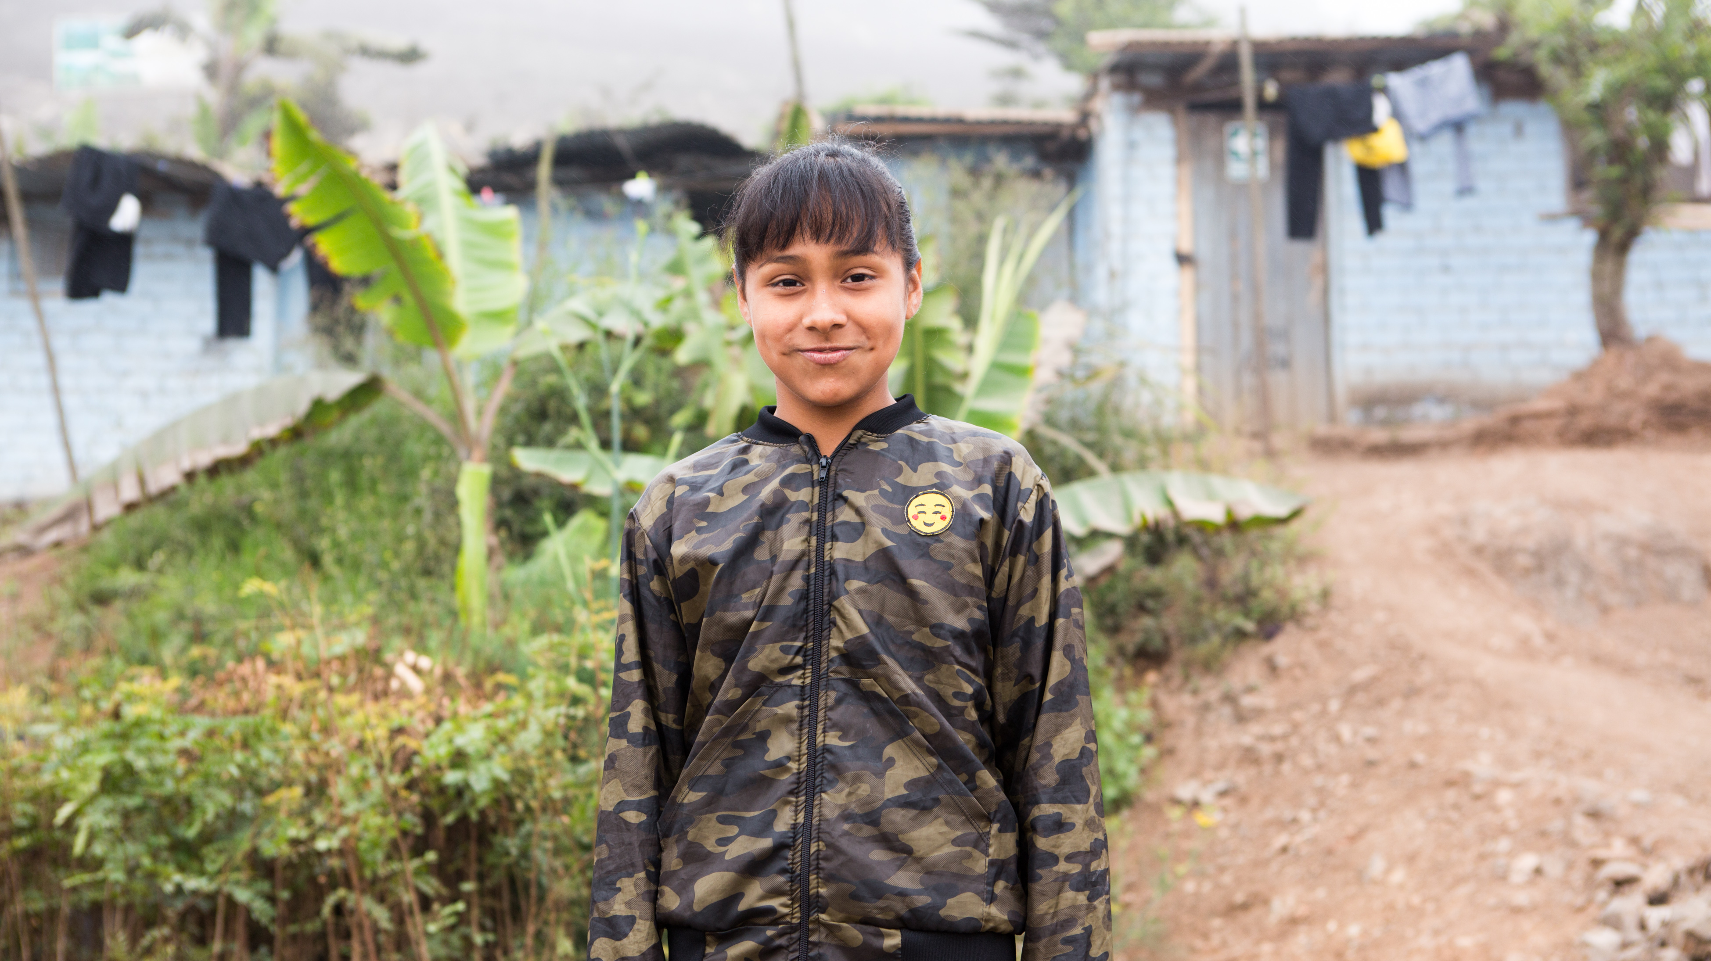

Slide 12
What does it mean to live in solidarity?

Slide 13
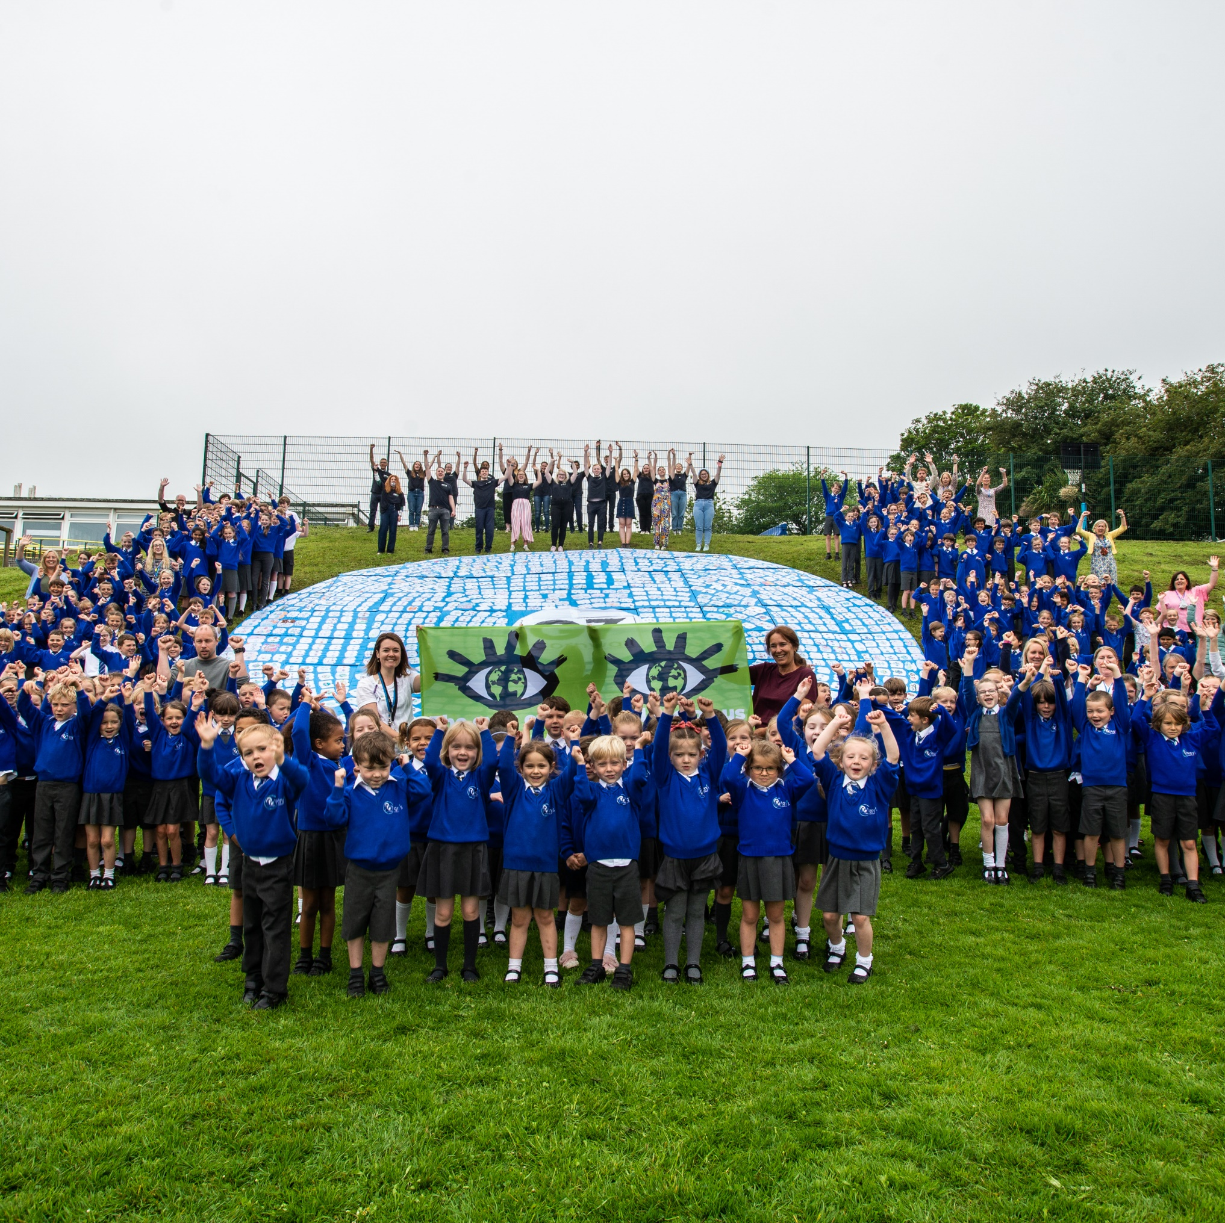
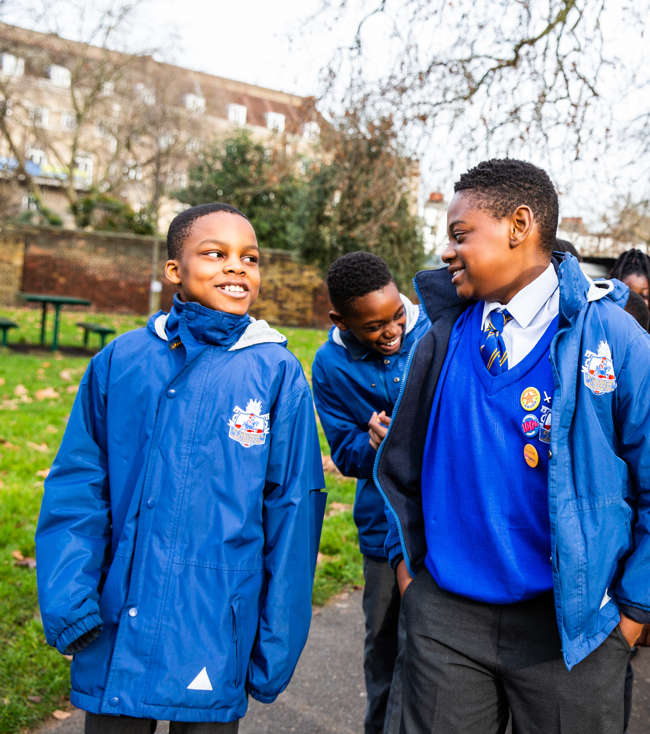
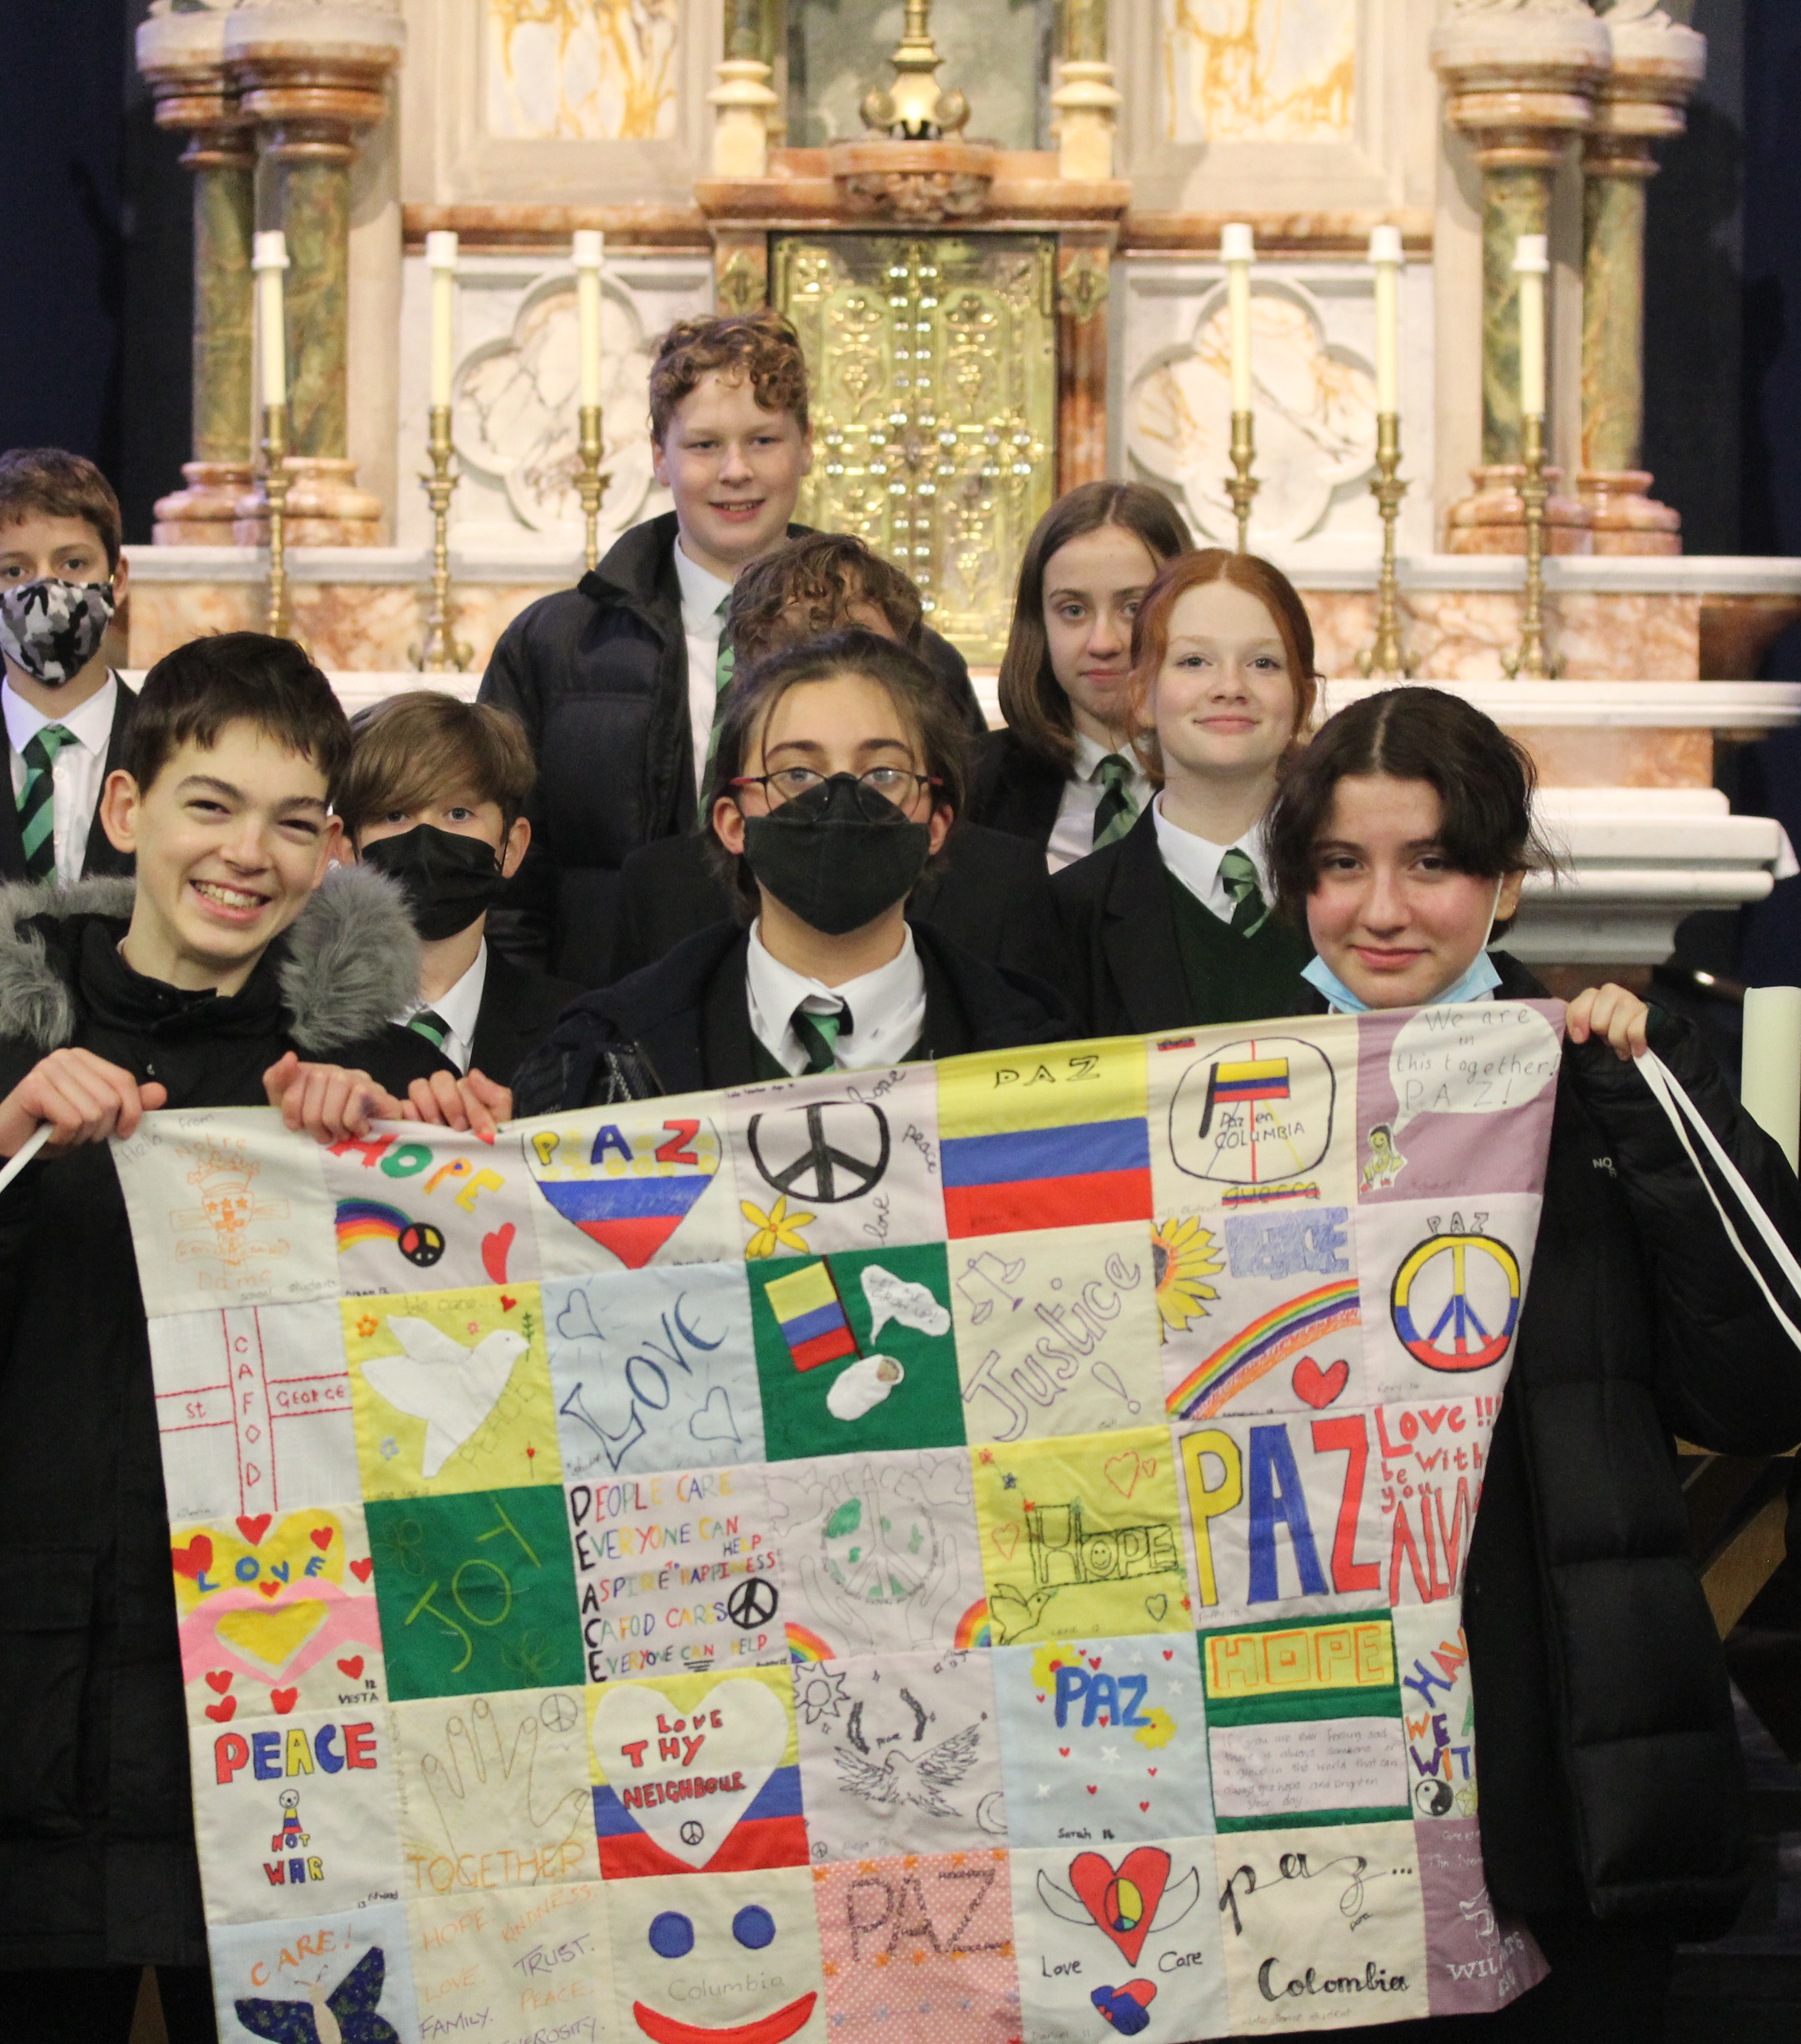

Slide 14
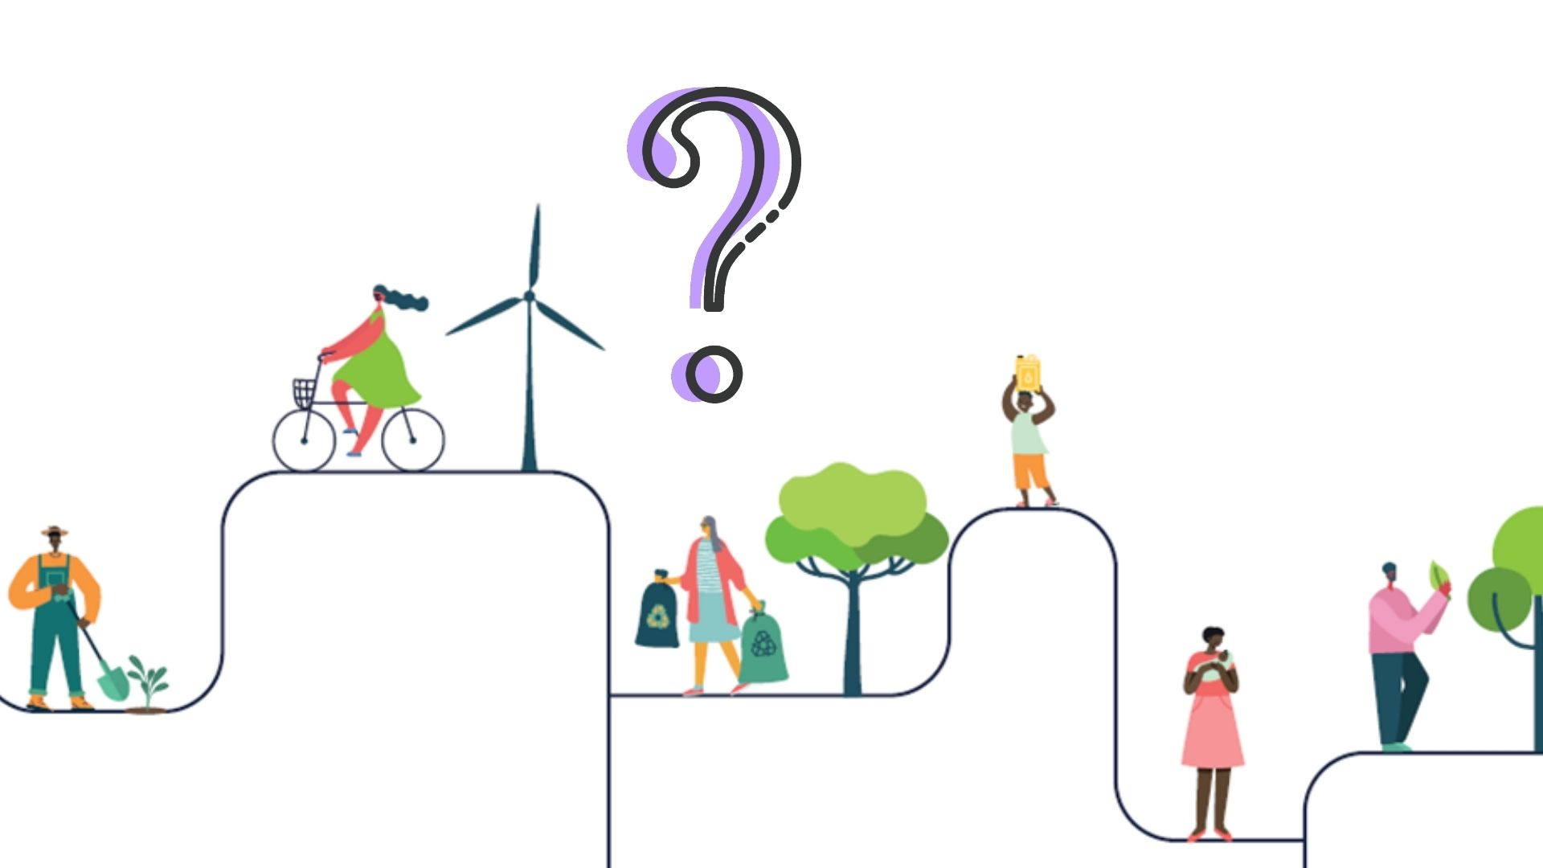

Slide 16
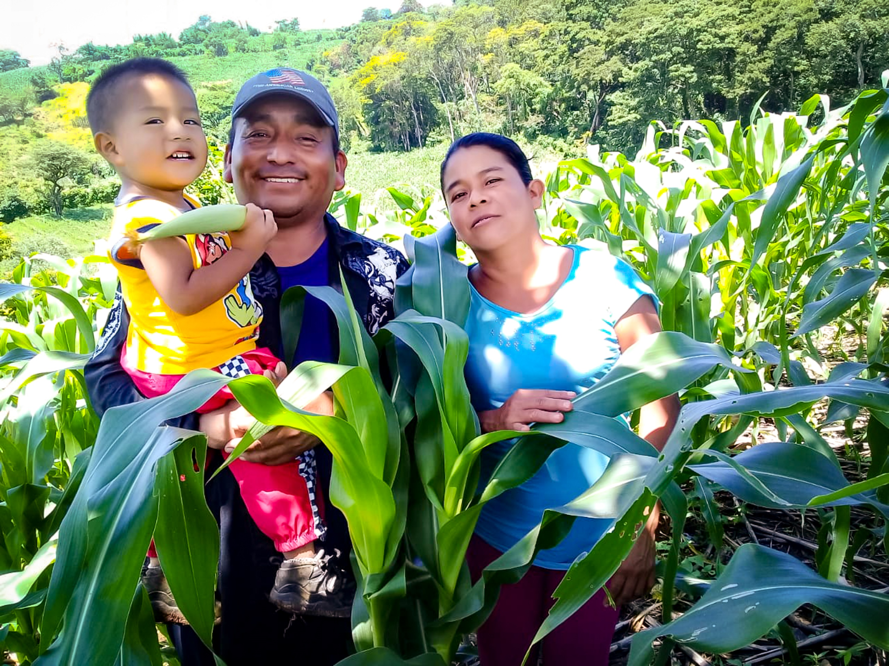
Loving God, you created the world for us all to share,

Slide 17
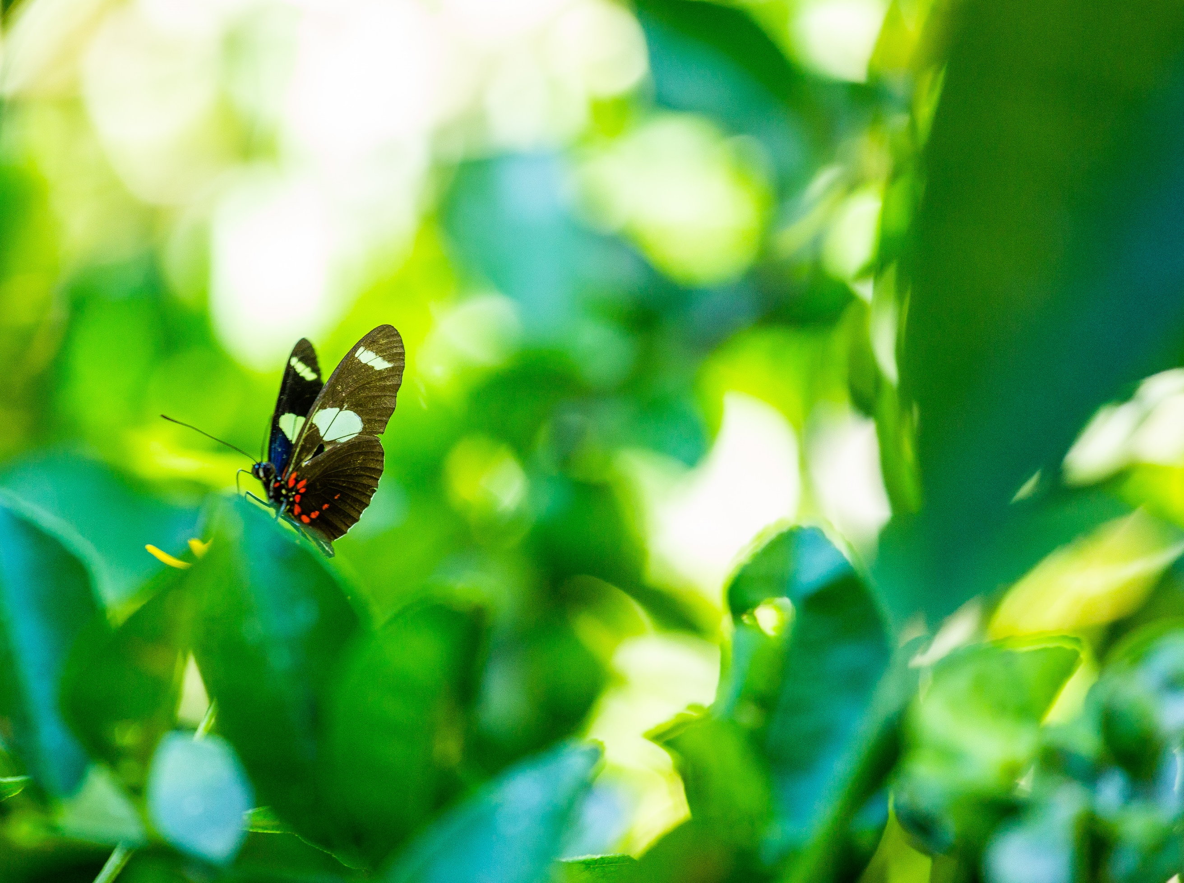
A world of beauty and plenty.

Slide 18
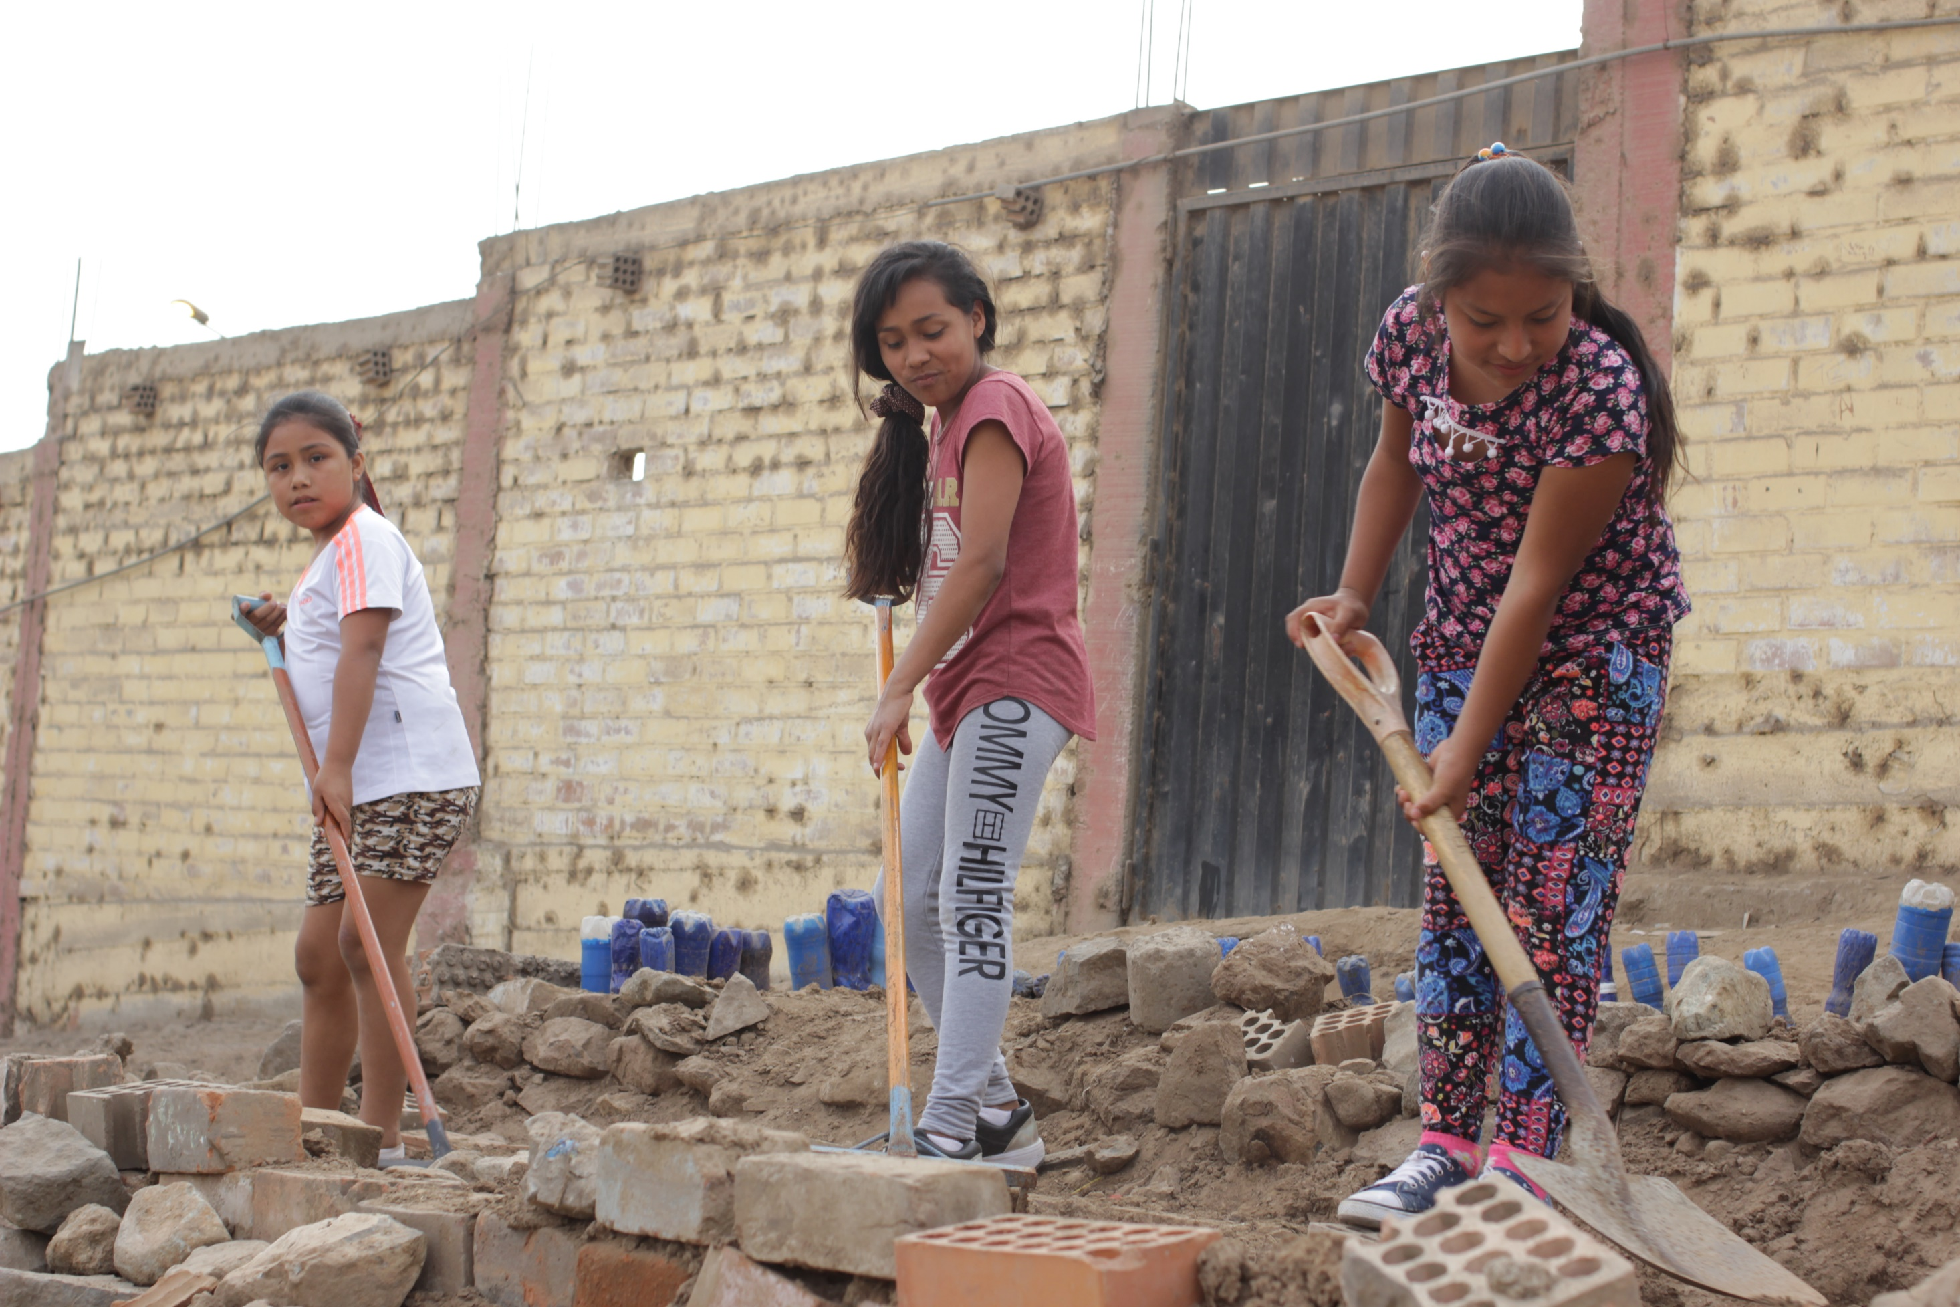
Create in us a desire to live simply, so we can see your generosity.

Slide 19
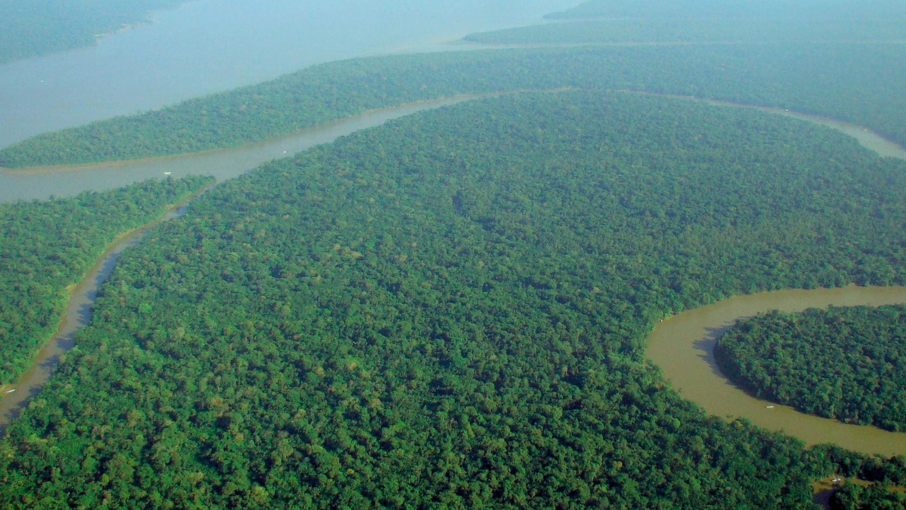
You gave us responsibility for the earth,

Slide 20
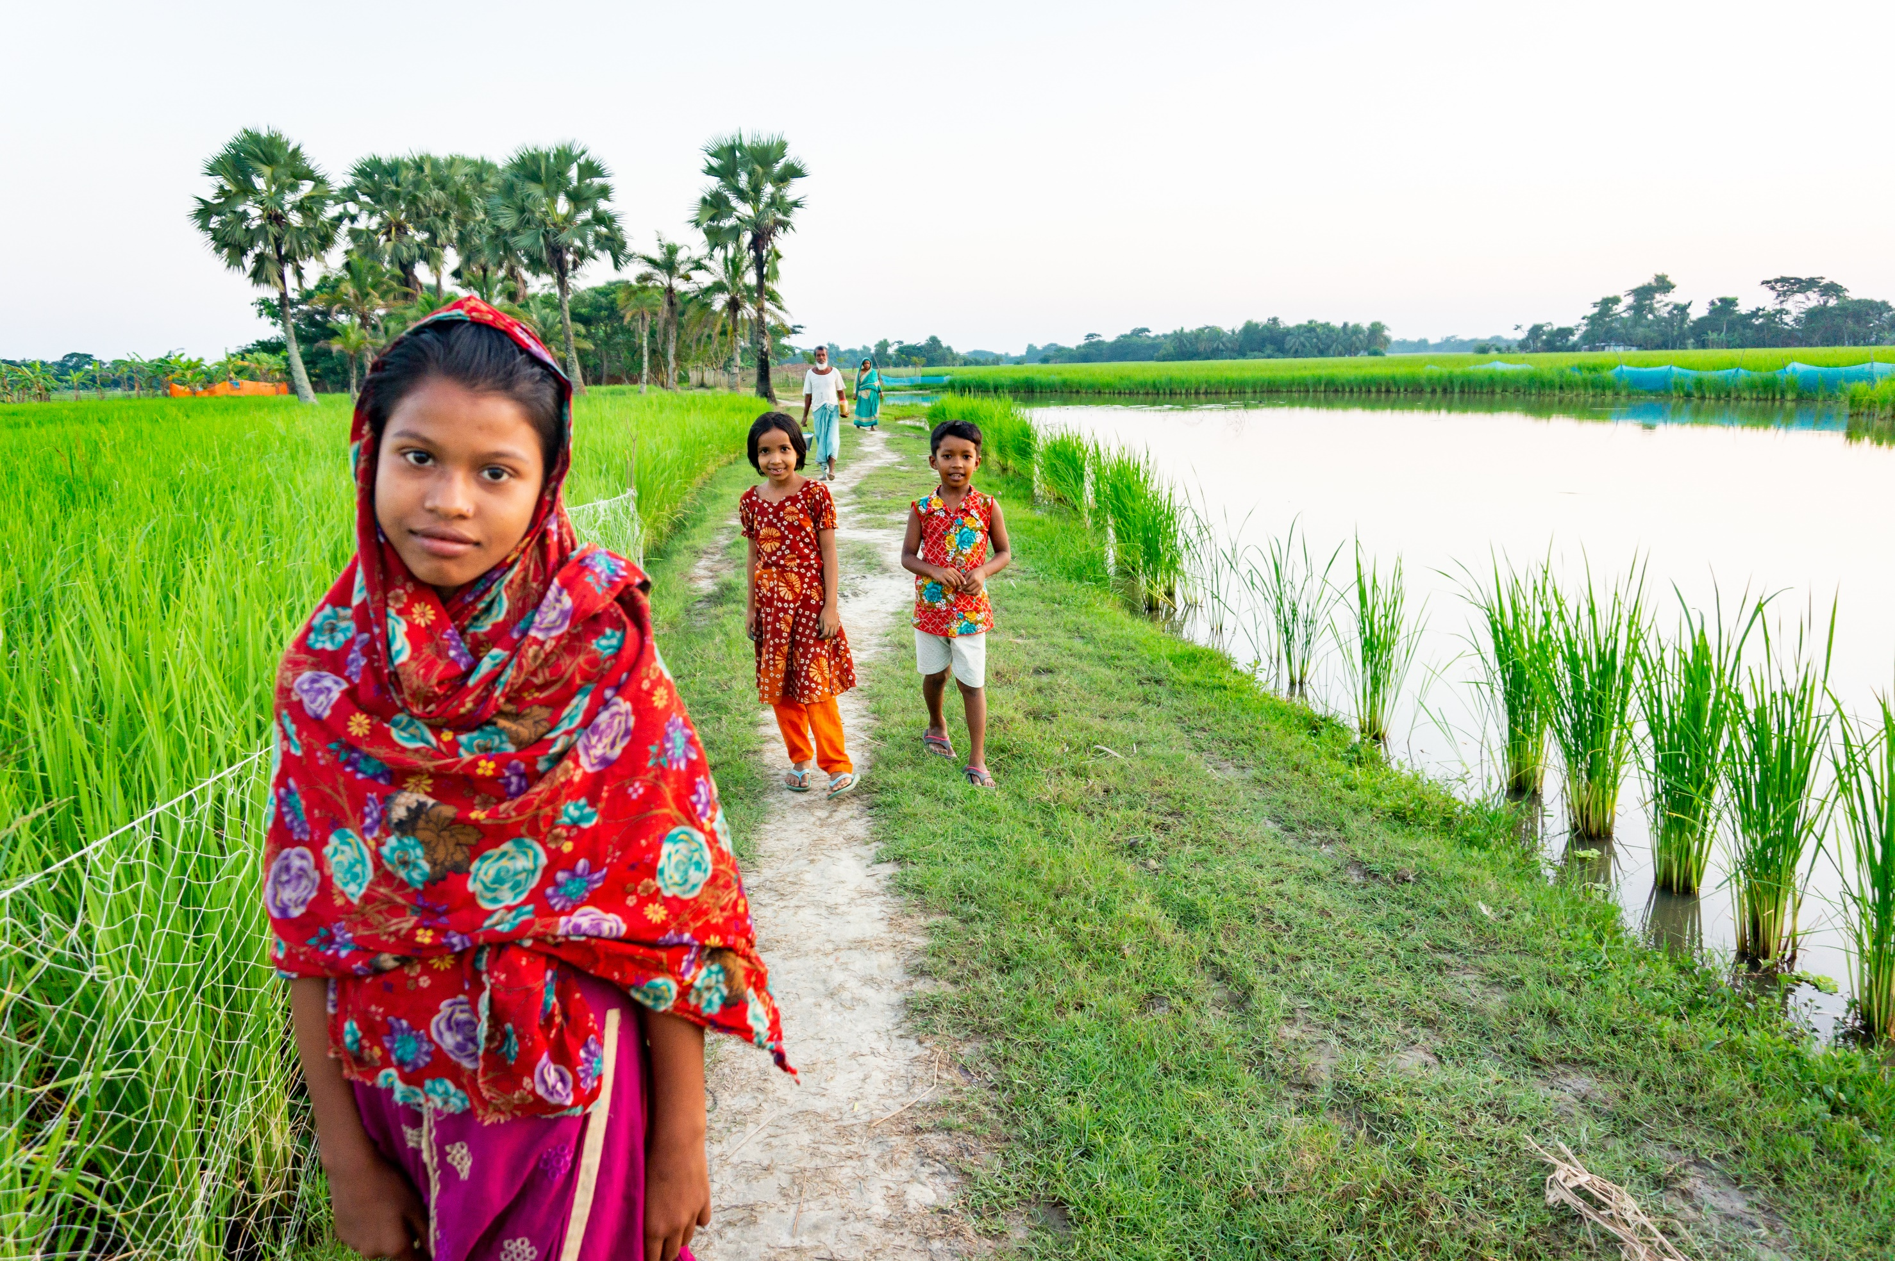
a world of riches and delight.

Slide 21
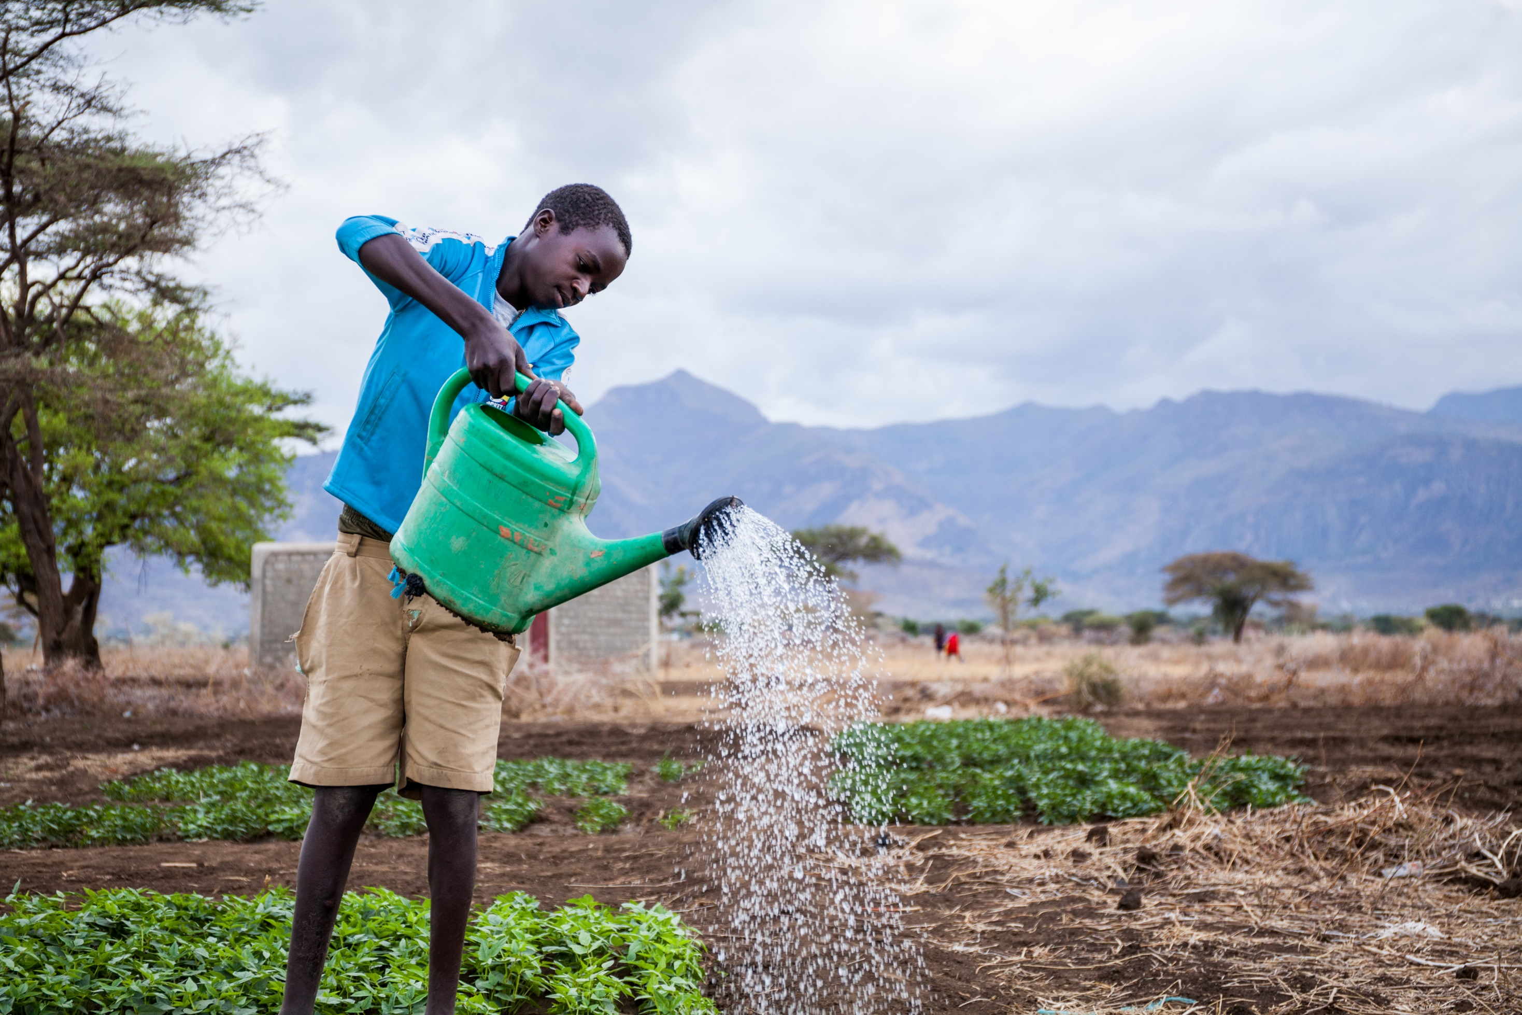
Help us to live sustainably, so that those who follow us may enjoy the fruits of your creation.

Slide 22
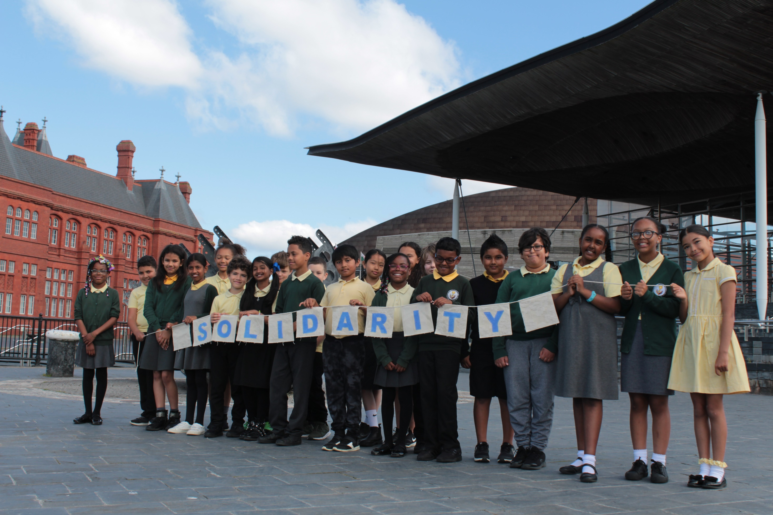
Help us to act in solidarity with all our brothers and sisters

Slide 23
so that we help create a fairer world.
Amen.

Slide 32
1 month

Slide 33
2 months

Slide 34
10-20 years

Slide 35
50 years

Slide 36
200 years

Slide 37
450 years

Slide 38
500 years

Slide 39
Unknown

