Slide 1
What happened at COP26?

Slide 2
THANK YOU
to everyone who joined our Eyes of the world campaign for COP26.
58,000 of you called on our government to keep the world’s poorest people at the heart of the talks.
Notes:
If you have time, at this point show the Eyes of the World banner tour video (1:41):
https://www.youtube.com/watch?v=SorwgqXwYYE

Slide 3
Your voices
were heard.

Slide 4
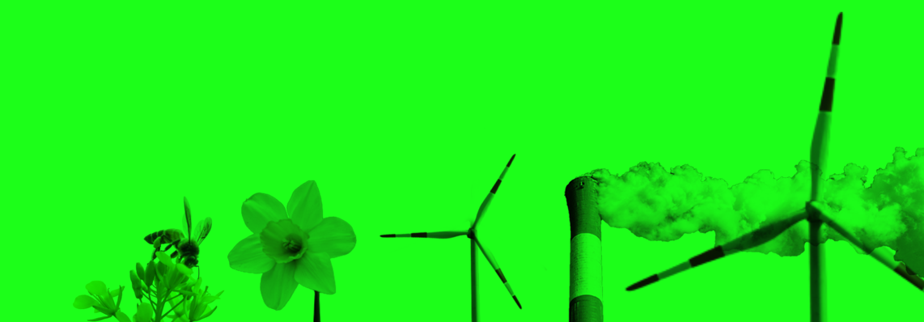
You asked for countries to stop funding fossil fuels overseas…
The Glasgow Climate Pact is the first COP agreement to mention fossil fuels, with an agreement to phase-down coal.

Slide 5
You called for countries to keep global temperature rises below 1.5 degrees….
Countries at COP26 agreed to come to COP27 next year with their plans for cutting emissions.

Slide 6
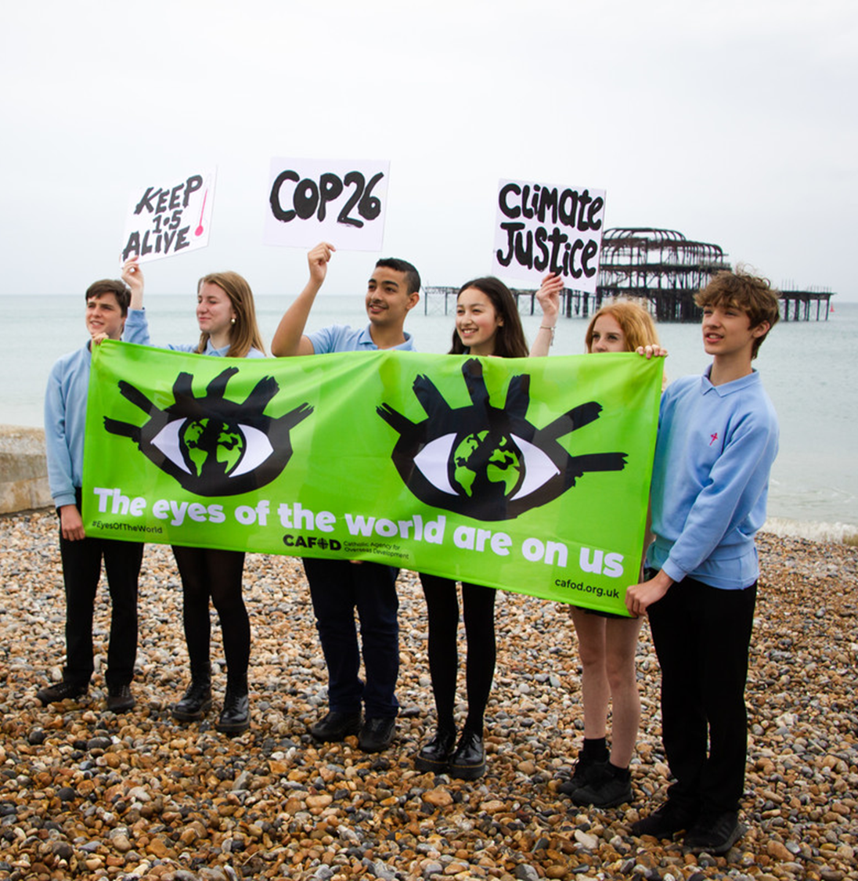
The tide is turning.
But COP26 was just the start. And it didn’t go far enough.
It hasn't delivered the action that’s urgently needed.

Slide 7
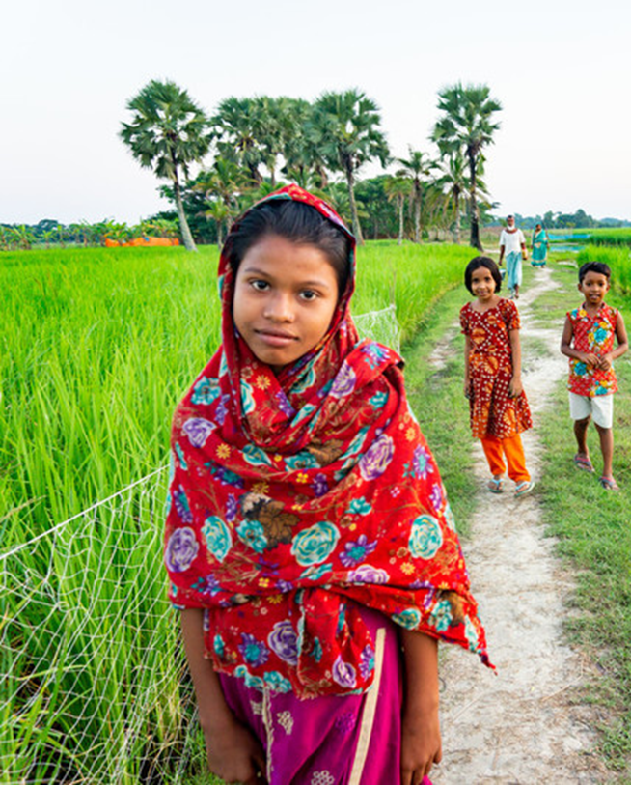
The hotter our climate gets, the more we will see extreme weather, flooding and droughts.
We are all affected by the climate crisis, but the world’s poorest communities,
who have done the least to cause it, are suffering the most right now.

Slide 8
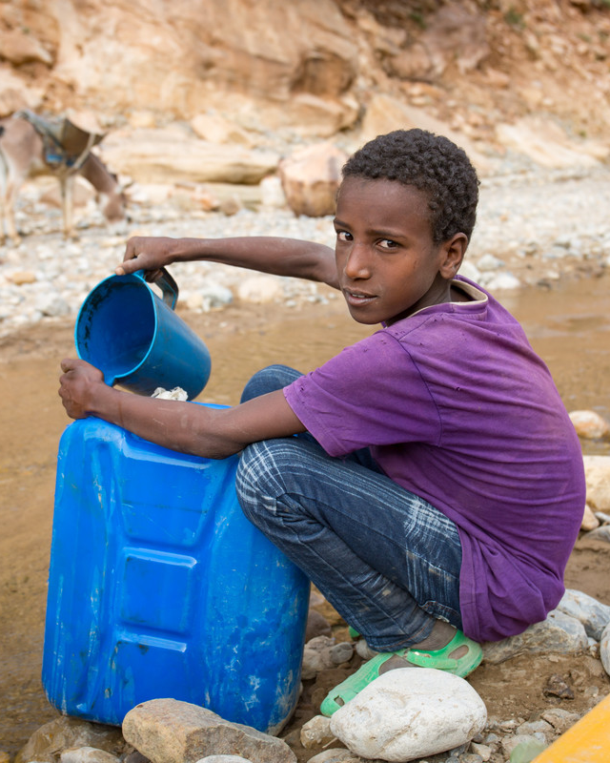
We are on a road with no turning back now. The question is, are we travelling 'far enough, fast enough and fairly enough' – to which the answer is no.
Climate justice is not just a concept for some, it is what must be delivered.
Christine Allen, CAFOD Director

Slide 9
Now is the time to act, urgently, courageously and responsibly.
Message to COP26, Pope Francis

Slide 10
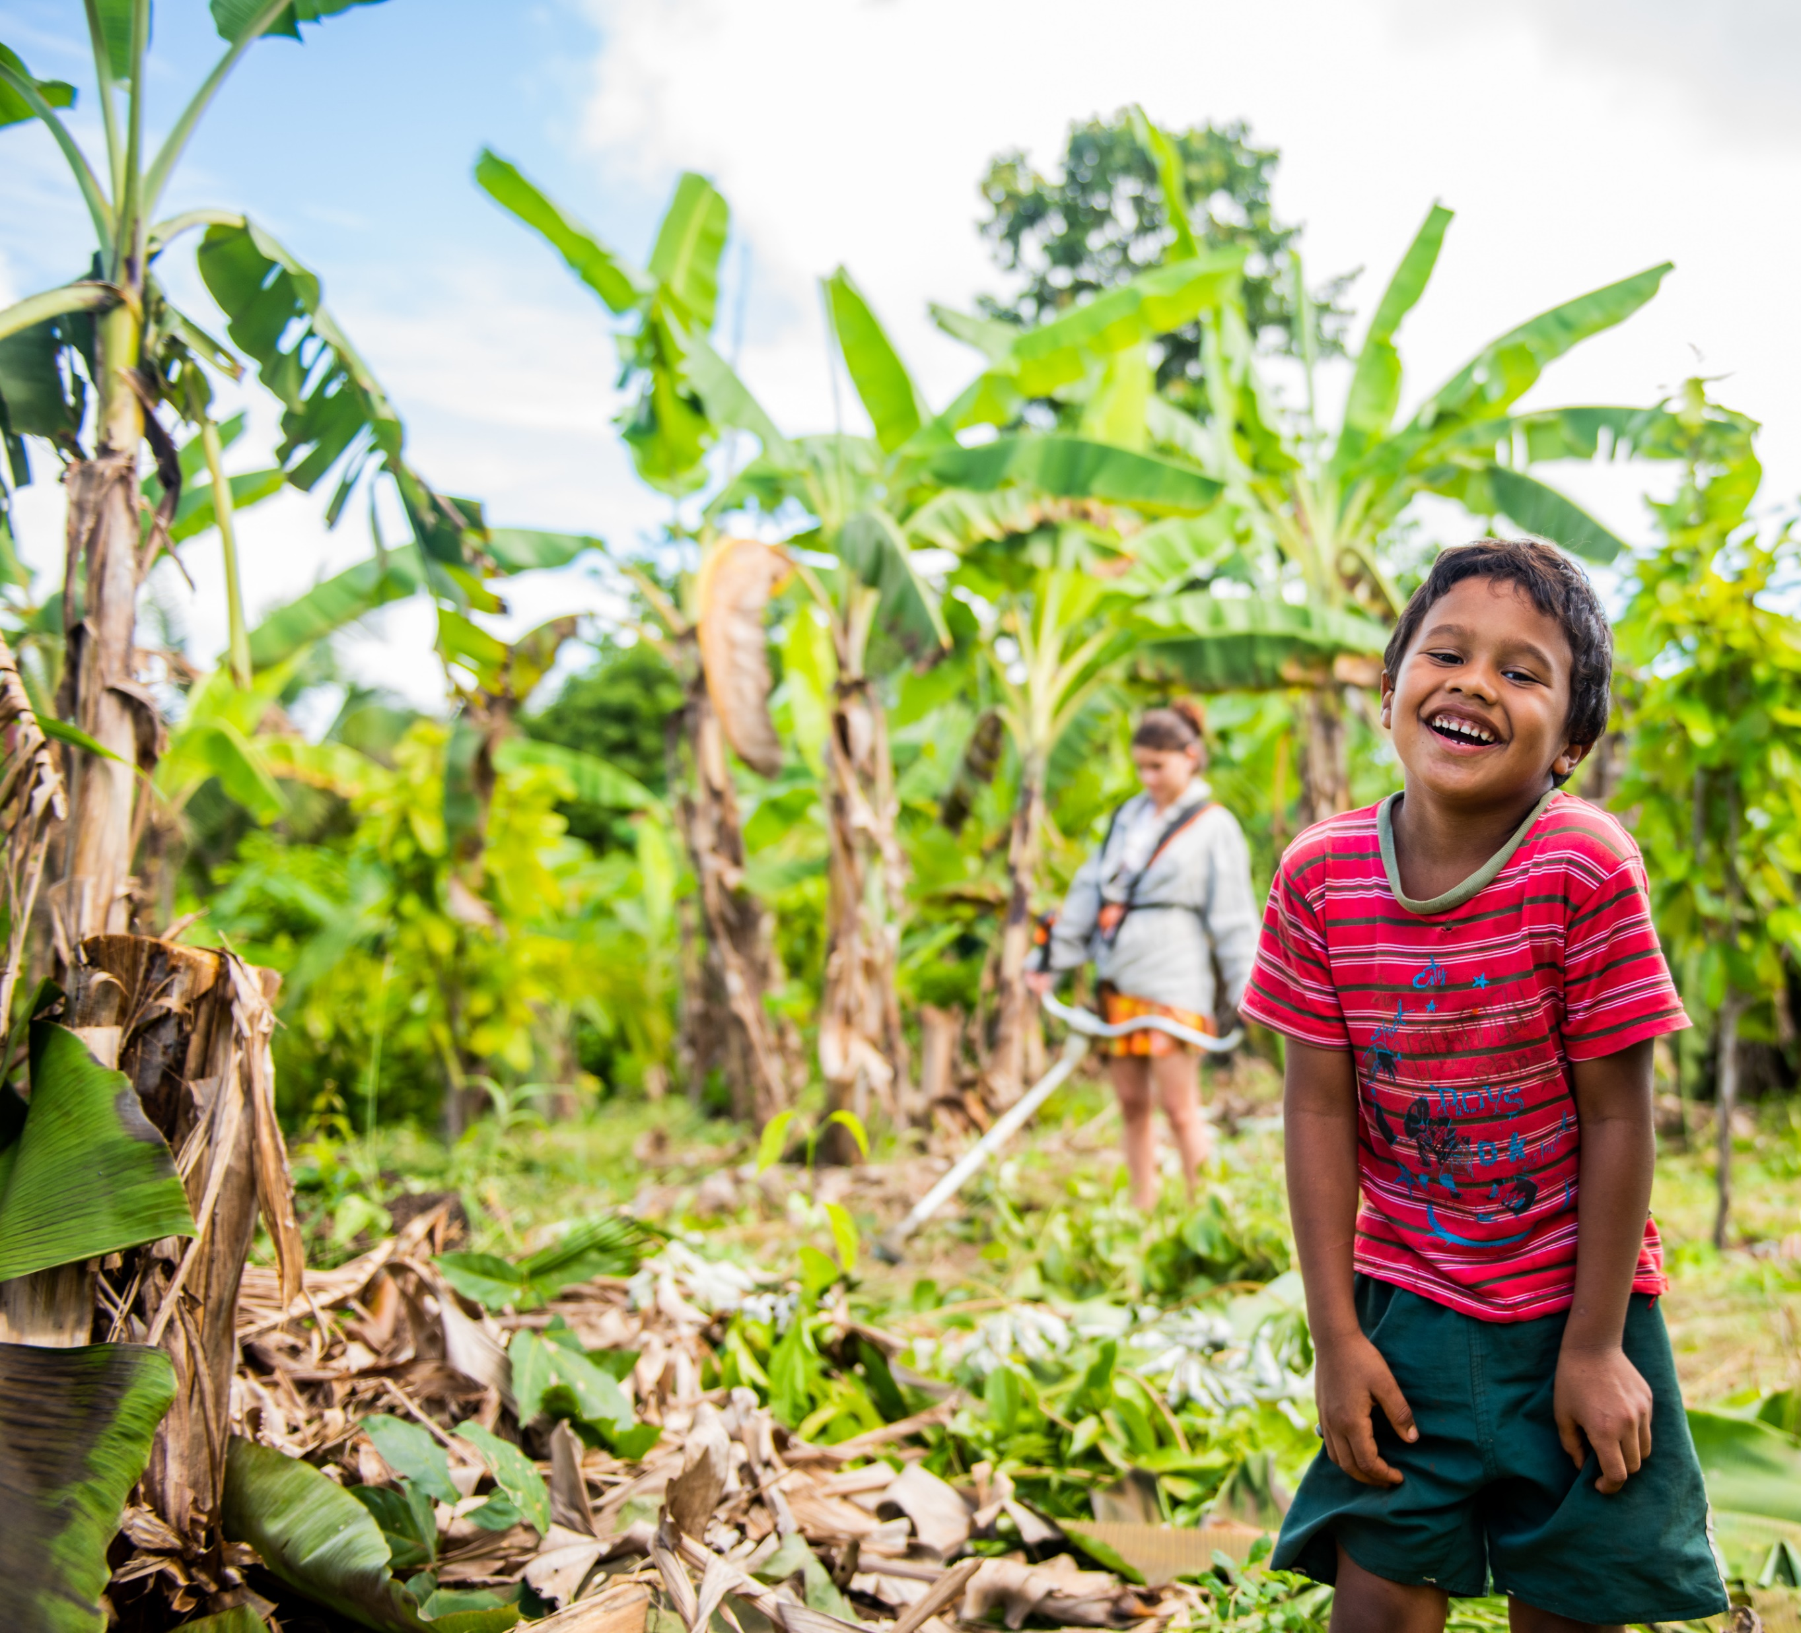
Let’s keep going!
By speaking up for our earth, acting and praying in solidarity with our global family,
we can build a better world.
Notes:
Picture credits: John Paul De Quay; Tamala Caesar; Louise Norton; Thom Flint; CAFOD

