Slide 1
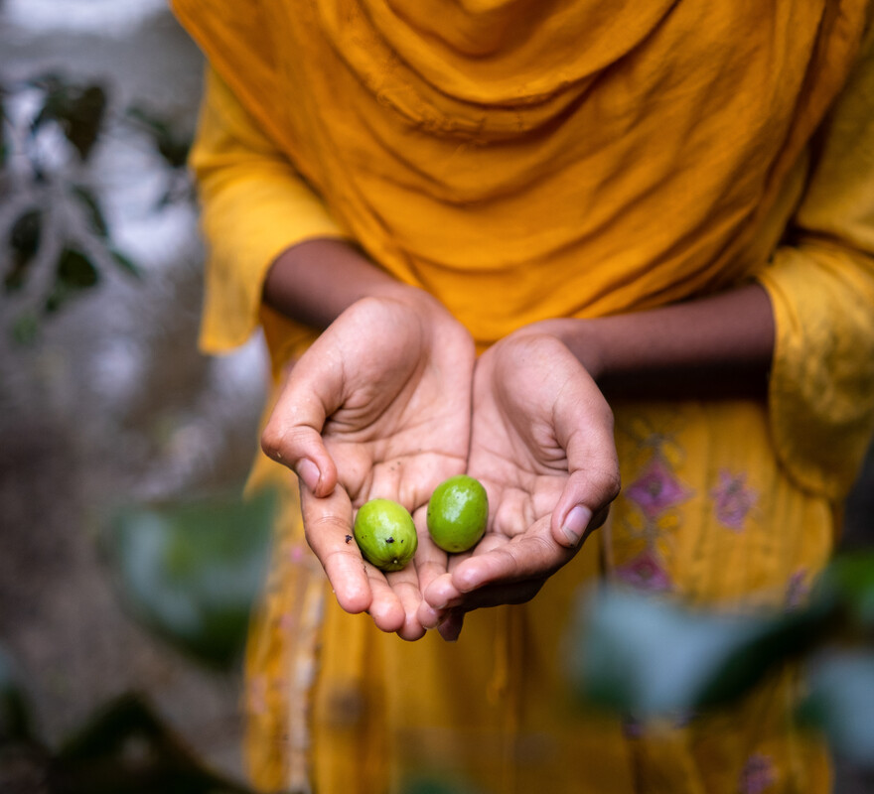
What can we do to show compassion and to help our brothers and sisters in need?
Gospel Celebration of the Word
Notes:
Children’s liturgy: Eleventh Sunday in Ordinary Time (Year A)
Preparation of the worship space
Colour: green
Song suggestions:
God’s Spirit is in my heart (864, Laudate)
Welcome
Today, we hear how Jesus was moved with compassion for people who were worried and who were looking for help. He sent the disciples out to care for them and he asks us to carry on this work today.
Dristy, Bangladesh
Photo credit: Amit Rudro

Slide 2
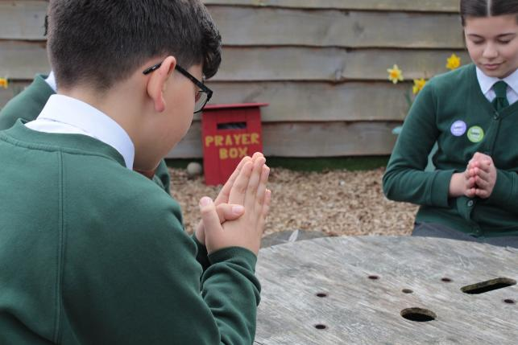
Loving God,
We thank you for your care for each one of us. Move us to help one another in whatever way we can, as we try to follow you.
Amen.
  Gather
Notes:
St Francis Xavier's RC Primary School, Herefordshire
Photo credit: Vicky Ahmed

Slide 3
Gospel: Matthew 9:36-10:8
As he saw the crowds, his heart was filled with pity for them, because they were worried and helpless, like sheep without a shepherd. So he said to his disciples, “The harvest is large, but there are few workers to gather it in. Pray to the owner of the harvest that he will send out workers to gather in his harvest.”
Jesus called his twelve disciples together and gave them authority to drive out evil spirits and to heal every disease and sickness. These are the names of the twelve apostles: first, Simon (called Peter) and his brother Andrew; James and his brother John, the sons of Zebedee; Philip and Bartholomew; Thomas and Matthew, the tax collector; James, son of Alphaeus, and Thaddeus, Simon the Patriot and Judas Iscariot, who betrayed Jesus.
Word

Slide 4
These twelve men were sent out by Jesus with the following instructions: “Do not go to any Gentile territory or any Samaritan towns. Instead, you are to go to the lost sheep of Israel. Go and preach, ‘The Kingdom of heaven is near!’ Heal the sick, bring the dead back to life, heal those who suffer from dreaded skin diseases, and drive out demons. You have received without paying, so give without being paid.”
Word

Slide 5
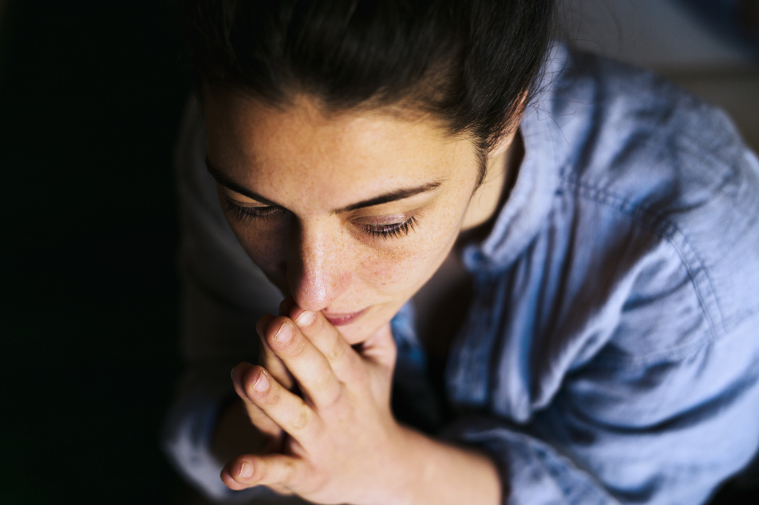
What do you remember from the Gospel reading?
Jesus can see that the people are worried, that they are struggling and that they are looking for some help.
Jesus is filled with compassion for them. But he doesn’t just feel sorry for them, he is also moved to take action.
Respond
Notes:
Woman in thought
Photo credit: Stock image

Slide 6

He gathers together his twelve apostles, his closest friends, and sends them out with instructions, not only to preach and share his message with the people, but also to care for them.
Jesus sends the apostles to help, support and heal people. And to do it all for free, without asking for anything in return.
Notes:
Caring
Photo credit: Stock image

Slide 7
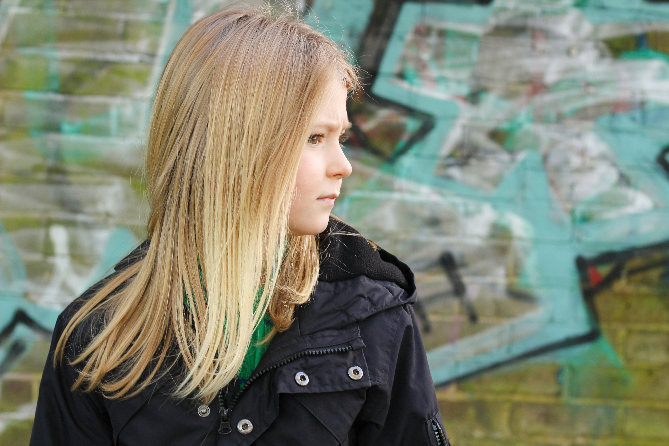
Can you think of a time when you saw that someone or a group of people needed some help or was worried about something? How did you feel? What did you do?
Jesus talks to the disciples about the harvest and how there are not enough workers to gather it in.
Can you guess what he was talking about here?
Notes:
Worried
Photo credit: Katie Gerrard on Unsplash

Slide 8
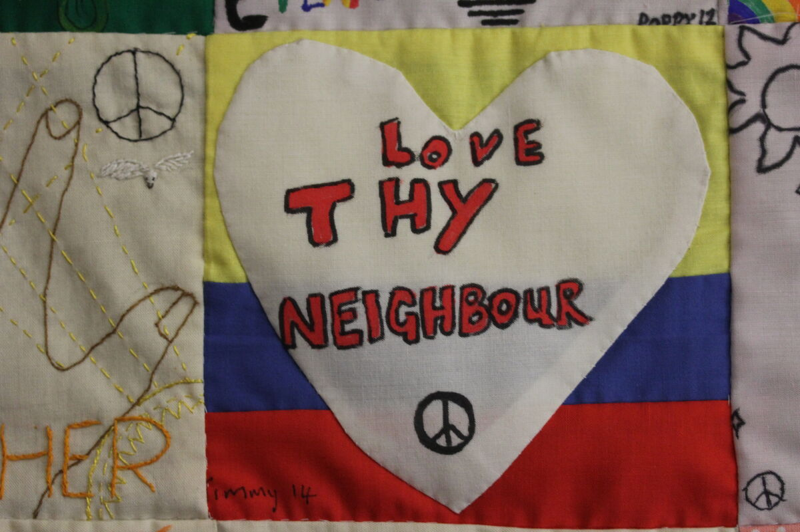
Jesus knows that everywhere around the world there are people who are looking for comfort and help.
There are people who need to hear his message of love. But that there is only so much that he and the twelve disciples can do themselves.
He asks the disciples to pray to the owner of the harvest to send more workers. Who do you think this owner might be?
Notes:
Hands On Magdalena Medio Norwich wall hanging, UK
Photo credit: Joe Savage

Slide 9
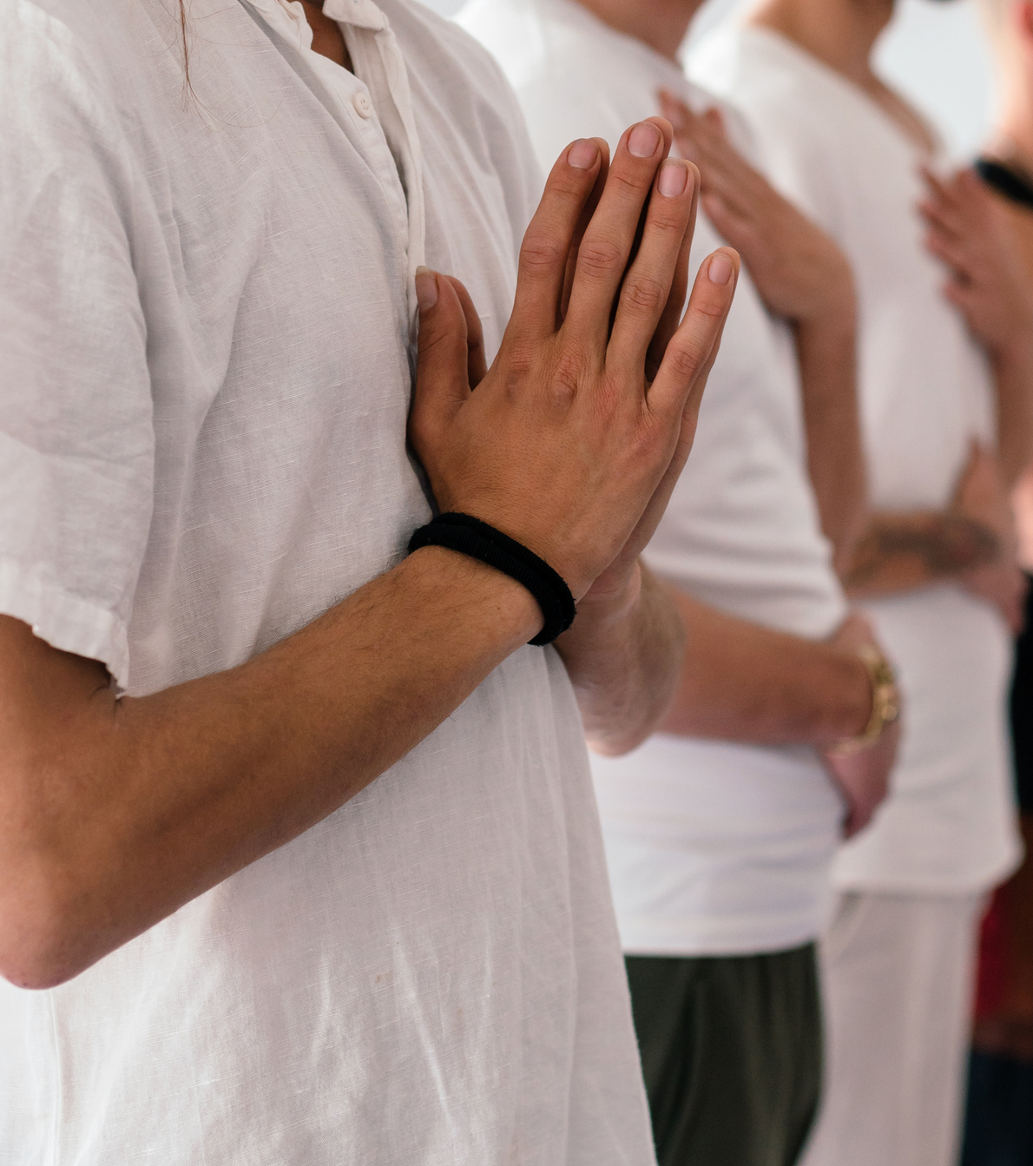
Jesus is telling the disciples to pray to God to send them more people to join in with their work, to follow Jesus and to share his love with others.
What do you think this means for us today?
Sometimes we are the people in need of help. Sometimes we are the people who can help others.
Notes:
Hands in prayer
Photo credit: Stock image

Slide 10
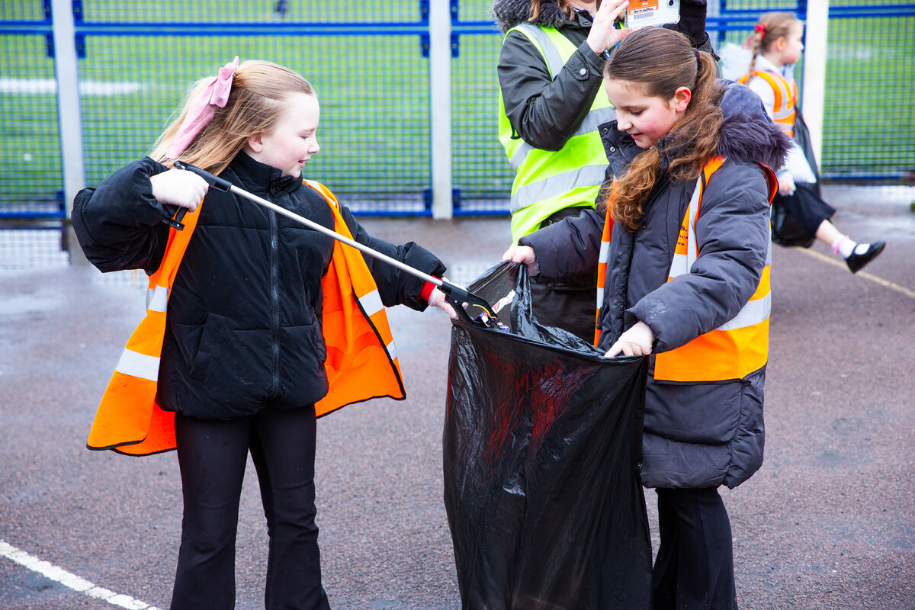
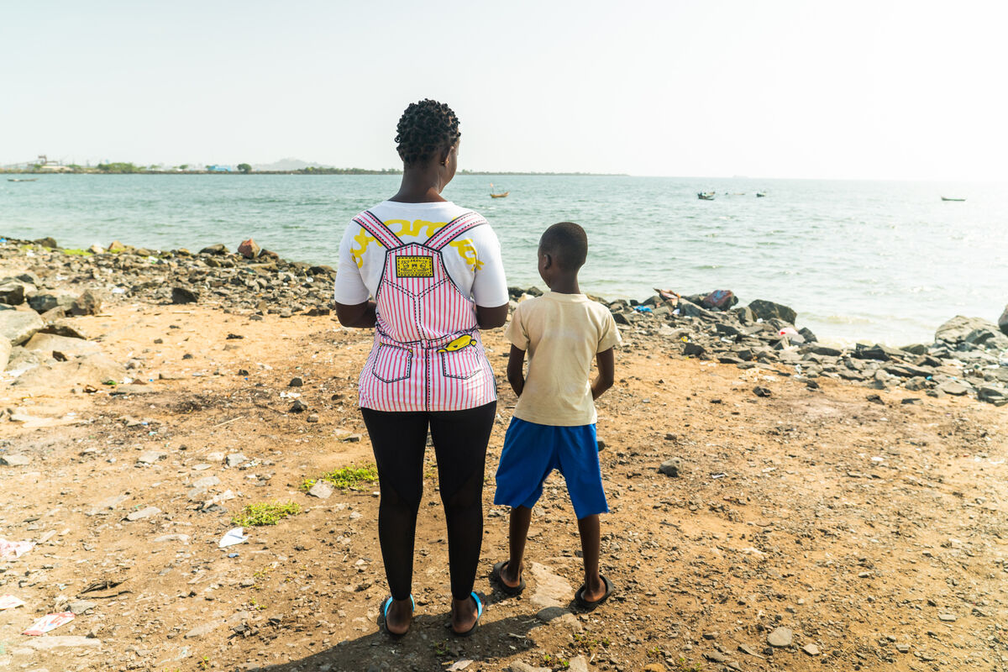
We are followers of Jesus and so we are called to do what we can to love and help other people.
The person who needs our help might be a member of our family or a friend, someone at school or church or in our local community.
It could be someone further away who we know, or even someone we’ve never met.
Notes:
Schoolchildren from Our Lady of Perpetual Help primary school, Manchester
Photo credit: Thom Flint
Cynthia and her son, Messi, DRC
Photo credit: Carielle Doe

Slide 11
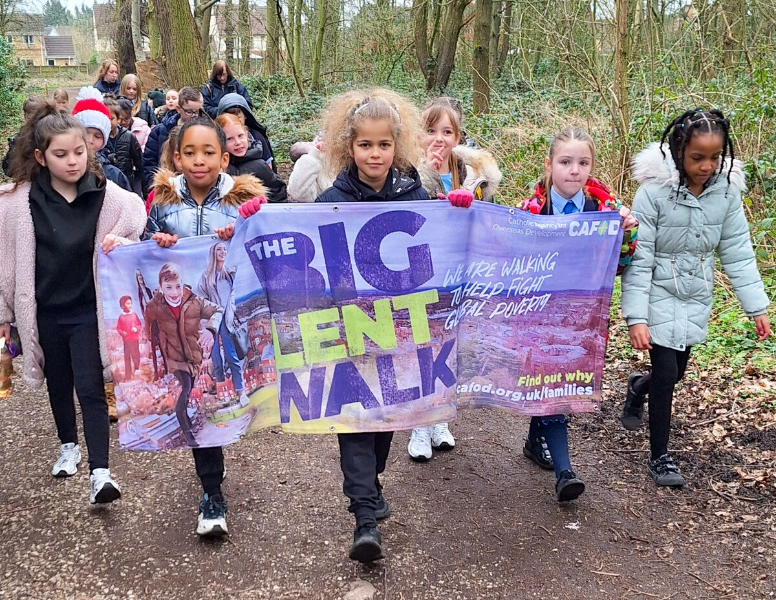
When we see a problem, we are asked not just to feel sorry for the person who is sad, worried, ill or struggling, but like Jesus, we are called to take action to help.
When we are struggling, we pray that others will do the same for us.
Notes:
School children taking part in the Big Lent Walk
Photo credit: CAFOD Liverpool

Slide 12
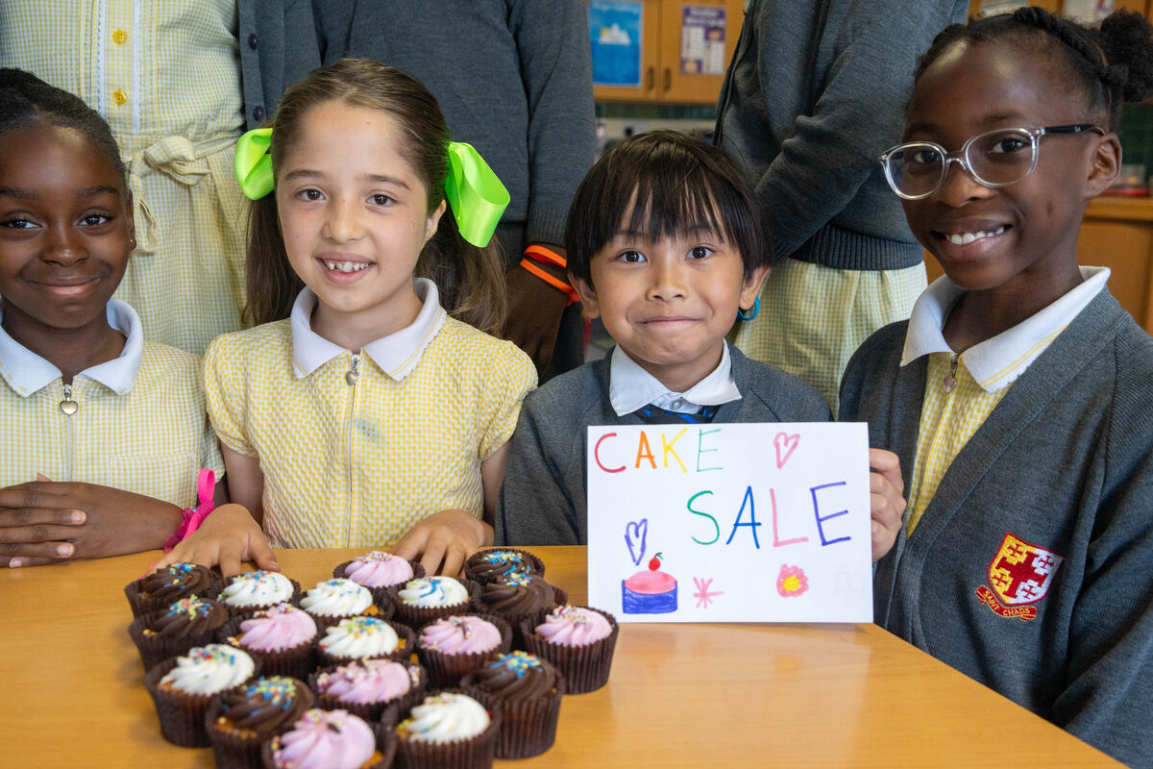
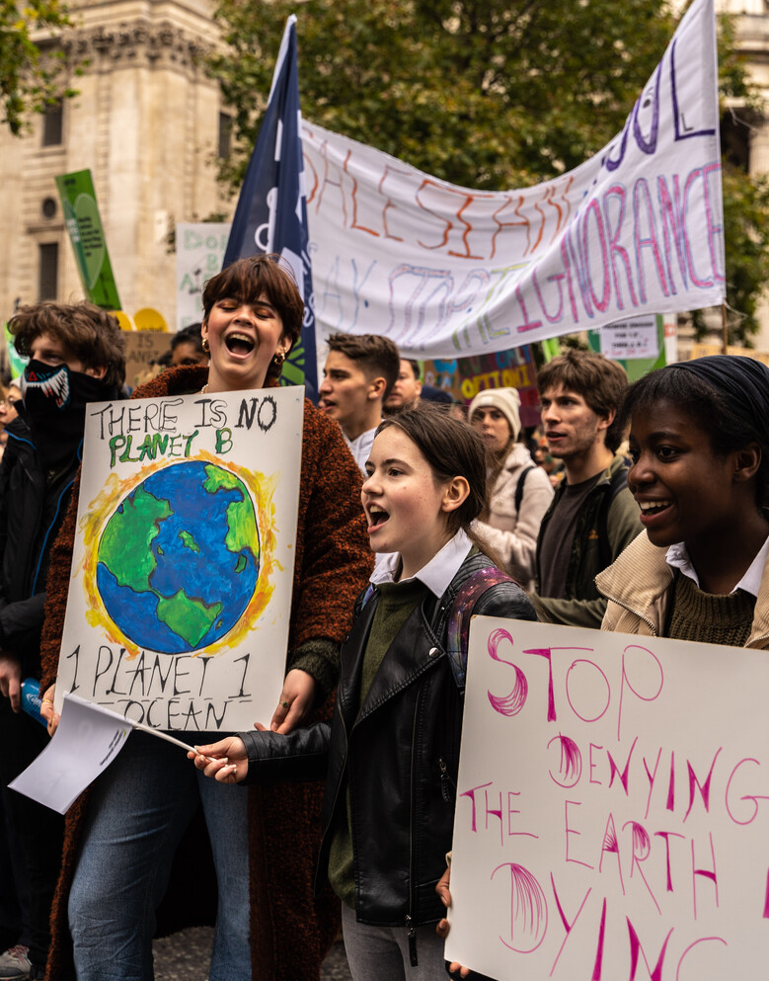
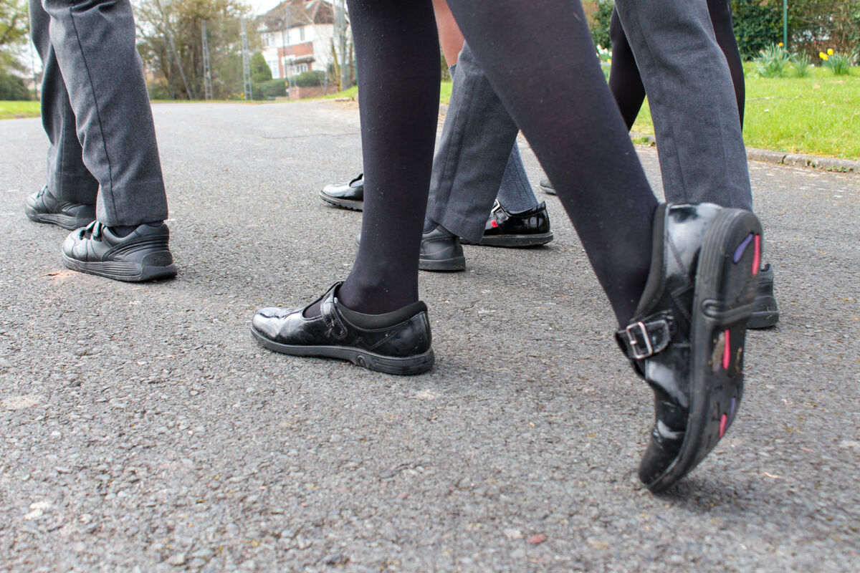
Thousands of children like you have raised money for CAFOD, helping communities living in poverty that you have never met.
Showing compassion and love, you may have baked for cake sales; organised a sponsored silence; walked the Big Lent Walk.
You might have helped by making your voice heard by writing to your MP or carrying a banner.
Notes:
Pupils at St Chad's, London
Photo credit: Joe Newman
Marching for climate change
Photo credit: David Gallardo
St Francis Xavier's RC Primary School, Herefordshire
Photo credit: Vicky Ahmed

Slide 13
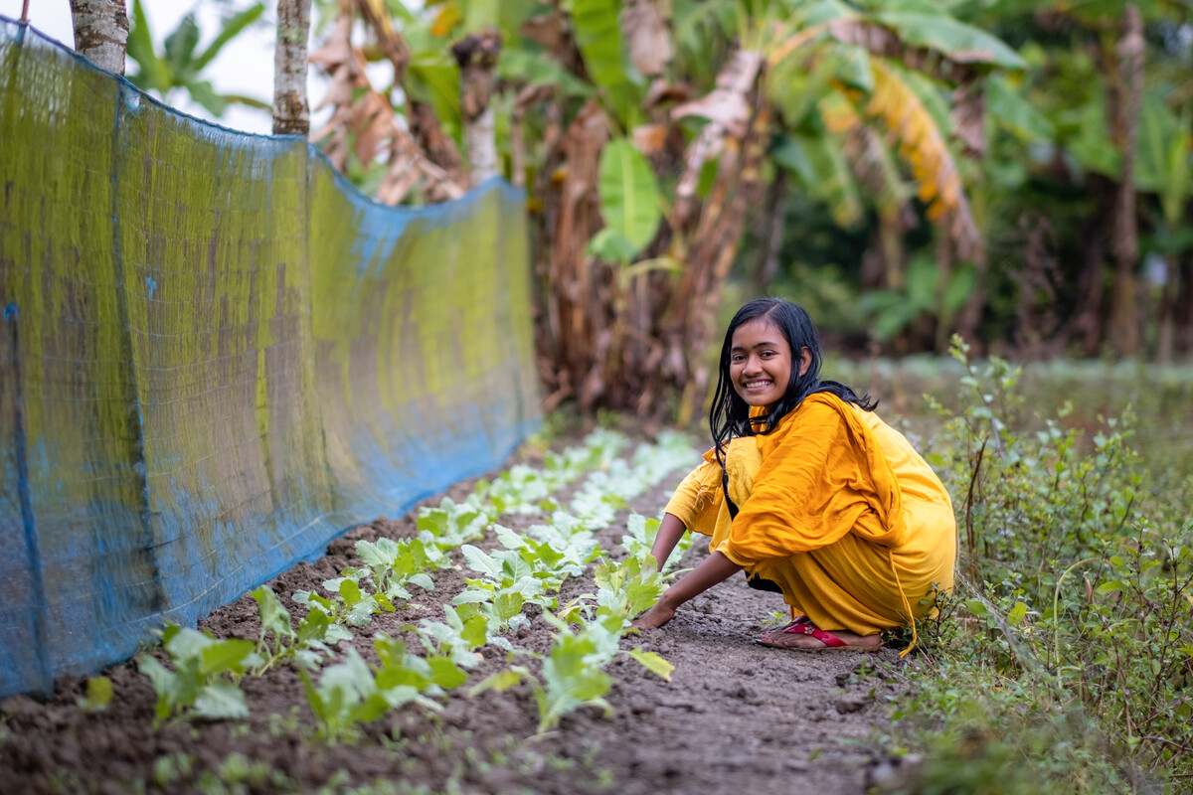
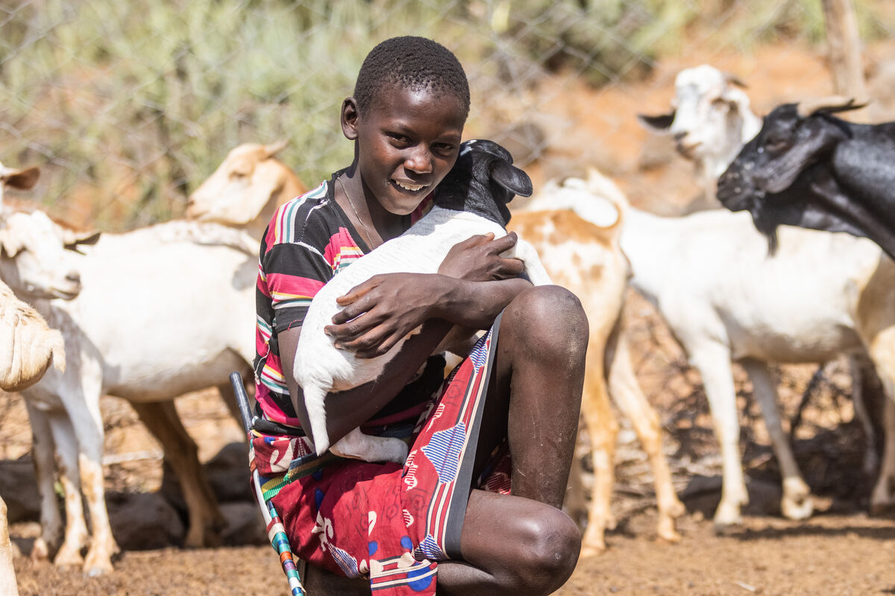
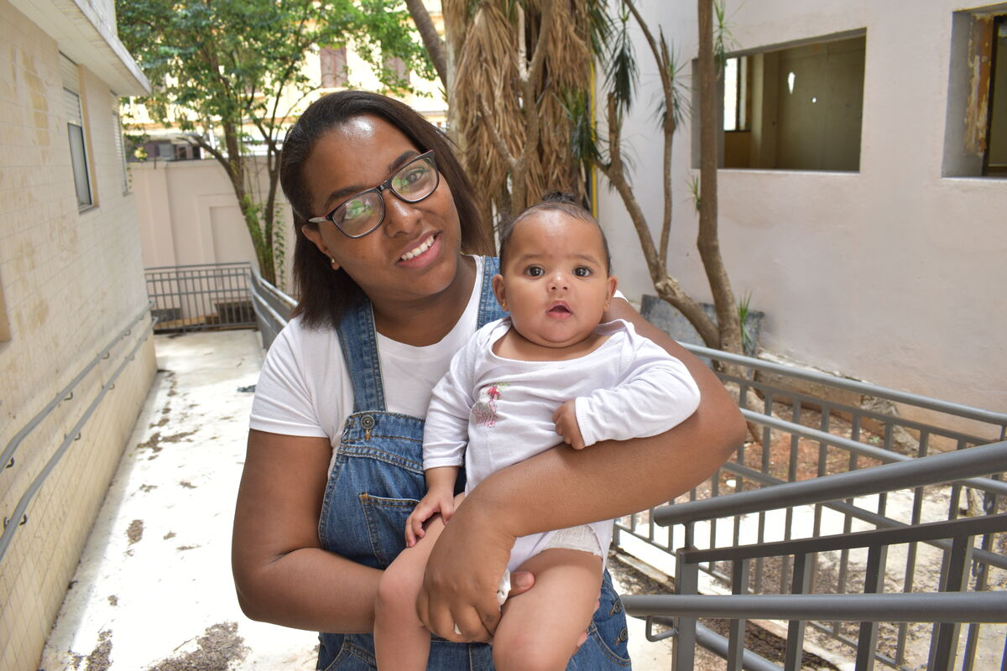
CAFOD has helped communities living in poverty have basic things like clean water, enough food and somewhere safe to live.
You have have helped change the lives of people like Dristy in Bangladesh, Saidimu in Kenya, Monica and her daughter in Brazil.
Let’s share God’s love with one another and act with compassion when others need our support.
Notes:
Dristy, Bangladesh
Photo credit: Amit Rudro
Saidimu, Kenya
Photo credit: Mwangi Kirubi
Monica and her baby, Brazil
Photo credit: Kezia Lavan

Slide 14
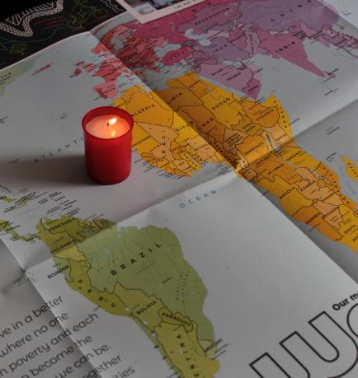
Let us pray
We pray for all people in our world, especially those who are worried, ill or finding things hard: that through God's grace, they may receive the comfort and care they need from those around them.
Lord in your mercy…
We pray for our parish, families and friends:
that we may be like the disciples, sharing God's love through our actions and asking nothing in return.
Lord in your mercy...

Slide 15
Let us pray
We pray for the Church throughout the world:
that we may continue to serve people, act with compassion and share God's loving care with all who are looking for help.
Lord in your mercy…
God of mercy: fill us with compassion for our brothers and sisters who are all loved by you. Lead us to take action to support one another in whatever way we can.
Amen.

Slide 16
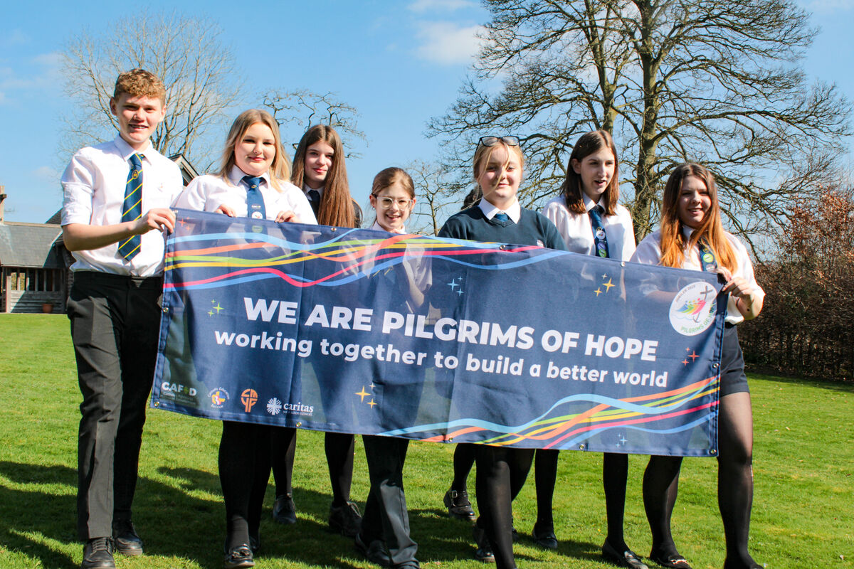
What can we do this week to show compassion and to help our brothers and sisters in need?
Send
Notes:
Pupils of St Mary's RC High School, Herefordshire
Photo credit: Victoria Ahmed

Slide 17
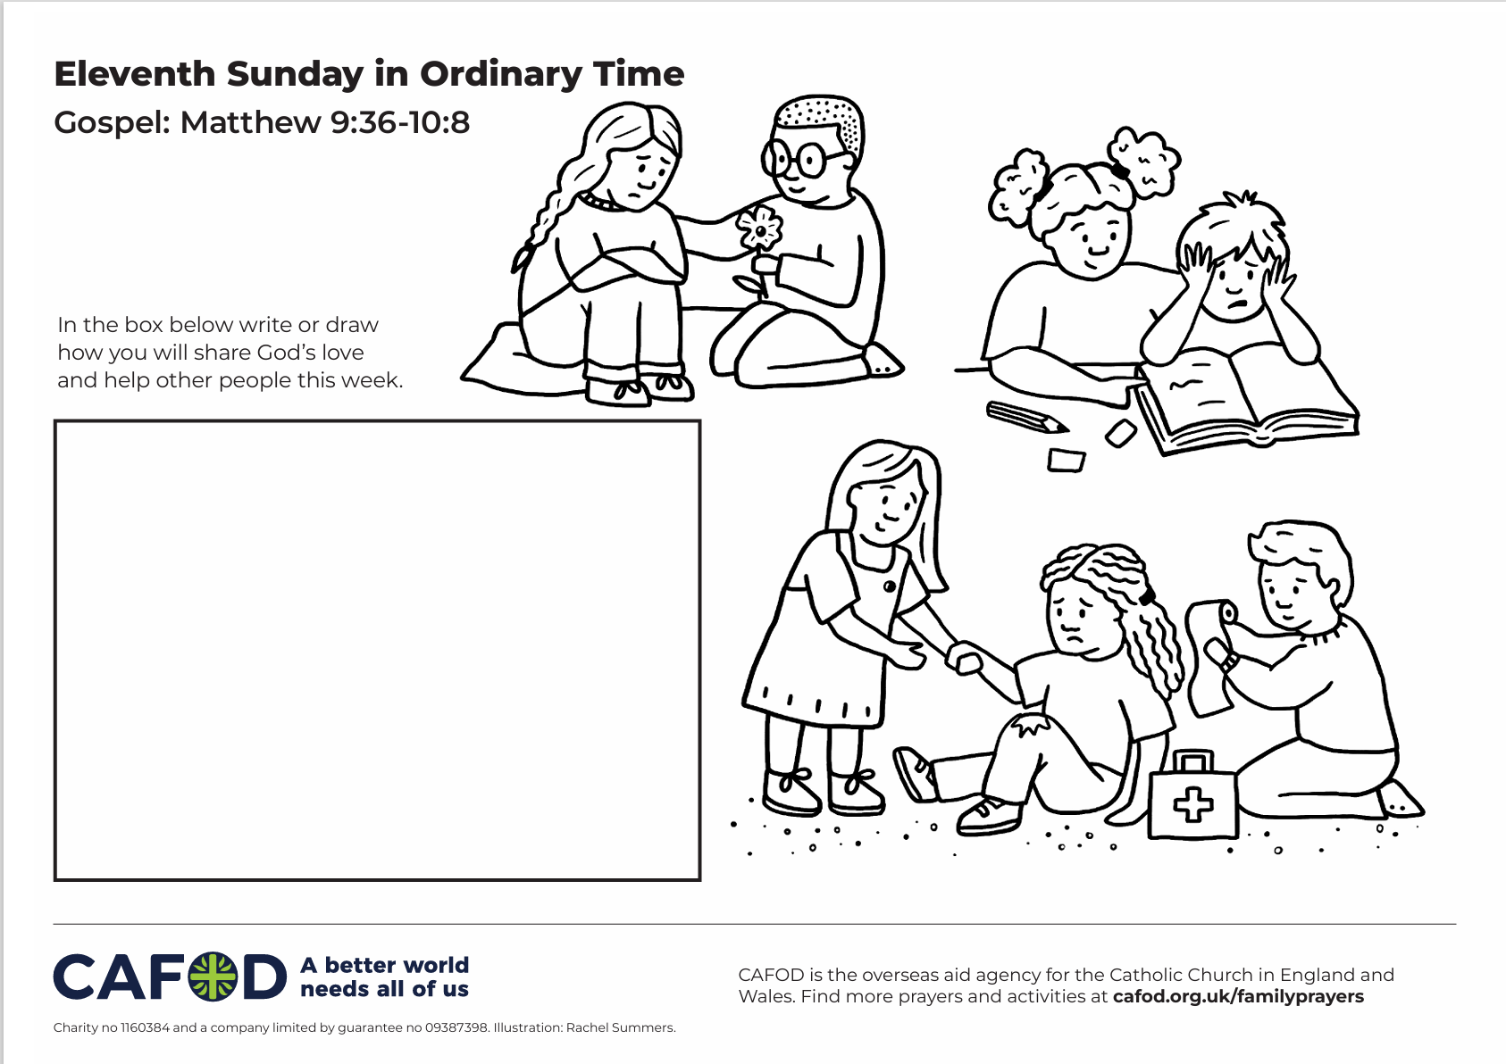
Activity suggestions
Download the illustration
Invite the children to colour in the accompanying illustration and to write or draw how they will share God’s love and help others in the coming week.
Remind the children to share all that they have heard and thought about today with the people at home.
Encourage them to try to do at least one thing in the coming week to show their compassion for others and to support someone who is looking for help.
For more CAFOD ideas and activities, please go to Primary teaching resources
Notes:
Illustration: Rachel Summers

Slide 18



Get involved with CAFOD this term
Explore our summer term resources
Ways to live out your Jubilee Pledge
Fundraise for a World Gift

Slide 19


