Slide 1
Pope Francis
A reflection for schools

Slide 2
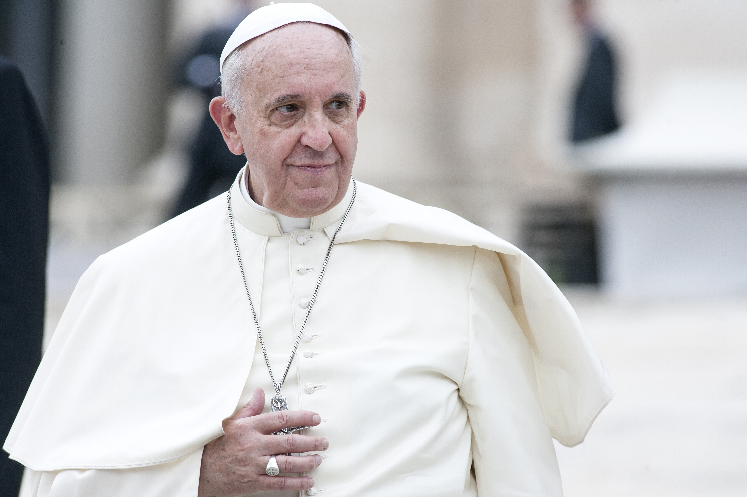
God in Heaven
We thank you for the gift of Pope Francis and for all the wonderful ways he inspired us to build a better world.
Help us to continue his work by being Pilgrims of Hope, like he was.
May he rest in your peace.
Amen.

