Slide 1
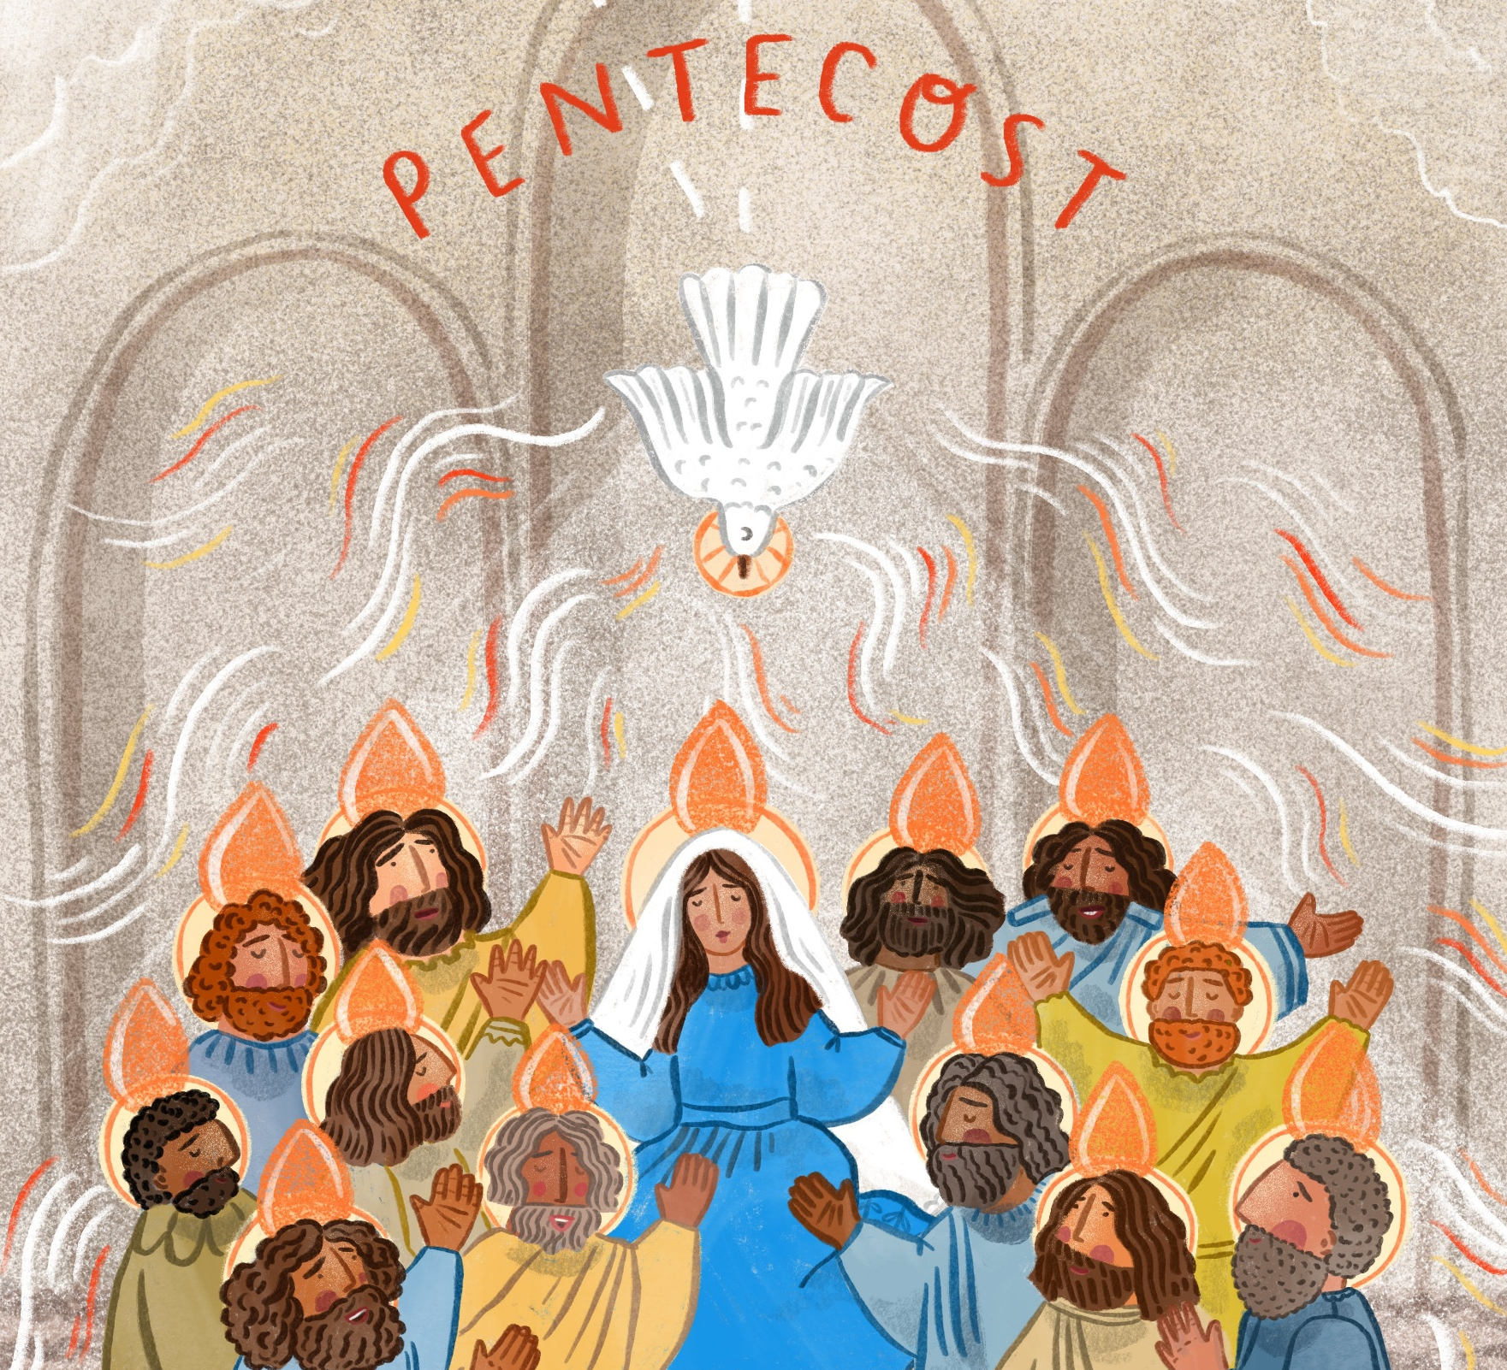
What will you do to try and spread peace in our world?
Gospel Celebration of the Word
Notes:
Children’s liturgy: Pentecost (Year A)
Preparation of the worship space
Colour: red
Song suggestions
Shine Jesus shine (770, Laudate) Spirit of the Living God (306, Laudate)
Welcome
Today, we hear how Jesus sent the Holy Spirit to be with the disciples, to help them be brave enough to share God’s message with others. Let’s think a bit about what the Holy Spirit does in our lives today.
Harare Youth Sports Day, Zimbabwe
Photo credit: Cynthia Matonhodze

Slide 2
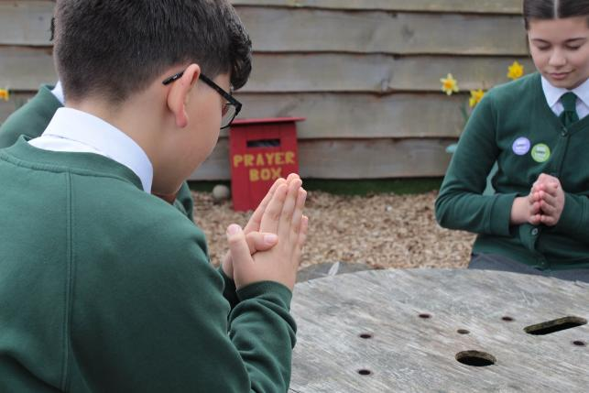
God of all, You sent your Spirit to be with the disciples, filling them with joy, peace and courage. May we also be filled with your Spirit, be brave and share your peace in our world. Amen.
Gather
Notes:
St Francis Xavier's RC Primary School, Herefordshire
Photo credit: Vicky Ahmed

Slide 3
Gospel: John 20: 19-23
It was late that Sunday evening, and the disciples were gathered together behind locked doors, because they were afraid of the Jewish authorities.
Then Jesus came and stood among them. “Peace be with you,” he said. After saying this, he showed them his hands and his side. The disciples were filled with joy at seeing the Lord.
Jesus said to them again, “Peace be with you. As the Father sent me, so I send you.”
He breathed on them and said: “Receive the Holy Spirit. If you forgive people’s sins, they are forgiven; if you do not forgive them, they are not forgiven.”
Word

Slide 4

What do you remember from the Gospel reading?
The disciples were alone and afraid, because their friend Jesus, who they knew was the Son of God, had been put to death.
Suddenly, Jesus appeared to them. What did Jesus say to the disciples?
And how did the disciples feel when they saw Jesus again?
They were filled with joy. Jesus repeated: “Peace be with you.”
Respond
Notes:
What did Jesus say to the disciples? (Peace be with you.)
Jesus
Photo credit: Myriam Zilles on Unsplash

Slide 5

What happened next?
Jesus breathed on the disciples and gave them the Holy Spirit. He told the disciples he was sending them out to spread his word.
The disciples had been sad, lonely and frightened. How do you think they felt after Jesus breathed the Holy Spirit onto them?
Notes:
Pupils at St Chad's primary school, London
Photo credit: Joe Newman

Slide 6
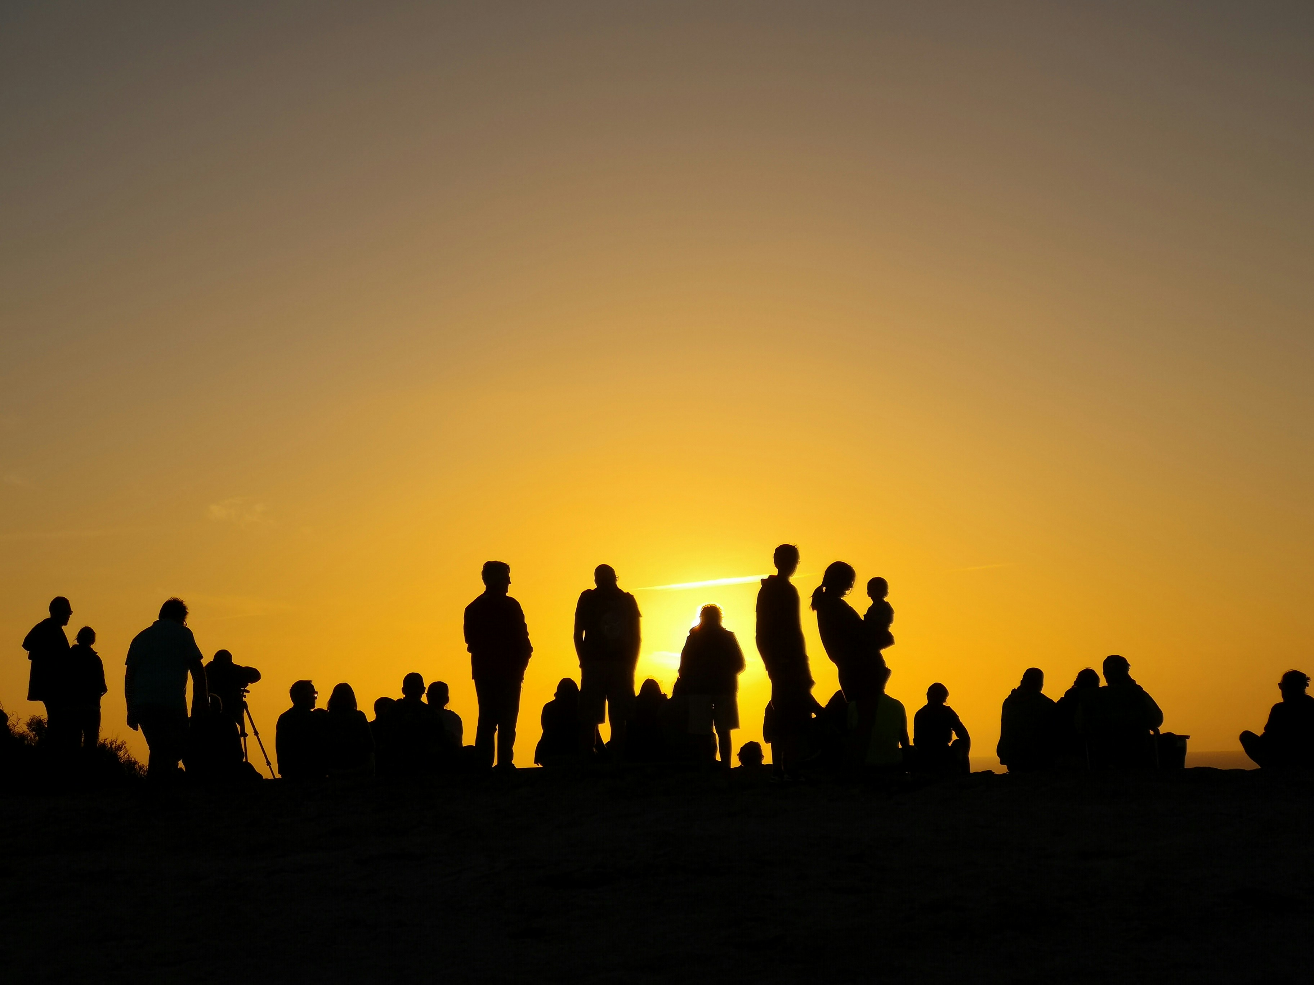
The disciples were filled with joy, hope and courage to go out and spread the word of God - God’s special message of peace for all people.
The Holy Spirit gives the disciples the courage to see that they can do what Jesus asks of them.
Notes:
People
Photo credit: Fernando Marques on Unsplash

Slide 7
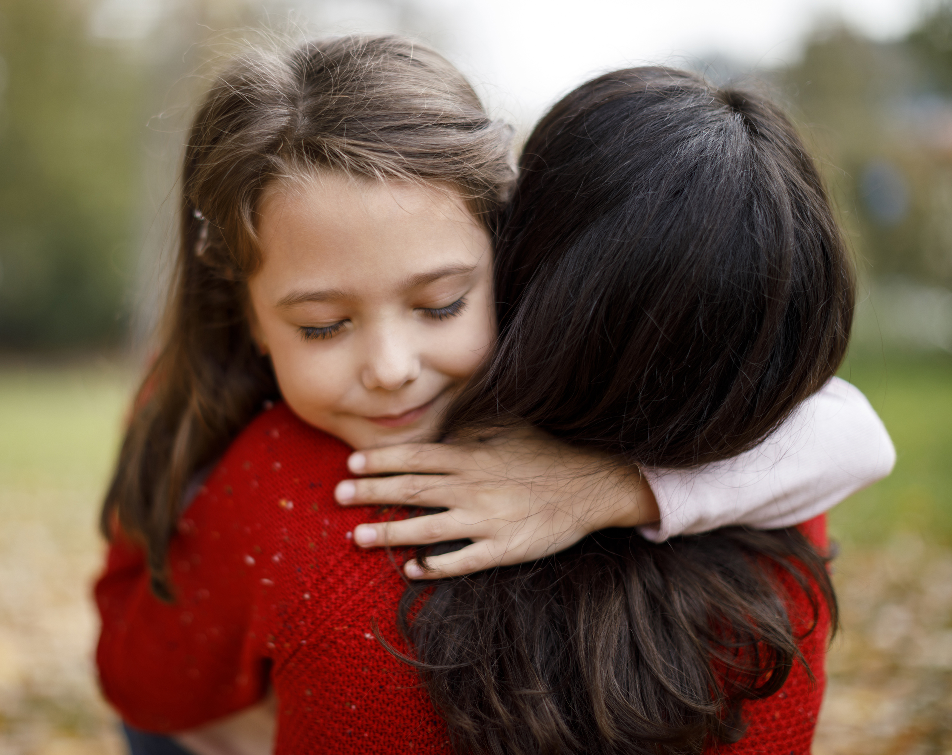
What does Jesus ask us to do?
How does Jesus want us to behave and treat other people?
Jesus asks us to do the same as the disciples – to spread his message of love and peace to all people through what we do, by loving our neighbour and caring for one another.
Notes:
Caring
Photo credit: Stock image

Slide 8
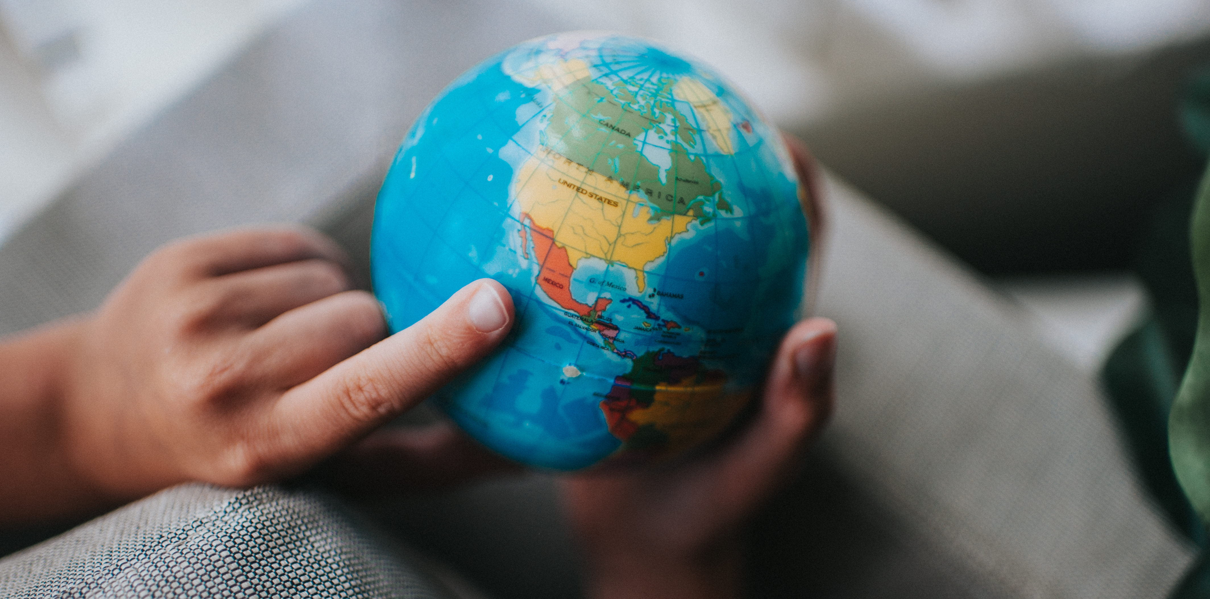
The Holy Spirit gives us the courage to answer Jesus’ call, to do what God asks of us even when it might be difficult.
We each answer that call in a different way, but the Holy Spirit helps and guides us along the way.
This week, let’s try to notice the Holy Spirit in our lives, helping us to be brave, and helping us to spread Jesus’ message of peace in our world.
Notes:
The world
Photo credit: Stock image

Slide 9
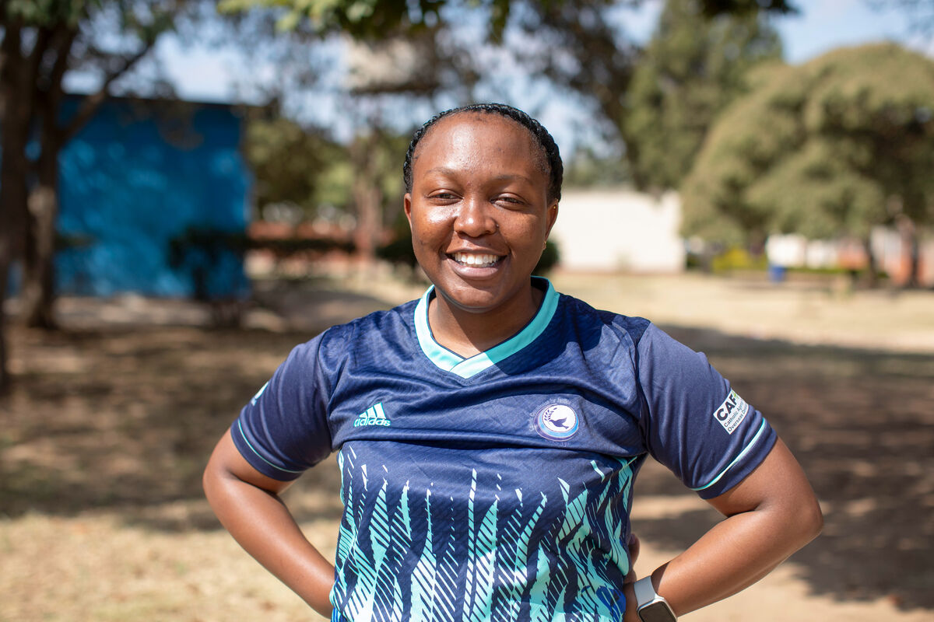
"My name is Vimbai and I work for the Catholic Commission for Justice and Peace in Zimbabwe," says Vimbai.
With CAFOD's help, she helped organise a Sports for Peace Day in Harare, the capital city of Zimbabwe.
Notes:
Vimbainashe 'Vimbai' Chiweshe, Catholic Commission for Justice and Peace, Zimbabwe
Photo credit: Cynthia Matonhodze

Slide 10
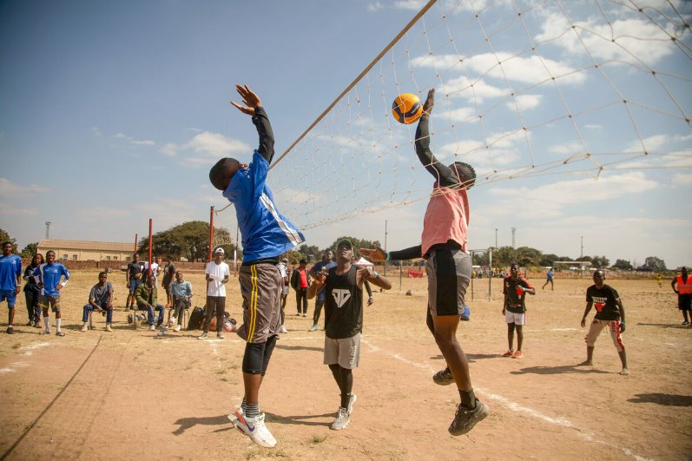
The young people who live in Harare face a lot of challenges, including unemployment. And there's not always a lot to do in their spare time.
This means they can get drawn into violence and crime, making
it difficult to live happy and peaceful lives.
Notes:
Harare Youth Sports Day, Zimbabwe
Photo credit: Cynthia Matonhodze

Slide 11
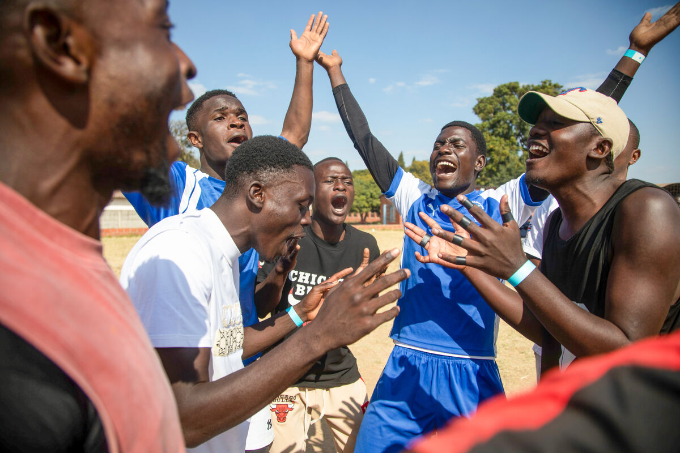
Lots of young people were invited to take part in the Sports for Peace Day to encourage a sense of community, cooperation and hope.
Playing sport together can help people live peacefully together.
And it looks like this group had a good time!
Notes:
Harare Youth Sports Day, Zimbabwe
Photo credit: Cynthia Matonhodze

Slide 12
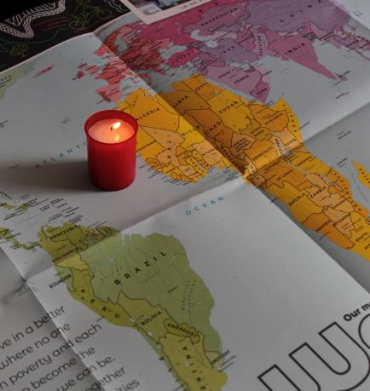
Let us pray
We pray for all people, especially those who have lived through war or conflict:
that, filled by the power of the Holy Spirit, they can find it in their hearts to move forward in peace and forgiveness.
Lord in your mercy…
We pray for our parish, families and friends:
that we may be inspired by the Holy Spirit to spread Christ's message of peace in all we do.
Lord in your mercy...

Slide 13
Let us pray
We pray for all those who work for peace in our world:
that they may have the courage and strength to carry on, even in the most difficult of times.
Lord in your mercy…
God of mercy: fill us with your spirit and guide us as we try to share your peace in our world. We ask this through Christ our Lord.
Amen.

Slide 14
What will you do this week to try and spread peace in our world?
Send
Notes:
Illustration: Erika Pal

Slide 15
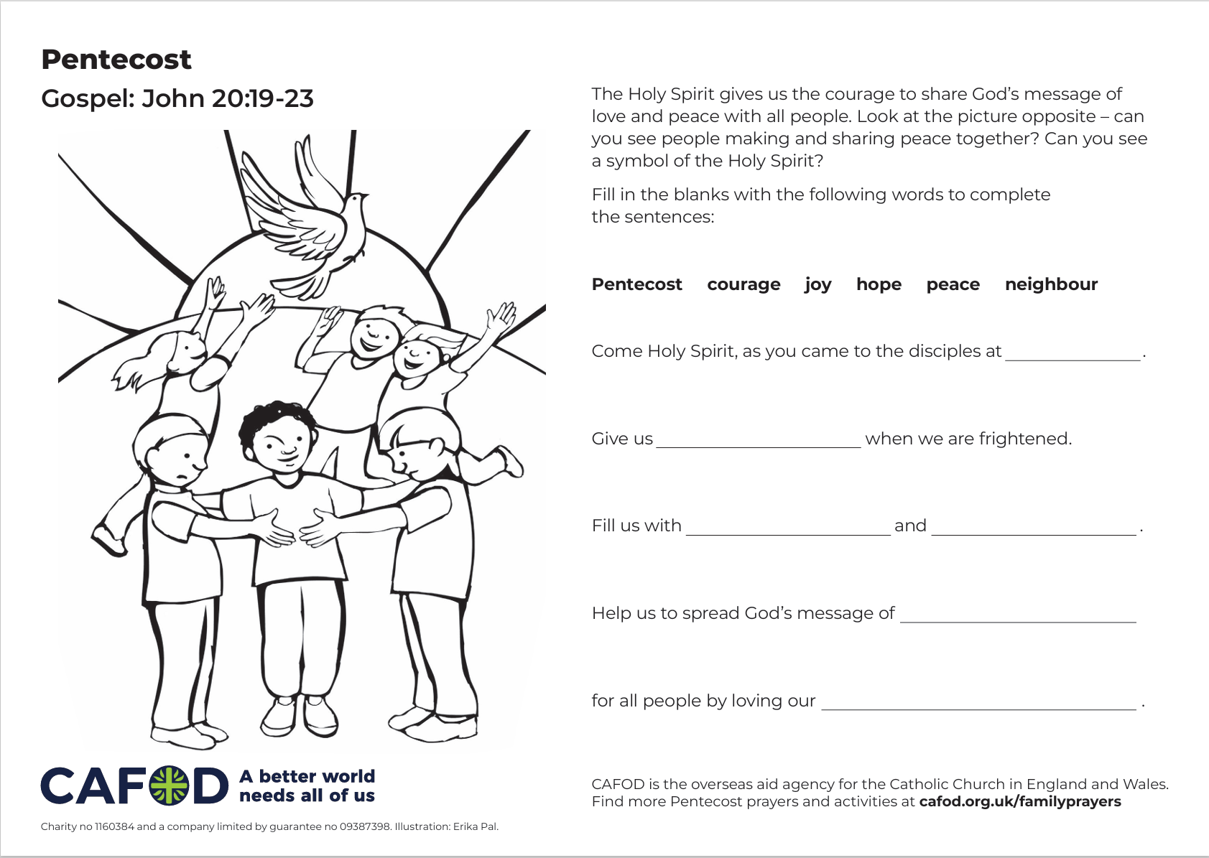
Activity suggestions
Download the illustration
Share the accompanying activity sheet with the children and encourage them to complete it, either in the liturgy or at home. Encourage the children to draw or write how they will share Jesus’ message of peace with others in the coming week on the back of the sheet. Invite the children to write a prayer for peace in our world.
Remind the children to share all that they have heard and thought about today with the people at home. If they have written a prayer, encourage them to say it at home together during the week. Encourage them to try to do at least one thing in the coming week to spread Jesus’ message of peace in our world.
See Family prayer ideas for more child-friendly Pentecost activities.
Notes:
Illustration: Erika Pal

Slide 16
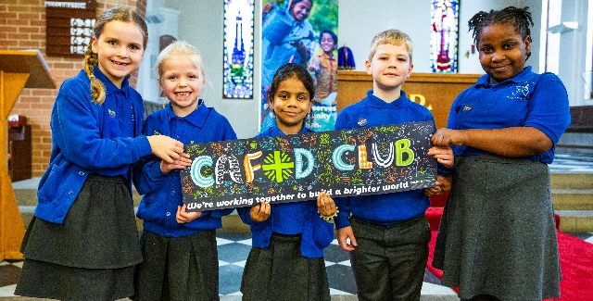
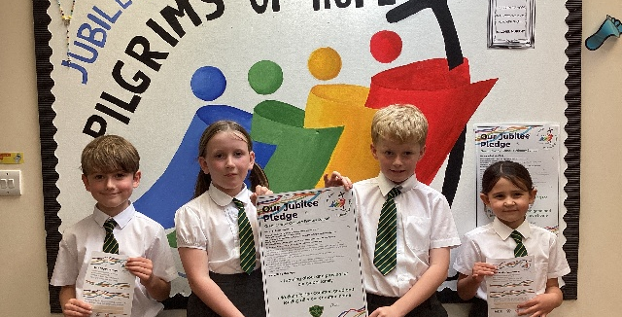

Get involved with CAFOD this term
Explore our summer term resources
Ways to live out your Jubilee Pledge
Fundraise for a World Gift

Slide 17
