Slide 1
The Jubilee Pledge
A session for school staff

Slide 2
Reflection
Do get your hopes up
Notes:
Opening reflection: Do get your hopes up | Jubilee Year | CAFOD
Our faith is at the heart of everything we do. With God, everything is possible, and we will build a better world!

Slide 3
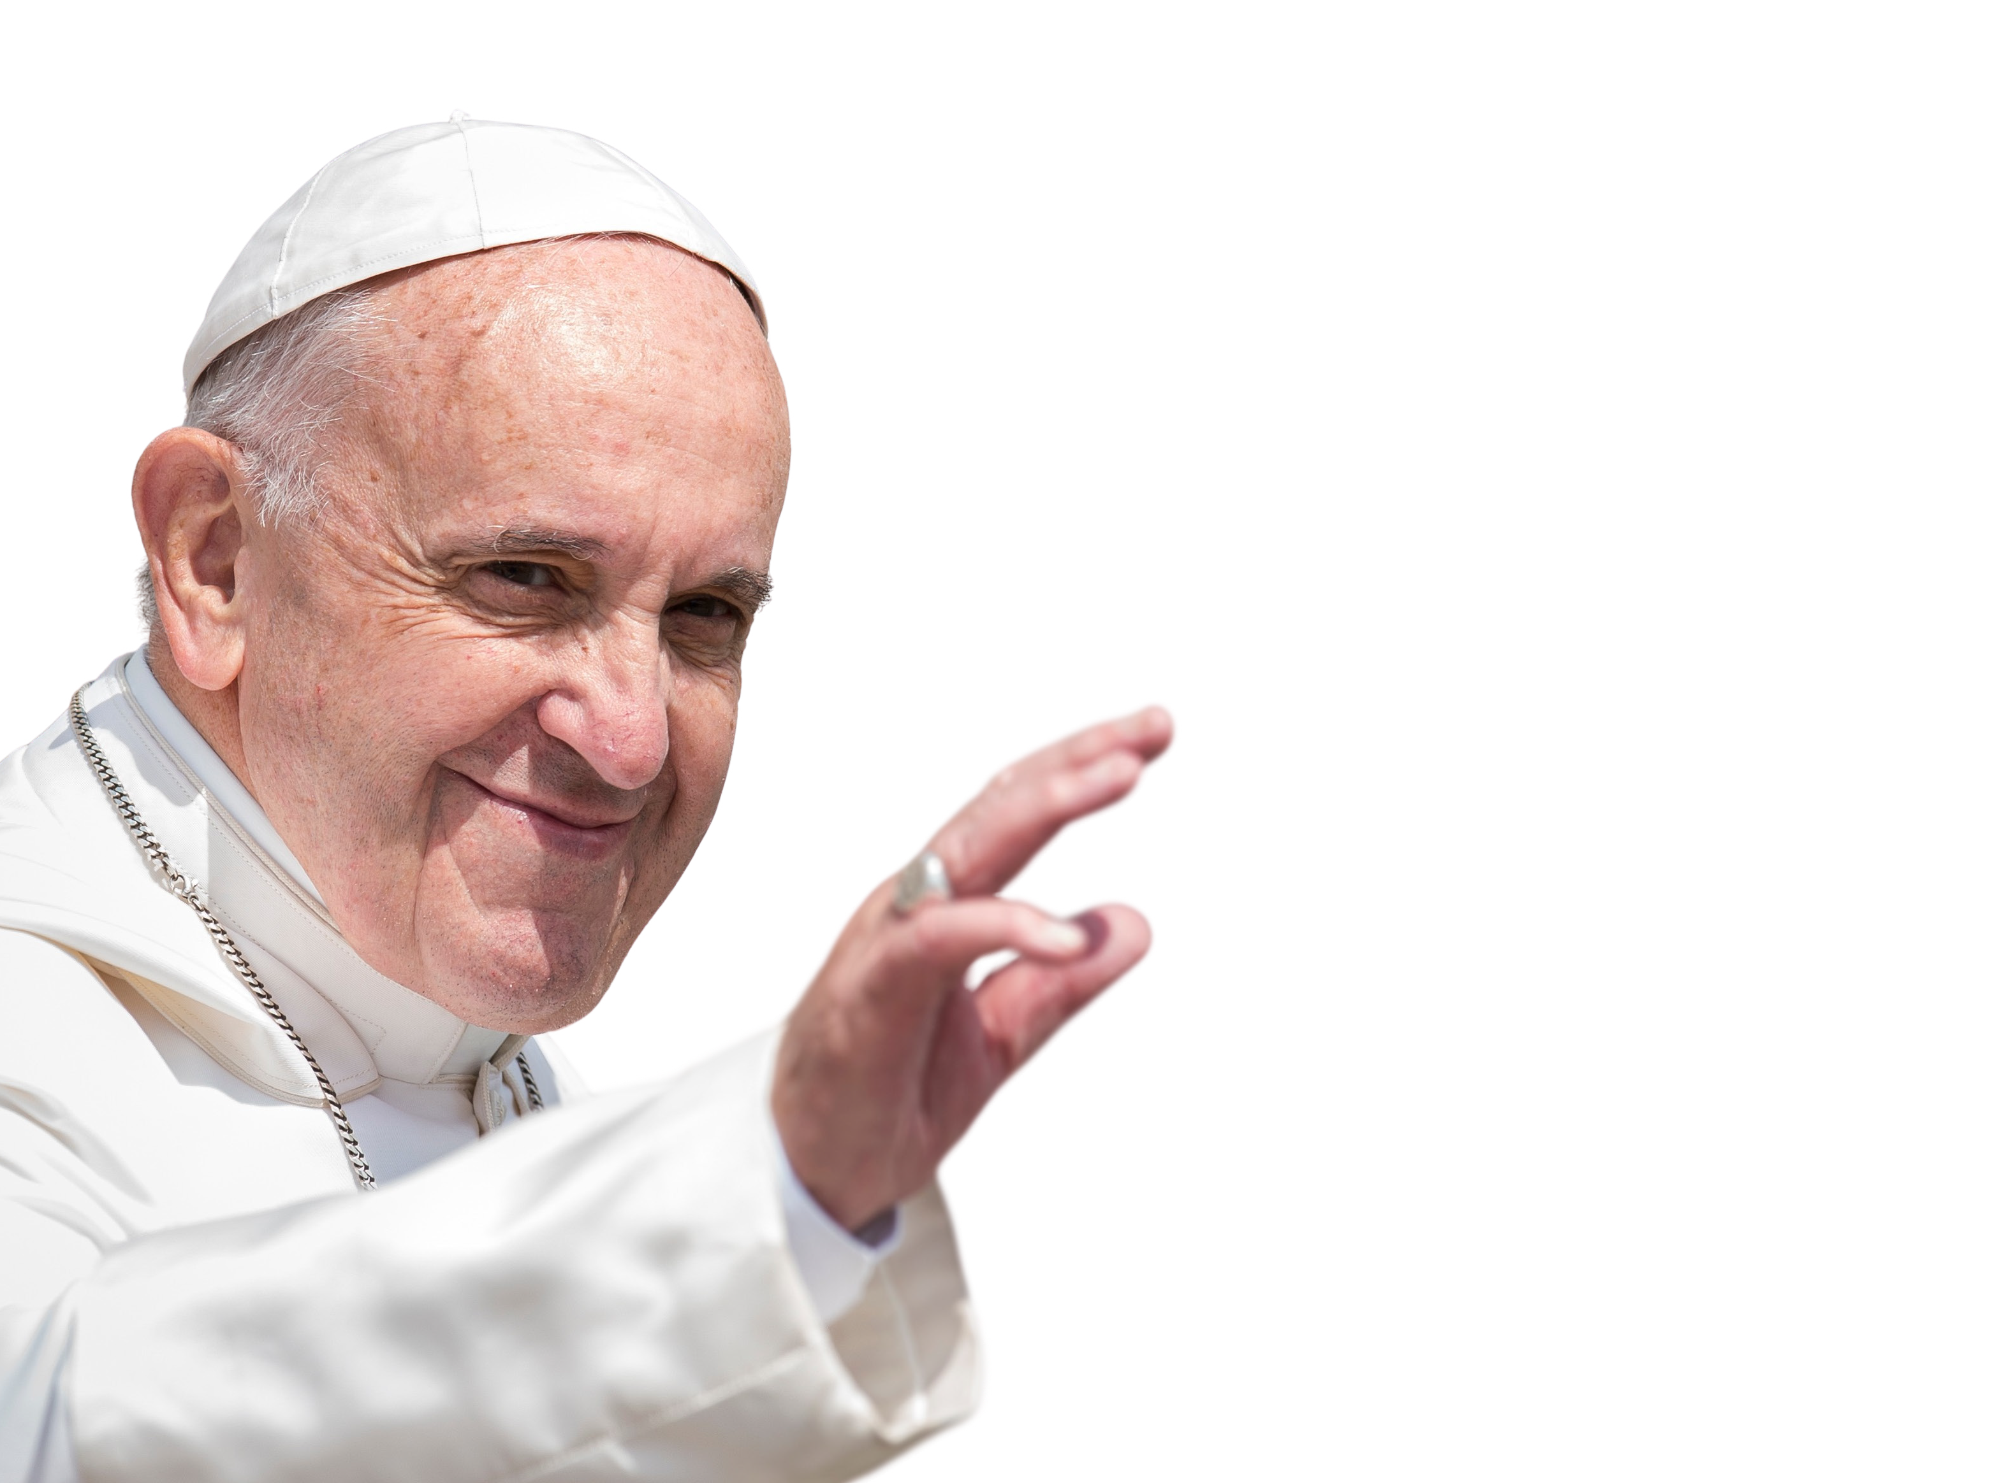
POPE FRANCIS
1936-2025
'Trusting in Him, we move forward with courage, building unity through discernment, to discover and implement God's dream for us, and the paths of action ahead.’
Let us Dream p.94
Notes:
Pope Francis has inspired us all to hold on to hope, to trust in God’s love and to discern well how build God’s Kingdom of love, peace and justice.

Slide 6
Reflective discussion points: building understanding of why we will make a Jubilee pledge.
Where do students hear about the world and how does this form their worldview?
How do we prepare students so all can flourish in a globalised world?
What are the challenges your students face when engaging with poverty, injustice, the environment etc?

Slide 7
The pledge
There are three parts:
Four lines at the beginning state the pledge itself, which can be recited as a group.
The bullet points expand on the vision of the first four lines, detailing what it means to live out the words of the pledge.
The final part is over to you! You can write down the ways in which your own school community will commit to living out the pledge in the long term.

Slide 8
The pledge
Q: Which line stands out to you?
Why?

Slide 9
Unpacking the pledge
Part One:
We are pilgrims of hope.
We are part of a global Church movement of renewal, transformation and hope.
“Christian hope does not deceive or disappoint because it is grounded in the certainty that nothing and no one may ever separate us from God’s love…” (SNC 3)
We walk in solidarity with our sisters and brothers worldwide, sharing challenges and celebrating joys.
Solidarity: showing we care with our words and actions. How?
Learning
A culture of encounter – getting to know all our neighbours, local and global
Prayer and liturgy
Fundraising
Campaigning

Slide 10
Unpacking the pledge
We promise to be agents of change, working together for justice, love and peace, locally and globally.
We are agents of change when we live out Catholic Social Teaching. Together, our small acts of love can bring about huge change!
We want to build a fairer world where every person, and the earth, can flourish.
Q: What does ‘a fairer world’ mean?
Everyone should have what they need to live life to the full.
Q: What could ‘flourishing’ mean in the Jubilee Year?
Restoring relationships with God, our neighbour, the earth itself.

Slide 11
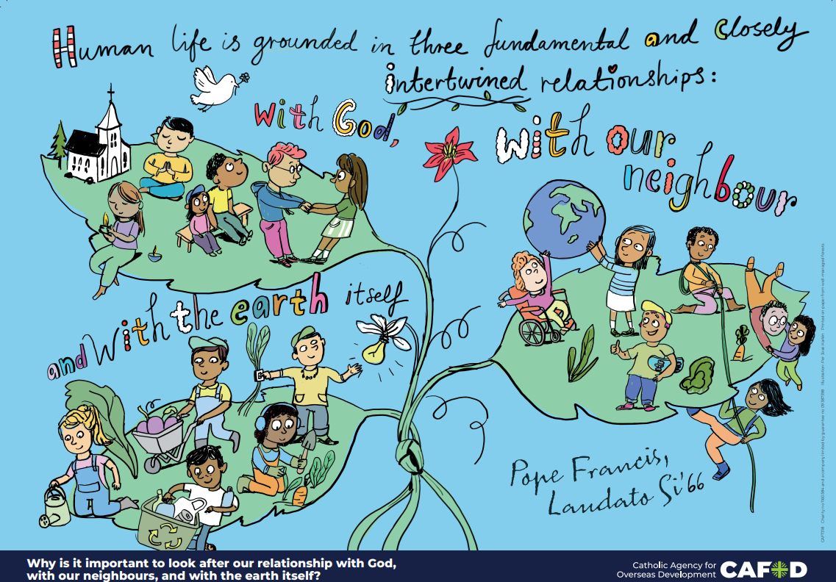
Notes:
In Laudato Si’, Pope Francis reminds us that our life is grounded in these three fundamental relationships. This teaching is highlighted in the Religious Education Directory. You can order this poster here: Primary RE Poster set – CAFOD Shop

Slide 12
Unpacking the pledge
Part two: Expanding the vision of the first four lines. Can you find the direct links to CST principles?
Dignity
Solidarity
Option for the poor
The common good
Stewardship
Peace building
Distributive justice
Participation
You bring these principles to life already in your school.
Q: Are there areas that need greater focus, or deeper learning?
Q: How can you plan to embed CST for the long term?

Slide 13
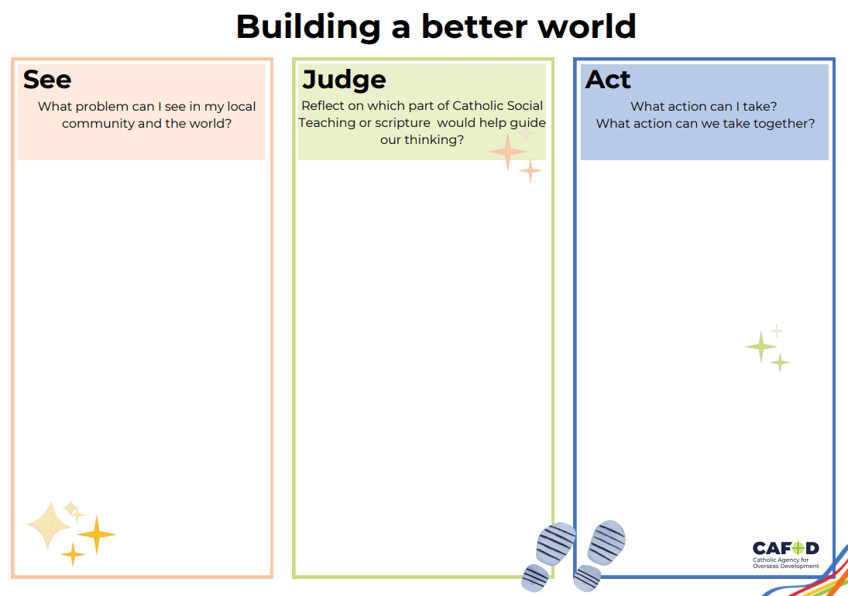
Unpacking the pledge
Ideas:
During assembly, pick out key lines and discuss how you already live out these principles. Ask your pupils where they think more needs to be done.
Reflect using the See Judge Act sheet – what actions do pupils want to take?
In 5 years time, how will making the Jubilee pledge have impacted your pupils? What will have changed?
This is an important moment on our pilgrimage journey. How can we be open to going where the Holy Spirit wants to lead us?

Slide 14
Writing your pledge
Part 3:
We will do this by…
You know your school community best! You will have your own areas of focus and commitment, but you may want to consider:
Fundraising for our neighbours both locally and globally – everyone should have what they need to live life to the full.
Campaigning for change – using our voices to speak out against injustice, supporting CAFOD and Caritas campaigns to challenge unjust laws and root causes of poverty.
Including our global family in our prayers every week, praying for peace and justice.
Using opportunities to learn about the wider world, our interconnectedness, and the challenges and joys of our sisters and brothers worldwide.
St Hope Catholic Primary School

Slide 15
Sample pledge phrases
Examples to get you started!
We will pray alongside our global family in our whole school liturgy every week, including global intercessions and praying for the coming of God’s kingdom of peace, justice and love.
Inspired by the life of Jesus, we will…
We will learn about communities locally and globally, opening our hearts to all of our sisters and brothers.
Our learning resources will include information and pictures that reflect our interconnected global family.
We will give of our time, energy and resources, raising money and taking action for those experiencing poverty, locally and globally.
We will work with CAFOD and Caritas on annual campaigns, raising our voices to tackle the root causes of poverty.
Living out stewardship and solidarity, we will undertake/renew the LiveSimply Award, praying, learning and taking action on the social and environmental crises.
Each year, we will hold an assembly to revisit our Jubilee pledge and renew our commitment.

Slide 16
Sample pledge phrases
We have decided to continue being Pilgrims of Hope long after this Jubilee has ended. We will strive to put faith into action so that earth will reflect the peace and justice of heaven itself.
Helping all students and staff to be their very best selves. To be caring, compassionate and responsive to the needs of all our global family.
We offer our talents, our energy, our eyes, our hands and our hearts to care for our neighbours and for all of God’s creation.

Slide 17
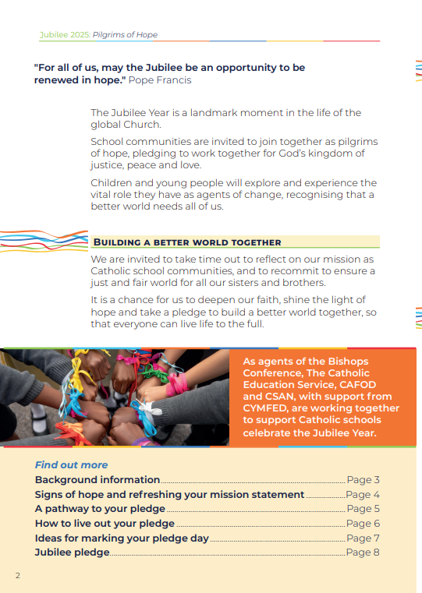
Find more information and ideas in our Pledge Guide

Slide 18
Watch this film to help you prepare for Pledge Day
Notes:
How to prepare for your Pledge Day | CAFOD

Slide 19
Pledge Day
Coming soon!
Visit Jubilee Pledge for schools for:
An outline plan for the day
A Pledge Day film
A Pledge Day Celebration of the Word
On online pledge map to register your pledge and receive a certificate

Slide 20
Sharing your pledge
Ways to share your pledge
Add your school to our online pledge map and we will send you a pledge certificate.
Share what you have been doing with your wider school community, your local MP, and with local media.
Share photos of Pledge Day on social media – don’t forget to tag @cafodschools on X using #Jubileepledge
Jubilee Pledge for schools

Slide 21
A Prayer of Hope
God, our loving Father,
In this Jubilee Year,
you remind us of our call to love creation.
Help us to work together
to replant, repair and renew.
Guide us on our journey as pilgrims of hope.
Notes:
Education_Jubilee_Prayercard.pdf
Jubilee for Schools 2025: Prayer card – CAFOD Shop

Slide 22
Jesus, our light,
In this Jubilee Year,
you remind us of our call to love our neighbours and to set free those who suffer.
Help us to treat everyone with dignity;
to be fair, forgiving and kind.
Guide us on our journey as pilgrims of hope.

Slide 23
Holy Spirit, our inspiration,
in this Jubilee Year,
you remind us of our call to grow in faith and love.
Help us to hear you in scripture,
to see Jesus in others,
and to be united as God’s global family.
Guide us on our journey as pilgrims of hope.

Slide 24
Useful links:
Jubilee for schools 2025 – Pilgrims of Hope
Jubilee Pledge for schools
Signs of hope
Jubilee 2025 - Caritas Social Action Network – CSAN
Education_Jubilee_VVMToolkit.pdf
Jubilee prayers for schools

