Slide 1
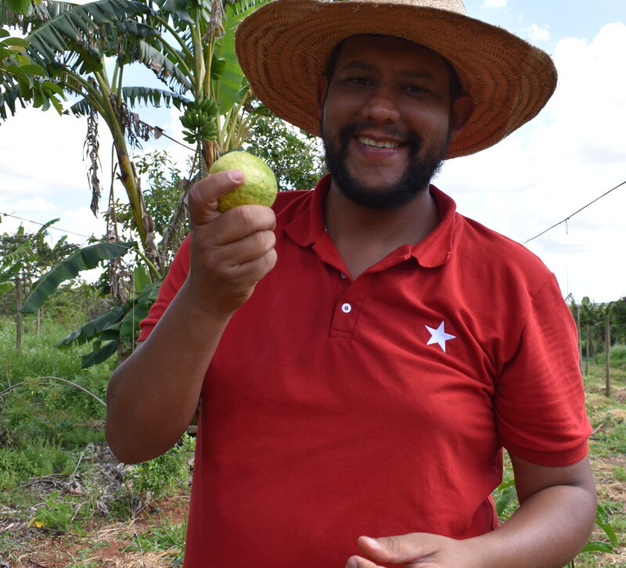
What will you do to share with others in need?
Gospel Celebration of the Word
Notes:
Children’s liturgy: Fifth Sunday of Lent (Year A)
Preparation of the worship space
Colour: purple
Song suggestions
Praise to you, O Christ our Saviour (200, Laudate)
Welcome
Today we hear about an amazing thing that Jesus does when his friend Lazarus becomes sick and dies. Let’s think a bit more about this today.
Vagner and his guava crop, Brazil
Photo credit: Kezia Lavan

Slide 2
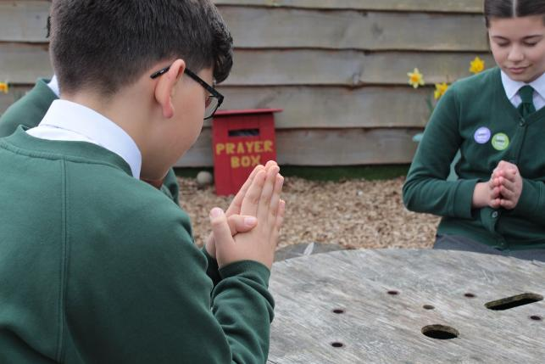

God of light and power, We give thanks to you for the gift of life. Help us to do what we can so all people throughout the world can enjoy this gift. Amen.
Gather
Notes:
St Francis Xavier's RC Primary School, Herefordshire
Photo credit: Vicky Ahmed

Slide 3

Gospel: John 11:1-45 or John 11:3-7, 17, 20-27, 33-45
The sisters sent Jesus a message: “Lord, your dear friend is ill.”
When Jesus heard it, he said, “The final result of this illness will not be the death of Lazarus; this has happened in order to bring glory to God, and it will be the means by which the Son of God will receive glory.”
Jesus loved Martha and her sister and Lazarus. Yet when he received the news that Lazarus was ill, he stayed where he was for two more days. Then he said to the disciples, “Let us go back to Judea.”
When Jesus arrived, he found Lazarus had been buried four days before.
Word
Notes:
On the slides is the shortened version.

Slide 4
When Martha heard that Jesus was coming, she went out to meet him, but Mary stayed in the house.
Martha said to Jesus, “If you had been here, Lord, my brother would not have died! But I know that even now God will give you whatever you ask him for.”
“Your brother will rise to life,” Jesus told her.
“I know,” she replied, “that he will rise to life on the last day.”
Jesus said to her, “I am the resurrection and the life. Those who believe in me will live, even though they die; and all those who live and believe in me will never die. Do you believe this?

Slide 5
“Yes, Lord!” she answered. “I do believe that you are the Messiah, the Son of God, who was to come into the world.”
Jesus saw her weeping, and he saw how the people who were with her were weeping also; his heart was touched, and he was deeply moved.
“Where have you buried him?” he asked them. “Come and see, Lord,” they answered.
Jesus wept. “See how much he loved him!” the people said. But some of them said, “He gave sight to the blind man, didn’t he? Could he not have kept Lazarus from dying?”

Slide 6
Deeply moved once more, Jesus went to the tomb, which was a cave with a stone placed at the entrance. “Take the stone away!” Jesus ordered.
Martha, the dead man’s sister, answered, “There will be a bad smell, Lord. He has been buried four days!”
Jesus said to her, “Didn’t I tell you that you would see God’s glory if you believed?”
They took the stone away. Jesus looked up and said, “I thank you, Father, that you listen to me. I know that you always listen to me, but I say this for the sake of the people here, so that they will believe that you sent me.”

Slide 7
After he had said this, he called out in a loud voice, “Lazarus, come out!"
He came out, his hands and feet wrapped in grave clothes, and with a cloth round his face. “Untie him,” Jesus told them, “and let him go.”
Many of the people who had come to visit Mary saw what Jesus did, and they believed in him.

Slide 8
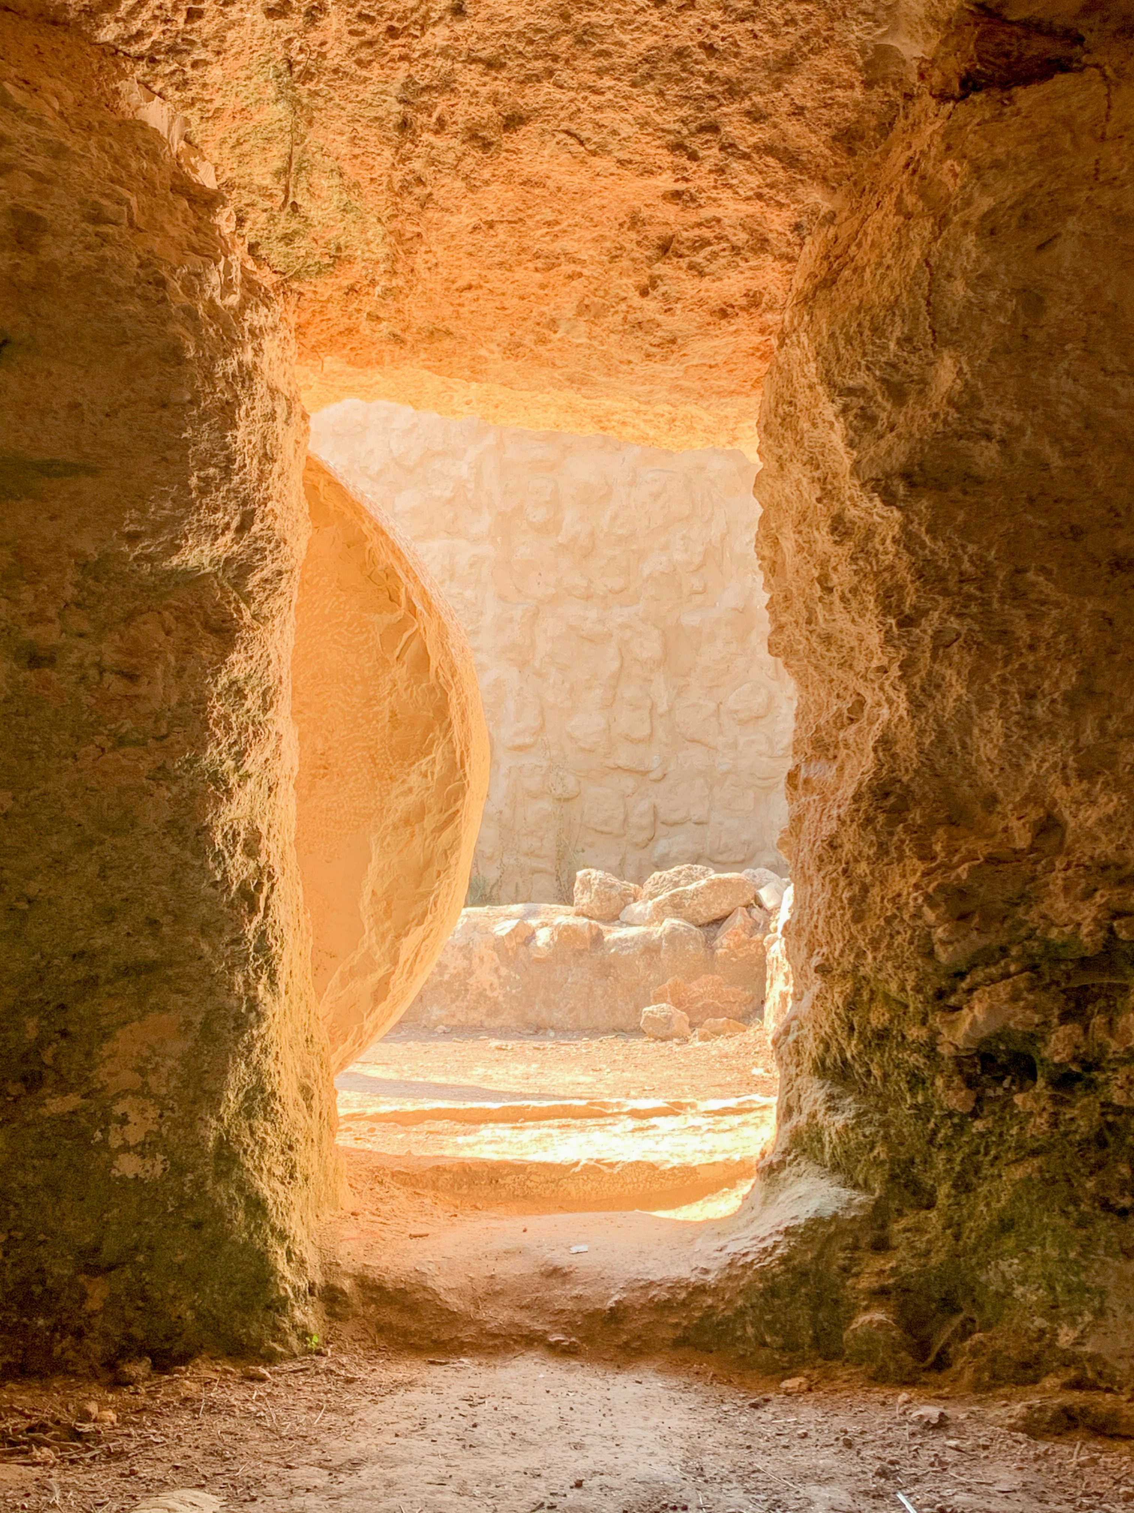

What do you remember from the Gospel reading?
Jesus hears his friend Lazarus, living in Bethany, is sick. By the time Jesus gets there, Lazarus is dead and has been buried for four days.
Jesus goes to the tomb and asks them to roll away the stone blocking the entrance.
He tells Lazarus to come out of the tomb. Lazarus walks out, covered in the cloths that he was buried in.
Respond
Notes:
A tomb
Photo credit: Pisit Heng on Unsplash

Slide 9
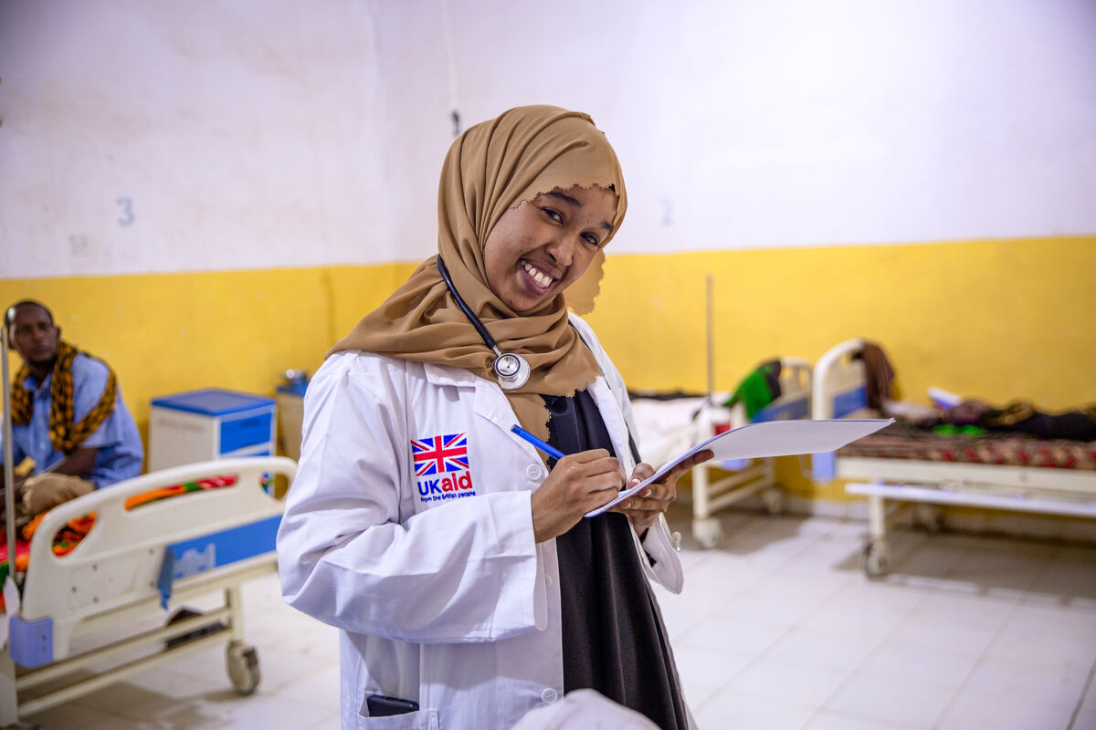
How do you think Mary, Martha and the other people there feel when they see Lazarus walking out of the tomb?
Why do you think Jesus raises Lazarus from the dead?
Unfortunately, sometimes, just like Lazarus in today’s gospel, people do get sick. When this happens, they go to the hospital where doctors and nurses work hard to care for them and try to make them better.
Dr. Shukri Hussein in her clinic, Somalia
Notes:
Why do you think Jesus raises Lazarus from the dead? (So that the people believe that Jesus is the Son of God. To show that he brings life to those who believe in him.)
Dr. Shukri Hussein Abdi at a District Hospital, Somalia
Photo credit: Trocaire

Slide 10
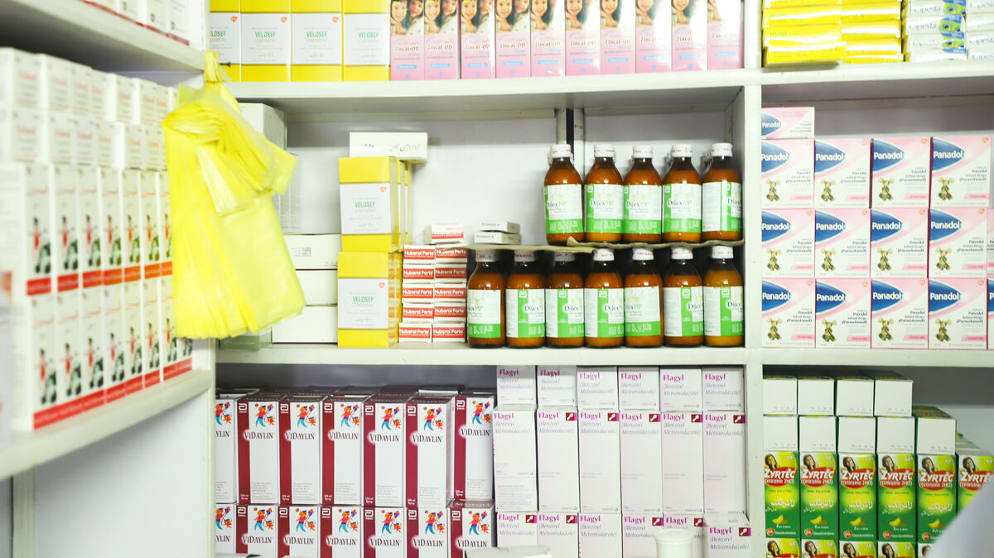
It can be very sad and worrying when someone we love is sick or dies. Jesus knows how we feel. He cried for his friend Lazarus who he loved.
Not everyone gets to see a doctor when they need to. It can be a long way to go to the nearest hospital or they might not be able to pay for their medicine.
Notes:
Medicines
Photo credit: Community World Service Asia (CWSA)

Slide 11
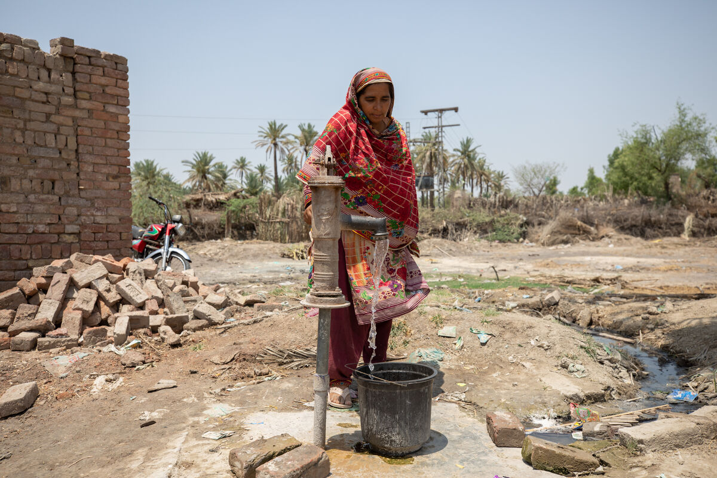
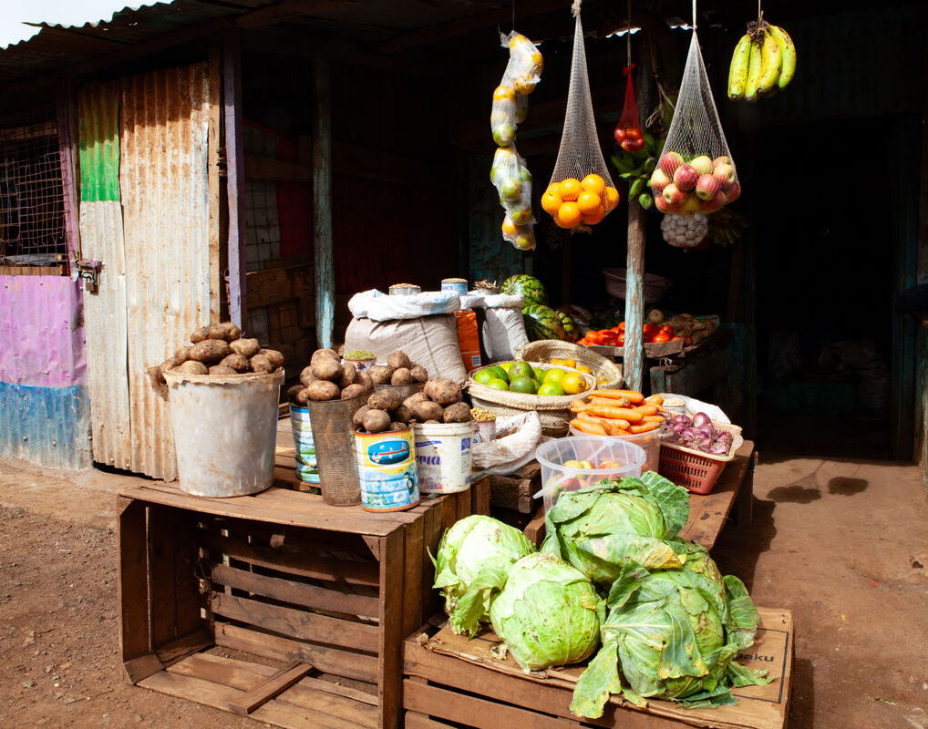
Some people find it hard to stay healthy because they do not have enough food to eat...
Sultana fetches clean water, Pakistan
...or safe water to drink.
Notes:
Local market, Marsabit, northern Kenya
Photo credit: Louise Norton
Sultana, Pakistan
Photo credit: Community World Service Asia (CWSA)

Slide 12
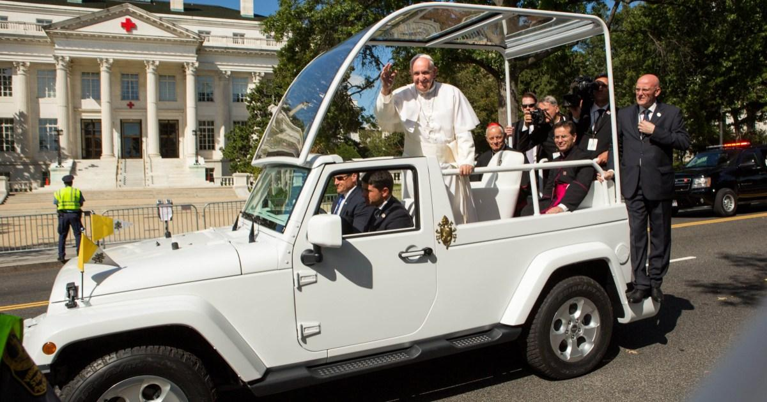
When Pope Francis died, he asked that his Popemobile be transformed into a mobile clinic for children in Gaza who are injured, malnourished or don’t have access to healthcare.
It is hoped that this new mobile clinic will be able to enter Gaza and start helping people soon.
Notes:
Pope Francis' Popemobile
Photo credit: The Metro newspaper

Slide 13
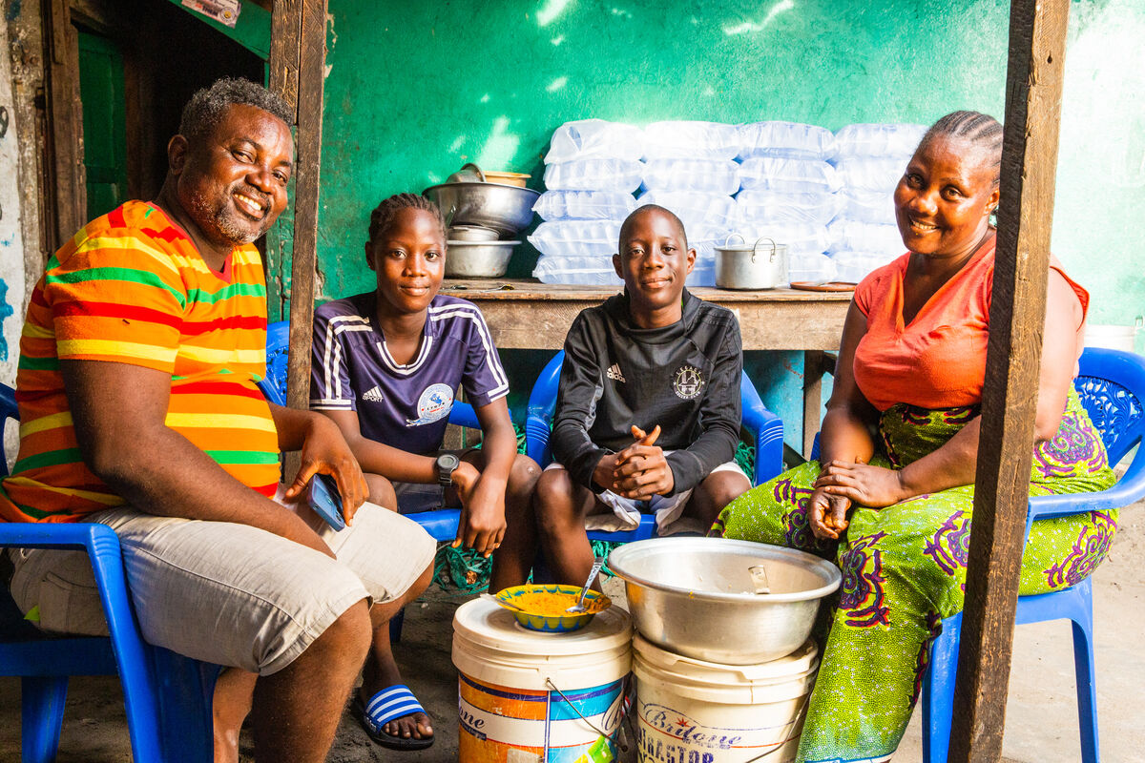
God gives life to us all.
God created us and wants every single one of us to live a happy life, with all the things that we need to grow and be the best people we can be.
Tekon and Vivien Blamo and their family, Liberia
Notes:
The world
Photo credit: Greg Rosenke on Unsplash

Slide 14
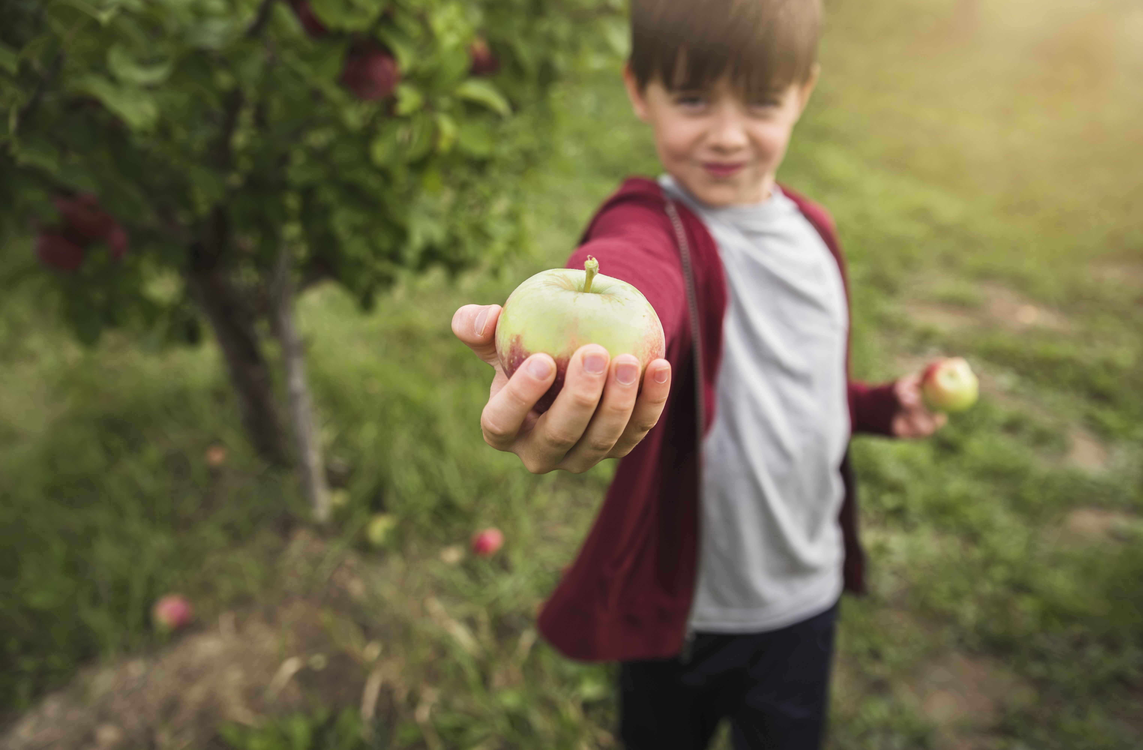
And Jesus came to show us how to live, how to treat others.
This Lent we can look at our own lives and think about the changes that we can make so everyone can live their lives to the full.
Just like Pope Francis, we can share what we have to help others who are in need.
Notes:
Sharing
Photo credit: Stock image

Slide 15
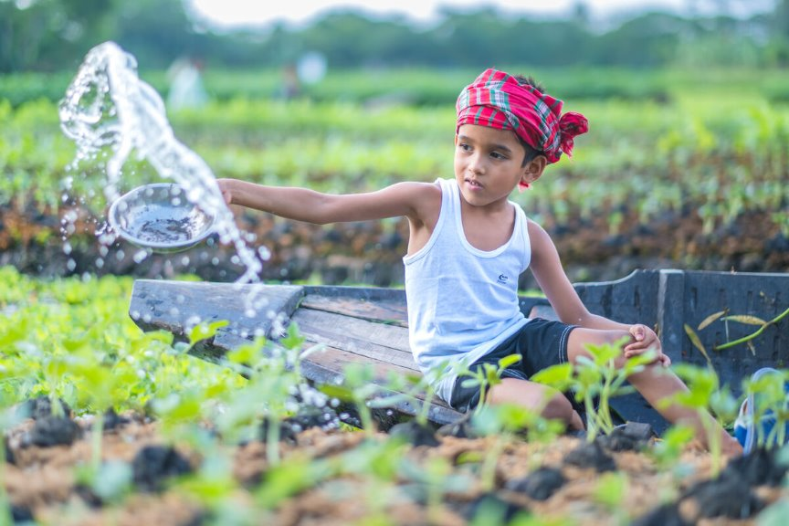
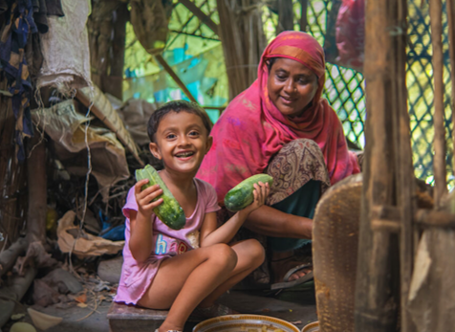
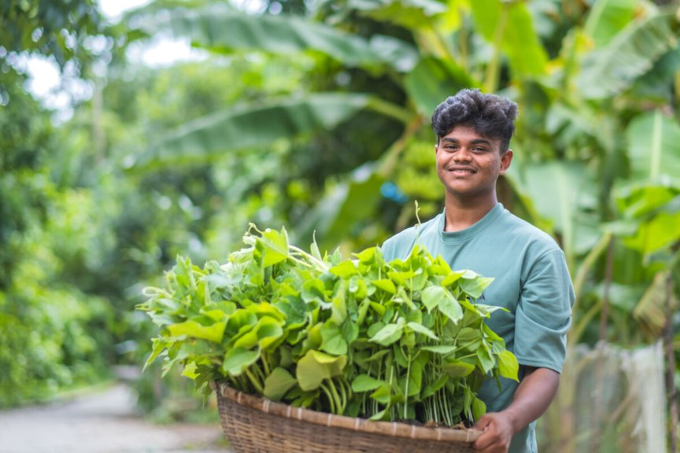

During Lent, we can pray for those living in poverty, asking God for the help they need so that they can live life to the full.
We can also do the Big Lent Walk to walk in solidarity with our brothers and sisters in need and get sponsored.
With the money you raise, CAFOD's local experts can help our global family to help themselves.
The Choto Bashail community in Bangladesh, cultivating floating gardens with CAFOD's help

Slide 16
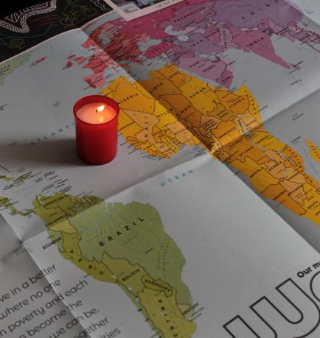
Let us pray
We pray for world leaders:
that the Holy Spirit may inspire them to work together for peace so that all people can live life to the full.
Lord in your mercy…
We pray for our parish, families and friends:
that Jesus may bring hope to us all as we try to live our lives as he asks us to.
Lord in your mercy...

Slide 17
Let us pray
We pray for people that are sick or injured throughout the world:
that they may get the care and help they need and find strength in the love of those around them.
Lord in your mercy…
Loving God: show us how to work together with others in love and with hope, so that together we may build a better world. Amen.

Slide 18
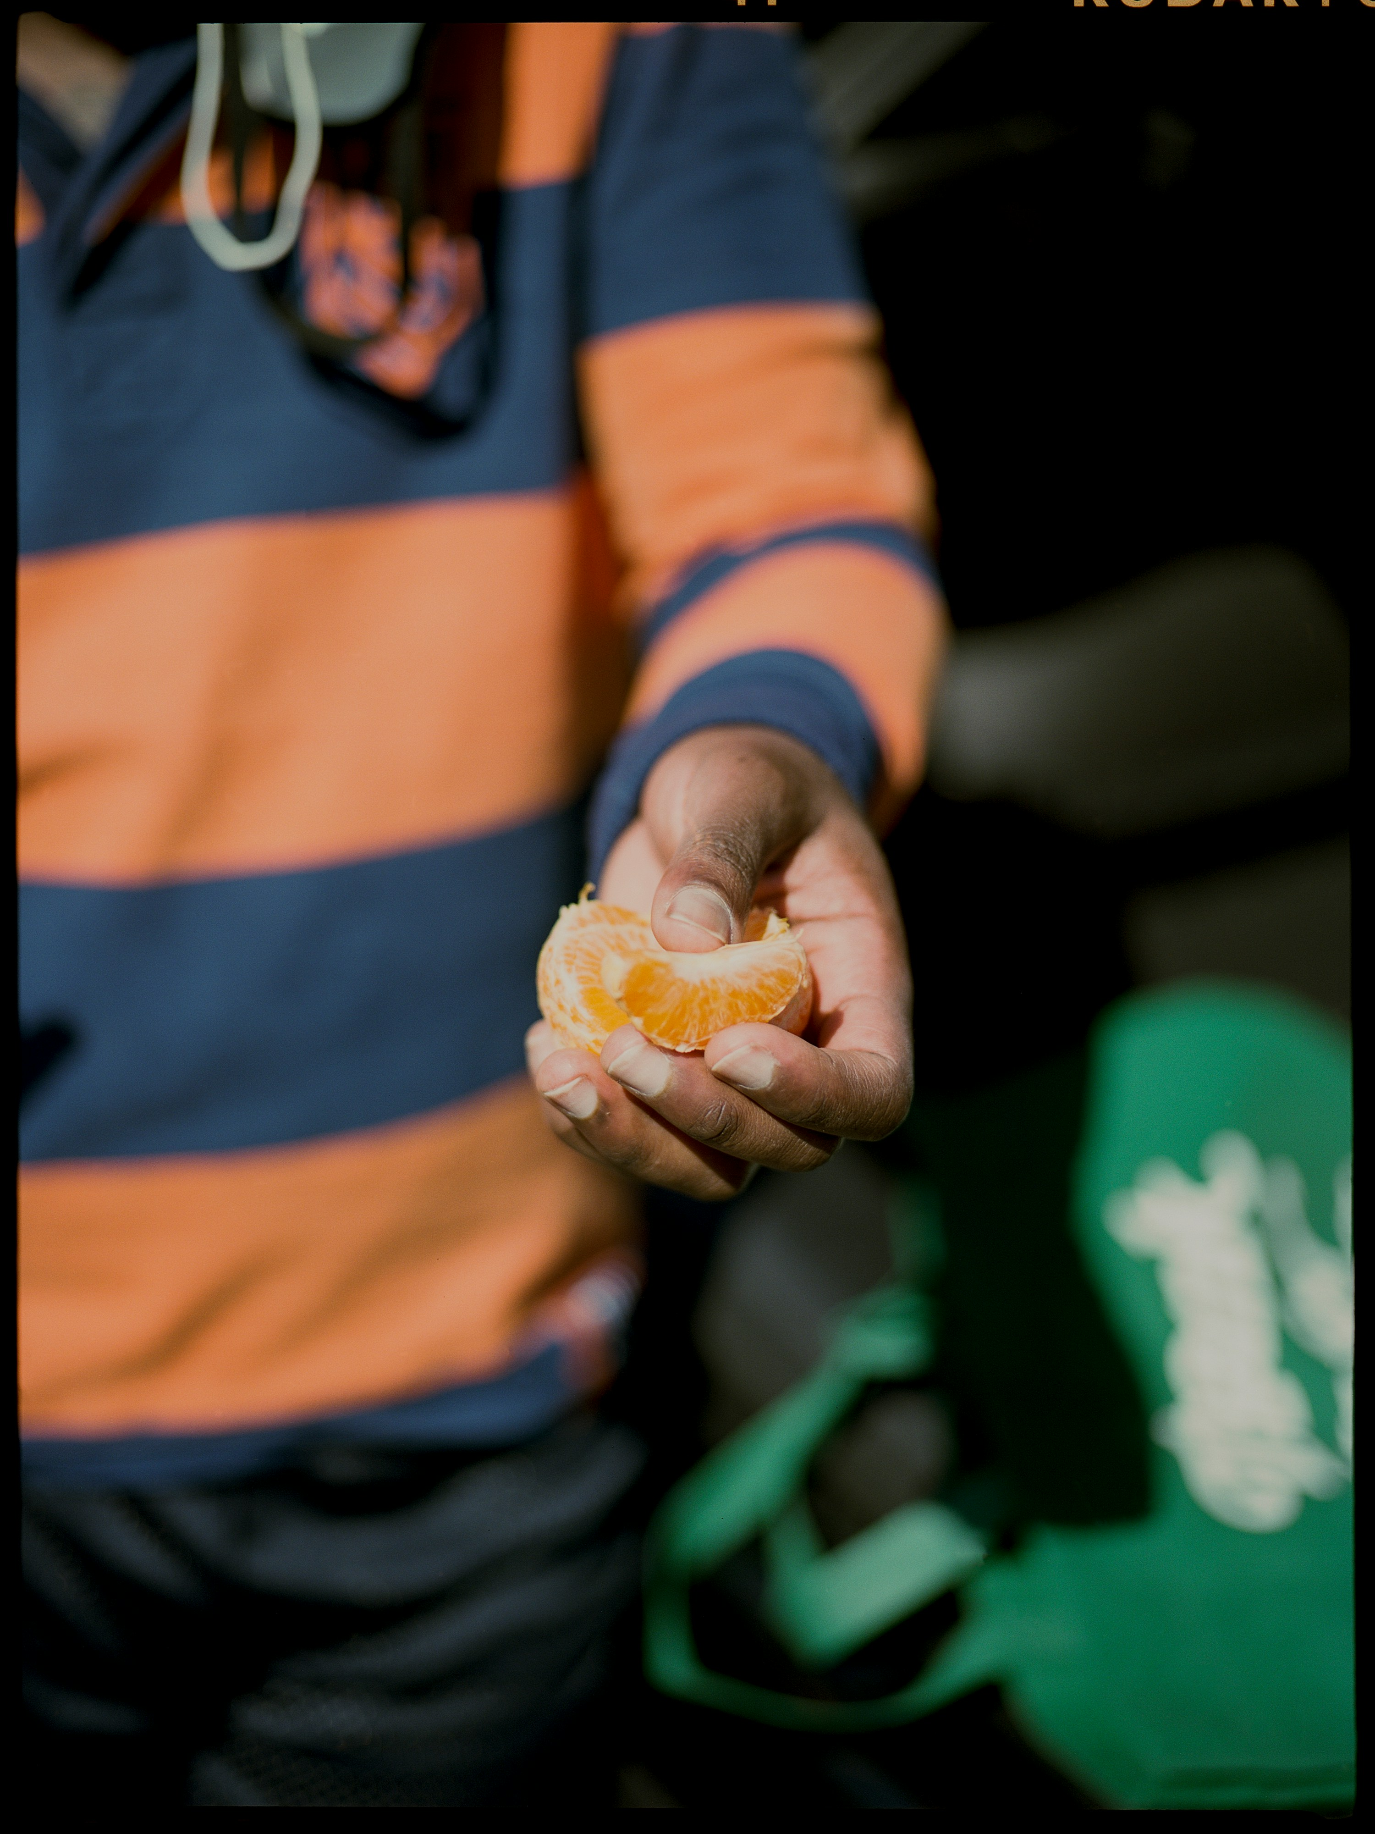

What will you do to share with others in need this week?
Send
Notes:
Sharing
Photo credit: M Cooper on Unsplash

Slide 19
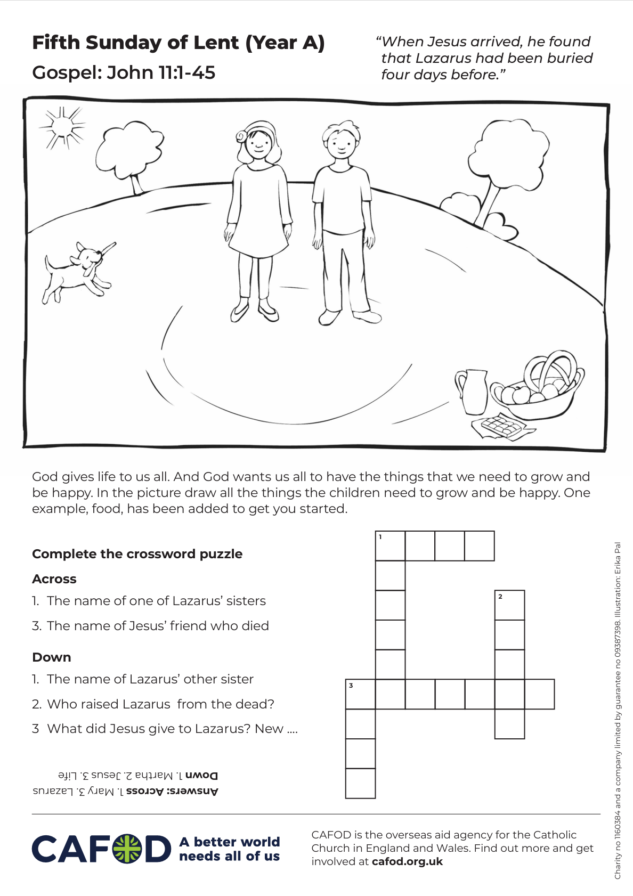
Activity suggestions
Download the illustration
Share the accompanying activity sheet with the children and encourage them to complete it, either in the liturgy or at home.
Invite them to colour in the illustration and to draw around the children the things they need to live a happy life and be the best people they can be e.g. clean water, the chance to go to school, medicine etc. One example – food – is there to get them started.
Remind the children to share all that they have heard and thought about today with the people at home. Encourage them to make one change to their own lives to live as Jesus asks us to, and to help others as they try to build a better world.
See Lent 2026 resources for primary schools for more child-friendly fundraising and other activities this Lent.
Notes:
Illustration: Erika Pal

Slide 20


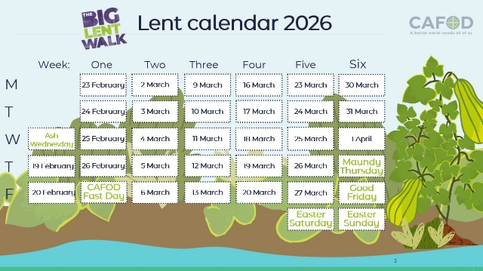
Get involved with CAFOD this term
Big Lent Walk resources
Lent national assembly
Lent resources
Join us on the Big Lent Walk!
Join our national assembly
Explore our Lent 2026 resources

Slide 21


