Slide 1
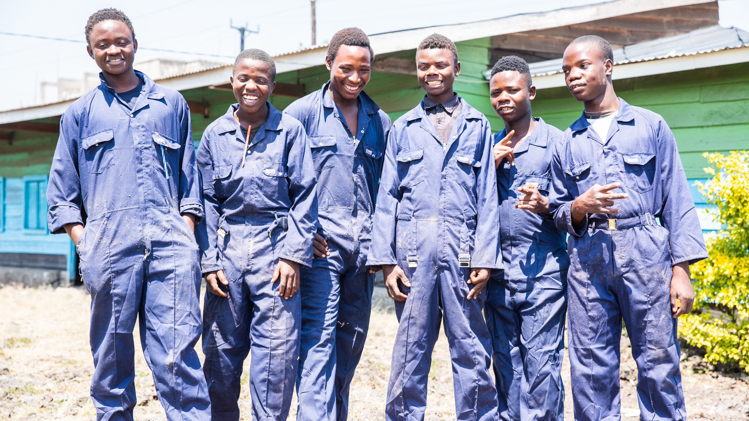

Slide 2
Photo
1
Key quote “If I wasn’t doing this work, I think I would also have gone to the armed groups like my friends… The thing I’m most proud of is this work that I’m doing.”
Daniel (third from left) with a group of other young men who have been taking part in the CAJED carpentry training. “Among my friends, there are many who have joined armed groups. My friends saw that life here was difficult, so they decided to go to the army. And with a sort of don’t care attitude, like ‘if we die there, then we will die’’.
Photo credit: Thom Flint, CAFOD

Slide 4
Photo
2
Key quote “If I wasn’t doing this work, I think I would also have gone to the armed groups like my friends… The thing I’m most proud of is this work that I’m doing.”
Daniel (right) with a friend at the carpentry workshop.
Photo credit: Thom Flint, CAFOD

Slide 6
Photo
3
Key quotes
“I’m studying teaching, but when I go to the university I would love to study medicine. I would love to be a doctor, so that I am able to protect myself and also so that I am able to cater for my own needs.”
Sagesse* at school. Sagesse, 15, is Bernadette’s daughter. She wants to be a doctor. Her favourite subjects are biology and chemistry. At the moment, as well as going to school, she helps her mother to make and sell charcoal stoves, as well as helping to cultivate and sell the mushrooms that are part of the CAJED project in Goma, DRC
*Sagesse is a pseudonym. Why do you think CAFOD need to use pseudonyms to protect their partners?
Photo credit: Thom Flint, CAFOD

Slide 8
Photo
4
Key quotes
“I’m very excited about our mushroom project. These mushrooms have helped me, at the age I am, to be able to change my diet. It has also helped me to take care of my children and with helping them at school.”
Bernadette with mushrooms grown in the CAJED compound as part of their livelihoods project. Bernadette was forced to flee from her home when rebels burned down the houses in her village and killed many people. Her husband joined the army after his own brother was killed. Bernadette escaped on foot with her four sons and fled across the country while she was pregnant with her fifth child. Sadly, she lost her baby, but she has been able to find a new place to live in Goma and is starting to rebuild her life.
Photo credit: Thom Flint, CAFOD

Slide 10
Photo
5
Key quotes
“I’m very excited about our mushroom project. These mushrooms have helped me, at the age I am, to be able to change my diet. It has also helped me to take care of my children and with helping them at school.”
Bernadette has learned how to cultivate mushrooms which is helping her to supplement her income selling these charcoal stoves. With the income she is able to earn, she is paying for her two youngest daughters to go to school, including Sagesse.
Photo credit: Thom Flint, CAFOD

Slide 12
Photo
6
Key quotes
“At the end [of the training], we received sewing machines and some basic materials and that’s how I became dressmaker. Since I’ve been doing this job, it’s helped me a lot to support my own needs and those of my brothers.
While we were doing the training, I was very happy, which is why I gave it my all to be able to finish and make my dream come true. God bless the CAJED programme, which has really helped us to be responsible for ourselves.”
Raı̈ssa (20) working in her workshop. Raı̈ssa finished the seamstress training provided by CAFOD partner CAJED in 2022. She dropped out of school in the fifth year of secondary school due to lack of means and enrolled in the CAJED training last year.
Photo credit: Thom Flint, CAFOD

Slide 14
Photo
7
Key quote (from Adeline)
“The most important [thing] for me is to go to school – so that I can be wiser.”
“I love to go to school. When I finish school, I would love to get a job. And then I would love to dress well, like others.”
Inside Adeline’s* (7) classroom. *Adeline is a pseudonym. Why would CAFOD need to use psuedonyms to protect its partners?
Photo credit: Thom Flint, CAFOD

Slide 16
Photo
8
Key quote
‘‘I think we need to continue to educate other young people to leave the streets and show them the benefit of learning how to build a better future.’’
Rizo* in the CAJED tailoring training classroom. Rizo, 17, was raised by her grandmother since she was 8 years old. She reached third grade at school but was forced to abandon her studies due to lack of resources. She moved to Goma and started to work as a domestic servant, but when that job fell through, she started living on the streets. Staff from CAJED, CAFOD’s partner organization, persuaded Rizo to take part in the seamstress training to help her earn a living. She is now living with her aunt in Goma while she takes part in the training to help her build a better future for herself. *Rizo is a pseudonym. Why would CAFOD need to use psuedonyms to protect its partners?
Photo credit: Thom Flint, CAFOD

Slide 18
Photo
9
Key quote
“This training is a way for me to redeem myself with my family, for me to rebuild and correct the mistakes I’ve made in the past. I dream of becoming a great seamstress after the training. Even though I had done some silly things in the past, I want my parents to be proud of me.’’
Dodo* taking part in a CAJED-led tailoring training session. Dodo, 16, dropped out of school in fifth grade and left home at the age of 13. She became pregnant while she was living on the streets. Staff from CAJED, CAFOD’s partner organisation, found Dodo when she was living on the street and persuaded her to take part in the seamstress training. She is now reconciled with her parents. *Dodo is a pseudonym. Why would CAFOD need to use psuedonyms to protect its partners?
Photo credit: Thom Flint, CAFOD

Slide 20
Photo
10
Key quote
“I’m happy that my children are going to school. Keeping my two younger children in school is crucial to me. I regret that some of my older children were not educated, and I want a better future for the younger ones. Education will empower them and give them a chance to grow differently from their elders.”
Bernadette (second from right, pink top) with Adeline* (middle, blue top, red skirt) and Sagesse* (third from left, black top, striped skirt) and their family outside their home. Bernadette can now pay for Adeline and Sagesse to attend school as a result of joining the mushroom growing project. Bernadette was forced to flee from her home in Walikale (a town in the North Kivu Province of DRC) when rebels burned down the houses in her village and killed many people. Her husband joined the army after his own brother was killed.
Photo credit: Thom Flint, CAFOD

Slide 22
Photo
11
Key quote
“There were times when we would get sick and for parents to get money to take you to the hospital, they had to get loans from people to borrow money. And also now the problem would come for time to pay back that borrowed money.”
Daniel and his younger siblings enjoying their family dinner. Daniel (21) comes from a family of 12 children. Before Daniel started the CAJED project his family were really struggling to find money for food. He was not able to go to school and struggled to get work in Goma, DRC. Many of his friends have been recruited as child combatants and he has faced pressure to become a combatant too. Since Daniel became involved in the CAJED carpentry project, he has learned new skills and is now able to earn money to help his family and to make sure he has food to eat.
Photo credit: Thom Flint, CAFOD

Slide 24
Photo
12
Key quote
“To give people a second chance is to save them.”
Msr Suleyman Simon is the teacher at the CAJED workshop. CAJED is the partner organisation working alongside CAFOD. Msr Suleyman Simon found another role at CAJED after a volcano erupted in 2002 and shut down the organisation he was working for. He works with students who, like Daniel, found themselves in extreme poverty or had been previously involved in the army. He said the greatest thing a teacher can do is to work alongside their students, make friends with them to reduce some of the trauma and show them a different life is possible. He notices that when the conflict in the DRC gets more severe, the amount of work decreases.
Photo credit: Thom Flint, CAFOD

