Slide 1
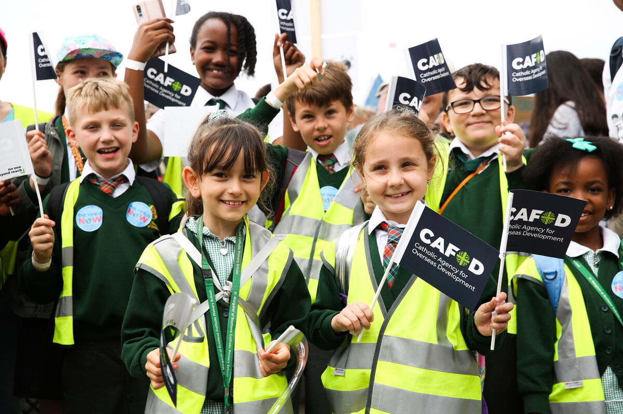
How can you be the best person you can be and make the world a better place for others?
Gather
Notes:
Children’s liturgy – Eighth Sunday in Ordinary Time (Year C)
Preparation of the worship space
Colour: green Props: coloured pens or pencils
Song suggestions: Christ be beside me (910, Laudate)
O Lord all the world belongs to you (847, Laudate)
Welcome: Today Jesus talks about how we have all done things that are wrong. Instead of picking on the tiny mistakes of others, we should change the things that are not so good about our own behaviour. Let’s think a bit more about this.
London school children campaigning for CAFOD
Photo credit: Eleanor Church

Slide 2
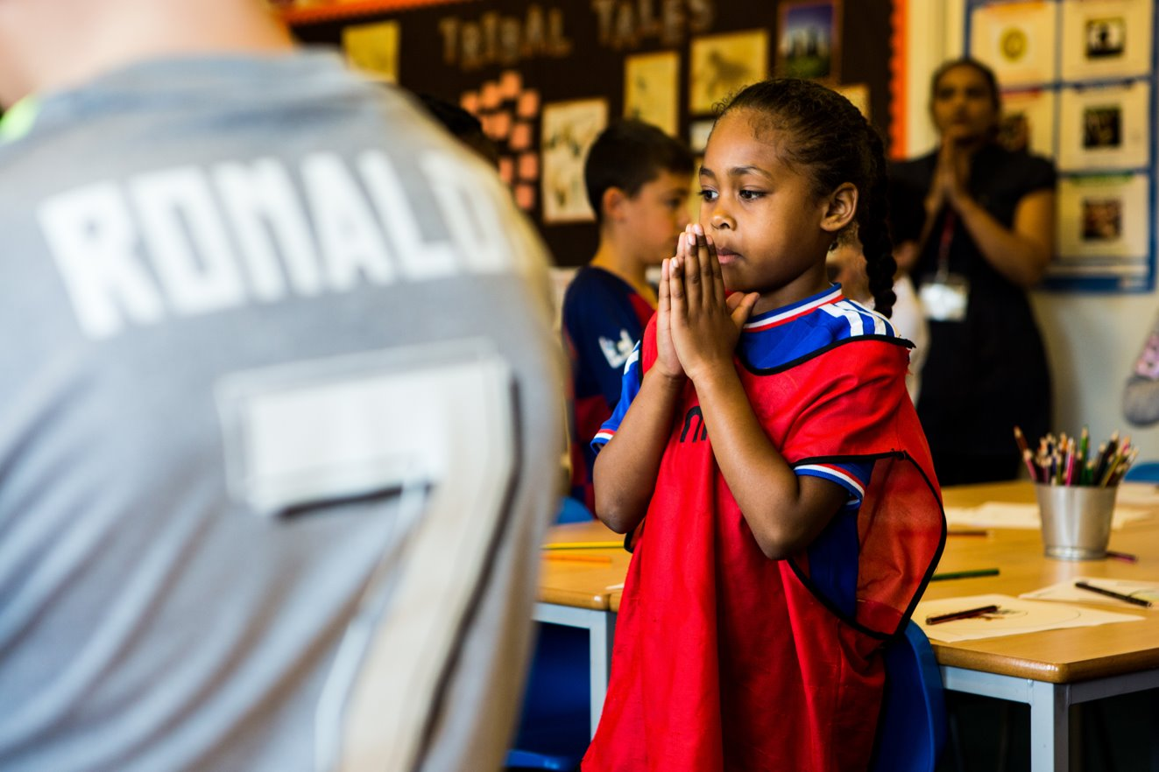
Loving God,
help us to see when we are doing something that hurts or upsets others. Help us to say sorry and to make a change. Fill our hearts with your love and goodness. Amen.
Notes:
Children at Our Lady Queen of Heaven Primary School
Photo credit: Thom Flint

Slide 3
Gospel: Luke 6:39-45
And Jesus told them this parable: “One blind man cannot lead another one; if he does, both will fall into a ditch. No pupil is greater than his teacher; but every pupil, when he has completed his training, will be like his teacher.
“Why do you look at the speck in your brother's eye, but pay no attention to the log in your own eye? How can you say to your brother, ‘Please, brother, let me take that speck out of your eye,’ yet cannot even see the log in your own eye? You hypocrite! First take the log out of your own eye, and then you will be able to see clearly to take the speck out of your brother's eye.
“A healthy tree does not bear bad fruit, nor does a poor tree bear good fruit. Every tree is known by the fruit it bears; you do not pick figs from thorn bushes or gather grapes from bramble bushes.
"A good person brings good out of the treasure of good things in his heart; a bad person brings bad out of his treasure of bad things. For the mouth speaks what the heart is full of."
Word

Slide 4
What do you remember from the Gospel reading?
Jesus is talking to the disciples – he talks about seeing a tiny speck of dust in someone else’s eye, but not seeing the great wooden log in our own.
Can anyone guess what Jesus means here?
Jesus is saying it is much easier to notice the mistakes that others make, than it is to realise when we have made a mistake or done something wrong ourselves.
What does Jesus tell the disciples they must do?
Respond
Notes:
Child staring out of the window
Photo credit: Stock image

Slide 5
He says they must take the log out of their own eye before they can take the speck out of someone else’s. He is saying we must change the way we act before we can expect anyone else to change.
If we cannot be good and do what is right, how can we ask other people to do the same?
Think quietly for a moment about something you might have done wrong. How could you change that? Could you share more? Be kinder or more helpful to others? Could you stop teasing a brother, sister or friend? Could you keep your room tidy? Or switch off lights when they’re not needed?
It’s not always easy to change the way we act but perhaps we can all try this week. Who do you think can help us to make this change?
Notes:
Photo credit: Stock image

Slide 6
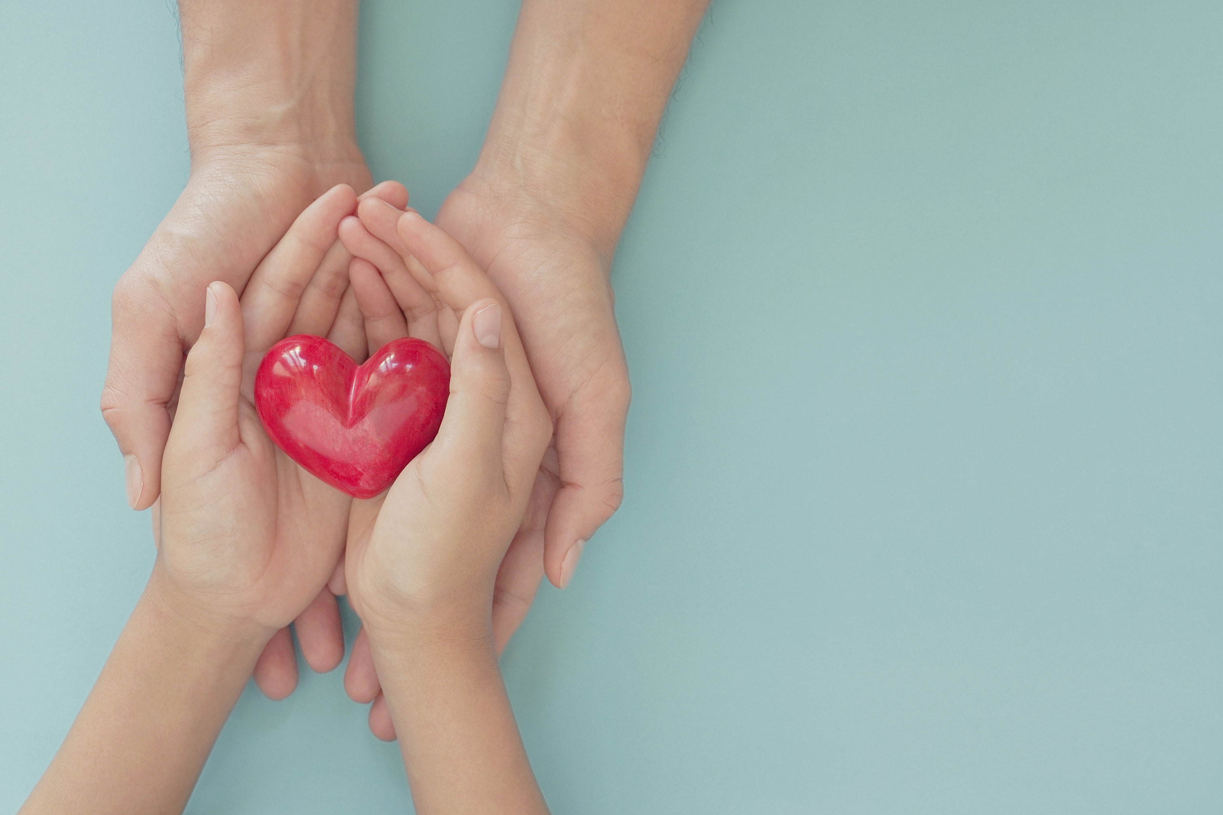
God can help us. If we let him, God will fill our hearts with goodness and love, hope, courage and generosity.
Filled with these things, we will not be able to stop ourselves from wanting to share them with others.
Jesus says in today's reading that good people have a store of goodness in their heart. That the words someone says come from what is in their heart.
So, if we let God fill our hearts with goodness and love, we will be able to speak words that share that goodness and love with others.
Notes:
Hands and heart
Photo credit: Stock image

Slide 7
This year is a special Jubilee Year and we are called to be “Pilgrims of Hope”.
There are all kinds of problems in our world, like poverty and hunger and climate change. Through our actions and the way we speak to others we can share hope as we all work together for a better world.
How will you use the store of goodness in your heart? How will you speak out and make changes to be the best person you can be and make the world a better place for others?

Slide 8
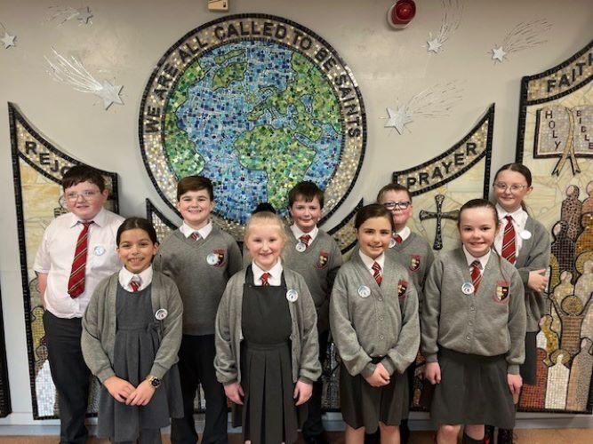
These children are from All Saints Catholic Primary School.
They have formed a group called 'Poverty Busters', whose ambition is to speak out and help tackle poverty in the UK and around the world.
The 'Poverty Busters' did the Big Lent Walk to raise money and stand in solidarity with their brothers and sisters in need around the world. They are trying to make the world a better place.
Notes:
Children from All Saints Catholic Primary School, Liverpool
Photo credit: All Saints Catholic Primary School

Slide 9
What can you do to make the world a better place?
We can be kind to others and try to do things that will help those around us.
We can also speak out and take action for our global family in need, like the Poverty Busters at All Saints school.
Why not try the Big Lent Walk too? You could take action by walking, skipping or even dancing your way to raising money for our brothers and sisters around the world!

Slide 10
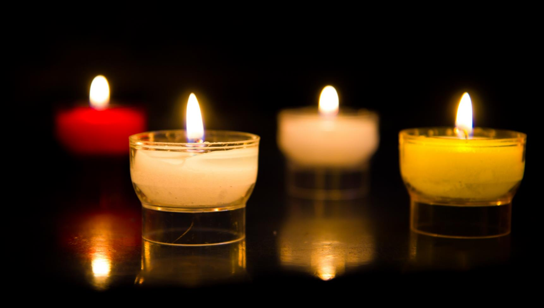
Let us pray…

Slide 11
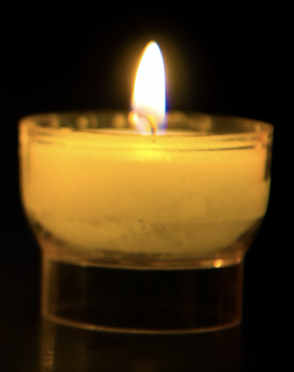
We pray for the Church throughout the world, our parish, our family and friends: that we may be willing to open our hearts to God, to admit our mistakes, to make a change and to speak up for what is right. Lord, in your mercy…
We pray for world leaders: that the words that they speak and the things that they do may come from a heart filled with goodness.
Lord, in your mercy…

Slide 12
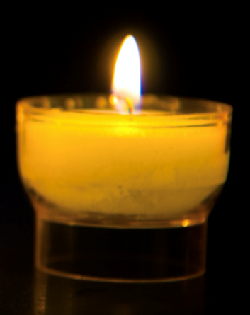
In this Jubilee Year, we pray that we may be signs of hope in our world through all that we do and how we treat one another. Lord, in your mercy…
Generous God, lead us to be the people you know we can be. Fill us with hope, courage and goodness. Help us to make a change so that the world may be a better place for all people. Amen.

Slide 13
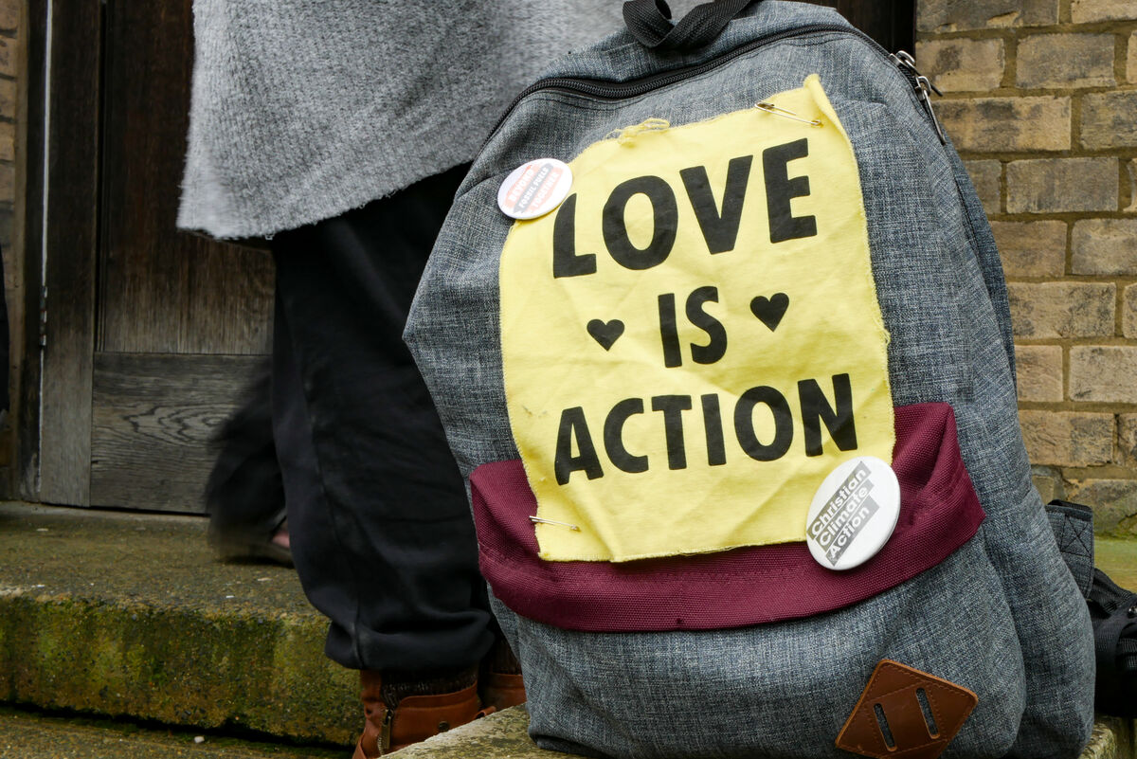
How can you be the best person you can be and make the world a better place for others?
Send
Notes:
Campaigning for CAFOD
Photo credit: Sophia White

Slide 14
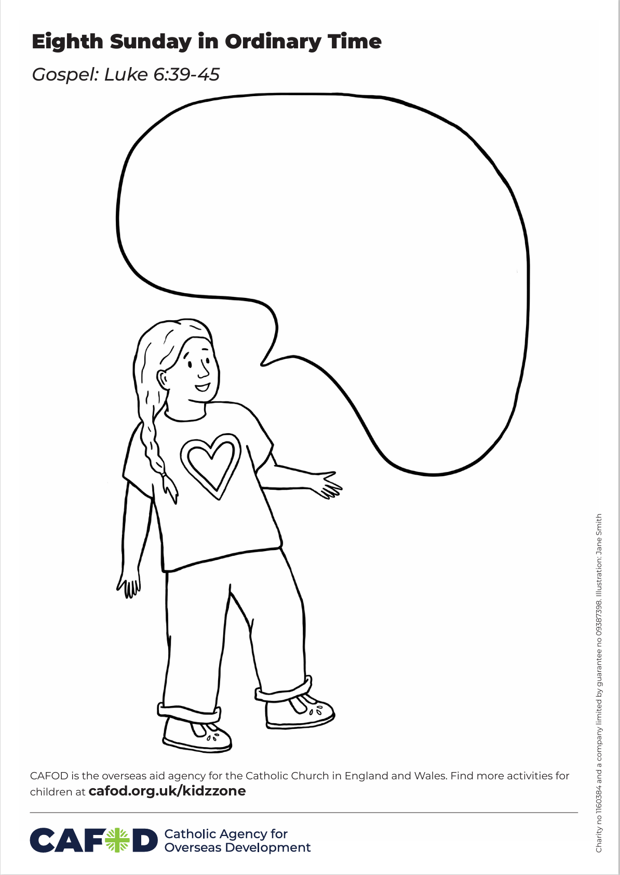
Activity suggestions
Invite the children to colour in the accompanying illustration of a person with a heart filled with love and goodness. Encourage them to write or draw in the speech bubble what it is they think the person is saying, or what they would most like to speak up about to make a change in our world.
Invite the children to pray to God to fill their hearts with goodness, love and courage to help them in these changes. You could use our special children’s prayer video for global neighbours, available at cafod.org.uk/kidzzone
Encourage the children to share all that they have heard and thought about today with the people at home. Remind them to try to make a change in the coming week and to speak out with love for the change that they would like to see in the world.
Notes:
Illustration: Jane Smith

Slide 15
Jubilee activities!
The Jubilee Year is a landmark moment in the life of the global church. School communities are invited to join together as pilgrims of hope, pledging to work together for God’s kingdom of justice, peace and love. Find resources at:
Jubilee for schools 2025 – Pilgrims of Hope
Why not make the Big Lent Walk part of your Jubilee pledge?
For sign up and more information go here:
BLW25 Schools Sign up - Formstack
A CAFOD club could strongly support the Catholic life of your school, particularly in this Jubilee year. Find out more:
https://cafod.org.uk/Education/For-teachers/CAFOD-clubs

Slide 16
Notes:
Illustration: Jane Smith

