Slide 1
The S.E.L.F. Program
Students Exploring Life’s Foundations

Slide 2
The S.E.L.F. Program
Module 2
Emotional Intelligence

Slide 3
The S.E.L.F. Program
The S.E.L.F. Program
Module 2
Emotional Intelligence
In this module we will be exploring things that cause us stress and anxiety – Teachers please use your professional judgement to alter activities or discussions based on the background of students in your class.

Slide 4
The S.E.L.F. Program
Emotional Intelligence
Module 2
The Pursuit of Happiness:
In this module we will be exploring things that cause us stress and anxiety – Teachers please use your professional judgement to alter activities or discussions based on the background of students in your class.

Slide 5
The S.E.L.F. Program
Emotional Intelligence
Module 2
What is Emotional Intelligence?
Activity:
1. With the person next to you, discuss
what you think 'emotional intelligence' is.
2. Discuss your ideas with the class.

Slide 6
The S.E.L.F. Program
Emotional Intelligence
Module 2
Your Soul =
Body
Soul
Spirit

Slide 7
The S.E.L.F. Program
Emotional Intelligence
Module 2
"If you don't like something, change it.
If you can't change it, change your attitude."
- Maya Angelou

Slide 8
The S.E.L.F. Program
Emotional Intelligence
Module 2
Developing Emotional Intelligence:

Slide 9
The S.E.L.F. Program
Emotional Intelligence
Module 2
Emotional Intelligence:
Get to know yourself.
Learn your triggers.
Empathise.
Own your emotions.
Go with your gut.

Slide 10
The S.E.L.F. Program
Emotional Intelligence
Module 2
Get to know yourself.
Emotional Intelligence:
Activity:
1. Complete the AUS Identity quiz on your laptop:
Take the Quiz
2. Complete Q1 on page 15.

Slide 11
The S.E.L.F. Program
Emotional Intelligence
Module 2
Learn your Triggers.
Do we choose our emotions?
We don’t choose WHICH emotions get triggered. Our emotions are triggered automatically by our brain’s response to our external environment. Our brains are wired for safety. Even though our emotions are automatically triggered, we still do in fact get to choose how to respond to them.

Slide 12
The S.E.L.F. Program
Emotional Intelligence
Module 2
Activity:
1. Write or draw 3 things that make you feel sad/ nervous/uncomfortable/angry/anxious.
E.g. 'Having lots of work to do'.

Slide 13
The S.E.L.F. Program
Emotional Intelligence
Module 2
Learn your triggers and how to cope:
Now, this video may seem a little young or childish, but the process, concept & strategies are tools even adults use on a day-to-day basis.
Keep in mind the 3 things you just wrote down (you need these for the next question).

Slide 14
The S.E.L.F. Program
Emotional Intelligence
Learn your triggers
Module 2
Activity
Activity:
2. Remember the 3 things that made you feel sad/nervous/uncomfortable/angry/anxious?
Now write down your example, how that makes you feel and a strategy you can use to manage it, by completing the table below in your books. (I have included an example response)
Remember the 3 things that made you feel sad/nervous/uncomfortable/angry/anxious?
1. Write down your example, how that makes you feel, and a strategy you can use to manage it, by completing the following table in your books. (I have included an example response).
Your example | This makes me feel | Strategies to cope
E.g. Having lots of work to do | Anxious | Take deep breaths to relax Exercise to release the anxiety Make a list to prioritise what needs to be done now and what can wait
Your example:
Your example:
Your example:

Slide 15
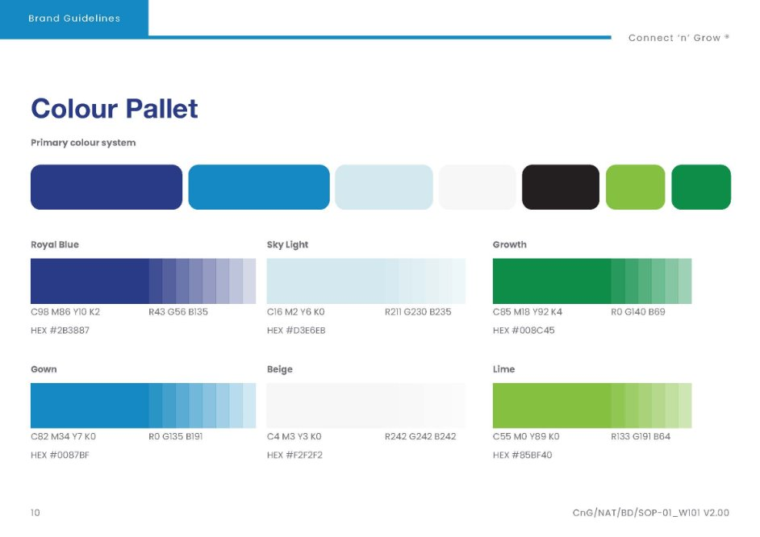
The S.E.L.F. Program
Emotional Intelligence
Learn your triggers
Module 2
Activity
Activity:
2. Remember the 3 things that made you feel sad/nervous/uncomfortable/angry/anxious?
Now write down your example, how that makes you feel and a strategy you can use to manage it, by completing the table below in your books. (I have included an example response)
Your example | This makes me feel | Strategies to cope
E.g. Having lots of work to do | Anxious | Take deep breaths to relax Exercise to release the anxiety Make a list to prioritise what needs to be done now and what can wait
Your example:
Your example:
Your example:
Your example | This makes me feel | Strategies to cope
E.g. Having lots of work to do | Anxious | Take deep breaths to relax Exercise to release the anxiety Make a list to prioritise what needs to be done now and what can wait
Your example:
Your example:
Your example:

Slide 16
The S.E.L.F. Program
Emotional Intelligence
Module 2
Empathise and your own emotions.
Inside out: Emotional Intelligence:

Slide 17
The S.E.L.F. Program
Emotional Intelligence
Module 2
Activity:
Answer the following questions in your notebook:
1. What emotion did Bing Bong feel?
2. How did Bing Bong react to this event?
3. Was Joy's strategy of distraction useful for Bing Bong? Why/Why not?
4. What strategy did Sadness use with Bing Bong?
5. How did this help?

Slide 18
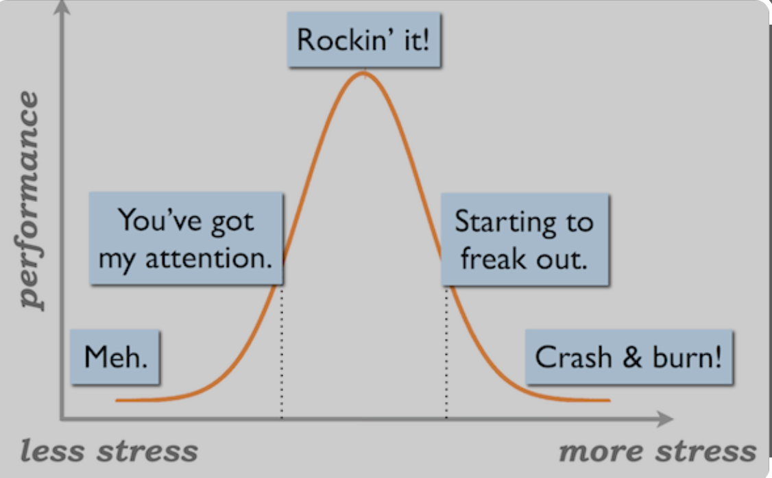
The S.E.L.F. Program
Emotional Intelligence
Module 2
Dealing with Stress and Anxiety
Is stress bad?
As a class, brainstorm everything you can think of that relates to stress.
Once you have formulated your opinion, watch the following video and discuss your thoughts:
Watch Video

Slide 19
The S.E.L.F. Program
Emotional Intelligence
Module 2
Activity:
Complete exercise 3a, b & c, on page 18-19 of your S.E.L.F workbook.

Slide 20
The S.E.L.F. Program
Emotional Intelligence
Module 2
“There is something in the human spirit that will survive and prevail, there is a tiny and brilliant light burning in the heart of man that will not go out no matter how dark the world becomes.”
–Leo Tolstoy

Slide 21
THE TROUBLE WHEN YOU DON’T KNOW WHO YOU ARE
The S.E.L.F. Program
Emotional Intelligence
Module 2
Your mind is like a battlefield. Use it wisely.
Your thoughts will shape you.
You become what you think.
Your beliefs shape your reality.
Your mind is way more powerful than you know.

Slide 22
The S.E.L.F. Program
Emotional Intelligence
Module 2
Activity:
1. What do you think it means to have a strong spirit? Discuss with a partner and brainstorm together with the class.
2. Using the website address below, create a 6 question KAHOOT on 'Strong Spirit':
https://headspace.org.au/explore-topics/aboriginal-torres-strait-islander-peoples/strong-spirit/
3. Complete exercise 3d &e on pages 20-21.

Slide 23
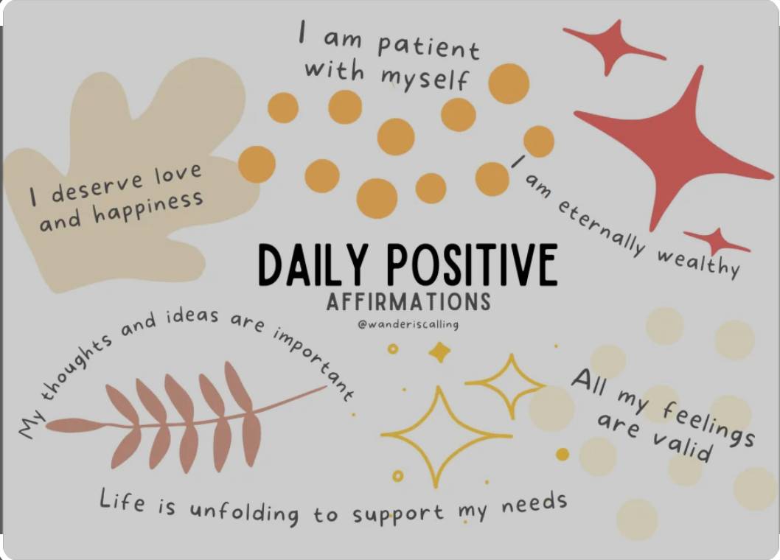
THE TROUBLE WHEN YOU DON’T KNOW WHO YOU ARE
The S.E.L.F. Program
Emotional Intelligence
Module 2
AFFIRMATIONS
Daily Positive Affirmations.
Use the final 5-7 minutes of the
lesson to write down positive affirmations.
Use the final 5-7 minutes of the lesson to complete affirmations.

Slide 24
Reflective Journal
The S.E.L.F. Program
Emotional Intelligence
Module 2
Reflective Journal
Please complete the questions on page 69 of your SELF work book for
Topic 2: Emotional Intelligence
Please complete the questions on page 69 of
your S.E.L.F workbook for Topic 2: Emotional Intelligence.

Slide 25
Teacher class resources
Entire Lesson | Laptop Projector & speakers Student SELF work books Student blank note book
Kahoot | Students require access to a laptop to create their own Kahoot
Affirmations | Post it size pieces of paper

