Slide 1
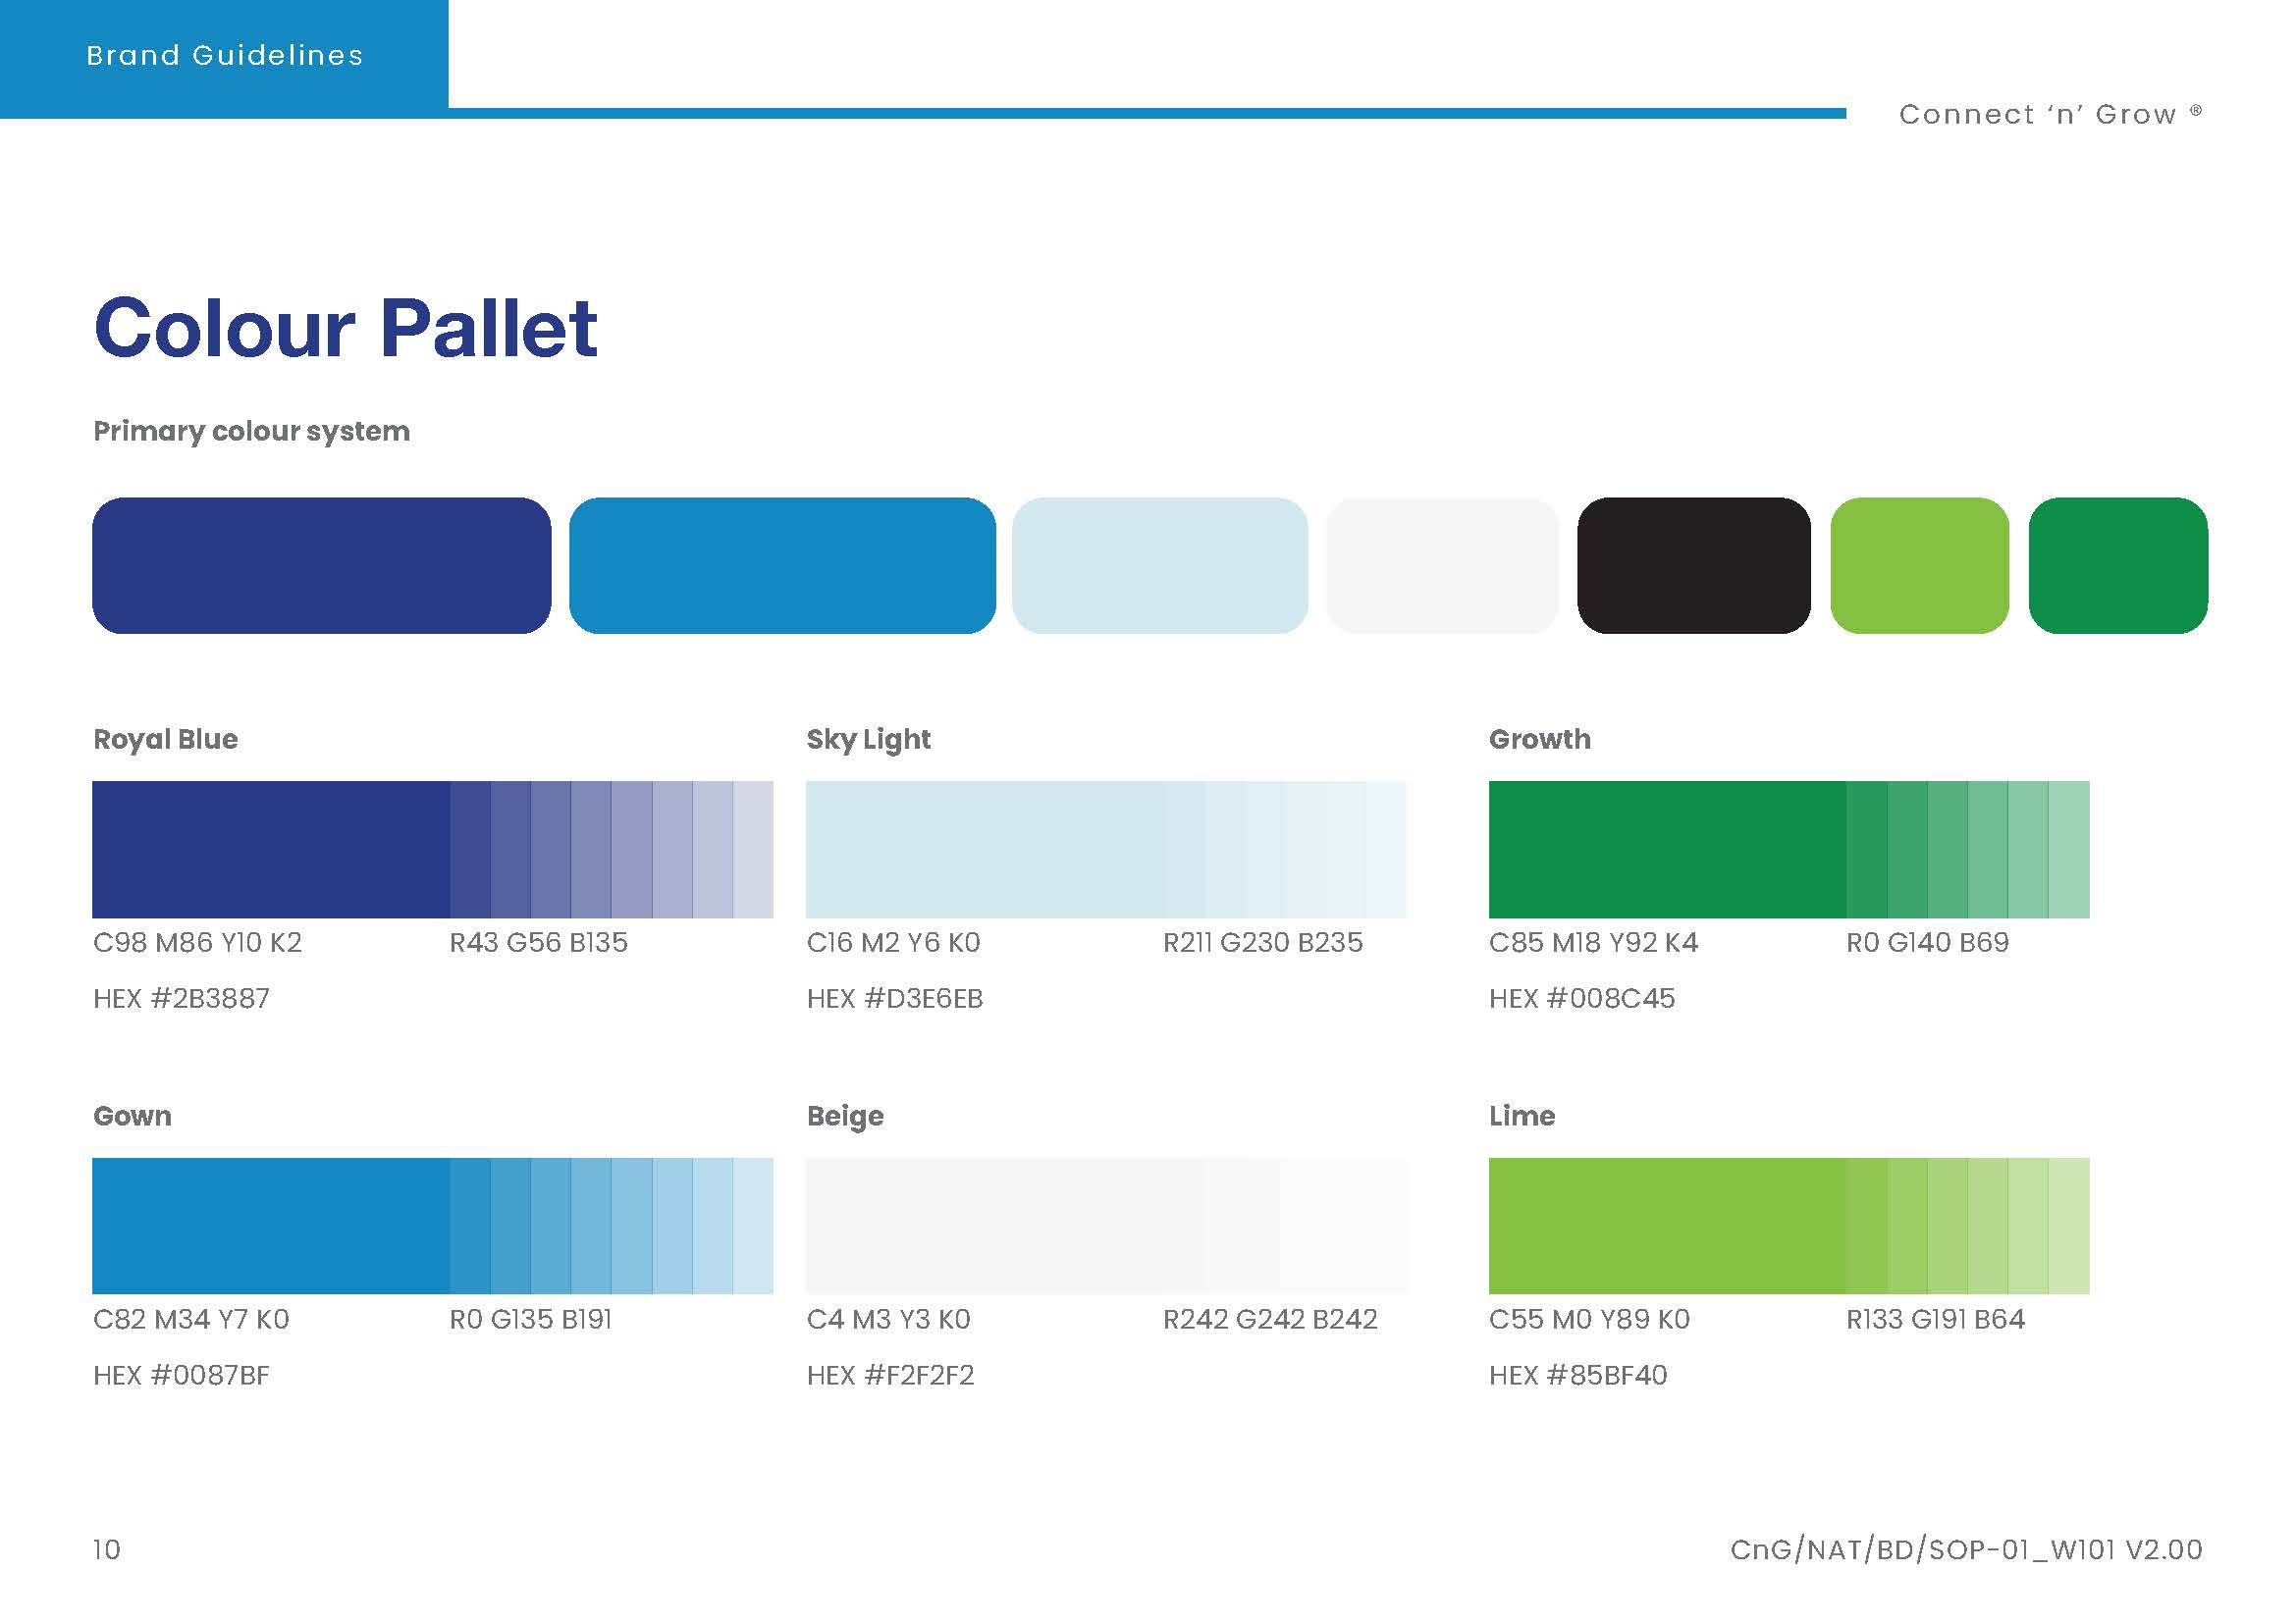
The S.E.L.F. Program
Module 3
Module 1
Students Exploring Life’s Foundations
Module 2
Module 6
Module 5
Module 4
Identity. Who Am I?
Emotional Intelligence.
Using Choice and Responsibility
My Core Values.
Your Purpose and Passion
Personal Wellbeing

Slide 2
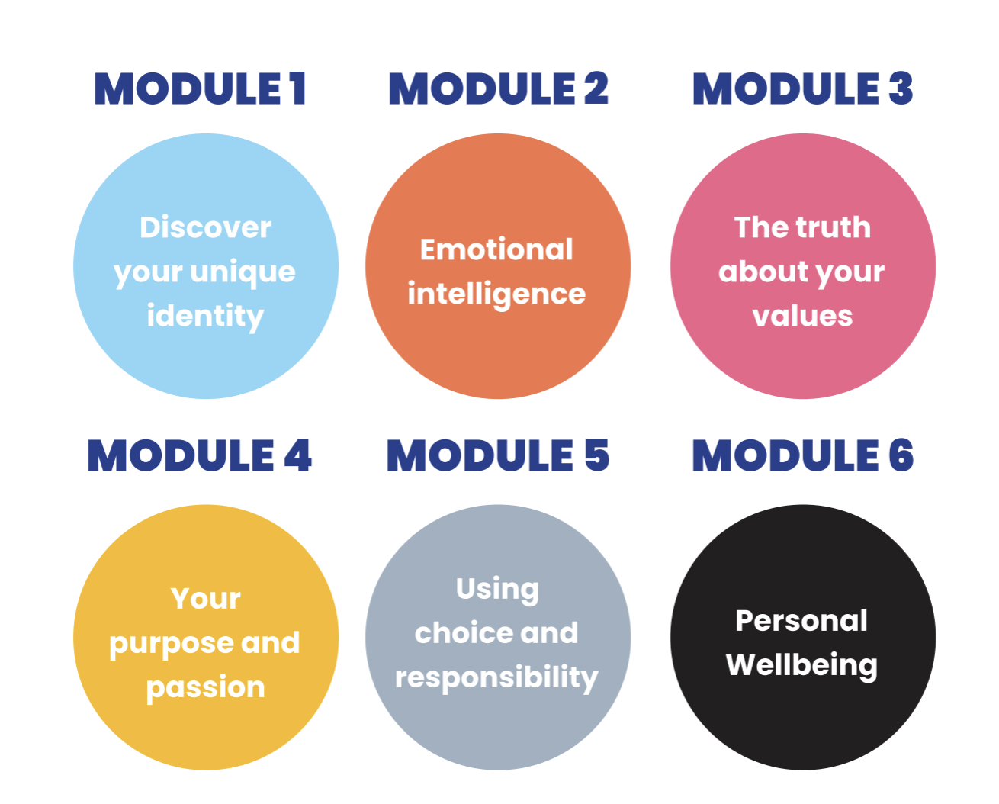
The S.E.L.F. Program
The S.E.L.F Program is organised around 6 key topics.
Module 1
Module 2
Module 3
Module 4
Module 5
Module 6
Identity. Who Am I?
Emotional Intelligence.
My Core Values.
Your Purpose and Passion
Using Choice and Responsibility
Personal Wellbeing

Slide 3
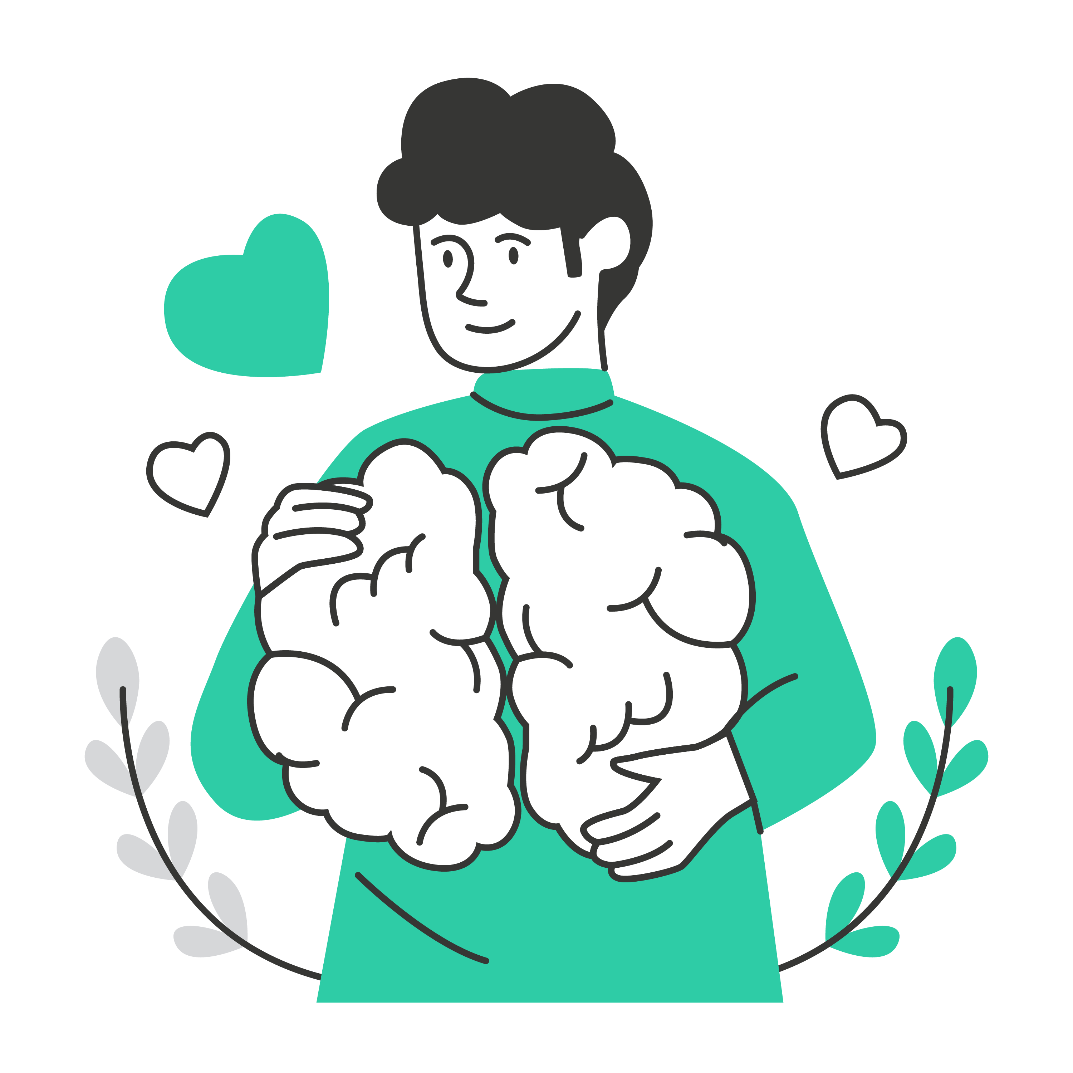
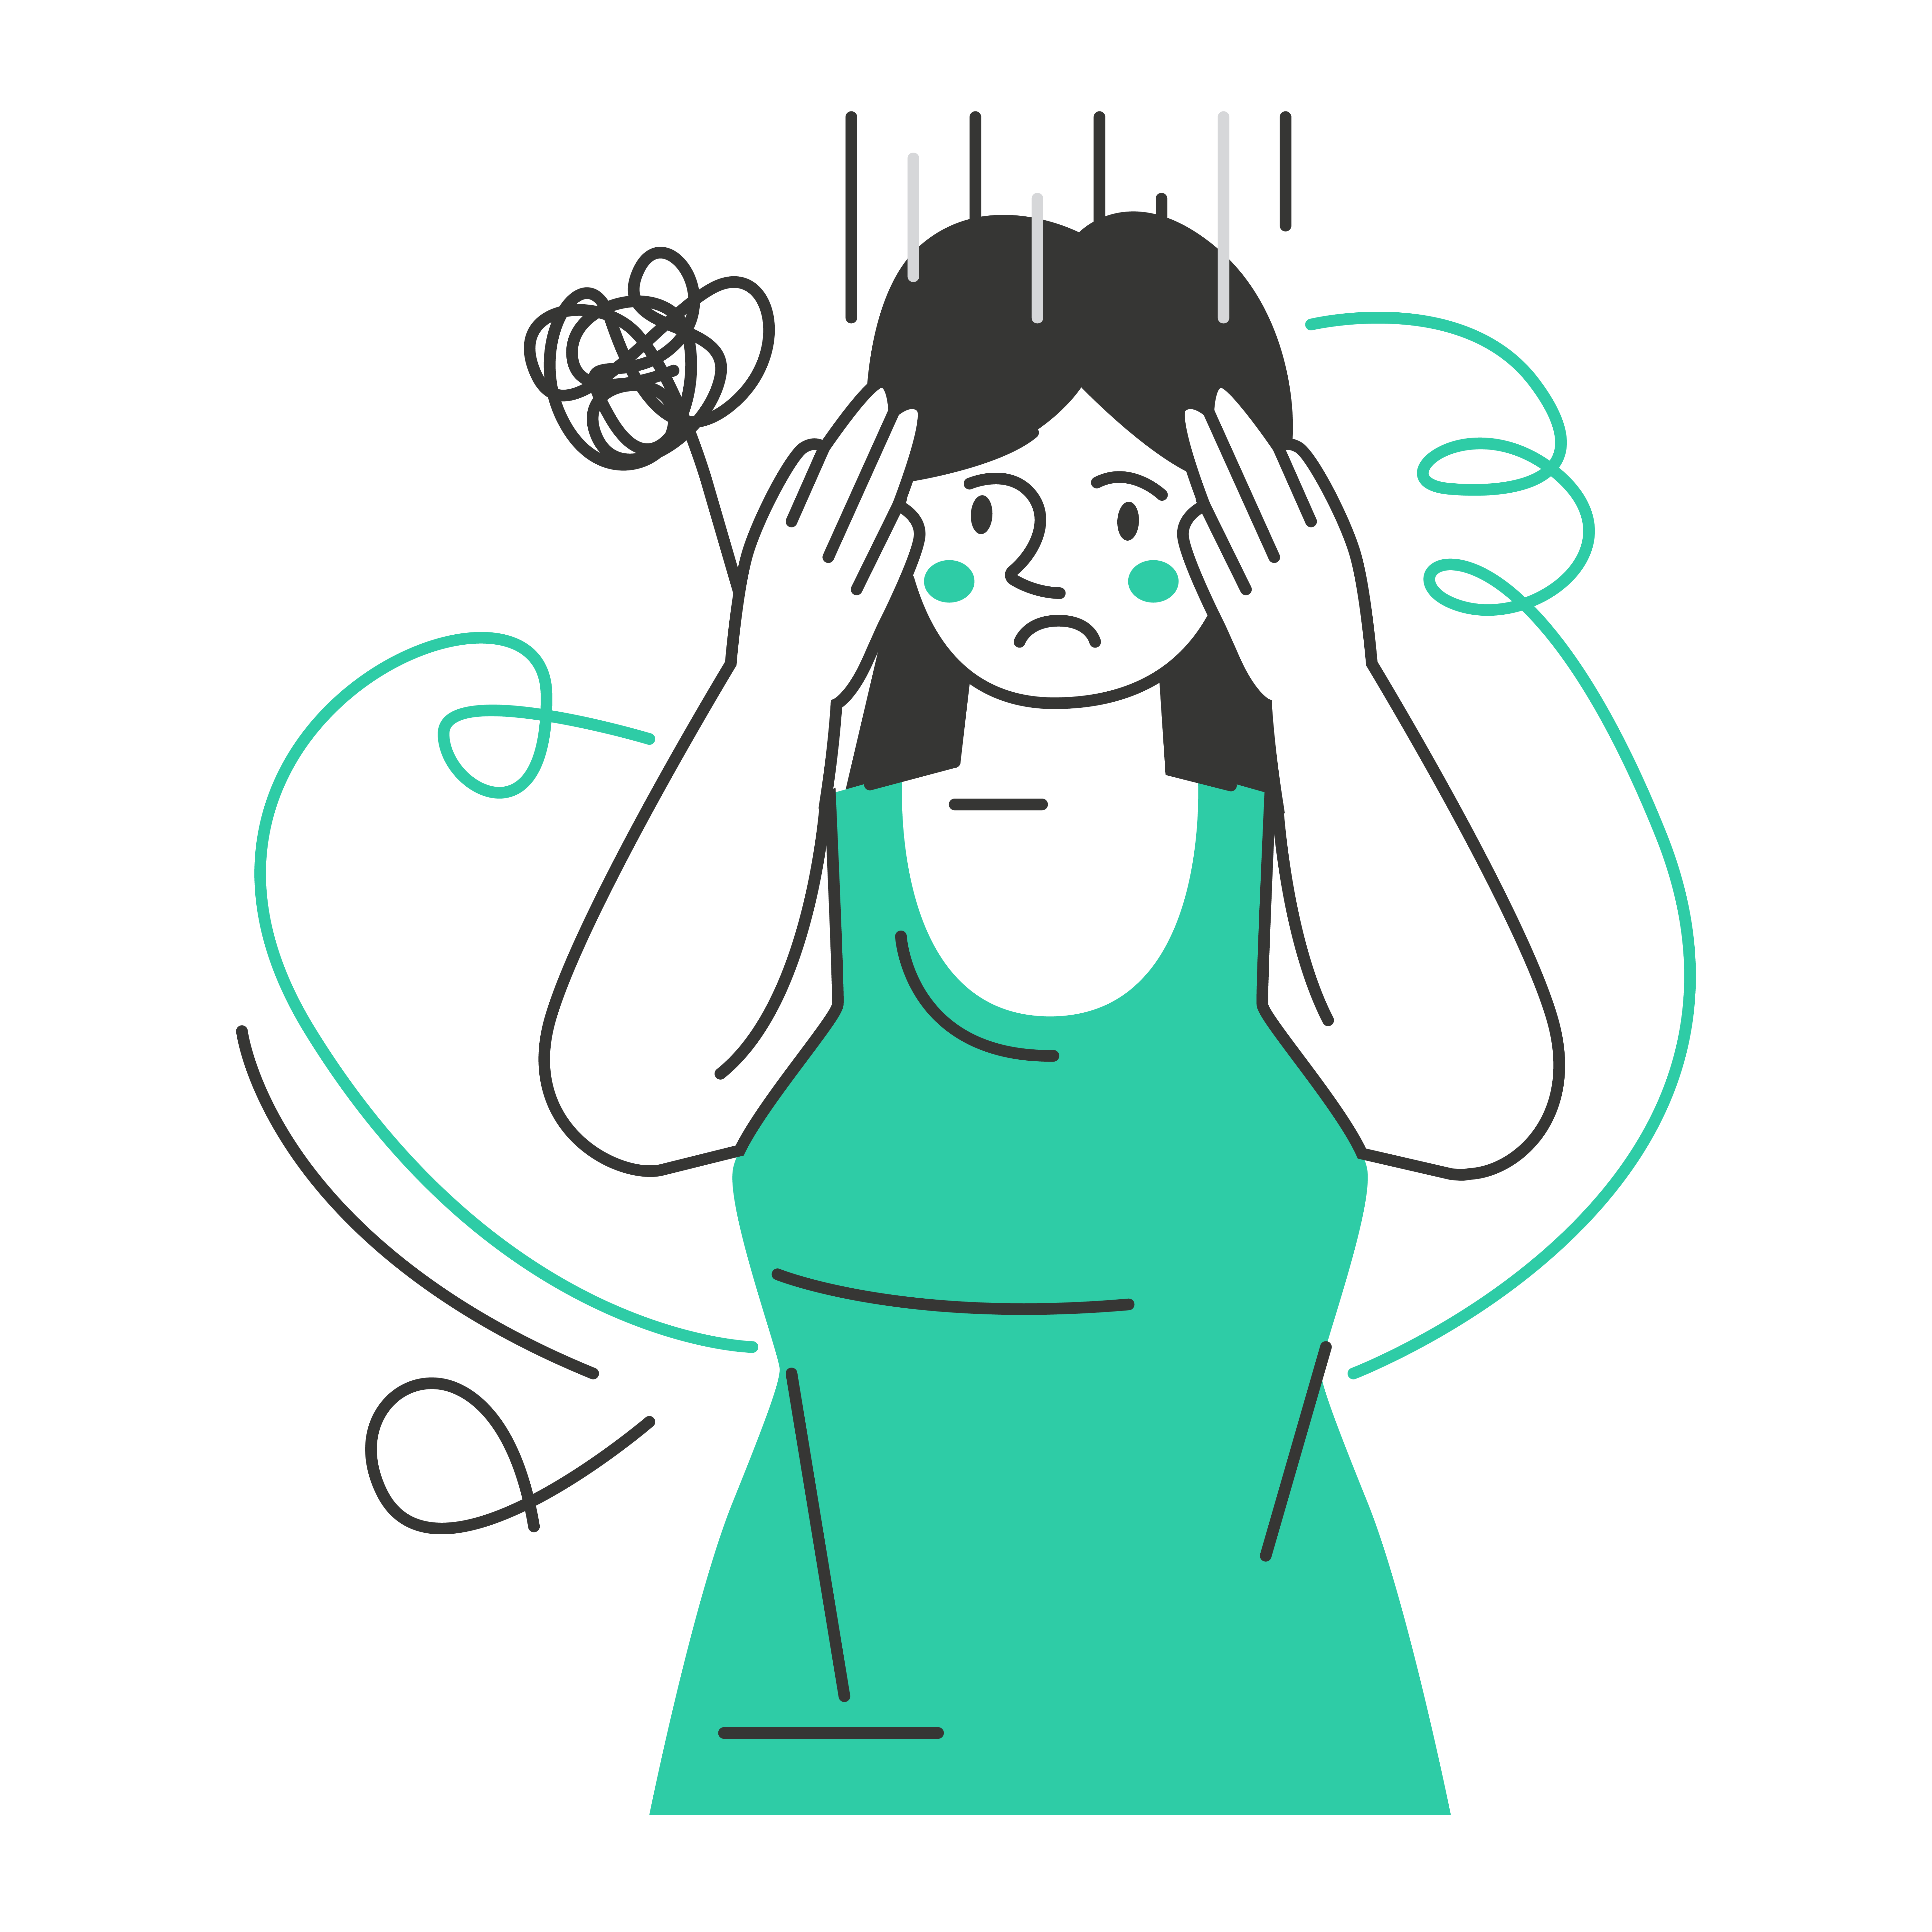
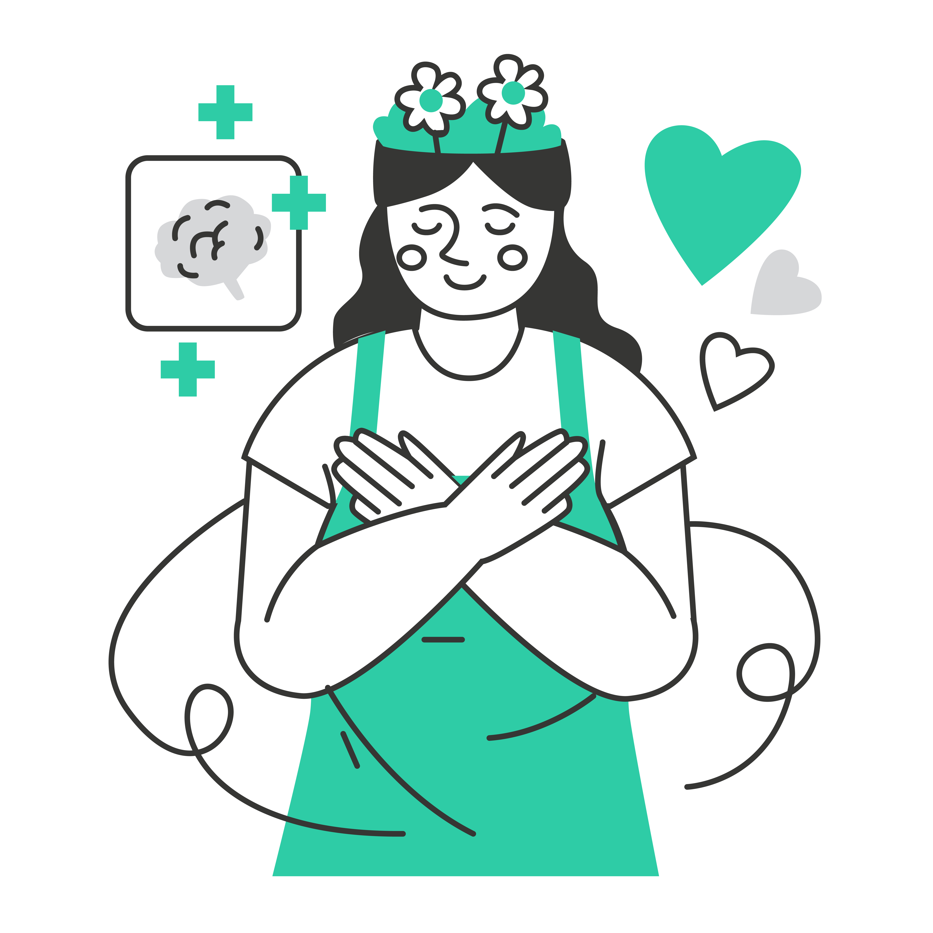
The S.E.L.F. Program
Why do the S.E.L.F Program?
The S.E.L.F. program aims to ensure you have a solid foundation in:
Module 3
Module 1
Achieving a sense of well-being and happiness
Module 2
Module 5
Module 4
Module 6
Self Awareness
Reducing
Anxiety
Increase of Self Confidence
Identity. Who Am I?
Emotional Intelligence.
Using Choice and Responsibility
My Core Values.
Your Purpose and Passion
Personal Wellbeing
These elements can help you navigate through life's challenges and thrive in the life of your choosing.

Slide 4
The S.E.L.F. Program
Module 1
Discover your Unique Identity

Slide 5
The S.E.L.F. Program
Discover your Unique Identity
Module 1
A Message to you from Kid President

Slide 6
The S.E.L.F. Program
Discover your Unique Identity
Module 1
Activity:
A Message to you from Kid President
Write a letter to your future self.
How:
Place your letter in an envelope with your name written on the front and hand it to your teacher. Your teacher will keep it until the end of the year, or whenever you finish the SELF course.
When:
Write this letter during your FIRST S.E.L.F lesson.
Why:
This will enable you to reflect on the person you were when you first wrote the letter, and whether you have changed over the duration of the year.

Slide 7
The S.E.L.F. Program
Discover your Unique Identity
Module 1
Activity:
A Message to you from Kid President
Write a letter to your future self.
What to include in your letter:
The purpose of this letter is to talk about things that may worry you now and any hopes or dreams you may have for yourself this year and in the future.
Use the prompts below to get started:
Favourite subjects at school
Any fears or worries you may have right now
What things you are most looking forward to this year
What things you are most looking forward to once you finish school
Do you have any specific goals you want to achieve this year and in the future
Do you have a dream job
Travel plans

Slide 8
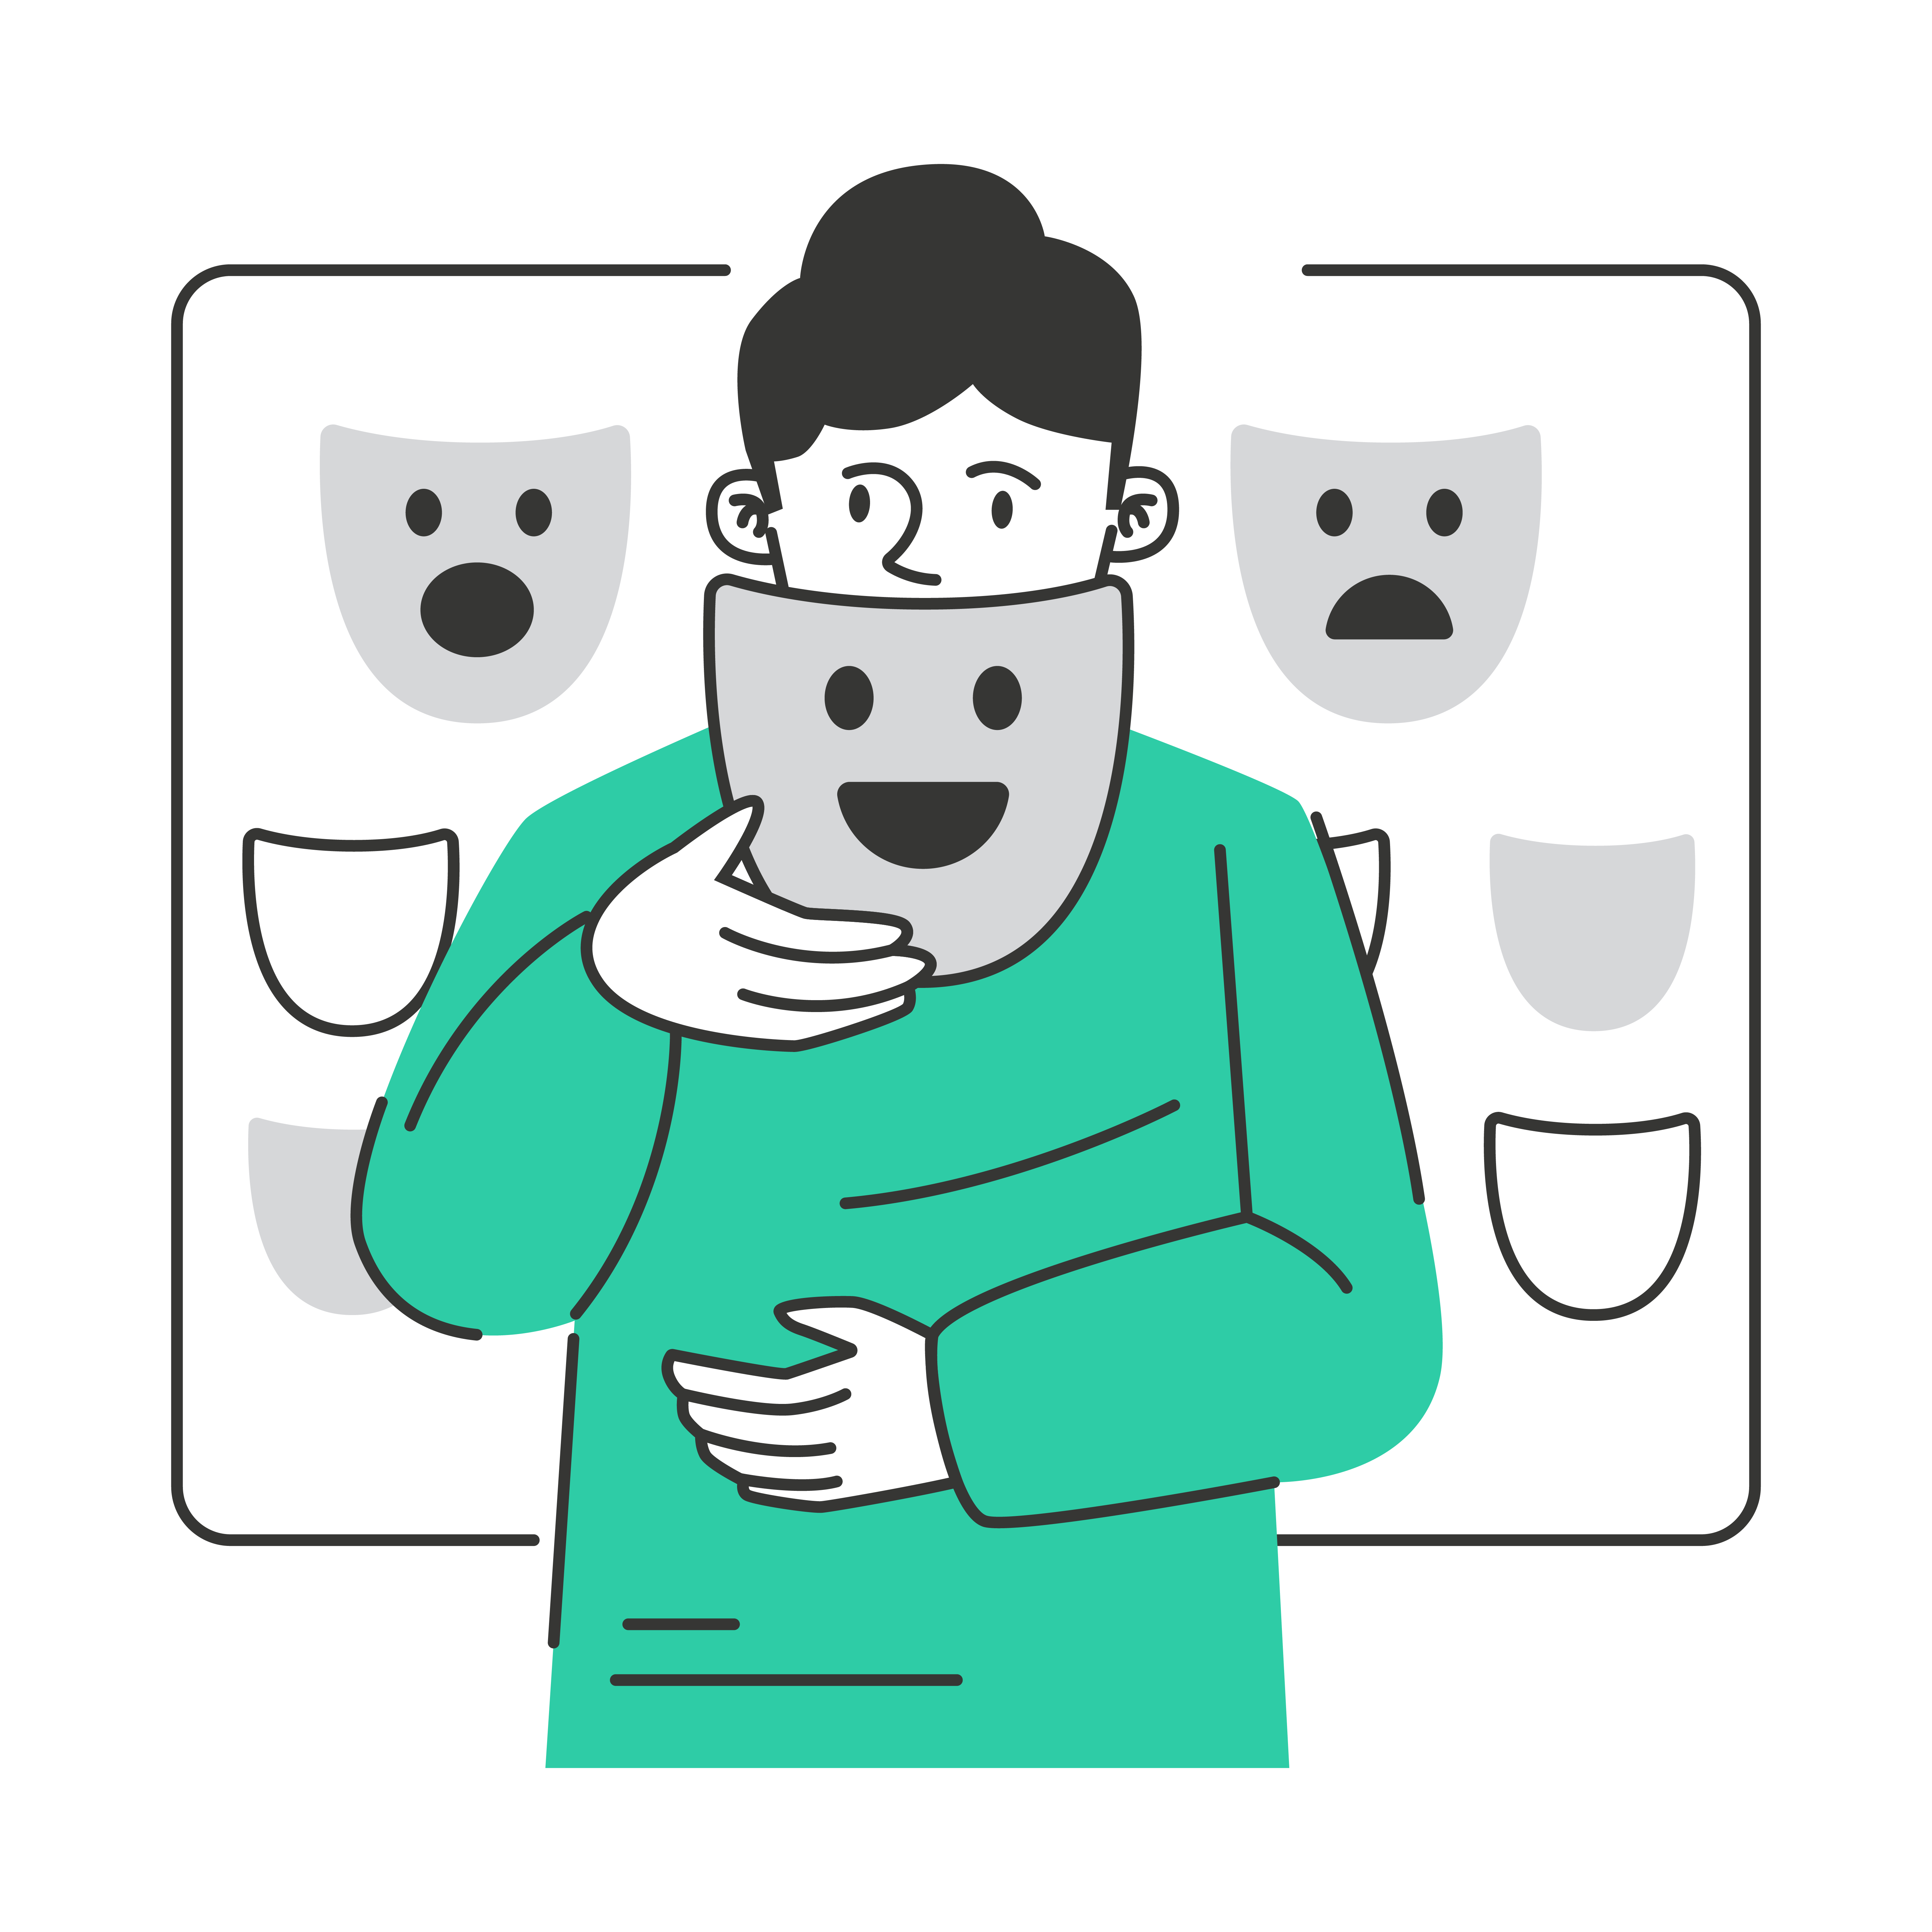
The S.E.L.F. Program
Discover your Unique Identity
Module 1
What does identity mean to you?
Activity:
A Message to you from Kid President
Write a letter to your future self.
1.
Discuss for 30 seconds with someone next to you.
2.
2-minute class mind map to create a class “word cloud”.
Make a word cloud

Slide 9
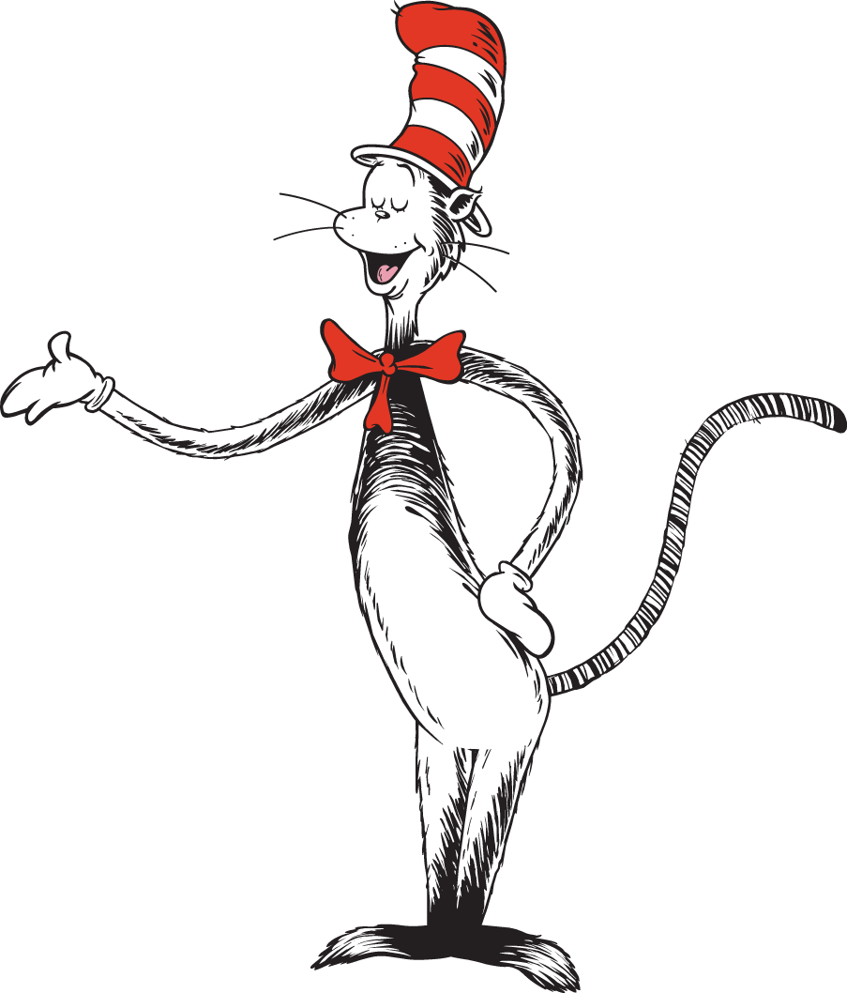
The S.E.L.F. Program
Discover your Unique Identity
Module 1
Activity:
What does identity mean to you?
A Message to you from Kid President
Write a letter to your future self.
The world needs you to be you.
Your best gift to your world is to be you.
Before you can be you, you have to know who you are.
1.
Discuss for 30 seconds with someone next to you.
“Today you are you,
That is truer than true.
There is no one alive
Who is Youer than YOU.”
2.
2-minute class mind map to create a class “word cloud”.
Make a word cloud
–Dr Seuss

Slide 10
The S.E.L.F. Program
Module 1
Discover your Unique Identity
Activity:
What does identity mean to you?
A Message to you from Kid President
Write a letter to your future self.
“Today you are you,
The world needs you to be you.
That is truer than true.
Your best gift to your world is to be you.
There is no one alive
Who is Youer than YOU.”
Before you can be you, you have to know who you are.
–Dr Seuss
1.
Discuss for 30 seconds with someone next to you.
2.
2-minute class mind map to create a class “word cloud”.
Make a word cloud

Slide 11
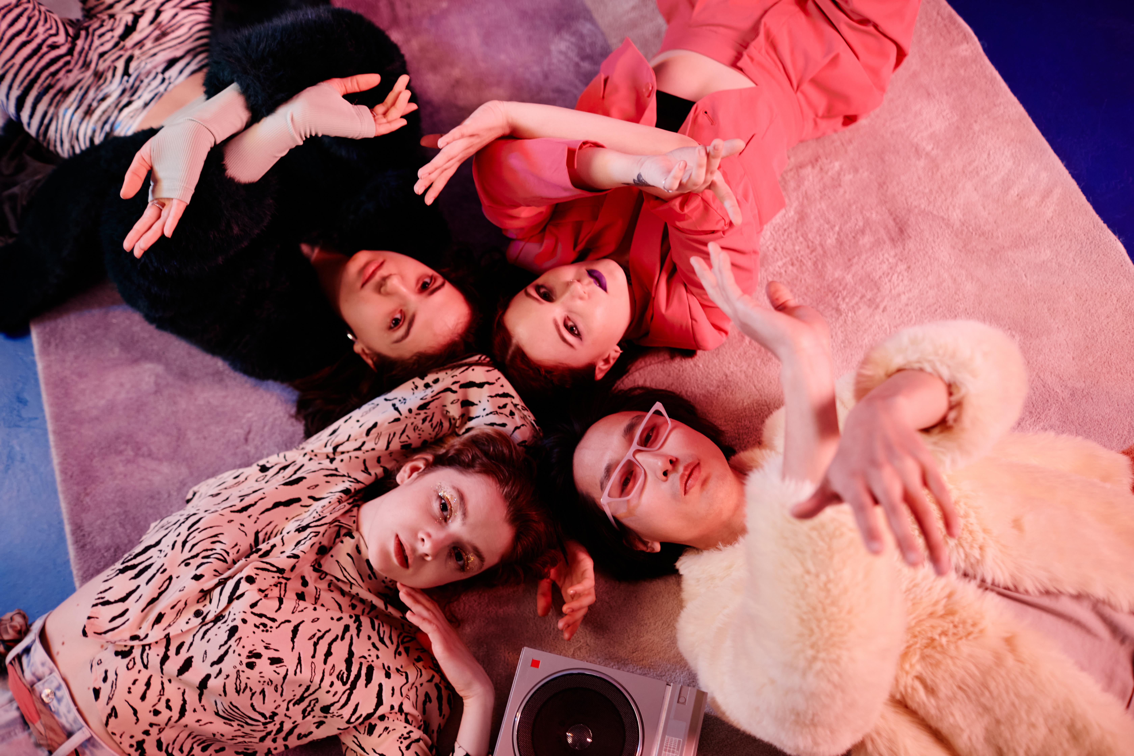
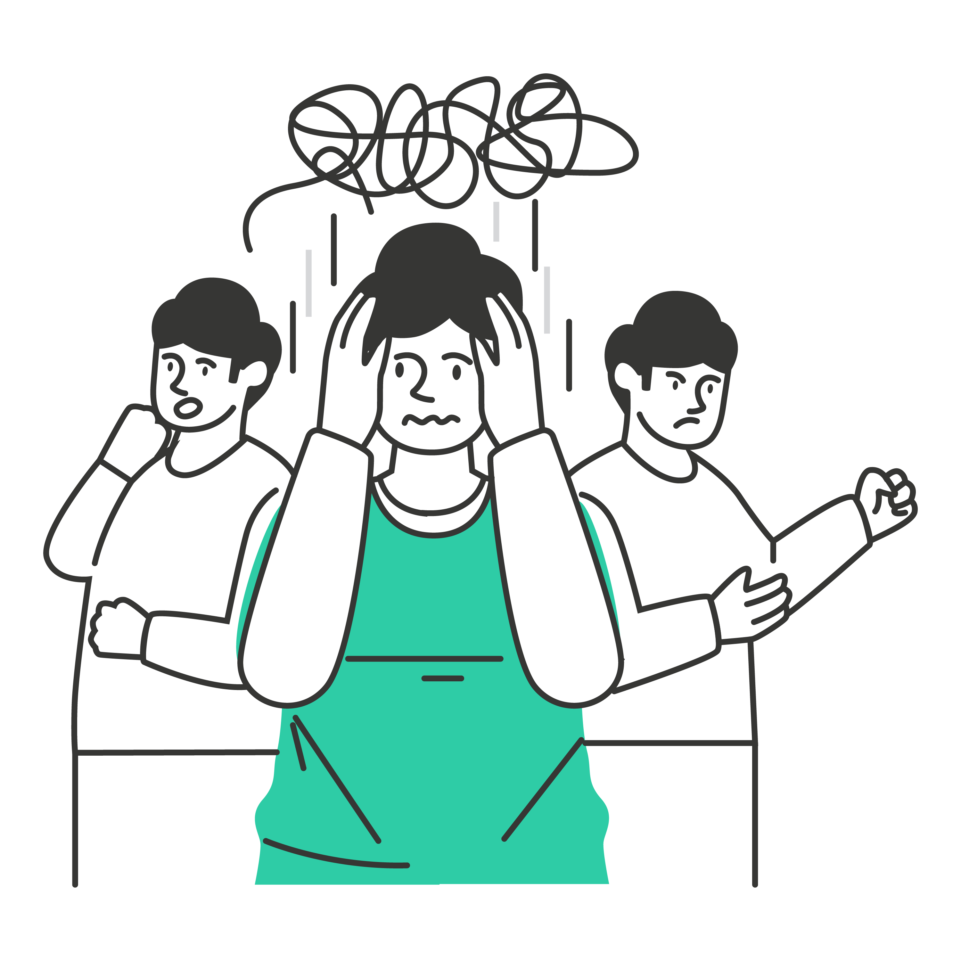
The S.E.L.F. Program
Discover your Unique Identity
Module 1
The benefits of knowing who you are
Activity:
What does identity mean to you?
A Message to you from Kid President
Write a letter to your future self.
1.
The world needs you to be you.
Take a moment to think about some of the benefits of knowing who you are.
Your best gift to your world is to be you.
Before you can be you, you have to know who you are.
2.
Feel free to discuss this with a partner, and open to the class for a discussion.
1.
Discuss for 30 seconds with someone next to you.
2.
2-minute class mind map to create a class “word cloud”.
Make a word cloud

Slide 12
Others will tell you who they think you should be.
You’ll strive to be someone you are not.
Most days you’ll feel you are not enough.
Uncertainty and anxiety.
Surely there’s more to life than this?
THE TROUBLE WHEN YOU DON’T KNOW WHO YOU ARE
The S.E.L.F. Program
Discover your Unique Identity
Module 1
The trouble when you don’t know who you are
Others will tell you who they think you should be.
You’ll strive to be someone you are not.
1.
Take a moment to think about some of the benefits of knowing who you are.
Most days you’ll feel you are not enough.
2.
Surely there’s more to life than this?
Feel free to discuss this with a partner, and open to the class for a discussion.
Uncertainty and anxiety.

Slide 13
The S.E.L.F. Program
Discover your Unique Identity
Module 1
Activity:
1. Open to page 10 of your booklet
2. Complete Exercise 1:
Write OR draw FIVE things you know about yourself

Slide 14
The S.E.L.F. Program
Discover your Unique Identity
Module 1
Your Identity is made up of…
Body
Soul
Spirit

Slide 15
The S.E.L.F. Program
Discover your Unique Identity
Module 1

Slide 16
The S.E.L.F. Program
Discover your Unique Identity
Module 1
Your Identity is your superpower!
Activity:
1. Open to page 13 of your booklet
2. Complete Exercise 2

Slide 17
The S.E.L.F. Program
Module 1
Discover your Unique Identity
Your Identity is your superpower!
“It’s humbling that I cannot be anything I want.
I don’t get to create myself.
I accept myself as God’s gift to me,
And accept becoming that person
as the task set before me.”
Activity:
1. Open to page 13 of your booklet
2. Complete Exercise 2
–John Ortberg

Slide 18
The S.E.L.F. Program
Discover your Unique Identity
Module 1
Activity: S.E.L.F Affirmations
WHY?
1. Collect your A3 envelope.
To let others know they are valued and
their ‘uniqueness’ is their greatest quality.
2. Write your name.
WHEN?
3. Decorate the front of your envelope.
Use words/images/drawings/interests that describe you. For example, music, football, dancing, reading, travelling, surfing etc.
This affirmation activity will run for the entire duration of your S.E.L.F course.
HOW?
4. Write ‘affirmations’ to others and place in their envelope.
At the end of each lesson, your teacher will give you 5-7 minutes to write an affirmation to place into your peer’s envelopes.
Once you reach the end of the S.E.L.F program, you will take your envelope home and read the messages from your peers.
Use a small piece of paper such as a post it note to write positive affirmations to your peers and place it in their envelope. This can be anonymous, or you can sign your name. E.g. “Natalie – I admire the way you always offer help to people”.

Slide 19
The S.E.L.F. Program
Discover your Unique Identity
Module 1
You did it! Module 1 is complete
Activity: S.E.L.F Affirmations
Why?
1. Collect your A3 envelope.
To let others know they are valued and
their ‘uniqueness’ is their greatest quality.
2. Write your name.
3. Decorate the front of your envelope.
When?
Use words/images/drawings/interests that describe you. For example, music, football, dancing, reading, travelling, surfing etc.
This affirmation activity will run for the entire duration of your S.E.L.F course.
How?
4. Write ‘affirmations’ to others and place in their envelope.
At the end of each lesson, your teacher will give you 5-7 minutes to write an affirmation to place into your peer’s envelopes.
Once you reach the end of the S.E.L.F program, you will take your envelope home and read the messages from your peers.
Use a small piece of paper such as a post it note to write positive affirmations to your peers and place it in their envelope. This can be anonymous, or you can sign your name. E.g. “Natalie – I admire the way you always offer help to people”.

Slide 20
The S.E.L.F. Program
Discover your Unique Identity
Module 1
Reflective Journal
Upon completion of MODULE 1 – Turn to page 68 of your workbook and answer the reflective questions.

Slide 21
Teacher class resources
Entire Lesson | - Projector & speakers Internet connection Laptop
Letter writing | Enough blank sheets of A4 paper for class Envelopes Spare pens/pencils
Student work booklets | 1 copy of of the S.E.L.F program student work booklet for each student
Affirmations | 1 A3 envelope/student Coloured pens/pencils/paints Small coloured ‘post it’ note sized pieces of paper. Hint: Create around 200 of these small pieces of paper and keep in a box or drawer in the classroom.

