Slide 1
The S.E.L.F. Program
Students Exploring Life’s Foundations

Slide 2
The S.E.L.F. Program
Module 4
Your Purpose and Passion

Slide 3
Discovering your Unique Life Purpose...

Slide 4
The S.E.L.F. Program
Your Purpose and Passion
Module 4
Exploring my Life Purpose.
Class Activity:
In your notebook, consider the following question:
What does purpose in life mean?

Slide 5
The S.E.L.F. Program
Your Purpose and Passion
Module 4
Video: What is your Purpose?

Slide 6
The S.E.L.F. Program
Your Purpose and Passion
Module 4
Exploring my Life Purpose.
Activity:
In your notebook, answer the following questions:
1. What are your favourite hobbies, and why?
2. Close your eye and think about you're grateful for. What comes up, what do you think that means for you?
3. What does your ideal day look like?
4. When you lose track of time, what are you typically doing?
5. When you were a kid, what did you want to be when you grew up? Is that what you're doing now?
6. What's the most important relationship in your life, and why?
7. When was the last time you felt really engrossed in a task, and what were you doing?
8. When do you feel the most loved?
9. Take a moment to write about all the things you worry about. Of those things, which ones are truly important?
10. Taking money out of the equation, what's your dream career?

Slide 7
What do you want for your life?
Why do you want this?

Slide 8
The S.E.L.F. Program
Your Purpose and Passion
Module 4
Discovering Me
Class Activity:
Around the classroom there will be various sheets of butcher's paper. These will be titled:
'Likes'
'Dislikes'
'Careers'
'My activities'
'Personality Traits'
'Travel'
The teach will allow 7-10 minutes for you to circulate the classroom and write your thoughts onto the paper. These will be collected and discussed as a class.

Slide 9
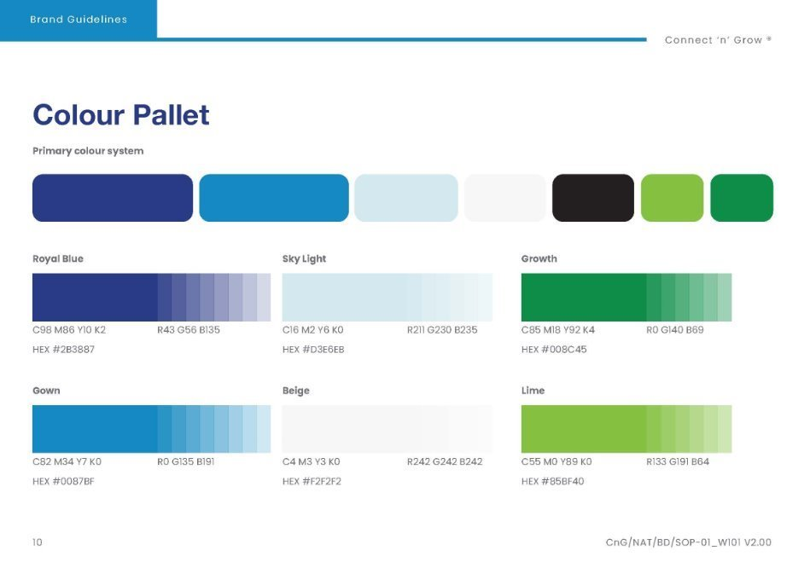
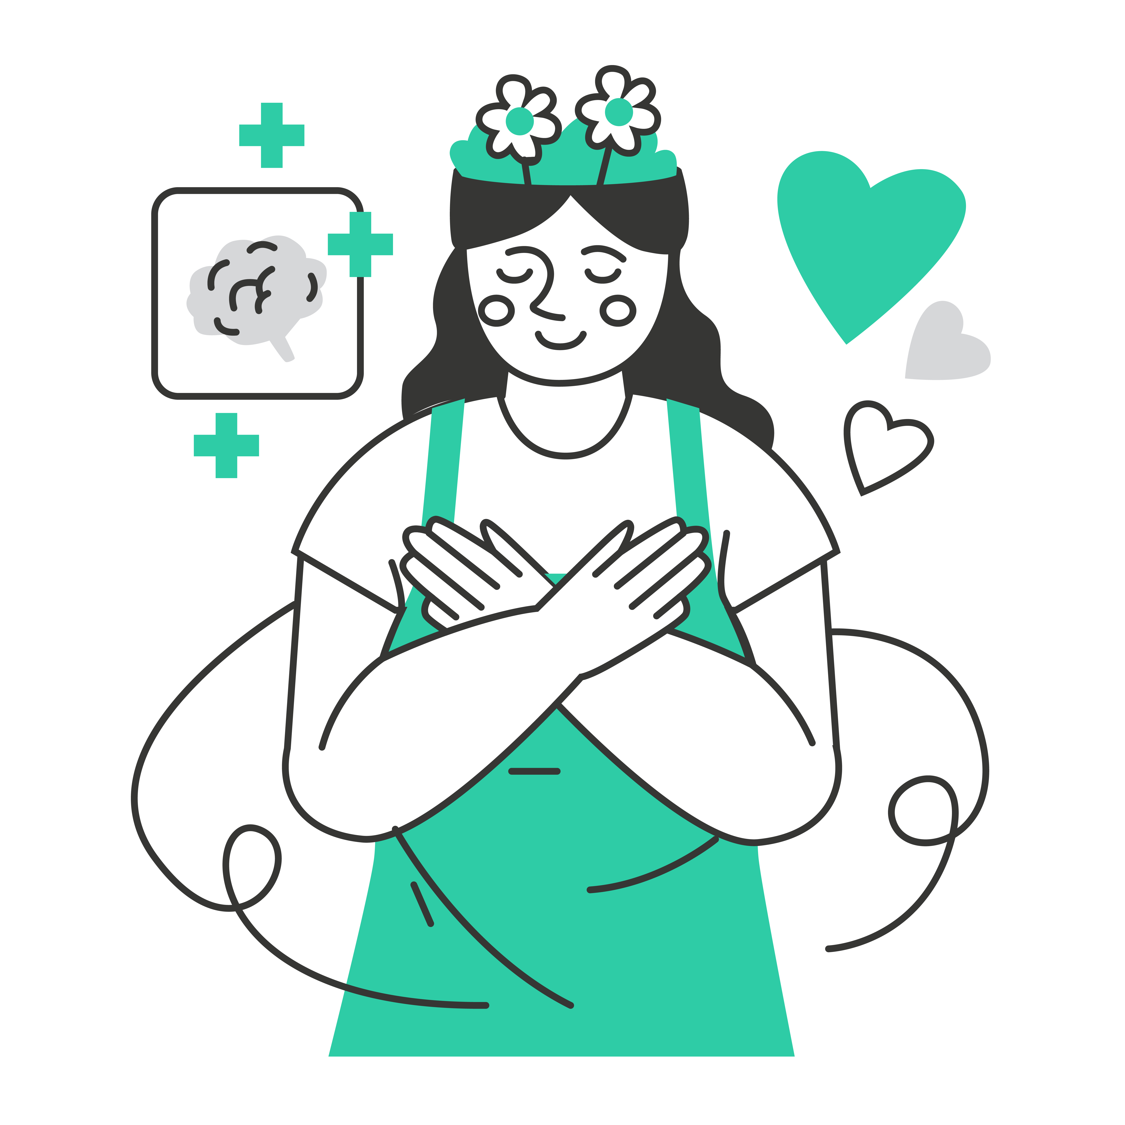
The S.E.L.F. Program
Module 4
Your Purpose and Passion
There's a 'ME' you think you should be.
There's always a 'ME' others want you to be and say you should be...
There's a 'ME' you don't want to be.
There's a 'ME' you're afraid to be.
AND THEN...
There's a 'ME' you were created to be.

Slide 10
The S.E.L.F. Program
Your Purpose and Passion
Module 4
There's a 'ME' in every one of you.
Activity:
Complete exercise 6 on page 35 of your S.E.L.F workbook.

Slide 11
The S.E.L.F. Program
Your Purpose and Passion
Module 4
The benefits of knowing your purpose:
If you don’t know your purpose, you
can’t make choices to move towards it.
If Knowing your purpose helps
you live a more clearly focused life.
Knowing your purpose will help you make wise investments.
You’ll set goals for activities that empower and fulfil you.
How you invest your time, money, relationships, and activities.
Knowing your purpose naturally
fills you with motivation and energy.
You will achieve success.

Slide 12
The S.E.L.F. Program
Your Purpose and Passion
Module 4
Design your own Tattoo.
Activity:
Think about the following questions:
"What do I want my life to be about?"
"What is most important to me?"
"What kind of person do I want to be?"
Next, design a tattoo that symbolises who you are and what you want for your life. You can look online for ideas or design something completely your own! After you are finished, reflect on why this image embodies who you are, what you value, and write down the things that you think about.

Slide 13
The S.E.L.F. Program
Your Purpose and Passion
Module 4
Video: The Red Car Theory:
Red Car Theory
VIDEO
Exercise: Selective Attention Test

Slide 14
The S.E.L.F. Program
Your Purpose and Passion
Module 4
Activity:
1. Take the Selective Attention Test:
2. Complete exercise 7 & 8 from pages 37 – 42 in your S.E.L.F workbook.
Take the Test

Slide 15
THE TROUBLE WHEN YOU DON’T KNOW WHO YOU ARE
The S.E.L.F. Program
Your Purpose and Passion
Module 4
Daily Positive Affirmations.
Use the final 5-7 minutes of the
lesson to write down some affirmations for your classmate(s).
Also write an affirmation for yourself.

Slide 16
Reflective Journal
The S.E.L.F. Program
Your Purpose and Passion
Module 4
Reflective Journal
Please complete the questions on page 69 of your SELF work book for
Topic 2: Emotional Intelligence
Please turn to page 71 of your S.E.L.F workbook and complete the reflective journal questions for Topic 4: Your Purpose and Passion.

Slide 17
TEACHER RESOURCES
Entire Lesson | Laptop Projector & speakers Student notebooks Student SELF work books
Journalling activity | Student notebooks
Discovering me | Six large pieces of butchers paper. Each one with a title: ‘Likes’ ‘Dislikes’ ‘Careers’ ‘My activities’ ‘Personality traits’ ‘Travel’
Design your own tattoo | Student notebooks Pencils &/or pens Laptop/device Paint
Affirmations | Post it size pieces of paper

