Slide 1
The S.E.L.F. Program
The S.E.L.F. Program
Students Exploring Life’s Foundations
Students Exploring Life’s Foundations

Slide 2
The S.E.L.F. Program
Module 5
Using Choice
And Responsibility

Slide 3
The S.E.L.F. Program
Module 5
Using Choice And Responsibility
In this module we will be analysing our life and exploring our mindset around this. This could be confronting for some students – Teachers please use your professional judgement to alter activities or discussions based on the background of students in your class.

Slide 4
The S.E.L.F. Program
Module 5
Using Choice And Responsibility
Video: How to Change the World:

Slide 5
Discovering the power in your...

Slide 6
The S.E.L.F. Program
Module 5
Using Choice and Responsibility
Video: The Waiting Room Test:

Slide 7
The S.E.L.F. Program
Module 5
Using Choice and Responsibility
Activity:
As a class discuss what was going on in this video. Would you act the same way? Why/why not?

Slide 8
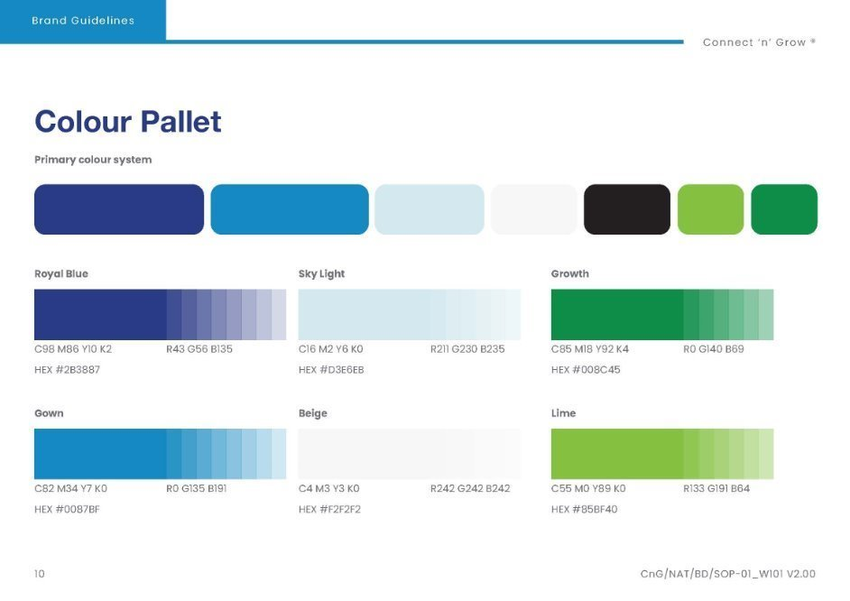
The S.E.L.F. Program
Module 5
Using Choice and Responsibility
Let's Recap:
There is no one quite like you! The world needs you to be YOU!
Your thoughts can be for you or against you. Choose your thoughts wisely.
Happy people know what’s important to them and make choices to align with their values.
You have been created on purpose, for a purpose. Knowing your purpose gives you clarity to make wise choices.

Slide 9
Sometimes life can feel like it’s ‘happening’ to us, and we are ‘stuck’ in our situation with no choice.

Slide 10
The S.E.L.F. Program
Module 5
Using Choice and Responsibility
Activity:
Complete exercise 9A, B, C, D & E on page 45 in your workbook.

Slide 11
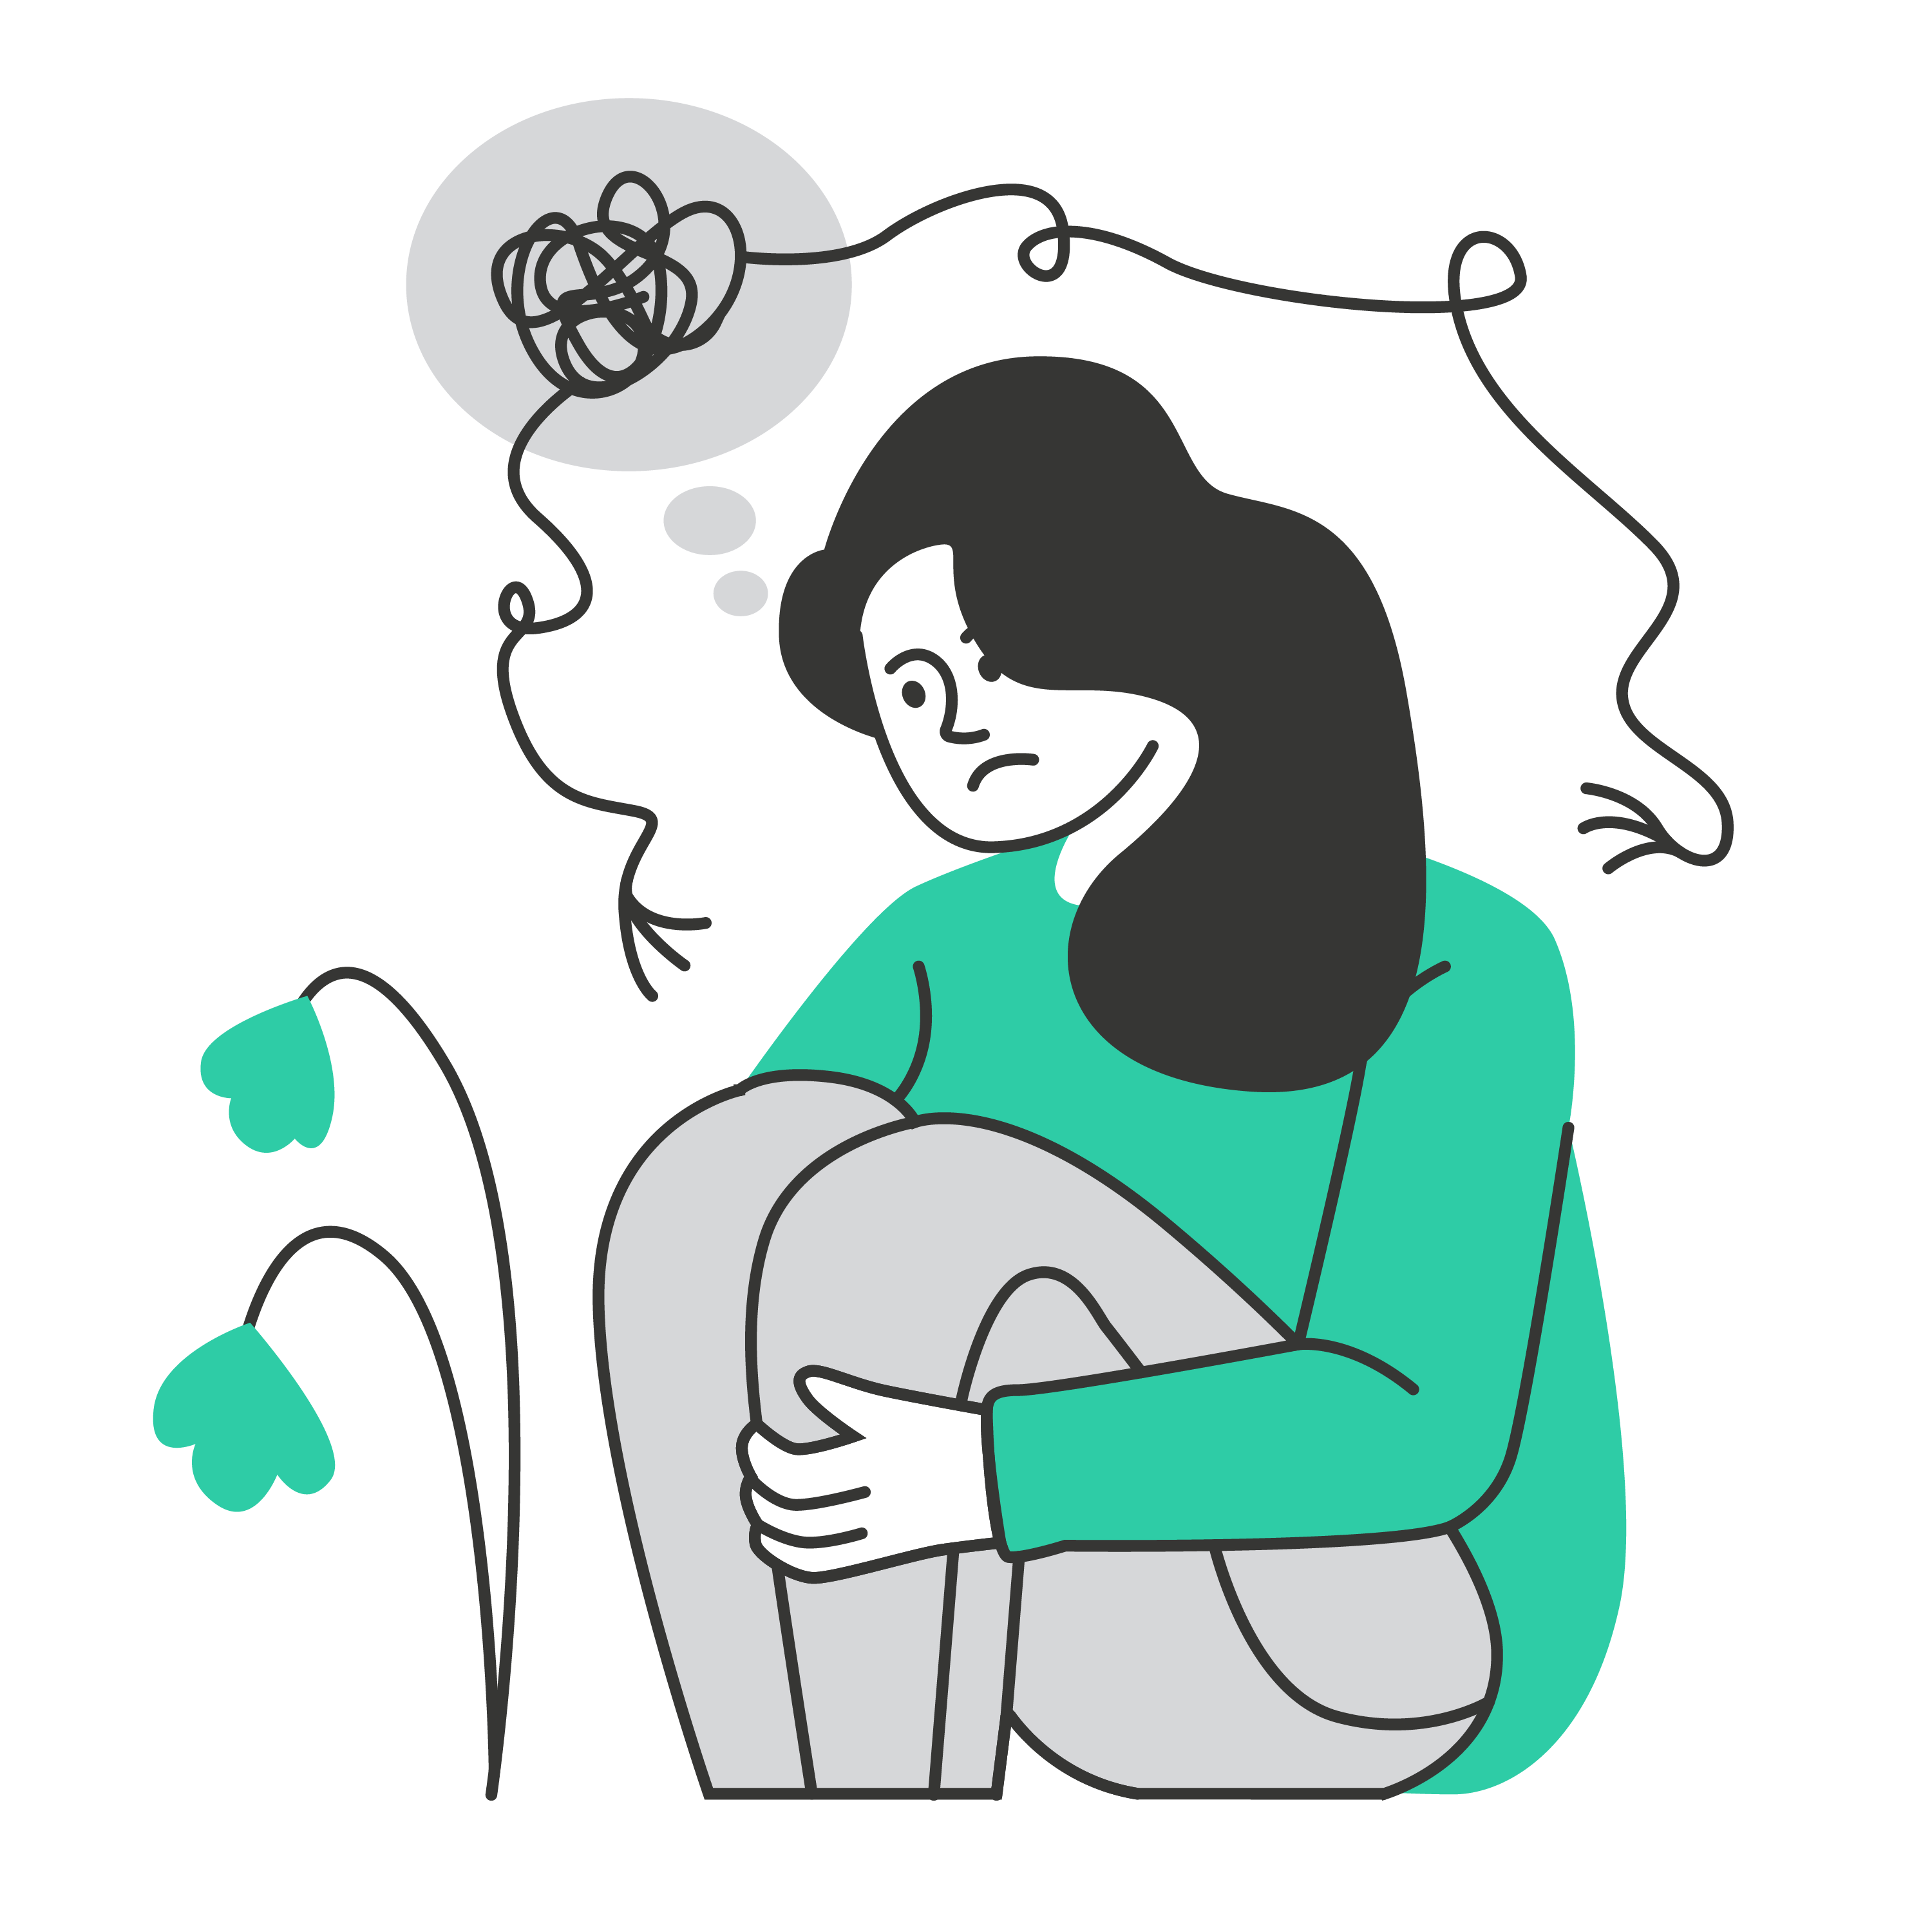
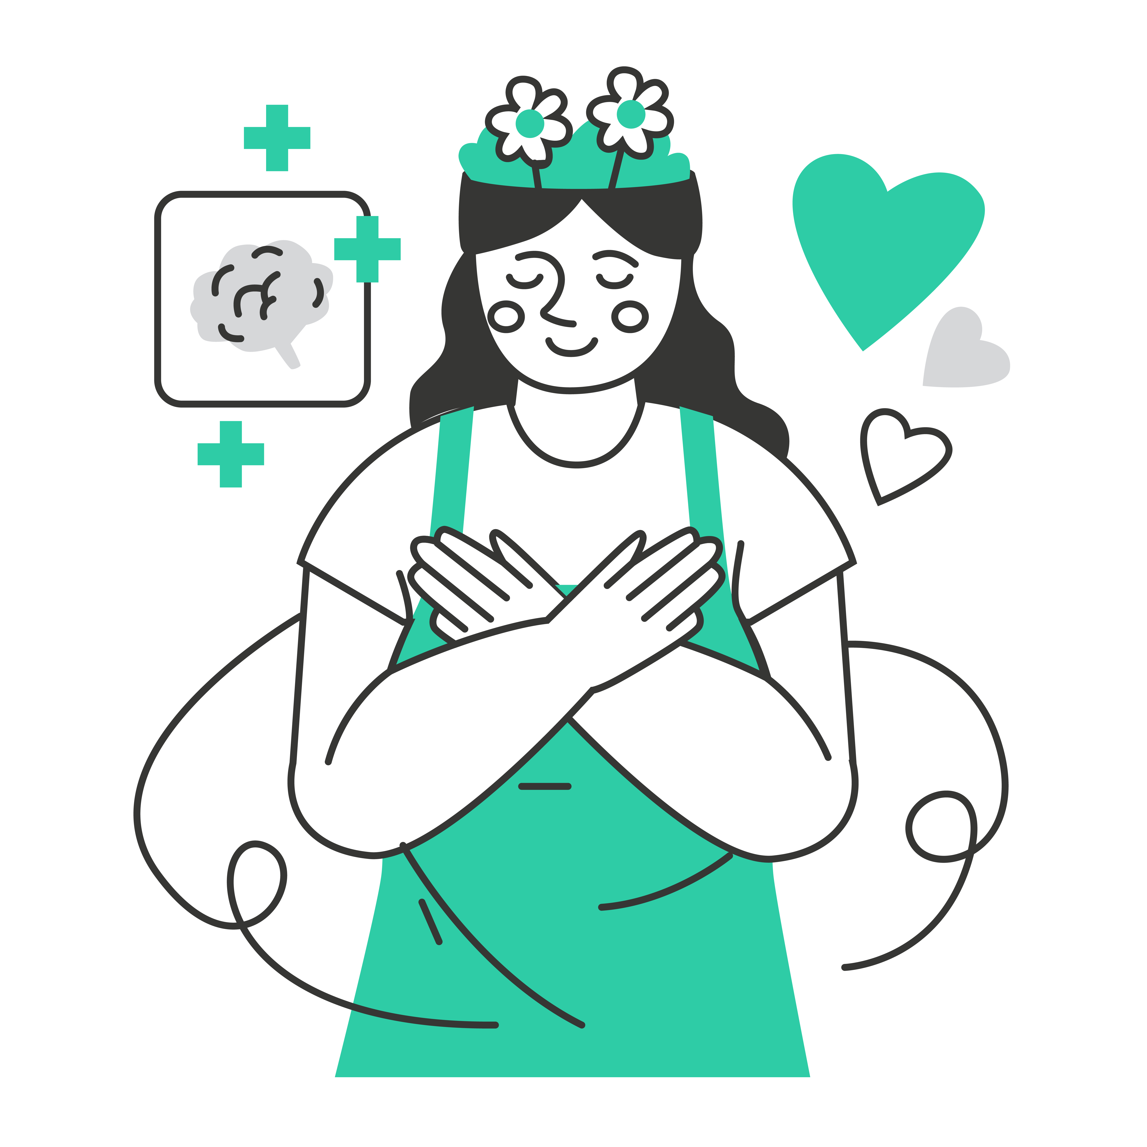
The S.E.L.F. Program
Module 5
Using Choice and Responsibility
We ALL have negative self-talk at times.
The trick is to catch it and try to reframe that negative talk into something more positive.

Slide 12
The S.E.L.F. Program
Module 5
Using Choice and Responsibility
Growth vs Fixed Mindset
Class Activity:
Have you ever heard of the 'Growth vs Fixed Mindset' concept?
As a class, discuss what you think a ‘fixed mindset’ is.
As a class, discuss what you think a ‘growth mindset’ is.

Slide 13
The S.E.L.F. Program
Module 5
Using Choice and Responsibility
Video: Growth vs. Fixed Mindsets:

Slide 14
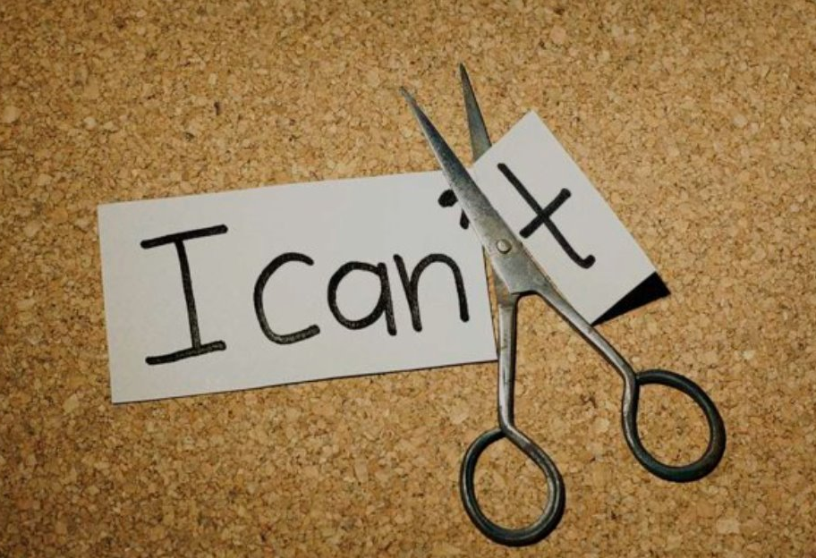
The S.E.L.F. Program
Module 5
Using Choice and Responsibility
When we shift our “I can’t” language to “I can’t.. yet”, this changes the way you approach difficult situations in your life. You are actively making the choice try, even if failing is highly likely.

Slide 15
The S.E.L.F. Program
Module 5
Using Choice and Responsibility
Activity:
Spend 10 minutes to research 4 people who have failed and have bounced back to achieve great things.
E.g. Walt Disney—Disney’s former newspaper editor informed him that he had no imagination and lacked any good ideas. Later, thanks to his accomplishments, his name would become synonymous with the word "imagination.”
Discuss as a class some of the celebrities you have found.

Slide 16
Watch the Video

Slide 17
The S.E.L.F. Program
Module 5
Using Choice and Responsibility
The Self-Aware Checklist
The growth mindset means having a strong sense of ourselves.
It means knowing our strengths and weaknesses, how we can improve, and what energises us as well as what causes us stress.
Activity:
Open your notebooks.
Your teacher is going to present questions on the board, and you need to honestly finish the sentence.

Slide 18
The S.E.L.F. Program
Module 5
Using Choice and Responsibility
I feel I am strong in the areas of _______

Slide 19
The S.E.L.F. Program
Module 5
Using Choice and Responsibility
I feel I am weak in the areas of _______

Slide 20
The S.E.L.F. Program
Module 5
Using Choice and Responsibility
I learn best when I _________

Slide 21
The S.E.L.F. Program
Module 5
Using Choice and Responsibility
I feel most stressed when I _________

Slide 22
The S.E.L.F. Program
Module 5
Using Choice and Responsibility
I find myself most comfortable when _________

Slide 23
The S.E.L.F. Program
Module 5
Using Choice and Responsibility
The thing I need the most help with is _________

Slide 24
The S.E.L.F. Program
Module 5
Using Choice and Responsibility
I'm most comfortable asking for help by _________

Slide 25
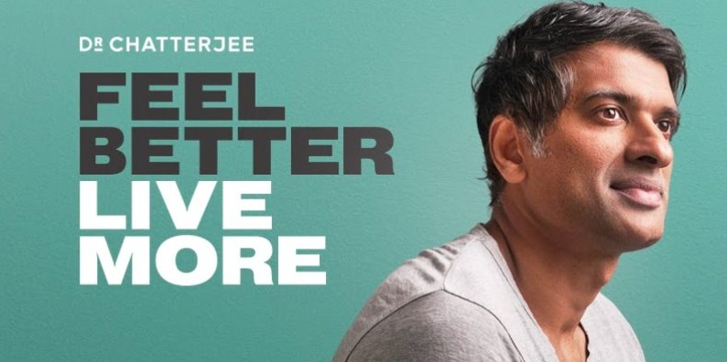
The S.E.L.F. Program
Module 5
Using Choice and Responsibility
Adding to your Toolbelt.
A part of this SELF program is about providing you with tools to add to your ‘life toolbelt’.
Below is a link to a video/podcast about 'How to Reprogram your Mind'. This is an optional video that you can choose to watch in your own time if you wish.
Podcast Suggestion:
Feel Better Live More.
Dr. Chatterjee
Watch the Video

Slide 26
The S.E.L.F. Program
Module 5
Using Choice and Responsibility
There will always be
many options to choose from!
How do I know I’ve made the right choice?
What if I make a mistake?

Slide 27
The Great News about Choices...
"We can't always think positive thoughts, but we have the power to choose again in any moment."
–Gabby Bernstein.

Slide 28
The S.E.L.F. Program
Module 5
Using Choice and Responsibility
Activity:
Complete exercise 10 on page 48 in your workbook.

Slide 29
The S.E.L.F. Program
Module 5
Using Choice and Responsibility
Video: It's You vs You:

Slide 30
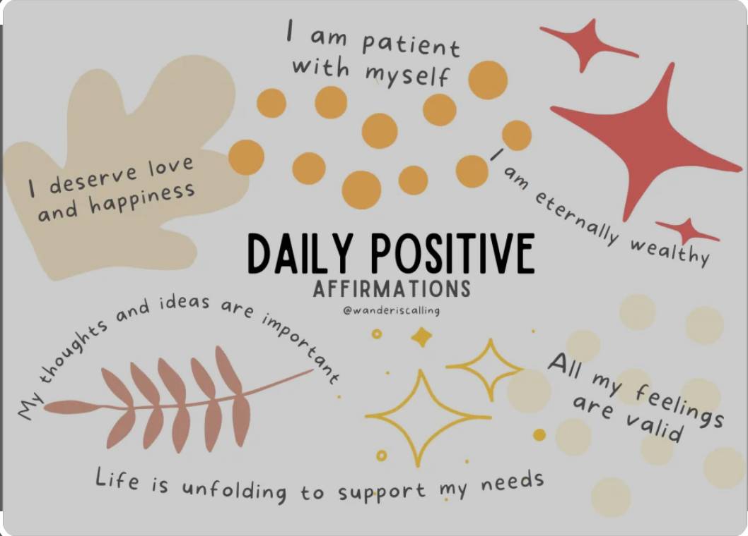
THE TROUBLE WHEN YOU DON’T KNOW WHO YOU ARE
The S.E.L.F. Program
Module 5
Using Choice and Responsibility
AFFIRMATIONS
Daily Positive Affirmations.
Use the final 5-7 minutes of the lesson to write down positive affirmations for others.
Use the final 5-7 minutes of the lesson to complete affirmations.

Slide 31
The S.E.L.F. Program
Module 5
Using Choice and Responsibility
Reflective Journal
Please complete the questions on page 69 of your SELF work book for
Topic 2: Emotional Intelligence
Please turn to page 72 of your S.E.L.F workbook to complete the reflective journal.

Slide 32
Teacher Resources
Entire Lesson | Laptop Projector & speakers SELF work book Student note books
Affirmations | Post it note sized pieces of paper Spare pens/pencils

