Slide 1


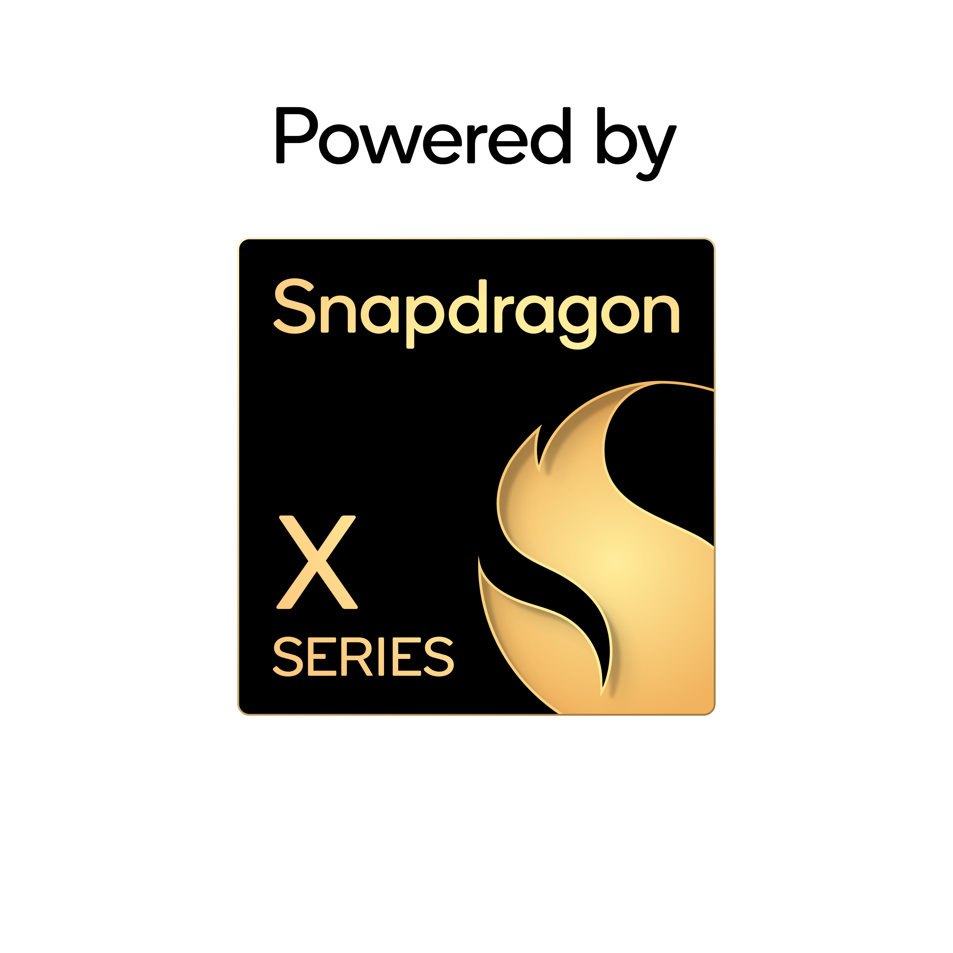










What could
built-in AI
unlock for
your team?
Explore the productivity-boosting, data-protecting possibilities of on-device AI.
Growing teams don't win by outspending bigger competitors. They win by
outmaneuvering them. The right tech and AI approach make that possible. The
mightier your hardware and software, the more efficient, secure, and competitive your
business becomes.
Lay the groundwork for better, faster workflows
If your team's PC processors aren't purpose-built to run AI, your business is missing out on a new generation of capabilities that accelerate everyday work.
To harness these capabilities, you need AI-ready PCs—devices with a dedicated neural processing unit (NPU). This “AI engine” unlocks more and more AI possibilities, all while keeping your laptop fast and limiting battery drain. Here's what to look for:
Minimum 40
TOPS NPU
Max unplugged performance
Multi-day battery life
Microsoft requires at least 40 NPU TOPS to qualify as a Copilot+ PC and run AI features on-device. Advanced apps benefit from even higher TOPS.
Some processors cut performance the second you unplug. The best platforms deliver max performance even on battery.
To work anywhere without scrambling for an outlet, look for battery life that lasts for days off a single charge.
Not all TOPS
are equal
Build a small but
mighty tech stack
Some PC chips cite GPU TOPS to boost perceived AI performance. But GPU TOPS aren't the same as NPU TOPS. When AI workloads run on the GPU instead of a dedicated NPU, PCs can draw more power, drain battery faster, and overheat more easily.
When you build your tech stack—from software to cloud services—on the right AI-ready PCs, you unlock tools and features that give your business a real competitive edge.
How do you...
Command every call?
What you need:
Calls that make you look polished and keep
you sounding crisp, plus tools that generate notes and next steps in real time
What to get:
Windows Studio Effects, Zoom and Teams, Microsoft Copilot
Do more, faster?
What you need:
Quick summaries of long documents and to turn everyday content into polished assets
What to get:
AnythingLLM, Affinity from Canva
Lock down data?
What you need:
Security that keeps sensitive data local, blocks threats without slowing performance, and replaces passwords with phishing-resistant logins
What to get:
LM Studio, Windows Hello Biometrics
One platform. Everything you need.
Battery life for days¹
The right Al-optimized tech helps your team move faster, show up better, and stay better protected. PCs powered by Snapdragon® X Series processors are the foundation that makes that all possible
by delivering:
Up to 80 NPU TOPS
Max performance even
on battery
Enterprise-grade security
How do you make Al work harder for your business?
Snapdragon. That’s how.
Learn More
Snapdragon and Qualcomm branded products are products of Qualcomm Technologies, Inc. and/or its subsidiaries.
1 Battery life varies significantly with device, settings, Usage, and other factors.

