Slide 1

Safety First
Thursday the 25th of June 2020
Safety Kick-off Meeting
https://www.dfds-news.com/safety/
Safety@dfds.com

Slide 2
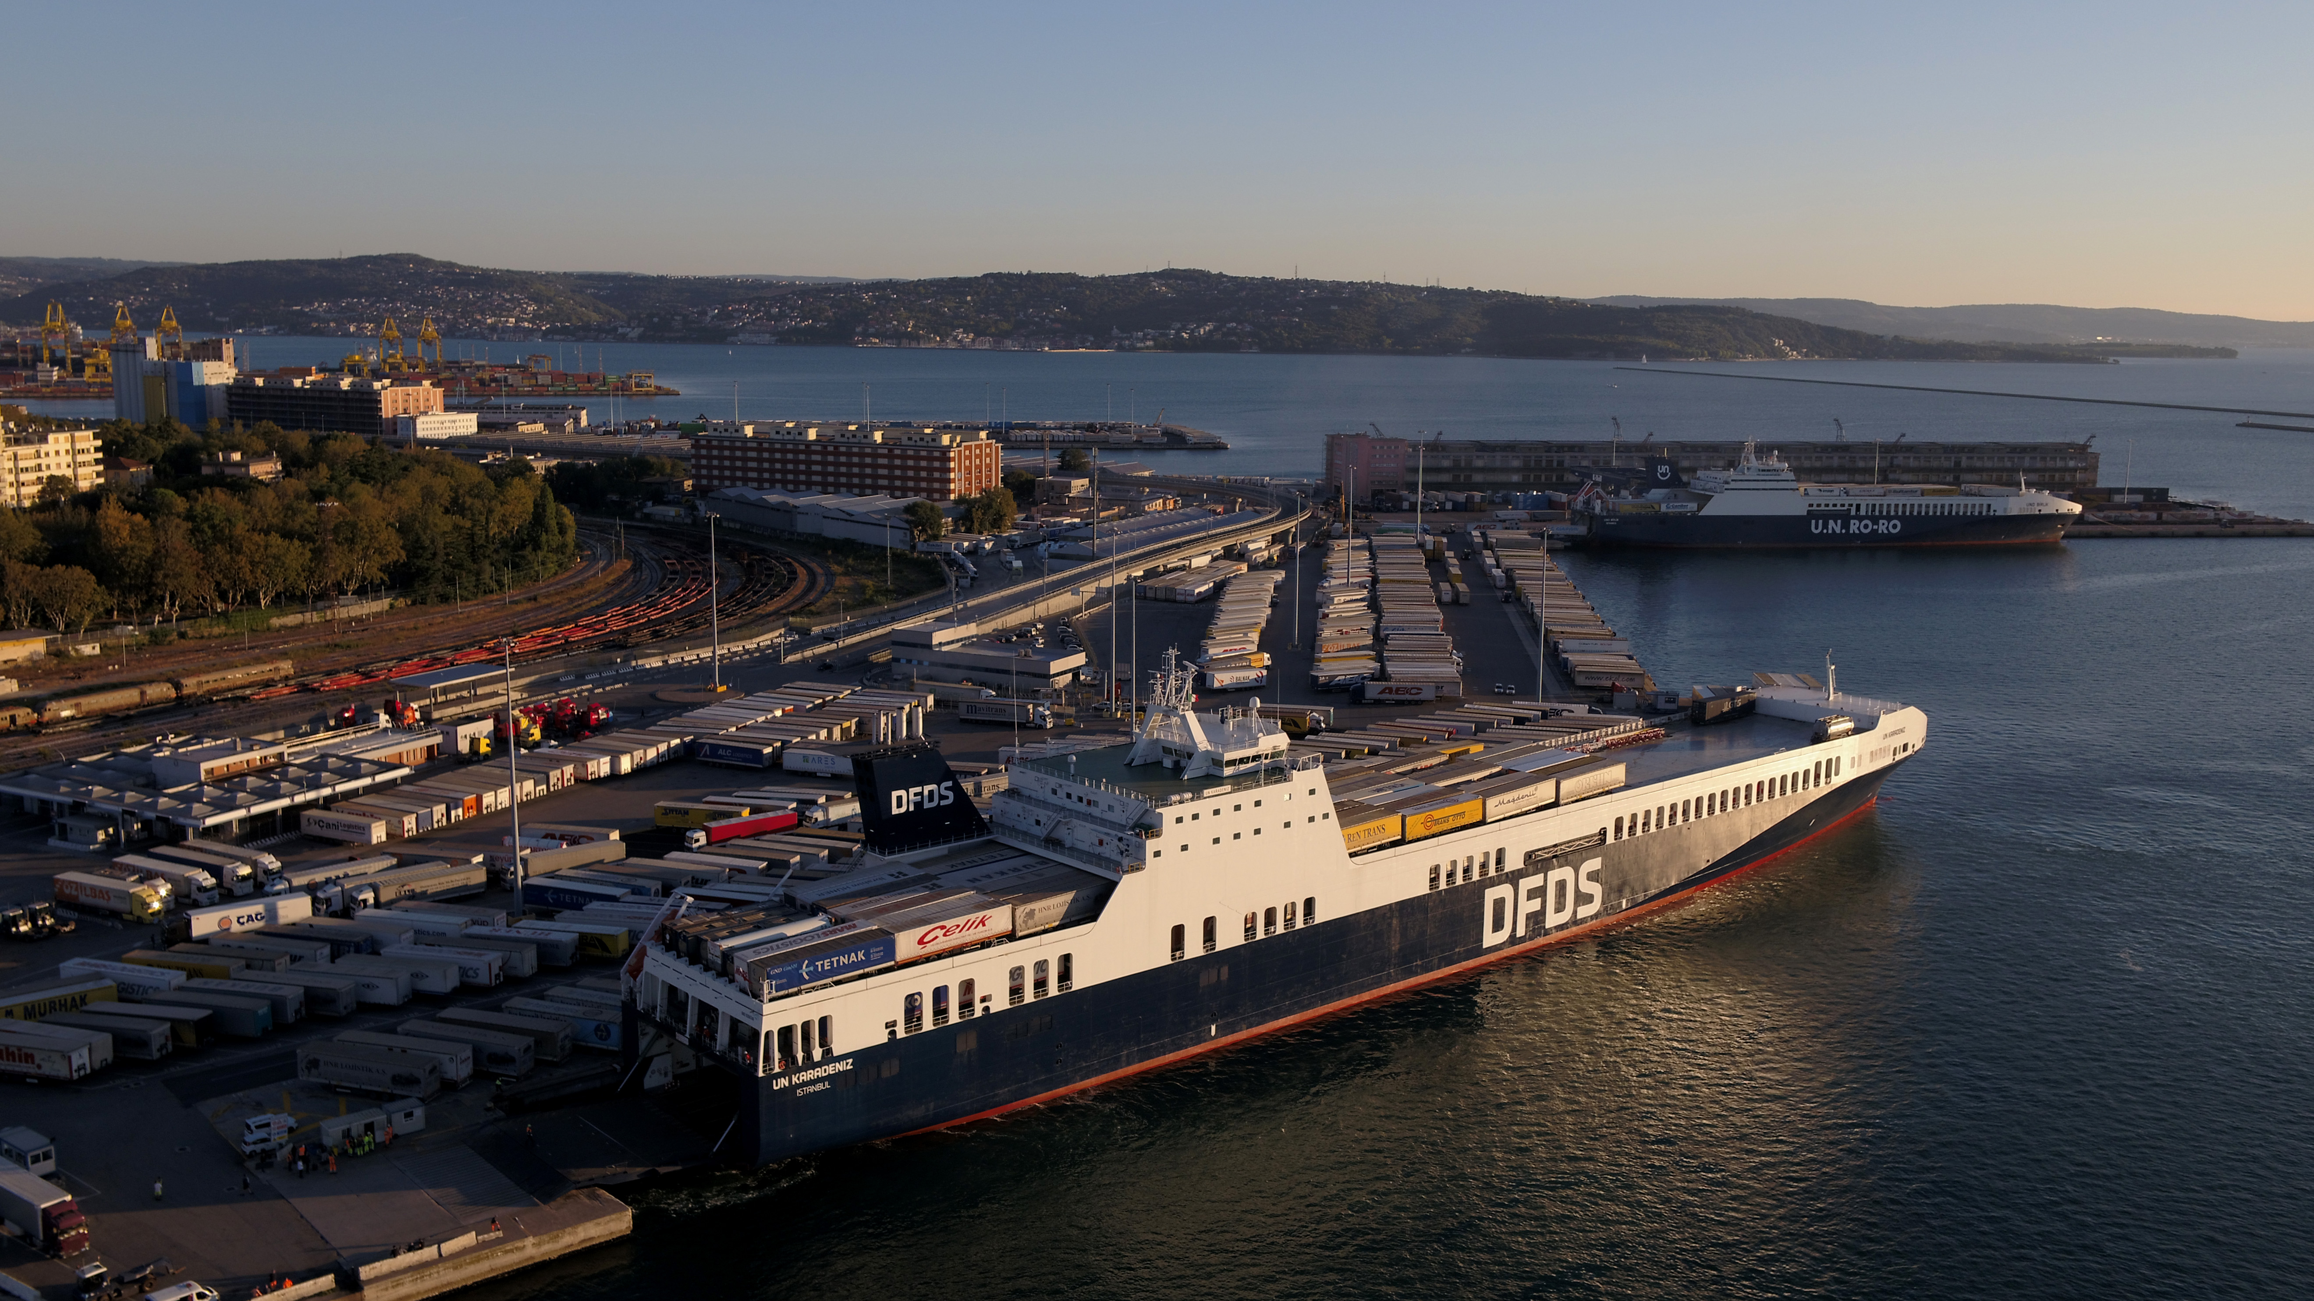
Agenda
Safety is priority in DFDS
Tragic accidents call for action
New Safety Programme to increase safety awareness
Safety survey to kick-off Programme
Initiatives to drive the Safety Programme
Information and prevention of accidents
Safety campaign
Upcoming events in the weeks to come
Case study from Seatruck Ferries Ltd

Slide 3

Safety is priority in DFDS
We have a strong safety culture. We strive to continuously improve our overall health and safety performance.
DFDS Corporate Social Responsibility and CSR Report

Slide 4
Recent tragic accidents call for action
Crewmember squeezed between 2 containers lifted by crane on board vessel
November 2017
September 2018
Accident involving an external driver in our terminal
External fire watchman hit by a trailer on board vessel
September 2019
Accident involving an external driver in our terminal
March 2020
March 2020
Accident involving a supplier on board vessel

Slide 5
New Safety Programme to prevent accidents and increase safety awareness. The Programme is coordinated centrally but managed locally
Programme Sponsors Executive Management | Programme Leads Jesper Nielsen (Fleet) and Michael Stig (Marine Standard) | Local Ambassadors Local Management and HSEQ | Target Audience Phase 1: vessels, terminal and warehouses Phase 2: Other DFDS entities

Slide 6

Survey to kick-off safety programme: Local feedback to identify areas for improvements
>600 answers received
Feedback will be used to
Identify areas for improvement
Guide and prioritize initiatives

Slide 7
Initiatives to drive the programme and support a high safety culture
Knowledge sharing across network to create best practice
Systems and procedures to voice and report concerns
Local ambassadors to drive safety awareness
Continuous improvement on safety

Slide 8





Information to drive safety awareness and increase knowledge-sharing. Prevention enabled by a focus on reporting of incidents and accidents.
2
Information
Prevention

Slide 9
Local ambassadors to drive safety awareness
Insert video

Slide 10

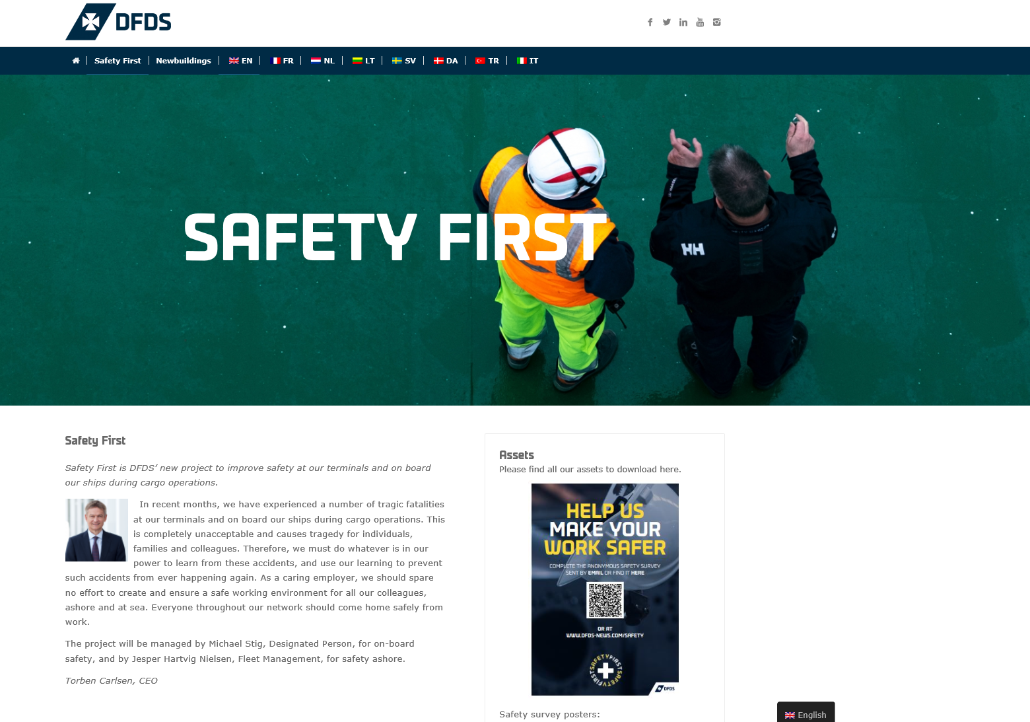
Safety campaign to drive increased focus on safety awareness
Safety material to ensure contiuous focus
Articles and competitions in internal media
Stories from local ambassadors
Safety guide
Videos
E-learning
With more to come..

Slide 11
Upcoming events in the weeks to come
Local kick-off of Safety Programme
Deadline for Safety Survey
Findings from Safety Survey presented
Monthly follow up meeting with local management
Story from local ambassador
Safety Guide published

Slide 12
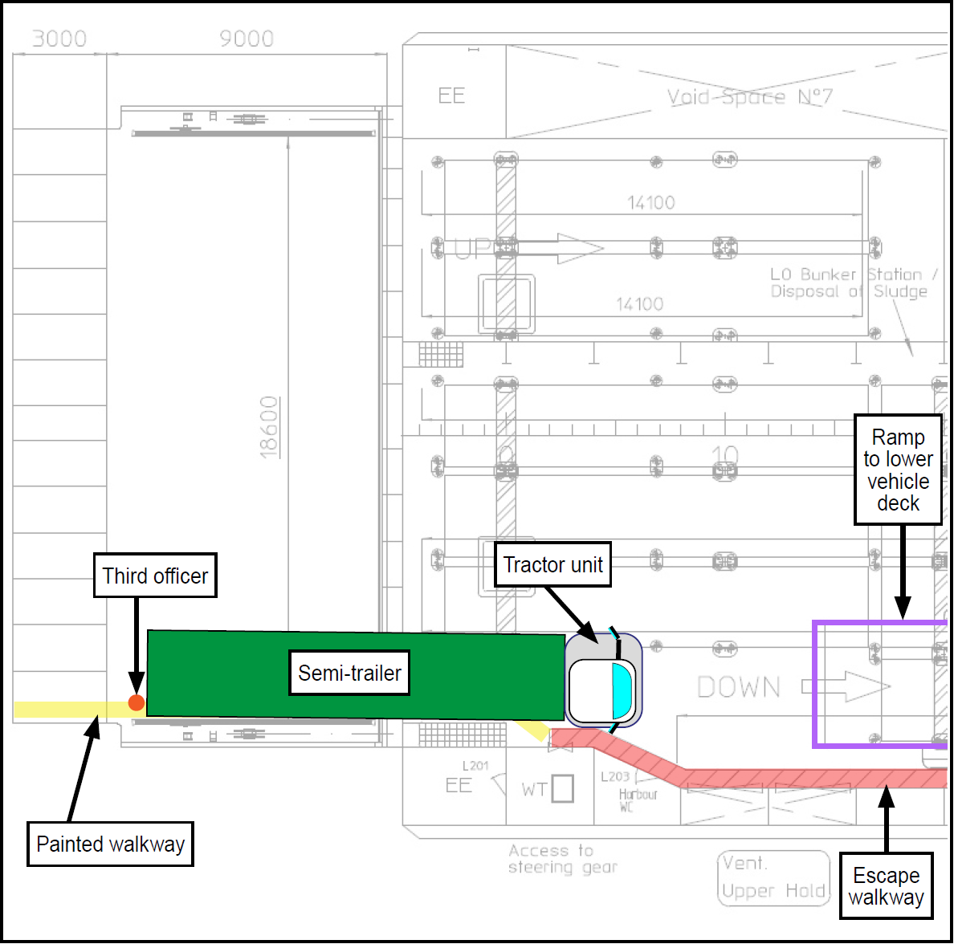
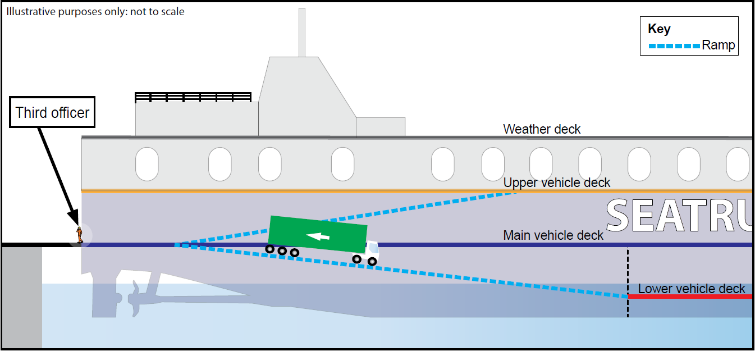
Safety needs to be a main priority in DFDS
Case from Seatruck Ferries May 2019: Fatal accident during cargo operation
Illustrations from Marine Accident Investigation Branch (MAIB) Investigation Report 10/2020: Seatruck Progress

