Slide 1
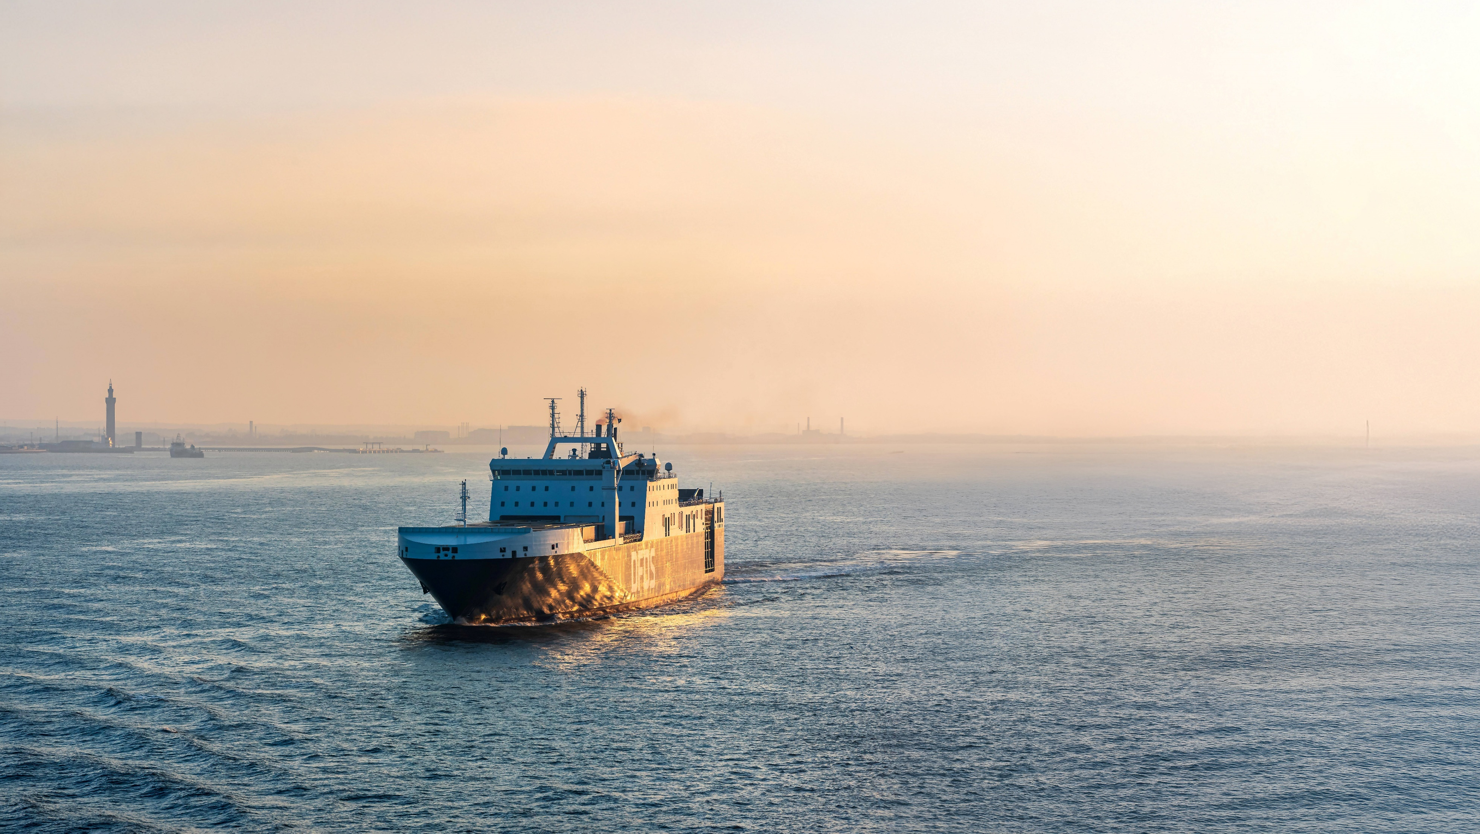
Unlocking value & earnings recovery
Q4 & FY 2024 investor call, 21 February 2025

Slide 2
Q4 & FY 2024 investor call agenda
Introduction
Q4 & FY overview
Moving to Green
2025 focus areas
Outlook & priorities
2

Slide 3
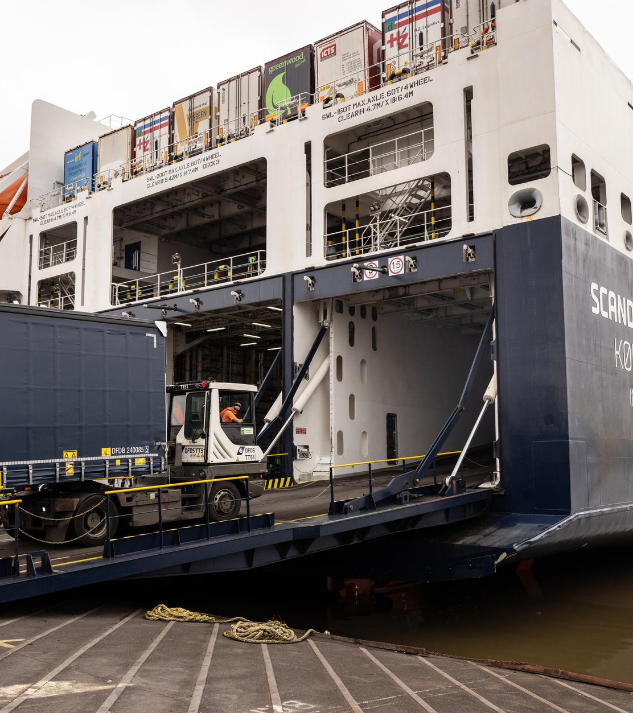
Moving Together Towards 2030 – Moving to green
Moving Together Towards 2030
Unlock network value, 2024-2026
Protect & Grow Profits
Standardise to simplify
Digitise to transform
Moving to green
Be a great place to work
Green transition, 2024-2030
45% reduction in ferry emission intensity
Low-emission ferry new-building programme
75% reduction of land emission intensity
Cash flow focus
Long-term NIBD/EBITDA target range of 2.0-3.0x
Deleverage capital structure
Non-core asset review
Working capital initiatives
3

Slide 4
Network expanded in financially challenging 2024
Network strengthened and expanded
Organic growth achieved
Strait of Gibraltar delivered
Ekol acquisition replicates model to Mediterranean
Jersey ferry services concession awarded
Sale of Oslo route completed
Financially challenging year
Results fell short of expectations
Macro and market headwinds
Underperforming units
Mediterranean competitor entry
Ekol International Transport turnaround
2025 transition to recovery
Financial ambitions no longer applicable
2025 a transition year for earnings recovery
Three specific focus areas to deliver recovery
2025 impacted by full-year effect from 2024 events
4

Slide 5
Q4 2024
5

Slide 6
5% revenue growth in Q4
Freight ferry organic* revenue down 1.4% due to lower freight rates
Passenger organic revenue up 1.2% as Channel growth was offset by lower Baltic Sea revenue
Logistics organic revenue up 4.6% driven mainly by UK & Ireland
Acquisitions, net added revenue of
DKK 509m
6
*Adjusted for BAF/ETS, acquisitions, and 2023 one-off releases impacting revenue

Slide 7
EBIT reduced considerably
Q4 EBIT of DKK 2m down from DKK 358m
Ferry Q4 EBIT down DKK 301m or 84% to DKK 56m driven by lower Mediterranean result and one-off gain in 2023
Logistics Q4 EBIT down DKK 117m to
DKK -30m and down DKK 55m to DKK 32m adjusting for the Ekol acquisition
UK & Ireland result level robust
Nordic & Continent results lowered by slowdown in road transport, Baltic region, automotive, and Brexit phase 3
7

Slide 8
Q4 2024 income statement
EBITDA down 25% following lower results in both divisions
EBIT Q4 2023 included gain of DKK 96m from sale and leaseback of ferries
Depreciation up 3% or DKK 21m driven mainly by addition of Ekol International Transport
Finance cost up 32% or DKK 57m
Variance from one-off income in 2023 related to sale and leaseback and higher net interest cost
8

Slide 9
Full-year 2024
9

Slide 10
2% organic revenue growth
Group organic revenue* up 1.9%
Freight ferry organic revenue on level with 2023
Passenger organic revenue up 9.6% driven by Channel from higher volumes and spend
Logistics organic revenue up 3.2% driven by all regions
Acquisitions, net added revenue of
DKK 2.0bn of which DKK 1.2bn from FRS Iberia/Maroc
10
*Adjusted for BAF/ETS, acquisitions, and 2023 one-off releases impacting revenue

Slide 11
EBIT lower in both divisions
FY EBIT decreased 35% to DKK 1.5bn
Ferry EBIT down DKK 574m or 27% to
DKK 1.5bn driven by lower Mediterranean result, oil spread decrease, and one-off gain in 2023
Positive development by Channel, Strait of Gibraltar, and Passenger
Logistics EBIT down DKK 269m or 57% to DKK 200m driven by market headwinds and underperformance
UK & Ireland result level robust
Nordic & Continent impacted by slowdown in road transport, Baltic region, automotive, and Brexit phase 3
11

Slide 12
Full-year 2024 income statement
EBITDA down 9% or DKK 449m following lower results in both divisions
Depreciation up 13% or DKK 318m mainly due to organic changes
Impairment reversal of DKK 32m related to sale of Oslo route
Finance cost up 25% or DKK 164m driven by higher debt and interest rate levels
12

Slide 13
Cash flows & capital
Operating cash flow down 7% vs 2023 to DKK 3.4bn driven by lower EBITDA and higher interest cost
Operating capex of DKK 1.45bn
Adjusted free cash flow of DKK 1.0bn
Operating capex and Adjusted free cash flow in 2023 included DKK 1.5bn from sale/leaseback of three freight ferries
Financial leverage, NIBD/EBITDA, of 3.9x up from 2.9x at end 2023
13

Slide 14
Moving to Green & Great Place to Work
14

Slide 15
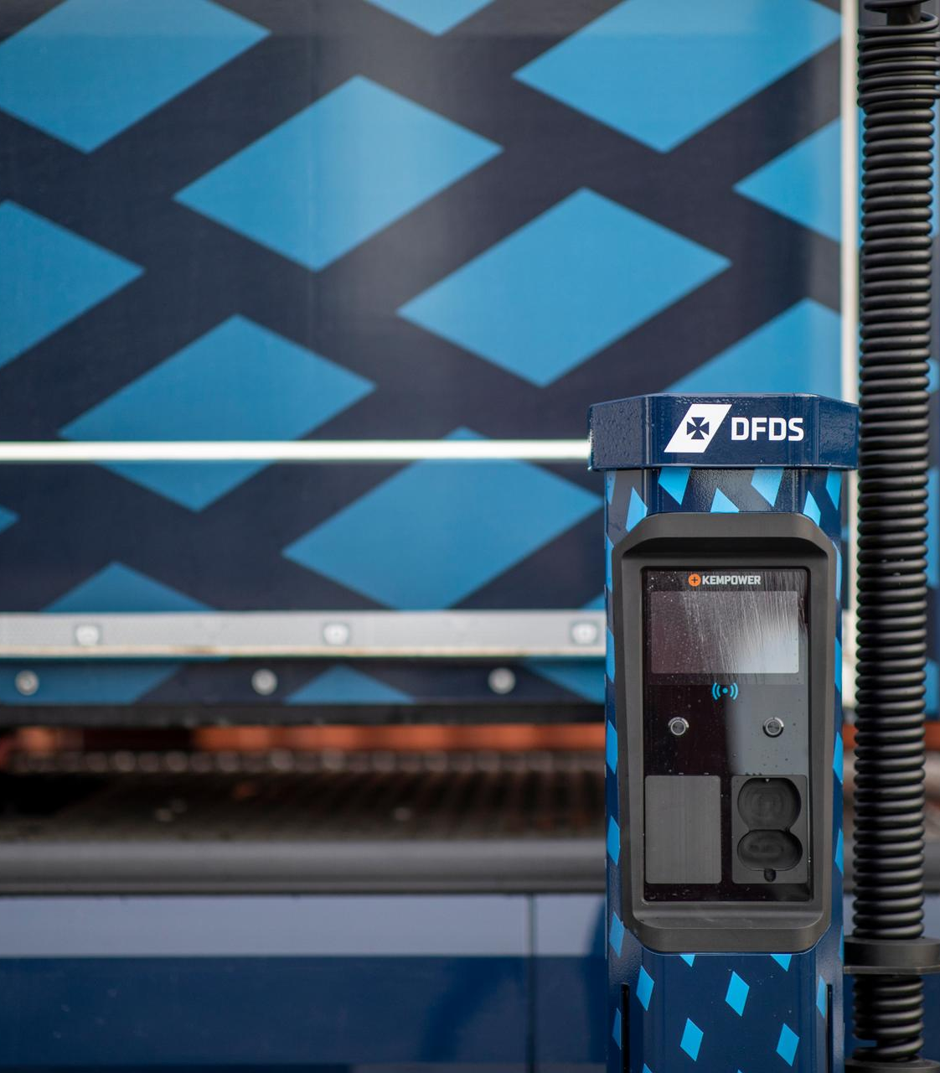
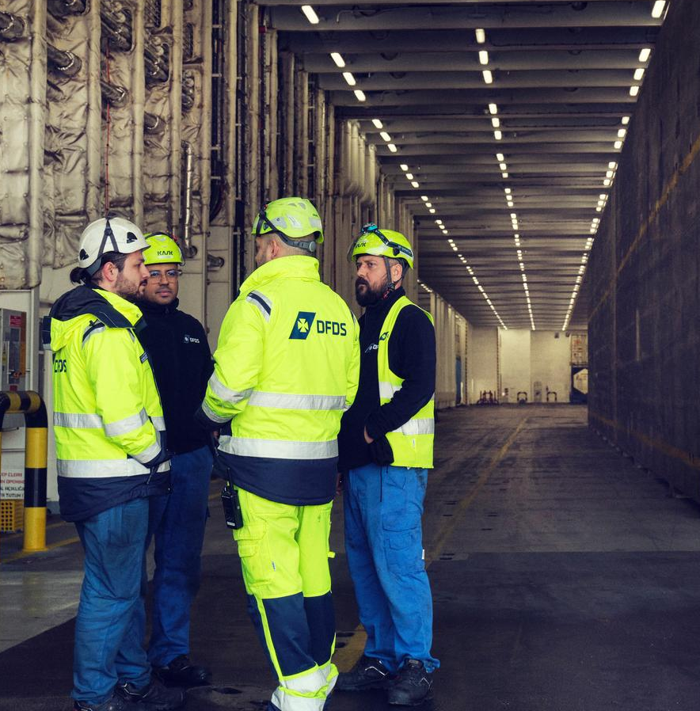
Solid continued commitment to ESG focus
Ferry CO2 emission intensity reduced 1.7% for own fleet adjusted for acquisitions
Low-emission ferry transition pace challenged by fuel availability
E-trucks: 131 e-trucks in operation
Electrification also driven by solar panels and port terminal equipment
Women in management positions up 1 ppt to 19%
Safety (LTIF) focus starting to show results for land-based activities
Ferry CO2 emission intensity reduced 5% across route network in 2023
Every Minute Counts schedule optimisation program delivered more than expected
E-trucks: 90 of 125 ordered trucks deployed end 2023
6 green ferries to be deployed by 2030
Ferry and Logistics on track for short-term emission reduction targets
15
15

Slide 16
2025 focus areas
16

Slide 17
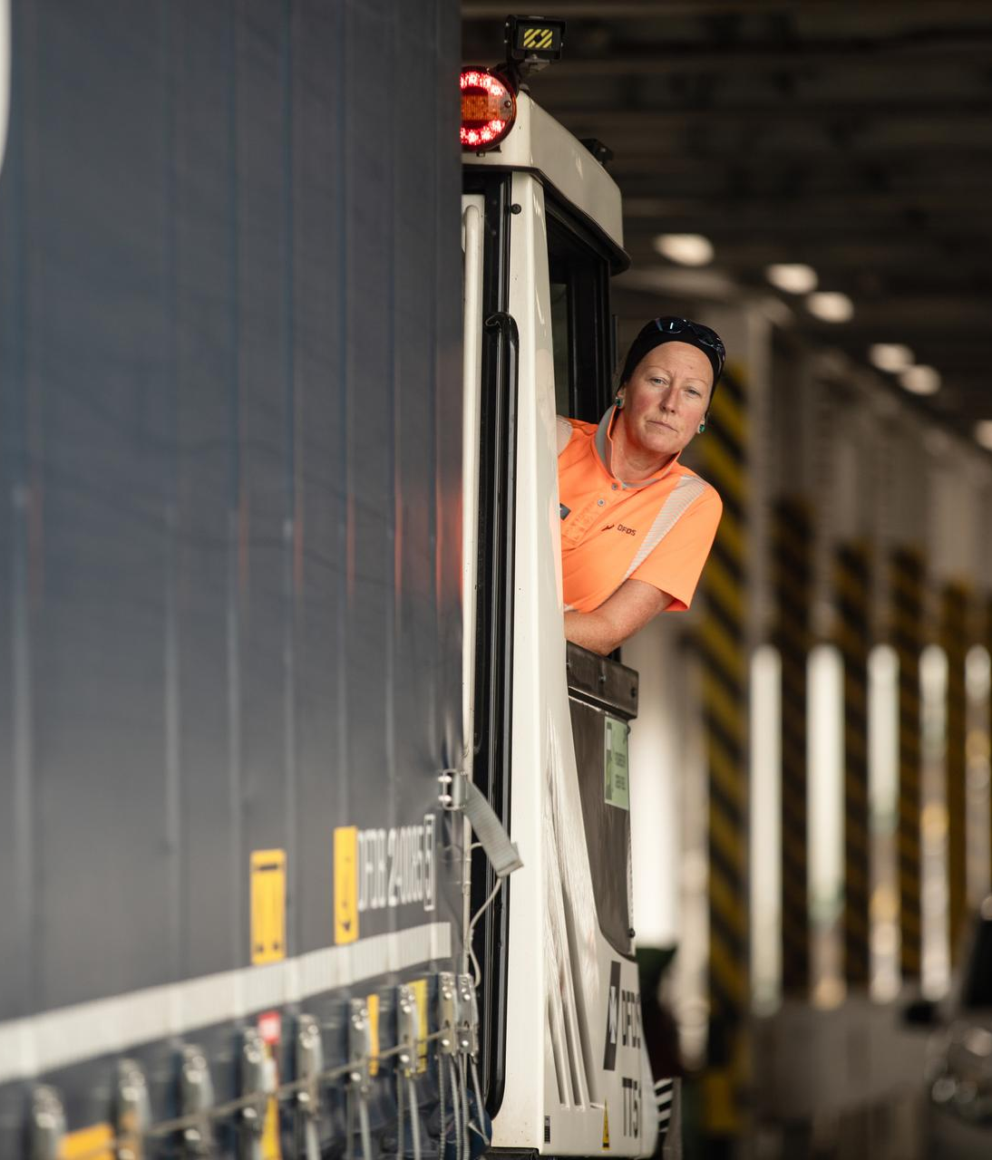
Underlying network strength intact
Majority of network expected to uphold performance or improve
North Sea/Channel/Baltic Sea
Strait of Gibraltar ex. Tarifa route – continued growth expected
Logistics – UK & Ireland robust, parts of Nordic/Continent challenged
Jersey – new 20-year ferry contract
17

Slide 18
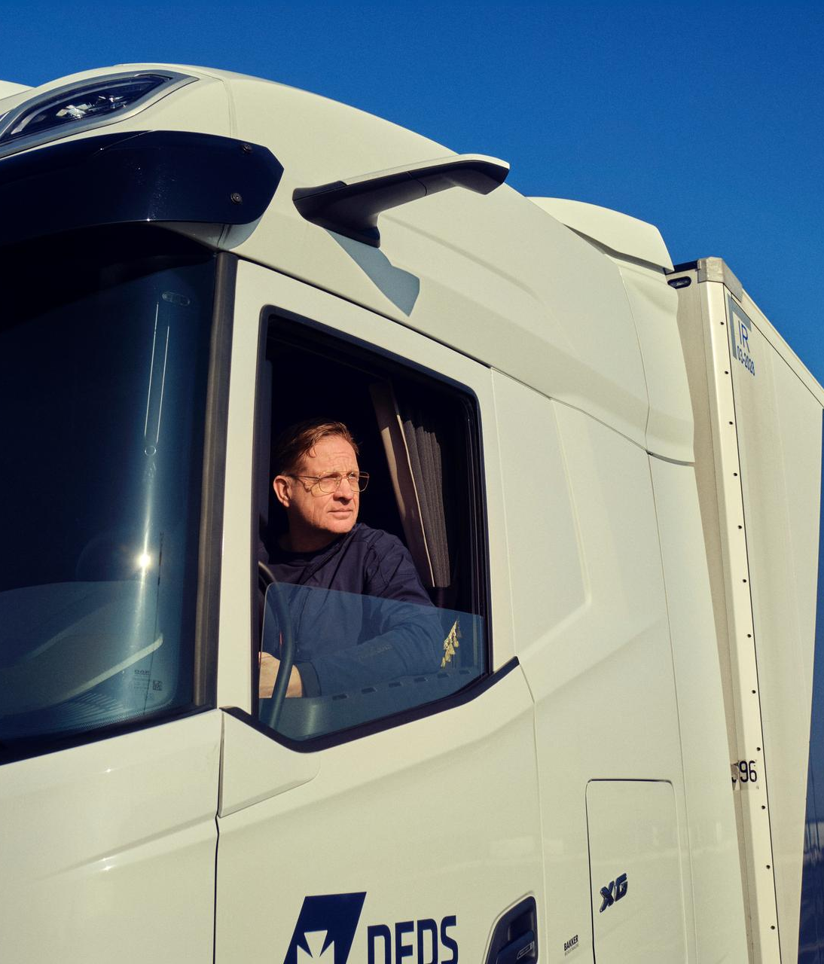
3 focus areas to resolve
in 2025
Adapting Mediterranean
Türkiye & Europe South turnaround
Logistics Boost projects
18

Slide 19

Adapting Mediterranean to new competitive environment
Overcapacity created on Istanbul-Trieste corridor by competitor entry mid-September 2024
Successful initial defense of market share
Market expected to rebalance during 2025 enabled by capacity adjustments
19

Slide 20
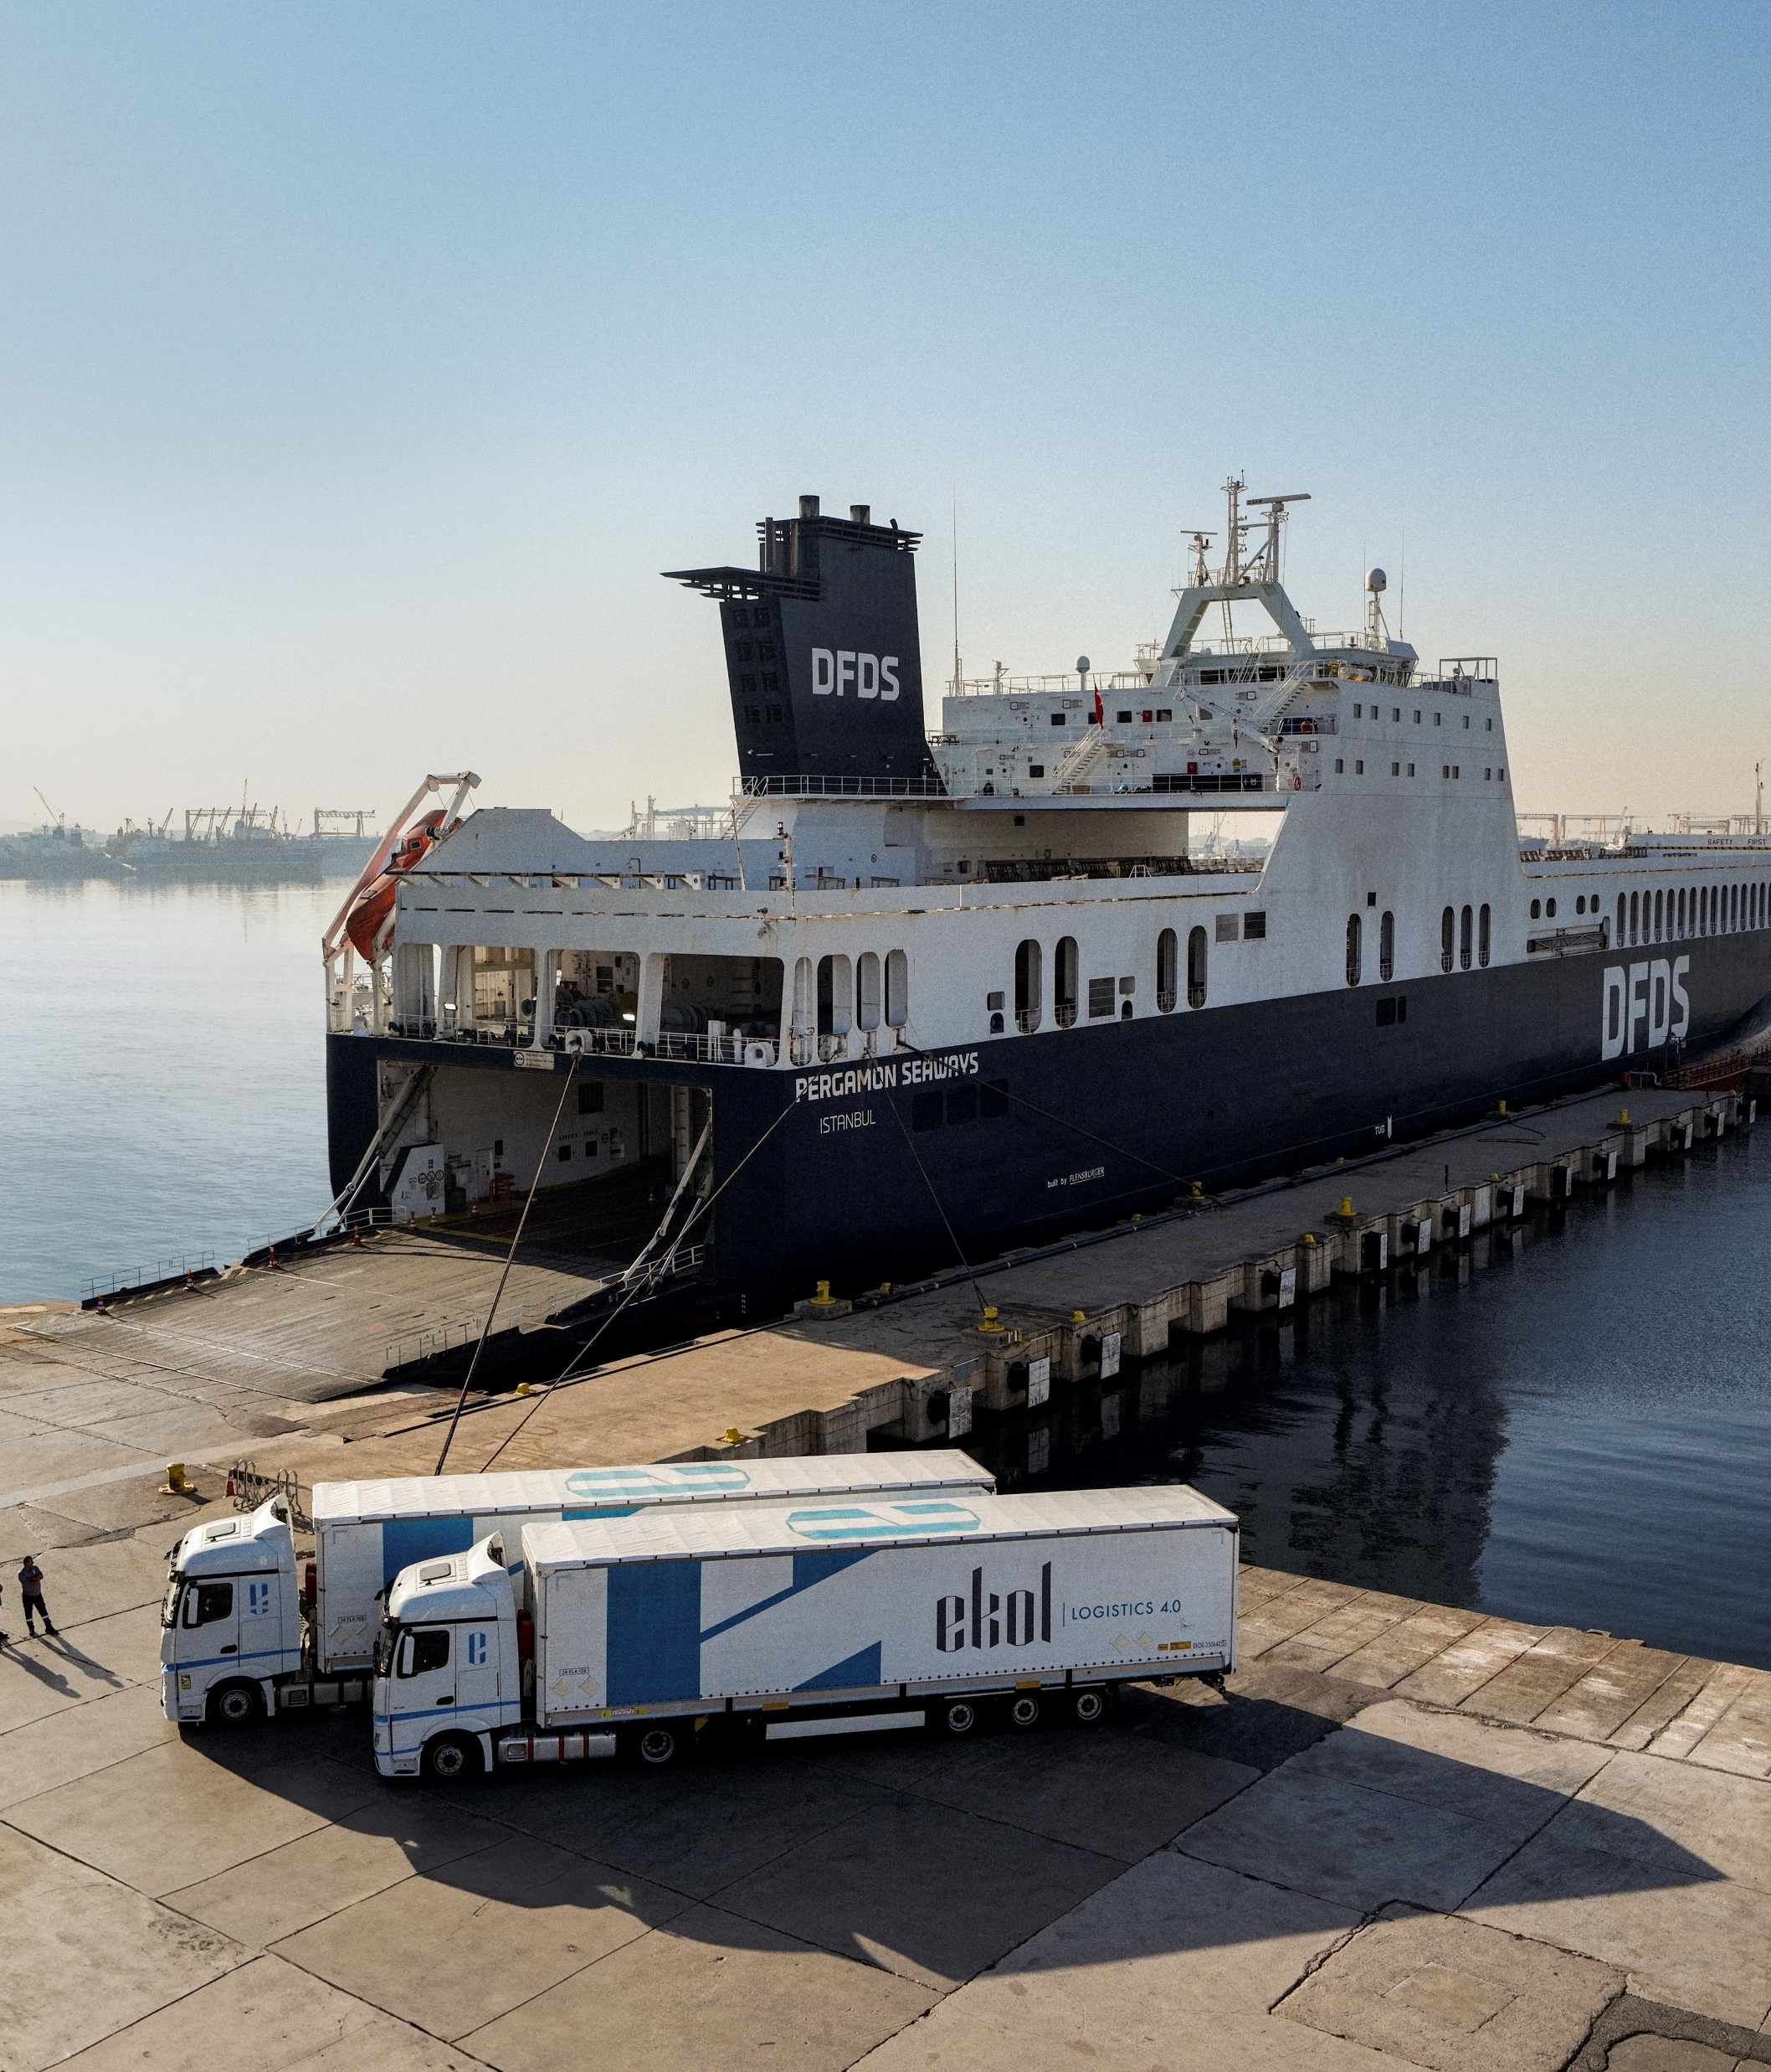
Turkiye & Europe South logistics turnaround on track
Progress in line with breakeven target for year-end 2025
Organisational restructuring impacts 125 Istanbul office employees
First results from cross-selling DFDS’ European network
Rightsizing of equipment fleet ongoing – subcontracted haulage planned to increase
Optimisation of European network
20

Slide 21
Deliver on Logistics Boost projects
Eight Boost projects initiated in 2024
Earnings impacted by combination of external forces and underperformance
Focused review and reporting process in place
Logistics Boost turnaround projects initiated in 2024
Cold chain | Automotive | Market slowdown | Geopolitical
Denmark domestic | Gothenburg logistics | Dutch full-load (FTL) flows | Baltic slowdown
Germany domestic | Ghent, flows and domestic | Dutch warehousing | Continent-UK, Brexit phase 3
Nordic/Continent
21

Slide 22
Outlook & priorities
22

Slide 23
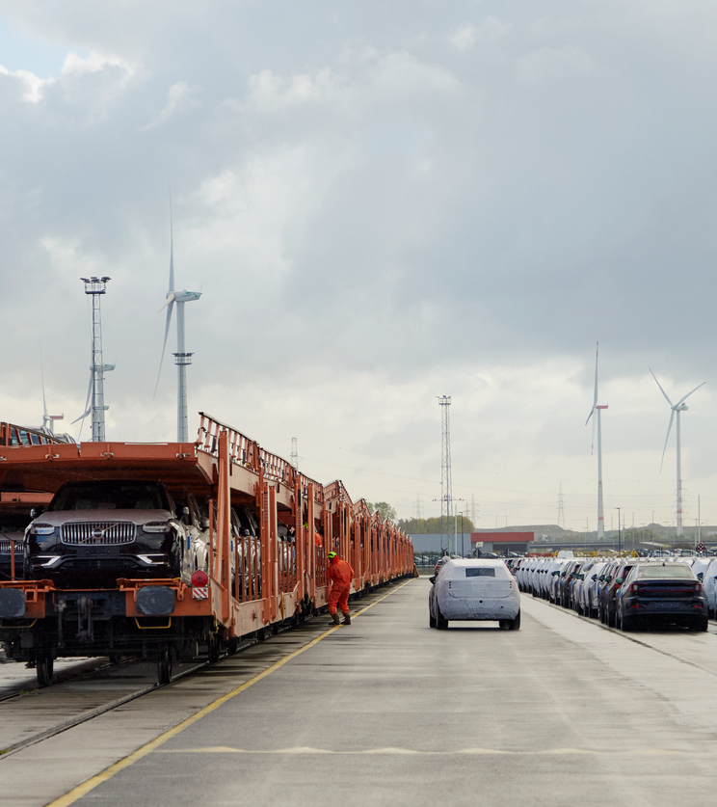
Outlook 2025 – modest tailwind assumed
European growth assumed to remain muted in 2025 due to continued macro uncertainty
Continued growth in Mediterranean and North Africa. DFDS freight ferry Mediterranean volumes impacted by competition
Road transport markets assumed to remain highly competitive
Passenger markets overall stable – Channel expected to grow
23

Slide 24
EBIT outlook impacted by focus areas
Revenue growth outlook of around 5% driven by organic growth and net positive impact from acquisitions/divestments
EBIT outlook of around DKK 1.0bn reflect impacts from Mediterranean and Türkiye & Europe South turnaround
Operating capex of around DKK 1.6bn
Adjusted free cash flow of around DKK 1.0bn includes positive impact from working capital improvement
24

Slide 25
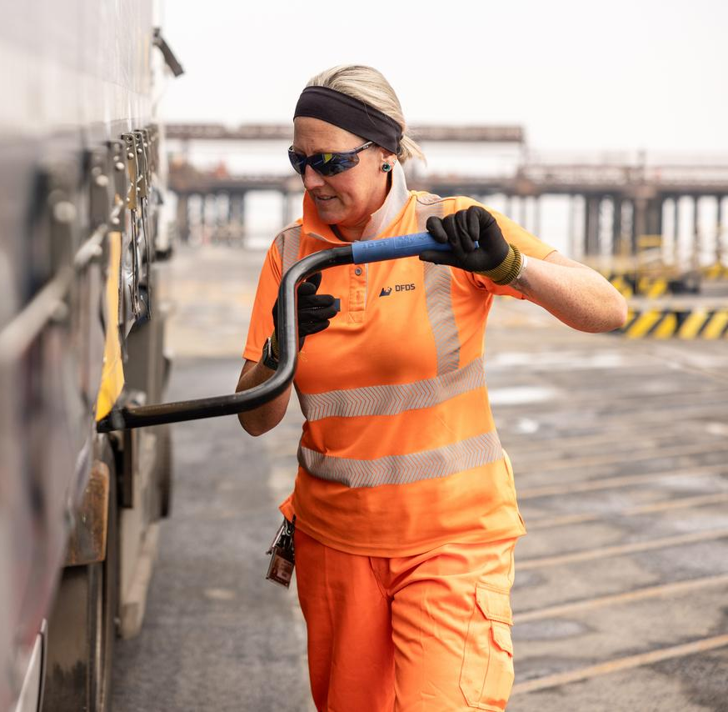
Key priorities 2025
Protect & grow underlying network strength
Organic growth focus
Resolve three specific focus areas
Cost focus – reverse cost increase trend
Cash flow focus
Green transition and Diversity - continue to deliver on targets
25

