Slide 1
Sample Lecture on Tuberculosis
King George’s Medical University
September 2023
Elsevier Health, India

Slide 2
Pre-Read

Slide 3
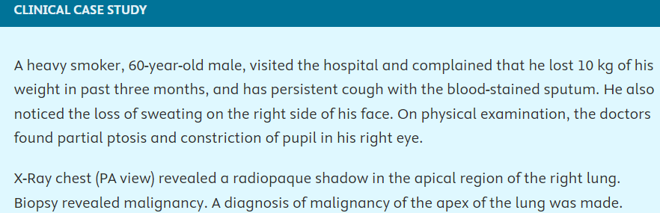
Internal Structure of the Lungs
Objective: Familiarize yourself with the internal structures of the lungs and how it correlates to tuberculosis as well as other pulmonary conditions.
Read the following topics:
Internal structure
Bronchial tree
Principal bronchi
Lobar bronchi
Tertiary (segmental) bronchi
Pulmonary units
Arterial supply of lungs (read full topic)
Venous drainage (read full topic)
Lymphatic drainage (read full topic)
Nerve supply
Bronchopulmonary segments
Number and nomenclature of brochopulmonary segments
Review the clinical case study at the end of this chapter

Slide 4
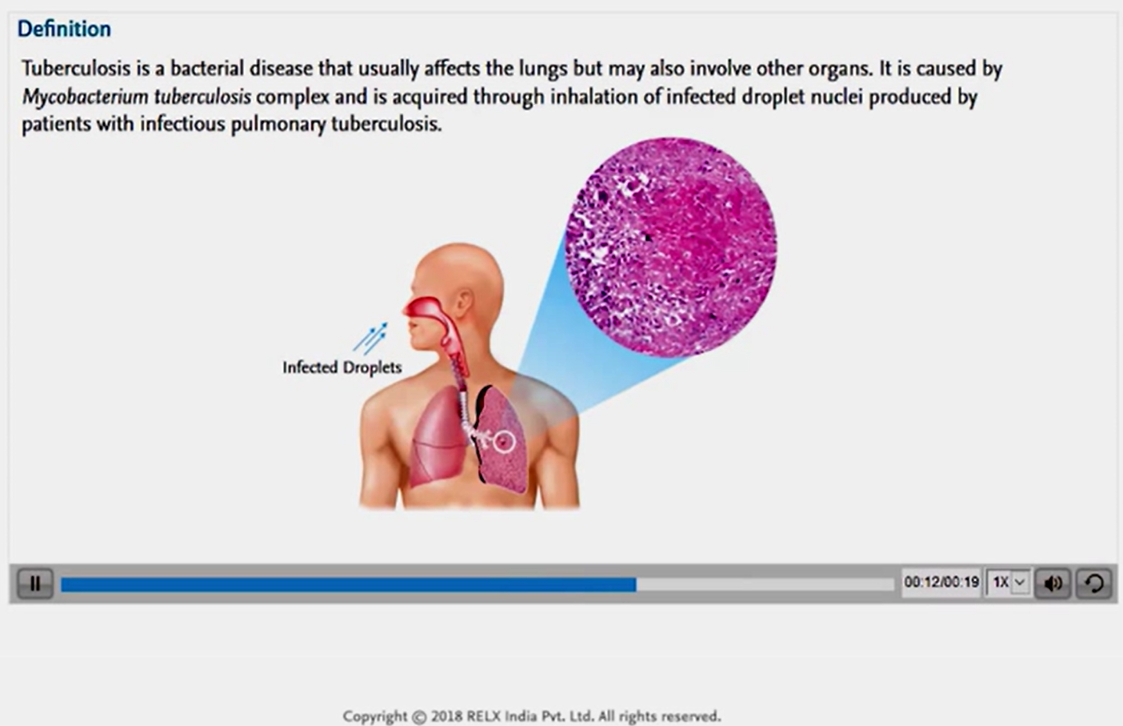
Warm-Up for the Brain
Objective: Introduce yourself to Tuberculosis basics and get ready for the lecture.
Watch this video - https://www.clinicalkey.com/student/content/video/3-s2.0-B9788131260333000110-v9788131260333_0002

Slide 5
Lecture

Slide 6
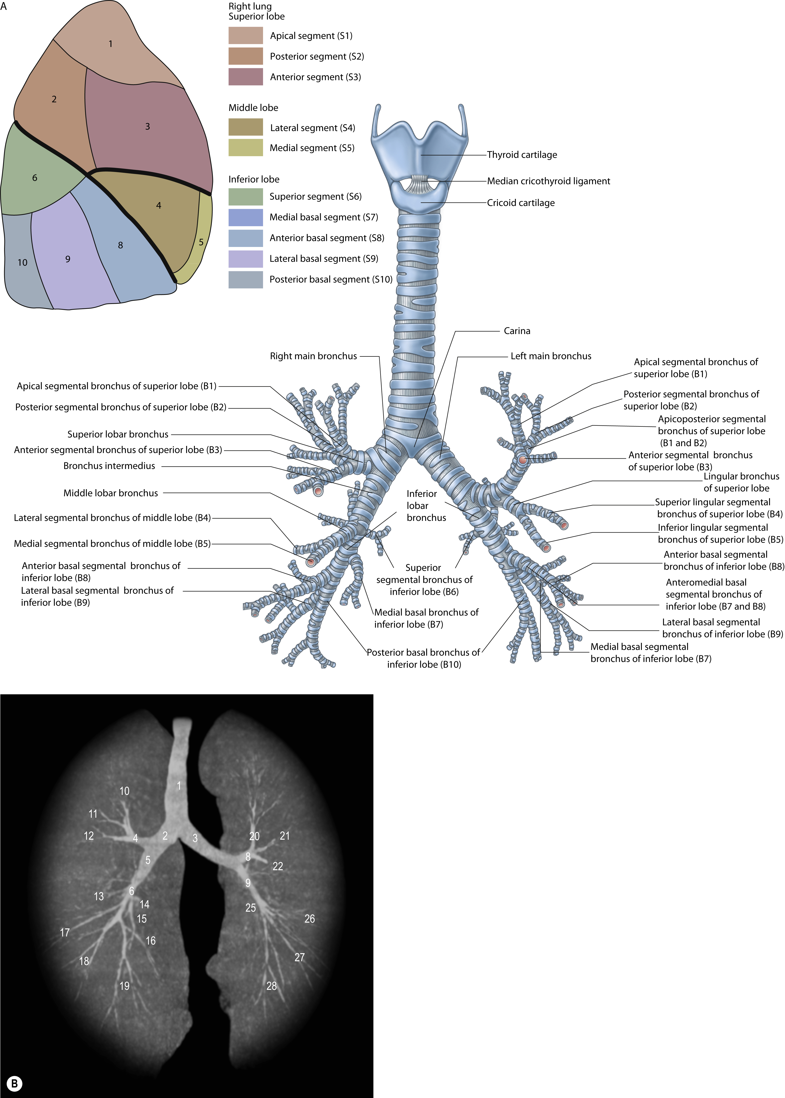
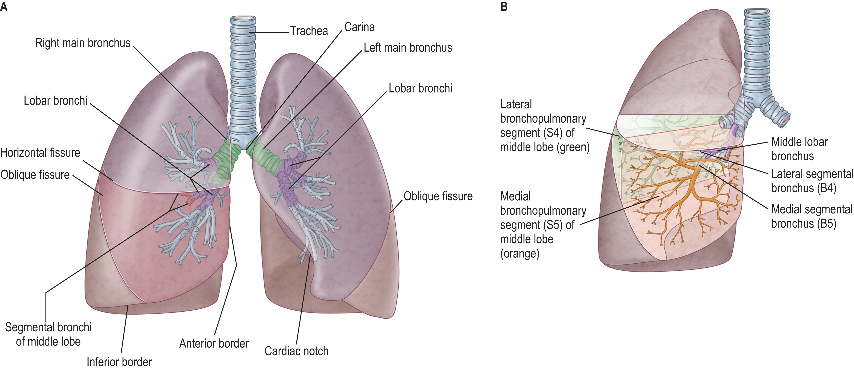
Lung Anatomy – Segmental Bronchi
Pleura, lungs, trachea and bronchi Standring, Susan, MBE, PhD, DSc, FKC, Hon FAS, Hon FRCS, Gray's Anatomy, Chapter 54, 1020-1037.e1 A, The cartilages of the larynx, trachea and bronchi (anterior view), and the bronchopulmonary segments on the costal surface of the right lung. The bronchopulmonary segment (S) and segmental bronchus (B) labels are shown in brackets. In the left ... Copyright © 2021 © 2021, Elsevier Limited. All rights reserved.
Pleura, lungs, trachea and bronchi Standring, Susan, MBE, PhD, DSc, FKC, Hon FAS, Hon FRCS, Gray's Anatomy, Chapter 54, 1020-1037.e1 Lungs and bronchi (anterior view). The segmental bronchi and subsequent bronchial tree are projected onto the middle lobe of the right lung in different colours (compare with Fig. 54.8). Sobotta Atlas of Human Anatomy © Elsevier GmbH, Urban & Fisc... Copyright © 2021 © 2021, Elsevier Limited. All rights reserved.
Source: https://www.clinicalkey.com/student/content/book/3-s2.0-B9780702077050000549#hl0000497; https://www.clinicalkey.com/student/content/book/3-s2.0-B9780702077050000549#hl0000487

Slide 7
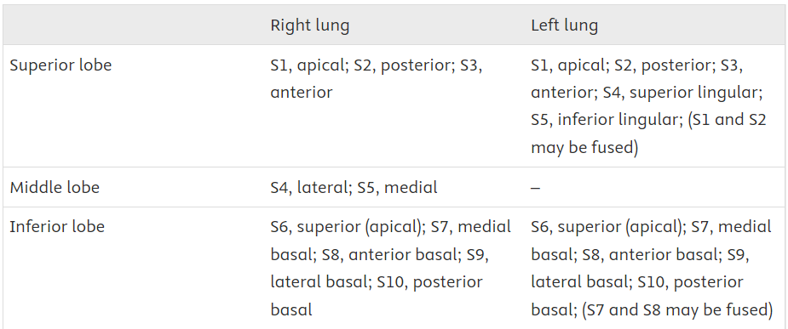
Lung Anatomy – Bronchopulmonary Segments
Right main (principal) bronchus, approx. 2.5 cm long, wider, shorter and more vertical than the left
Lung lobation and the morphology of the tracheobronchial tree can predict the atrial situs.
Left main (principal) bronchus is narrower, less vertical and twice as long (approx. 5 cm)
Passing to the left, inferior to the aortic arch, it crosses anterior to the oesophagus, thoracic duct and descending thoracic aorta
The left and right main bronchi divide into lobar bronchi that subsequently divide into segmental bronchi. A segmental bronchus supplies a structurally separate and functionally independent unit of lung tissue called a bronchopulmonary segment. The bronchopulmonary segments are named and numbered (S1–S10) according to their supplying segmental bronchus (B1–B10
Source: https://www.clinicalkey.com/student/content/book/3-s2.0-B9780702077050000549#hl0000415;

Slide 8
Group Discussion
Based on your pre-read and our current discussion, what are the clinical implications of each bronchopulmonary segment acting as an independent unit?
Source:

Slide 9
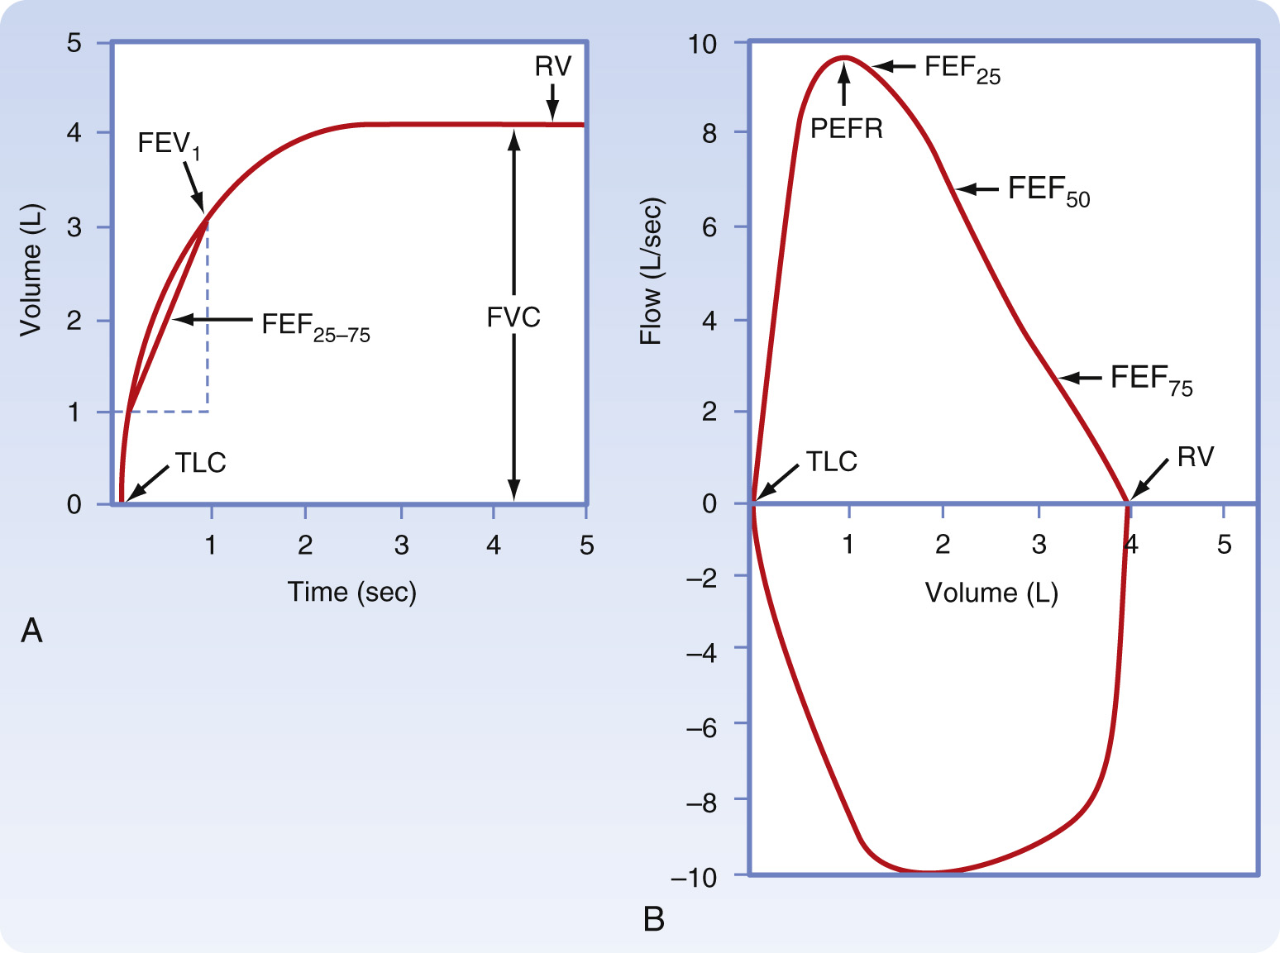
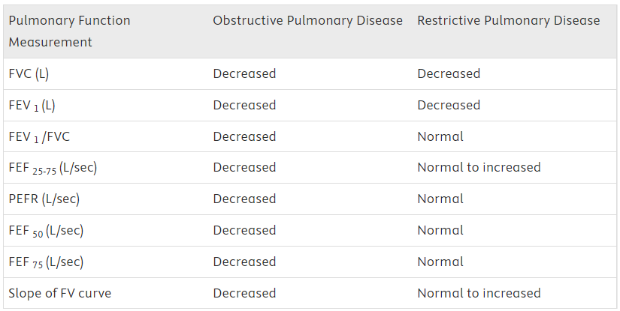
Measurement of Expiratory Flow
Measurement of expiratory flow rates and expiratory volumes is an important clinical tool for evaluating and monitoring respiratory diseases.
A spirogram displays the volume of gas exhaled as a function of time and measures: (1) forced vital capacity (FVC), (2) forced expiratory volume in 1 second (FEV ₁ ), (3) the ratio of FEV ₁ to FVC (FEV ₁ /FVC), and (4) the average midmaximal expiratory flow (FEF ₂₅₋₇₅ ).
Dynamic Lung and Chest Wall Mechanics Koeppen, Bruce M., MD, PhD, Berne & Levy Physiology, 22, 456-465 The clinical spirogram (A) and flow-volume loop (B). The individual takes a maximal inspiration and then exhales as rapidly, as forcibly, and as maximally as possible. The volume exhaled is plotted as a function of time. In the spirogram that is r... Copyright © 2018 Copyright © 2018 by Elsevier, Inc. All rights reserved.
Source: https://www.clinicalkey.com/student/content/book/3-s2.0-B9780323393942000225#hl0000378
Notes:
Commonly used clinical tests have the patient inhale maximally to total lung capacity (TLC) and then exhale as rapidly and completely as possible to residual volume (RV). The test results are displayed either as a spirogram or as a flow-volume curve/loop. Results from individuals with suspected lung disease are compared with results predicted from normal healthy volunteers. Predicted or normal values vary with age, sex, ethnicity, height, and to a lesser extent, weight. Abnormalities in values indicate abnormal pulmonary function and can be used to predict abnormalities in gas exchange.

Slide 10
Tuberculosis
Tuberculosis (TB): a granulomatous disease caused by the slow-growing, acid-fast bacillus Mycobacterium tuberculosis (Mtb). Leading infectious disease cause of death worldwide before Covid
Two states of M. tuberculosis infection are recognized: Latent tuberculosis infection (LTBI) and acute tuberculosis disease. 5% to 15% have progression to tuberculosis disease.
Multidrug resistant TB – disease caused by Mtb strains resistant to at least isoniazid (INH) and rifampin (RIF)
Extensively drug resistant TB – disease caused by drug resistant strains that are also resistant to
Primary versus Secondary/ Reactivation TB
ICD-10CM CODES
A15.0 Tuberculosis of lung
A15.7 Primary respiratory tuberculosis
Source: https://www.clinicalkey.com/student/content/book/3-s2.0-B9780323930383002999; https://www.clinicalkey.com/student/content/book/3-s2.0-B9780323755764009388#hl0000554
Notes:
Mycobacterium tuberculosis , the causative agent of tuberculosis (TB), is estimated to have infected one quarter of the world’s population and is a leading cause of infectious disease death worldwide. M. tuberculosis is spread by aerosol transmission. Most often, infected individuals develop latent TB infection, but approximately 10% of individuals will develop active disease, either due to progressive primary infection or reactivation of latent infection. Interferon-gamma (IFN-γ), tumor necrosis factor-alpha (TNF-α), and CD4 T cells are critical in host immune control of infection. In individuals in whom these responses are impaired, such as inborn errors in the IL-12-IFN-γ signaling axis, treatment with anti–TNF-α agents, and HIV coinfection, the risk of developing active infection and disseminated disease is markedly increased. Active TB is most often pulmonary, but a wide variety of extrapulmonary disease manifestations also occur. The challenges associated with diagnosing and treating TB are compounded by HIV coinfection and drug resistance. As a result, TB remains an enormous global health threat.

Slide 11
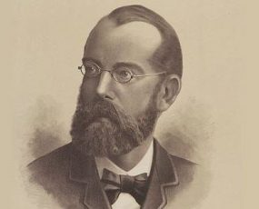
Tuberculosis – Etiology/ Causative Agents
Causative Agents:
M. tuberculosis
M. africanum
M. bovis (commonly associated with intestinal tract TB via consumption of unpasteurized dairy products).
M. canetti (cases seen in the Horn of Africa).
M. pinnipedii (exposure to seals).
M. microti (a rodent pathogen).
Bacillus Calmette–Guérin (BCG).
M. tuberculosis discovered by Dr. Robert Koch in 1882.
Source: https://www.clinicalkey.com/student/content/book/3-s2.0-B9780323568661000329#hl0000305;

Slide 12
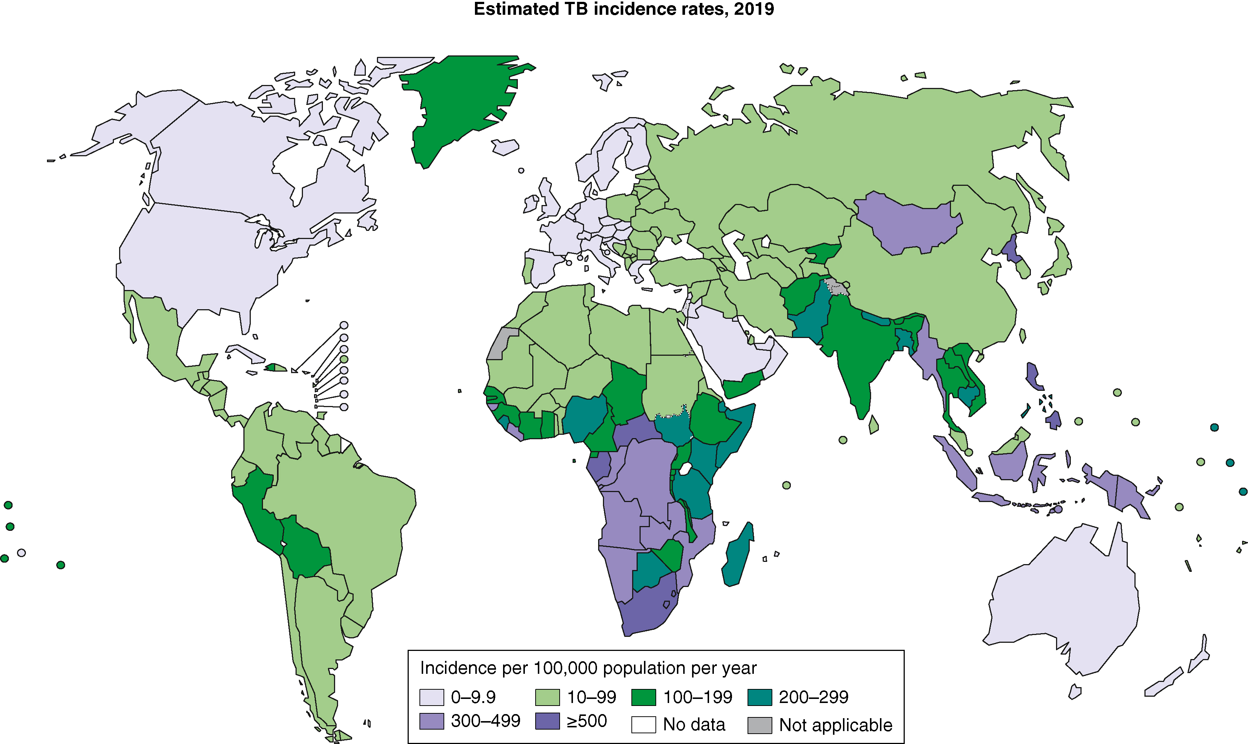
Tuberculosis – Epidemiology
WHO estimates that 1.7 billion people (25% of global population) has LTBI.
35% of cases occur in women.
Disease peaks in young adults.
10% of TB cases globally occur in HIV+ patients and TB is the leading cause of death amongst HIV patients.
In 2019, there was a total of 2,404,815 TB cases detected across India, and this decreased by 24.9% in 2020 (1,805,670 cases). While there was a higher number of total TB cases detected in 2021 (2,135,830 cases) compared to 2020, this was 11.2% lower compared to 2019.
Tuberculosis Bailey, Thomas C., Goldman-Cecil Medicine, 299, 2031-2044.e1 Estimated TB incidence rates, 2019 (from Global Report, 2020). The severity of national TB epidemics in terms of the annual number of incident TB cases relative to population size (the incidence rate) in 2019. High-income countries and low-income ... Copyright © 2024 Copyright © 2024 by Elsevier Inc. All rights reserved.
Source: https://www.clinicalkey.com/student/content/book/3-s2.0-B9780323930383002999#hl0000653; https://www.ncbi.nlm.nih.gov/pmc/articles/PMC10226868/#:~:text=In%202019%2C%20there%20was%20a,11.2%25%20lower%20compared%20to%202019.

Slide 13
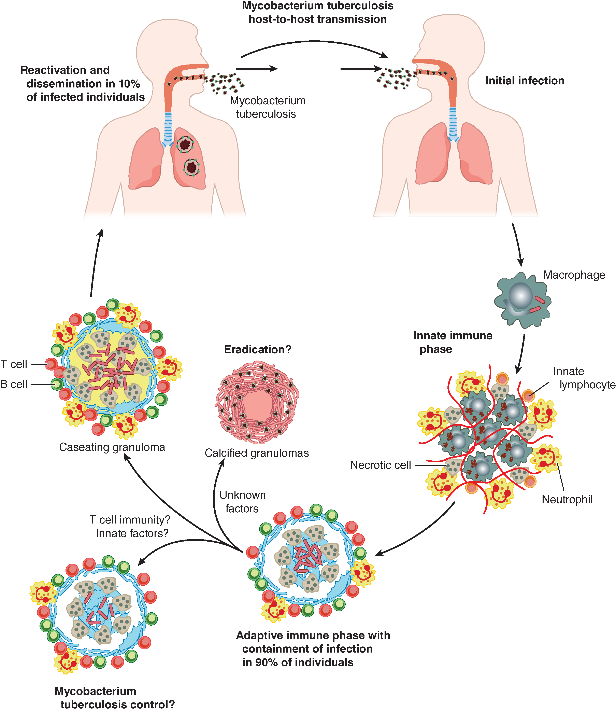
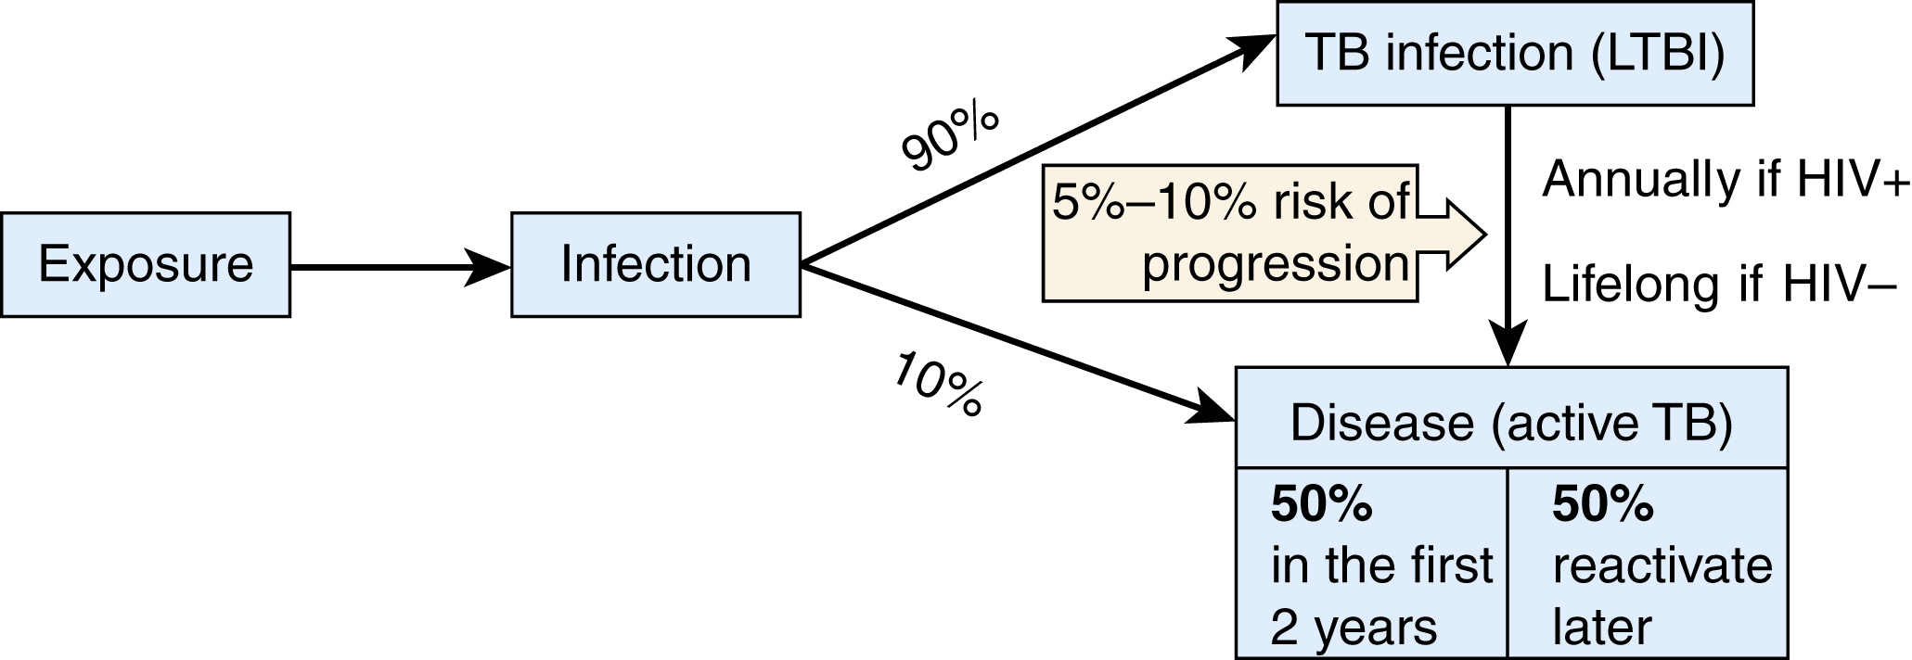
Tuberculosis – Pathogenesis/ Pathobiology
Tuberculosis Bailey, Thomas C., Goldman-Cecil Medicine, 299, 2031-2044.e1 Pathogenesis of tuberculosis. M. tuberculosis is transmitted by aerosol and first infects alveolar macrophages in the distal alveoli. During the innate immune phase of the infection, inflammatory cells are recruited to the site of infection, but t... Copyright © 2024 Copyright © 2024 by Elsevier Inc. All rights reserved.
Tuberculosis Mejia-Chew, Carlos R., Comprehensive Review of Infectious Diseases, 32, 465-471 Latent TB infection diagram. Copyright © 2020 © 2020, Elsevier Limited. All rights reserved.
Source: https://www.clinicalkey.com/student/content/book/3-s2.0-B9780323930383002999#hl0000679
Notes:
M. tuberculosis effectively disarms the innate immune response, persists in the face of adaptive immunity, and disseminates, thereby leading to a wide spectrum of infectious manifestations. The infection cycle begins when M. tuberculosis is transmitted from a person with active pulmonary TB through aerosolized particles that are small enough to reach the alveoli (1 to 5 μM). The degree of infectiousness depends upon the severity of cough, which is promoted by sulfolipid in the mycobacterial cell envelope, and the extent of bacterial burden. Patients with cavitary lesions, which can have 10 ⁷ to 10 ⁹ bacilli, are the most infectious. Patients who do not have visible acid-fast bacilli on sputum smears are much less likely to transmit, but they still can infect others. Patients with HIV are less likely to develop cavitary disease, to be smear positive, or to transmit infection. On average, infectious individuals will infect 3 to 10 people per year. In household settings, where exposure may be intense and prolonged, 25 to 50% of contacts become infected.

Slide 14
Tuberculosis – Risk Factors
RISK FACTORS FOR INFECTION
Exposure to patient(s) with active TB infection
Homelessness
Work-related exposure, including for healthcare professionals
Immigrants from an endemic area
Incarceration (jail time)
Intravenous drug use
Immunologically compromised due to old age, cancer, HIV, other reasons
RISK FACTORS FOR PROGRESSION
Diabetes
Intravenous drug use
Intestinal bypass
TNF-α inhibitors
HIV or other immunocompression
End-stage renal disease
CXR abnormalities
Recent TB infection
Silicosis
Source: https://www.clinicalkey.com/student/content/book/3-s2.0-B9780323568661000329#hl0000360

Slide 15
Tuberculosis – Physical Findings & Clinical Presentation
Primary pulmonary TB infection generally asymptomatic
Secondary or Reactivation pulmonary TB manifests as:
Fever
Night sweats
Cough
Hemoptysis
Scanty nonpurulent sputum
Weight loss
Chest pain
Progressive primary pulmonary TB disease: Same as reactivation pulmonary TB manifests as:
TB pleurisy – pleuritic chest pain, fever, shortness of breath
Rare massive, suffocating, fatal hemoptysis secondary to erosion of pulmonary artery within a cavity (Rasmussen aneurysm)
Chest examination for TB can be non-specific; tends to underestimate the extent of disease and may encounter posttusive rales.
Source: https://www.clinicalkey.com/student/content/book/3-s2.0-B9780323755764009388#hl0000659

Slide 16
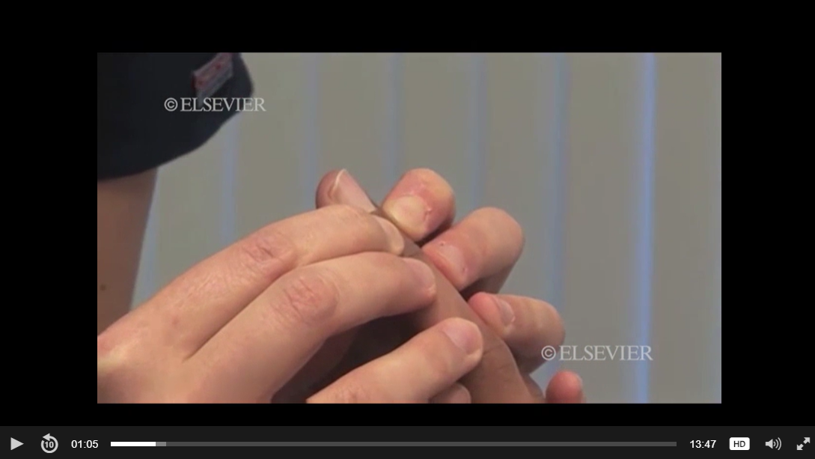
Tuberculosis – Performing a Physical Exam
Play this video - https://www.clinicalkey.com/student/content/video/23-s2.0-mm_9780323847704_0002
Source: https://www.clinicalkey.com/student/content/video/23-s2.0-mm_9780323847704_0002

Slide 17
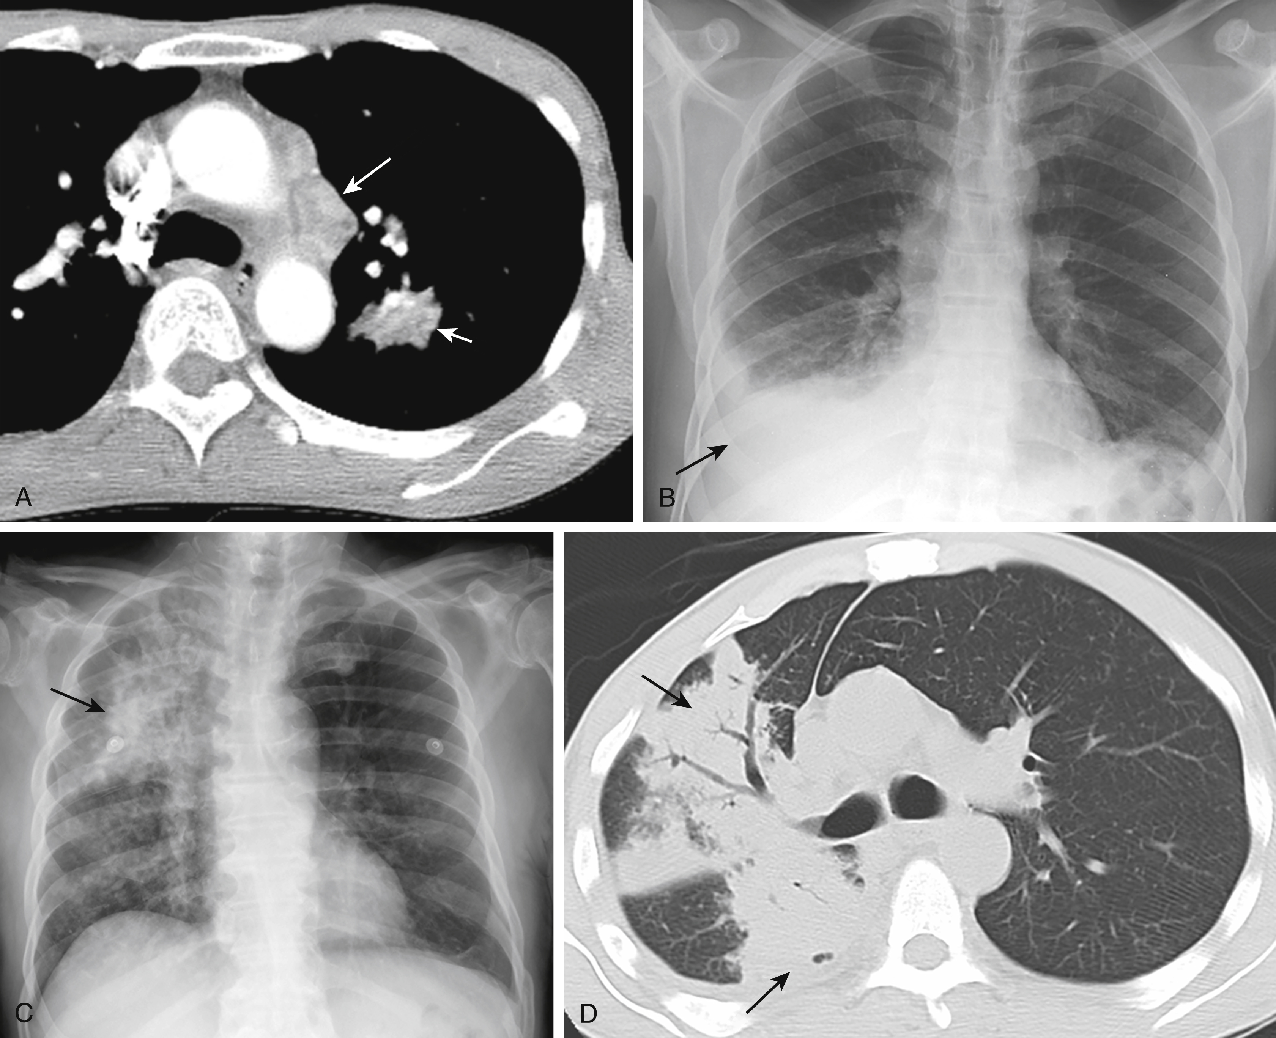
Tuberculosis – Diagnosis Overview
In countries with limited resources and a high burden of TB, the diagnosis of active TB may be based solely upon typical clinical symptoms and signs, with or without sputum microscopy.
The characteristic histopathologic feature of TB is the presence of caseating (“cheese-like”) granulomatous inflammation.
Pulmonary TB often diagnoses based on detailed history-taking and clinical suspicion, which warrant radiological imaging and sputum testing.
Radiology often shows pulmonary infiltrates
Differential diagnosis – community-acquired pneumonia
Sputa should be collected for microscopic examination, culture, and PCR testing.
Extrapulmonary TB is a diagnostic challenge. Suspicion is key. Negative AFB stains and cultures are common.
Tuberculosis Bailey, Thomas C., Goldman-Cecil Medicine, 299, 2031-2044.e1 Radiographic images of primary and progressive primary tuberculosis (TB). A, Ghon focus in a 33-year-old woman. Chest computed tomographic image at the level of the aortopulmonary window shows the left-sided focal parenchymal opacity (short arrow)... Copyright © 2024 Copyright © 2024 by Elsevier Inc. All rights reserved.
Source: https://www.clinicalkey.com/student/content/book/3-s2.0-B9780323930383002999#hl0000869
Notes:
The number of organisms in an extrapulmonary specimen is smaller than in pulmonary TB, so negative AFB stains and cultures are common. Furthermore, if a tissue is biopsied and infection is not initially considered, the sample may be placed in formalin and not submitted to the microbiology laboratory. PCR for TB can be performed by reference laboratories on fixed tissue, but the sensitivity is lower than with culture, particularly for specimens that stain negatively for AFB.
The cerebrospinal fluid (CSF) in TB meningitis may show a predominance of neutrophils but classically shows a lymphocytic CSF pleocytosis
For TB adenitis, lymph node biopsy or aspirations will typically show granulomas with or without acid-fast organisms, and cultures are positive in approximately 70% of cases.
In pleural TB, the pleural fluid is often paucibacillary, so a pleural biopsy may be needed to diagnose TB pleuritis.
In TB peritonitis, ascitic fluid is most often exudative, and it is commonly negative for acid-fast bacilli on smear and culture. The highest diagnostic yield is achieved with peritoneal biopsy.
For intestinal TB (due to either M. tuberculosis or M. bovis ), histopathology and culture are used.

Slide 18
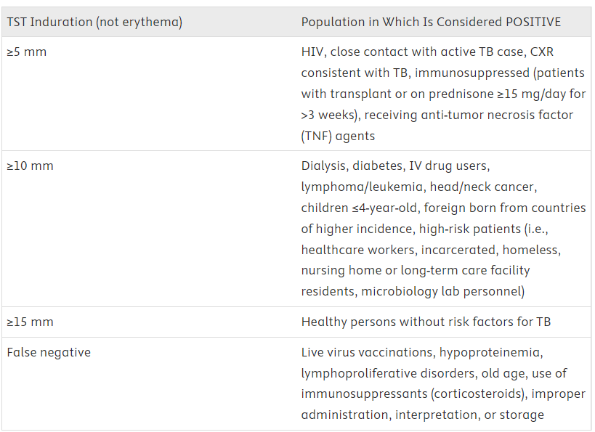
Tuberculosis – Diagnosis, Mantoux Tuberculin Skin Test
Asymptomatic infection is diagnosed through a positive Mantoux tuberculin skin test (TST) or an interferon gamma release assay (IGRA).
Highly dependent upon appropriate storage, correct administration, and accurate interpretation.
A confirmatory IGRA should be performed if a patient has a positive tuberculin skin test result without any known risk for TB exposure or has a history of BCG vaccination.
Source: https://www.clinicalkey.com/student/content/book/3-s2.0-B9780323568661000329#hl0000374
Notes:
The Mantoux tuberculin skin test uses an intradermal injection of five tuberculin units of M. tuberculosis purified protein derivative (PPD). After 48 to 72 hours (and up to 96 hours), the width of dermal reaction reflects infiltration of host immune effector cells.

Slide 19
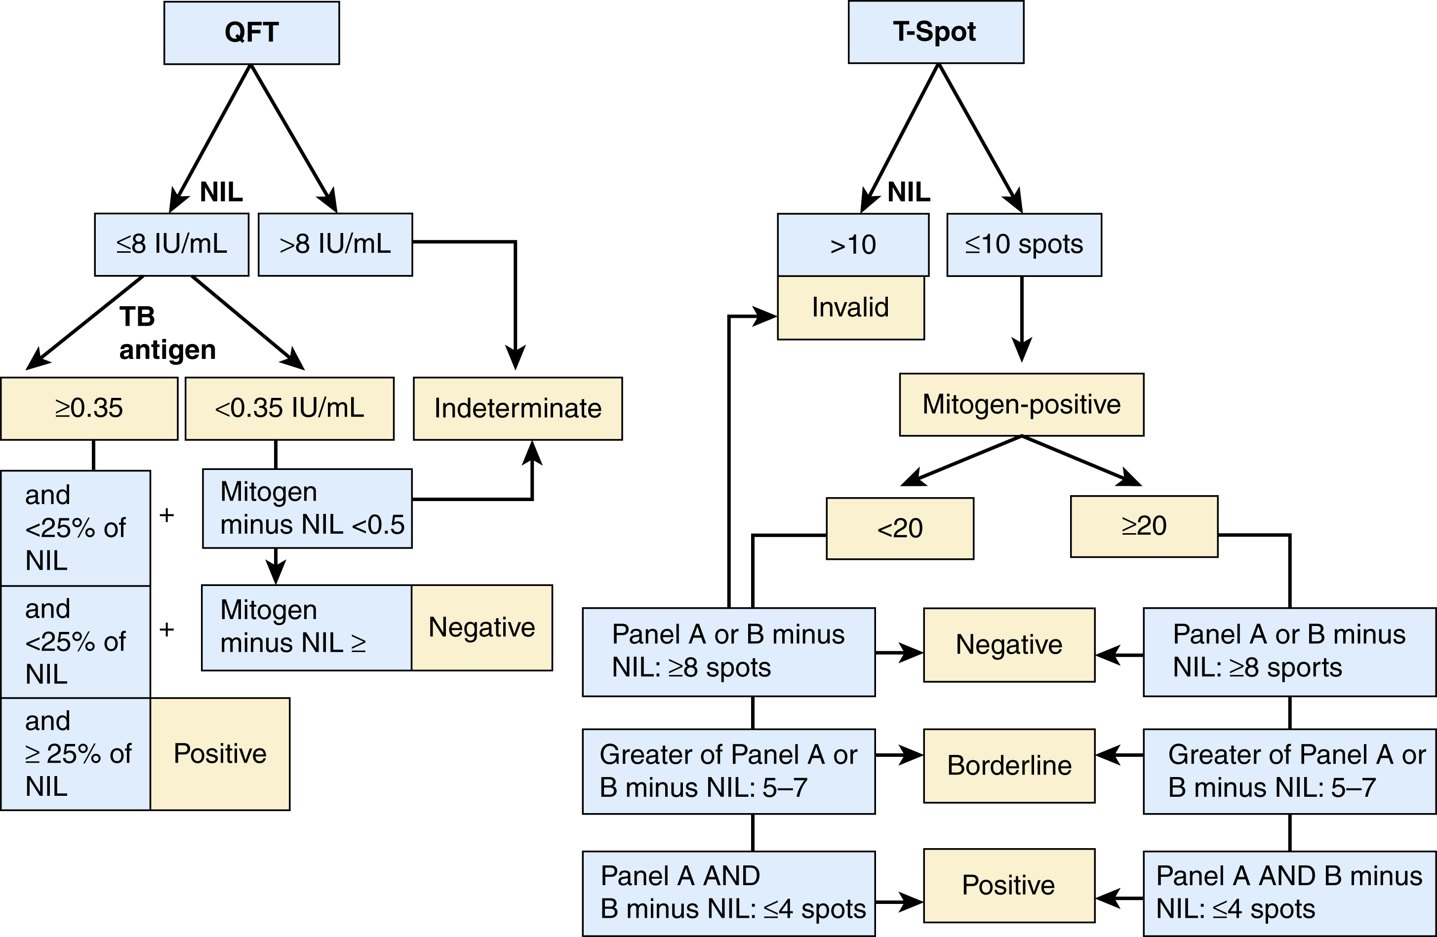
Tuberculosis – Diagnosis, IGRA
Interferon Gamma Release Assay (IGRA) blood test preferred over TST. 2 types of IGRA – T-Spot and QFT-Plus
In people living with HIV, both IGRA and TST may be negative (>10%). In the setting of advanced disease (i.e., CD4 count <50) and if there has been recent exposure to a person with infectious TB, LTBI treatment should be considered despite negative screening tests.
Tuberculosis Mejia-Chew, Carlos R., Comprehensive Review of Infectious Diseases, 32, 465-471 Indeterminate (QFT) or invalid (T-spot) results may be caused by either a failed positive (mitogen) or negative (NIL) control. When the controls are valid, results are interpreted after subtraction of the NIL result from the patient result. Copyright © 2020 © 2020, Elsevier Limited. All rights reserved.
Source: https://www.clinicalkey.com/student/content/book/3-s2.0-B9780323568661000329#hl0000374; https://www.clinicalkey.com/student/content/book/3-s2.0-B9780323930383002999#hl0000827

Slide 20
Tuberculosis – Diagnosis, Sputum Exam
Three sputum specimens should be collected at least 8 hours apart, with two of them collected in the morning on separate days.
The gold standard for diagnosis is growth of M. tuberculosis in culture, typically within 1 to 3 weeks by modern testing methods.
PCR testing and direct microscopic examination can yield a diagnosis more quickly, but they are less sensitive than culture.
Fluorochrome stains, which are standard in clinical TB laboratories, are more sensitive for detecting M. tuberculosis than classical AFB stains, but approximately 50% of patients with pulmonary TB are sputum smear negative.
DNA amplification testing by GenXpert MTB/RIF, which is more than 95% sensitive and specific in diagnosing TB from smear-positive sputum, can rapidly confirm the diagnosis of TB and detect the presence of rpoB mutations that confer rifampin resistance, which is strongly correlated with multidrug-resistant TB.
Source: https://www.clinicalkey.com/student/content/book/3-s2.0-B9780323930383002999#hl0000873

Slide 21
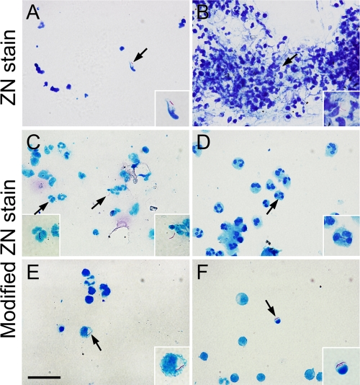
M. tuberculosis Staining
Mtb, a slow-growing, aerobic, nonspore-forming, nonmotile bacillus, with a lipid-rich cell wall: lacks pigment, produces niacin, reduces nitrate, produces heat-labile catalase.
Tuberculosis is an acid-fast bacterium (AFB), and is therefore, undetectable when stained using a Gram stain technique.
Microscopic examination of clinical samples for acid-fast bacilli using the Ziehl-Neelsen (ZN) stain has been a standard diagnostic tool and is used globally for rapid TB diagnosis. Microscopy can detect 60% to 70% of culture-positive samples with a lower limit of detection of 5 × 103 organisms/mL.
Newer fluorochrome stains, such as auramine and rhodamine, appear to have better detection compared with the ZN stain.
Image Source: https://www.ncbi.nlm.nih.gov/pmc/articles/PMC3318527/
Source: https://www.clinicalkey.com/student/content/book/3-s2.0-B9780323930383002999#hl0000873

Slide 22
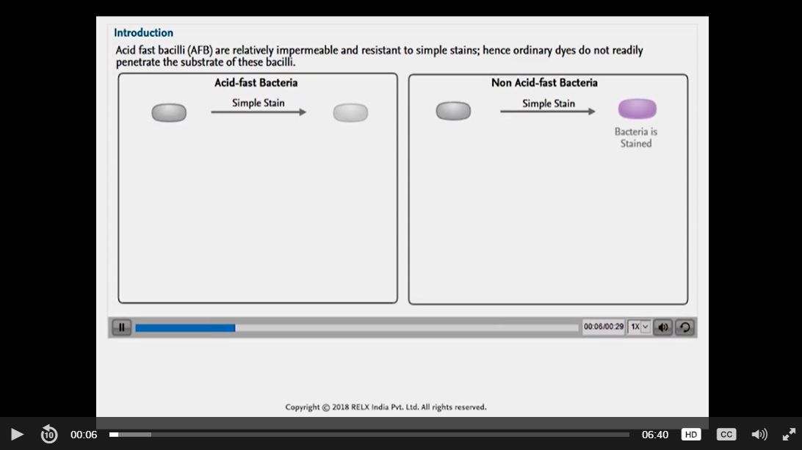
M. tuberculosis Staining
Play this video - https://www.clinicalkey.com/student/content/video/3-s2.0-B9788131260432000116-v9788131260432_0002
Source: https://www.clinicalkey.com/student/content/video/3-s2.0-B9788131260432000116-v9788131260432_0002

Slide 23
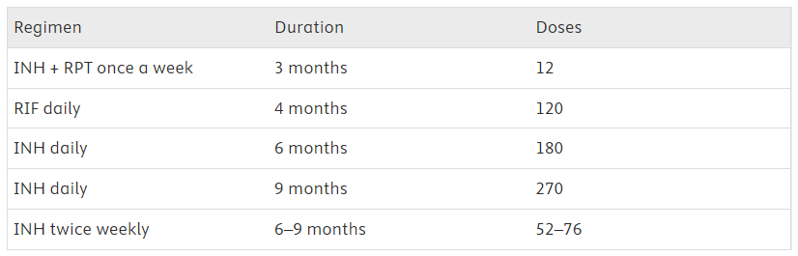
Tuberculosis – Treatment of LTBI
Treatment of LTBI: Effective treatment of LTBI reduces the risk of progression to TB disease by 60%–90%
Strongly recommended regimen is 3 months of rifapentine plus isoniazid given weekly for 12 doses to adults, including patients with HIV infection, unless there are contraindications.
Directly observed therapy (DOT), whereby a health care provider or another designee watches a person with TB take each dose, assists with adherence and prevention of adverse events.
Second preferred regimen is 4 months of daily rifampin
Source: https://www.clinicalkey.com/student/content/book/3-s2.0-B9780323568661000329#hl0000415; https://www.clinicalkey.com/student/content/book/3-s2.0-B9780323930383002999#hl0000924
Notes:
The single most important thing before treating TB infection is to rule out active TB disease (symptom review, physical exam, and baseline chest X-ray–CXR).
The completion rate for self-administered therapy is inferior to the completion rate with directly observed therapy. However, DOTS is expensive, labour intensive
3 months of rifapentine plus isoniazid runs risk of hypotension and syncope severe enough to require hospitalization

Slide 24
Tuberculosis – Treatment of Active TB
Active TB should be managed by or with the guidance of an experienced TB clinician.
All TB patients should have their isolates tested for drug susceptibility.
Use GenXpert MTB/RIF to confirm Mtb DNA and rifampin-resistance mutations. Drug regimen should depend upon drug-susceptible versus drug-resistant TB.
Patients who have pulmonary TB are considered infectious until they have had at least 2 weeks of therapy, show a clinical response (e.g., reduced cough, weight gain, resolution of fever and night sweats), and have no detectable acid-fast bacilli by microscopy on three sputum specimens at least 8 hours apart.
Follow-up must include monthly visits for clinical assessment and examination of sputum until the sputum is negative on at least two consecutive cultures. By 2 months after the start of therapy, about 75 to 80% of patients with pulmonary TB will be sputum culture negative, and about 95% will be negative after 3 months.
TB treatment helps cure the patient AND protect the community/ population.
For drug regimens refer here - https://www.clinicalkey.com/student/content/book/3-s2.0-B9780323930383002999#t0020; https://www.clinicalkey.com/student/content/book/3-s2.0-B9780323930383002999#t0025; https://www.clinicalkey.com/student/content/book/3-s2.0-B9780323930383002999#t0030
Source: https://www.clinicalkey.com/student/content/book/3-s2.0-B9780323930383002999#hl0000943
Notes:
The single most important thing before treating TB infection is to rule out active TB disease (symptom review, physical exam, and baseline chest X-ray–CXR).
The completion rate for self-administered therapy is inferior to the completion rate with directly observed therapy. However, DOTS is expensive, labour intensive
3 months of rifapentine plus isoniazid runs risk of hypotension and syncope severe enough to require hospitalization

Slide 25
Tuberculosis – Treatment of Extrapulmonary TB
Most patients with drug-sensitive extrapulmonary TB can be managed with standard 6- to 9-month therapy. Nine- to 12-month therapy is recommended for scrofula and for miliary, meningeal, bone, joint, genitourinary, gastrointestinal, or spinal TB.
Surgical débridement may be required for bone or spinal TB.
Adjunctive corticosteroids (e.g., dexamethasone 0.4 mg/kg/day for 7 days then 0.3 mg/kg/day for 7 days, then 0.2 mg/kg/day for 7 days, then 0.1 mg/kg/day for 7 days, then 4 mg/day for 7 days, and then tapered off by 1 mg/day each week) confer a mortality benefit in both HIV-negative and HIV-positive persons with TB meningitis. However, corticosteroids have no proven benefit for TB at other sites.
Shunting may be required for TB-related hydrocephalus.
Source: https://www.clinicalkey.com/student/content/book/3-s2.0-B9780323930383002999#hl0000943
Notes:
The single most important thing before treating TB infection is to rule out active TB disease (symptom review, physical exam, and baseline chest X-ray–CXR).
The completion rate for self-administered therapy is inferior to the completion rate with directly observed therapy. However, DOTS is expensive, labour intensive
3 months of rifapentine plus isoniazid runs risk of hypotension and syncope severe enough to require hospitalization

Slide 26
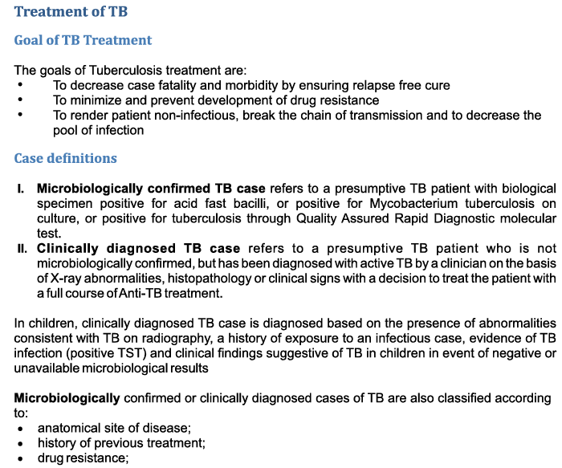
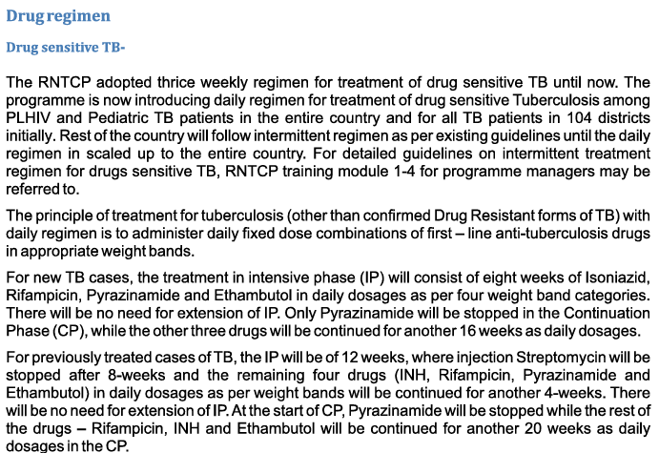
Tuberculosis – Guidelines for Treatment by Central TB Division
Source: https://tbcindia.gov.in/WriteReadData/l892s/8337437943TOG-Chapter%204-Treatment%20of%20TB%20Part%201.pdf

Slide 27
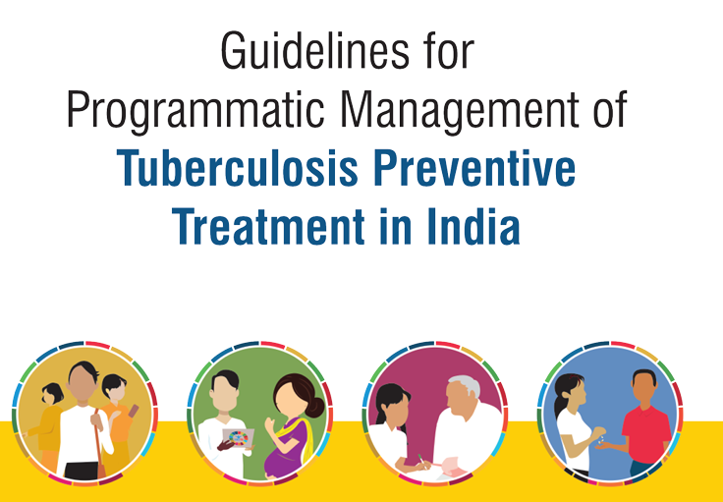
Tuberculosis – Guidelines for Management and Prevention in India
#EndTB in India by 2025 - TB Mukt Bharat
Tuberculosis Preventive Treatment (TPT) – key intervention recommended by WHO.
At risk populations – HIV+ adults, adolescents and children; all households in contact with pulmonary TB patients
Guidelines include but not limited to:
Enumerating target population
Assessing eligibility and providing TPT
Contraindications for TPT
Councelling
Special situations like women; those with renal failure, liver disease or HIV; intravenous drug users, babies born to mothers with TB
Monitoring and support
Implementation strategy
Source: https://tbcindia.gov.in/WriteReadData/l892s/Guidelines%20for%20Programmatic%20Management%20of%20Tuberculosis%20Preventive%20Treatment%20in%20India.pdf

Slide 28
Tuberculosis – Case-Based Learning
CASE 1
A 25-year-old male presents with fever, headache, productive cough and dyspnea. Physical examination reveals an elevated body temperature, oral thrush and increased respiratory rate. Laboratory examination for CD4 cells shows a CD4 count of 90 mm3. As a consultant, what is your opinion about the underlying process in this case?
CASE 2
A 44-year-old Asian man presents with a cough. This has been present for the last 2 months and has been associated with night sweats and 5 kg weight loss. He has not had any recent contact with anyone who has had similar illnesses; however, 3 months ago he went to Pakistan to visit his family.
On examination, his observations are stable, heart rate 80 beats/min, blood pressure 100/60 mmHg and respiratory rate 16 breaths/min. He is afebrile. There are no added sounds on auscultation of the chest.
Chest X-ray reveals hilar lymphadenopathy and apical scarring of the right lung.
Blood cultures, sputum cultures and routine blood tests are sent. Given the above history, examination and investigation findings, what is the most likely diagnosis?
More clinical cases and quiz questions available in ClinicalKey Student Assessment. Leverage the platform to identify cases for class discussion or create an assignment for students that can be used as a class quiz or for formative assessment.
Source: ClinicalKey Student Assessment

Slide 29
Post-Read

Slide 30
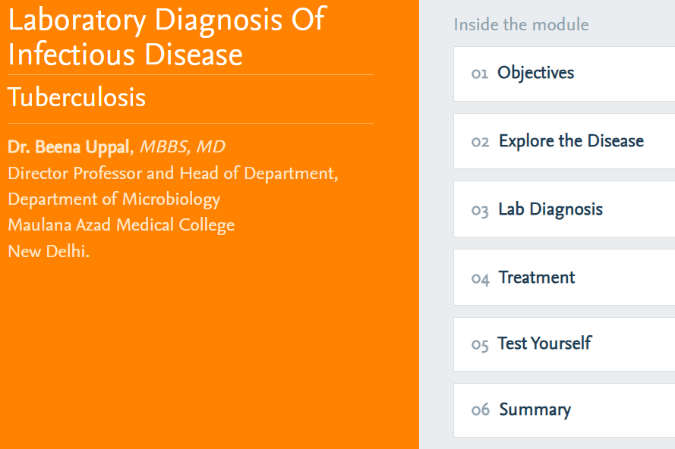
Summary of Tuberculosis Lecture
Tuberculous causative agents, pathogenesis, lab diagnostics
COURSE LINK
https://indiambbsskills.clinicalkey.com/mod/url/view.php?id=155467

Slide 31
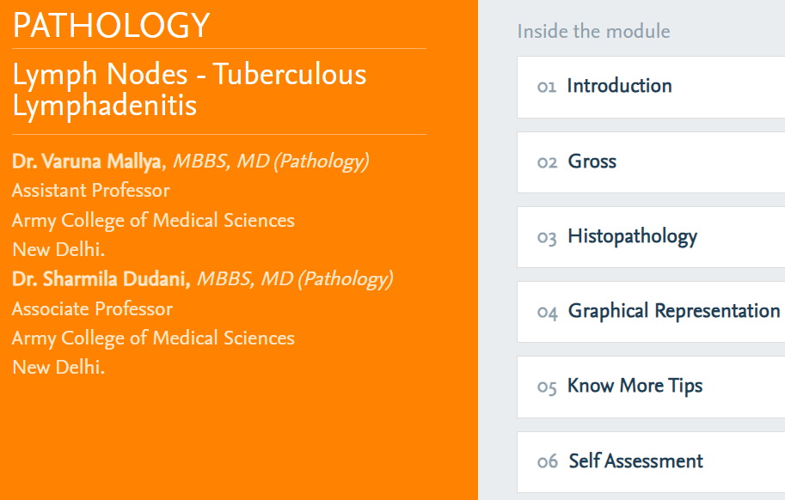
More about Tuberculous Lymphadenditis
Tuberculous Lymphadenitis – one of the most frequent presentations of extrapulmonary tuberculosis
Review the following topic in this course
COURSE LINK
https://indiambbsskills.clinicalkey.com/local/courses/2495/m08_lymph_node_s04_Tuberculous_LN/data/LandingPg.html

Slide 32
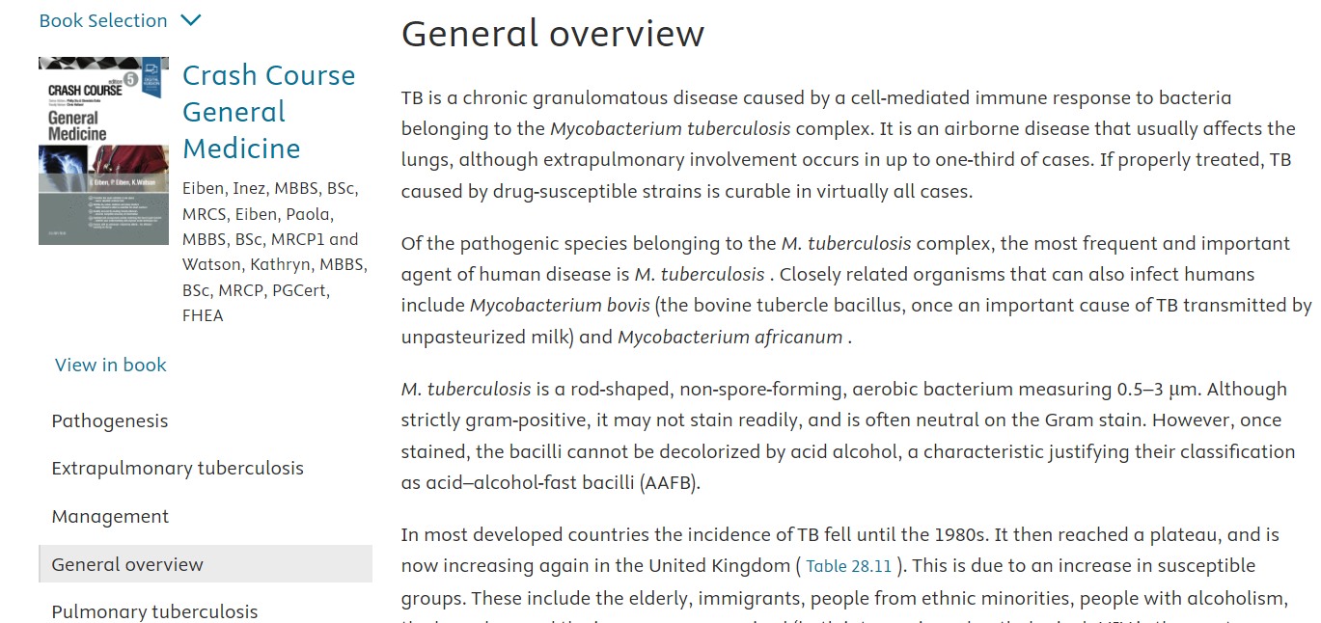
Refer to the Quick Access Summary
https://www.clinicalkey.com/student/topic/tuberculosis#hl0001885

Slide 33
Additional Learning Material
Lab Diagnosis
Experiment and Observation
Result
Summary of ZN Stain smear examination
Tuberculosis Treatment

Slide 34
Appendix

Slide 35
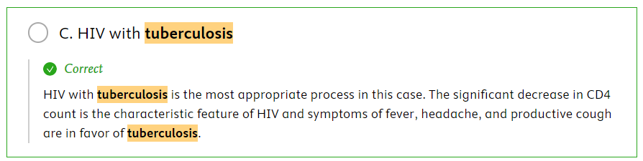
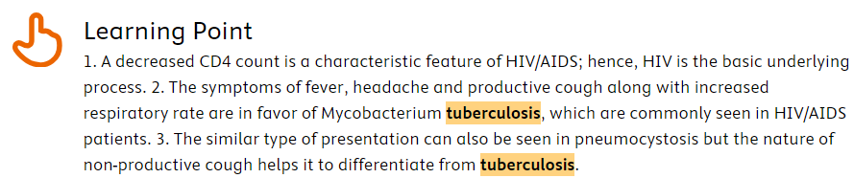
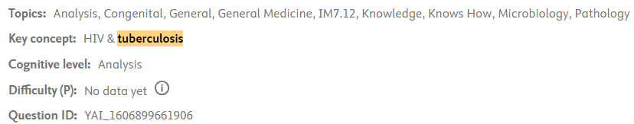
Tuberculosis – Case-Based Learning
CASE 1
A 25-year-old male presents with fever, headache, productive cough and dyspnea. Physical examination reveals an elevated body temperature, oral thrush and increased respiratory rate. Laboratory examination for CD4 cells shows a CD4 count of 90 mm3. As a consultant, what is your opinion about the underlying process in this case?
Source: ClinicalKey Student Assessment

Slide 36
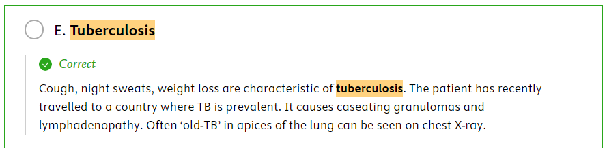
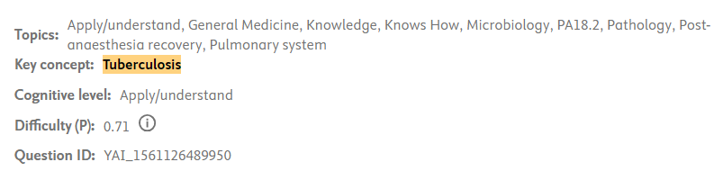
Tuberculosis – Case-Based Learning
CASE 2
A 44-year-old Asian man presents with a cough. This has been present for the last 2 months and has been associated with night sweats and 5 kg weight loss. He has not had any recent contact with anyone who has had similar illnesses; however, 3 months ago he went to Pakistan to visit his family.
On examination, his observations are stable, heart rate 80 beats/min, blood pressure 100/60 mmHg and respiratory rate 16 breaths/min. He is afebrile. There are no added sounds on auscultation of the chest.
Chest X-ray reveals hilar lymphadenopathy and apical scarring of the right lung.
Blood cultures, sputum cultures and routine blood tests are sent. Given the above history, examination and investigation findings, what is the most likely diagnosis?
Source: ClinicalKey Student Assessment

