Slide 1
Surgery lecture 2
Hernia
Prof X

Slide 2
Case
A 48-year-old male without significant past medical history presents to the general surgery office with a complaint of left groin pain. The pain is intermittent and seems to worsen with heavy lifting and straining. This has been occurring for approximately 2 years but has recently become more intense. Upon further questioning, he admits to feeling an occasional bulge in his left groin, especially with prolonged standing.

Slide 3
Importance of Hernia
Result
A total of 4642 surgeries were performed per year for a population of 88,273. Cataract (22.8%), Caesareans (3.8%), surgeries for fractures (3.27%) and hernia (2.86%) were the commonest surgeries. 44.2% of surgeries belonged to the essential surgeries. We estimated 3646 surgeries would be required per 100,000 Indian population per year. One-third of these surgeries would be needed for the age group 30–49 years, in the Indian population.
Conclusion
A total of 3646 surgeries were estimated annually to meet the surgical needs of Indian population as compared to the global estimate of 5000 surgeries per 100,000 people. Caesarean section, cataract, surgeries for fractures and hernia are the major contributors to the surgical needs. More enumeration-based studies are needed for better estimates from rural as well as other urban areas.

Slide 4
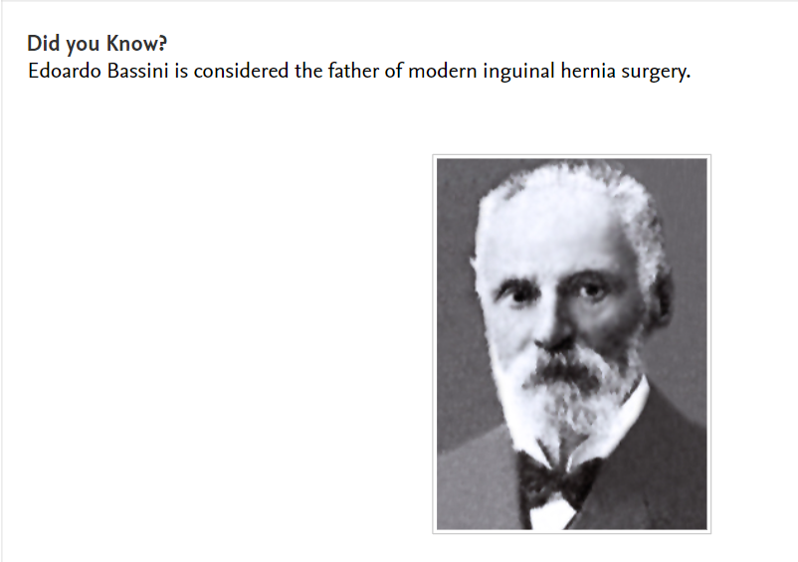
Who is father of inguinal surgery?

Slide 5
What is Inguinal Hernia
https://indiambbsskills.clinicalkey.com/local/courses/2309/s07_m19_Inguinal_hernia/data/DetailsPage.html?page=s7m19_01_01&language=_en&end=_s_001_en_main&level=LandingPg

Slide 6
Types of Hernia
This is the most common type of hernia and is substantially more prevalent in men. There are two types: indirect (85%) and direct (15%) inguinal hernias.
• Indirect: the hernial sac enters the inguinal canal through the deep ring (lateral to the inferior epigastric artery) and traverses through the canal to the superficial ring; it may eventually reach the scrotum or labia majora. It is the result of a congenital abnormality. Strangulation is a common complication because of the narrow neck of the hernial sac.
• Direct: the hernial sac protrudes through a weakness in the fascia transversalis (medial to the inferior epigastric artery) and does not normally descend into the scrotum or labia majora. It originates as a result of weakened abdominal muscles (usually acquired in the elderly). The neck of the sac is wide so strangulation is rare.
Clinically, it is difficult to distinguish between direct and indirect inguinal hernias.

Slide 7
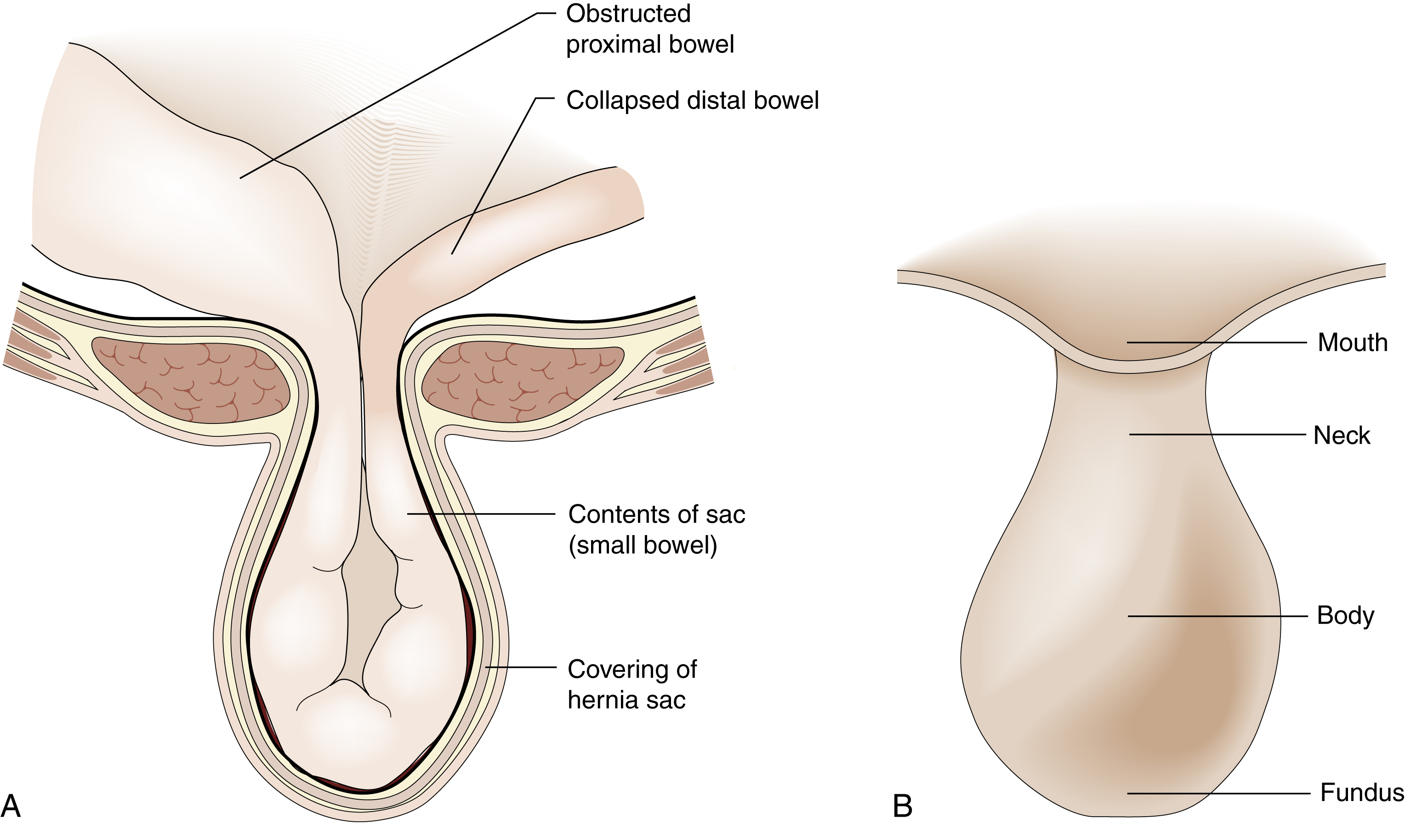
The abdominal wall and hernia East, Barbora, Principles and Practice of Surgery, 12, 150-161 Hernia. (A) Anatomic structure. (B) Parts of the hernial sac. Copyright © 2023 © 2023, Elsevier Limited. All rights reserved.

Slide 8
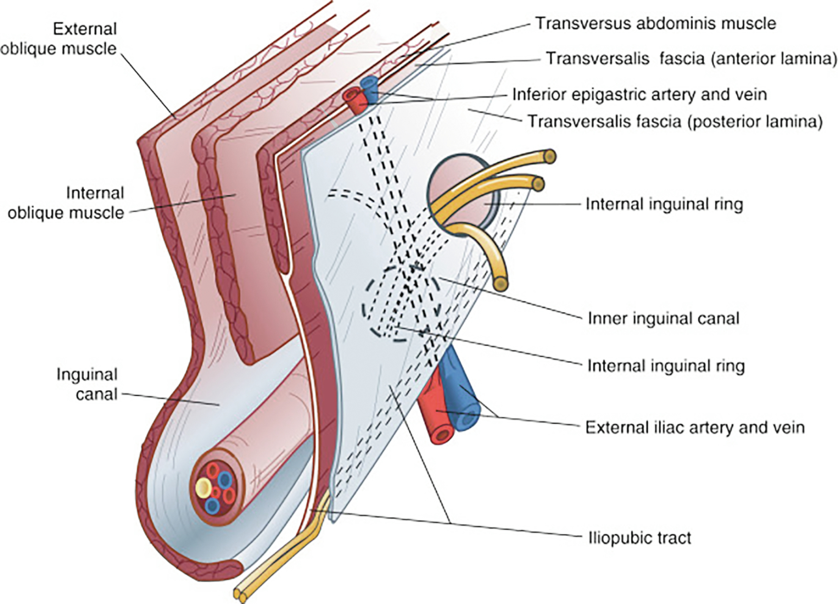
Groin Mass in a 48-Year-Old Male Williams, Austin D., Surgery Morning Report: Beyond the Pearls, Chapter 9, 83-89 Inguinal anatomy. (From Malangoni MA, Rosen MJ: Hernias. In Townsend CM Jr, Beauchamp D, editors: Sabiston textbook of surgery, Philadelphia, 2017, Elsevier, pp 1092–1119.) Copyright © 2020 Copyright © 2020 by Elsevier, Inc. All rights reserved.

Slide 9
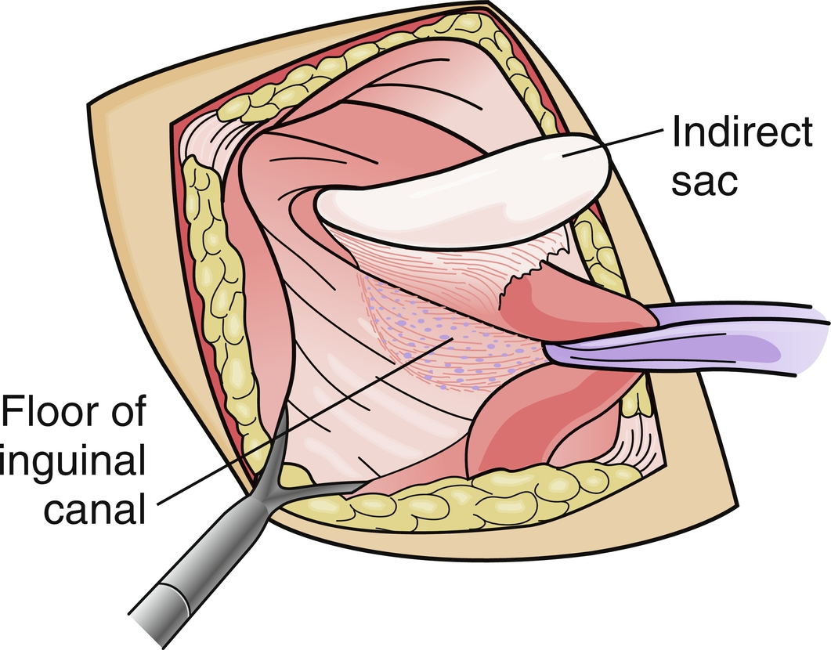
Groin Mass in a 48-Year-Old Male Williams, Austin D., Surgery Morning Report: Beyond the Pearls, Chapter 9, 83-89 Open inguinal hernia repair. (Redrawn from Mann BD: Operation 9: open inguinal hernia repair. In Surgery: a competency-based companion, Philadelphia, 2009, Elsevier, p 685.) Copyright © 2020 Copyright © 2020 by Elsevier, Inc. All rights reserved.

Slide 10
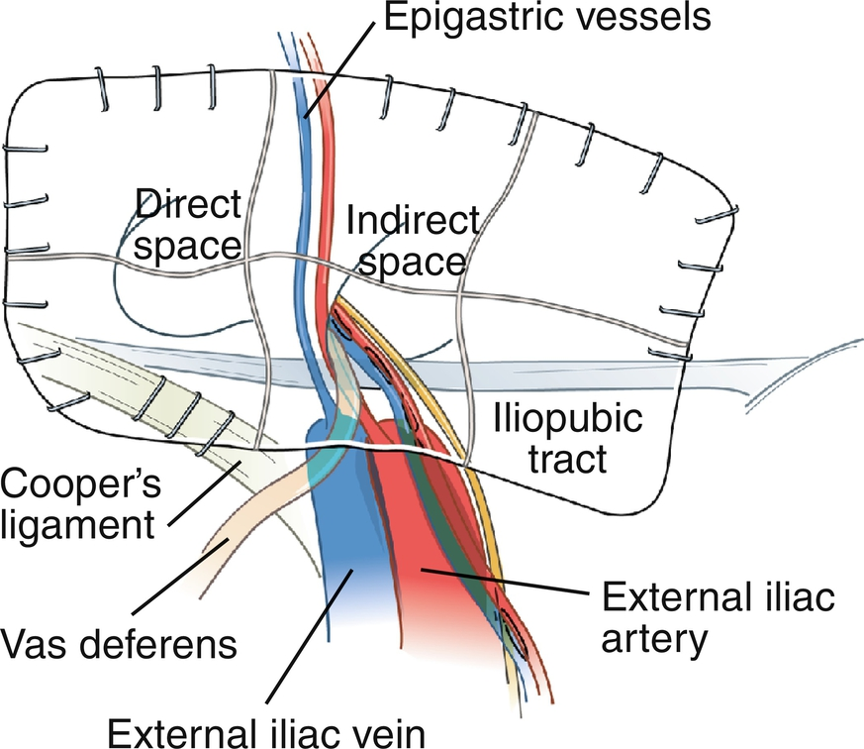
Groin Mass in a 48-Year-Old Male Williams, Austin D., Surgery Morning Report: Beyond the Pearls, Chapter 9, 83-89 Laparoscopic inguinal hernia repair. (Redrawn from Mann BD: Operation 10: laparoscopic inguinal hernia repair. In Surgery: a competency-based companion, Philadelphia, 2009, Elsevier, p 686.) Copyright © 2020 Copyright © 2020 by Elsevier, Inc. All rights reserved.

Slide 11
Hernia Video
https://indiambbsskills.clinicalkey.com/local/courses/2309/s07_m19_Inguinal_hernia/data/LandingPg.html
https://www.clinicalkey.com/student/content/video/23-s2.0-mm_9780323790185_0077

Slide 12
Book Chapter
https://www.clinicalkey.com/student/content/book/3-s2.0-B9780702082511000121#hl0000468
https://www.clinicalkey.com/student/content/book/3-s2.0-B9780323597593000093

Slide 13
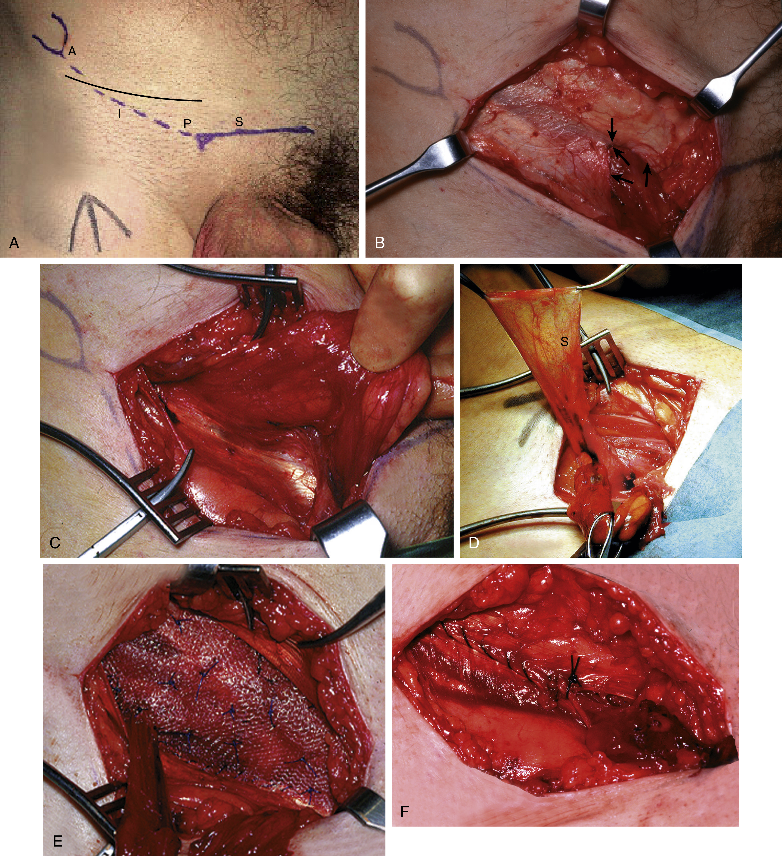
Hernias and Other Groin Problems Quick, Clive R.G., MBBS(London), FDS, FRCS(England), MS(London), MA(Cantab), Essential Surgery: Problems, Diagnosis and Management, 32, 432-443 Technique of Mesh Hernia Repair. (A) Skin markings demonstrating the upper border of the pubic arch (S), the anterior superior iliac spine (A), the pubic tubercle (P) and the inguinal ligament (I). Note the side of the planned operation has been m... Copyright © 2020 © 2020, Elsevier Limited. All rights reserved.

Slide 14
Case
https://www.clinicalkey.com/student/content/book/3-s2.0-B9780323597593000226?origin=share&title=Surgery%20Morning%20Report%3A%20Beyond%20the%20Pearls&meta=2020%2C%20Yanala%2C%20Ujwal&img=https%3A%2F%2Fcdn.clinicalkey.com%2Fck-thumbnails%2FC20170009254%2Fcov200h.gif

Slide 15
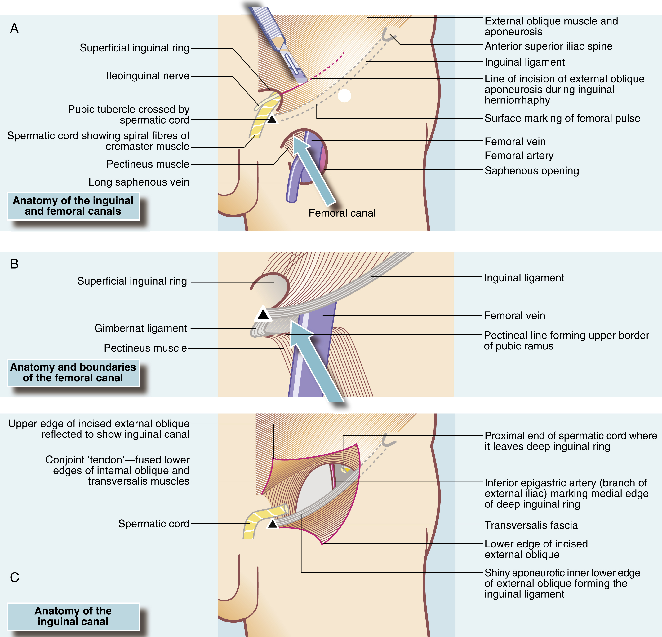
Hernias and Other Groin Problems Quick, Clive R.G., MBBS(London), FDS, FRCS(England), MS(London), MA(Cantab), Essential Surgery: Problems, Diagnosis and Management, 32, 432-443 Structure of the Inguinal and Femoral Canals. (A) The entire groin area. The surface marking of the femoral pulse is shown, midway between the pubic symphysis and the anterior superior iliac spine; the deep ring lies 2.5 cm above it. (B) Structure... Copyright © 2020 © 2020, Elsevier Limited. All rights reserved.

Slide 16
https://forms.gle/wap1ayxvktBoYKqb8

