Slide 1
Sample Lecture on Protein Structure and Function
King George’s Medical University
March 2024
Elsevier Health, India

Slide 2
Purpose of this Document
The purpose of this document is to share innovative ideas, approaches and techniques that faculty can adopt to make medical teaching:
Outcomes-based
Self-directed
Engaging
We encourage faculty to focus on student-centricity, patient-centricity and contextualization.
We hope these workshops will help you move forward with the new competence-based curriculum in an efficient and effective manner.
Ideas, approaches and techniques are suggestive only. Faculty should select those that are most conducive based on their personal preferences.

Slide 3
Learning Objectives
Understand the role of proteins
Understand structure of proteins and how it relates to their function
Understand and describe pathological conditions arising from structural abnormalities in proteins
Number | Competency Student should be able to | Domain K/S/A/C | Level K/KH/SH/P | Core (Y/N) | Suggested Teaching Learning method | Suggested Assessment method | Number required to certify P | Vertical Integration | Horizontal Integration
BI5.1 | Describe and discuss structural organization of proteins. | K | KH | Y | Lecture, Small group discussion | Written/ Viva voce
BI5.2 | Describe and discuss functions of proteins and structure-function relationships in relevant areas eg, hemoglobin and selected hemoglobinopathies | K | KH | Y | Lecture, Small group discussion | Written/ Viva voce |  | Pathology, General Medicine | Physiology

Slide 4
Pre-Read

Slide 5
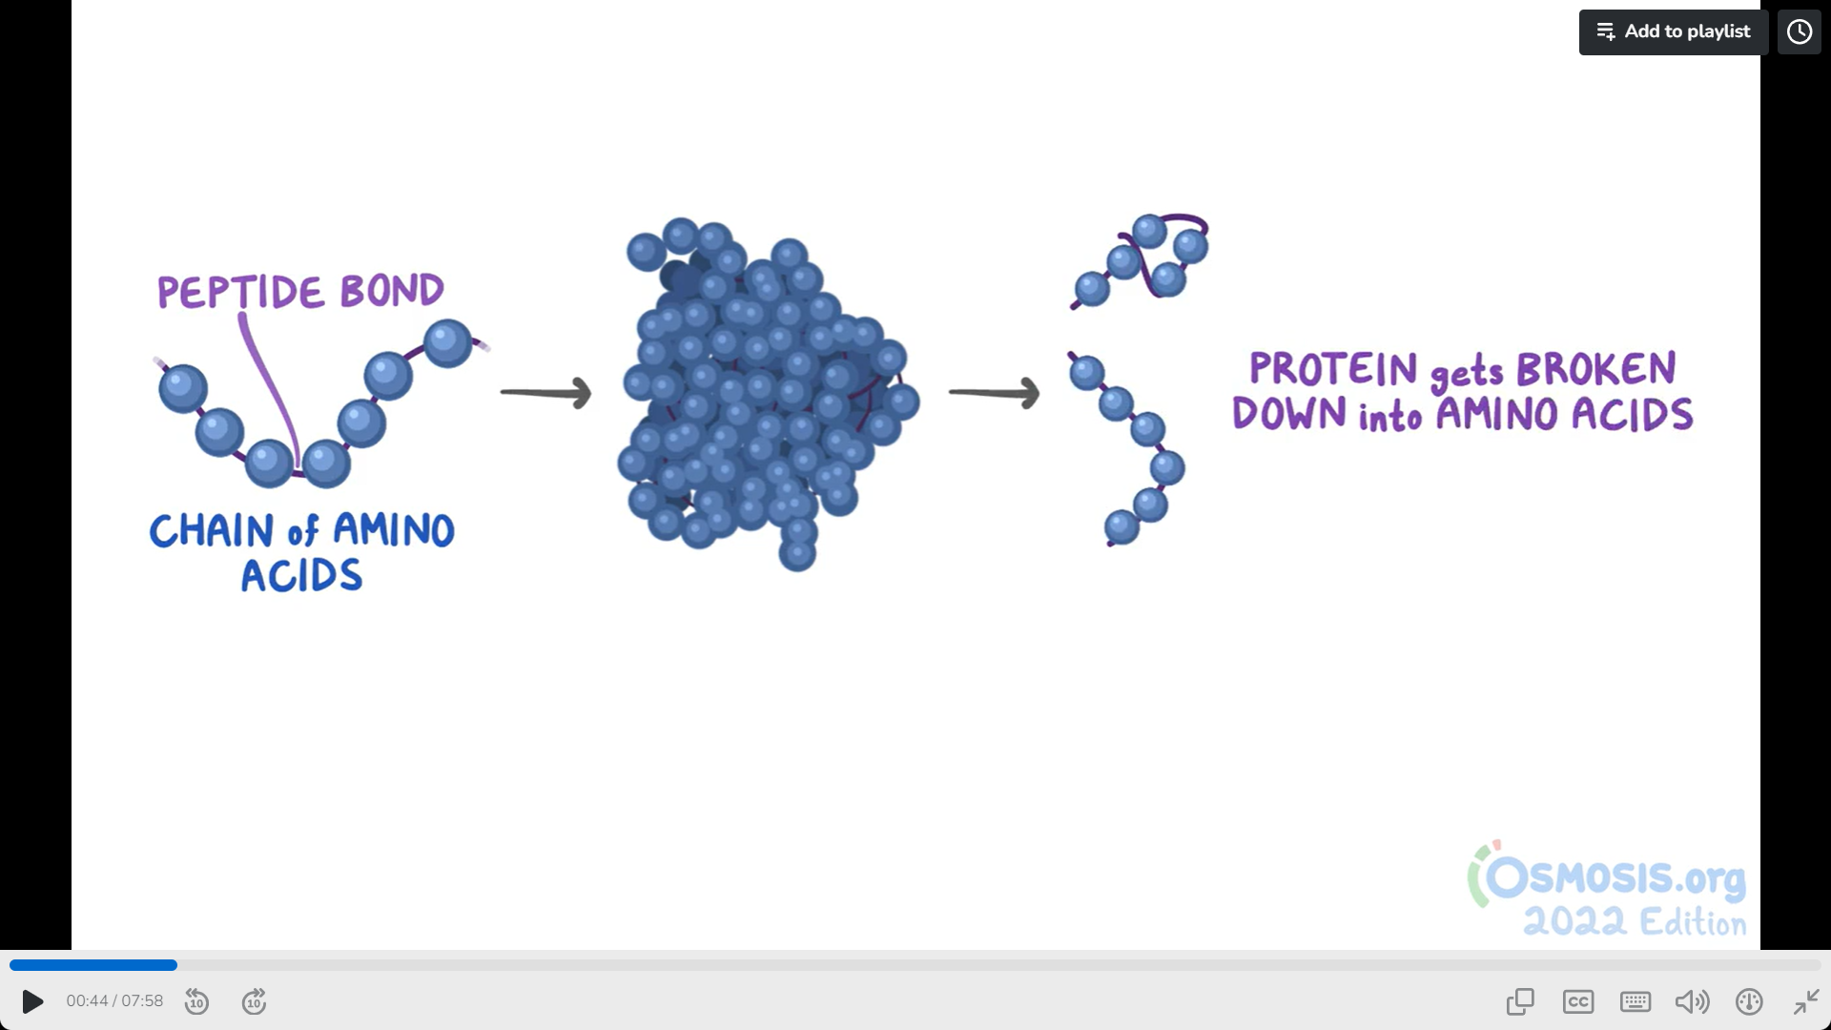
Overview of Proteins – Video
Sources: Osmosis

Slide 6
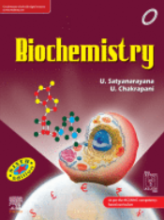
Protein Structure
Objective: Pre-read key concepts in Protein Structure to benefit from a lively class discussion.
Proteins and Amino Acids - Biochemistry
Satyanarayana, U., Dr.; Chakrapani, U., Dr.;
TOC:
Origin of the word “protein”
Functions of proteins
Elemental composition of proteins
Proteins are polymers of amino acids
Proteins are born at translation
Standard amino acids
Classification of amino acids
Non-standard amino acids
Structure of Proteins – Primary, Secondary, Supersecondary, Tertiary, Quarternary
Protein Conformation
Properties of Proteins
Denaturation
Nephlometry and Turbidimetry
Classification of Proteins
Sources: Biochemistry, 6th Ed.

Slide 7
Lecture

Slide 8
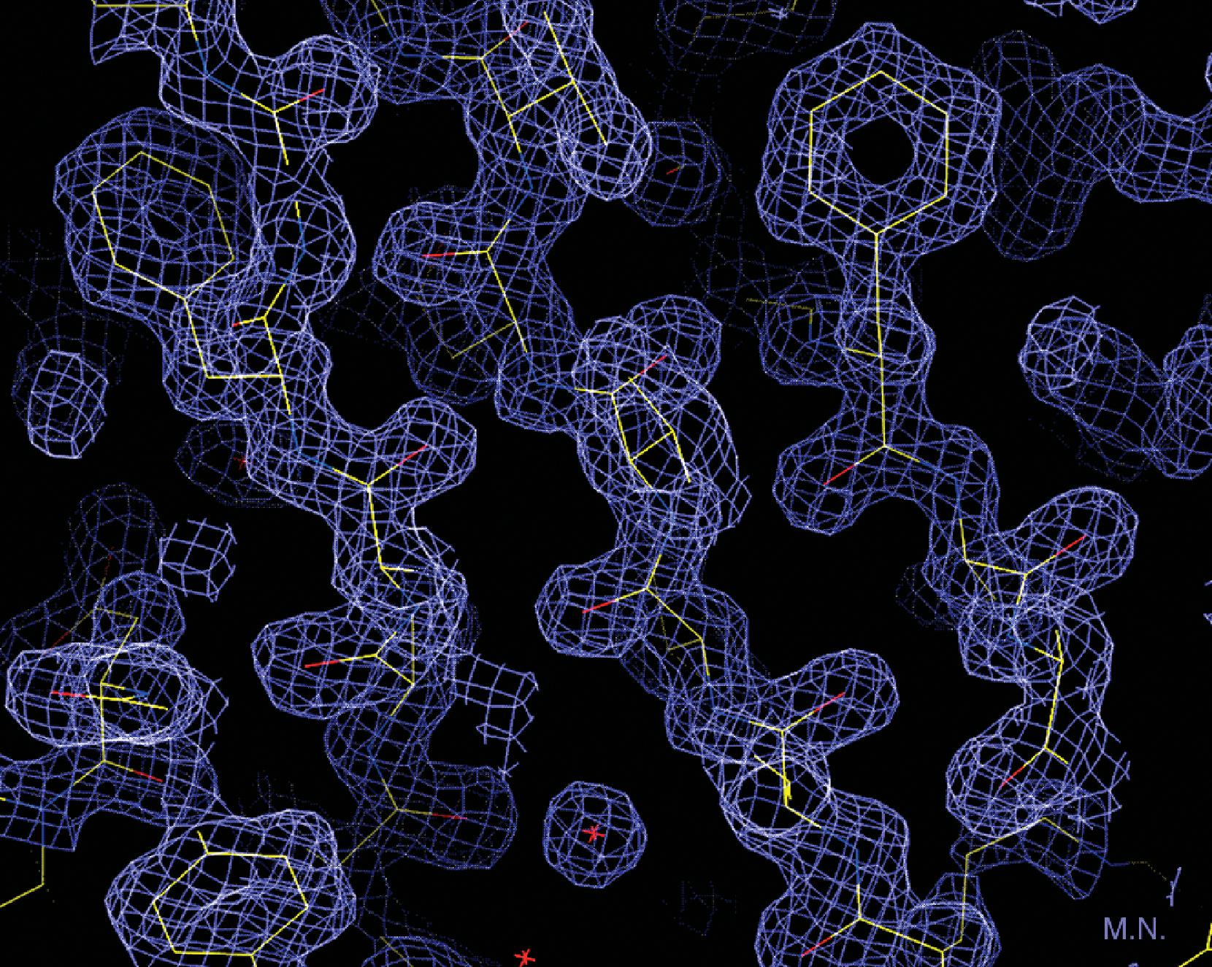
What are Proteins?
Most abundant macromolecule
Occur in all cells and parts of cells
Range from small peptides to large polymers with molecular weight in millions
Display great diversity in form and function
Molecules: Structures and Dynamics Pollard, Thomas, Cell Biology, Chapter3, 33-54 PROTEIN STRUCTURE DETERMINATION BY X-RAY CRYSTALLOGRAPHY. A small part of an electron density map at 1.5-Å resolution of the cytoplasmic T1 domain of the shaker potassium channel from Aplysia. The chicken-wire map shows the electron density. The s... Copyright © 2023 Copyright © 2023 by Elsevier . All rights reserved.
Source: https://www.clinicalkey.com/student/content/book/3-s2.0-B9788131264973500091
Essentials of Biochemistry

Slide 9
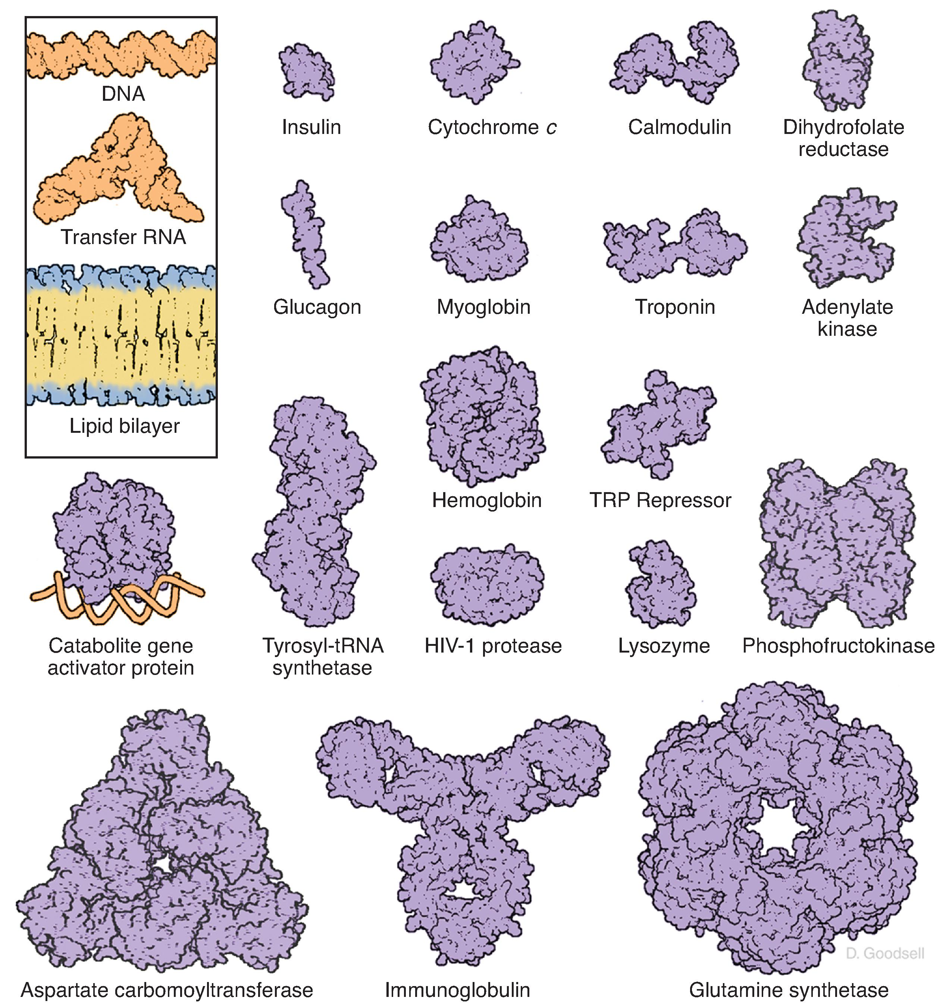
Bird’s Eye View of the Diversity of Proteins
Molecules: Structures and Dynamics Pollard, Thomas, Cell Biology, Chapter3, 33-54 A GALLERY OF MOLECULES. Space-filling models of proteins compared with a lipid bilayer, transfer RNA (tRNA), and DNA, all on the same scale. TRP, tryptophan. (Modified from Goodsell D, Olsen AJ. Soluble proteins: Size, shape, and function. Trends ... Copyright © 2023 Copyright © 2023 by Elsevier . All rights reserved.
Source: Cell Biology, 4th Ed

Slide 10
What are Proteins?
Class Discussion
What roles do proteins play across all cells and life forms?
Read more here: https://www.clinicalkey.com/student/search/role%20of%20proteins?source=search-results

Slide 11
What are Proteins made of?
Long chains of amino acids linked by peptide bonds wherein the carboxyl group of one amino acid links to the amino group of the other amino acid
Every single protein has a well defined, unique amino acid sequence AND a 3D structure (conformation).
No. of amino acids in a protein can vary from a few to several thousands
Proteins can comprise a single polypeptide chain or multiple chains held together by non-covalent bonds. These are called multi-subunit proteins.
Multi-subunit protein with at least 2 identical polypetide chains = oligomeric protein
Multi-subunit protein with 2 subunits = homodimer or heterodimer
Multi-subunit protein with 4 subunits = homotetramer or hetertetramer
Source: https://www.clinicalkey.com/student/content/book/3-s2.0-B9780323834506000024#3-s2.0-B9780323834506000024-f02-09-9780323834506
Medical Biochemistry, 6th Ed.

Slide 12
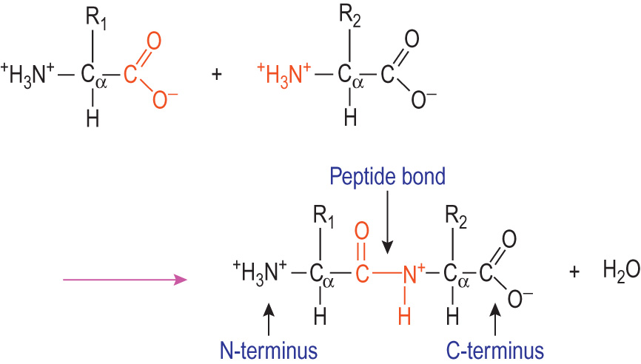
What are Proteins made of?
Biochemistry and cell biology Dominiczak, Marek H., Medical Sciences, 2, 15-56 The peptide bond. Copyright © 2019 © 2019, Elsevier Limited All rights reserved.
Source: Medical Sciences, 3rd Ed.

Slide 13
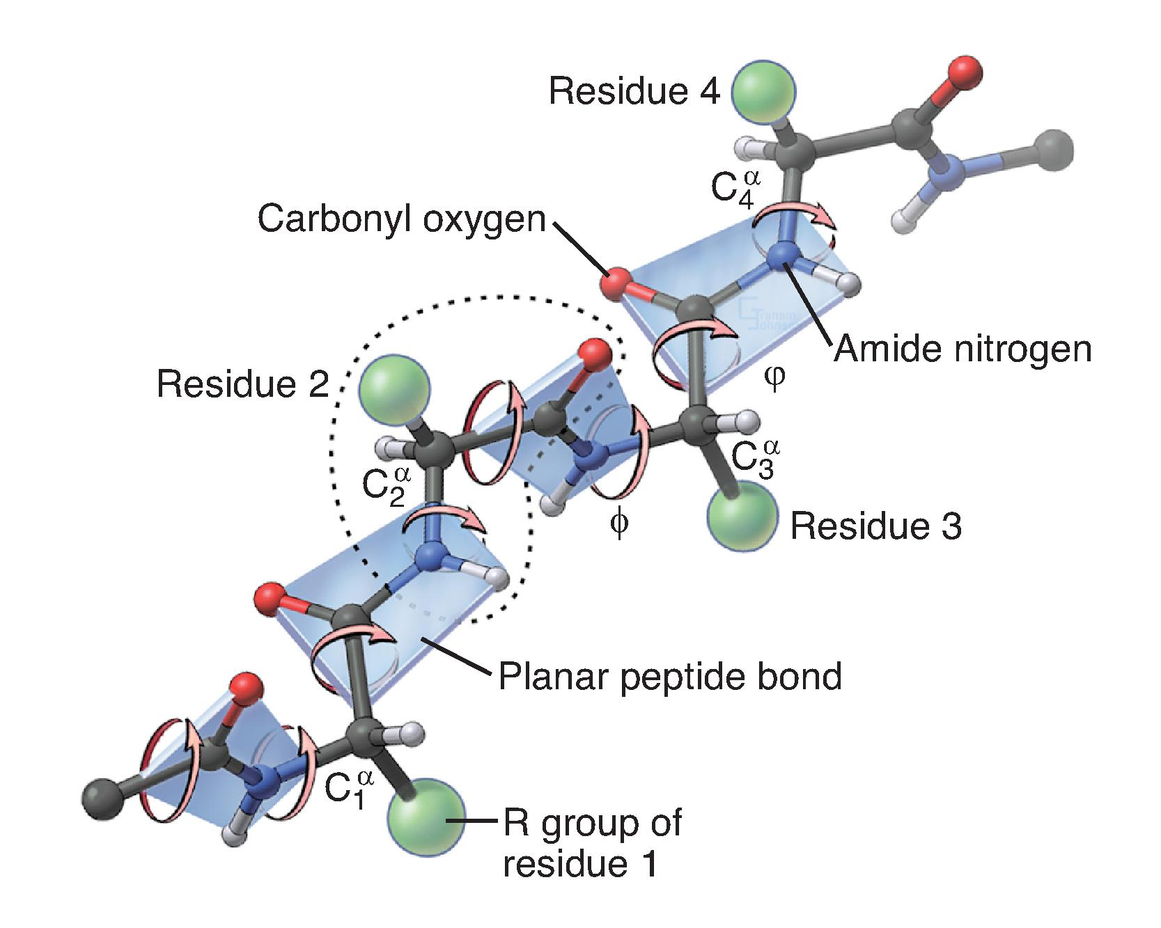
What are Proteins made of?
Molecules: Structures and Dynamics Pollard, Thomas, Cell Biology, Chapter3, 33-54 THE POLYPEPTIDE BACKBONE. This perspective drawing shows four planar peptide bonds, the four participating α-carbons (labeled 1 to 4), the R groups represented by the green spheres, amide protons, carbonyl oxygens, and the two rotatable backbone b... Copyright © 2023 Copyright © 2023 by Elsevier . All rights reserved.
Source: Cell Biology, 4th Ed

Slide 14
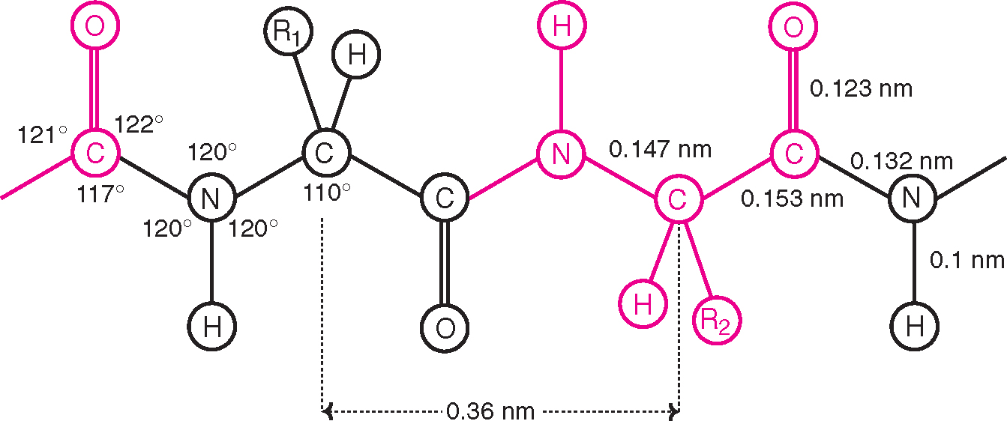
What are Proteins made of?
Proteins and Amino Acids Satyanarayana, U., Dr., Biochemistry, 4, 45-71 Dimensions of a fully extended polypeptide chain. (The distance between two adjacent α-carbon atoms is 0.36 nm). Copyright © 2021 Copyright © 2021 Dr. U. Satyanarayana. All Rights Reserved.
Source: Biochemistry, 6th Ed

Slide 15
Lecture Part 1 – Structure and Properties of Amino Acids

Slide 16
Structure of Amino Acids
Amino acids contain an α-Carbon (C_{α}) linked to:
An amine group (H₃N⁺)
A carboxyl group (COO⁻)
An H
An R chain – unique for each amino acid. Determines the chemical properties.
20 simple amino acids occur naturally
COO⁻ + H₃N⁺ → CO—NH + H₂O --- Peptide or Amide Bond
Source: https://www.clinicalkey.com/student/content/book/3-s2.0-B9788131264355500146#hl0000656
Biochemistry, 6th Ed.

Slide 17
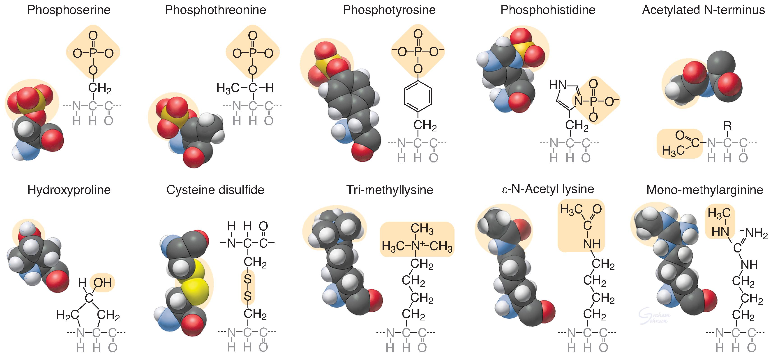
Structure of Amino Acids
Molecules: Structures and Dynamics Pollard, Thomas, Cell Biology, Chapter3, 33-54 MODIFIED AMINO ACIDS. Protein kinases add a phosphate group to serine, threonine, tyrosine, histidine, and aspartic acid (not shown). Other enzymes add one or more methyl groups to lysine, arginine, or histidine (not shown); a hydroxyl group to pr... Copyright © 2023 Copyright © 2023 by Elsevier . All rights reserved.
Source: Cell Biology, 4th Ed

Slide 18
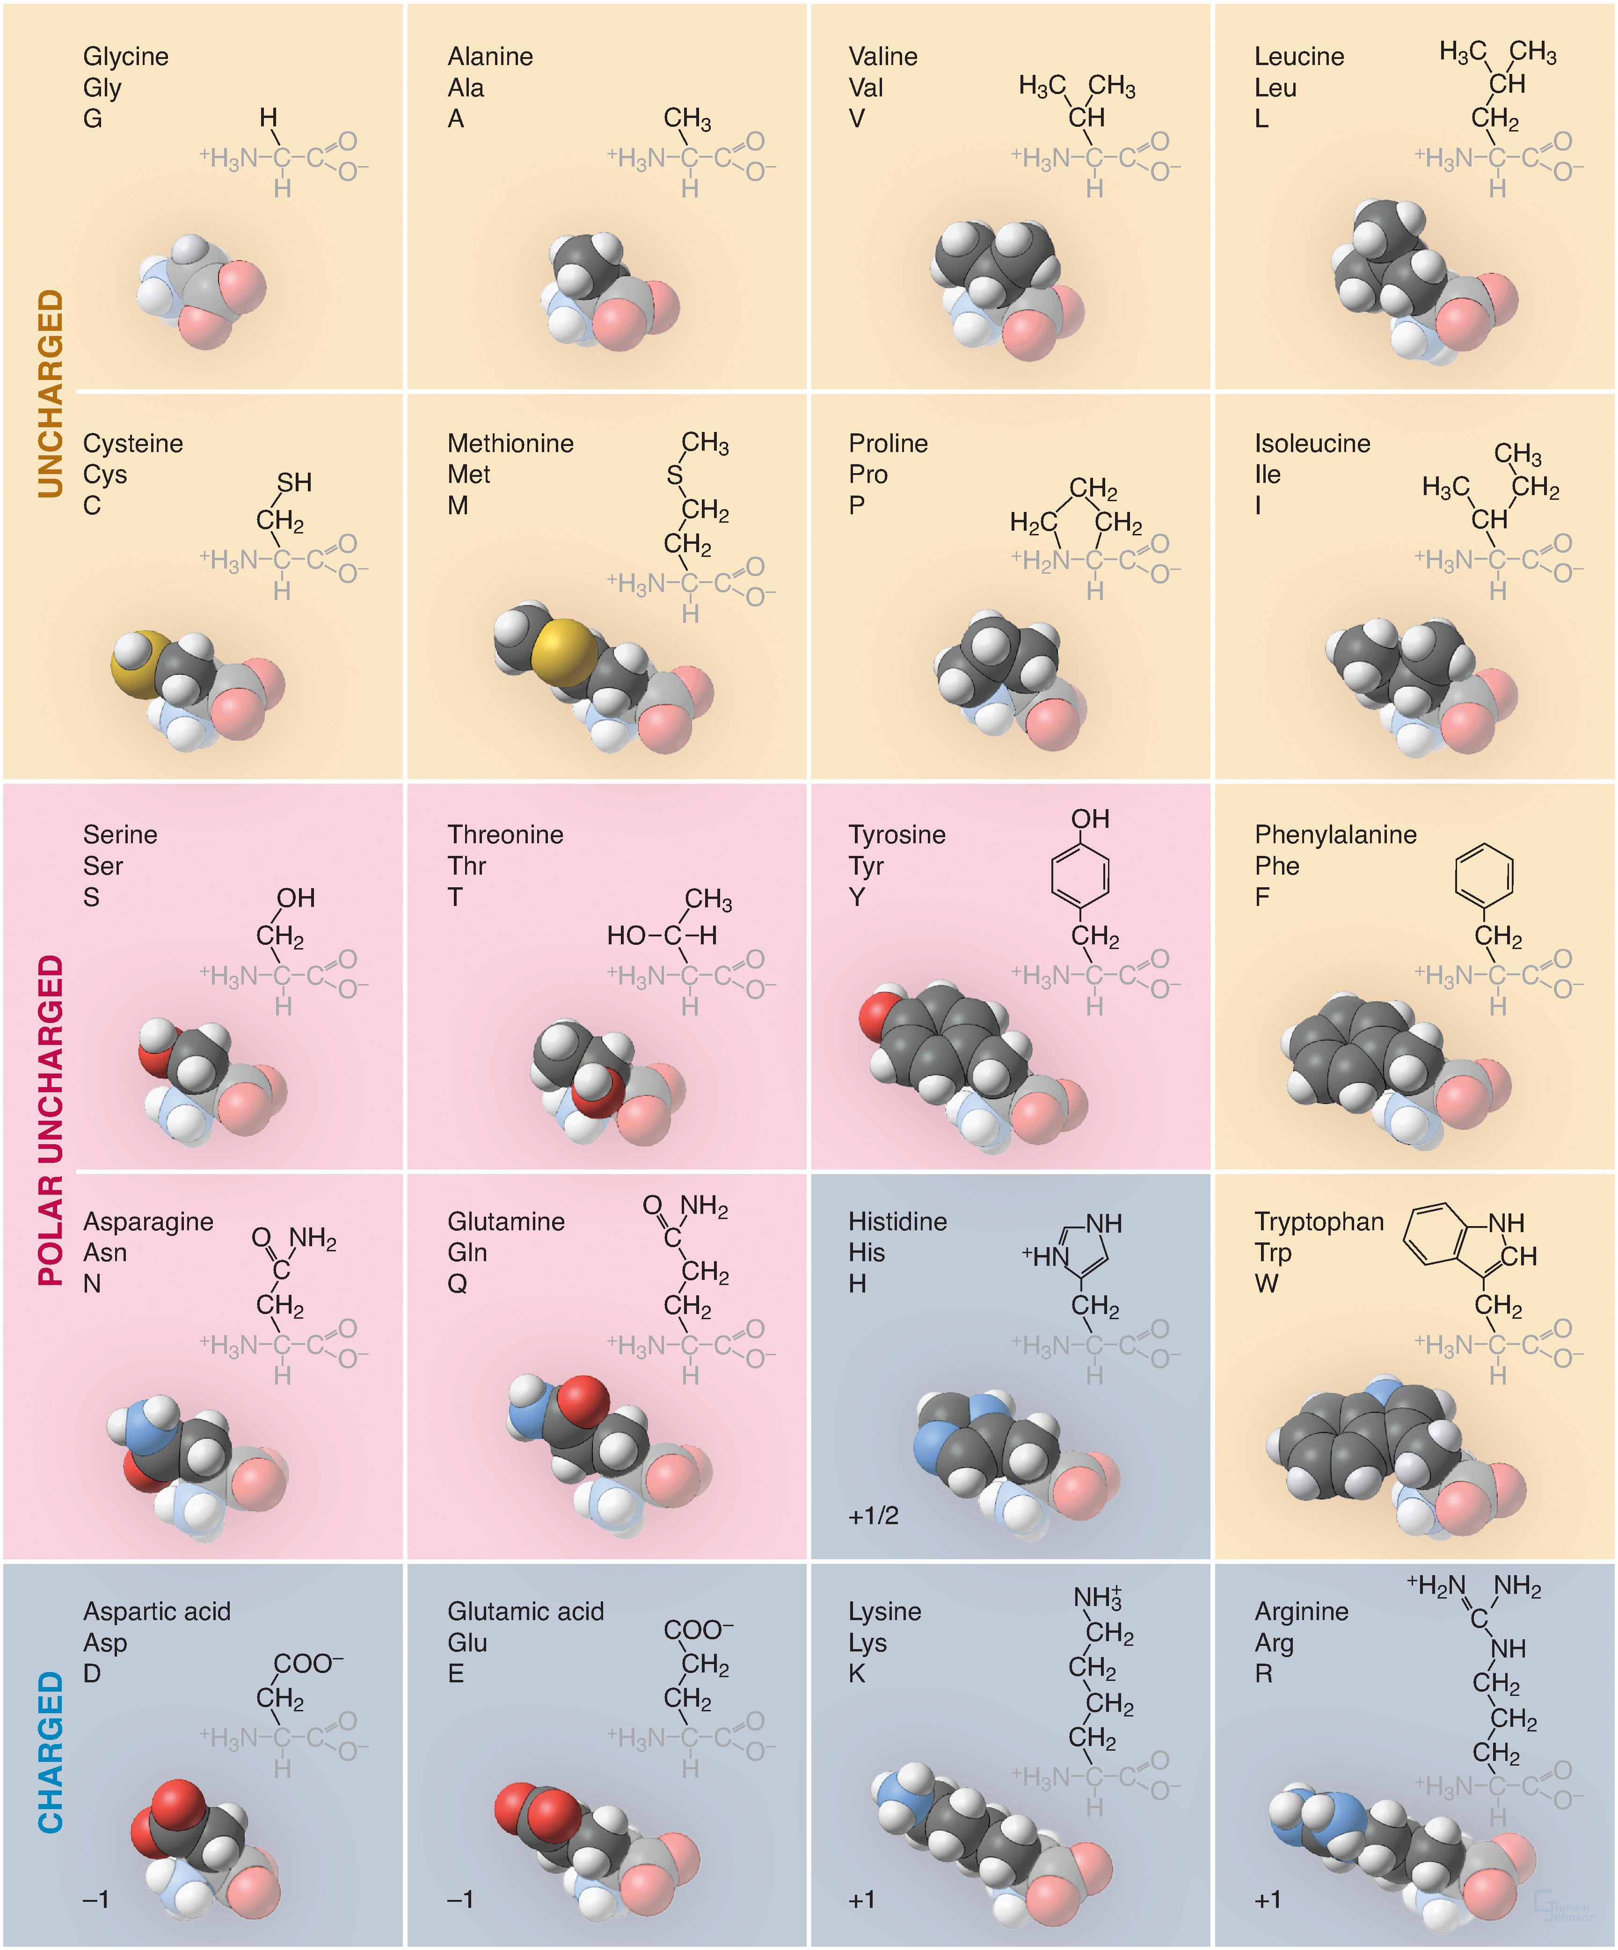
Structure of Amino Acids
All but one of the 20 amino acids commonly used in proteins consist of an amino group, bonded to the α-carbon, bonded to a carboxyl group. Proline is a variation on this theme, with a cyclic side chain bonded back to the nitrogen to form an imino group.
After incorporation into polypeptide chains, aminos acids undergo enzymatic modification called posttranslational modification, for example:
Phosphorylation of amino acid side chains
Conjugation with sugars in asparagine, serine, threonine
Methylation and acetylation of lysines
Molecules: Structures and Dynamics Pollard, Thomas, Cell Biology, Chapter3, 33-54 THE 20 l-AMINO ACIDS SPECIFIED BY THE GENETIC CODE. Shown for each are the full name, the three-letter abbreviation, the single-letter abbreviation, a stick figure of the atoms, and a space-filling model of the atoms in which hydrogen is white, ca... Copyright © 2023 Copyright © 2023 by Elsevier . All rights reserved.
Source: https://www.clinicalkey.com/student/content/book/3-s2.0-B9780323758000000037#hl0000399
Cell Biology, 4th Ed.

Slide 19
Properties of Amino Acids
Physical Properties
Soluble in water, insoluble in organic solvents
Melt at high temp., >20^{O}C
Can be sweet, tasteless or bitter
All the amino acids except glycine possess optical isomers due to the presence of asymmetric α-carbon atoms.
Ampholytes – contain an acidic (-COOH) and basic (-NH₂) group. Therefore, Zwitterion or dipolar.
Isoelectric pH is the pH at which the molecule exists as a Zwitterion, that is, no net charge.
Chemical Properties
Form salts with bases and esters with alcohols
Amino acids undergo decarboxylation to produce corresponding amines, such as, histamine, tyramine, GABA.
The carboxyl group of dicarboxylic amino acids reacts with NH 3 to form amide, such as, Asparagine, Glutamine
Can be identified by colour reactions
Undergo Transamination - Transfer of an amino group from an amino acid to a keto acid to form a new amino acid
Source: https://www.clinicalkey.com/student/content/book/3-s2.0-B9788131264973500091#hl0000502
Essentials of Biochemistry,

Slide 20
Disease Conditions Related to Amino Acids Variations
Group Assignment
Identify a pathological condition in humans caused by an amino acid variation and highlight the following:
Disease overview
Symptoms
Etiology including the impact on protein structure and function, and the resultant physical manifestations
Diagnosis
Treatment
Prognosis
Hint: Read more here: Phenylketonuria, Alkaptonuria, Richner-Hanhart Syndrome, Sickle Cell Disease ; Gaucher disease; Tay-Sachs disease; von Gierke disease; Glucose-6-phosphate dehydrogenase deficiency

Slide 21
Lecture Part 2 – Structure and Function of Proteins

Slide 22
Properties of Proteins
High molecular weight
Can be fibrous or globular. Globular proteins are generally soluble in water and can be diluted in salt solution to varying degrees.
Amphoteric compounds
Precipitate by heat, in alcohols and at their isoelectric point – So what do you think happens when we cook proteins?
Source: https://www.clinicalkey.com/student/content/book/3-s2.0-B978813126560400048X#hl0000128; https://www.clinicalkey.com/student/content/book/3-s2.0-B9780323930383000411#hl0000223
Textbook of Physiology for Medical Students, 2nd Ed. Goldman-Cecil Medicine, 27th Ed.

Slide 23
Classification of Proteins
Classification of Proteins
Chemical Composition
Shape
Biological Function
Simple proteins – yield only amino acids upon hydrolysis. Eg, Ribonuclease A, chymotrypsin
Conjugated proteins – include a prosthetic group. Eg, glycoprotein, metalloprotein, lipoprotein, hemoprotein, phosphoprotein
Globular – polypeptide chains tightly folded into a globular share. Eg, hemoglobin
Fibrous – polypeptide chains arranged into long strands. Insoluble in water. Eg, collagen, keratin, elastin
Catalyst eg, enzymes
Transport eg, hemoglobin, albumin
Nutrient and storage eg, casein, ferritin
Contractile eg, actin, myosin
Structural eg, keratin, elastin, collagen
Defense eg, immunoglobulins, thrombin
Regulatory eg, somatotropin
Toxins
Source: https://www.clinicalkey.com/student/content/book/3-s2.0-B978813126560400048X#hl0000128; https://www.clinicalkey.com/student/content/book/3-s2.0-B9780323930383000411#hl0000223
Textbook of Physiology for Medical Students, 2nd Ed. Goldman-Cecil Medicine, 27th Ed.

Slide 24
Protein Structure
Primary structure – unique sequence of amino acids as determined by genes → covalent peptide/amide bonds. Not affect by protein denaturation, such as, by heat. Need to by hydrolyzed by strong acids at elevated temperatures, non-enzymatically.
Secondary structure – some have none, others have different degrees of secondary structure → hydrogen bonds between C=O and NH to form α-helix and β-sheets. Also includes collagen helix. Hydrogen bonds formed between amino acids within a single polypeptide chain. β-sheets can be parallel or anti-parallel.
Tertiary structure – all intracellular globular proteins → ionic bonds, disulphide bonds, hydrophobic interactions, hydrogen bonds between R-groups of the same chain. Spatial arrangement of amino acids that are far apart in a polypeptide (unlike secondary structure). 3D conformation of a polymer. Interaction between the R-chains determines folding.
Quaternary structure – all proteins comprising more than 1 polypeptide subunit → ionic bonds, disulphide bonds, hydrophobic interactions, hydrogen bonds between R-groups of different chains
Proteins in any of their functional, folded conformations are called native proteins.
Source: https://www.clinicalkey.com/student/content/book/3-s2.0-B978813126560400048X#hl0000128; https://www.clinicalkey.com/student/content/book/3-s2.0-B9780323930383000411#hl0000223
Textbook of Physiology for Medical Students, 2nd Ed. Goldman-Cecil Medicine, 27th Ed.

Slide 25
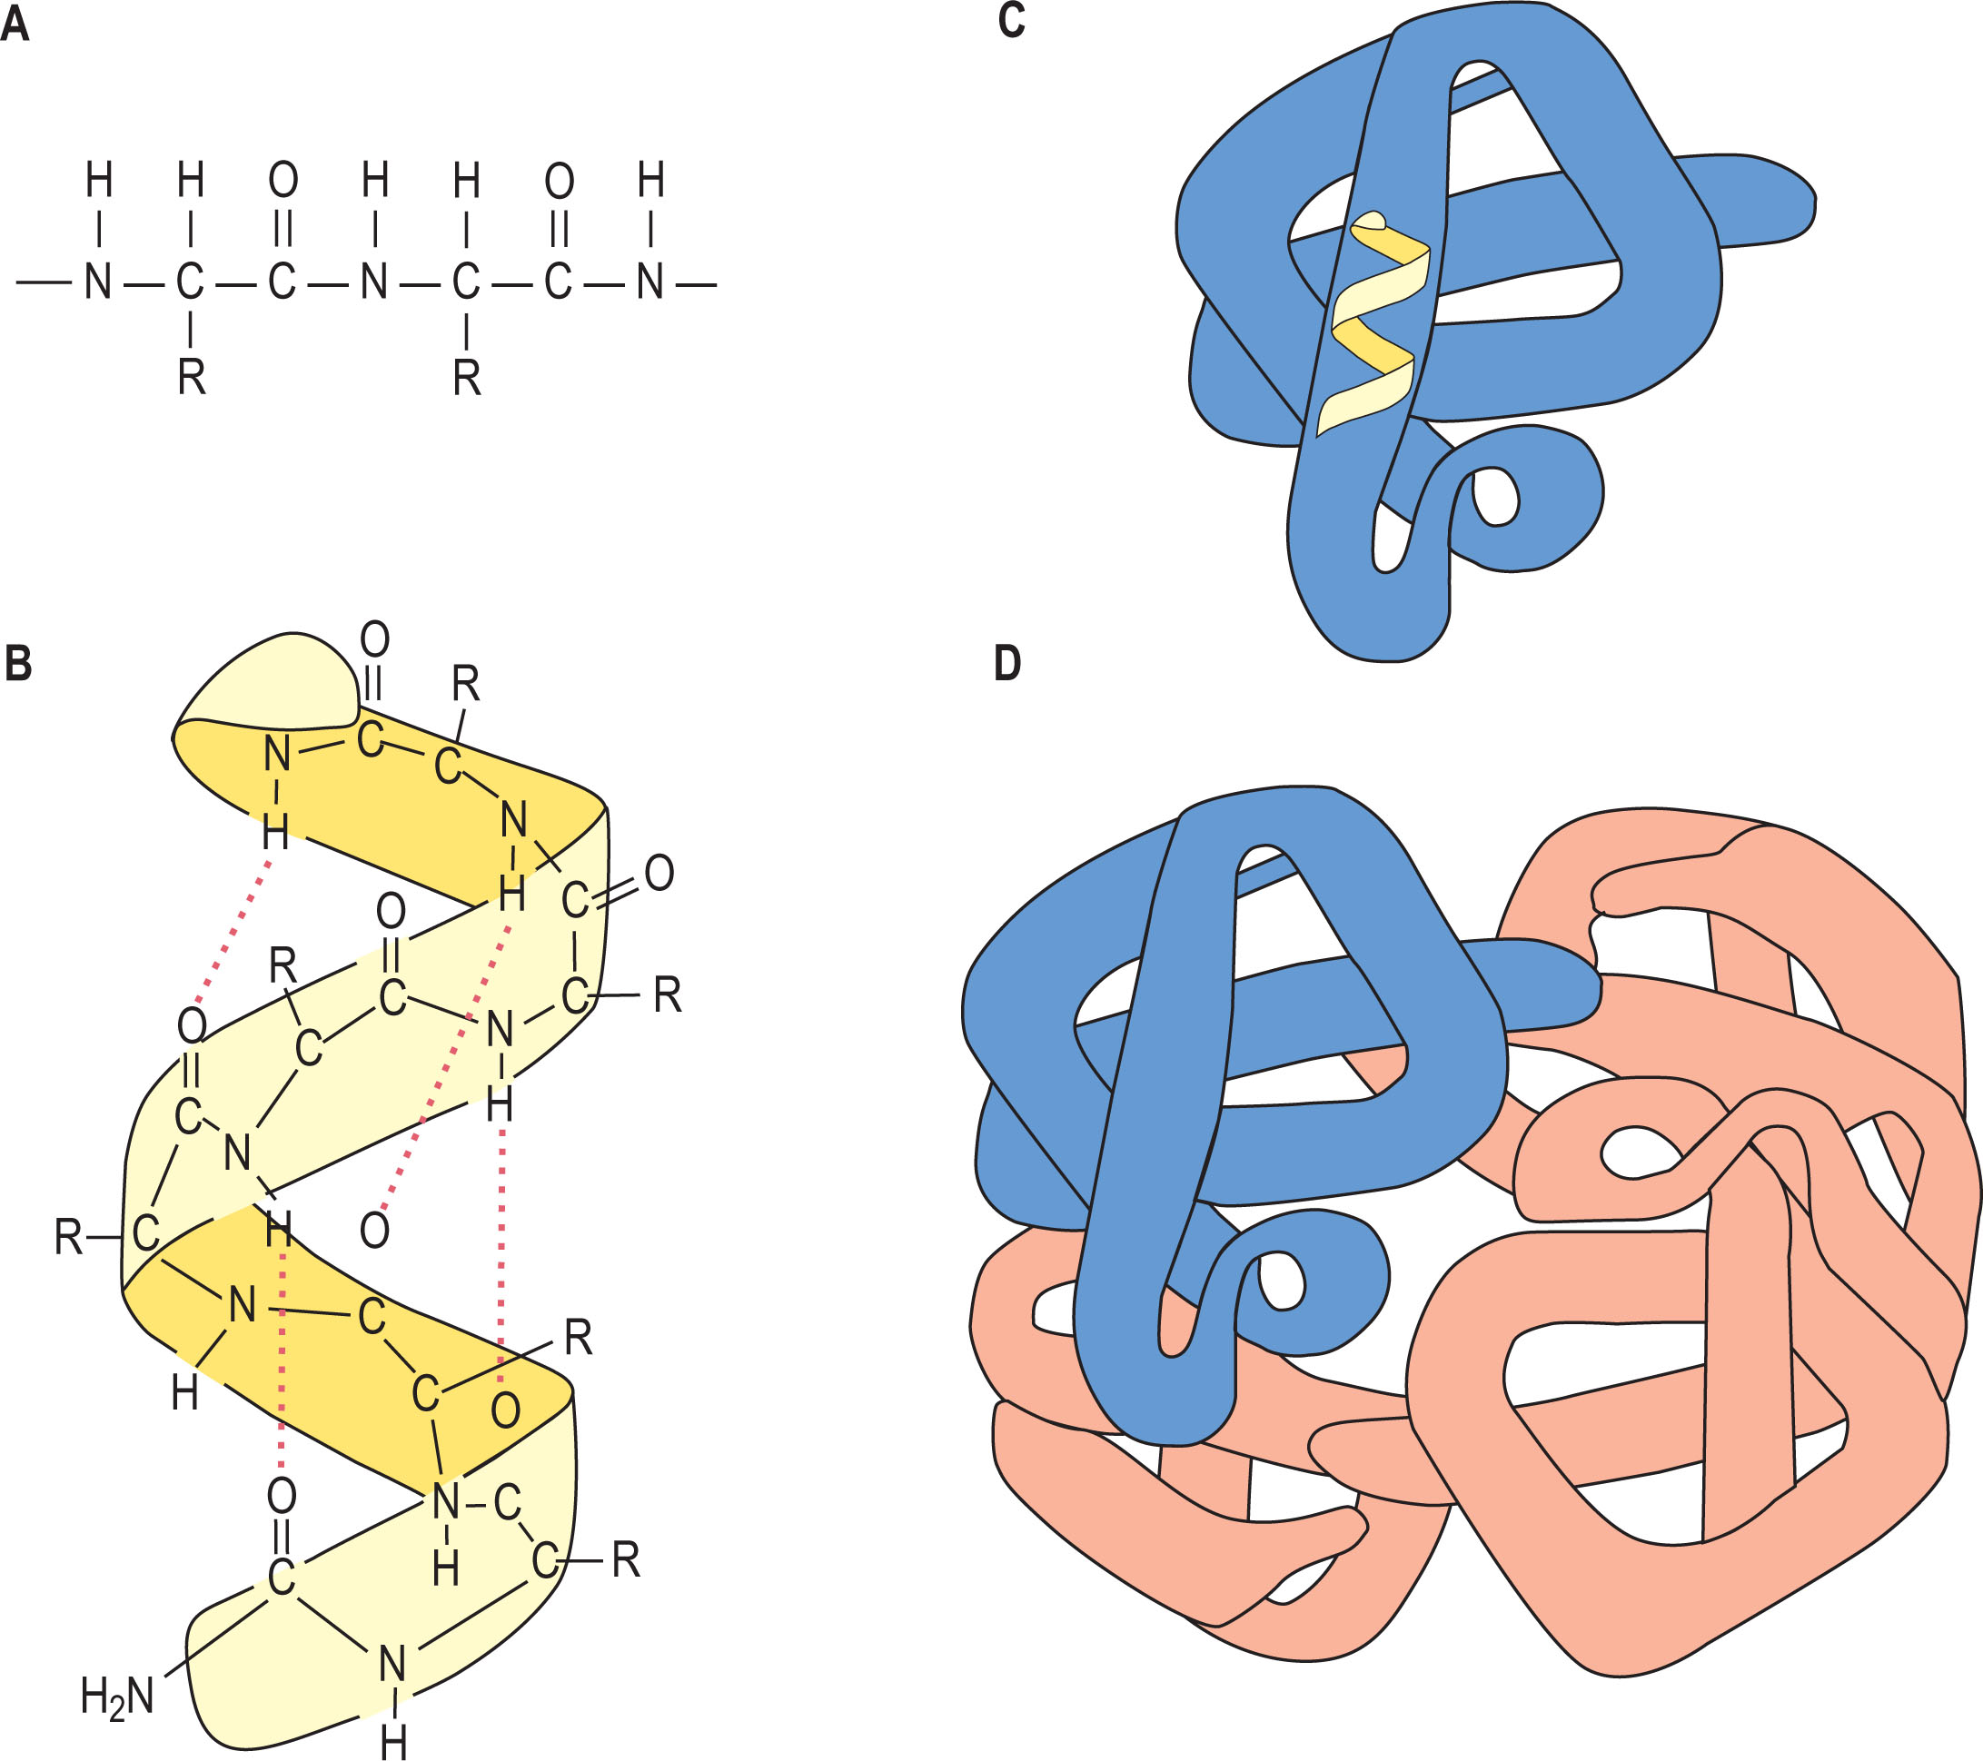
Protein Structure
Amino Acids and Proteins Nagai, Ryoji, Medical Biochemistry, Chapter 2, 9-24 Primary, secondary, tertiary, and quaternary structures. (A) The primary structure is composed of a linear sequence of amino acid residues of proteins. (B) The secondary structure indicates the local spatial arrangement of the polypeptide backbone... Copyright © 2023 © 2023, Elsevier Limited. All rights reserved.
Source: Medical Biochemistry, 6th Ed

Slide 26
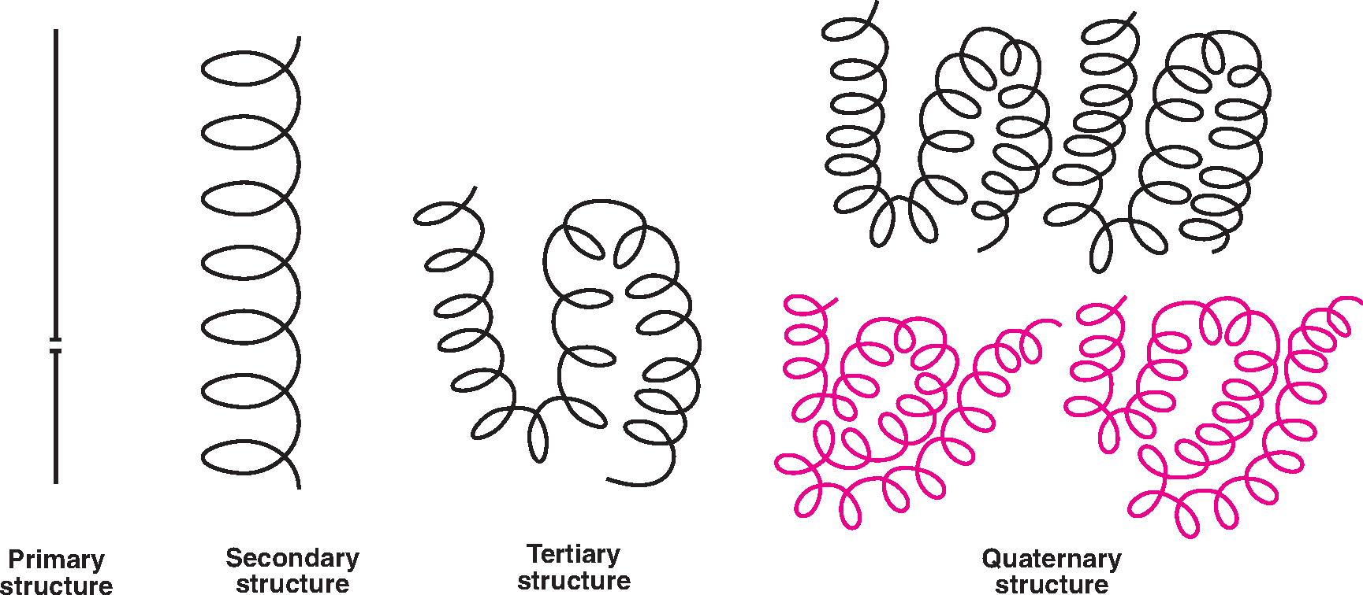
Protein Structure
PROTEINS AND AMINO ACIDS Satyanarayana, U., Dr., Essentials of Biochemistry, 4, 21-32 Diagrammatic representation of protein structure (Note :The four subunits of two types in quaternary structure). Copyright © 2021 Copyright © 2021 Dr. U. Satyanarayana. All Rights Reserved.
Source: Essentials of Biochemistry

Slide 27
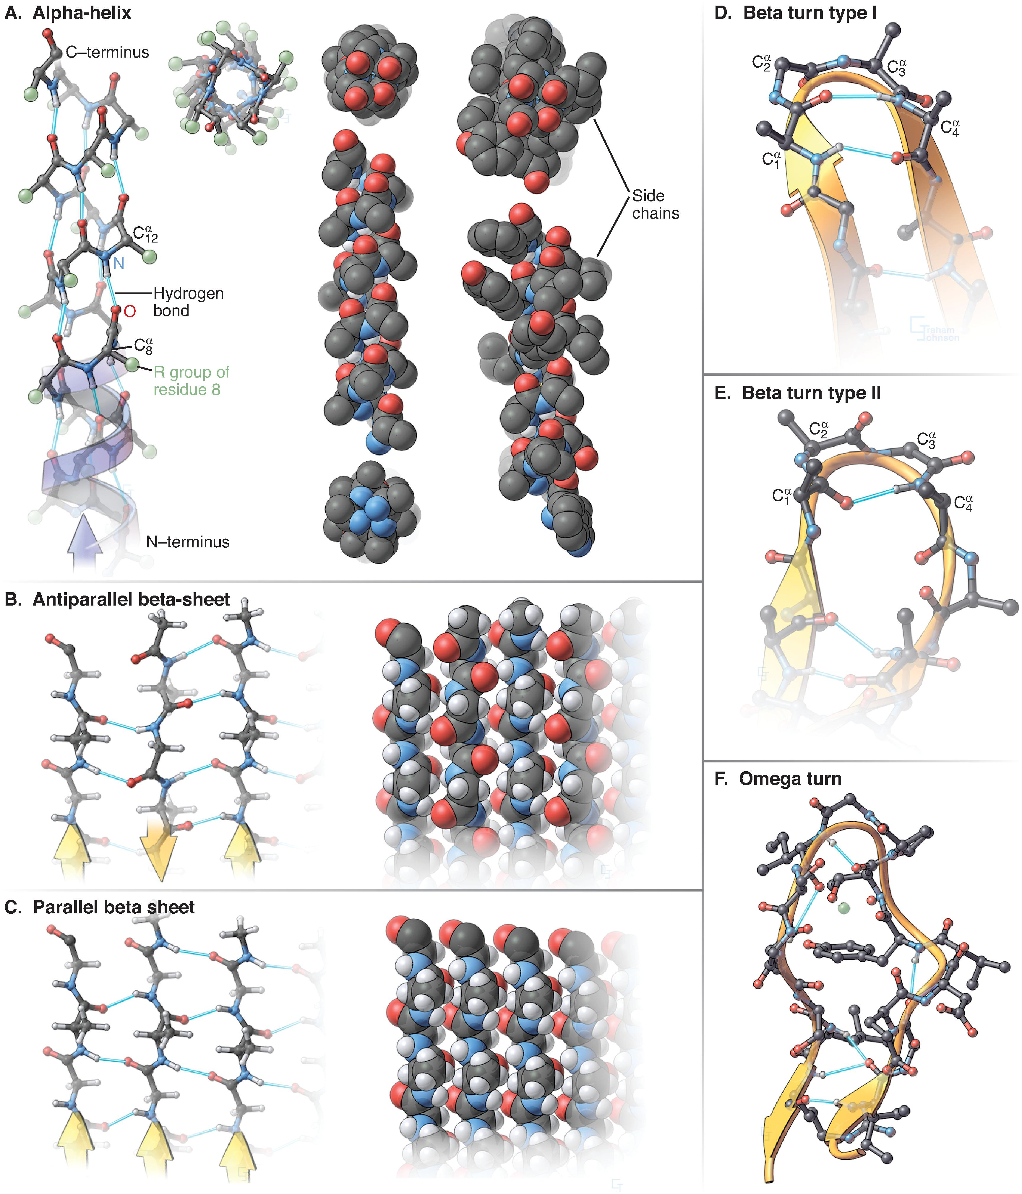
Protein Structure
Molecules: Structures and Dynamics Pollard, Thomas, Cell Biology, Chapter3, 33-54 MODELS OF SECONDARY STRUCTURES AND TURNS OF PROTEINS. A, α-Helix. The stick figure (left) shows a right-handed α-helix with the N-terminus at the bottom and side chains R represented by the β-carbon. Hydrogen bonds between backbone atoms are indic... Copyright © 2023 Copyright © 2023 by Elsevier . All rights reserved.
Source: Cell Biology, 4th Ed..

Slide 28
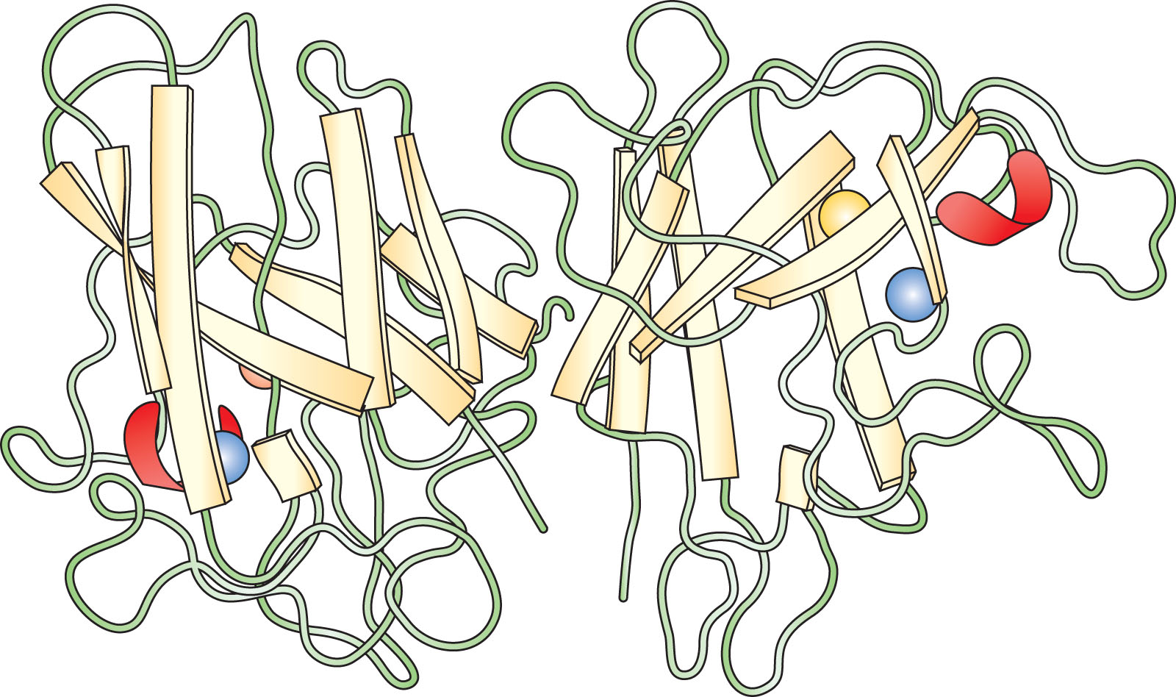
Protein Structure
Amino Acids and Proteins Nagai, Ryoji, Medical Biochemistry, Chapter 2, 9-24 Three-dimensional structure of a dimeric protein. Quaternary structure of Cu,Zn-superoxide dismutase from spinach. Cu,Zn-superoxide dismutase has a dimeric structure, with a monomer molecular mass of 16,000 Da. Each subunit consists of eight antip... Copyright © 2023 © 2023, Elsevier Limited. All rights reserved.
Source: Medical Biochemistry, 6th Ed

Slide 29
Structure of Hemoglobin
Hemoprotein – 4 polypeptide chains + 4 heme groups
Protein part or Globin – two α chains and two β chains = α₂β₂
One heme is bound to each polypeptide chain, partially buried in a pocket lined with hydrophobic amino acid side chains. Binds to the polypeptide chain through a coordination bond between the Fe atom and R-chain of His.
The homology between the α and β chains is sufficient that they have similar conformations, a series of seven helices enveloping a single heme.
Single Hb molecule can bind 4 0₂ molecules.
Source: https://www.clinicalkey.com/student/content/book/3-s2.0-B978813126560400048X#hl0000128; https://www.clinicalkey.com/student/content/book/3-s2.0-B9780323930383000411#hl0000223; https://www.clinicalkey.com/student/content/book/3-s2.0-B978145574377300029X#hl0000426;
Textbook of Physiology for Medical Students, 2nd Ed. Goldman-Cecil Medicine, 27th Ed.

Slide 30
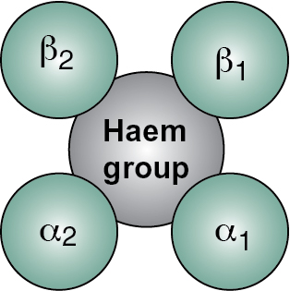
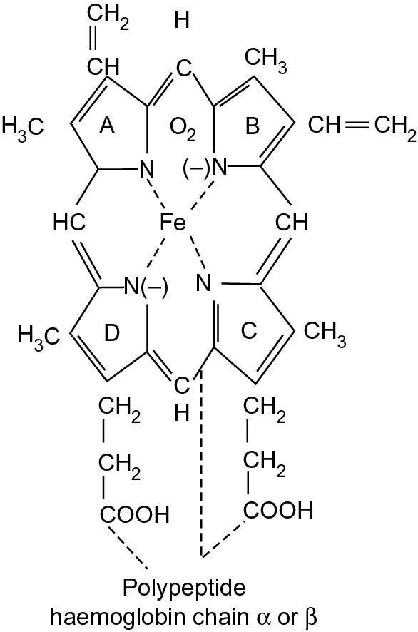
Structure of Hemoglobin
Structure of hemoglobin
Medical Biochemistry: Preparatory Manual for Undergraduates, 5, 184-242
Dandekar, Sucheta P, PhD, FAIMER, PHIL, IFME, MHPE (UK); Mahdi, Abbas Ali, PhD, FIABS, FAMS
Structure of Hb
Joshi's-Physiology Preparatory Manual for Undergraduates, 2, 25-82
Joshi-Mendhurwar, Sadhana, MD
Source: https://www.clinicalkey.com/student/content/book/3-s2.0-B9788131261507000144#3-s2.0-B9788131261507000144-f05-15-9788131261507; https://www.clinicalkey.com/student/content/book/3-s2.0-B9788131264911000116#3-s2.0-B9788131264911000116-f02-05-9788131264911
Medicine: Prep Manual for Undergraduates, 7th Ed; Joshi's-Physiology Preparatory Manual for Undergraduates, 7th Ed.

Slide 31
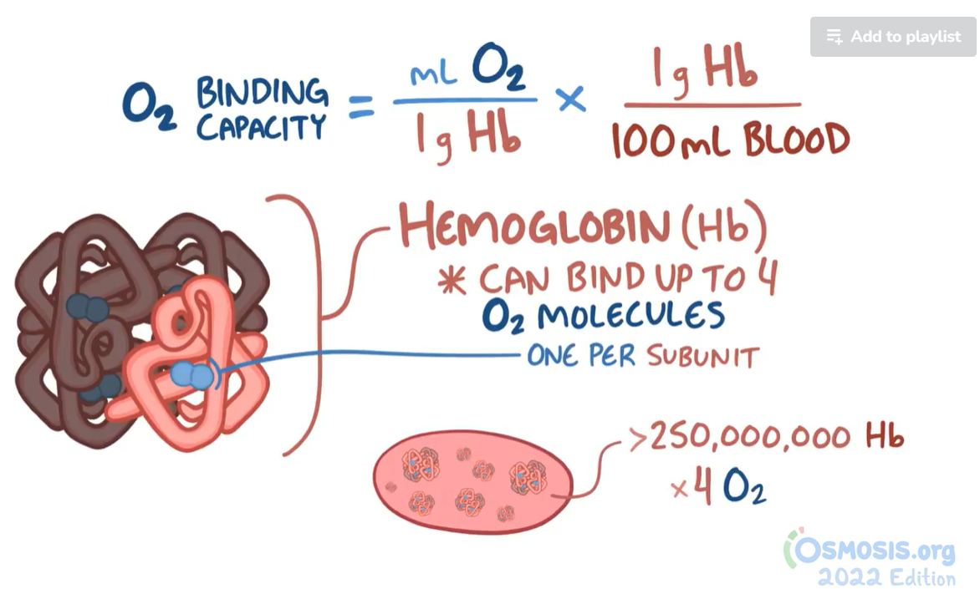
Oxygen Binding Capacity
Source: https://www.osmosis.org/learn/Oxygen_binding_capacity_and_oxygen_content

Slide 32
Hemoglobin Structural Alterations
Class Exampleª | Amino Acid Substitution | Pathophysiological Effect of Variant | Inheritance
Hb S | β chain: p.Glu6Val | Deoxygenated Hb S polymerizes → sickle cells → vascular occlusion and hemolysis | AR
Hb Hammersmith | β chain: p.Phe42Ser | An unstable Hb → Hb precipitation → hemolysis; also low oxygen affinity | AD
Hb MHyde Park | β chain: p.His92Tyr | The substitution makes oxidized heme iron resistant to methemoglobin reductase → Hb M, which cannot carry oxygen → cyanosis (asymptomatic) | AD
Hb Kempsey | β chain: p.Asp99Asn | The substitution keeps the Hb in its high oxygen affinity structure → less oxygen to tissues → polycythemia | AD
Hb E | β chain: p.Glu26Lys | The variant → an abnormal Hb and decreased synthesis (abnormal RNA splicing) → mild thalassemia ^{b} (see Fig. 12.11 ) | AR
AD , Autosomal dominant; AR , autosomal recessive; Hb M , methemoglobin (See text.)
a Hemoglobin variants are often named after a location related to the first described patient(s).
b Additional βchain gene variants that cause βthalassemia are depicted in Table 12.5 .
Source: https://www.clinicalkey.com/student/content/book/3-s2.0-B978032354762800012X#hl0000789; https://www.clinicalkey.com/student/content/book/3-s2.0-B9788131265604000193#hl0000528
Thompson & Thompson Genetics and Genomics in Medicine, 9th Ed. ; Textbook of Physiology for Medical Students, 2nd Ed.

Slide 33
Sickle Cell Disease
Hemoglobin synthesis disorder in which the substitution of valine for glutamic acid at position six of the beta-globin chain yields a variant molecule, hemoglobin S
In its deoxygenated form, hemoglobin S (deoxy HgbS) polymerizes into long strands, deforming red blood cells (RBCs) into a characteristic sickle shape.
Episodic vaso-occlusive events that are associated with pain crises, hemolytic anemia, stroke, acute chest syndrome, pulmonary hypertension, urologic and renal complications.
Approximately 18 to 25% of the population of Sub-Saharan Africa are sickle cell carriers
Although sickle cell disease is most commonly associated with anemia and repeated pain episodes, the pathophysiologic process can affect all organs in the body
Lab Tests – Anemia (from chronic hemolysis), reticulocytosis, leukocytosis, and thrombocytosis are common. Hgb S/β 0 and Hgb S/β + thalassemia will have microcytosis; Hgb S/C is also typically microcytic. Hgb S/C may have normal or near-normal hematocrit but will have characteristic changes on peripheral smear (target cells). Elevations of bilirubin, lactate dehydrogenase, and low haptoglobin are consistent with chronic hemolysis. Peripheral blood smear reveals sickle cells.
Source: https://www.clinicalkey.com/student/content/book/3-s2.0-B9780323755764008358; https://www.clinicalkey.com/student/content/book/3-s2.0-B9780323930383001490
Goldman-Cecil Medicine, 27th Ed.; Ferri's Clinical Advisor 2024

Slide 34
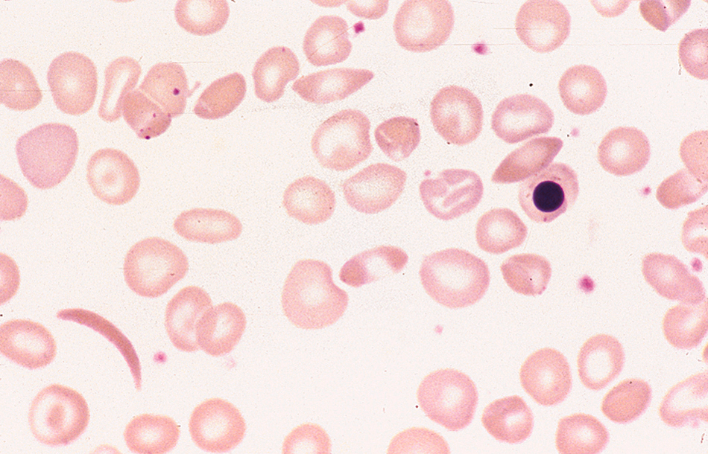
Sickle Cell Disease
Photomicrograph of a blood film.
Sickle cell anemia (homozygosity for hemoglobin S). Shown are a sickle cell, boat-shaped cells, a nucleated red cell, and target cells.
From Bain BJ et al: Dacie and Lewis practical haematology, ed 12, Philadelphia, 2017, Elsevier.
Source: https://www.clinicalkey.com/student/content/book/3-s2.0-B9780323755764008358; https://www.clinicalkey.com/student/content/book/3-s2.0-B9780323930383001490
Goldman-Cecil Medicine, 27th Ed.; Ferri's Clinical Advisor 2024

Slide 35
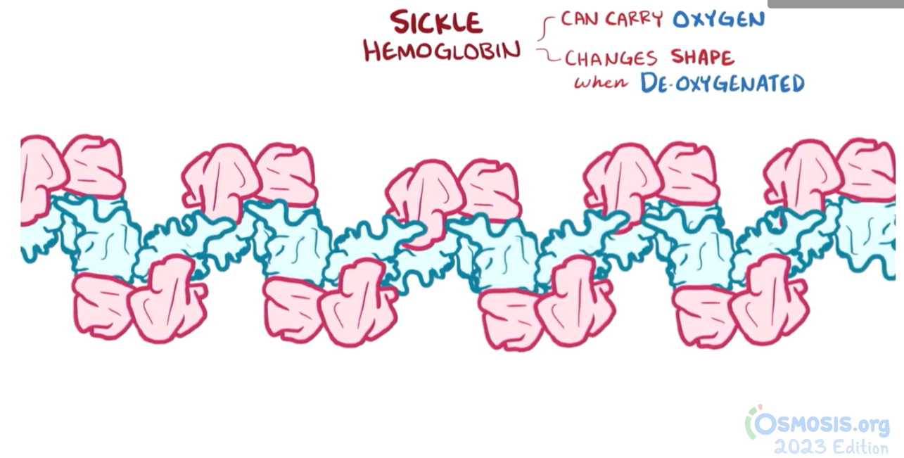
Sickle Cell Disease
Source: https://www.osmosis.org/learn/Sickle_cell_disease_%28NORD%29

Slide 36
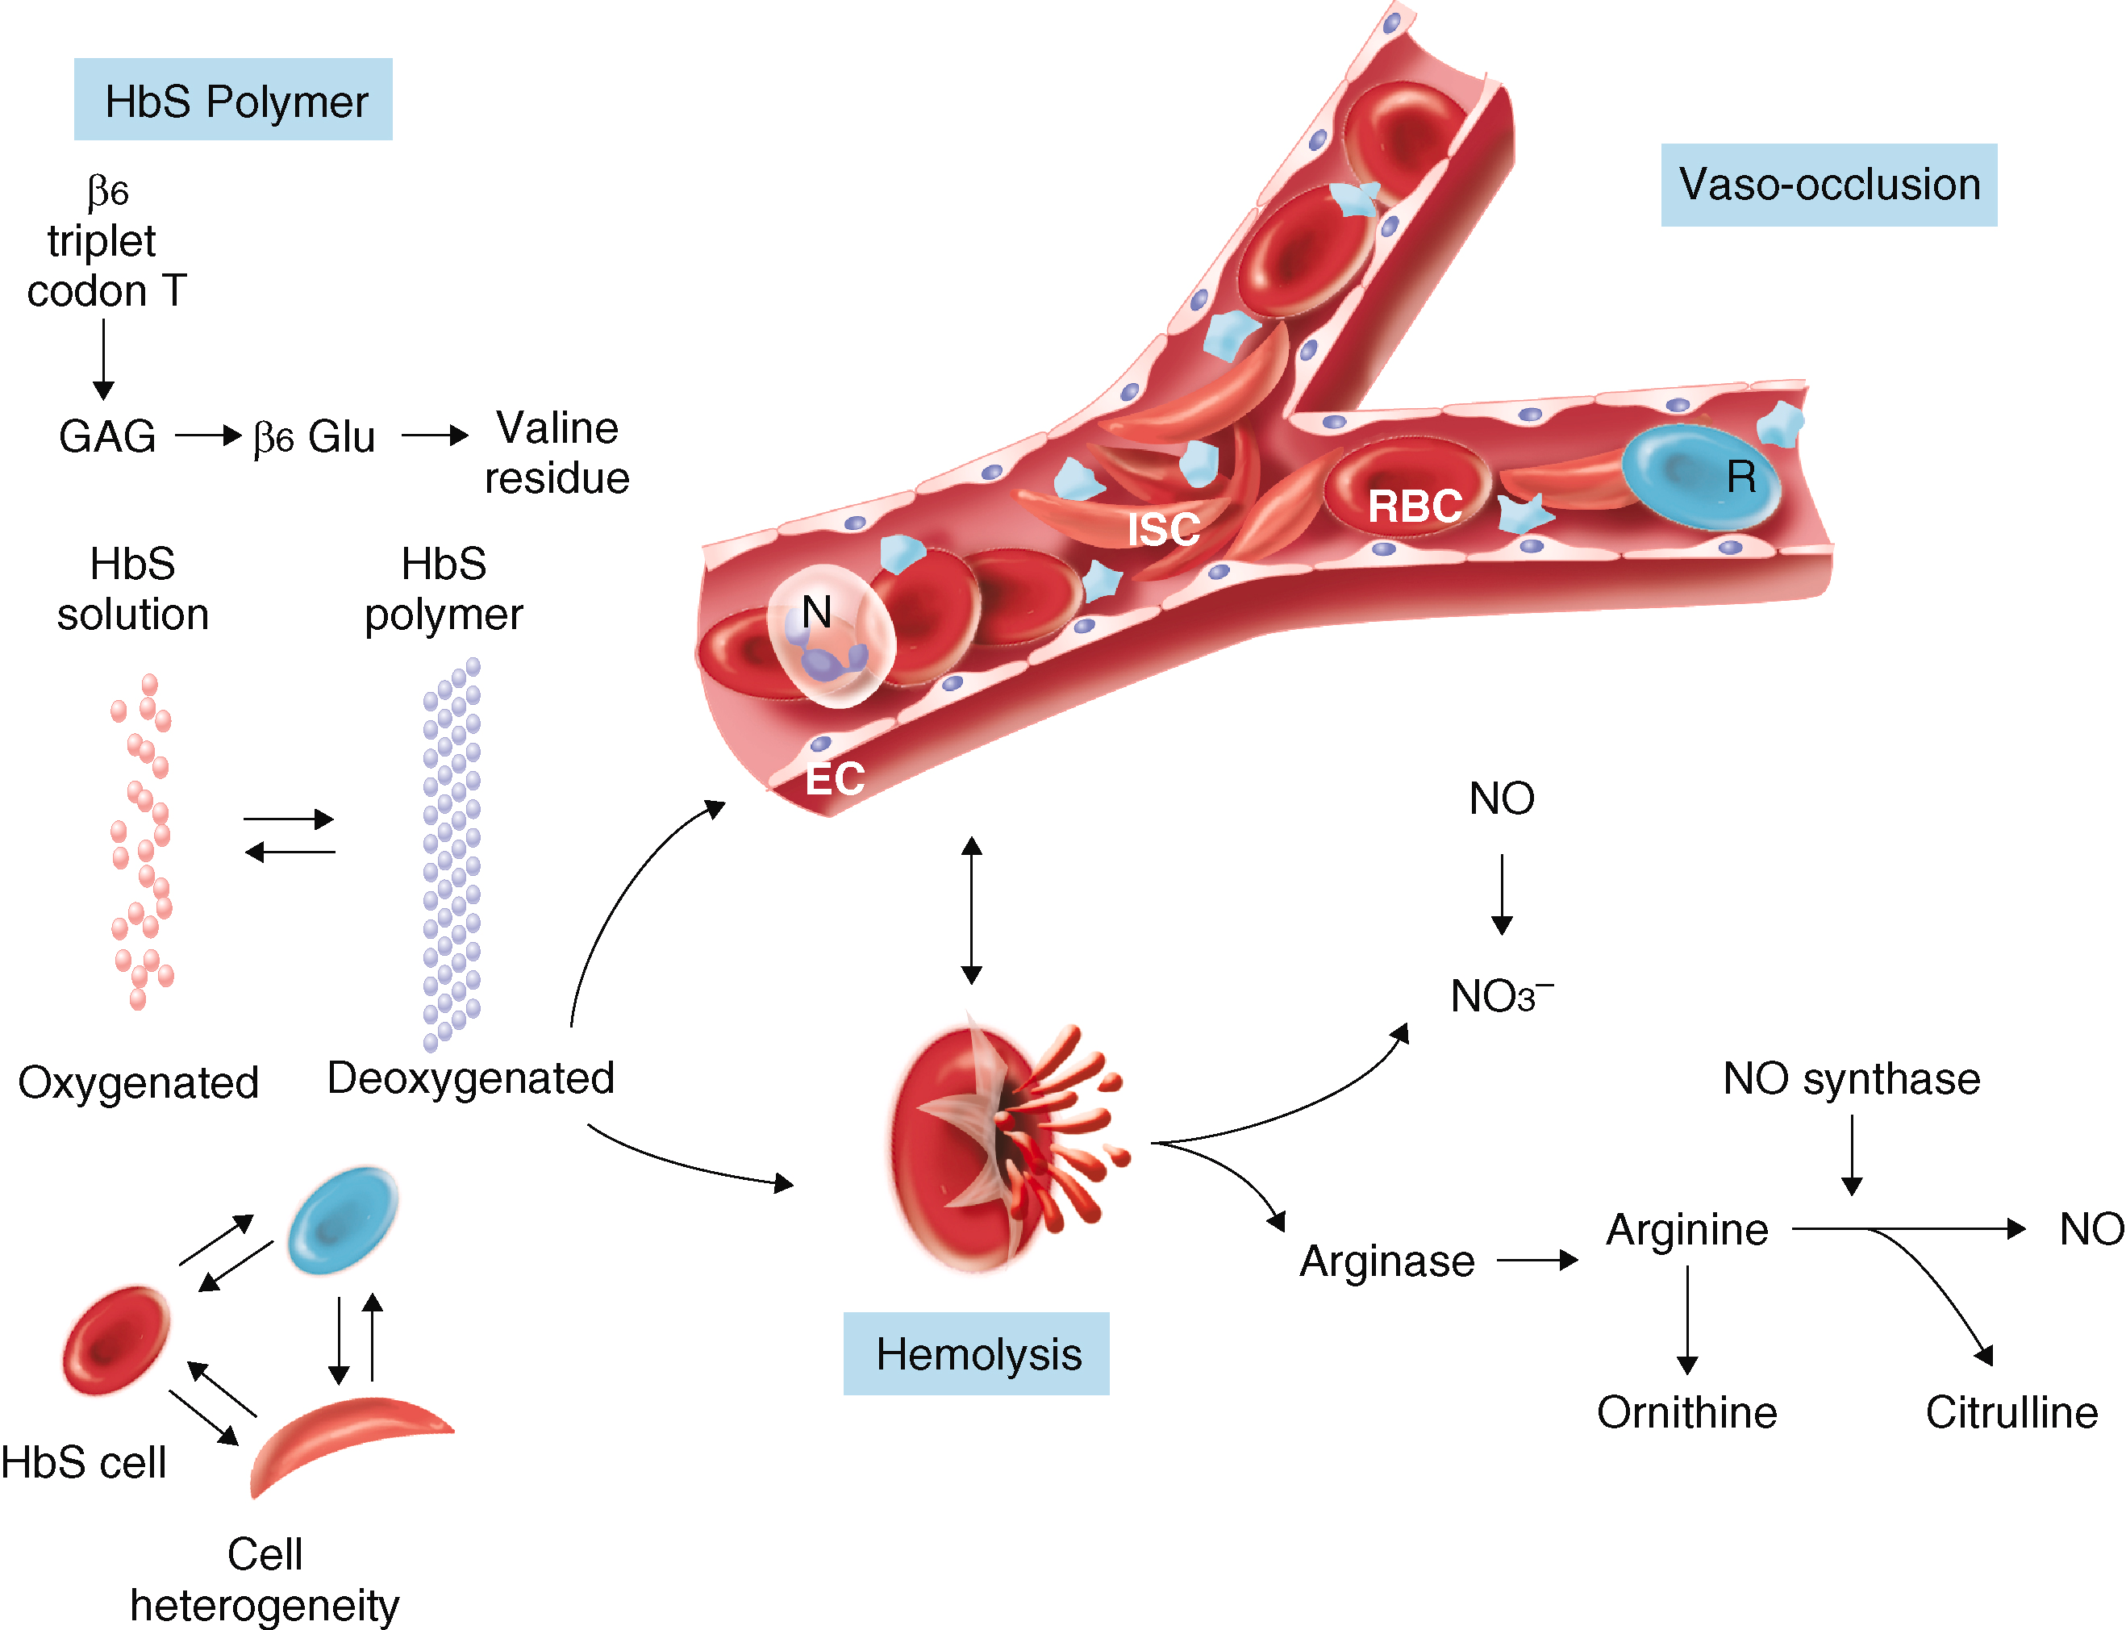
Sickle Cell Disease
Pathophysiology of sickle cell disease.
An adenine (A) to thymidine (T) transversion (A6T) at codon 6 in the β-hemoglobin gene on chromosome 11 ( HBB ) leads to the substitution of a glutamic acid codon by a valine codon. β6 valine allows the hemoglobin S (HbS) molecule (α ₂ β ₂ ^{S} ) to polymerize when it is deoxygenated. DeoxyHbS polymer injures the erythrocyte and leads to a heterogeneous population of sickle cells with damaged membrane cytoskeleton, reduced cation and water content, and altered distribution of membrane lipids. In the vasculature, sickle cells interact with endothelium and other blood cells to cause vaso-occlusion. Some damaged erythrocytes hemolyze intravascularly, thereby releasing heme into the plasma to scavenge nitric oxide (NO) and to reduce hemoglobin to methemoglobin and nitrate. NO, by binding soluble guanylate cyclase, converts cyclic guanosine triphosphate to guanosine monophosphate, thereby relaxing vascular smooth muscle and causing vasodilation. A state of reduced endothelial NO bioavailability in sickle cell disease impairs the homeostatic vascular functions of NO, such as inhibition of platelet activation and aggregation and transcriptional repression of genes transcribing cell adhesion molecules. Hemoglobin, heme, and heme iron catalyze the production of oxygen radicals and protein nitration, potentially further limiting NO bioavailability and activating endothelium. Lysed erythrocytes also liberate arginase, which destroys l -arginine, the substrate for NO production, providing another mechanism for endothelial NO deficiency. The normal balance of vasoconstriction versus vasodilation is therefore skewed toward vasoconstriction as well as endothelial activation and proliferation. EC = epithelial cell; ISC = irreversibly sickled cell; N = neutrophil; R = reticulocyte; RBC = red blood cell.
Source: https://www.clinicalkey.com/student/content/book/3-s2.0-B9780323755764008358; https://www.clinicalkey.com/student/content/book/3-s2.0-B9780323930383001490
Goldman-Cecil Medicine, 27th Ed.; Ferri's Clinical Advisor 2024

Slide 37
Sickle Cell Disease
Reading Assignment
Read the chapter, “Sickle Cell Disease and Other Hemoglobinopathies - Goldman-Cecil Medicine” to learn:
Definition
Epidemiology
Pathobiology
Clinical Manifestations – SCD trait, pain, anemia, neurologic, cardiorespiratory and urologic complications, priapism, infection
Diagnosis
Treatment and Prevention
Curative Therapies
Source: https://www.clinicalkey.com/student/content/book/3-s2.0-B9780323930383001490
Goldman-Cecil Medicine, 27th Ed.;

Slide 38
Live Quiz During Class – BYOP*
Dietary protein is essential to maintain health. Amino acids are the building blocks for proteins. Some amino acids cannot be synthesized by humans.
A All 20 types of amino acids must be present in the diet | B Normal adults in the developed world have a daily requirement of about 150 g of protein
C The quality of protein is measured by the amount of energy it contains per unit weight | D An adequate intake of carbohydrate and fat decreases the requirements for dietary high-quality protein
What protein structure is characterized by two or more polypeptide subunits forming dimers, tetramers or oligomers?
A Any of the classification stages | B Primary Structure
C Secondary Structure | D Quarternary Structure
Most proteins contain regions of polypeptide chain folding as α-helices and/or β-pleated sheets. At which level of protein structure does this occur?
A Any of the classification stages | B Primary Structure
C Secondary Structure | D Quarternary Structure
Source: https://www.clinicalkey.com/student/test/#/browseQuestions search “protein” or “protein structure” and look cognitive level of “remember” and “understand”
*BYOP – Bring Your Own Platform, for example, Kahoot, Google Form, MSFT Teams Form, Mentimeter, Survey Monkey etc.

Slide 39
Sample Assignment Questions
Question Source: ClinicalKey Student, Elsevier, Copyright 2024 Which autosomal dominant condition is characterized by adult-onset of personality change and depression, later accompanied by choreiform movements, jerking and dementia?
Answer Options A. Schizophrenia is incorrect
Schizophrenia is a psychotic illness associated with a reduction in the size of the thalamus, thinner frontal cortex, medial temporal cortex and hippocampus, particularly in the left hemisphere. Compared to normal individuals, during working memory tasks there is less change in cerebral blood flow in the frontal cortex.
B. Pick’s disease is incorrect
The pathology in Pick's disease is characterized by severe neuronal loss and gliosis in the frontal and temporal cortex, with the presence of neuronal inclusions (tau proteins).
C. Dyslexia is incorrect
Dyslexia is associated with less electrical activity in the angular gyrus lying immediately behind Wernicke’s area. If this region is destroyed while Wernicke's area in the temporal lobe is still intact, the person can still interpret auditory experiences as usual, but the stream of visual experiences passing into Wernicke's area from the visual cortex is largely blocked.
D. Huntington’s disease is correct
The genetic abnormality in Huntington's disease is an excess number of tandemly repeated CAG nucleotide sequences. The number of repeats influences the age of onset: the more repeats, the earlier the onset (i.e. the condition shows anticipation).
E. Alzheimer’s disease is incorrect
Alzheimer’s disease is characterized by an excess accumulation of beta-amyloid peptide as plaques in the brain. All currently known mutations associated with Alzheimer's disease increase the production of beta-amyloid peptides. Additionally, patients with trisomy 21 (Down syndrome) have three copies of the gene for amyloid precursor protein and develop neurological characteristics of Alzheimer's disease by midlife. Patients who have an abnormality of a gene that controls apolipoprotein E, a blood protein that transports cholesterol to the tissues, have accelerated deposition of amyloid and greatly increased risk for Alzheimer's disease.
Source: ClinicalKey Student Assessment

Slide 40
Sample Assignment Questions
Question Source: ClinicalKey Student, Elsevier, Copyright 2024 Aggrecan is a proteoglycan that forms a crucial part of cartilage. It is well adapted to resist compressive forces in the joint as it generates a high osmotic pressure, drawing water into the joint cartilage and therefore allowing compression. Why is aggrecan able to generate a high osmotic pressure?
Answer Options A. Aggrecan has a high molecular weight is incorrect
Aggrecan is an exceptionally large protein and does have a large molecular weight. This is due to its high glycosylation (many glycosaminoglycan (GAG) chains are attached to the core protein). However, aggrecan’s high molecular weight is not in itself why it is able to generate a high osmotic pressure; if it had the same molecular weight but did not contain any polar GAGs it would not generate osmotic pressure and bring water into the cartilage. GAGs are made up of repeating disaccharide units and are highly polar. They therefore attract significant amounts of water.
B. Aggrecan contains a high proportion of non-polar amino acid residues is incorrect
This is incorrect as non-polar amino acid residues would not be charged and would therefore not attract water, so could not generate osmotic pressure in the cartilage. Aggrecan attracts water due to high levels of glycosylation, as glycosaminoglycan chains are highly polar, rather than due to the properties of its amino acid residues.
C. Aggrecan is highly glycosylated is correct
This is correct; aggrecan is highly glycosylated (many glycosaminoglycan (GAG) chains are attached to the core protein). GAGs are made up of repeating disaccharide units and are highly polar. They therefore attract significant amounts of water into the cartilage, generating considerable osmotic pressure.
D. Aggrecan is able to form fibrils is incorrect
This is incorrect as aggrecan does not form fibrils. Type II collagen, another key component of cartilage, is important due to its ability to form fibrils. This forms a matrix which traps aggrecan and other proteoglycans in the cartilage tissue, helping it to resist swelling pressure. Collagen fibril formation also gives cartilage its high tensile strength. However, aggrecan attracts water through its high glycosylation, which is not related to fibril formation.
Source: ClinicalKey Student Assessment

Slide 41
Sample Assignment Questions
Question Source: ClinicalKey Student, Elsevier, Copyright 2024 Haemoglobin plays an important role in carrying oxygen in the red blood cells. Which of the following statements about haemoglobin is true?
Answer Options A. In normal human adults, all haemoglobin molecules are of the same type is incorrect
The haemoglobin molecules are mostly type A, but a small proportion is A2.
B. It consists of six subunits is incorrect
It contains four subunits.
C. There is one haem moiety per haemoglobin molecule is incorrect
There is one per polypeptide chain, therefore four haem moieties per haemoglobin molecule.
D. The haem moiety contains ferric iron (Fe³⁺) is incorrect
The haem moiety contains ferrous iron (Fe²⁺).
E. It is a globular protein is correct
The haemoglobin molecule plays an important role in carrying oxygen in the red blood cells. It is a globular protein made up of four subunits. In normal human adults, most haemoglobin is of the type haemoglobin A, which consists of four polypeptide chains: two α chains and two β chains. However, a small proportion of the haemoglobin is haemoglobin A2, which consists of two α chains and two δ chains. This is clinically important, as the proportion of haemoglobin A2 increases in diseases with defective β chain production. There is a haem moiety conjugated to each polypeptide chain. The haem moiety is a porphyrin derivative containing ferrous iron, and is responsible for binding to oxygen molecules. When exposed to various oxidizing drugs, the ferrous iron may be converted to ferric iron, forming methaemoglobin. Methaemoglobin is dark-coloured, and may give rise to bluish discoloration of the skin, resembling cyanosis.
Source: ClinicalKey Student Assessment

Slide 42
Protein Structure and Function – Case-Based Learning
CASE 1
A newborn girl, born at 37 weeks’ gestation to a healthy mother, is found to have dark urine in her nappies. Fresh urine is yellow to clear, but the addition of sodium hydroxide (NaOH) to the urine or leaving it stand for more than half an hour causes it to turn dark. Based on these findings what is the most probable diagnosis and etiology?
CASE 2
A 5-month-old infant is admitted to hospital with breathing problems and poor feeding. On examination he has a respiratory rate of 50 breaths/min. On auscultation of the chest he has widespread crackles. He has moderate intercostal recession, and oxygen saturation of 92% in air. He was born at term with a birthweight of 3.6 kg (50th centile). His weight is now 5.2 kg (< 0.4th centile). This is his first admission to hospital but he ‘is always chesty’. You suspect the child has cystic fibrosis. What confirmatory diagnostics are advisable? What is the disease etiology and gene mutation?
More clinical cases and quiz questions available in:
ClinicalKey Student Assessment
Medicine Morning Report: Beyond the Pearls
Medicine Morning Report Subspecialties
Leverage the platform to identify cases for class discussion or create an assignment for students that can be used as a class quiz or for formative assessment.
Source: ClinicalKey Student Assessment

Slide 43
Post-Lecture Video Assignments

Slide 44
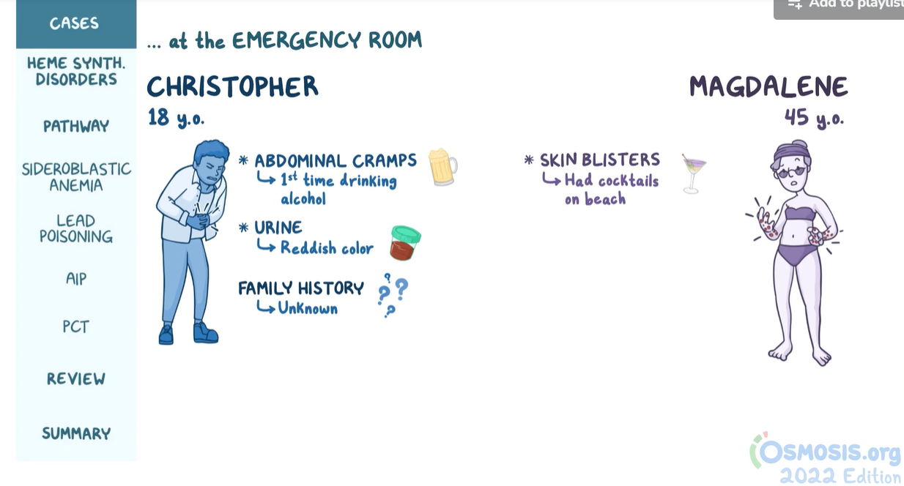
Heme Synthesis Disorders – Pathology Review
Source: https://www.osmosis.org/learn/Heme_synthesis_disorders:_Pathology_review

Slide 45
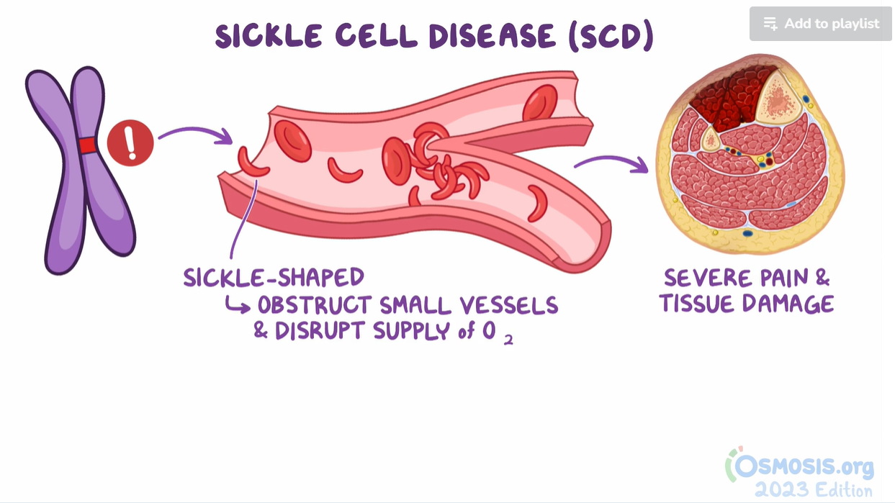
Sickle Cell Disease – Clinical Sciences
Source: https://www.osmosis.org/learn/Sickle_cell_disease:_Clinical_sciences

Slide 46
Further Learning

Slide 47
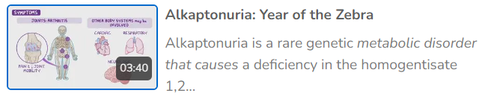
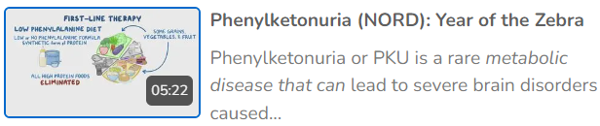
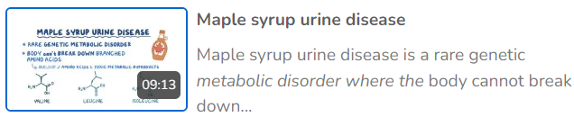
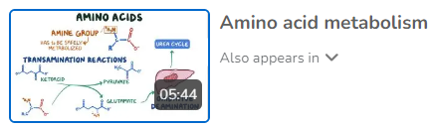
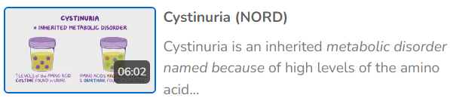
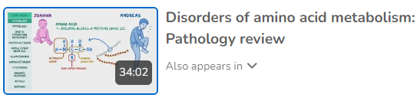
Review this playlist to learn about other “inborn errors of metabolism”
https://www.osmosis.org/playlist/h10rZN2R_4X
Source: https://www.osmosis.org/playlist/h10rZN2R_4X

Slide 48
Appendix

Slide 49
Long List of Textbooks on Protein Structure and Function
Textbooks
Cell Biology, 4th Ed
Biochemistry, 6th Ed
Medical Biochemistry, 6th Ed
Medical Sciences, 3rd Ed.
Essentials of Biochemistry
Goldman-Cecil Medicine, 27th Ed.
Medicine: Prep Manual for Undergraduates, 7th Ed.
Cecil Essentials of Medicine, 10th Ed.
Thompson & Thompson Genetics and Genomics in Medicine, 9th Ed.
Textbook of Physiology for Medical Students, 2nd Ed.
Ferri's Clinical Advisor 2024
Joshi's-Physiology Preparatory Manual for Undergraduates, 7th Ed.

