Slide 1

Reform and practice in medical imaging education for MBBS international students——
Student-centered, Case-based, and
Problem-oriented teaching method
Qianni Du
Department of Radiology
Xiamen Cardiovascular Hospital of Xiamen University

Slide 2
鉴于Z世代学生群体具有强烈的数字化、互动性学习需求，传统的教学模式亟待革新。厦门大学医学院采取以学生为中心、以案例为基础，结合问题导向的教学方法，引导学生深入理解，有效激发学生的学习兴趣，提高其自主学习能力，以期全面提升医学影像学的教学质量。此次，本人试着以2例复杂病例为例，通过数字媒体进行信息获取，带给学生更多元化的学习体验，激发学生自主学习的兴趣和动力。
Preface

Slide 3
CASE 1

Slide 4
CASE PRESENTATION
51y, Female
Complaint: Transient loss of consciousness 10 days ago
History: Myomectomy for uterine leiomyoma 3 years ago
Menstrual history: Menarche at 13 years old, lasting for 4 days each time, with moderate menstrual flow, no dysmenorrhea, and regular menstrual periods
Physical examination: T 36.5℃, P 83/min, R 20/min, BP 133/80mmHg

Slide 5

Transient loss of consciousness (TLOC) - defined as spontaneous disruption of consciousness not due to head trauma and with complete recovery - has a lifetime prevalence of 50%.
The rapid and accurate distinction of the diagnoses is vital to allow appropriate further management but at least 20-30% of patients are not managed optimally or misdiagnosed.
From CLINICAL TRIAL: Development of a Clinical Decision Aid for the Differential Diagnosis of Transient Loss of Consciousness

Slide 6
Q1: What can lead to transient loss of consciousness?
A1:
Transient loss of consciousness can be divided into syncope and nonsyncope conditions.
Nonsyncope conditions include but are not limited to seizures, hypoglycemia, metabolic conditions, drug or alcohol intoxication, and concussion due to head trauma.
The underlying mechanism of syncope is presumed to be cerebral hypoperfusion, whereas nonsyncope conditions are attributed to different mechanisms.
From ARTICLE: JACC (Journal of the American College of Cardiology), 2017-08-01, Volume 70, Issue 5, Pages e39-e110

Slide 7
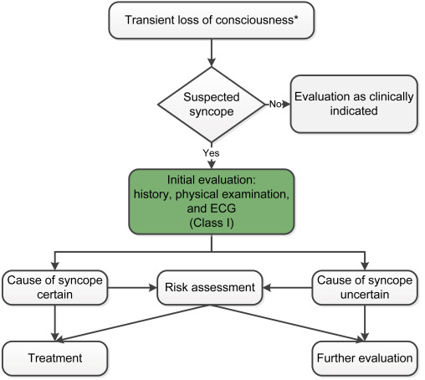
Q2: What are the fundamental principles for evaluating patients following an episode of syncope?
A2:
From ARTICLE: JACC (Journal of the American College of Cardiology), 2017-08-01, Volume 70, Issue 5, Pages e39-e110
Notes:
Syncope Initial Evaluation

Slide 8
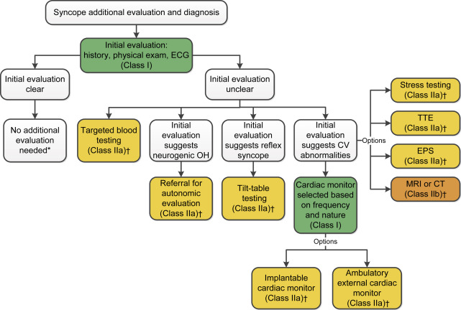
From ARTICLE: JACC (Journal of the American College of Cardiology), 2017-08-01, Volume 70, Issue 5, Pages e39-e110
Notes:
Additional Evaluation and Diagnosis for Syncope
*Applies to patients after a normal initial evaluation without significant injury or cardiovascular morbidities; patients followed up by primary care physician as needed.
CT indicates computed tomography; CV, cardiovascular; ECG, electrocardiogram; EPS, electrophysiological study; MRI, magnetic resonance imaging; OH, orthostatic hypotension; and TTE, transthoracic echocardiography.

Slide 9
Complementary information:
The patient provided a history of lifting a heavy object prior to the onset of symptoms (Situational trigger) .
ECG: (-)
NT-proBNP: 331pg/ml (⬆)
Brain CT& MRI: (-)
Echocardiographic: (+)

Slide 10
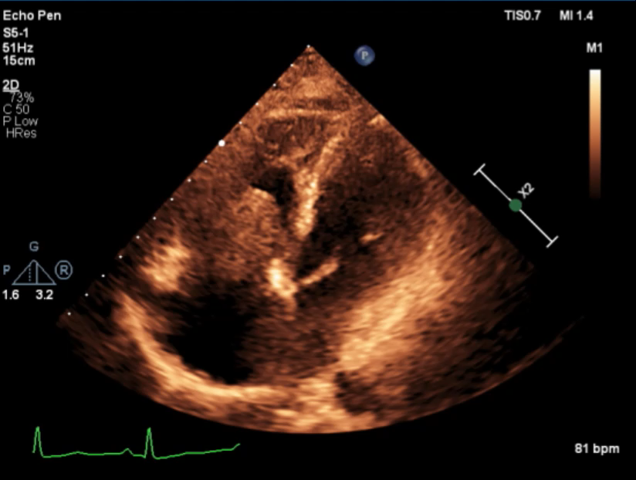
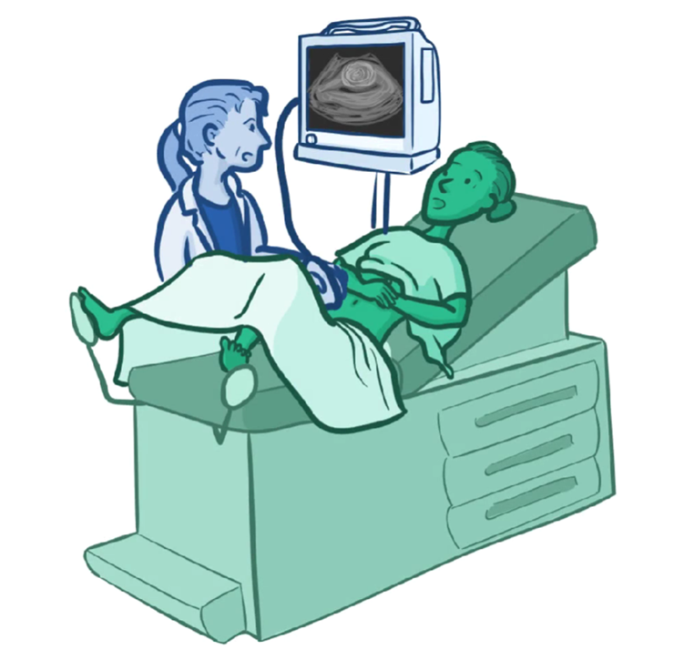
Transthoracic echocardiography

Slide 11
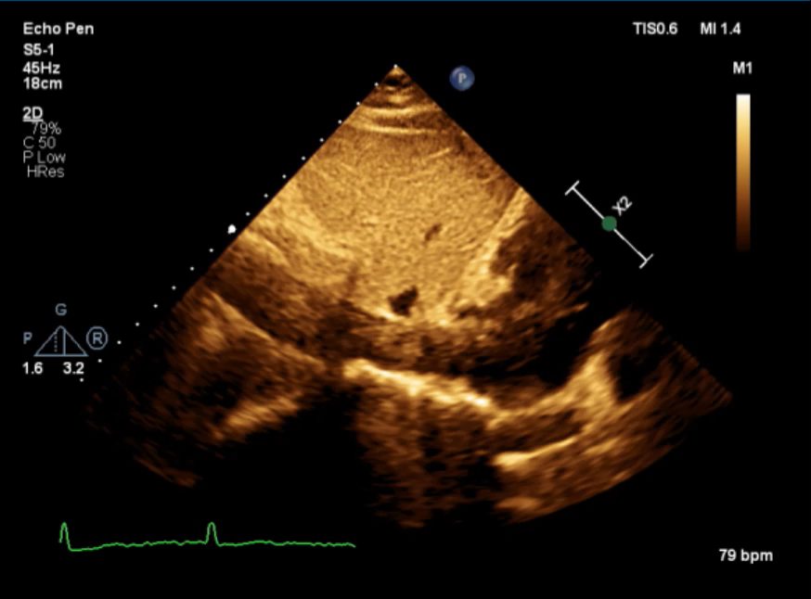
Transthoracic echocardiography

Slide 12
Q3: What additional diagnostic tests are required for the patient?
A3:
CT or MRI
Imaging modalities, including CT and MRI, are usually reserved for selected patients presenting with syncope, especially when other noninvasive means are inadequate or inconclusive. These modalities offer superior spatial resolution in delineating cardiovascular anatomy (e.g., in patients with structural, infiltrative, or congenital heart disease [CHD]).
From ARTICLE: JACC (Journal of the American College of Cardiology), 2017-08-01, Volume 70, Issue 5, Pages e39-e110

Slide 13
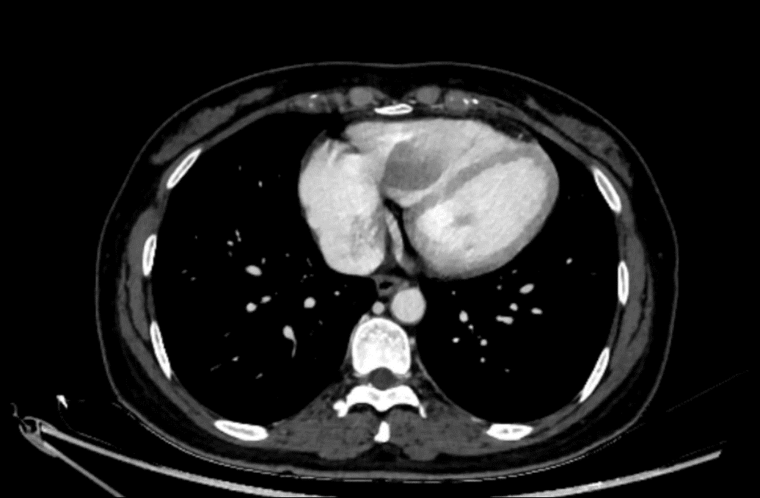

CTV

Slide 14
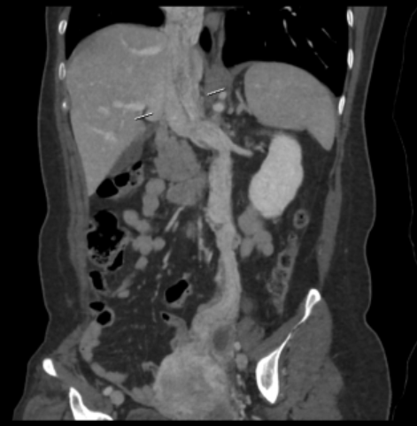
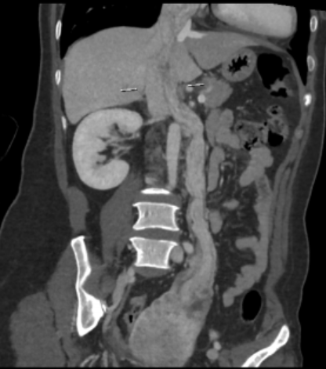
CTV-CPR

Slide 15
Q4: What abnormalities are found in the CTV examination?
A4:
Intravenous filling defect
Uterine and left adnexal mass

Slide 16
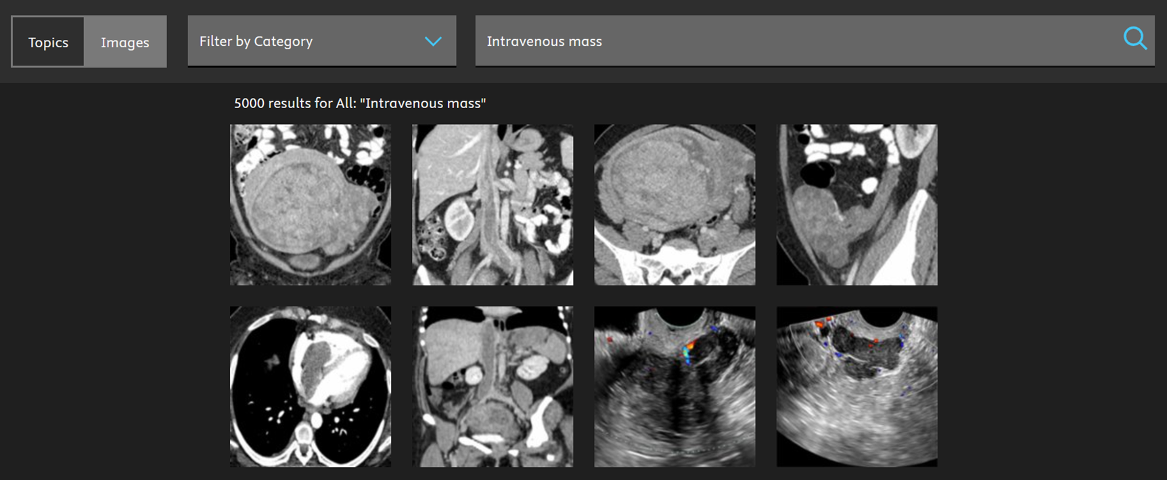

Q5: Given the patient's clinical presentation and accompanying image, what is the most probable diagnosis?
A5:
Intravenous Leiomyomatosis

Slide 17
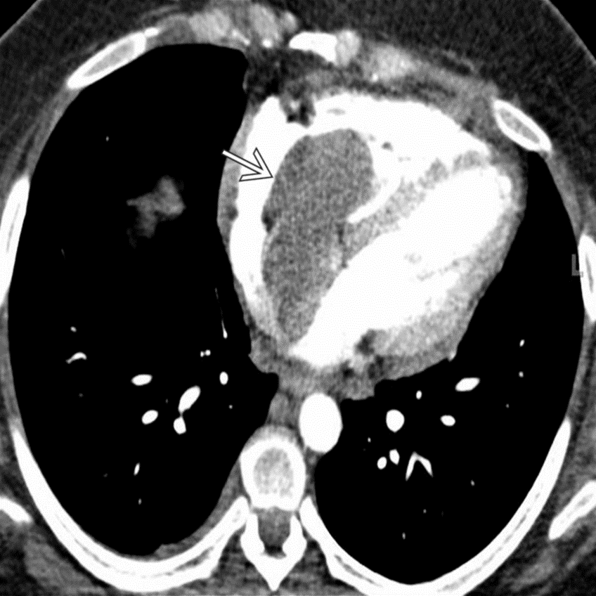
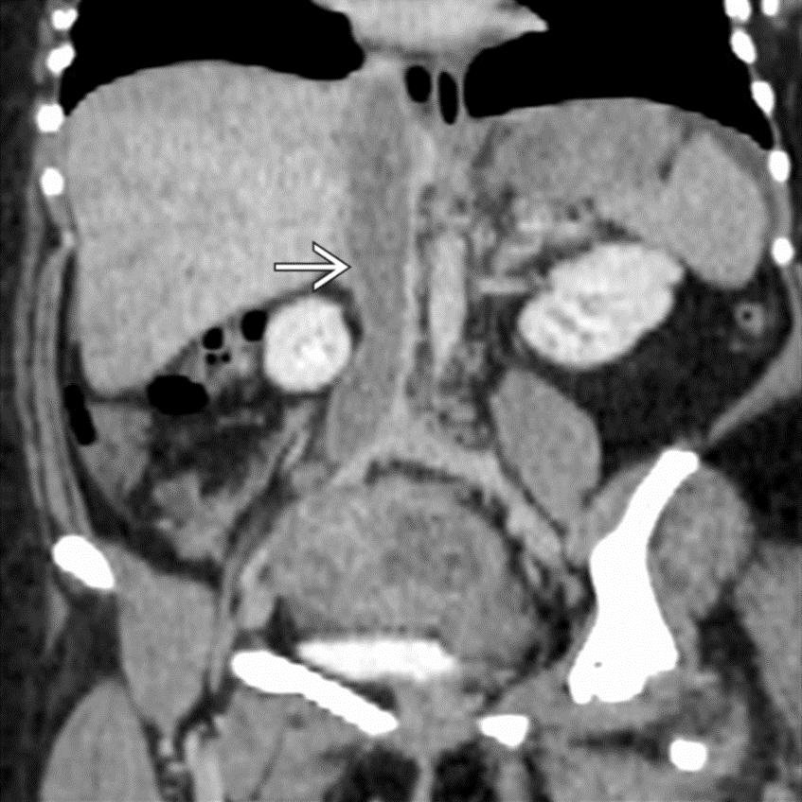
From STATdx-Intravenous Leiomyomatosis

Slide 18
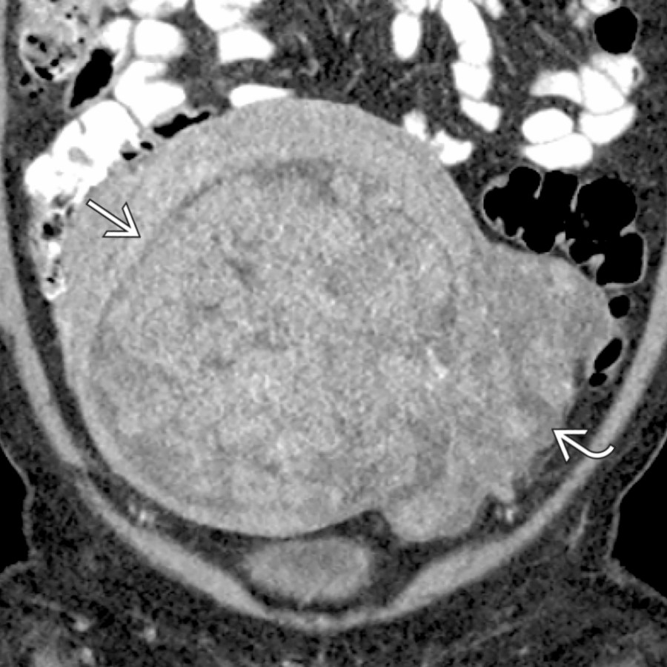
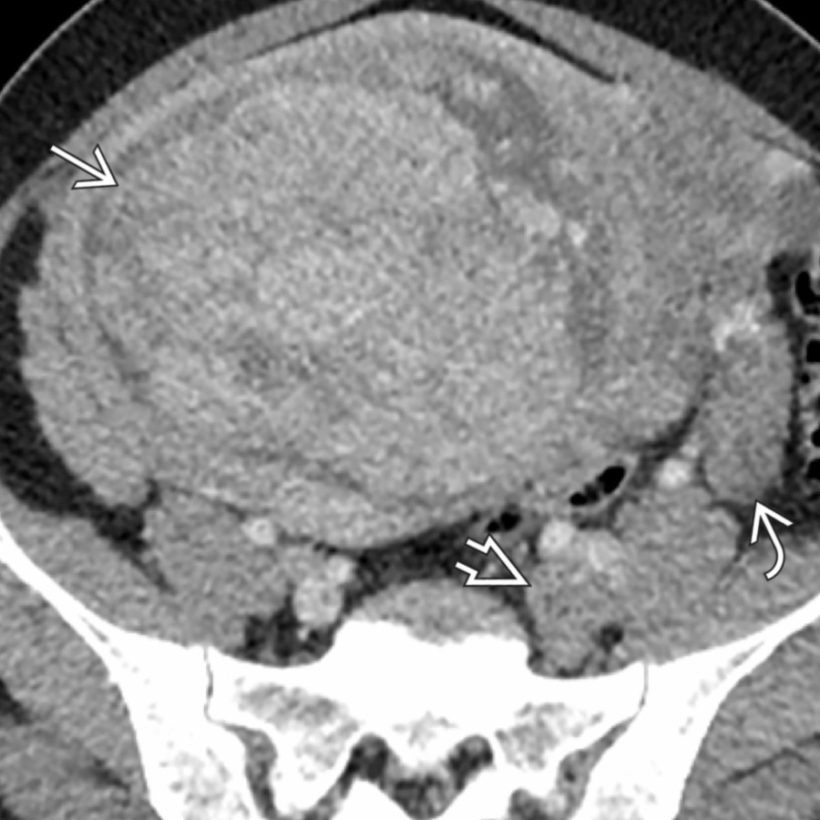
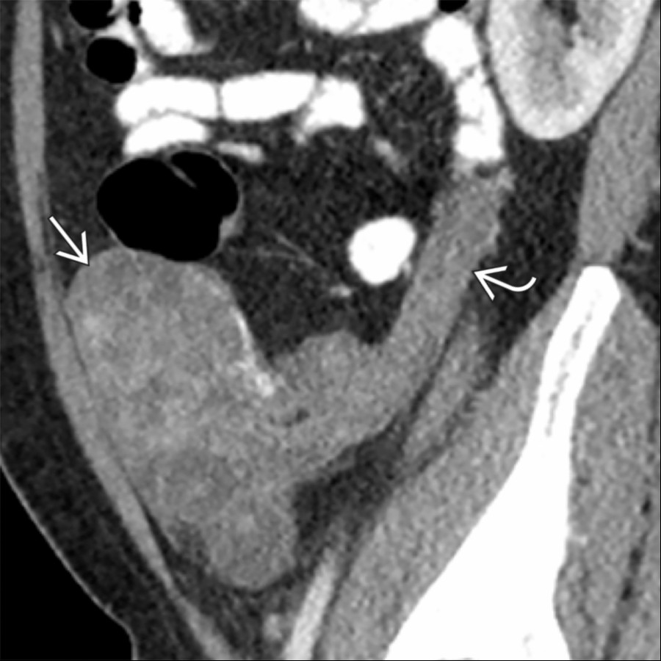
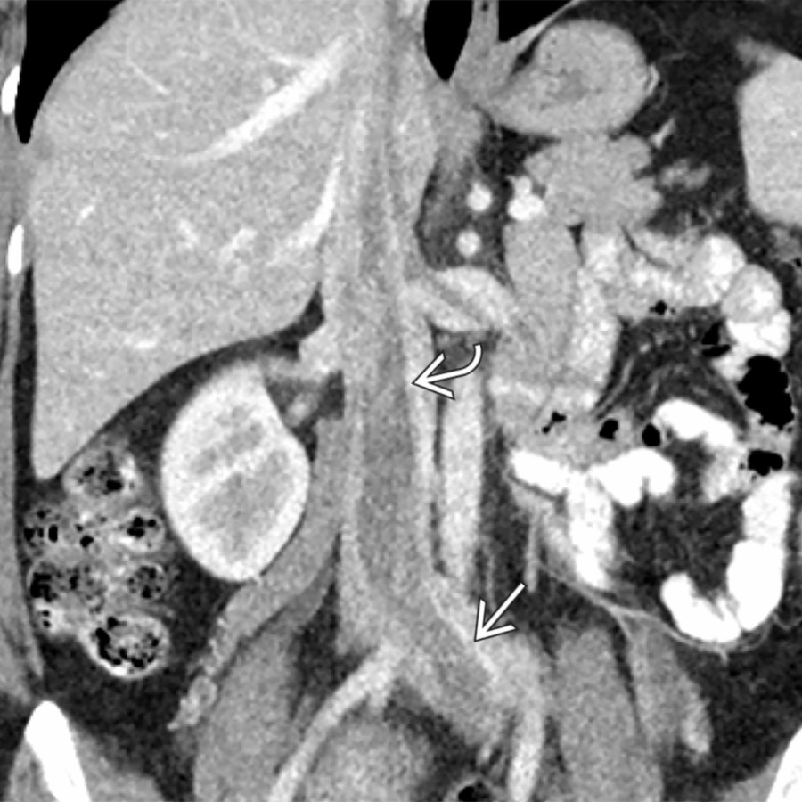
From STATdx-Intravenous Leiomyomatosis

Slide 19
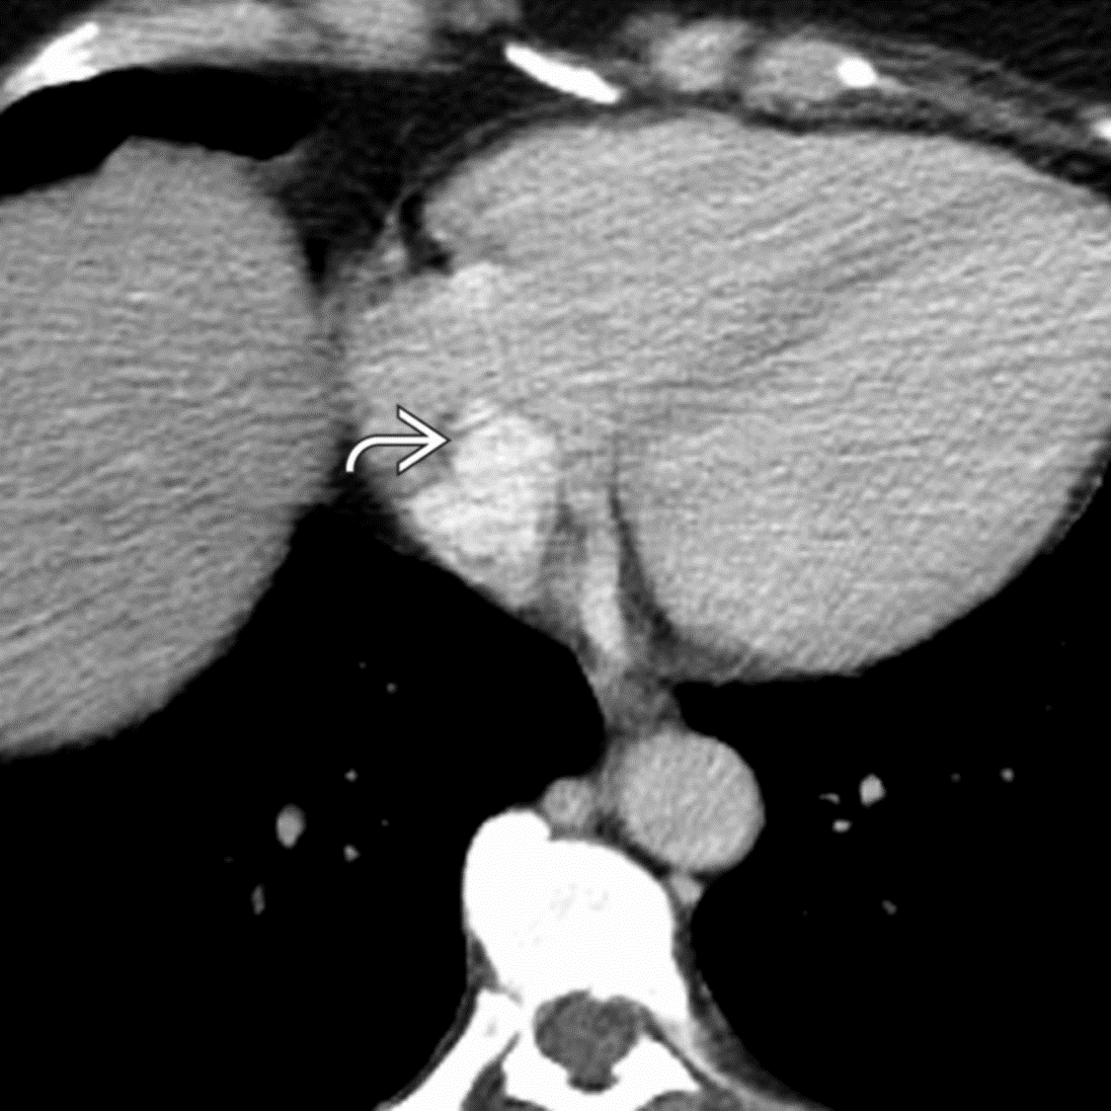
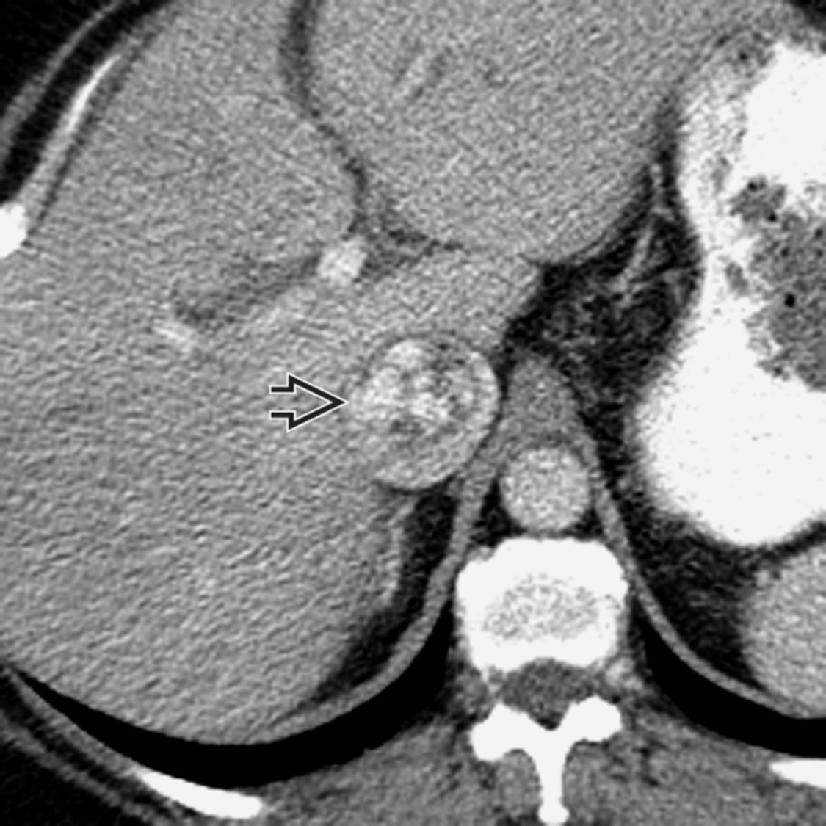
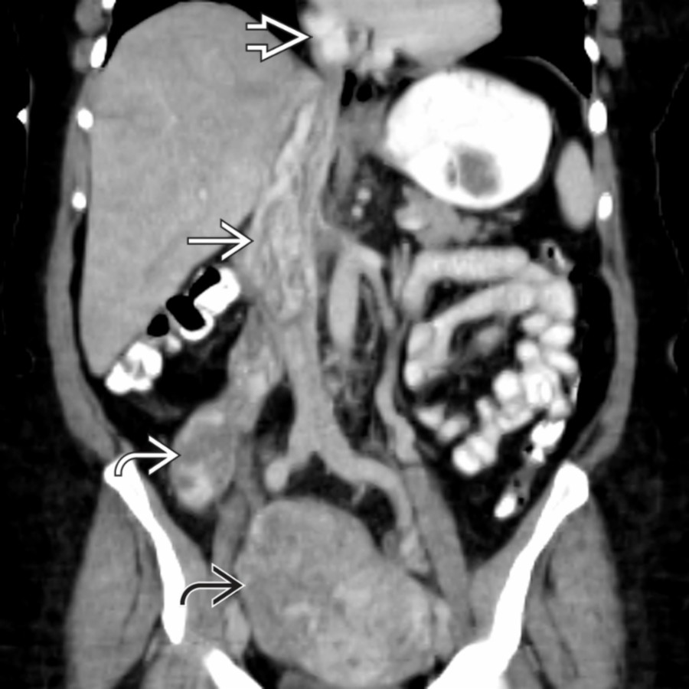
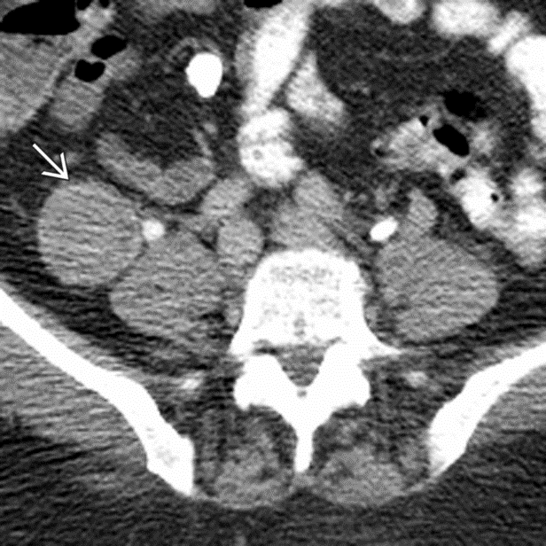
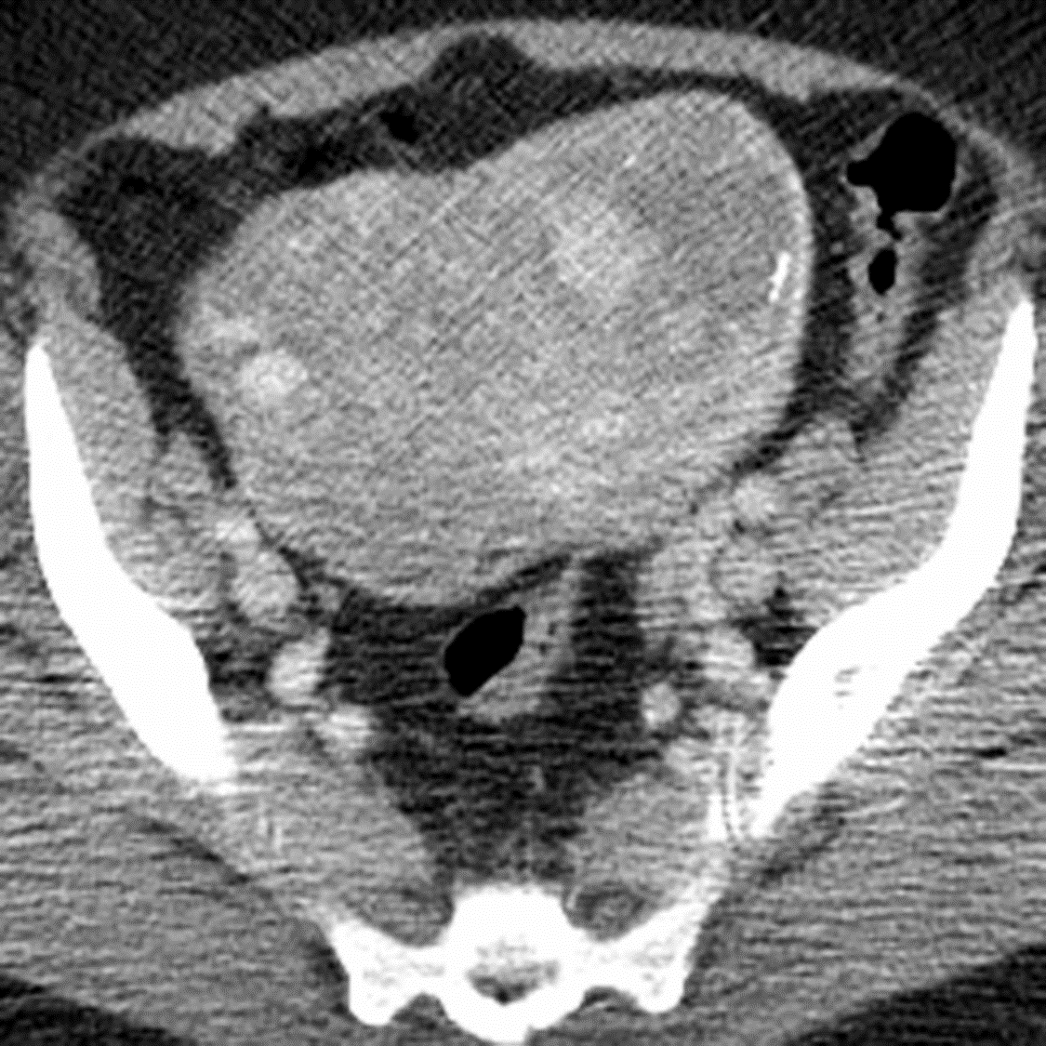
From STATdx-Intravenous Leiomyomatosis

Slide 20
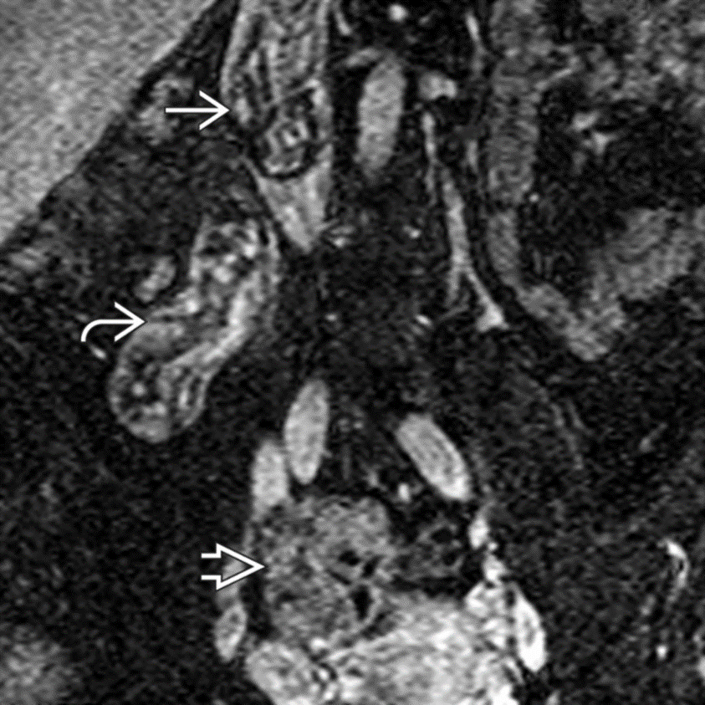
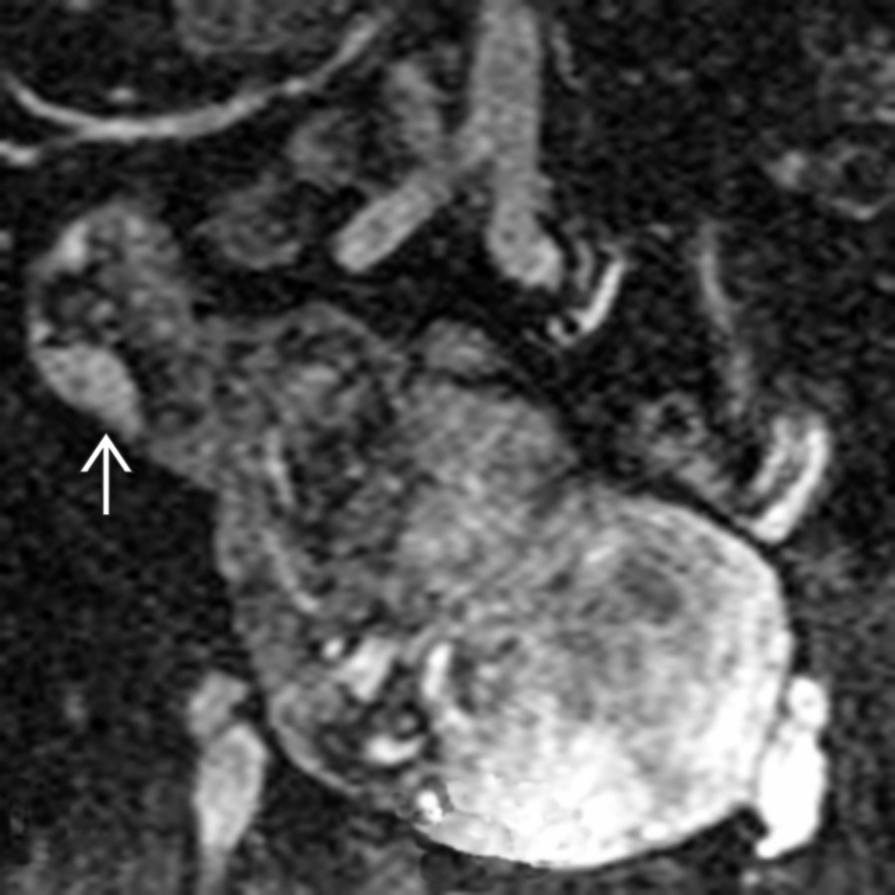
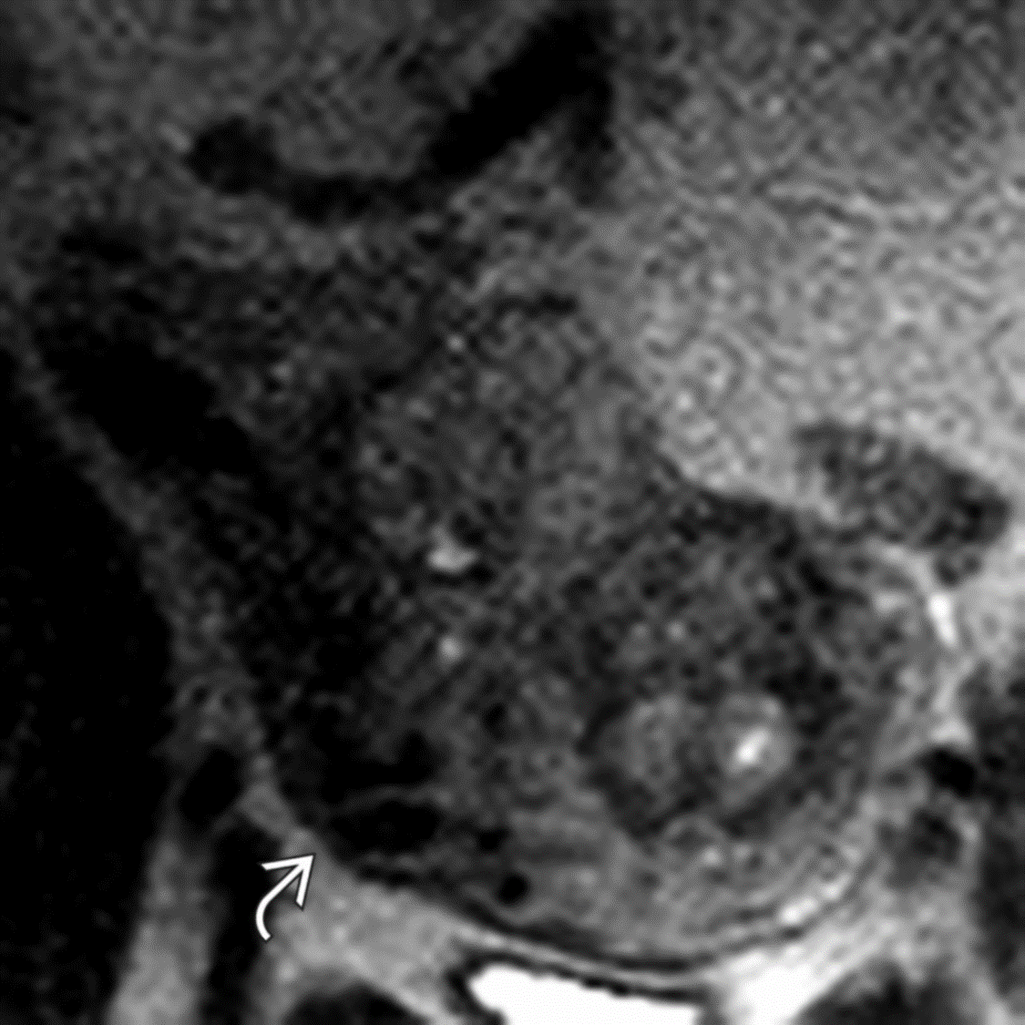
From STATdx-Intravenous Leiomyomatosis

Slide 21
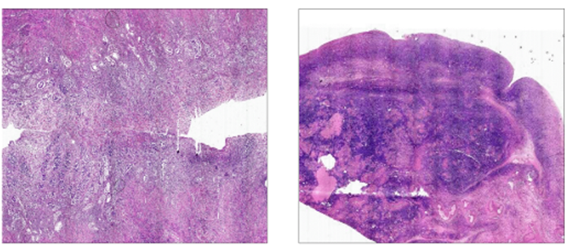
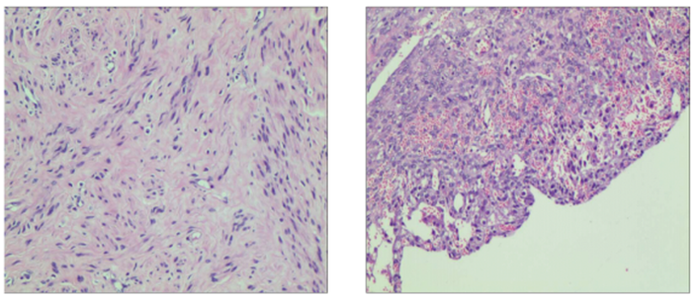
Histology

Slide 22
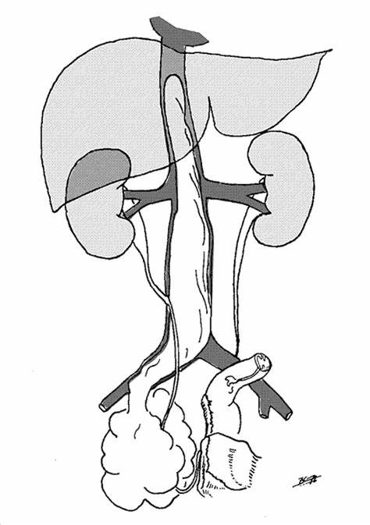
Q6: What is the etiology of intravenous leiomyomatosis?
A6:
An unusual entity characterized by intravascular proliferation of benign-appearing smooth muscle. Rare form of uterine leiomyoma that extends directly into adjacent pelvic veins and may involve inferior vena cava (IVC), right heart, and pulmonary arteries.
From Book: Robbins & Cotran Pathologic Basis of Disease. Chapter 22: The Female Genital Tract: Morphology.

Slide 23
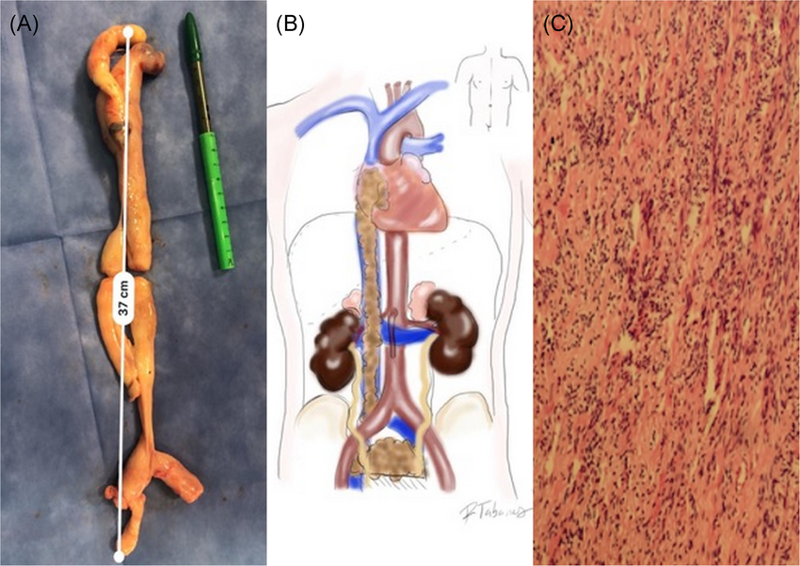
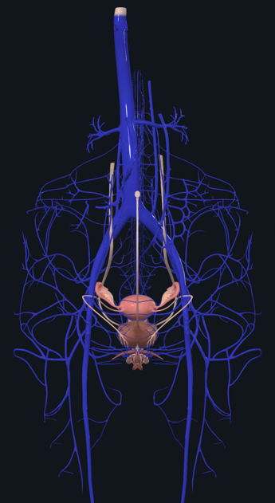
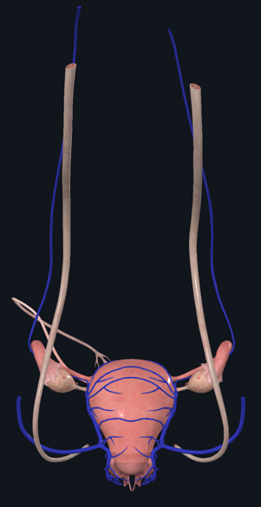

Clinical Pearl-Normal pelvic and ovarian venous anatomy
From ARTICLE: Surgical removal of intravascular leiomyomas with intracardiac extension: A two-case report.

Slide 24
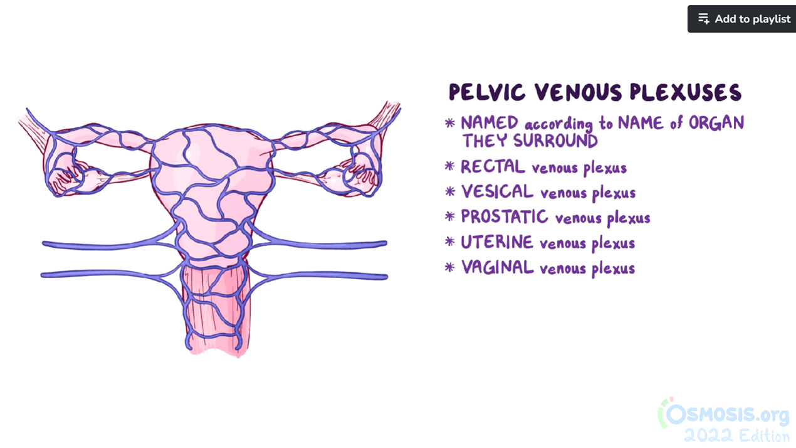


From Osmosis- Arteries and veins of the pelvis

Slide 25
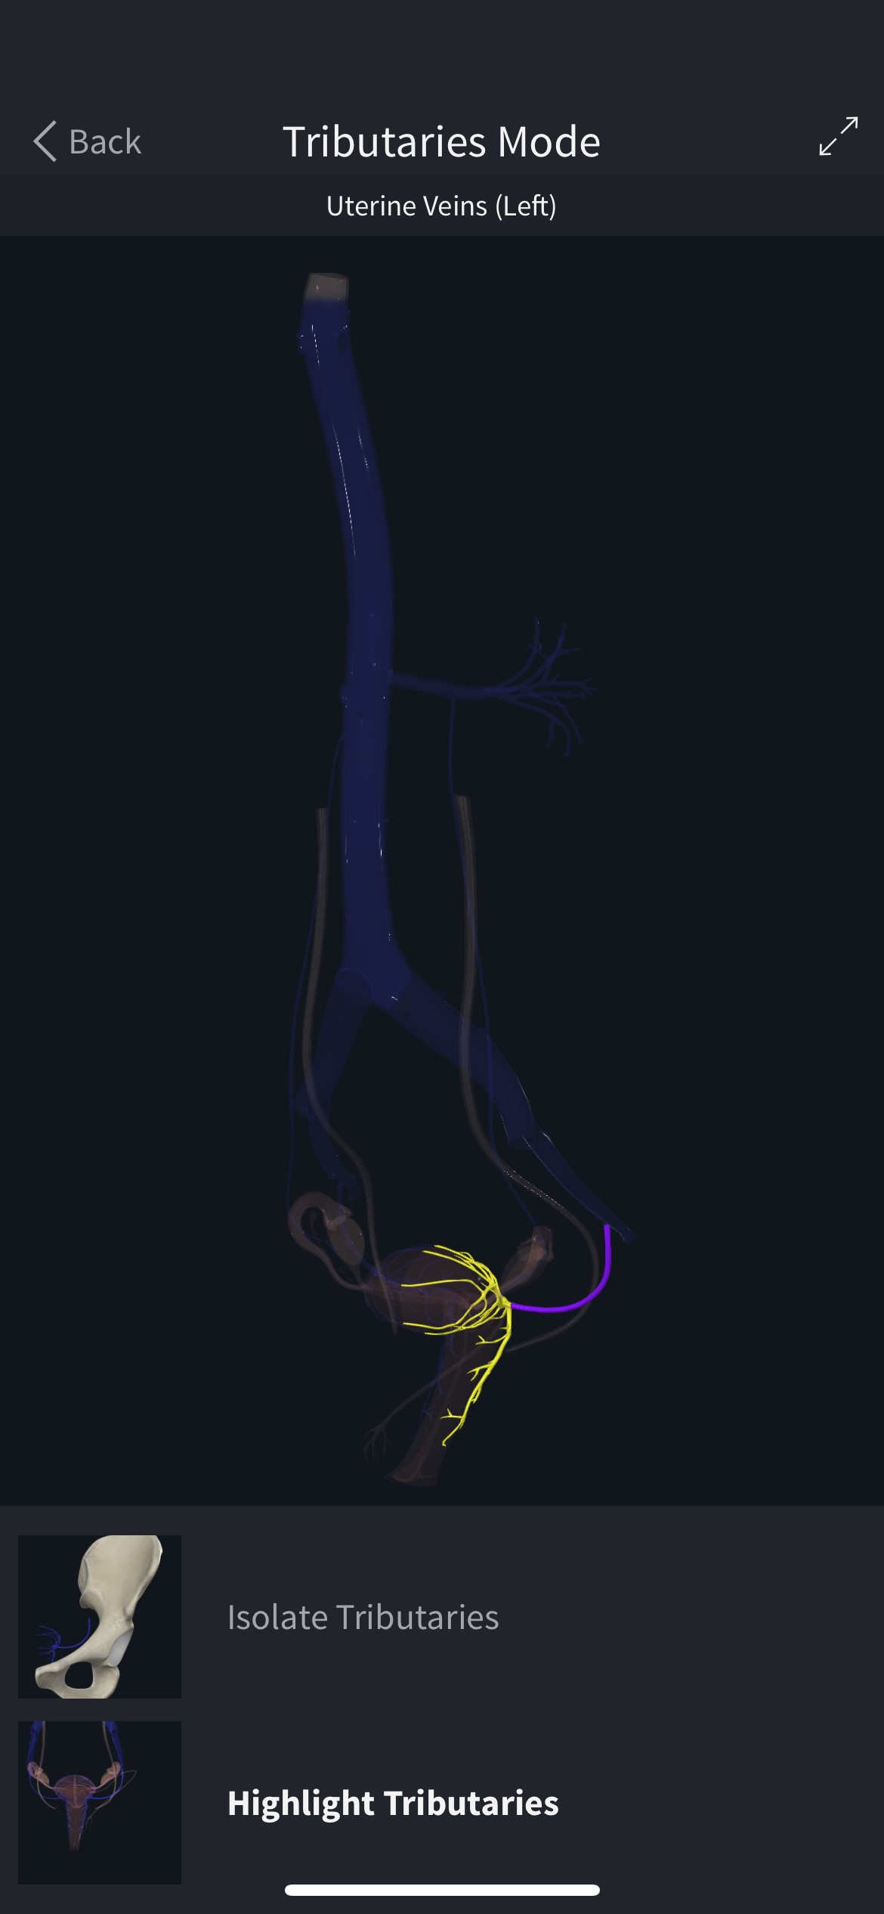
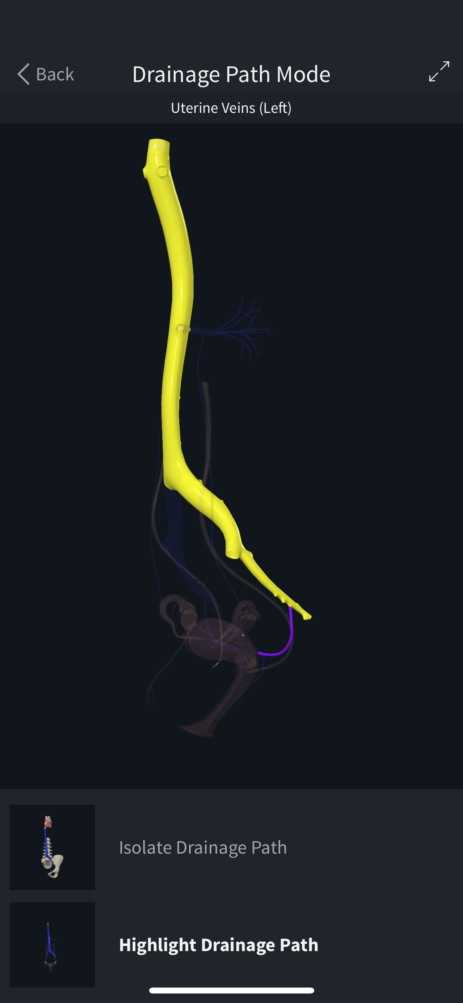
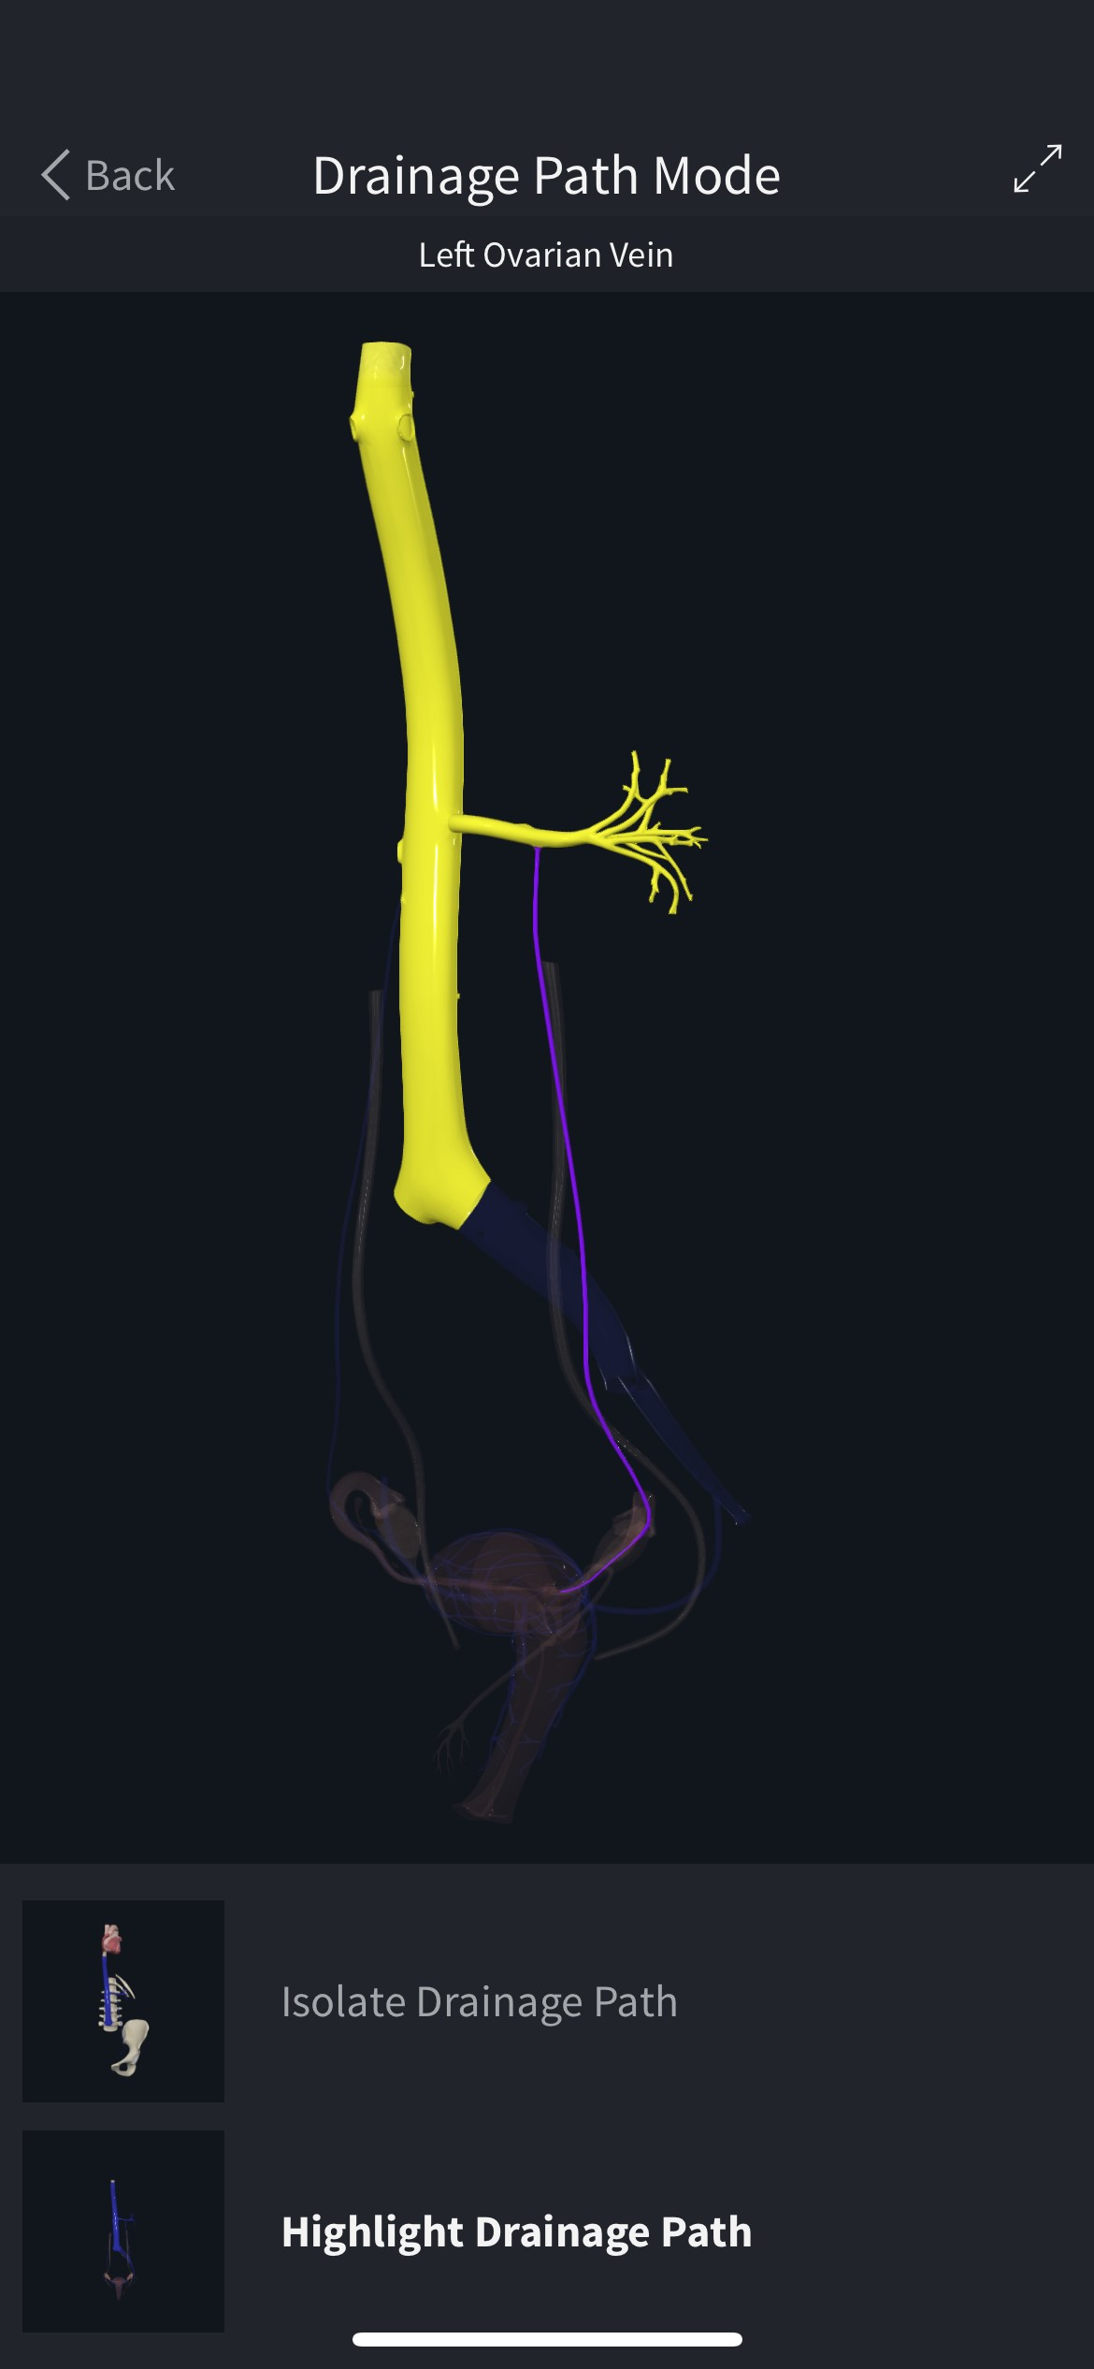

Slide 26
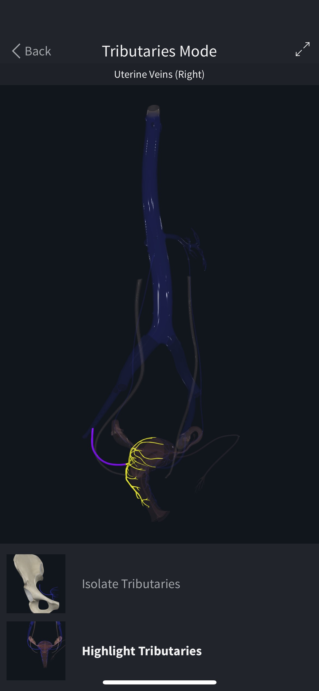
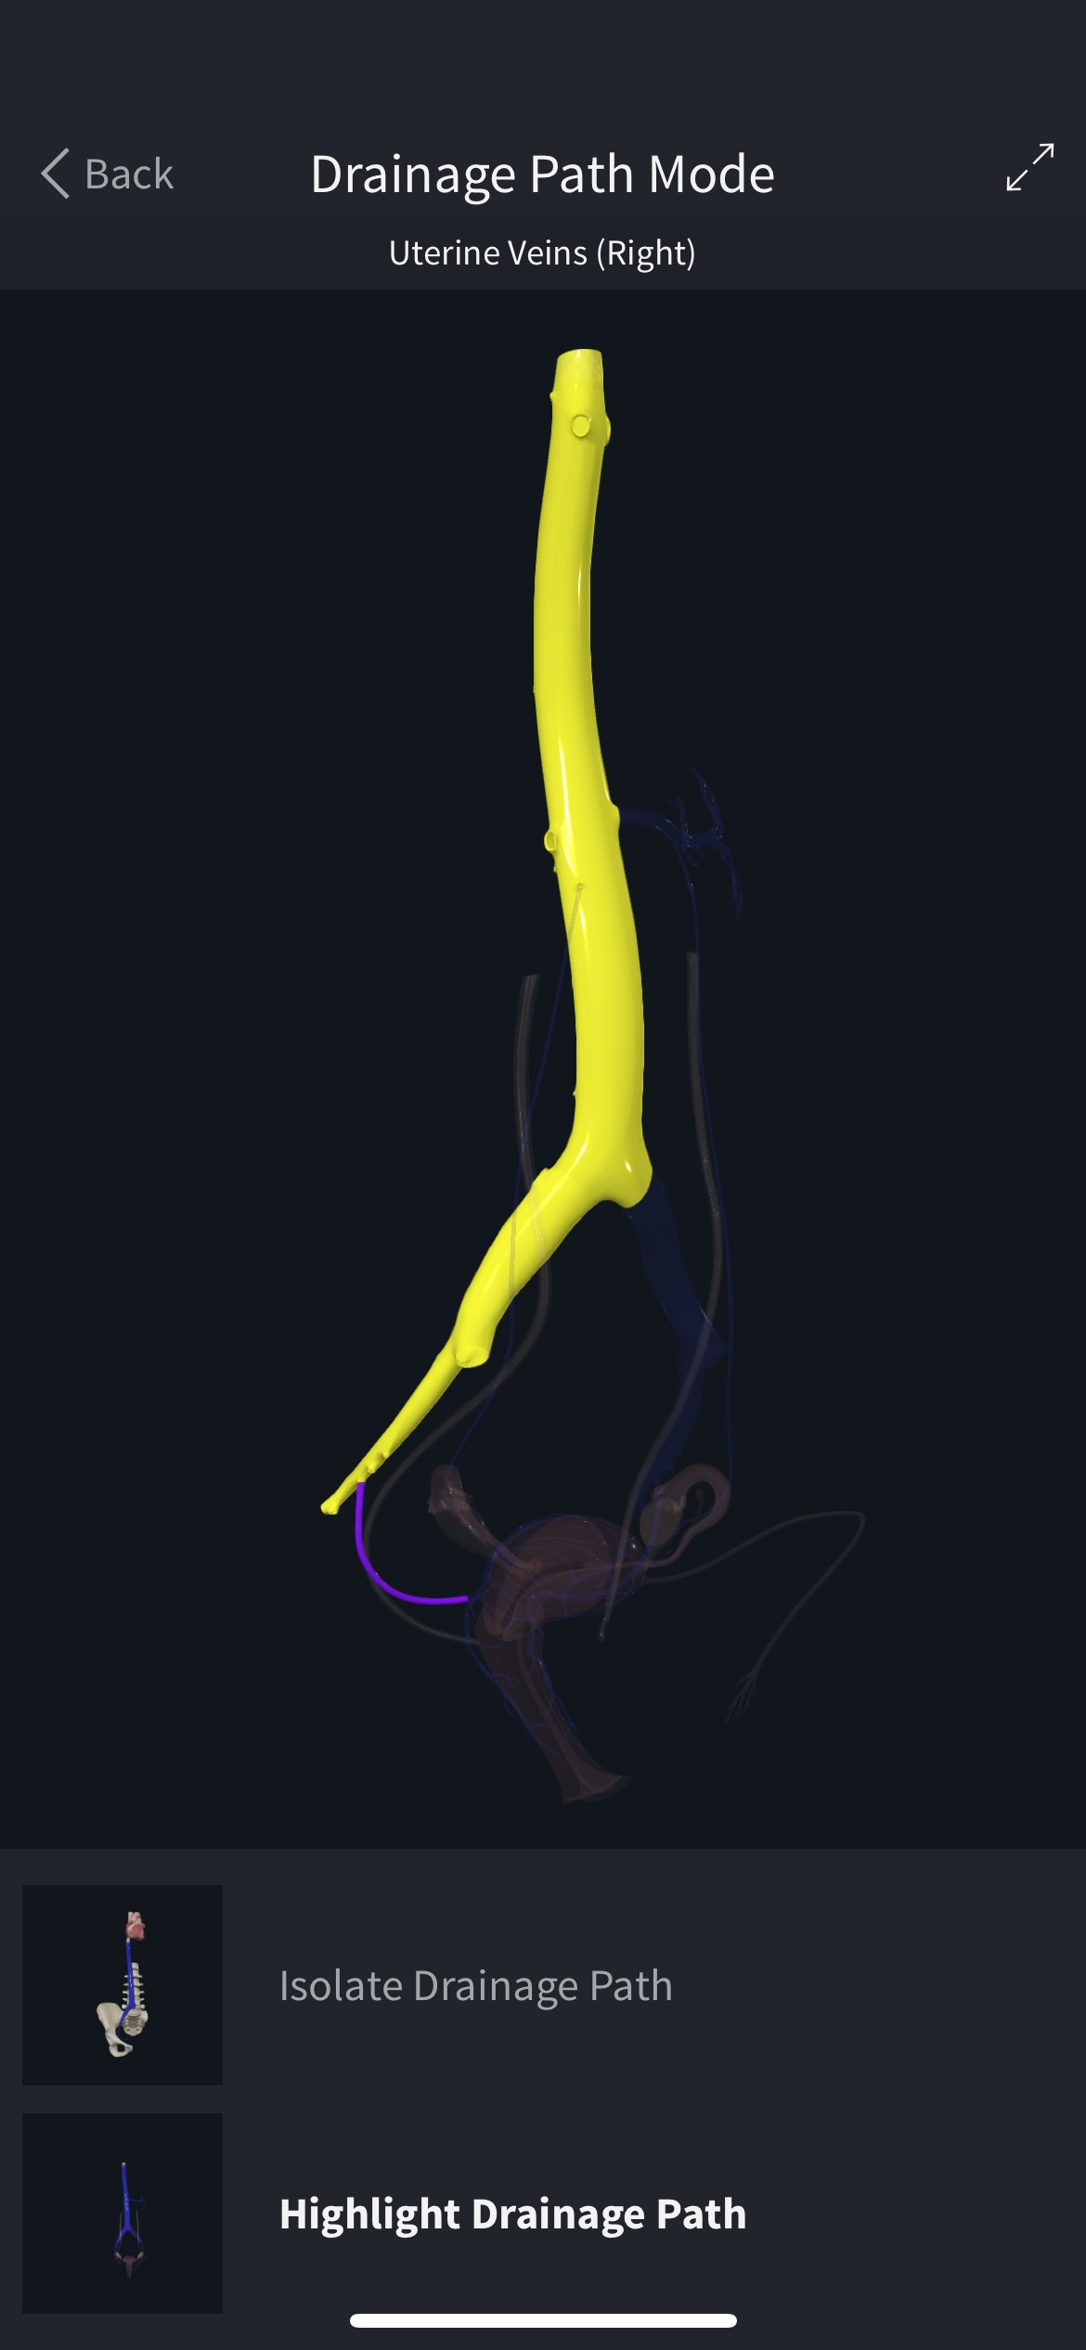
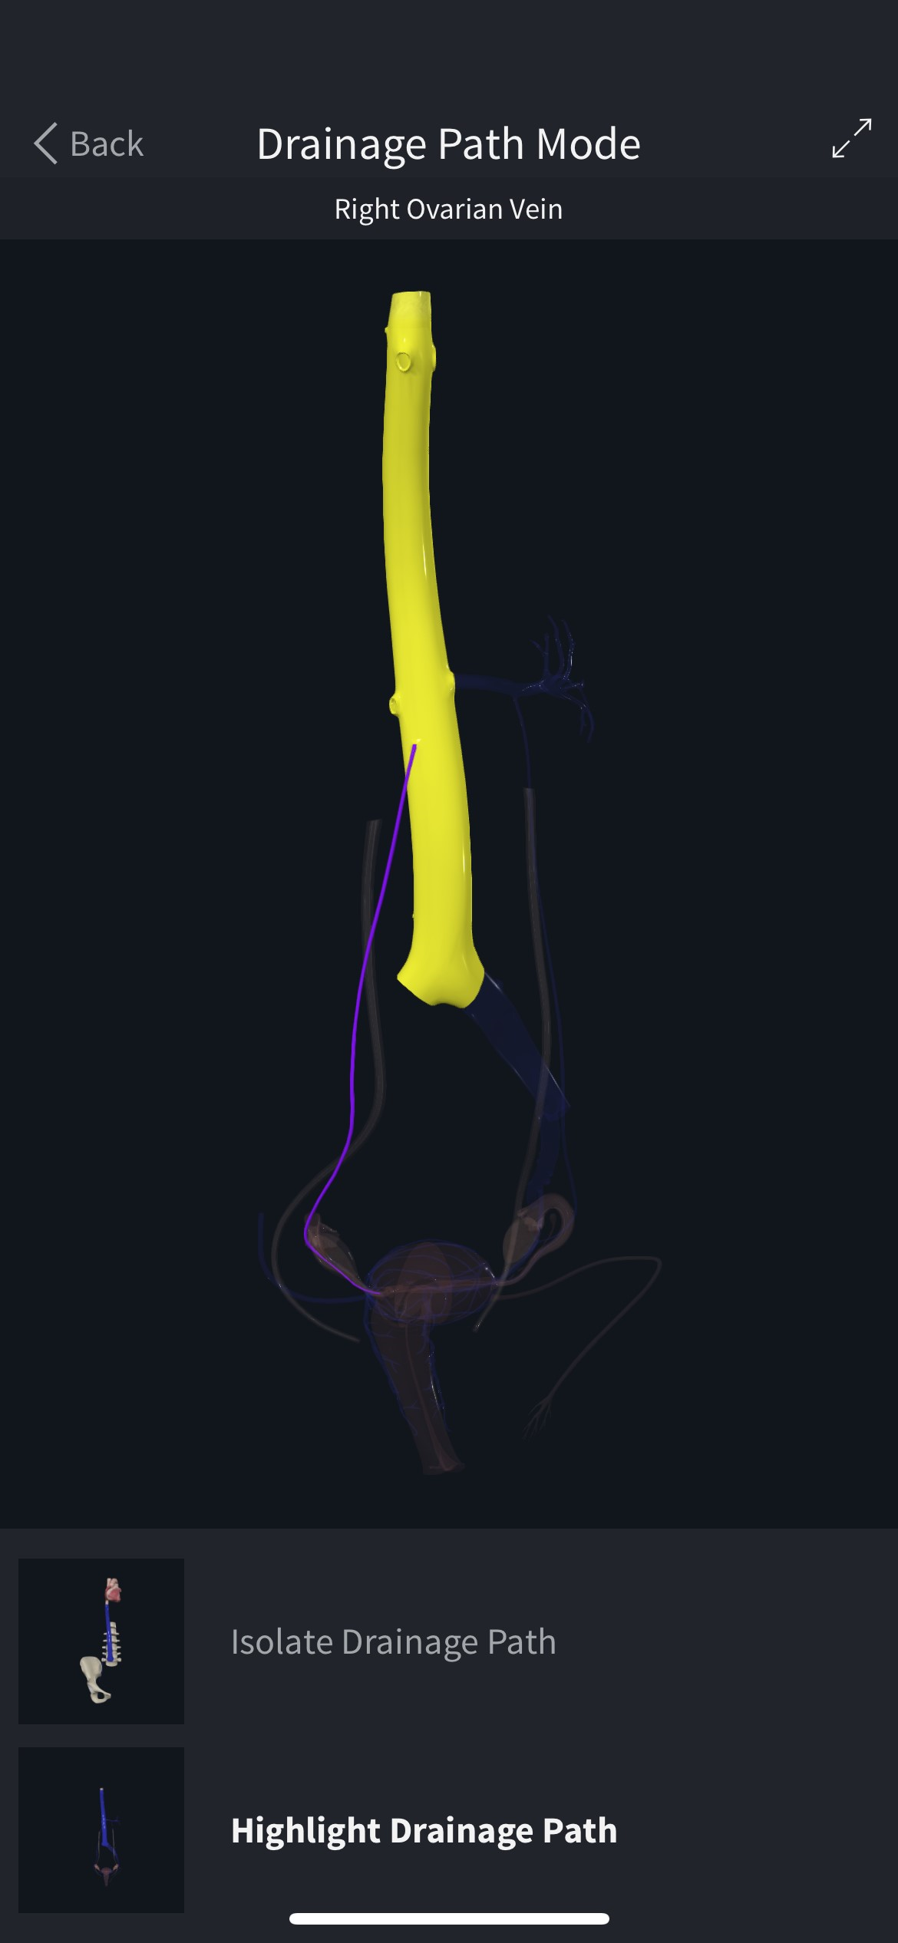

Slide 27
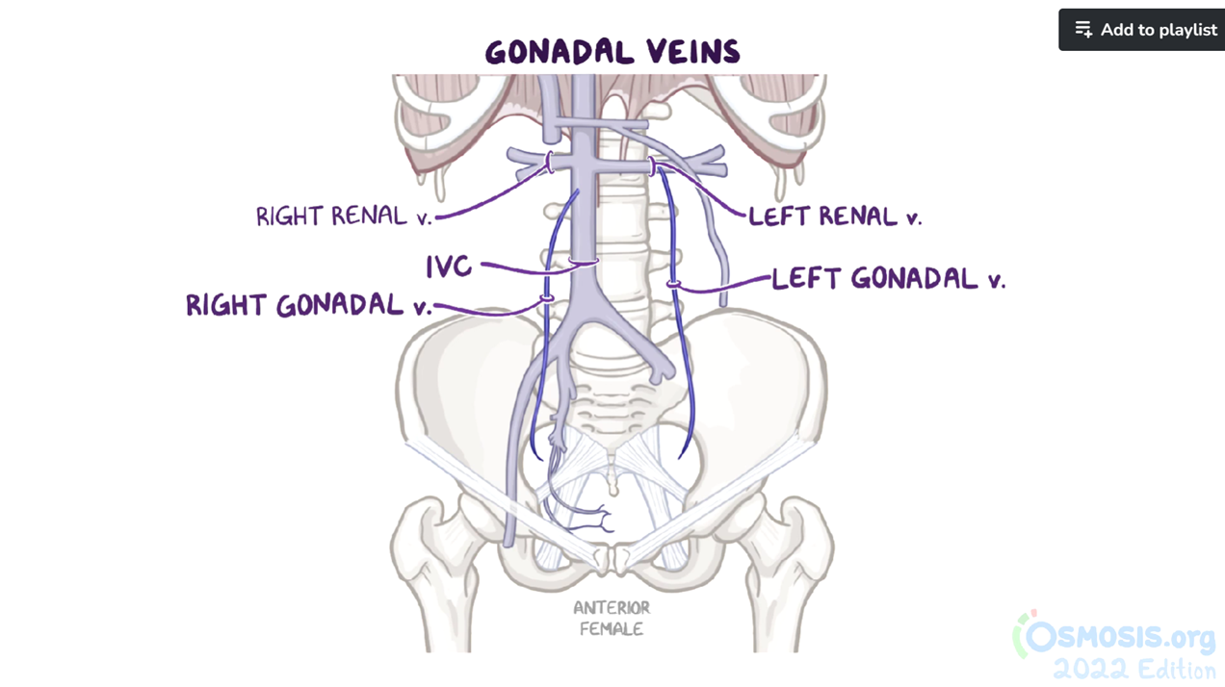
From Osmosis- Arteries and veins of the pelvis

Slide 28
COMPANION CASE 2

Slide 29
CASE PRESENTATION
37y, Female
Complaint: Shortness of breath for over 6 years, palpitations for 2 days
History: Postpartum hemorrhage following a cesarean section occurring over 6 years ago. A mass was discovered in the right broad ligament of the uterus during cesarean section, suggesting the presence of a benign uterine tumor. Six years ago, interventional surgery was conducted as a result of abnormal varices of pelvic vessels identified through ultrasound examination.
Menstrual history: Regular periods with low menstrual flow
Physical examination: T 36.4℃, P 140/min, R 19/min, BP(Lying) 139/75 at the right arm, 128/62mmHg at the left arm

Slide 30
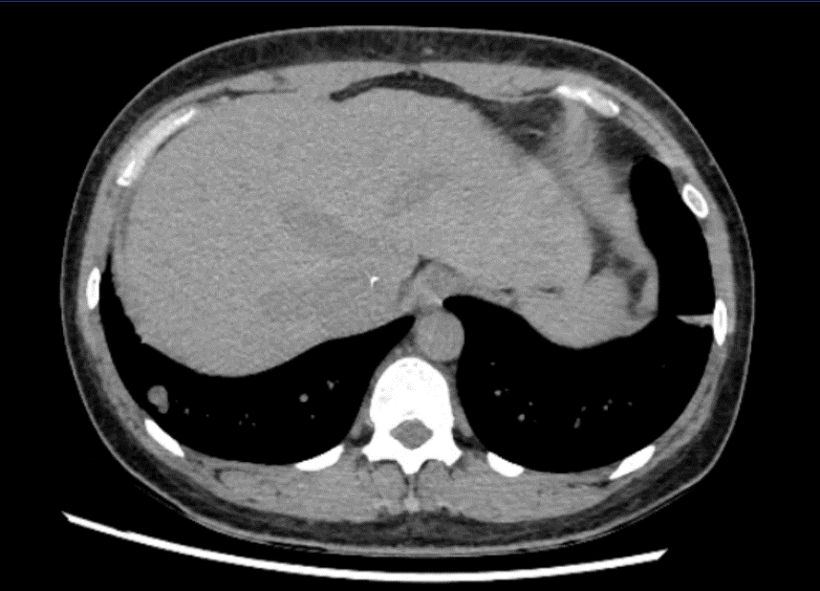
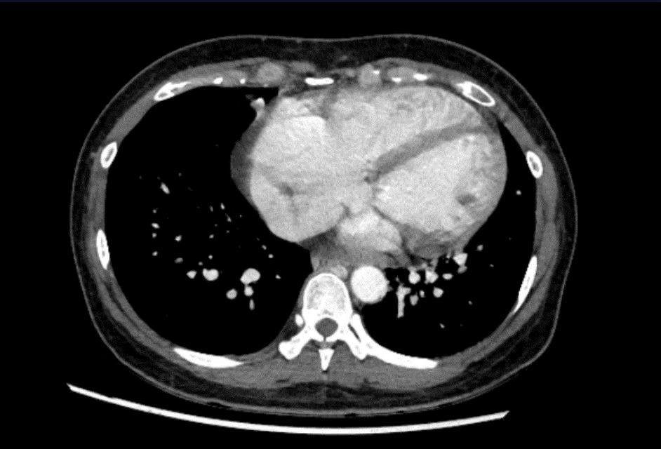
Abdominal plain CT and contrast-enhanced CT

Slide 31
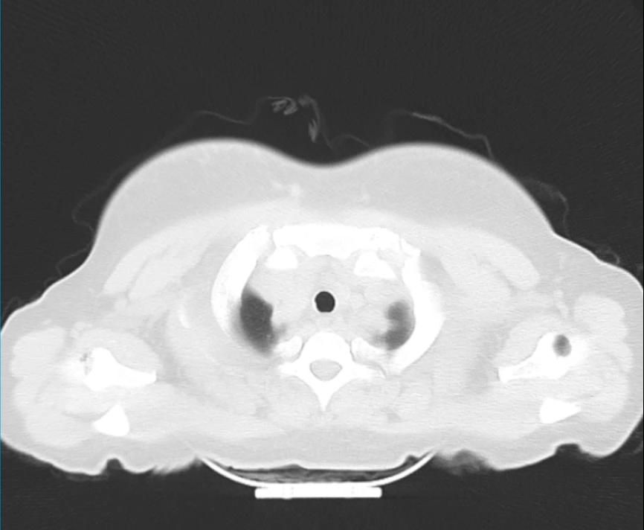
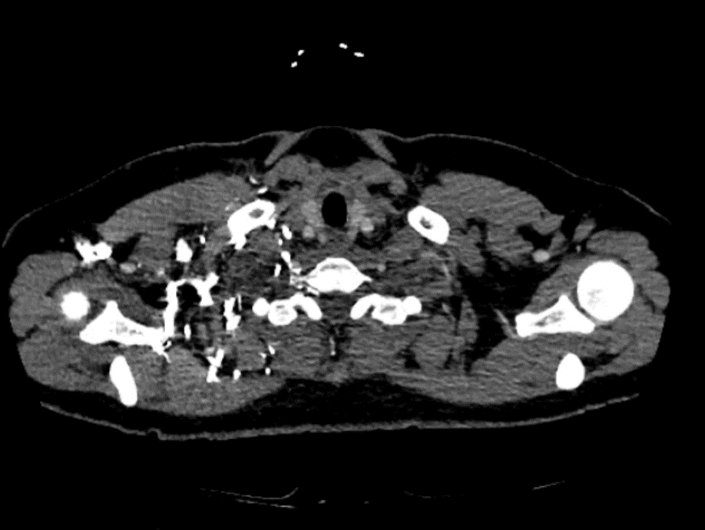
Lung CT & CTPA

Slide 32
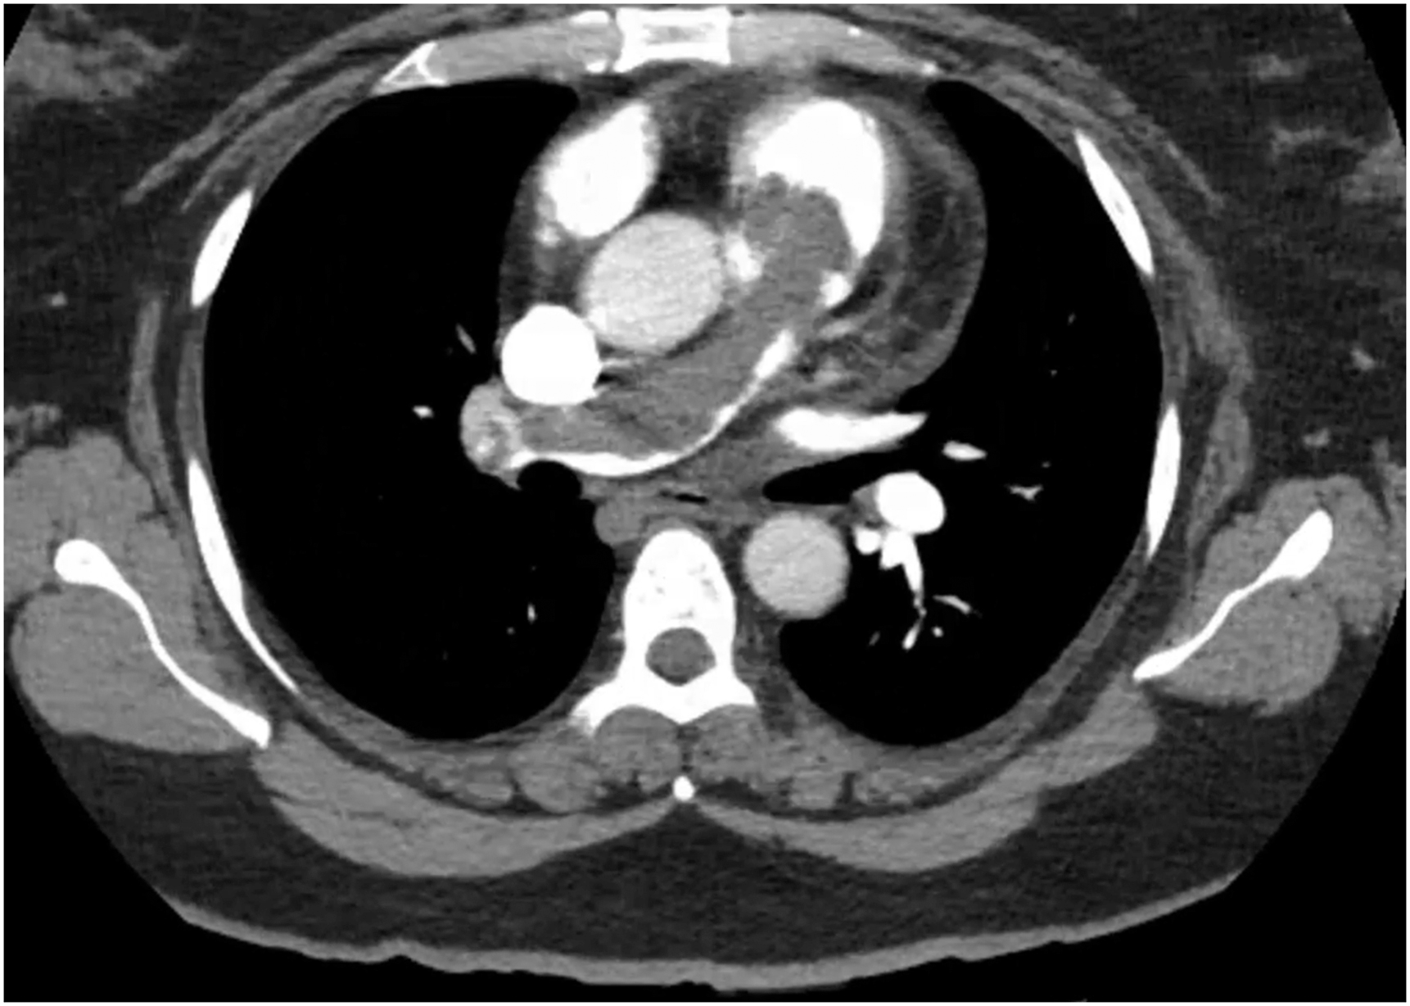
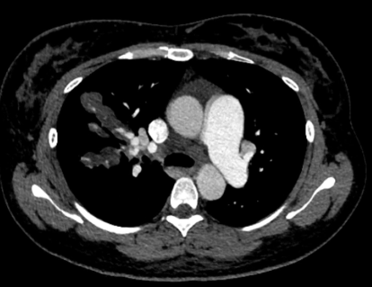
Q7: What are the imaging characteristics of the two cases?
From ARTICLE: Journal of Vascular Surgery Cases, Innovations and Techniques, 2023-12-01, Volume 9, Issue 4, Article 101302

Slide 33
A7:
Filling defects in the pulmonary artery
Lesions characterized by a distribution centered around the pulmonary artery

Slide 34
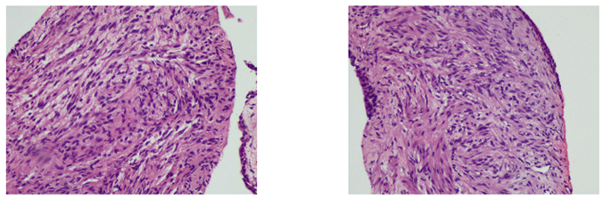
Histology

Slide 35
A7:
Filling defects in the pulmonary artery→Intravenous leiomyomatosis with intracardiac extension
Lesions characterized by a distribution centered around the pulmonary artery→Pulmonary benign metastasizing leiomyoma

Slide 36
Q8: What is the etiology of benign metastasizing leiomyoma?
A8:
Benign metastasizing leiomyoma is a term used to describe the presence of cytologically bland, mitotically inactive smooth muscle proliferations occurring in the lung or lymph nodes of patients with similar-appearing uterine smooth muscle tumors.
From BOOK: Diagnostic Histopathology of Tumors, Chapter 13: Tumors of the Female Genital Tract, 702-912

Slide 37
Thank you for your attention

