Slide 1
Sample Lecture on Cardiac Cycle
University Name
February 2024
Elsevier Health, India

Slide 2
Purpose of this Document
The purpose of this document is to share innovative ideas, approaches and techniques that faculty can adopt to make medical teaching:
Outcomes-based
Self-directed
Engaging
We encourage faculty to focus on student-centricity, patient-centricity and contextualization.
We hope these workshops will help you move forward with the new competence-based curriculum in an efficient and effective manner.
Ideas, approaches and techniques are suggestive only. Faculty should select those that are most conducive based on their personal preferences.

Slide 3
Learning Objectives
Understand the relevance of cardiac cycle and how it links to Heart Rate
Understand the phases of the cardiac cycle
Understand the blood flow, pressure and volume changes in each phase
Describe the origin of and identify heart sounds
Correlate cardiac cycle to ECG
Summarize the events of a cardiac cycle in a diagram (Wigger’s Diagram)
Number | Competency Student should be able to | Domain K/S/A/C | Level K/KH/SH/P | Core (Y/N) | Suggested Teaching Learning method | Suggested Assessment method | Number required to certify P | Vertical Integration | Horizontal Integration
PY5.3 | Discuss the events occurring during the cardiac cycle | K | KH | Y | Lecture, Small group discussion | Written/ Viva voce

Slide 4
Pre-Read

Slide 5
Heart Anatomy
Objective: Familiarize/ revise key concepts in heart anatomy.
Read the following topics:
Electrical cells, Ion channels, Conduction system, Contractile cells
Anatomy of the Heart
Coronary Blood Flow
Metabolic Regulation of the Cardiovascular System
Sources: Goldman-Cecil Medicine, 27th Ed.

Slide 6
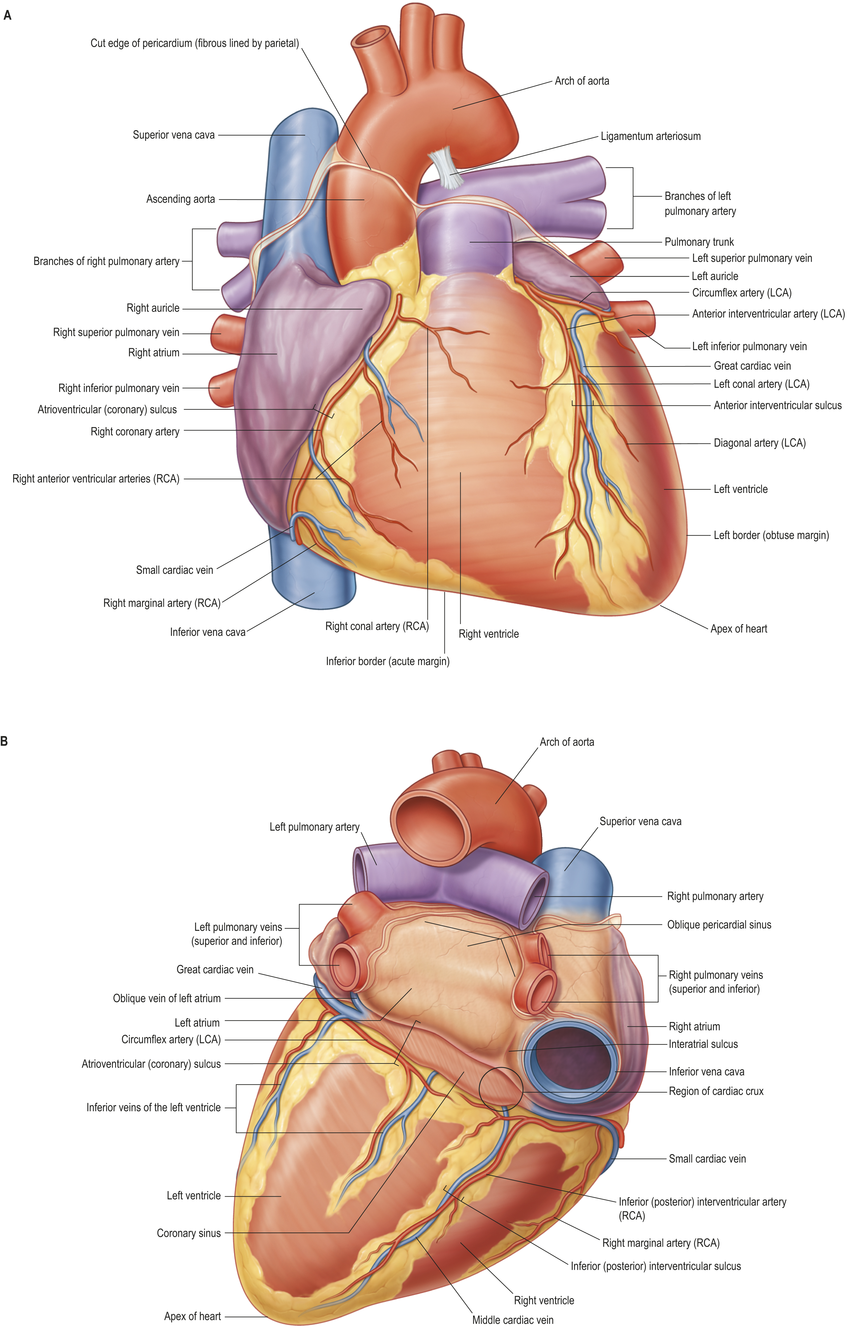
Heart Anatomy
Heart Standring, Susan, MBE, PhD, DSc, FKC, Hon FAS, Hon FRCS, Gray's Anatomy, Chapter 57, 1068-1096.e1 The heart and great vessels. A, Anterior view. B, Inferior view. Abbreviations: RCA, branch of right coronary artery; LCA, branch of left coronary artery. C–D, Corresponding three-dimensional reconstructions from multislice computed tomography (CT... Copyright © 2021 © 2021, Elsevier Limited. All rights reserved.
View in Source
Sources: Gray’s Anatomy, 42nd Ed.

Slide 7
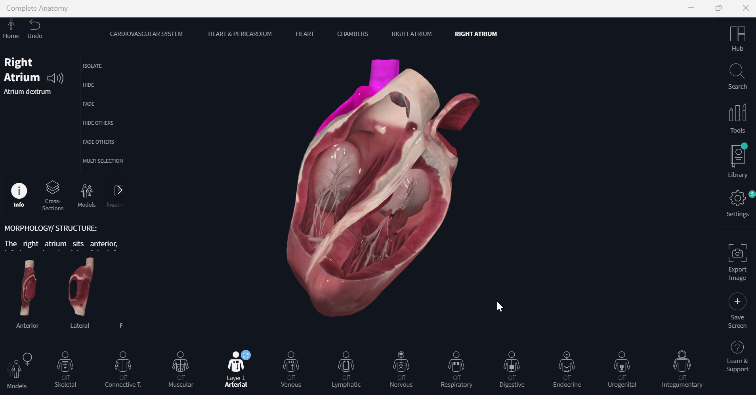
Heart Chambers
Heart Chambers on Complete Anatomy

Slide 8
Lecture

Slide 9
Overview of Cardiac Cycle
Cardiac cycle is the sequence of electrical and mechanical events occurring from initiation of one heartbeat to the initiation of next subsequent heartbeat. It includes
Diastole (relaxation) – heart fills with blood
Systole (contraction) – follows diastole, heart contracts to eject the blood. Right atrial systole comes first, followed by left atrial systole
When the heart muscle is relaxed at end diastole, the ventricular pressure is at its resting level (end-diastolic pressure) and the ventricular volumes are at their maximal value (end-diastolic volume).
At the end of ventricular systole when contraction is maximum, ejection ends, and the ventricular volumes are at their lowest (end-systolic volume).
Stroke Volume (SV) = volume of ejected blood = End-Diastolic Volume (EDV) – End-Systolic Volume (ESV)
Ejection Fraction (EF) = SV/EDV X 100
Cardiac cycle duration = 60/Heart Rate (HR). So, for normal HR, duration = 60/75 = 0.8s
Source: https://www.clinicalkey.com/student/content/book/3-s2.0-B978813126560400048X#hl0000128; https://www.clinicalkey.com/student/content/book/3-s2.0-B9780323930383000411#hl0000223
Textbook of Physiology for Medical Students, 2nd Ed. Goldman-Cecil Medicine, 27th Ed.

Slide 10
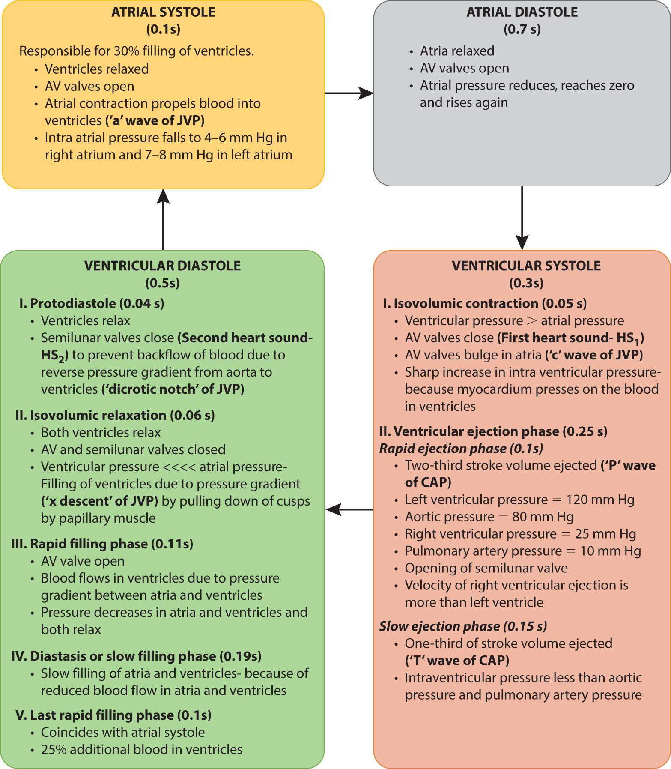
Overview of Cardiac Cycle
Atrial Cycle
Atrial systole – 0.1s
Atrial diastole – 0.7s
Ventricle Cycle
Ventricular systole – 0.3s – isovolumetric contraction (0.5s), ventricular ejection (rapid and slow, 0.25s)
Ventricular diastole – 0.5s – protodiastole (0.04s), isovolumetric relaxation (0.06s), rapid passive filling (0.11s), reduced filling or diastasis (0.19s), Last rapid filling phase which coincides with the atrial systole (0.1 second)
Cardiac cycle Singh, Harminder, MD, Textbook of Physiology for Medical Students, 39, 363-368 Representation of events of cardiac along with duration, pressure and volume changes. (CAP, Carotid arterial pulse; JVP, Jugular venous pulse.) Copyright © 2023 Copyright © 2023 by RELX India Pvt. Ltd.
Source: https://www.clinicalkey.com/student/content/book/3-s2.0-B978813126560400048X#hl0000128; https://www.clinicalkey.com/student/content/book/3-s2.0-B9780323930383000411#hl0000223
Textbook of Physiology for Medical Students, 2nd Ed. Goldman-Cecil Medicine, 27th Ed.

Slide 11
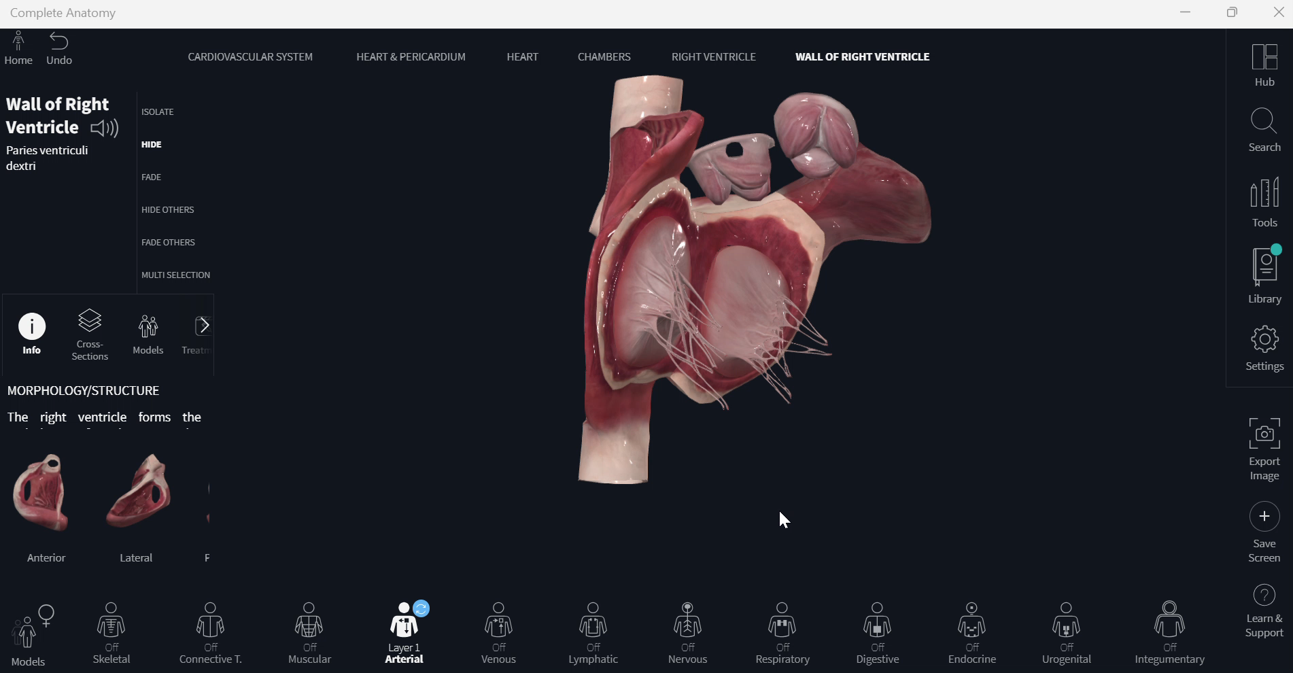
Overview of Cardiac Cycle – Beating Heart Valves
Source: Complete Anatomy

Slide 12
Overview of Cardiac Cycle
Class Discussion
What do you think happens when HR rises to 200, for example, in the gym?
Read more here: https://www.clinicalkey.com/student/content/book/3-s2.0-B9780323930383000411#hl0000286
Effect of Exercise on Blood Pressure and Heart Rate

Slide 13
Atrial Systole
Before the beginning of atrial systole, the ventricles are relaxing, AV valves are open and the blood is flowing from the great veins into the atria and from the atria into the ventricles. Thus, the atria and ventricles form a continuous cavity.
Coincides with last rapid filling phase
Increase in intra-atrial pressure – sharp increase in pressure, 4-6mmHg in RA, 7-8mmHg, LA. Pressure wave recorded as a-wave.
Intraventricular pressure rises due to filling of blood in the ventricles (not due to contraction) to 6-7mmHg in RV, 7-8mmHg in LV.
When the atrial contraction begins about 105 mL (75%) of the blood has already flown into the ventricles. The atrial contraction causes additional 25 mL (25%) filling of the ventricles. Thus, at the end of atrial systole (also the end of ventricular diastole), ventricular volume is about 130 mL (EDV).
Source: https://www.clinicalkey.com/student/content/book/3-s2.0-B9788131264737000263#hl0000312
Concise Textbook of Physiology, 4th Ed.

Slide 14
Atrial Diastole
Just after atrial systole
Lasts for 0.7s and coincides with ventricular systole and majority of ventricular diastole
Atrial muscles relax with gradual filling of the atria with blood. The pressure gradually increases in the atria and then drops due to opening of the AV valves.
Then the pressure again rises and follows the ventricular pressure during the rest of atrial diastole.
Source: https://www.clinicalkey.com/student/content/book/3-s2.0-B9788131264737000263#hl0000348
Concise Textbook of Physiology, 4th Ed.

Slide 15
Ventricular Systole
Lasts 0.3s. Includes these phases:
Phase I
Isovolumic Contraction (0.05s)
Ventricular pressure exceeds atrial pressure causing rapid closure of AV valves (first heart sound)
AV and semilunar valves closed so pressure increases in the ventricles due to contraction.
Isovolumic = no change in blood volume.
Due to pressure AV valves bulge into the atria causing slight increase in pressure (c-wave).
Lasts until pressure in LV and RV exceeds aorta (80mmHg) and pulmonary artery (10mmHg) and valves open.
Phase II
Ventricular Ejection (0.25s)
Semilunar valves open
Rapid Ejection – 2/3*SV (89ml) blood rapidly ejects out because semilunar valves open. Ventricles contracting faster than blood ejection, hence increase in pressure to max 12mmHg in LV and 25mmHG in RV.
Source: https://www.clinicalkey.com/student/content/book/3-s2.0-B9788131264737000263#hl0000356
Concise Textbook of Physiology, 4th Ed.

Slide 16
Ventricular Systole
Lasts 0.3s. Includes these phases:
Phase II
Ventricular Ejection (0.25s)
Slow Ejection – 0.15s. Rate of ejection declines. Ventricular contraction stops. Pressure starts declining. 1/3*SV ejected. Intraventricular pressure starts declining and falls to a value slightly lower than in the aorta. Aortic pressure, which was rising during rapid ejection, also starts falling.
About 50ml of the blood in each ventricle at the end of ventricular systole is called end-systolic volume
Source: https://www.clinicalkey.com/student/content/book/3-s2.0-B9788131264737000263#hl0000356
Concise Textbook of Physiology, 4th Ed.

Slide 17
Ventricular Diastole
Protodiastole – 0.04s. Ventricular systole ends, ventricles relax, intraventricular pressure falls. Elevated pressure in the distended arteries (aorta and pulmonary artery) immediately pushes the blood back towards ventricles. Semilunar valves close. Closing of semilunar valves pushes blood back into the ventricles and makes second heart sound.
Isovolumic Relaxation - Semilunar valves have closed and the AV valves have not yet opened, so the ventricles continue to relax as closed chambers. Rapid fall in pressure from 80mmHg to 2-3mmHg in LV. Aortic pressure declines until another ventricular systole boosts the aortic pressure again. Phase ends when AV valves open (v-wave on the atrial pressure curve).
Rapid Passive Filling – 0.11s. Atria in diastole, venous return brings blood into the atria and pressure rises. When the AV valves open, the high atrial pressure causes a rapid, initial flow of blood into the ventricles (third heart sound). Once the AV valves open, the atria and ventricles are a common chamber and pressure in both cavities falls as ventricular relaxation continues.
Reduced Filling and Diastasis – 0.19s. Pressure in atria and ventricles reduces slowly to just above zero. Decreases the rate of blood flow from the atria to ventricle causing a very slow filling called diastasis.
Last Rapid Filling – 0.1s. Ventricular diastole coincides with atrial systole. Atrial systole brings about the last rapid filling phase and pushes the additional 25% of the blood in the ventricles.
Source: https://www.clinicalkey.com/student/content/book/3-s2.0-B9788131264737000263#hl0000404
Concise Textbook of Physiology, 4th Ed.

Slide 18
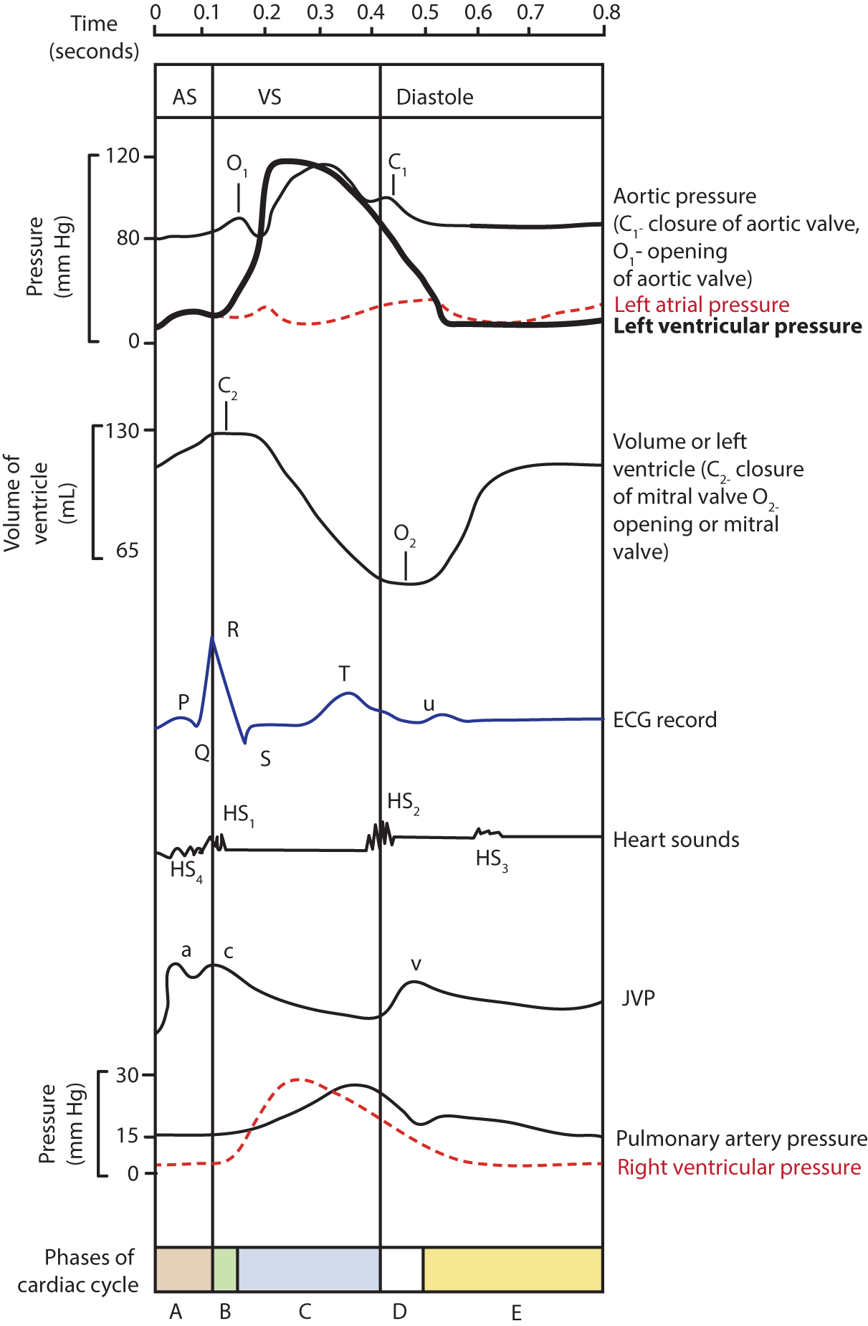
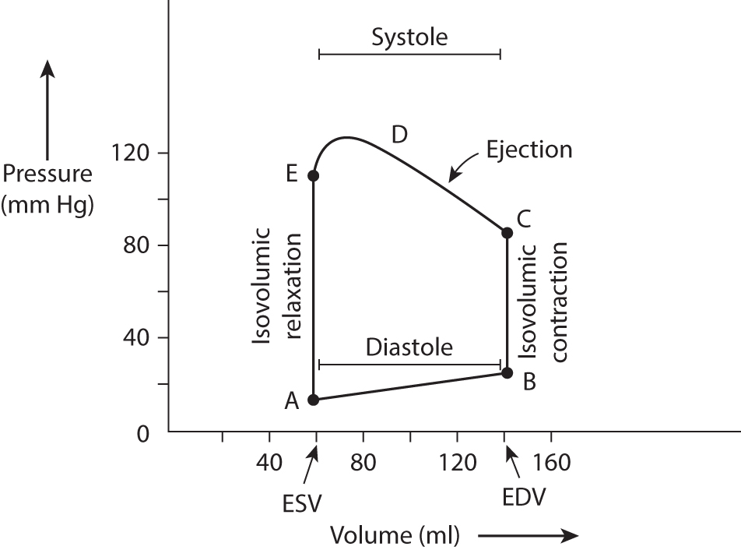
Full Cycle Pressure Curve and ECG
Cardiac cycle Singh, Harminder, MD, Textbook of Physiology for Medical Students, 39, 363-368 Events of cardiac cycle when heart rate is 75/min. A, atrial systole; B, isovolumic ventricular contraction; C, ventricular ejection phase; D, isovolumic ventricular relaxation; E, ventricular filling phase; AS, atrial systole, VS, ventricular sys... Copyright © 2023 Copyright © 2023 by RELX India Pvt. Ltd.
View in Source
Cardiac cycle Singh, Harminder, MD, Textbook of Physiology for Medical Students, 39, 363-368 Pressure–volume loop in cardiac cycle. (ESV, End systolic volume; EDV, End diastolic volume.) Copyright © 2023 Copyright © 2023 by RELX India Pvt. Ltd.
Source: https://www.clinicalkey.com/student/content/book/3-s2.0-B978813126560400048X#hl0000388
Textbook of Physiology for Medical Students, 2nd Ed.

Slide 19
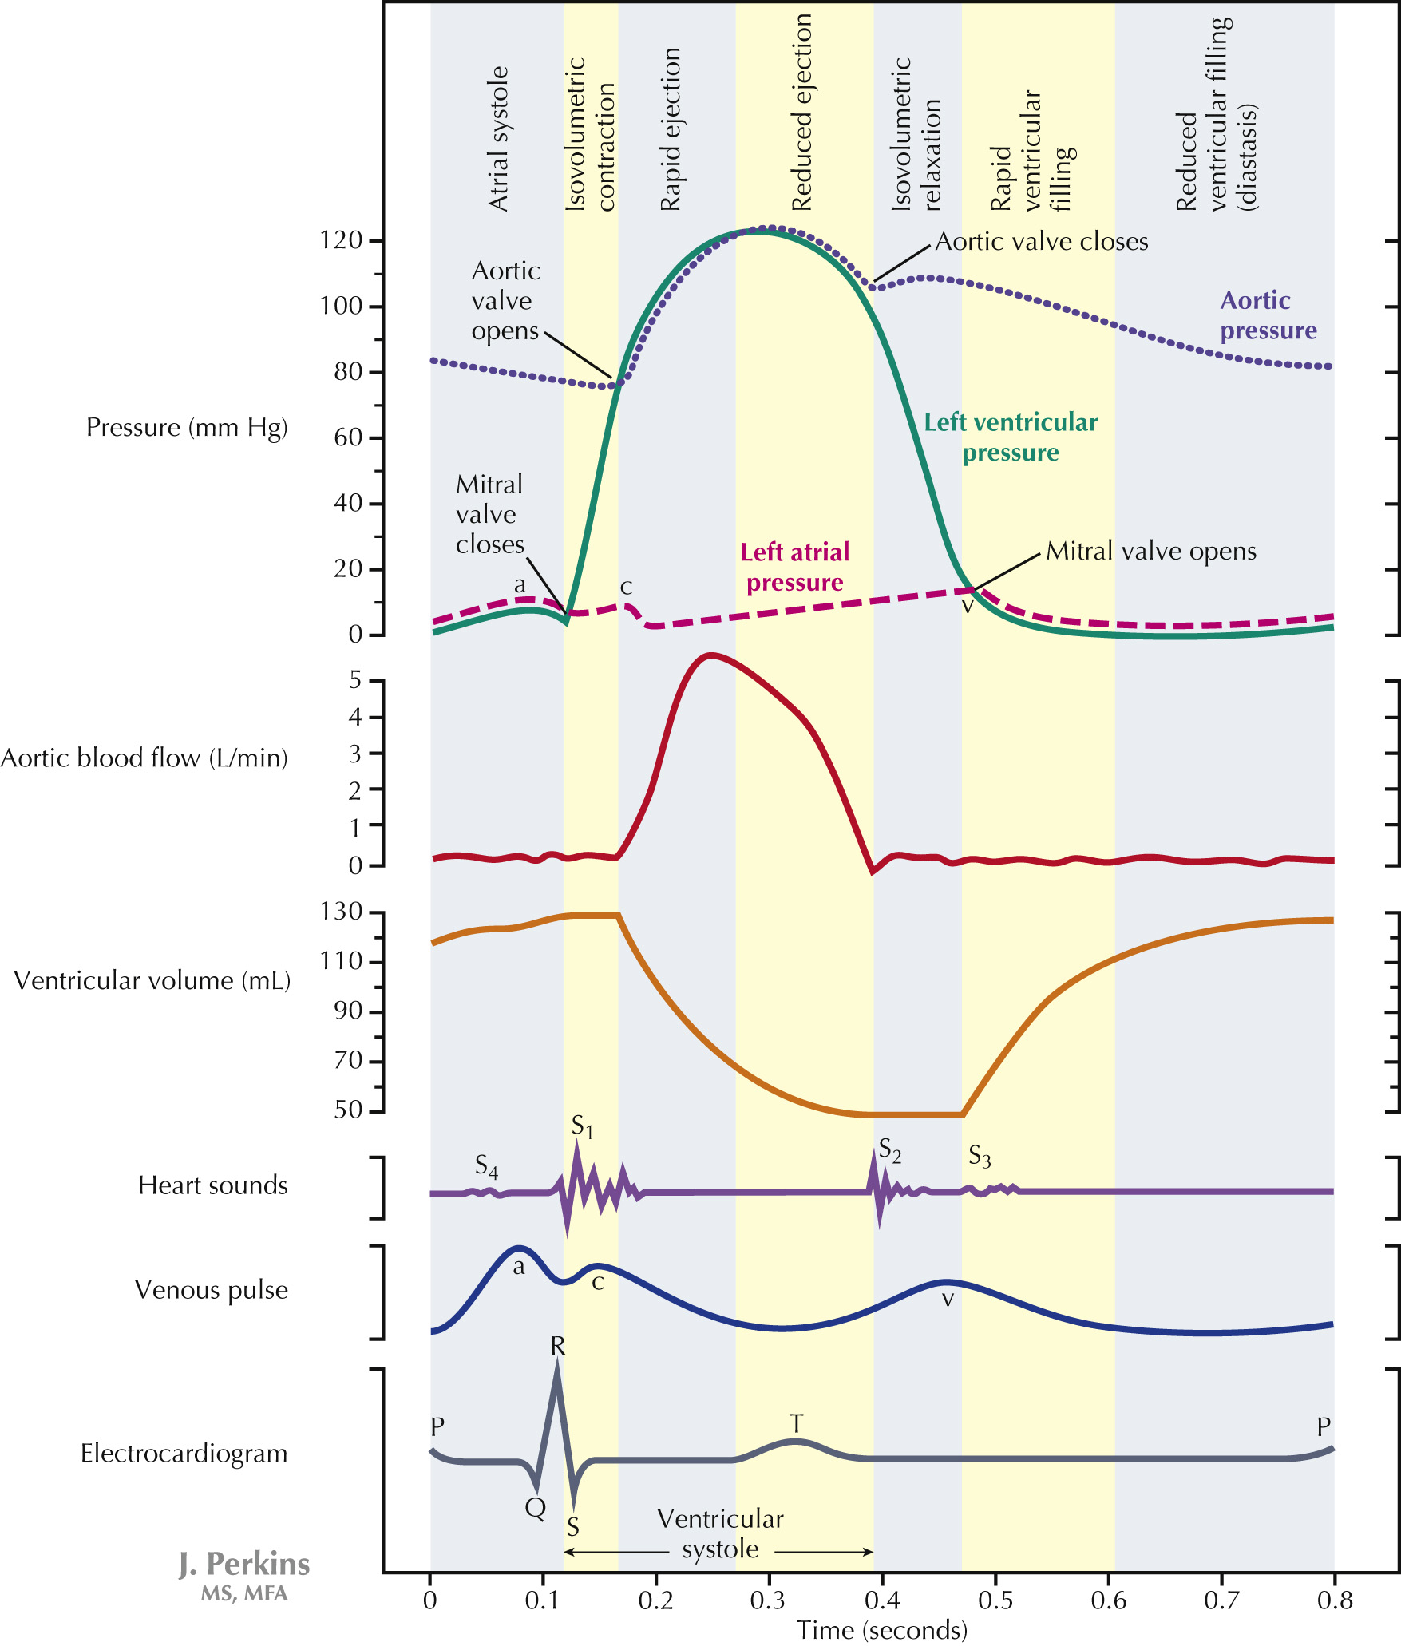
Wigger’s Diagram
The Cardiac Pump Mulroney, Susan E., PhD, Netter's Essential Physiology, Chapter 12, 118-129 The Cardiac Cycle The cardiac cycle (or Wiggers diagram) is a simultaneous depiction of several parameters related to blood flow and volume, the electrocardiogram, and the echocardiogram through a cycle of cardiac systole and diastole. Ventricular... Copyright © 2016 Copyright © 2016 by Elsevier, Inc. All rights reserved.
The cardiac cycle (or Wiggers diagram) is a simultaneous depiction of several parameters related to blood flow and volume, the electrocardiogram, and the echocardiogram through a cycle of cardiac systole and diastole. Ventricular systole begins with a short period of isovolumetric contraction, during which all of the heart valves are closed. This period is followed by the ejection phase of systole and then isovolumetric relaxation, when the heart valves are again all closed. Cardiac filling occurs after isovolumetric relaxation. The temporal relationships between features of these various curves or tracings are predictable, based on functional relationships within the cycle. The a, c, and v waves are identified on both the venous pulse and atrial pressure curves.
Source: https://www.clinicalkey.com/student/content/book/3-s2.0-B9780323358194000121#hl0000073
Netter's Essential Physiology, 2nd Ed.

Slide 20
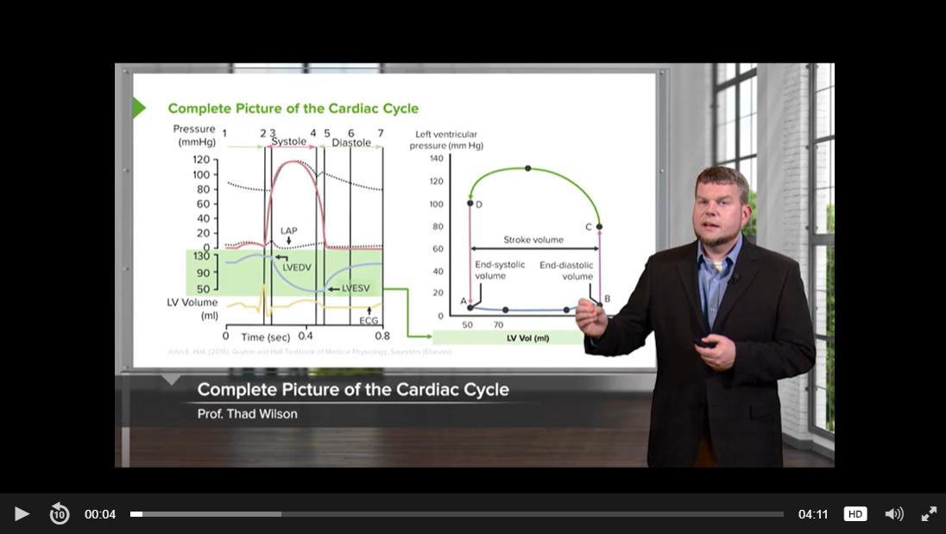
Cardiac Cycle Summary
Source: https://www.clinicalkey.com/student/content/video/23-s2.0-mm_9780323798662_0019

Slide 21
Live Quiz During Class – BYOP*
Duration of cardiac cycle at heart rate of 80 beats per minute is:
A 0.65 sec | B 0.75 sec
C 0.85 sec | D 1 sec
The contribution of atrial systole to ventricular filling at rest is about:
A 50% | B 40%
C 20% | D 5%
First heart sound (S ₁ ):
A Characterized by high pitch and sharp sound | B Marks the onset of ventricular systole
C Best heard over aortic and pulmonary areas | D Caused by the closure of semilunar valves
The maximally achievable systolic pressure by left ventricle is:
A 120 | B 150
C 200 | D 300
Source: Exam Questions
*BYOP – Bring Your Own Platform, for example, Kahoot, Google Form, MSFT Teams Form, Mentimeter, Survey Monkey etc.

Slide 22
Sample Assignment Questions
Question Source: ClinicalKey Student, Elsevier, Copyright 2024 Contraction of the ventricles is known as ventricular systole. Which of the following statements about ventricular systole is true?
Answer Options
A. The tricuspid valve is closed during a large part of this cardiac cycle is correct
The mitral and tricuspid valves close at the beginning of ventricular systole.
B. The pulmonary valve is closed during a large part of this cardiac cycle is incorrect
The pulmonary valve is open for long periods during the cardiac cycle.
C. It is followed by atrial systole is incorrect
Ventricular systole follows atrial systole.
D. It is indicated by the interval between the P and R waves on the ECG is incorrect
The R wave marks the start of ventricular systole.
E. The left ventricular pressure remains below 50 mmHg is incorrect
It increases to 120 mmHg during ventricular systole.
Source: ClinicalKey Student Assessment

Slide 23
Sample Assignment Questions
Question Source: ClinicalKey Student, Elsevier, Copyright 2024 Stroke volume is part of the cardiac cycle. What is stroke volume?
Answer Options
A. Amount of blood ejected to the pulmonary artery is incorrect
The amount of blood ejected to the pulmonary artery is the pulmonary ejection fraction (right ventricular ejection fraction: RVEF).
B. Amount of blood pumped entering the right atrium is incorrect
The stroke volume is the amount of blood pumped at each heartbeat.
C. Amount of blood pumped per heartbeat is correct
Stroke volume (SV) is the amount of blood pumped at each heartbeat, and is about 70 mL in an ‘average’ person at rest. The amount of blood pumped per minute in called the cardiac output (CO). The sequence of events which makes up each heartbeat is called the cardiac cycle. The period of contraction of the heart muscle is called systole and the period of relaxation is called diastole.
D. Period of contraction is incorrect
The period of contraction is called systole.
E. Period of relaxation is incorrect
The period of relaxation is called diastole.
Source: ClinicalKey Student Assessment

Slide 24
Sample Assignment Questions
Question Source: ClinicalKey Student, Elsevier, Copyright 2024 Normal heart sounds are produced by the opening and closing of valves during the cardiac cycle. Which of the following describes the first heart sound?
Answer Options
A. It is partly caused by the closure of the tricuspid valve is correct
The first heart sound occurs at the beginning of the ventricular systole, and is caused by the closure of the mitral and the tricuspid valves. Hence it is louder at the apex of the heart. The first heart sound has a lower pitch and a longer duration than the second because the mitral and tricuspid valves close more gradually than the pulmonary and aortic valves.
B. It is partly caused by the closure of the pulmonary valve is incorrect
It is partly caused by the closure of the mitral and the tricuspid valves.
C. It is louder at the base than the apex of the heart is incorrect
It is loudest at the apex.
D. It signals the end of ventricular systole is incorrect
The first heart sound signals the beginning of ventricular systole.
E. It has a higher pitch than the second heart sound is incorrect
It has a lower pitch than the second heart sound.
Source: ClinicalKey Student Assessment

Slide 25
Cardiac Cycle – Case-Based Learning
CASE 1
A 24-year-old man consults for a systematic physical examination. His blood pressure AT REST is currently 120/80 mmHg and his heart rate is 75 beats/min. He is recommended to begin an exercise program. When he returns 3 months later his heart rate has decreased to 50 beats/min (asymptomatic). What values would you expect to see different in this patient AT REST compared to those obtained 3 months earlier?
CASE 2
A patient with a resting cardiac output of 4 L/min does maximum exercise and their cardiac output increases to 8 L/min. What's their cardiac reserve?
More clinical cases and quiz questions available in:
ClinicalKey Student Assessment
Medicine Morning Report: Beyond the Pearls
Medicine Morning Report Subspecialties
150 ECG Cases, 5th Ed.
Leverage the platform to identify cases for class discussion or create an assignment for students that can be used as a class quiz or for formative assessment.
Source: ClinicalKey Student Assessment

Slide 26
Post-Lecture Video and Skills Assignments

Slide 27
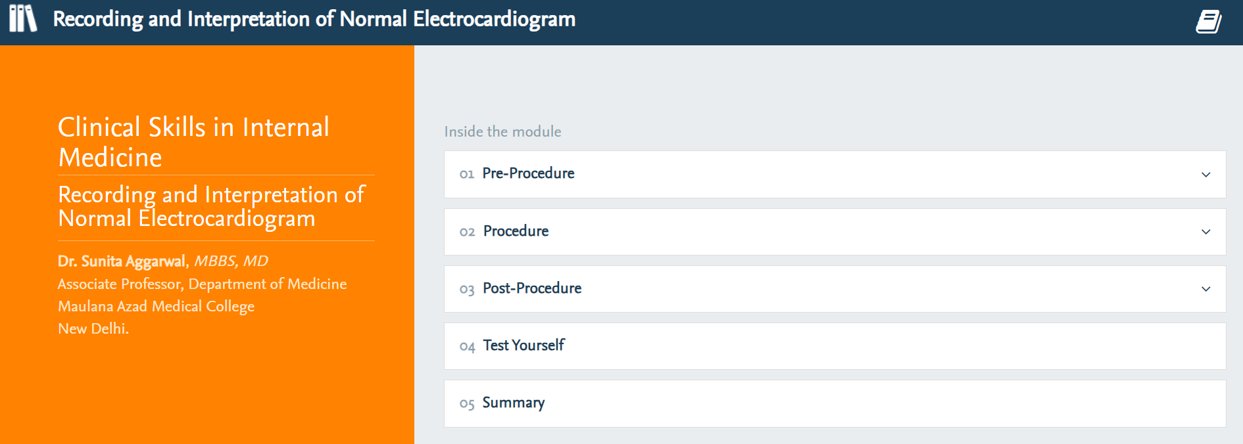
Recording and Interpretation of Normal ECG
Source: https://indiambbsskills.clinicalkey.com/local/courses/2535/s02_m06_dv_electrocardiogram/data/LandingPg.html

Slide 28
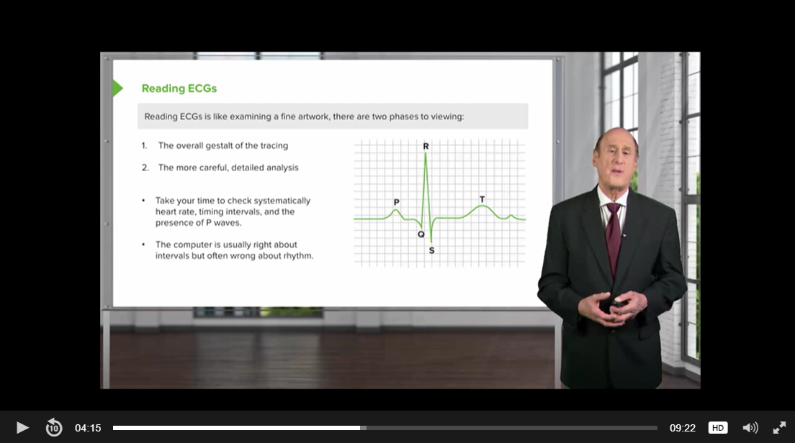
How to Read an ECG
Source: https://www.clinicalkey.com/student/content/video/23-s2.0-mm_9780323798716_0001

Slide 29
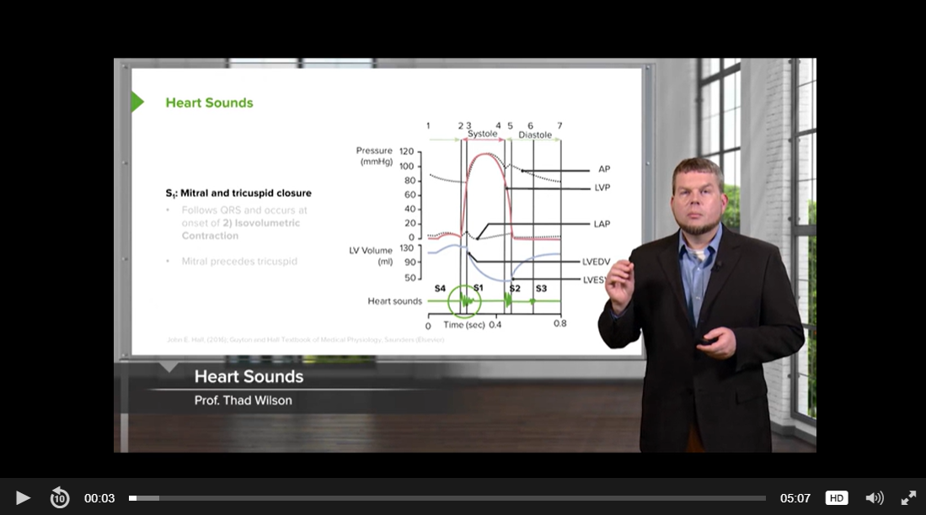
Heart Sounds
Source: https://www.clinicalkey.com/student/content/video/23-s2.0-mm_9780323798662_0021

Slide 30
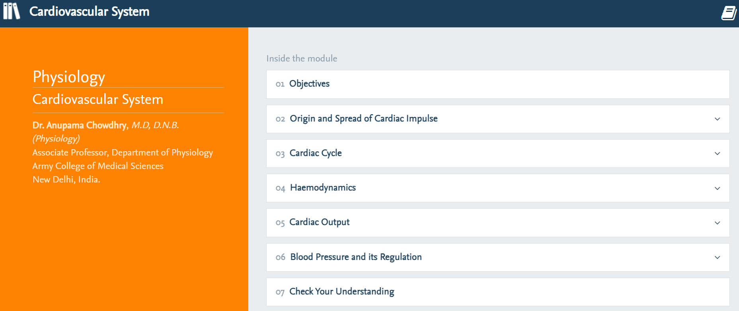
Physiology – Cardiovascular System
Source: https://indiambbsskills.clinicalkey.com/local/courses/2319/s06_m40_cvs/data/LandingPg.html

Slide 31
Further Learning

Slide 32
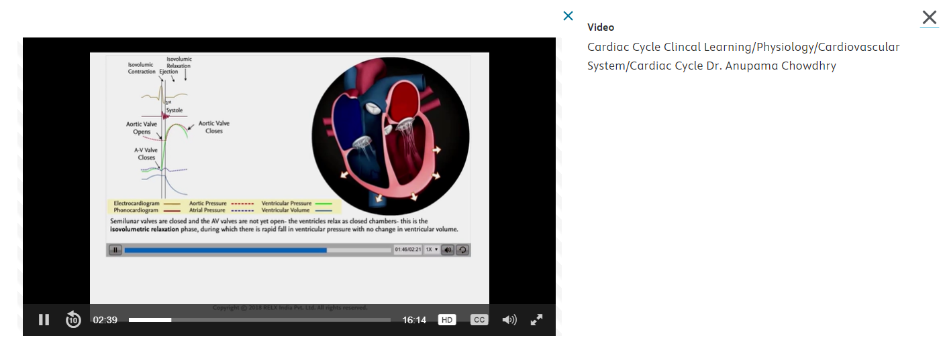
Summary of Cardiac Cycle Lecture
COURSE LINK
https://www.clinicalkey.com/student/content/book/3-s2.0-B9788131258903000129?origin=share&title=Clinical%20Learning%2FCardiovascular%20System&meta=2018%2C%20Chowdhry%2C%20Anupama%2C%20Dr.&img=https%3A%2F%2Fcdn.clinicalkey.com%2Fck-thumbnails%2FC20190018511%2Fcov200h.gif

Slide 33
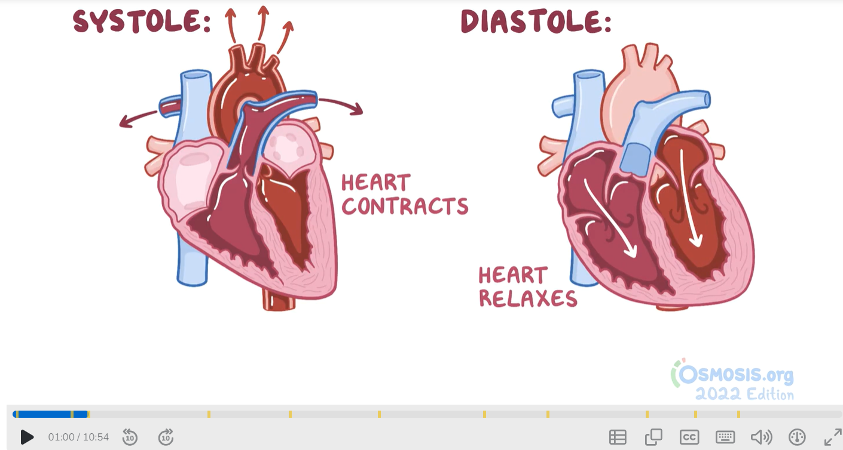
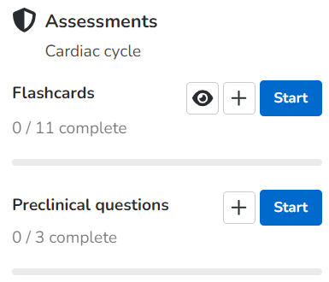
Cardiac Cycle Quick Revision
Watch the video
Practice using flashcards
Answer the preclinical questions
Source: https://www.osmosis.org/learn/Cardiac_cycle

Slide 34
Appendix

Slide 35
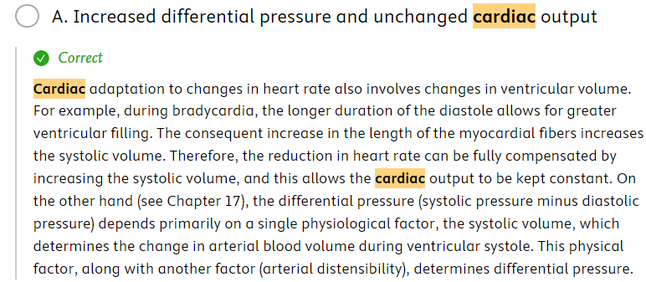
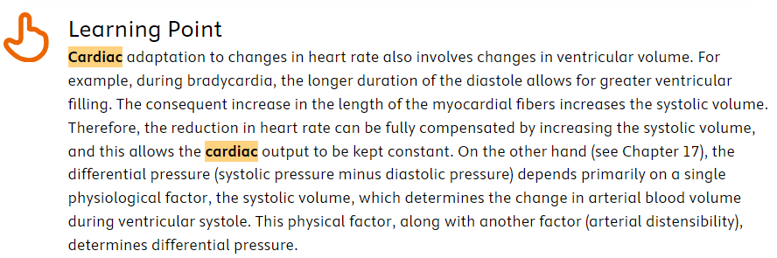
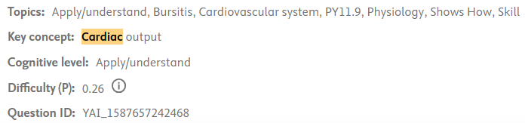
Cardiac Cycle – Case-Based Learning
CASE 1
A 24-year-old man consults for a systematic physical examination. His blood pressure AT REST is currently 120/80 mmHg and his heart rate is 75 beats/min. He is recommended to begin an exercise program. When he returns 3 months later his heart rate has decreased to 50 beats/min (asymptomatic). What values would you expect to see different in this patient AT REST compared to those obtained 3 months earlier?
Source: ClinicalKey Student Assessment

Slide 36
Long List of Resources on Cardiac Cycle
Textbooks
Gray's Anatomy, 42nd Ed.
Textbook of Physiology for Medical Students, 2nd Ed.
Goldman-Cecil Medicine, 27th Ed.
Concise Textbook of Physiology, 4th Ed.
Netter's Essential Physiology, 2nd Ed.
Seidel's Guide to Physical Examination, 10th Ed.
Joshi's-Physiology Preparatory Manual for Undergraduates, 7th Ed.
Guyton & Hall Textbook of Medical Physiology: 3rd South Asia Ed.
Medical Physiology for Undergraduate Students, 3rd Ed.
Textbooks
Costanzo Physiology, 7th Ed.
Textbook of Physical Diagnosis: History and Examination, 8th Ed.
Clinical Examinations in Cardiology, 2nd Ed.
Crash Course Cardiology, 5th Ed.
Cecil Essentials of Medicine, 10th Ed.
Kumar and Clark's Clinical Medicine, 10th Ed.
Cardiovascular Physiology, 11th Ed.
Netter's Integrated Review of Medicine
Crash Course Anatomy and Physiology, 5th Ed.
Medical Secrets, 6th Ed.
Videos
Cardiac Cycle
ECG Intervals
Cardiac Work
Other videos on ClinicalKey Student
India Skills Modules
Cardiovascular System
Cardiovascular System Examination
Effect of Exercise on Blood Pressure and Heart Rate
Recording and Interpretation of Normal ECG
Other Resources
Images
Browse Questions – Search “cardiac cycle”

