Slide 1


Slide 2


Slide 3


Slide 4


Slide 5


Slide 6


Slide 7
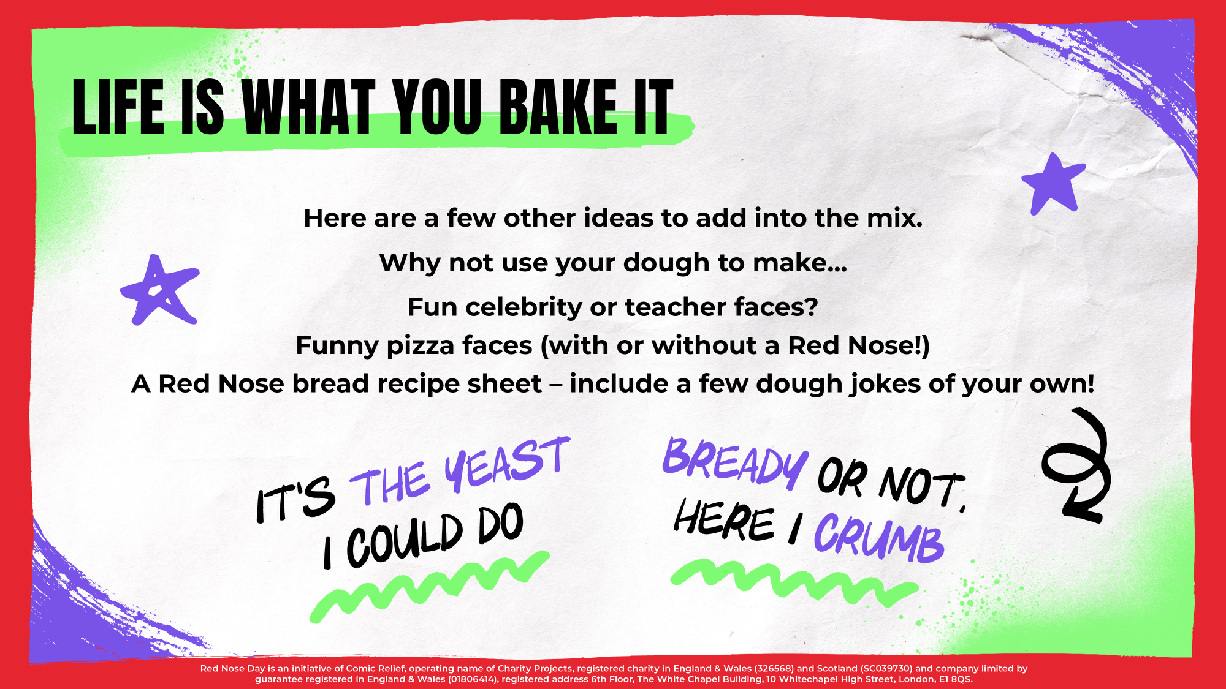

Slide 8


Slide 9


Slide 10
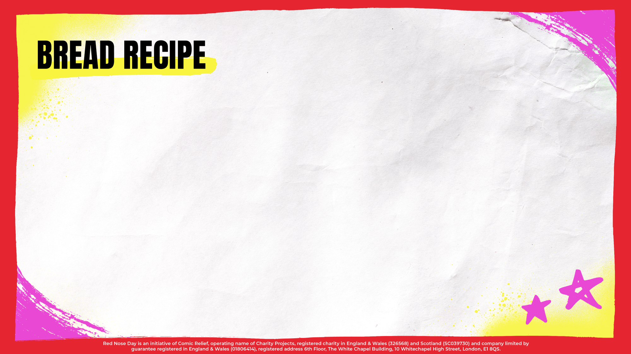
Teacher – Delete and add in your selected bread recipe if different from this basic bread recipe or you are making open sandwiches. See links to recipes in the Teacher’s Guide.
Ingredients
• 500 g strong flour
• 1 x 7 g sachet dried yeast
• 300 ml water (lukewarm)
• 2 x teaspoons salt
• 2 x teaspoons sugar
• Ideas for savoury toppings – cheese, tomatoes, tomato puree, peppers, mushrooms, herbs, peas
Equipment
• 1 non-stick baking tin (or tin lined with greaseproof paper)
• Weighing scales
• Measuring jug
• Measuring spoons
• Mixing bowl
• Mixing spoon
• Oven gloves

Slide 11
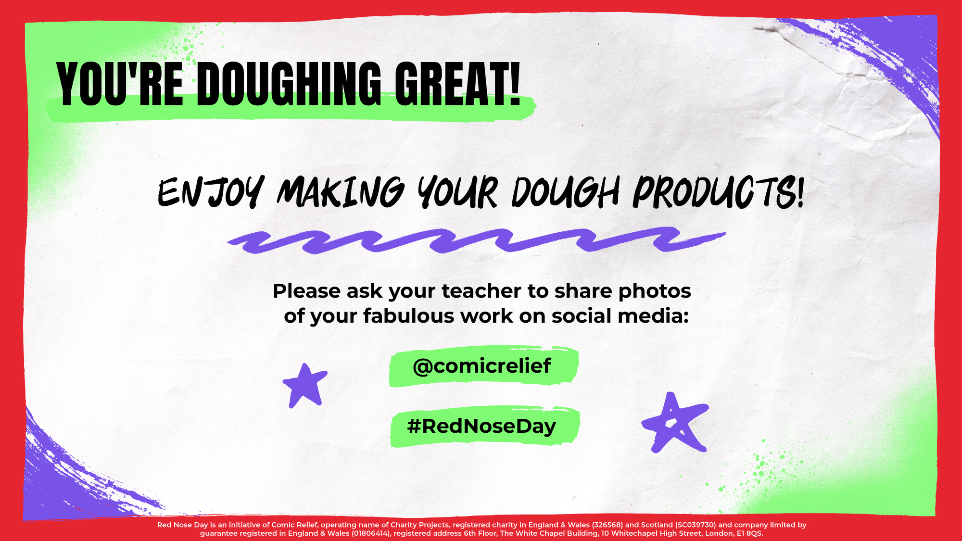

Slide 12


Slide 13


