Slide 1


Slide 2


Slide 3


Teacher:
Please add pics in here of teachers / school staff wearing their Red Noses/ pulling faces etc.

Slide 4


Slide 5


Slide 6


Slide 7


Slide 8
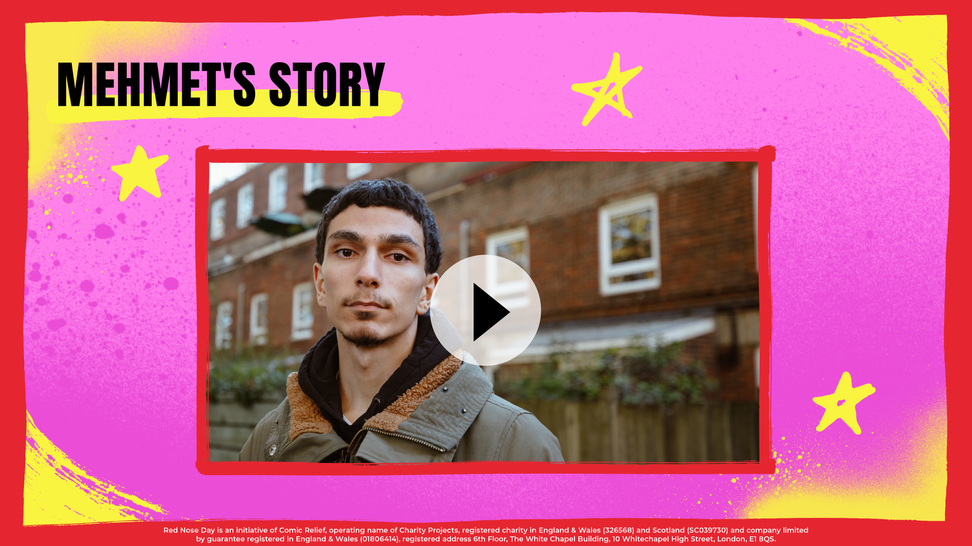

Slide 9


Slide 10


Slide 11


Slide 12

Teacher:
Please customise this slide with your school’s fundraising plans.

Slide 13


